Slide 1
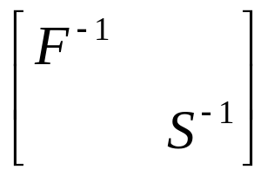
Solution
component
Example
methods
Packages
MPSalsa
(Epetra)
Nonlinear
Solver
Newton-Krylov
Methods
NOX
(Epetra)
Linear
Solver
GMRESR
AztecOO
(TSF, Epetra)
block
precondition
Meros
(TSF)
MPSalsa ⇒ Epetra submatrices
Epetra ⇔ TSF
Epetra/TSF matrix add & multiply
M⁻¹ for TSF subblocks
F⁻¹:
GMRES/AMG
S⁻¹:
CG/AMG
Subblocks
(AztecOO,
ML, Epetra)
Notes:
Say or notate which parts we will implement in TSF (for Salsa problem for example)
Pressures on cell centers, velocities on cell faces
MAC discretization
Implemented in Trilinos/Petra; using ML for multigrid
Outer linear solve: GMRES
F / J solves: GMRES/MG
Ap solves: CG/MG

