Slide 1

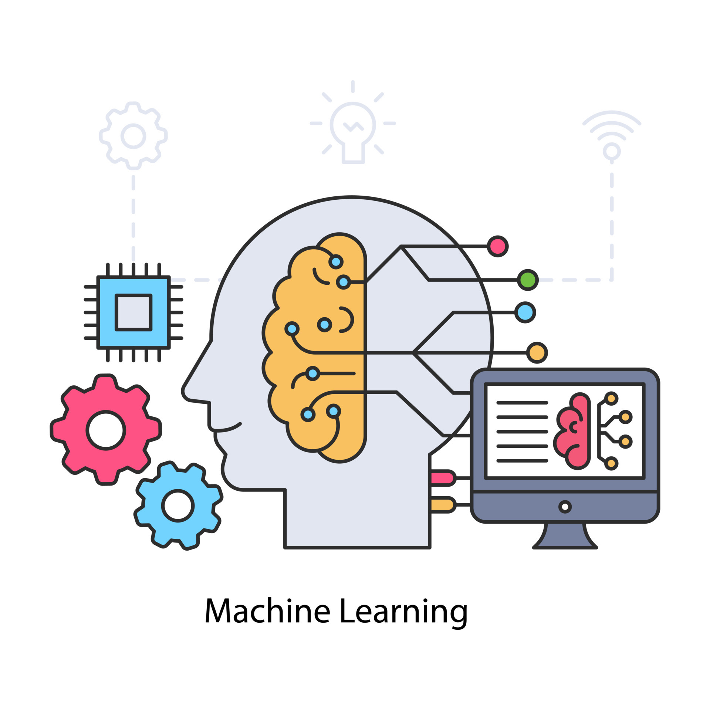
Introduction to Machine Learning
Group 5
Hanoi, 6/2022

Slide 2
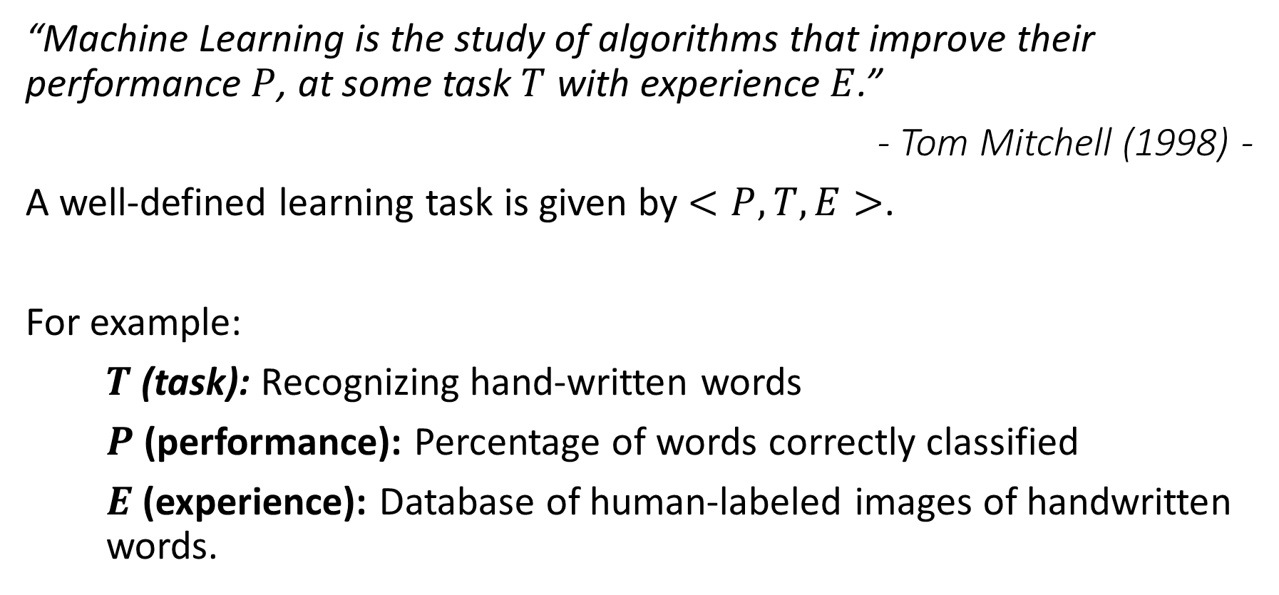
Definition
“Machine Learning is the study of algorithms that improve their performance $P$, at some task $T$ with experience $E$.”
- Tom Mitchell (1998) -
A well-defined learning task is given by $<P,T,E>$.
For example:
$T$ (task): Recognizing hand-written words
$P$ (performance): Percentage of words correctly classified
$E$ (experience): Database of human-labeled images of handwritten words.

Slide 3
Comparison
Traditional Programming
Computer
Data
Output
Program
Machine Learning
Computer
Data
Program
Output

Slide 4
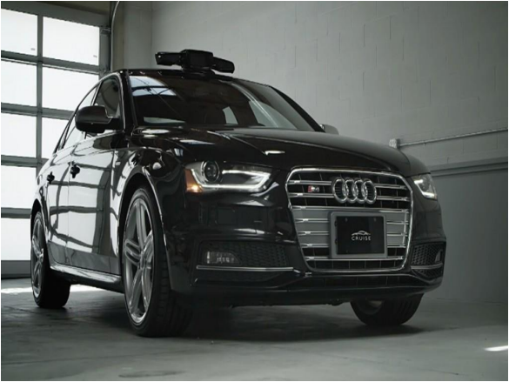
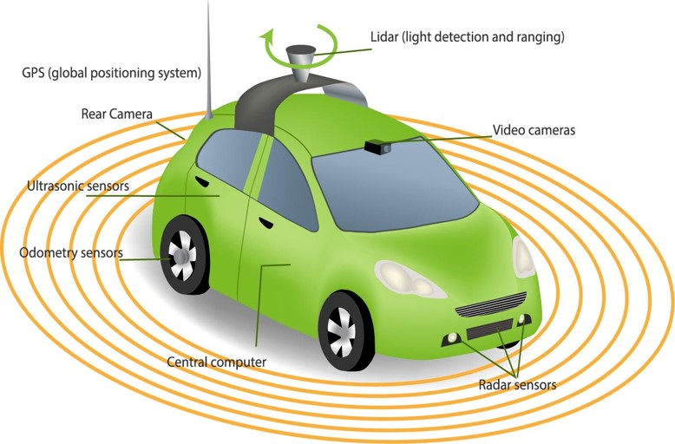
Applications

Slide 5
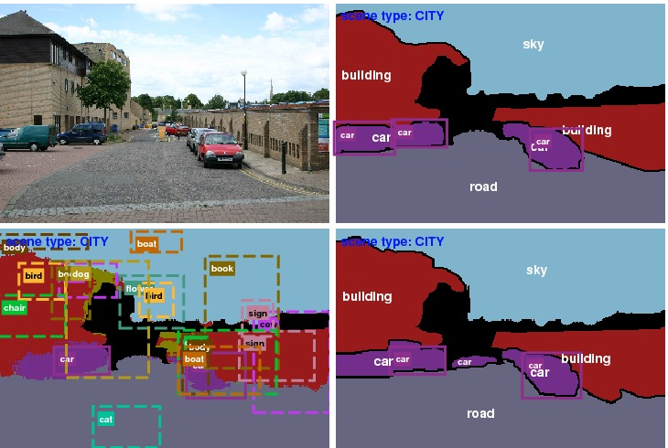
Applications

Slide 6
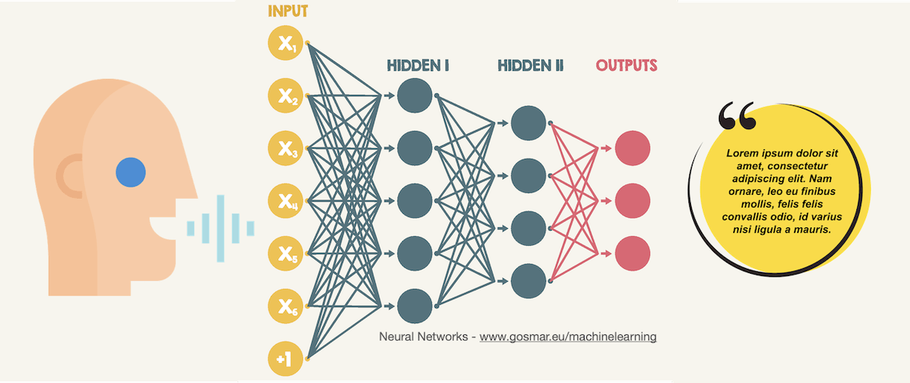
Applications

Slide 7
Types of ML
Supervised Learning:
Given: training data + labels
Unsupervised Learning:
Given: training data (without labels)
Semi-supervised Learning:
Given: training data + a few labels
Reinforcement Learning:
Rewards from sequence of actions

Slide 8
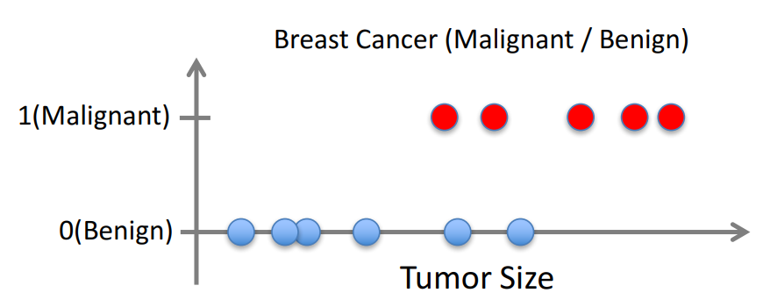
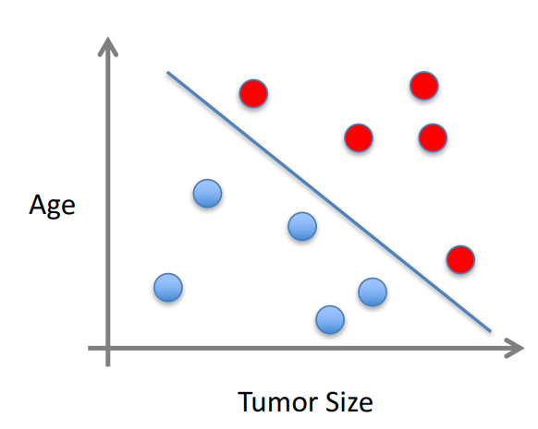

Types of ML
Supervised Learning
Given $\left(x_{1},y_{1}\right),\left(x_{2},y_{2}\right)$,…, $\left(x_{n},y_{n}\right)$
Learn a function $f\left(x\right)$to predict $y$ given $x$
$x$ can be multi-dimensional

Slide 9
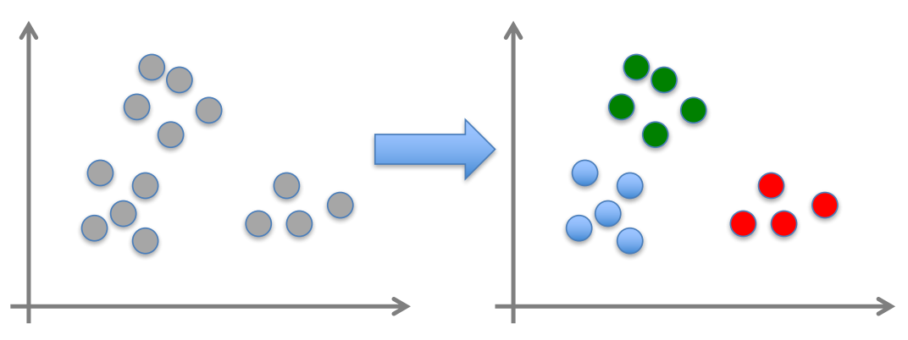

Types of ML
Unsupervised Learning
Given ${ x}_{1},x_{2},…,x_{n}$ (without labels)
Output hidden structure behind the $x$’s

Slide 10
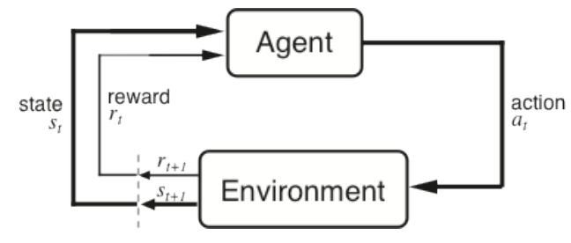
Types of ML
Reinforcement Learning
Given a sequence of states and actions with (delayed) rewards, output a policy
Policy is a mapping from states => actions that tells you what to do in a given state

Slide 11
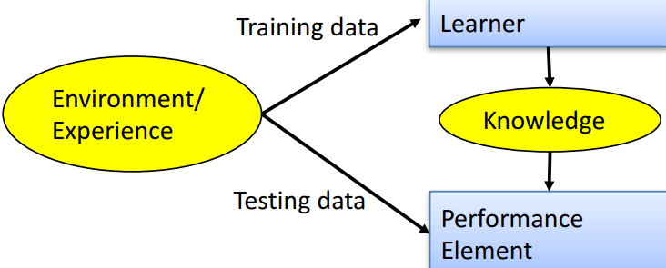
Designing a Learning System
Choose the training experience
Choose exactly what is to be learned
Choose how to represent the target function
Choose a learning algorithm to infer the target function from the experience

Slide 12
ML in a Nutshell
Every ML algorithm has three components:
Representation
Optimization
Evaluation

Slide 13
Representation
Numerical functions
– Linear regression
– Neural networks
– Support vector machines
Symbolic functions
– Decision trees
– Rules in propositional logic
– Rules in first-order predicate logic
Instance-based functions
– Nearest-neighbor
– Case-based
Probabilistic Graphical Models
– Naïve Bayes
– Bayesian networks
– Hidden-Markov Models (HMMs)
– Probabilistic Context Free Grammars (PCFGs)
– Markov networks

Slide 14
Optimization
Gradient descent
– Perceptron
– Backpropagation
Dynamic Programming
– HMM Learning
– PCFG Learning
Divide and Conquer
– Decision tree induction
– Rule learning
Evolutionary Computation
– Genetic Algorithms (GAs)
– Genetic Programming (GP)
– Neuro-evolution

Slide 15
Evaluation
Accuracy
Precision and recall
Squared error
Likelihood
Posterior probability
Cost / Utility
Margin
Entropy
K-L divergence
etc

Slide 16

THANKS FOR LISTENING!

