Slide 1
Machine Learning
Approach based on Decision Trees

Slide 2
Decision Tree Learning
  Practical inductive inference method
  Same goal as Candidate-Elimination algorithm
    Find Boolean function of attributes
    Decision trees can be extended to functions with more than two output values.
  Widely used
  Robust to noise
  Can handle disjunctive (OR’s) expressions
  Completely expressive hypothesis space
  Easily interpretable (tree structure, if-then rules)

Slide 3
LARGE EXAMPLE
SHOULD WE PLAY TENNIS?

Slide 4
Example: PlayTennis
  Four attributes used for classification:
    Outlook = {Sunny,Overcast,Rain}
    Temperature = {Hot, Mild, Cool}
    Humidity = {High, Normal}
    Wind = {Weak, Strong}
  One predicted (target) attribute (binary)
    PlayTennis = {Yes,No}
  Given 14 Training examples
    9 positive
    5 negative

Slide 5
TENNIS
Training Examples

Slide 6
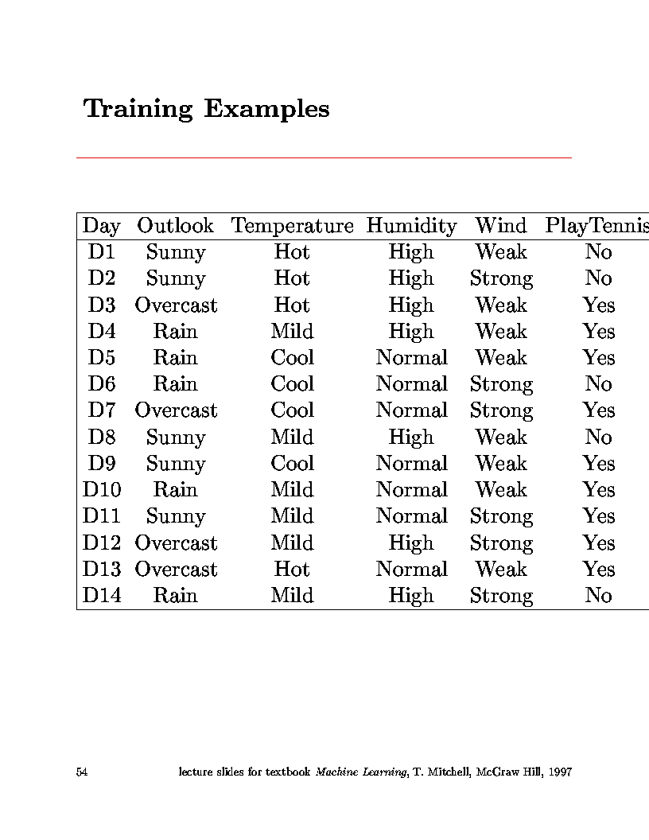
Training Examples
Attribute, variable, property
Object, sample, example
Shall we play tennis today? (Tennis 1)
decision

Slide 7
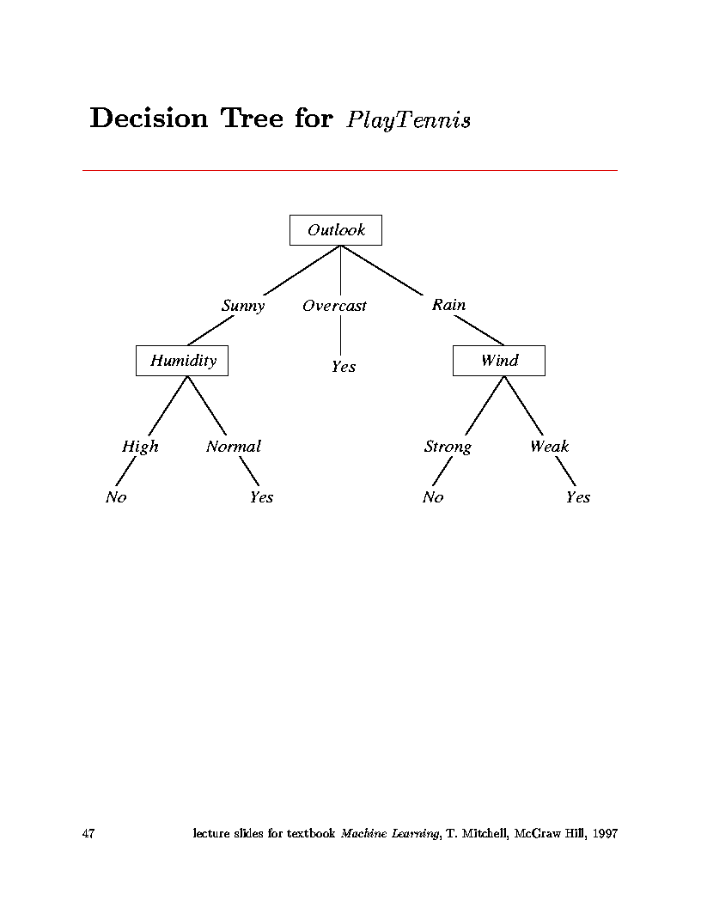
Decision trees do classification
  Classifies instances into one of a discrete set of possible categories
  Learned function represented by tree
  Each node in tree is test on some attribute of an instance
  Branches represent values of attributes
  Follow the tree from root to leaves to find the output value.
Shall we play tennis today?

Slide 8
The tree itself forms hypothesis
  Disjunction (OR’s) of conjunctions (AND’s)
  Each path from root to leaf forms conjunction of constraints on attributes
  Separate branches are disjunctions
Example from PlayTennis decision tree:
  (Outlook=Sunny ∧ Humidity=Normal)
  ∨
  (Outlook=Overcast)
  ∨ 
  (Outlook=Rain ∧ Wind=Weak)

Slide 9
Types of problems decision tree learning is good for:
  Instances represented by attribute-value pairs
    For algorithm in book, attributes take on a small number of discrete values
    Can be extended to real-valued attributes
      (numerical data)
    Target function has discrete output values
    Algorithm in book assumes Boolean functions
    Can be extended to multiple output values

Slide 10
  Hypothesis space can include disjunctive expressions.
    In fact, hypothesis space is complete space of finite discrete-valued functions
  Robust to imperfect training data
    classification errors
    errors in attribute values
    missing attribute values
Examples:
  Equipment diagnosis
  Medical diagnosis
  Credit card risk analysis
  Robot movement
  Pattern Recognition
    face recognition
    hexapod walking gates

Slide 11
  What is a greedy search?
    At each step, make decision which makes greatest improvement in whatever you are trying optimize.
    Do not backtrack (unless you hit a dead end)
    This type of search is likely not to be a globally optimum solution, but generally works well.
  What are we really doing here?
    At each node of tree, make decision on which attribute best classifies training data at that point.
    Never backtrack (in ID3)
    Do this for each branch of tree.
    End result will be tree structure representing a hypothesis which works best for the training data.

Slide 12
Information Theory Background

Slide 13
Information Theory Background
If there are n equally probable possible messages, then the probability p of each is 1/n
Information conveyed by a message is -log(p) = log(n)
Eg, if there are 16 messages, then log(16) = 4 and we need 4 bits to identify/send each message.
In general, if we are given a probability distribution
  P = (p1, p2, .., pn)
the information conveyed by distribution (aka Entropy of P) is:
  I(P) = -(p1*log(p1) + p2*log(p2) + .. + pn*log(pn))

Slide 14
Question?
How do you determine which attribute best classifies data?
Answer: Entropy!
Information gain:
  Statistical quantity measuring how well an attribute classifies the data.
    Calculate the information gain for each attribute.
    Choose attribute with greatest information gain.

Slide 15
But how do you measure information?
  Claude Shannon in 1948 at Bell Labs established the field of information theory.
  Mathematical function, Entropy, measures information content of random process:
    Takes on largest value when events are equiprobable.
    Takes on smallest value when only one event has
    non-zero probability.
  For two states:
    Positive examples and Negative examples from set S:
    H(S) = -p₊log₂(p₊) - p₋log₂(p₋)
Entropy of set S denoted by H(S)

Slide 16
Entropy

Slide 17
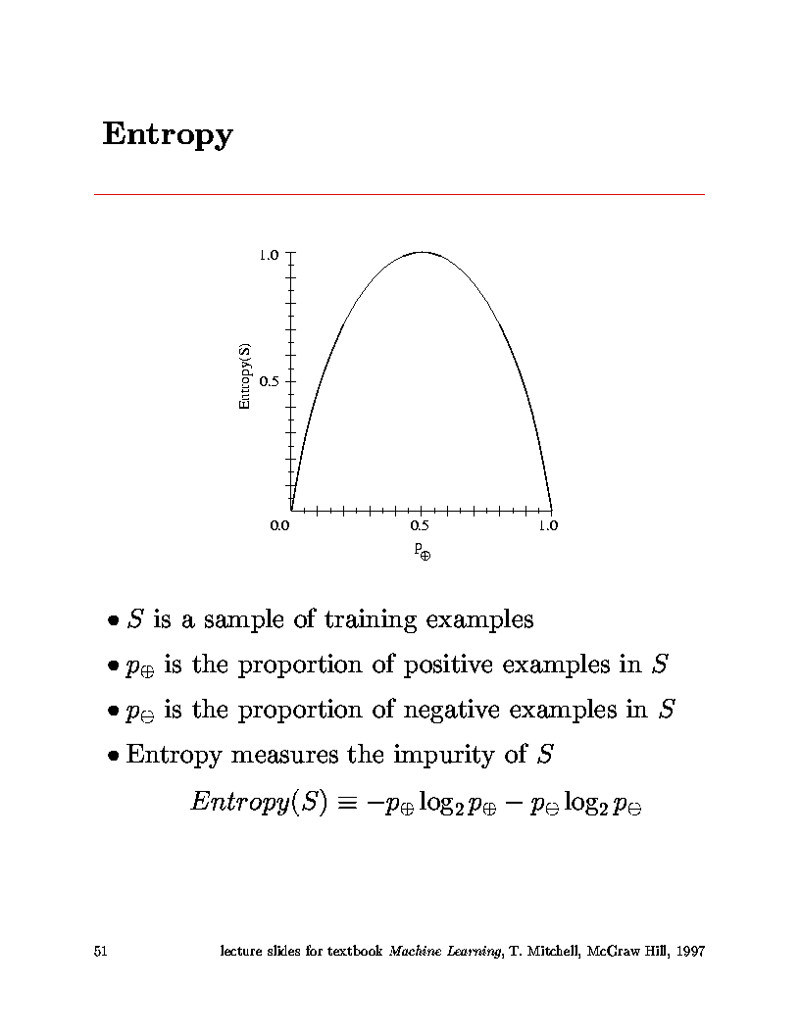
Largest entropy
Entropy
Boolean functions with the same number of ones and zeros have largest entropy

Slide 18
But how do you measure information?
  Claude Shannon in 1948 at Bell Labs established the field of information theory.
  Mathematical function, Entropy, measures information content of random process:
    Takes on largest value when events are equiprobable.
    Takes on smallest value when only one event has
    non-zero probability.
  For two states:
    Positive examples and Negative examples from set S:
    H(S) = - p₊log₂(p₊) - p₋ log₂(p₋)
Entropy
= Measure of order in set S

Slide 19
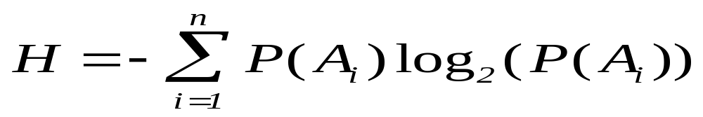
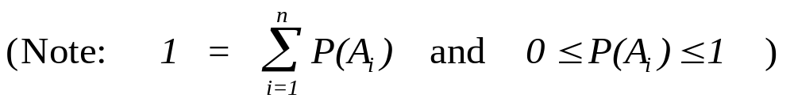
In general:
  For an ensemble of random events: {A₁,A₂,...,A_{n}},
  occurring with probabilities: z ={P(A₁),P(A₂),...,P(A_{n})}
If you consider the self-information of event, i, to be: -log₂(P(A_{i}))
Entropy is weighted average of information carried by each event.
Does this make sense?

Slide 20
  Does this make sense?
  If an event conveys information, that means it’s a surprise.
  If an event always occurs, P(A_{i})=1, then it carries no information. -log₂(1) = 0
  If an event rarely occurs (e.g. P(A_{i})=0.001), it carries a lot of info. -log₂(0.001) = 9.97
  The less likely the event, the more the information it carries since, for 0 ≤ P(A_{i}) ≤ 1,
  -log₂(P(A_{i})) increases as P(A_{i}) goes from 1 to 0.
    (Note: ignore events with P(A_{i})=0 since they never occur.)

Slide 21
What about entropy?
  Is it a good measure of the information carried by an ensemble of events?
  If the events are equally probable, the entropy is maximum.
  1) For N events, each occurring with probability 1/N.
  H = -∑(1/N)log₂(1/N) = -log₂(1/N)
  This is the maximum value.
  (e.g. For N=256 (ascii characters) -log₂(1/256) = 8
  number of bits needed for characters.
  Base 2 logs measure information in bits.)
  This is a good thing since an ensemble of equally probable events is as uncertain as it gets.
(Remember, information corresponds to surprise - uncertainty.)

Slide 22
  2) H is a continuous function of the probabilities.
    That is always a good thing.
  3) If you sub-group events into compound events, the entropy calculated for these compound groups is the same.
    That is good since the uncertainty is the same.
It is a remarkable fact that the equation for entropy shown above (up to a multiplicative constant) is the only function which satisfies these three conditions.

Slide 23
Choice of base 2 log corresponds to choosing units of information.(BIT’s)
Another remarkable thing:
  This is the same definition of entropy used in statistical mechanics for the measure of disorder.
  Corresponds to macroscopic thermodynamic quantity of Second Law of Thermodynamics.

Slide 24
The concept of a quantitative measure for information content plays an important role in many areas:
For example,
  Data communications (channel capacity)
  Data compression (limits on error-free encoding)
Entropy in a message corresponds to minimum number of bits needed to encode that message.
In our case, for a set of training data, the entropy measures the number of bits needed to encode classification for an instance.
  Use probabilities found from entire set of training data.
  Prob(Class=Pos) = Num. of positive cases / Total case
  Prob(Class=Neg) = Num. of negative cases / Total cases

Slide 25
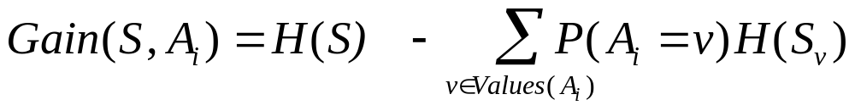
We want to select the variables (attributes) that will lead to the smallest tree. It means, maximizing the information gain.
Information gain is our metric for how well one attribute A ^{i} classifies the training data.
Information gain for a particular attribute =
  Information about target function,
  given the value of that attribute.
  (conditional entropy)
Mathematical expression for information gain:
entropy
Entropy for value v

Slide 26
ID3 algorithm (for boolean-valued function)
  Calculate the entropy for all training examples
    positive and negative cases
    p₊ = #pos/Tot p₋ = #neg/Tot
    H(S) = -p₊log₂(p₊) - p₋log₂(p₋)
  Determine which single attribute best classifies the training examples using information gain.
    For each attribute find:
    Use attribute with greatest information gain as a root

Slide 27
Using Gain Ratios to find the best order of variables in every subtree
GOING BACK TO TENNIS EXAMPLE

Slide 28
Using Gain Ratios to find the best order of variables in every subtree
The notion of Gain introduced earlier favors attributes that have a large number of values.
  If we have an attribute D that has a distinct value for each record, then Info(D,T) is 0, thus Gain(D,T) is maximal.
To compensate for this Quinlan suggests using the following ratio instead of Gain:
  GainRatio(D,T) = Gain(D,T) / SplitInfo(D,T)
SplitInfo(D,T) is the information due to the split of T on the basis of value of categorical attribute D.
  SplitInfo(D,T) = I(|T1|/|T|, |T2|/|T|, .., |Tm|/|T|)
where {T1, T2, .. Tm} is the partition of T induced by value of D.

Slide 29
14 cases
9 positive cases
Step 1: Calculate entropy for all cases:
      N_{Pos} = 9 N_{Neg} = 5 N_{Tot} = 14
      H(S) = -(9/14)*log₂(9/14) - (5/14)*log₂(5/14) = 0.940
entropy

Slide 30
Step 2: Loop over all attributes, calculate gain:
  Attribute = Outlook
    Loop over values of Outlook
      Outlook = Sunny
      N_{Pos} = 2 N_{Neg} = 3 N_{Tot} = 5
      H(Sunny) = -(2/5)*log₂(2/5) - (3/5)*log₂(3/5) = 0.971
      Outlook = Overcast
      N_{Pos} = 4 N_{Neg} = 0 N_{Tot} = 4
      H(Sunny) = -(4/4)*log₂4/4) - (0/4)*log₂(0/4) = 0.00
Want to select best separation of values for all selected attributes.
Approximate this by selecting an attribute with the highest information gain.

Slide 31
      Outlook = Rain
      N_{Pos} = 3 N_{Neg} = 2 N_{Tot} = 5
      H(Sunny) = -(3/5)*log₂(3/5) - (2/5)*log₂(2/5) = 0.971
    Calculate Information Gain for attribute Outlook
    Gain(S,Outlook) = H(S) - N_{Sunny}/N_{Tot}*H(Sunny)
    - N_{Over}/N_{Tot}*H(Overcast)
    - N_{Rain}/N_{Tot}*H(Rainy)
    Gain(S,Outlook) = 9.40 - (5/14)*0.971 - (4/14)*0 - (5/14)*0.971 Gain(S,Outlook) = 0.246
  Attribute = Temperature
    (Repeat process looping over {Hot, Mild, Cool})
    Gain(S,Temperature) = 0.029

Slide 32
  Attribute = Humidity
    (Repeat process looping over {High, Normal})
    Gain(S,Humidity) = 0.029
  Attribute = Wind
    (Repeat process looping over {Weak, Strong})
    Gain(S,Wind) = 0.048
  Find attribute with greatest information gain:
  Gain(S,Outlook) = 0.246, Gain(S,Temperature) = 0.029
  Gain(S,Humidity) = 0.029, Gain(S,Wind) = 0.048
  ∴ Outlook is root node of tree

Slide 33
  Iterate algorithm to find attributes which best classify training examples under the values of the root node
  Example continued
    Take three subsets:
      Outlook = Sunny (N_{Tot} = 5)
      Outlook = Overcast (N_{Tot} = 4)
      Outlook = Rainy (N_{Tot} = 5)
    For each subset, repeat the above calculation looping over all attributes other than Outlook

Slide 34
  For example:
    Outlook = Sunny (N_{Pos} = 2, N_{Neg}=3, N_{Tot} = 5) H=0.971
      Temp = Hot (N_{Pos} = 0, N_{Neg}=2, N_{Tot} = 2) H = 0.0
      Temp = Mild (N_{Pos} = 1, N_{Neg}=1, N_{Tot} = 2) H = 1.0
      Temp = Cool (N_{Pos} = 1, N_{Neg}=0, N_{Tot} = 1) H = 0.0
      Gain(S_{Sunny},Temperature) = 0.971 - (2/5)*0 - (2/5)*1 - (1/5)*0
      Gain(S_{Sunny},Temperature) = 0.571
    Similarly:
    Gain(S_{Sunny},Humidity) = 0.971
    Gain(S_{Sunny},Wind) = 0.020
    ∴ Humidity classifies Outlook=Sunny
    instances best and is placed as the node under
    Sunny outcome.
  Repeat this process for Outlook = Overcast &Rainy

Slide 35
  Important:
    Attributes are excluded from consideration if they appear higher in the tree
  Process continues for each new leaf node until:
    Every attribute has already been included along path through the tree
    or
    Training examples associated with this leaf all have same target attribute value.

Slide 36
  End up with tree:

Slide 37
  Note: In this example data were perfect.
    No contradictions
    Branches led to unambiguous Yes, No decisions
    If there are contradictions take the majority vote
      This handles noisy data.
  Another note:
    Attributes are eliminated when they are assigned to a node and never reconsidered.
      e.g. You would not go back and reconsider Outlook under Humidity
  ID3 uses all of the training data at once
    Contrast to Candidate-Elimination
    Can handle noisy data.

Slide 38
CHOOSING RESTAURANT
EXAMPLE

Slide 39
Another Example: Russell’s and Norvig’s Restaurant Domain
Develop a decision tree to model the decision a patron makes when deciding whether or not to wait for a table at a restaurant.
Two classes: wait, leave
Ten attributes: alternative restaurant available?, bar in restaurant?, is it Friday?, are we hungry?, how full is the restaurant?, how expensive?, is it raining?,do we have a reservation?, what type of restaurant is it?, what's the purported waiting time?
Training set of 12 examples
~ 7000 possible cases

Slide 40
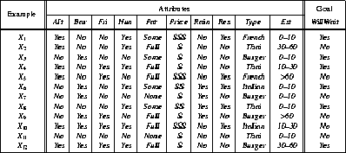
A Training Set
alternative restaurant available?
do we have a reservation?
bar in restaurant?,
how full is the restaurant?
what type of restaurant is it?
is it Friday?
how expensive?,
are we hungry?
what's the purported waiting time?
is it raining?
Shall we wait?

Slide 41
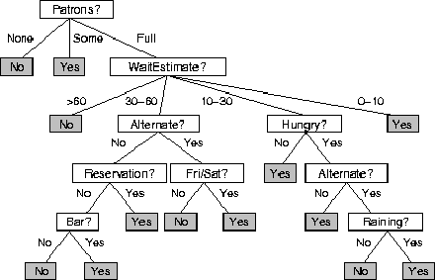
A decision Tree from Introspection

Slide 42
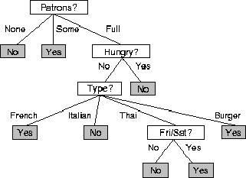
ID3 Induced
Decision Tree

Slide 43
ID3
A greedy algorithm for Decision Tree Construction developed by Ross Quinlan, 1987
Consider a smaller tree a better tree
Top-down construction of the decision tree by recursively selecting the "best attribute" to use at the current node in the tree, based on the examples belonging to this node.
  Once the attribute is selected for the current node, generate children nodes, one for each possible value of the selected attribute.
  Partition the examples of this node using the possible values of this attribute, and assign these subsets of the examples to the appropriate child node.
  Repeat for each child node until all examples associated with a node are either all positive or all negative.
this is not exhaustive method
What to do if several attributes have the same information gain.
How do we know that we get a globally minimum solution?
How do we know that the minimum tree is best?

Slide 44
ID3 Algorithm
  Top-down, greedy search through space of possible decision trees
    Remember, decision trees represent hypotheses, so this is a search through hypothesis space.
  What is top-down?
    How to start tree?
      What attribute should represent the root?
    As you proceed down tree, choose attribute for each successive node.
    No backtracking:
      So, algorithm proceeds from top to bottom

Slide 45
The ID3 algorithm is used to build a decision tree, given a set of non-categorical attributes C1, C2, .., Cn, the categorical attribute C, and a training set T of records.
function ID3 (R: a set of non-categorical attributes,
C: the categorical attribute,
S: a training set) returns a decision tree;
begin
If S is empty, return a single node with value Failure;
If every example in S has the same value for categorical
attribute, return single node with that value;
If R is empty, then return a single node with most
frequent of the values of the categorical attribute found in
examples S; [note: there will be errors, i.e., improperly
classified records];
Let D be attribute with largest Gain(D,S) among R’s attributes;
Let {dj| j=1,2, .., m} be the values of attribute D;
Let {Sj| j=1,2, .., m} be the subsets of S consisting
respectively of records with value dj for attribute D;
Return a tree with root labeled D and arcs labeled
d1, d2, .., dm going respectively to the trees
ID3(R-{D},C,S1), ID3(R-{D},C,S2) ,.., ID3(R-{D},C,Sm);
end ID3;
recursion

Slide 46
Choosing the Best Attribute
The key problem is choosing which attribute to split a given set of examples.
Some possibilities are:
  Random: Select any attribute at random
  Least-Values: Choose the attribute with the smallest number of possible values (fewer branches)
  Most-Values: Choose the attribute with the largest number of possible values (smaller subsets)
  Max-Gain: Choose the attribute that has the largest expected information gain, i.e. select attribute that will result in the smallest expected size of the subtrees rooted at its children.
The ID3 algorithm uses the Max-Gain method of selecting the best attribute.

Slide 47
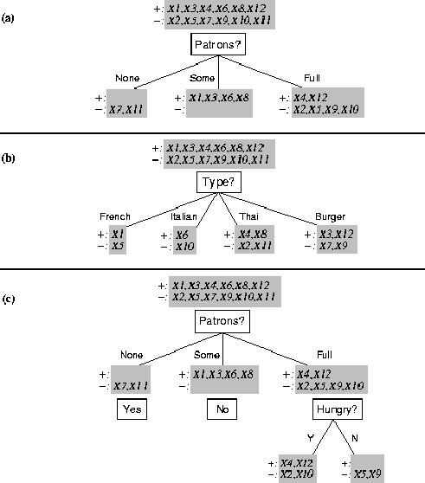
Splitting Examples by Testing Attributes

Slide 48
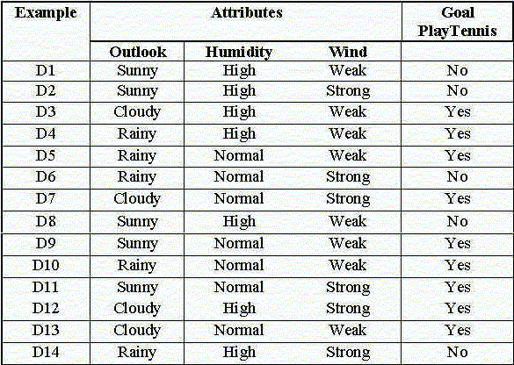
Another example: Tennis 2 (simplified former example)

Slide 49
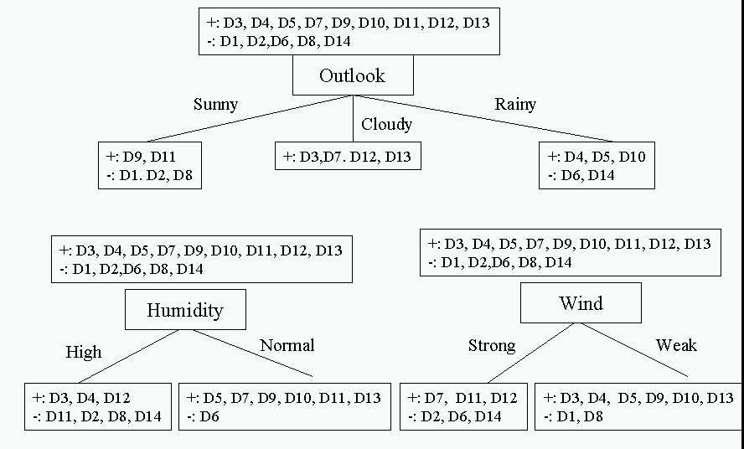
Choosing the first split

Slide 50
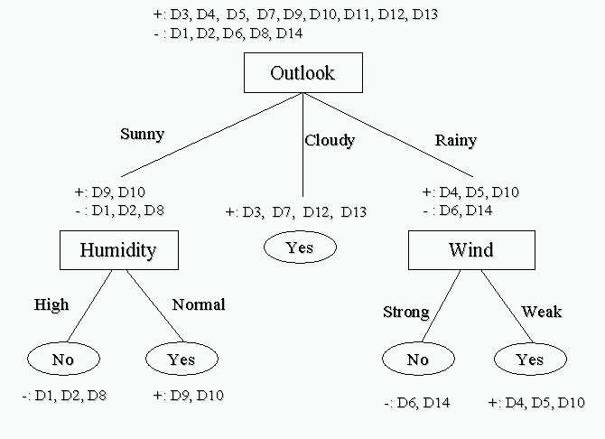
Resulting Decision Tree

Slide 51
The entropy is the average number of bits/message needed to represent a stream of messages.
Examples:
  if P is (0.5, 0.5) then I(P) is 1
  if P is (0.67, 0.33) then I(P) is 0.92,
  if P is (1, 0) then I(P) is 0.
The more uniform is the probability distribution, the greater is its information gain/entropy.
Entropy assumes that function with half-ones half-zeros is the most complicated.
Statistically it is true.
It may be not true for specific functions.
We can recognize classes of these specific functions and improve the branching method.

Slide 52
What is the hypothesis space for decision tree learning?
  Search through space of all possible decision trees
    from simple to more complex guided by a heuristic: information gain
  The space searched is complete space of finite, discrete-valued functions.
    Includes disjunctive and conjunctive expressions
ID3 and similar methods only maintain one current hypothesis
    In contrast to Candidate-Elimination
  Not necessarily global optimum
    attributes eliminated when assigned to a node
    No backtracking
    Different trees are possible

Slide 53
Inductive Bias: (restriction vs. preference)
  ID3
    searches complete hypothesis space
    But, incomplete search through this space looking for simplest tree
    This is called a preference (or search) bias
  Candidate-Elimination
    Searches an incomplete hypothesis space
    But, does a complete search finding all valid hypotheses
    This is called a restriction (or language) bias
  Typically, preference bias is better since you do not limit your search up-front by restricting hypothesis space considered.

Slide 54
How well does the decision tree method work?
Many case studies have shown that decision trees are at least as accurate as human experts.
  A study for diagnosing breast cancer:
    humans correctly classifying the examples 65% of the time,
    the decision tree classified 72% correct.
  British Petroleum designed a decision tree for gas-oil separation for offshore oil platforms/
    It replaced an earlier rule-based expert system.
  Cessna designed an airplane flight controller using 90,000 examples and 20 attributes per example.

Slide 55
Summary of ID3 Inductive Bias
  Short trees are preferred over long trees
    It accepts the first tree it finds
  Information gain heuristic
    Places high information gain attributes near root
    Greedy search method is an approximation to finding the shortest tree
  Why would short trees be preferred?
    Example of Occam’s Razor:
    Prefer simplest hypothesis consistent with the data.
    (Like Copernican vs. Ptolemic view of Earth’s motion)

Slide 56
Extensions of the Decision Tree Learning Algorithm
Using gain ratios
Real-valued data
Noisy data and Overfitting
Generation of rules
Setting Parameters
Cross-Validation for Experimental Validation of Performance
Incremental learning
Leo Deng and HIV research

Slide 57
Extensions of the decision tree learning algorithm
C4.5 is an extension of ID3 that accounts for unavailable values, continuous attribute value ranges, pruning of decision trees, rule derivation, and so on

Slide 58

C4.5
C4.5 is an extension of ID3 that accounts for unavailable values, continuous attribute value ranges, pruning of decision trees, rule derivation, and so on.
C4.5: Programs for Machine Learning
J. Ross Quinlan, The Morgan Kaufmann Series in Machine Learning, Pat Langley,
Series Editor. 1993. 302 pages. paperback book & 3.5" Sun disk. $77.95. ISBN 1-55860-240-2

Slide 59
Algorithms used:
  ID3 Quinlan (1986)
  C4.5 Quinlan(1993)
  C5.0 Quinlan
  Cubist Quinlan
  CART Classification and regression trees Breiman (1984)
  ASSISTANT Kononenco (1984) & Cestnik (1987)
ID3 is algorithm discussed in textbooks
  Simple, but representative
  Source code publicly available
Entropy first time was used
C4.5 (and C5.0) is an extension of ID3 that accounts for unavailable values, continuous attribute value ranges, pruning of decision trees, rule derivation, and so on.

Slide 60
Real-valued data
Select a set of thresholds defining intervals;
  each interval becomes a discrete value of the attribute
We can use some simple heuristics
  always divide into quartiles
We can use domain knowledge
  divide age into infant (0-2), toddler (3 - 5), and school aged (5-8)
or treat this as another learning problem
  try a range of ways to discretize the continuous variable
  Find out which yield “better results” with respect to some metric.

Slide 61
Real-valued data
Or treat this as another learning problem
  Try a range of ways to discretize the continuous variable and see which yield “better results” w.r.t. some metric
  E.g., try midpoint between every pair of values

Slide 62
Continuous Valued Attributes
Create a discrete attribute to test continuous
Temperature = 24.5⁰C
(Temperature > 20.0⁰C) = {true, false}
Where to set the threshold?
Temperature
15⁰C
18⁰C
19⁰C
22⁰C
24⁰C
27⁰C
PlayTennis
No
No
Yes
Yes
Yes
No
(see paper by [Fayyad, Irani 1993]

Slide 63
Overfitting
One of the biggest problems with decision trees is Overfitting

Slide 64
Noisy data and Overfitting
Many kinds of "noise" that could occur in the examples:
  Two examples have same attribute/value pairs, but different classifications
  Some values of attributes are incorrect because of:
    Errors in the data acquisition process
    Errors in the preprocessing phase
  The classification is wrong (e.g., + instead of -) because of some error
Some attributes are irrelevant to the decision-making process,
  e.g., color of a die is irrelevant to its outcome.
  Irrelevant attributes can result in overfitting the training data.

Slide 65
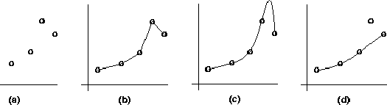
outlier
I have a set of points and I want to fit the curve to them.
I do not know what is the real curve.
better fit for data, poor generalization
outlier
not fit for the outlier (possibly due to noise), but better generalization

Slide 66
Overfitting:
  learning result fits data (training examples) well but does not hold for unseen data
    This means, the algorithm has poor generalization
  Often need to compromise fitness to data and generalization power
  Overfitting is a problem common to all methods that learn from data
(b and (c): better fit for data, poor generalization
(d): not fit for the outlier (possibly due to noise), but better generalization
Fix overfitting/overlearning problem
  By cross validation (see later)
  By pruning lower nodes in the decision tree.
  For example, if Gain of the best attribute at a node is below a threshold, stop and make this node a leaf rather than generating children nodes.

Slide 67
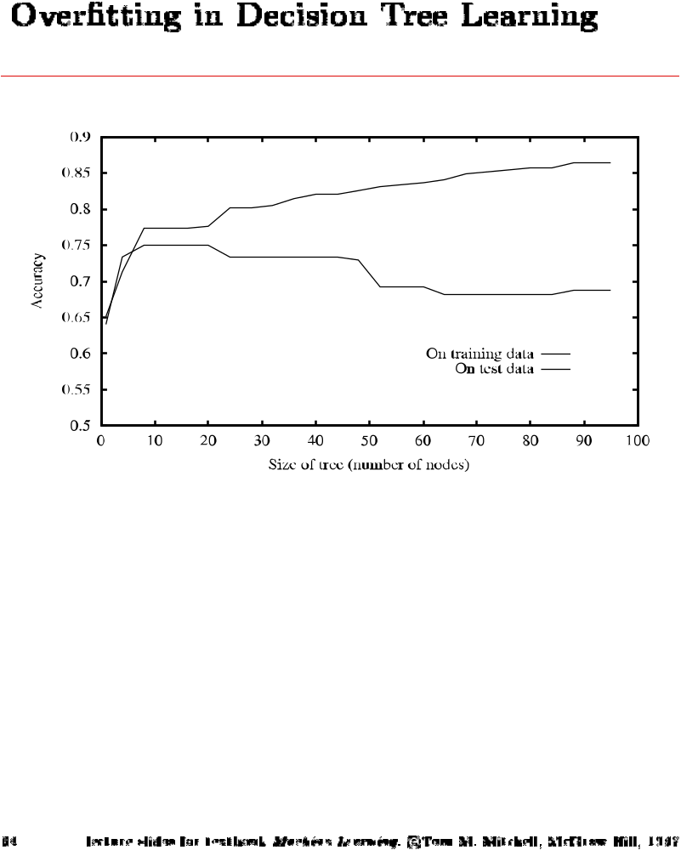
Overfitting in Decision Tree Learning
Size of tree

Slide 68
Another explanation of overfitting
Attribute 2
Best separation
Assume that these are all possible examples
Attribute 1

Slide 69
Another explanation of overfitting (cont)
Attribute 2
Separation based on the data from small training set
Best separation
Assume that red outline are all examples used in training
Attribute 1

Slide 70
How can we Avoid Overfitting?
How can we avoid overfitting?
Stop growing when data split not statistically significant
Grow full tree then post-prune
Minimum description length (MDL):
  Minimize:
  size(tree) + size(misclassifications(tree))

Slide 71
Pruning Decision Trees

Slide 72
Pruning Decision Trees
Pruning of the decision tree is done by replacing a whole subtree by a leaf node.
The replacement takes place if a decision rule establishes that the expected error rate in the subtree is greater than in the single leaf. E.g.,
  Training: eg, one training red success and one training blue Failures
  Test: three red failures and one blue success
  Consider replacing this subtree by a single Failure node.
After replacement we will have only two errors instead of five failures.
Color
Color
FAILURE
red
blue
red
blue
2 success
4 failure
1 success
0 failure
0 success
1 failure
1 success
3 failure
1 success
1 failure

Slide 73
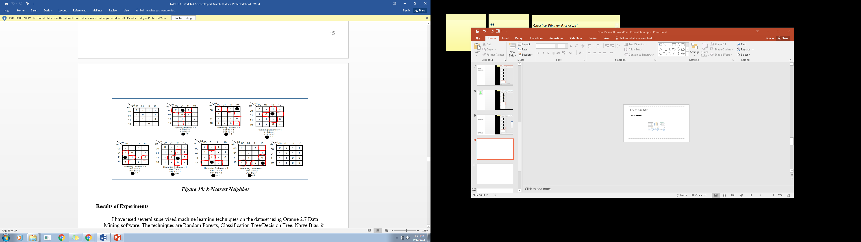
Using Kmaps to illustrate cofactoring or splitting
THIS METHOD ASSUMES NO PRUNNING
a=0
a=1
c=0
c=1
c=1
c=0
1
0
1
a*c
a*c
b=1
SOLUTION
a*c
+
b=0
+
a*c
a*c
*b*d
0
d
a*c
*b*d
The same as

Slide 74
Using Kmaps to illustrate cofactoring or splitting
THIS METHOD ASSUMES PRUNNING when there is more ones than zeros in a cofactor group or more zeros than ones
a=0
a=1
c=0
c=1
c=1
c=0
0
1
1
0
a*c
*b*d
In this cofactor a*c we have more zeros than ones so we prune to constant 0
The same as
SOLUTION
a*c
+
a*c

Slide 75
Conclusion on Prunning
SOLUTION without PRUNNING
a*c
+
+
a*c
a*c
*b*d
SOLUTION with PRUNNING
a*c
+
a*c
These are two different functions.
PRUNNING OR NO PRUNNING CAN LEAD TO OVERFITTING

Slide 76
Unknown Attribute Values
What if some examples have missing values of A?
Use training example anyway sort through tree
If node n tests A, assign most common value of A among other examples sorted to node n.
Assign most common value of A among other examples with same target value
Assign probability pi to each possible value vi of A
  Assign fraction pi of example to each descendant in tree
Classify new examples in the same fashion

Slide 77
Incremental Learning
Incremental learning
  Change can be made with each training example
  Non-incremental learning is also called batch learning
  Good for
    adaptive system (learning while experiencing)
    when environment undergoes changes
  Often with
    Higher computational cost
    Lower quality of learning results
  ITI (by U. Mass): incremental DT learning package

Slide 78
Evaluation Methodology

Slide 79
Evaluation Methodology for Supervised Learning Algorithms
Standard methodology: cross validation
  1. Collect a large set of examples (all with correct classifications!).
  2. Randomly divide collection into two disjoint sets: training and test.
  3. Apply learning algorithm to training set giving hypothesis H
  4. Measure performance of H w.r.t. test set
Important: keep the training and test sets disjoint!
Learning is not to minimize training error (wrt data) but the error for test/cross-validation: a way to fix overfitting
To study the efficiency and robustness of an algorithm, repeat steps 2-4 for different training sets and sizes of training sets.
If you improve your algorithm, start again with step 1 to avoid evolving the algorithm to work well on just this collection.

Slide 80
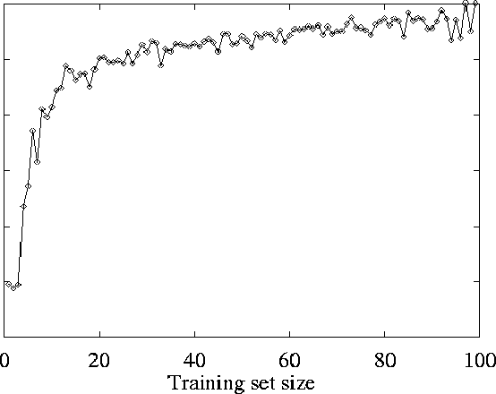
Restaurant Example
Learning Curve

Slide 81
Occam’s Razor

Slide 82
Preference Bias: Ockham's Razor
Aka Occam’s Razor, Law of Economy, or Law of Parsimony
Principle stated by William of Ockham (1285-1347/49), a scholastic, that
  “non sunt multiplicanda entia praeter necessitatem”
  or, entities are not to be multiplied beyond necessity.
The simplest explanation that is consistent with all observations is the best.
Therefore, the smallest decision tree that correctly classifies all of the training examples is best.
Finding the provably smallest decision tree is NP-Hard
Therefore we do not construct the absolute smallest tree consistent with the training examples.
We construct a tree that is pretty small.

Slide 83
Occam’s Razor
Why prefer short hypotheses?
Argument in favor of Occam Razor Principle:
  There are fewer short hypotheses than long hypotheses
  A short hypothesis that fits the data is unlikely to be a coincidence
  A long hypothesis that fits the data might be a coincidence
Argument opposed to Occam Razor Principle:
  There are many ways to define small sets of hypotheses
    Some may be completely nonsensical, based on small number of examples.
      Generalization ”Towers are red” because all examples of towers happened to be red.
      Generalization ”All prime numbers start with letter o, t or f”, because a small set of prime numbers was given as examples.
  What is so special about small sets based on size of hypothesis?

Slide 84
Practical Example of Rule and Decision Tree Learning
Example: Rule Acquisition from Historical Data
Data
  Patient 103 (time = 1): Age 23, First-Pregnancy: no, Anemia: no, Diabetes: no, Previous-Premature-Birth: no, Ultrasound: unknown, Elective C-Section: unknown, Emergency-C-Section: unknown
  Patient 103 (time = 2): Age 23, First-Pregnancy: no, Anemia: no, Diabetes: yes, Previous-Premature-Birth: no, Ultrasound: abnormal, Elective C-Section: no, Emergency-C-Section: unknown
  Patient 103 (time = n): Age 23, First-Pregnancy: no, Anemia: no, Diabetes: no, Previous-Premature-Birth: no, Ultrasound: unknown, Elective C-Section: no, Emergency-C-Section: YES
Learned Rule
  IF no previous vaginal delivery, AND abnormal 2nd trimester ultrasound, AND malpresentation at admission, AND no elective C-Section THEN probability of emergency C-Section is 0.6
  Training set: 26/41 = 0.634
  Test set: 12/20 = 0.600

Slide 85
  Note: In this example data were perfect.
    No contradictions
    Branches led to unambiguous Yes, No decisions
    If there are contradictions take the majority vote
      This handles noisy data.
  Another note:
    Attributes are eliminated when they are assigned to a node and never reconsidered.
      e.g. You would not go back and reconsider Outlook under Humidity
  ID3 uses all of the training data at once
    Contrast to Candidate-Elimination
    Can handle noisy data.

Slide 86
One goal is to classify correctly, another goal is to understand the data
But WHO has to understand the data?

Slide 87
Transforming Decision Trees to Rules
It is easy to derive a rule set from a decision tree: write a rule for each path in the decision tree from the root to a leaf.
In that rule the left-hand side is easily built from the label of the nodes and the labels of the arcs.
The resulting rules set can be simplified:
  Let LHS be the left hand side of a rule.
  Let LHS' be obtained from LHS by eliminating some conditions.
  We can certainly replace LHS by LHS' in this rule if the subsets of the training set that satisfy respectively LHS and LHS' are equal.
  A rule may be eliminated by using metaconditions such as "if no other rule applies".

Slide 88
Converting a Tree to Rules
Outlook
Sunny
Overcast
Rain
Humidity
Yes
Wind
High
Normal
Strong
Weak
No
Yes
No
Yes
R₁: If (Outlook=Sunny) ∧ (Humidity=High) Then PlayTennis=No
R₂: If (Outlook=Sunny) ∧ (Humidity=Normal) Then PlayTennis=Yes
R₃: If (Outlook=Overcast) Then PlayTennis=Yes
R₄: If (Outlook=Rain) ∧ (Wind=Strong) Then PlayTennis=No
R₅: If (Outlook=Rain) ∧ (Wind=Weak) Then PlayTennis=Yes

Slide 89
EXAMPLE 3
Huffman
Trees

Slide 90
Example of using probabilities to create trees: Huffman code
In 1952 MIT student David Huffman devised, in the course of doing a homework assignment, an elegant coding scheme
This scheme is optimal in the case where all symbols’ probabilities are integral powers of 1/2.
A Huffman code can be built in the following manner:
  1. Rank all symbols in order of probability of occurrence.
  2. Successively combine the two symbols of the lowest probability to form a new composite symbol;
    eventually we will build a binary tree where each node is the probability of all nodes beneath it.
  3. Trace a path to each leaf, noticing the direction at each node.

Slide 91
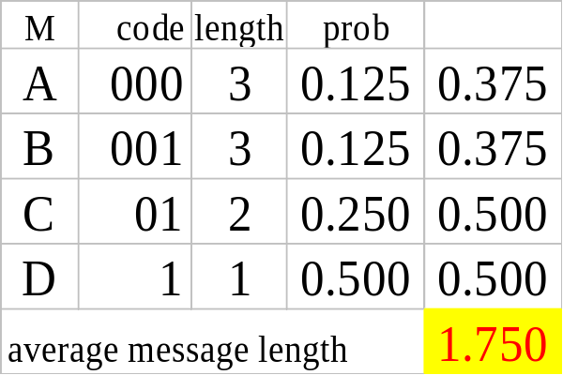
Huffman code example as a prototypical idea from other area
Message Probability.
A .125
B .125
C .25
D .5
1
0
1
.5
.5
D
0
1
If we need to send many messages (A,B,C or D) and they have this probability distribution and we use this code, then over time, the average bits/message should approach 1.75
(= 0.125*3+0.125*3+0.25*2*0.5*1)
.25
.25
C
0
1
.125
.125
A
B

Slide 92
If a set T of records is partitioned into disjoint exhaustive classes (C1,C2,..,Ck) on the basis of the value of the categorical attribute, then the information needed to identify the class of an element of T is
  Info(T) = I(P)
where P is probability distribution of partition (C1,C2,..,Ck):
  P = (|C1|/|T|, |C2|/|T|, ..., |Ck|/|T|)
If we partition T w.r.t attribute X into sets {T1,T2, ..,Tn} then the information needed to identify the class of an element of T becomes the weighted average of the information needed to identify the class of an element of Ti,
  i.e. the weighted average of Info(Ti):
  Info(X,T) = Σ|Ti|/|T| * Info(Ti) = Σ|Ti|/|T| * log |Ti|/|T|

Slide 93
Gain
Consider the quantity Gain(X,T) defined as
Gain(X,T) = Info(T) - Info(X,T)
This represents the difference between
  information needed to identify an element of T and
  information needed to identify an element of T after the value of attribute X has been obtained,
that is, this is the gain in information due to attribute X.
We can use this to rank attributes and to build decision trees where at each node is located the attribute with greatest gain among the attributes not yet considered in the path from the root.
The intents of this ordering are twofold:
  1. To create small decision trees so that records can be identified after only a few questions.
  2. To match a hoped for minimality of the process represented by the records being considered (Occam's Razor).
We will use this idea to build decision trees, ID3

Slide 94
So what does the Huffman code have to do with information theory?
Shannon’s entropy gives the average length of the smallest encoding theoretically possible for a weighted alphabet.
The information theoretical limit to encoding this alphabet is:
-0.5*log(0.5) – 0.25*log(0.25) – 0.125*log(0.125) – 0.125*log(0.125) = 1.75
Huffman’s code is optimal in the information theoretical sense, and yields encodings which are very very close to the theoretical limit.

Slide 95
DECISION TREES versus RANDOM FORESTS

Slide 96
RANDOM FOREST

Slide 97
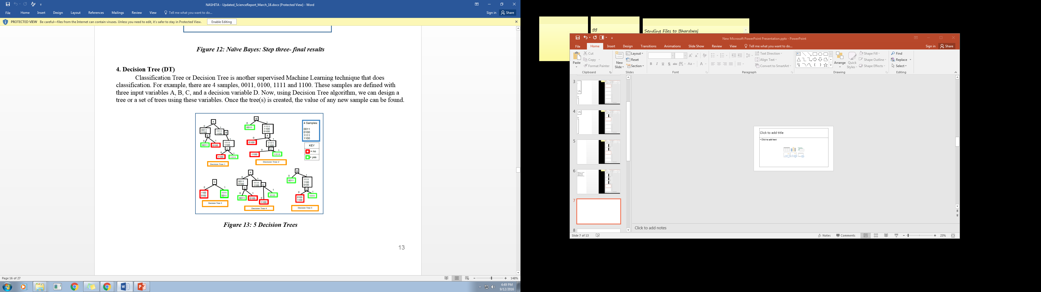
Last bit is the value of the decision variable
1
0
Idea of Random Forests is simple;
create many trees except of one tree, do this on subsets of examples, on all of them or on somehow preprocessed examples.
Use different order of variables in the trees.

Slide 98
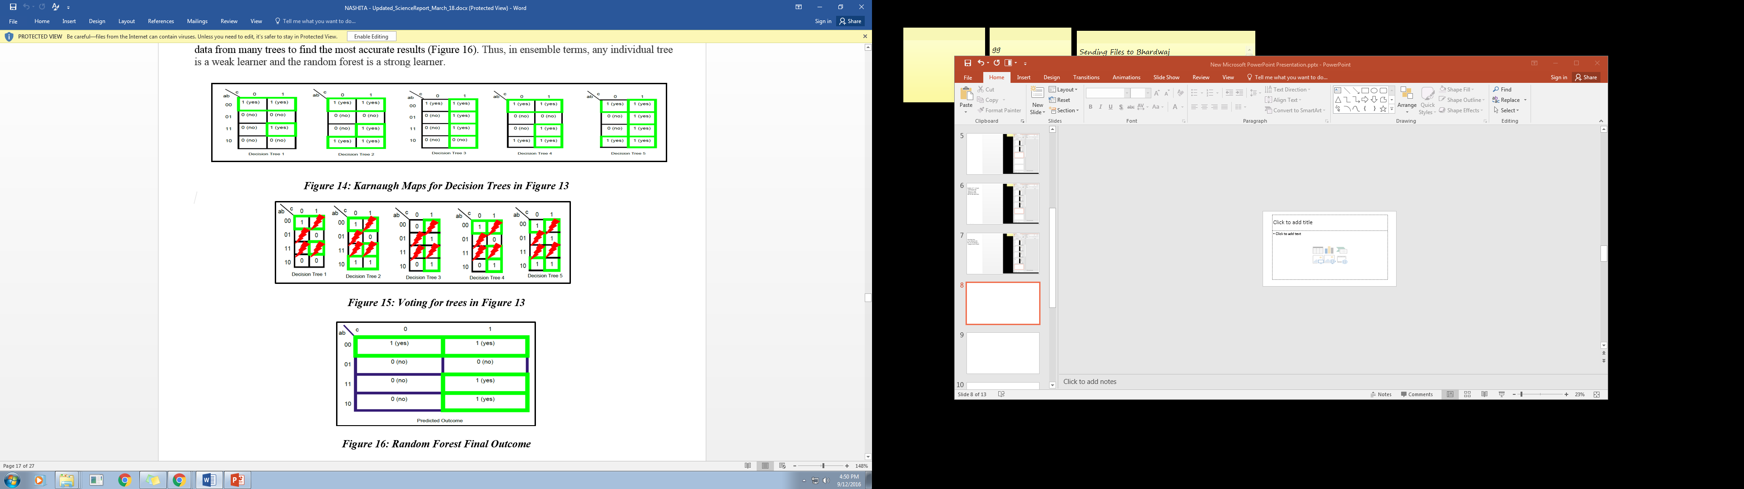
One variant of random forest
1. Create trees for selected good but random orders of variables. Here for instance 5 trees.
2. Find the Kmap for each tree. It has no don’t cares
voting
3. Vote for don’t cares (red minterms have fixed values as the examples for training.
3. The result of voting.

Slide 99
NOW IT IS A TIME TO BE MORE PHILOSOPHICAL AND GENERAL

Slide 100
What is learning?
“Learning denotes changes in a system that ... enable a system to do the same task more efficiently the next time.” –Herbert Simon
“Learning is constructing or modifying representations of what is being experienced.”
–Ryszard Michalski
“Learning is making useful changes in our minds.” –Marvin Minsky

Slide 101
Why learn?
Understand and improve efficiency of human learning
  Use to improve methods for teaching and tutoring people (e.g., better computer-aided instruction)
Discover new things or structure that were previously unknown to humans
  Examples: data mining, scientific discovery
Fill in skeletal or incomplete specifications about a domain
  Large, complex AI systems cannot be completely derived by hand and require dynamic updating to incorporate new information.
  Learning new characteristics expands the domain or expertise and lessens the “brittleness” of the system
Build software agents that can adapt to their users or to other software agents

Slide 102
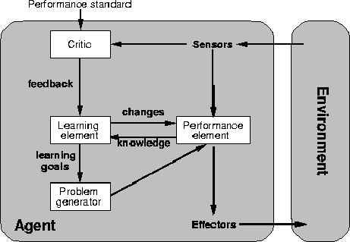
A general model of learning agents

Slide 103
Major paradigms of machine learning
Rote learning – One-to-one mapping from inputs to stored representation. “Learning by memorization.” Association-based storage and retrieval.
Induction – Use specific examples to reach general conclusions
Clustering – Unsupervised identification of natural groups in data
Analogy – Determine correspondence between two different representations
Discovery – Unsupervised, specific goal not given
Genetic algorithms – “Evolutionary” search techniques, based on an analogy to “survival of the fittest”
Reinforcement – Feedback (positive or negative reward) given at the end of a sequence of steps

Slide 104
The inductive learning problem
Extrapolate from a given set of examples to make accurate predictions about future examples
Supervised versus unsupervised learning
  Learn an unknown function f(X) = Y, where X is an input example and Y is the desired output.
  Supervised learning implies we are given a training set of (X, Y) pairs by a “teacher”
  Unsupervised learning means we are only given the Xs and some (ultimate) feedback function on our performance.
Concept learning or classification
  Given a set of examples of some concept/class/category, determine if a given example is an instance of the concept or not
  If it is an instance, we call it a positive example
  If it is not, it is called a negative example
  Or we can make a probabilistic prediction (e.g., using a Bayes net)

Slide 105
Supervised concept learning
Given a training set of positive and negative examples of a concept
Construct a description that will accurately classify whether future examples are positive or negative
That is, learn some good estimate of function f given a training set {(x₁, y₁), (x₂, y₂), ..., (x_{n}, y_{n})} where each y_{i} is either + (positive) or - (negative), or a probability distribution over +/-

Slide 106
Inductive learning framework
Raw input data from sensors are typically preprocessed to obtain a feature vector, X, that adequately describes all of the relevant features for classifying examples
Each x is a list of (attribute, value) pairs. For example,
  X = [Person:Sue, EyeColor:Brown, Age:Young, Sex:Female]
The number of attributes (a.k.a. features) is fixed (positive, finite)
Each attribute has a fixed, finite number of possible values (or could be continuous)
Each example can be interpreted as a point in an n-dimensional feature space, where n is the number of attributes

Slide 107
Inductive learning as search
Instance space I defines the language for the training and test instances
  Typically, but not always, each instance i ∈ I is a feature vector
  Features are also sometimes called attributes or variables
  I: V₁ x V₂ x … x V_{k}, i = (v₁, v₂, …, v_{k})
Class variable C gives an instance’s class (to be predicted)
Model space M defines the possible classifiers
  M: I → C, M = {m1, … mn} (possibly infinite)
  Model space is sometimes, but not always, defined in terms of the same features as the instance space
Training data can be used to direct the search for a good (consistent, complete, simple) hypothesis in the model space

Slide 108
Model spaces
Decision trees
  Partition the instance space into axis-parallel regions, labeled with class value
Version spaces
  Search for necessary (lower-bound) and sufficient (upper-bound) partial instance descriptions for an instance to be a member of the class
Nearest-neighbor classifiers
  Partition the instance space into regions defined by the centroid instances (or cluster of k instances)
Associative rules (feature values → class)
First-order logical rules
Bayesian networks (probabilistic dependencies of class on attributes)
Neural networks

Slide 109
Model spaces
I
I
-
-
-
-
+
+
+
+
I
Nearest
neighbor
-
Decision
tree
-
+
Instance space I defines the language for the training and test instances
+
Version space

Slide 110
Decision tree-induced partition – example
The space of all
I
Color
green
red
blue
Size
+
Shape
big
small
square
round
-
+
Size
+
big
small
-
+
Instance space I defines the language for the training and test instances

Slide 111
Computational learning theory
Probably approximately correct (PAC) learning:
  Sample complexity (# of examples to “guarantee” correctness) grows with the size of the model space
Stationarity assumption: Training set and test sets are drawn from the same distribution
  Lots of recent work on what to do if this assumption is violated, but you know something about the relationship between the two distributions
Theoretical results apply to fairly simple learning models (e.g., decision list learning)

Slide 112
Summary of DT Learning
Inducing decision trees is one of the most widely used learning methods in practice
Can out-perform human experts in many problems
Strengths include
  Fast
  simple to implement
  can convert result to a set of easily interpretable rules
  empirically valid in many commercial products
  handles noisy data
Weaknesses include:
  "Univariate" splits/partitioning using only one attribute at a time so limits types of possible trees
  large decision trees may be hard to understand
  requires fixed-length feature vectors

Slide 113
Conclusion on Projects
Now you have sufficient knowledge to use Decision Tree as a software for Supervised Learning in robotic projects.
You can use Decision Tree from OpenCV but better to use Orange.
Using Orange would allow you to compare several supervised learners and do interesting data preprocessing such as discretization.
Do not program the ML algorithms by yourself. They are complicated. Use OpenCV, R, WEKA or preferably ORANGE.
If you are interested in deeper research, I have several ongoing projects related to ML.

Slide 114
Questions and Problems
1. Think how the method of finding best variable order for decision trees that we discussed here be adopted for:
    ordering variables in binary and multi-valued decision diagrams
    finding the bound set of variables for Ashenhurst and other functional decompositions
2. Find a more precise method for variable ordering in trees, that takes into account special function patterns recognized in data
3. Write a Lisp program for creating decision trees with entropy based variable selection.

Slide 115
Questions and Problems
Explain one practical problem for supervised Machine Learning, similar to tennis.
When you have a decision tree, how to find the rules from it?
Explain intuitively on examples what is entropy and what is information gain.
Illustrate entropy and information gain on a Boolean Function of 4 variables.
How information gain is used to select best order of variables (attributes)?
Do you see another application of the information gain in Machine Learning?
Why information gain may be not enough?

Slide 116
Questions and Problems
Calculate information gain for Restaurant example
What are the main ideas of ID3?
Explain the concept of split or separation in decision trees. Can you use this idea to some data structure that is not a tree?
What are all possible extensions to the concept of Machine Learning using the decision tree model of learning?
How to apply decision trees to multiple-valued data?
How to apply decision trees to fuzzy data?
How to apply decision trees to continuous data?

Slide 117
Questions and Problems
What is overfitting?
How to fight overfitting?
Explain cross-validation on one practical example of learning a simple Boolean Function.
Formulate Occam Razor Principle.
What is the Learning Curve?
What is “interpretability of results”?
What are Huffman Trees?
What is their link with decision trees?
What is the link of Huffman Trees and Information Theory?

Slide 118
Questions and Problems
What are Random Forests?
Discuss various principles of creating Random Forests?
What are Model Spaces?
What are Instance Spaces?
Give example of Instance Space for a simple Machine Learning problem of your creation.

Slide 119
  Sources
    Tom Mitchell
      Machine Learning, Mc Graw Hill 1997
    Allan Moser
    Tim Finin,
    Marie desJardins
    Chuck Dyer

