Slide 1


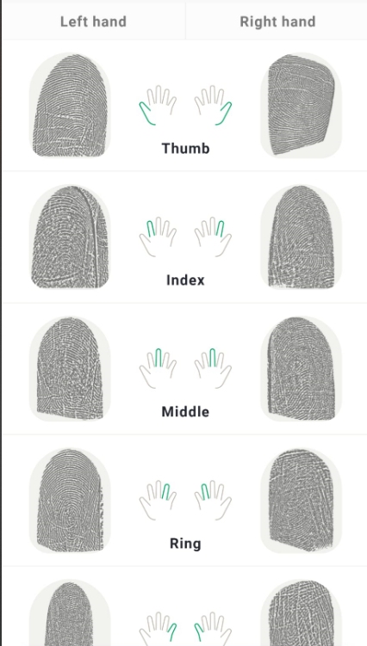
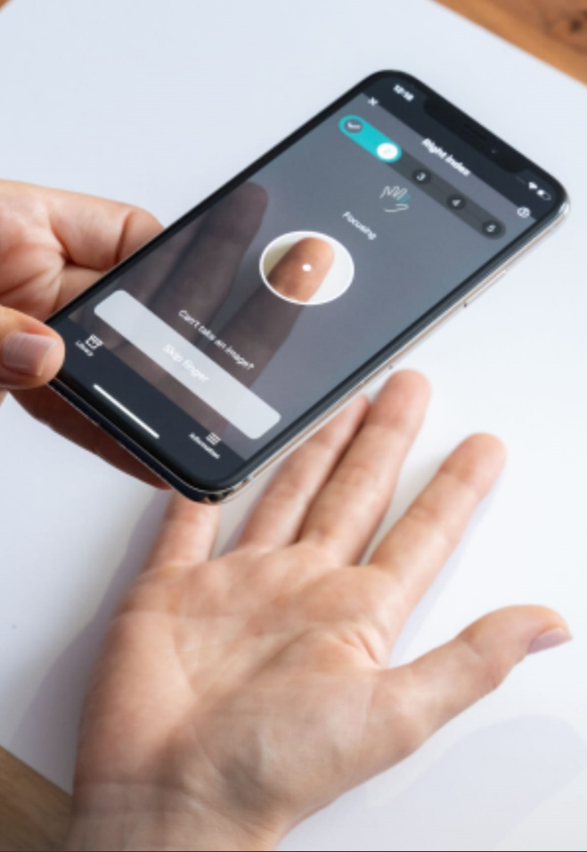
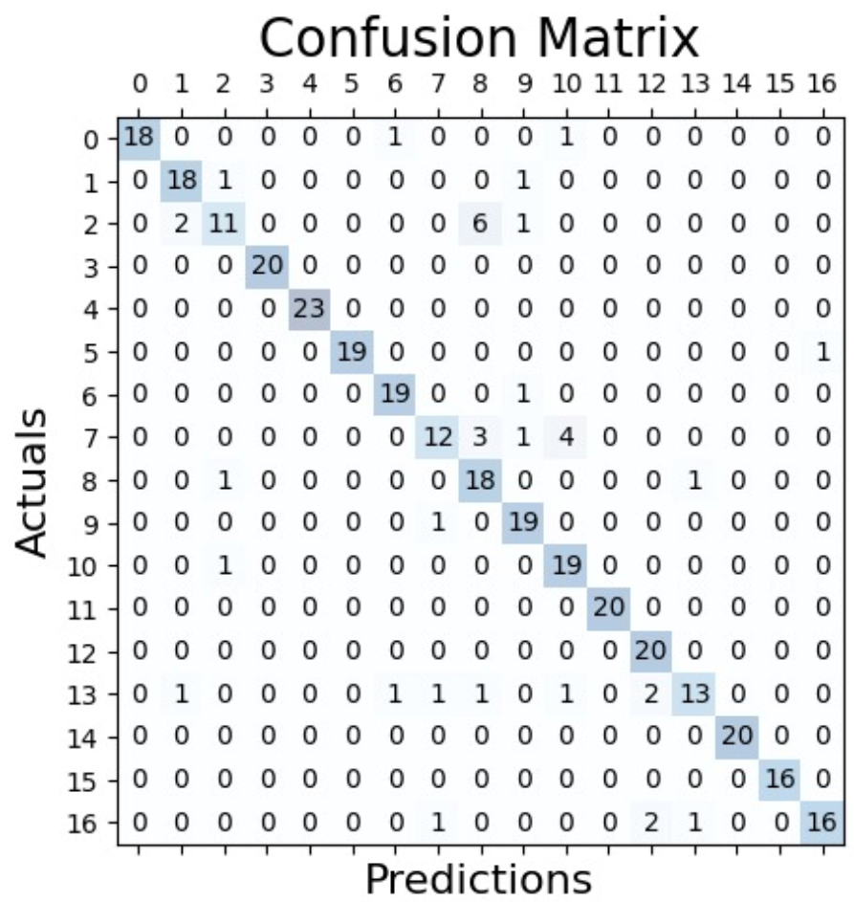
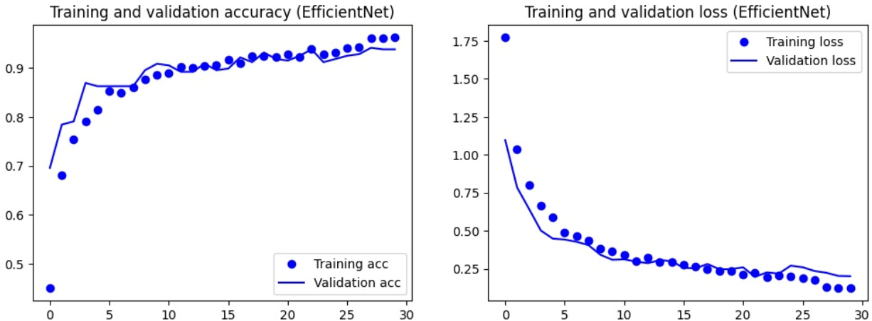
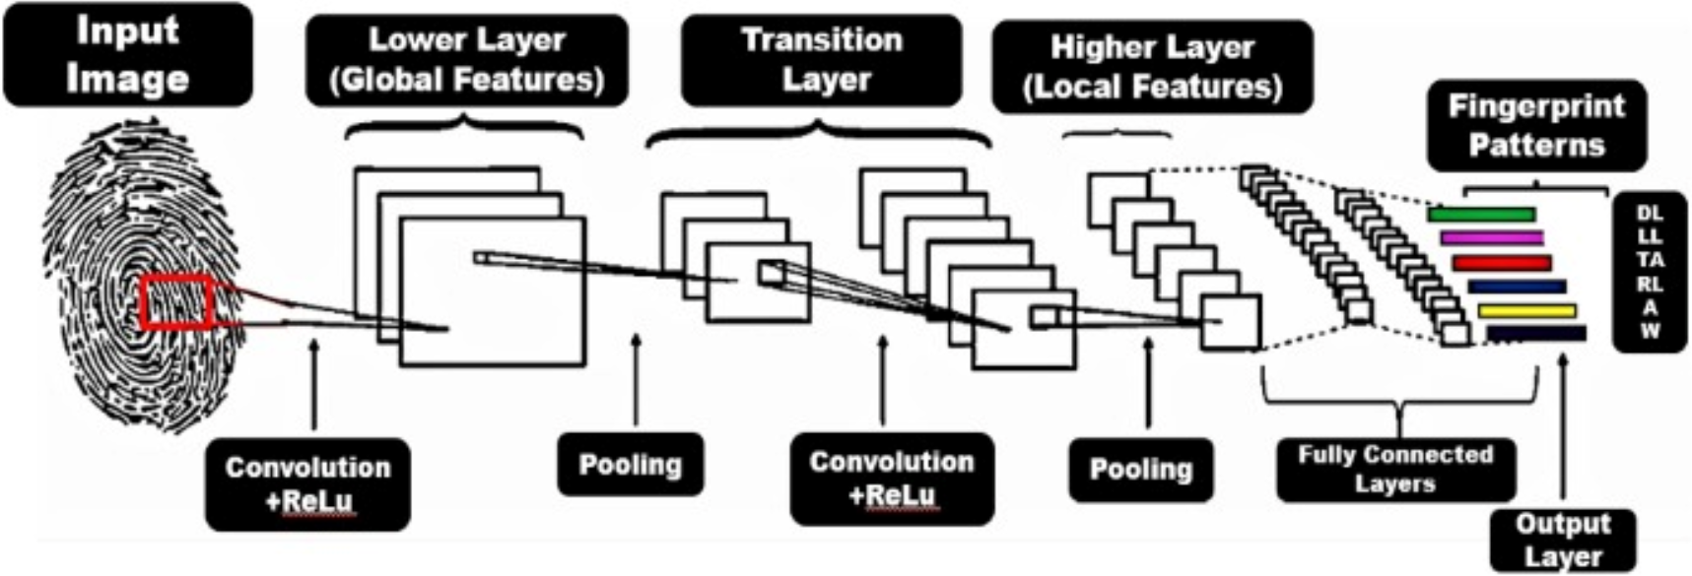
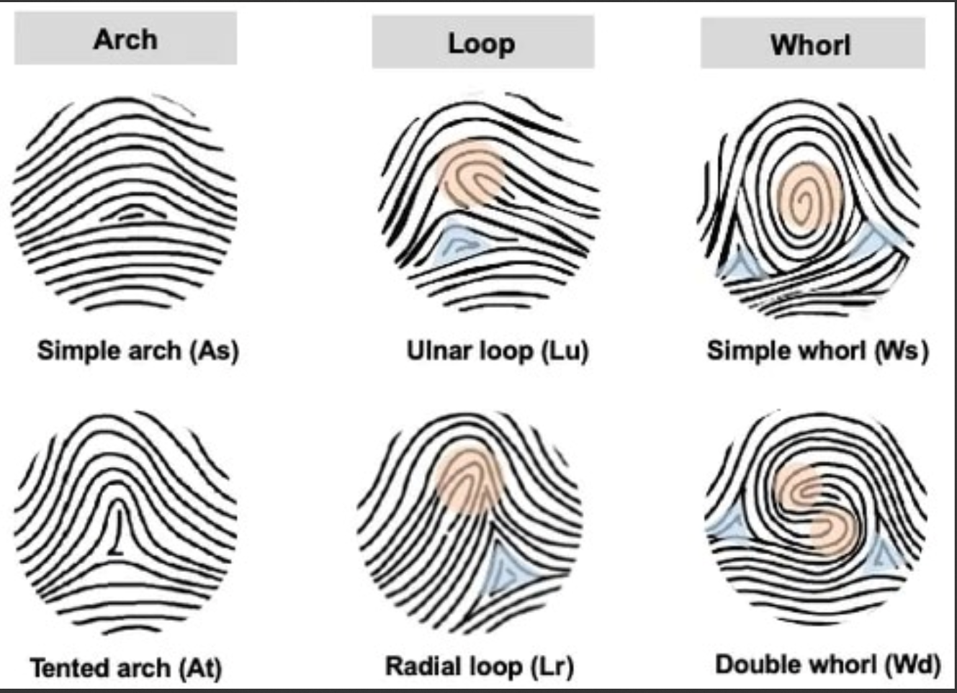
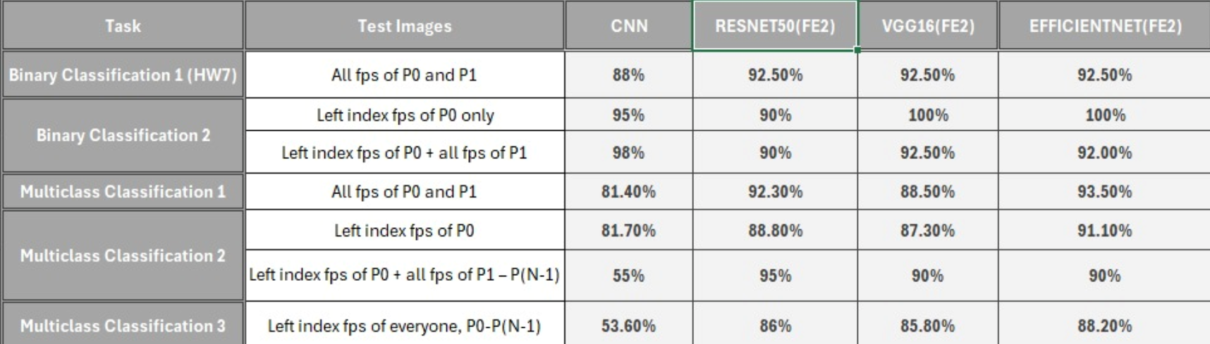
Exploring Fingerprint Individuality and Commonalities: Deep Learning Insights
Kalyan Naik Vankudothu, MSCS Candidate, Rakesh Kethavath, MSCS Candidate, Hemanth Indurthi Venkata, MSCS Candidate, Siri Sri churakanti, MSCS Candidate, CJ Chung, PhD, Professor
College of Arts & Science, Lawrence Technological University
INTRODUCTION including Goals
METHODS
RESULTS
In the realm of biometric security, fingerprint identification stands as a cornerstone, widely recognized for its uniqueness to each individual. This distinctiveness makes fingerprints a reliable method for authentication and identification in various security applications, from law enforcement to personal device access. However, despite the general acceptance of their individuality, recent advances in technology and research invite us to reexamine this assumption and explore potential commonalities across different fingerprints.
This project, titled "Exploring Fingerprint Individuality and Commonalities: Deep Learning Insights," delves into the capabilities of deep learning technologies to unravel these aspects of fingerprints. Employing Convolutional Neural Networks (CNNs) and advanced pretrained models such as VGG16, ResNet50, and EfficientNet, this study investigates both the unique and shared traits of fingerprints. The research is conducted through rigorous Binary and Multi-Class Classification tasks using a curated dataset of fingerprints, which includes both self-captured and partner-provided samples.
Our primary aim is to assess the accuracy and reliability of these deep learning models in recognizing and differentiating fingerprints, thereby challenging the traditional understanding of fingerprint uniqueness. Additionally, by exploring the shared characteristics among fingerprints, we aim to uncover insights that could significantly enhance the robustness and accuracy of biometric identification systems.
This inquiry not only pushes the boundaries of conventional biometric technology but also paves the way for innovative applications in security and forensic science, where understanding both the uniqueness and commonalities of fingerprints can lead to more sophisticated and secure identification systems.
Dataset Preparation: The study utilizes a self-compiled dataset comprising fingerprints from 17 individuals, including both self and partner fingerprints. Each individual provided fingerprints from all ten fingers, captured under controlled conditions to minimize variability in lighting and positioning. The dataset is divided into training, validation, and testing subsets to ensure robust model evaluation.
Preprocessing: Prior to training, fingerprints are preprocessed to enhance clarity and contrast, involving steps such as resizing to a uniform scale, normalization of pixel values, and augmentation techniques (e.g., rotations and shifts) to increase the diversity of training data and prevent overfitting.
Model Architecture and Training:
Binary Classification: For individual fingerprint recognition, we deploy several CNN architectures, including VGG16, ResNet50, and EfficientNet. These models are trained to distinguish between two classes: the subject's fingerprint and others. This setup tests the model's ability to recognize a fingerprint amidst diverse samples.
Multi-Class Classification: To explore commonalities among fingerprints, we implement multi-class classifiers that predict the specific finger based on the fingerprint image. This approach examines whether certain fingerprints share common features that can be systematically recognized by the model.
Feature Extraction and Transfer Learning: Utilizing pretrained models allows leveraging learned features from extensive external datasets, enhancing the ability to detect nuanced patterns in fingerprint data. We fine-tune these models on our specific dataset, adjusting the final layers to suit our binary and multi-class classification tasks.
Performance Metrics: Model performance is assessed using accuracy, precision, recall, and F1 score for both training and validation phases. Additionally, confusion matrices are generated to visualize the models' performance across different classes, highlighting potential areas for improvement.
Computational Environment: All models are trained and tested using TensorFlow and Keras frameworks on a high-performance computing environment, ensuring efficient handling of large-scale data and intensive computational processes.
Our study yielded several significant findings, underpinned by detailed visual proof to substantiate the effectiveness and nuances of the deep learning models employed.
Model Performance: Binary Classification Accuracy: The pretrained EfficientNet model demonstrated the highest accuracy, achieving a test accuracy of 94.5%. This superior performance is visually represented through a bar chart comparing the accuracy rates of VGG16, ResNet50, and EfficientNet across the testing dataset.
Multi-Class Classification: The multi-class classification task showed that the model could distinguish between different fingers with an accuracy of 89%. A heatmap of the confusion matrix for this task provides a visual representation of the model's ability to correctly identify each finger, highlighting areas where misclassifications occurred.
Visual Proof:
Accuracy Charts: Bar charts display the accuracy, precision, recall, and F1 scores for each model, providing a clear visual summary of their performance.
Confusion Matrices: Heatmaps of the confusion matrices for both binary and multi-class tasks illustrate the distribution of predictions across different classes, pinpointing the specific areas where the models excel or falter.
Representative Case Studies: We include side-by-side comparisons of fingerprint images that were correctly and incorrectly classified, accompanied by the model's confidence scores. This juxtaposition offers insights into the challenges faced by the models under different conditions.
Unexpected Findings:
Commonalities in Fingerprints: Contrary to traditional beliefs about fingerprint uniqueness, our analyses revealed unexpected similarities among fingerprints that occasionally led to misclassifications. A detailed discussion accompanied by cluster diagrams shows how certain fingerprints share common traits that confuse the models.
Variability in Model Performance: The research also uncovered that the performance variability among different fingers is noteworthy. For instance, thumbprints were consistently recognized with higher accuracy compared to little fingers. A series of line graphs demonstrate these performance trends across different fingers.
DATA COLLECTION
Data Collection Equipment:
The data collection process involved using an android phone to collect fingerprint. The Fingerprint software ,by MyMarq was used to take collect the data.
Data Classification:
The collected dataset was divided into Train, Validation and Test. Data was also collected from 17 different people each providing 20 scans of all 10 fingers resulting in a dataset of 3400 fingerprints, split as 340 for Testing, 340 for validation and 2720 for Training
TECHNICAL DETAILS
This project leverages state-of-the-art deep learning frameworks and technologies to explore the individuality and commonalities of fingerprints through advanced pattern recognition techniques.
Computational Tools and Frameworks:
TensorFlow and Keras: Our models are built and trained using TensorFlow 2.x, with Keras as the high-level API for rapid prototyping and experimentation. This combination allows for efficient management of large datasets and complex neural network architectures.
Python: All scripting and data handling were conducted in Python (version 3.8), utilizing libraries such as NumPy for numerical operations and Matplotlib for data visualization.
Model Architectures: Convolutional Neural Networks (CNNs): We employed several CNN architectures, including VGG16, ResNet50, and EfficientNet. These models are known for their effectiveness in image recognition tasks and were adapted for the specific needs of fingerprint classification.
Pretrained Models: Leveraging pretrained networks provided a significant head start in feature recognition capabilities. These models were originally trained on large datasets like ImageNet and were fine-tuned to our specific task of fingerprint recognition.
Feature Extraction Techniques: Techniques such as MaxPooling and Dropout were utilized to enhance the generalization capabilities of the networks and prevent overfitting.
Data Handling:
Image Preprocessing: Fingerprint images were preprocessed to standardize input size and format. This included resizing images to a fixed dimension, normalizing pixel values to a [0,1] range, and applying data augmentation techniques like rotation and width shifting to increase the robustness of the models.
Dataset Splitting: The dataset was split into training, validation, and testing sets. This division was crucial for evaluating the model's performance and ensuring that it could generalize well to new, unseen data.
Performance Metrics: To objectively assess model performance, we utilized metrics such as accuracy, precision, recall, and F1-score. These metrics provide a comprehensive view of the model's effectiveness across various aspects of classification tasks.
Model Evaluation: Models were rigorously tested using a hold-out test set, and performance was compared using confusion matrices to visually assess the rate of false positives and false negatives alongside true classifications.
Computational Resources: The training and evaluation of models were performed on a high-performance computing (HPC) environment equipped with NVIDIA GPUs, which significantly reduced the time required for training and provided the necessary computational power to handle multiple model architectures and hyperparameter tuning.
SUMMARY, DISCUSSION, and/or Conclusion
FUTURE WORK
REFERENCES
This study's findings challenge traditional conceptions of fingerprint uniqueness and introduce substantial insights into the capabilities and limitations of using deep learning for fingerprint analysis.
Interpretation of Results:
The high accuracy achieved by the EfficientNet model in binary classification tasks confirms the potential of advanced deep learning architectures in enhancing biometric security systems. The robustness of these models against a diverse set of fingerprints underscores their practical applicability in real-world scenarios.
The discovery of commonalities among different fingerprints, particularly in multi-class classification tasks, suggests that while fingerprints are generally unique, subpatterns and traits can indeed be shared across individuals. This observation could redefine our understanding of fingerprint individuality and its forensic implications.
Implications:
Security Systems: The ability of deep learning models to accurately identify individual fingerprints could lead to more secure biometric authentication systems. However, the observed commonalities might pose challenges, suggesting a potential need for combining fingerprint analysis with other biometric factors to enhance security.
Forensic Science: In forensic applications, understanding the conditions under which fingerprints can exhibit common traits is crucial. This could impact how fingerprints are used in criminal investigations and legal proceedings.
Limitations:
The study was limited to a relatively small dataset from a specific demographic group, which may not capture the full variability of fingerprint patterns globally. Further research with a more diverse dataset is essential to validate these findings. While the models performed well in controlled settings, their effectiveness in less controlled environments, such as poor quality or partial fingerprints, remains to be thoroughly investigated.
Algorithm Enhancement: Future studies could explore the integration of other machine learning techniques, such as unsupervised learning or reinforcement learning, to improve the differentiation of fingerprints and handle more complex pattern variations.
Broader Application: Expanding the research to include other biometric traits, such as palm prints or retinal scans, could provide a more holistic view of the potential and limitations of using deep learning in biometric security.
Real-World Testing: Implementing these models in real-world scenarios, such as public security systems or mobile device authentication, would provide valuable data on their performance and practical challenges
Based on the findings and limitations of the current study, several areas of future work can be explored to enhance the performance and applicability of the water spill detection system:
Diverse Data Collection: Collecting more diverse data from various environments, including different floor types, lighting conditions, and spill materials, will help improve the model's robustness and generalization capabilities. It will also enable the system to handle a broader range of real-world scenarios.
Improved Pre-processing Techniques: Investigating advanced pre-processing techniques or deep learning architectures that can handle low-contrast images and better preserve details while reducing noise is crucial. This will help improve the system's performance in complex backgrounds and low brightness and contrast situations.
Model Optimization: Experimenting with different CNN architectures and hyperparameter tuning can help enhance the model's performance, especially in full-scale scenarios. Additionally, further research on the balance between noise reduction and detail preservation will be valuable in refining the model.
Integration with Security Cameras: Adapting the proposed method for use with existing public security camera systems will enable real-time spill detection and alert workers to clean spills promptly, reducing the risk of falls and injuries.
Comparison with Other Methods: Comparing the performance of the proposed system with other state-of-the-art methods, such as different segmentation models or object detection algorithms, can help identify areas for improvement and guide future research in spill detection.
Expanding the Scope: Extending the research to include different liquids, scenarios, and object recognition challenges will enhance the system's applicability and address more complex issues, such as the detection of transparent objects or the elimination of complex background noise.
By addressing these areas, the water spill detection system can be refined to achieve better performance and contribute to a safer environment in public spaces.
Krizhevsky, A., Sutskever, I., & Hinton, G. E. (2012). ImageNet Classification with Deep Convolutional Neural Networks. Advances in Neural Information Processing Systems.
Simonyan, K., & Zisserman, A. (2014). Very Deep Convolutional Networks for Large-Scale Image Recognition. arXiv preprint arXiv:1409.1556.
He, K., Zhang, X., Ren, S., & Sun, J. (2016). Deep Residual Learning for Image Recognition. Proceedings of the IEEE conference on computer vision and pattern recognition.
Tan, M., & Le, Q. (2019). EfficientNet: Rethinking Model Scaling for Convolutional Neural Networks. ICML.
Deng, J., Dong, W., Socher, R., Li, L. J., Li, K., & Fei-Fei, L. (2009). ImageNet: A Large-Scale Hierarchical Image Database. IEEE Conference on Computer Vision and Pattern Recognition.
Chollet, F. (2017). Deep Learning with Python. Manning Publications.
Goodfellow, I., Bengio, Y., & Courville, A. (2016). Deep Learning. MIT Press.
Sandler, M., Howard, A., Zhu, M., Zhmoginov, A., & Chen, L. C. (2018). MobileNetV2: Inverted Residuals and Linear Bottlenecks. Mobile networks for classification, detection and segmentation.
Kingma, D. P., & Ba, J. (2014). Adam: A Method for Stochastic Optimization. arXiv preprint arXiv:1412.6980.
Tariq, S., Lee, S., Kim, H., Shin, Y., & Woo, S. S. (2020). A Deep Learning Approach for Fingerprint Feature Extraction: A Study Using MNIST Handwritten Digits and Fashion Items. IEEE Access.

