Slide 1
Hi!
Brandy Churchill
Agile Coach, CH Robinson

Slide 2
WTF is agile?
Let’s explore!

Slide 3
Stand Up!
(Yeah, really! Stand up! ☺)

Slide 4
As we stand here…
Let’s go around the room!
Name
10 words on what you’d like to learn today
STANDUP
Notes:
Congrats! You just experienced standup, one of the easiest and most common parts of agile teams/team processes – checkpoint on a regular basis (usually daily)

Slide 5
Let’s Plan!
Review backlog of upcoming work
Prioritize
“Pull in” top priorities we think we can complete
SPRINT PLANNING
Notes:
Most applications of agile frameworks involve some kind of planning. This is what helps a team check in on whether they’re working on the most important thing they can for this iteration, gives their leadership and business stakeholders a chance to reprioritize, and creates a checkpoint for the team to “kick off” an iteration.

Slide 6
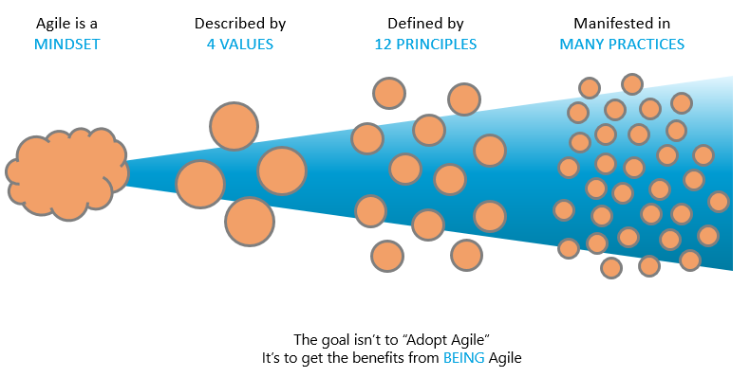
Agile Funnel (S)
Adapted From: Ahmed Sidky, IC Agile; www.plays-in-business.com

Slide 7
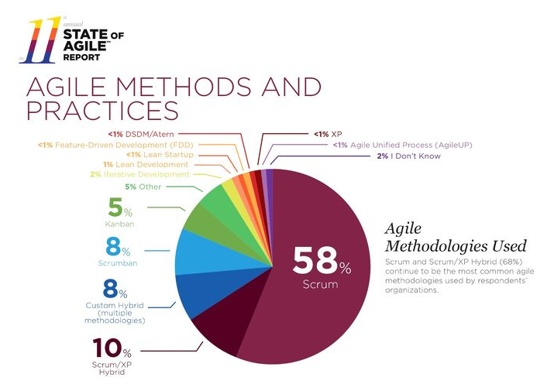
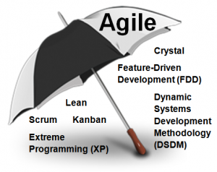
Agile Umbrella (S)
Credit: Scrum Alliance
Credit: https://explore.versionone.com/state-of-agile/versionone-11th-annual-state-of-agile-report-2
Notes:
There are lots of frameworks (more than are listed here) for applying agile principles at work.

Slide 8
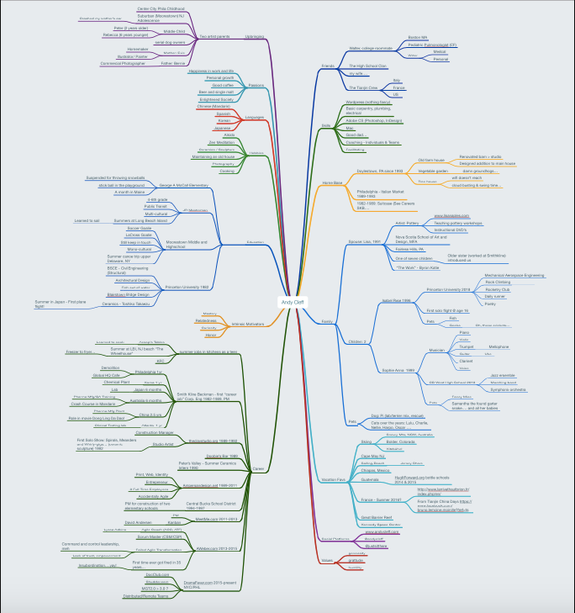
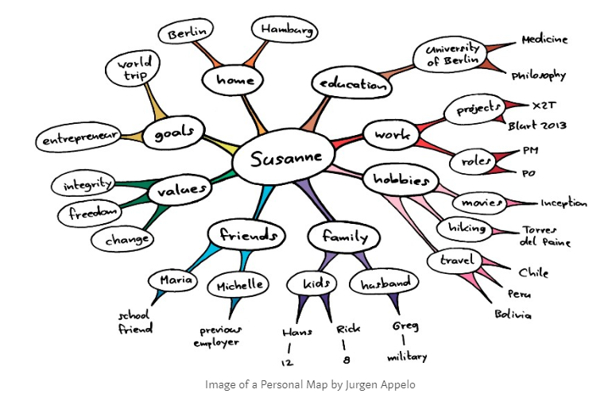
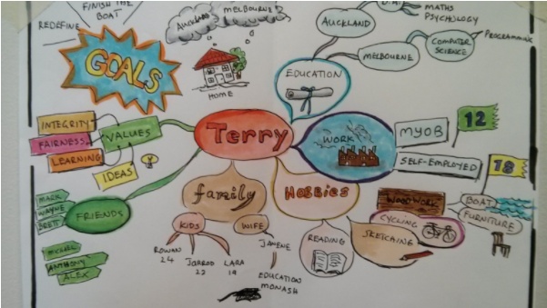
Personal maps (M)
Credit: https://medium.com/@tadeumarinho/decreasing-mental-distance-with-personal-maps-11cc69d15af3
Credit: https://management30.com/practice/personal-maps/
Credit: http://www.andycleff.com/2015/11/personal-maps-getting-to-know-the-whole-human-being/
Notes:
It’s important for teams to understand how their teammates work and think – what’s important in their lives, what they value, where they’ve been!

Slide 9
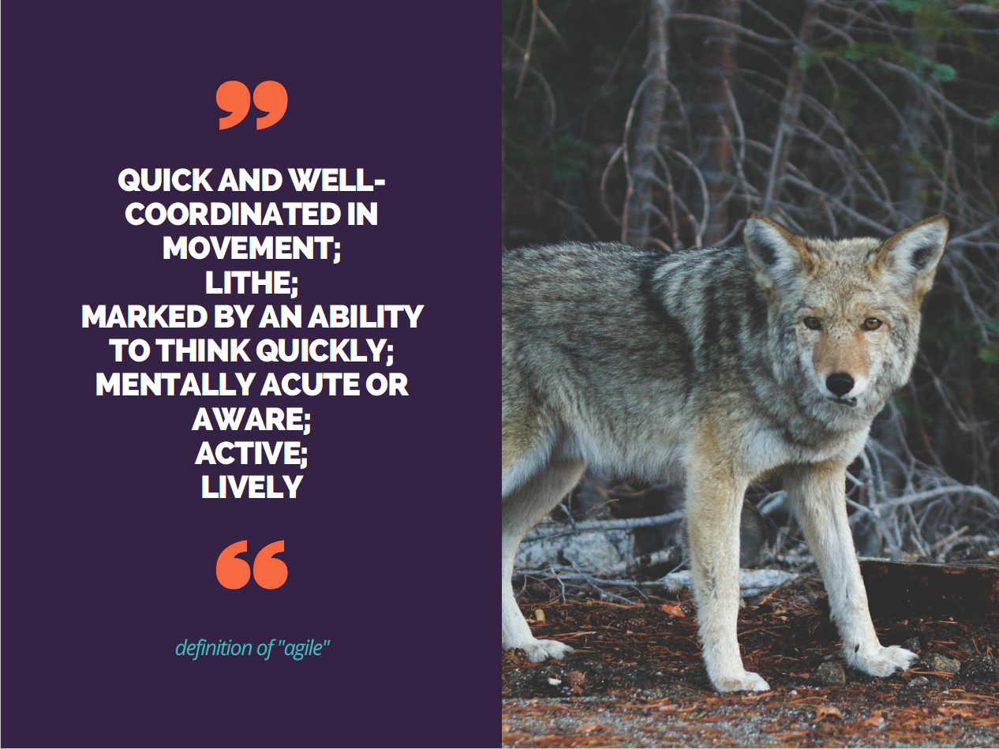
Agile Principles at Work (L)
Notes:
Not going into verbatim agile principles…just what agility means in the context of people and process at work!

Slide 10
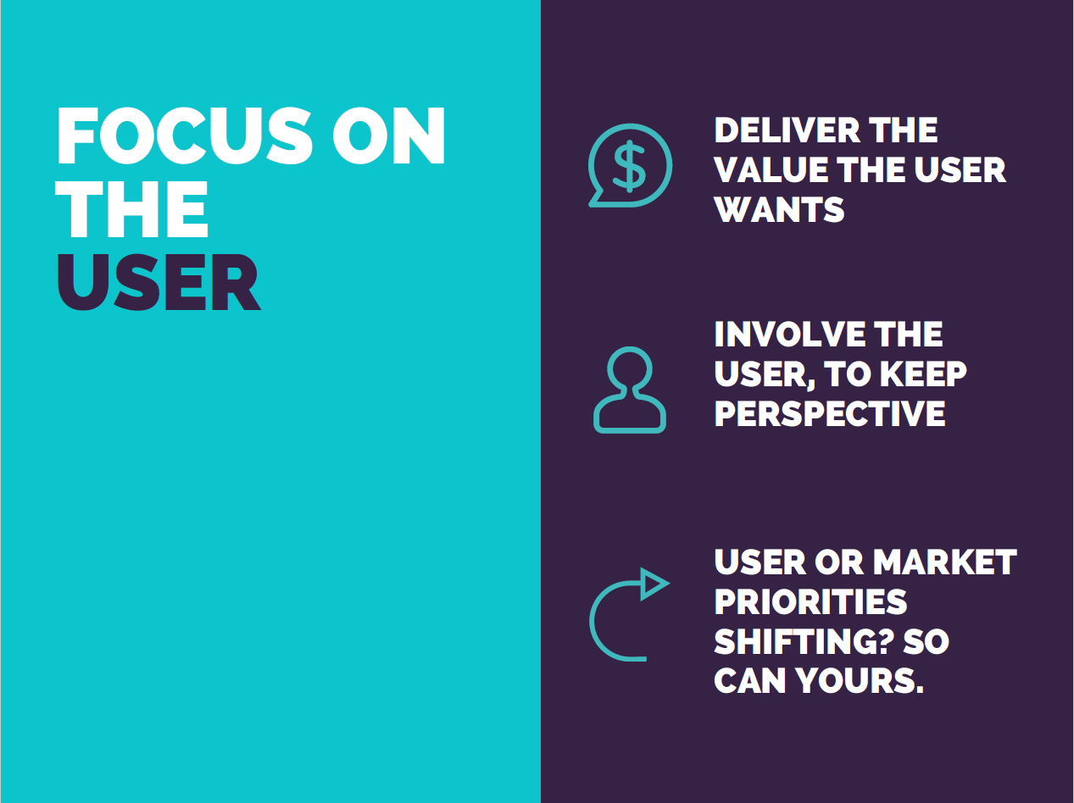

Slide 11
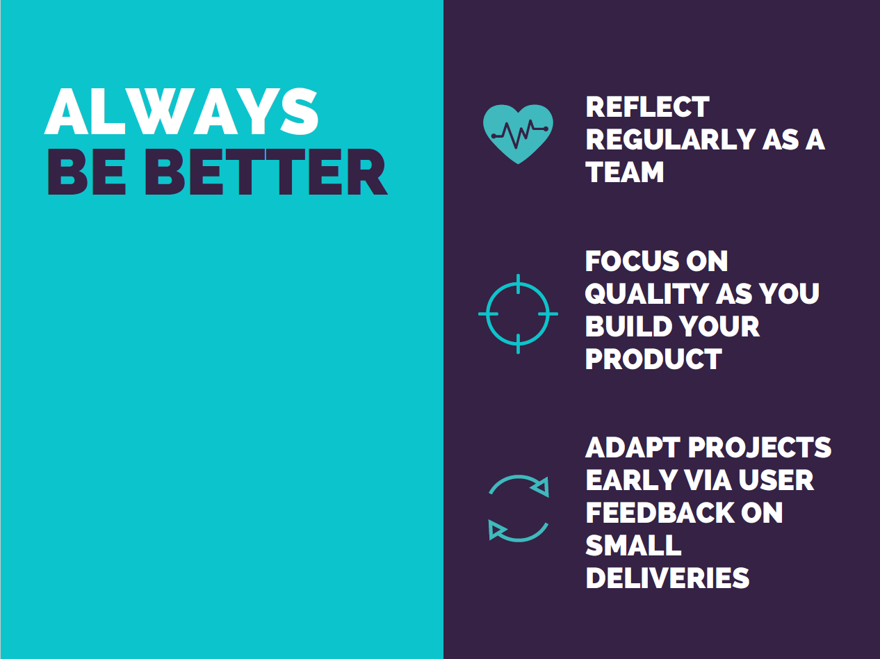

Slide 12
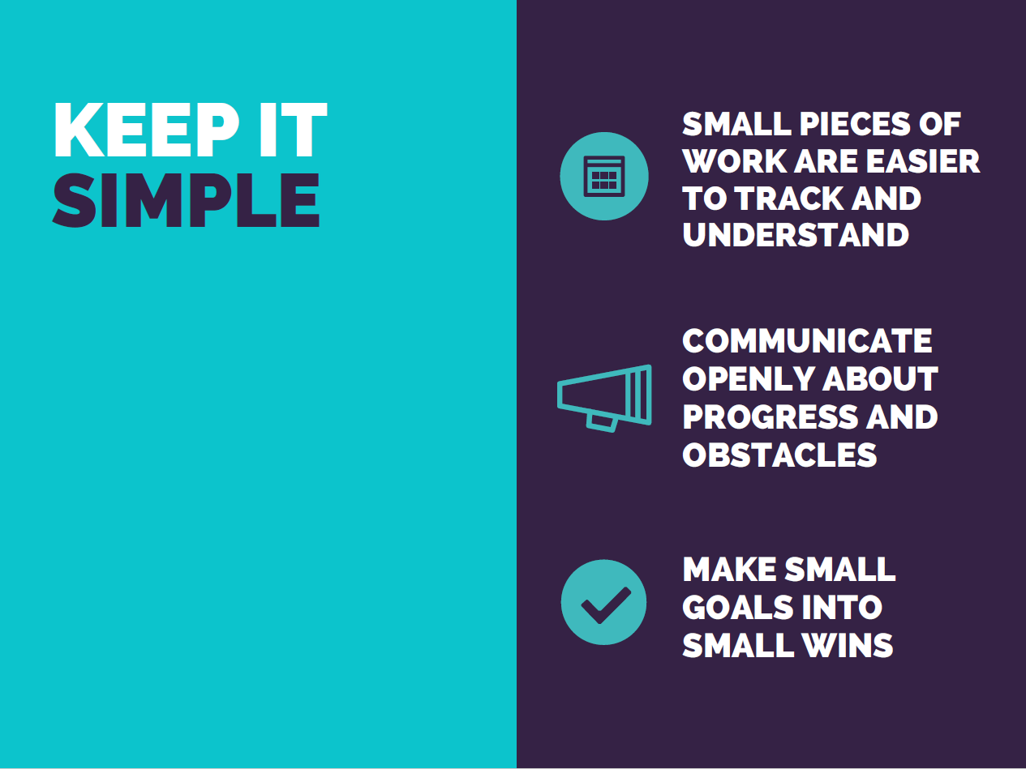

Slide 13
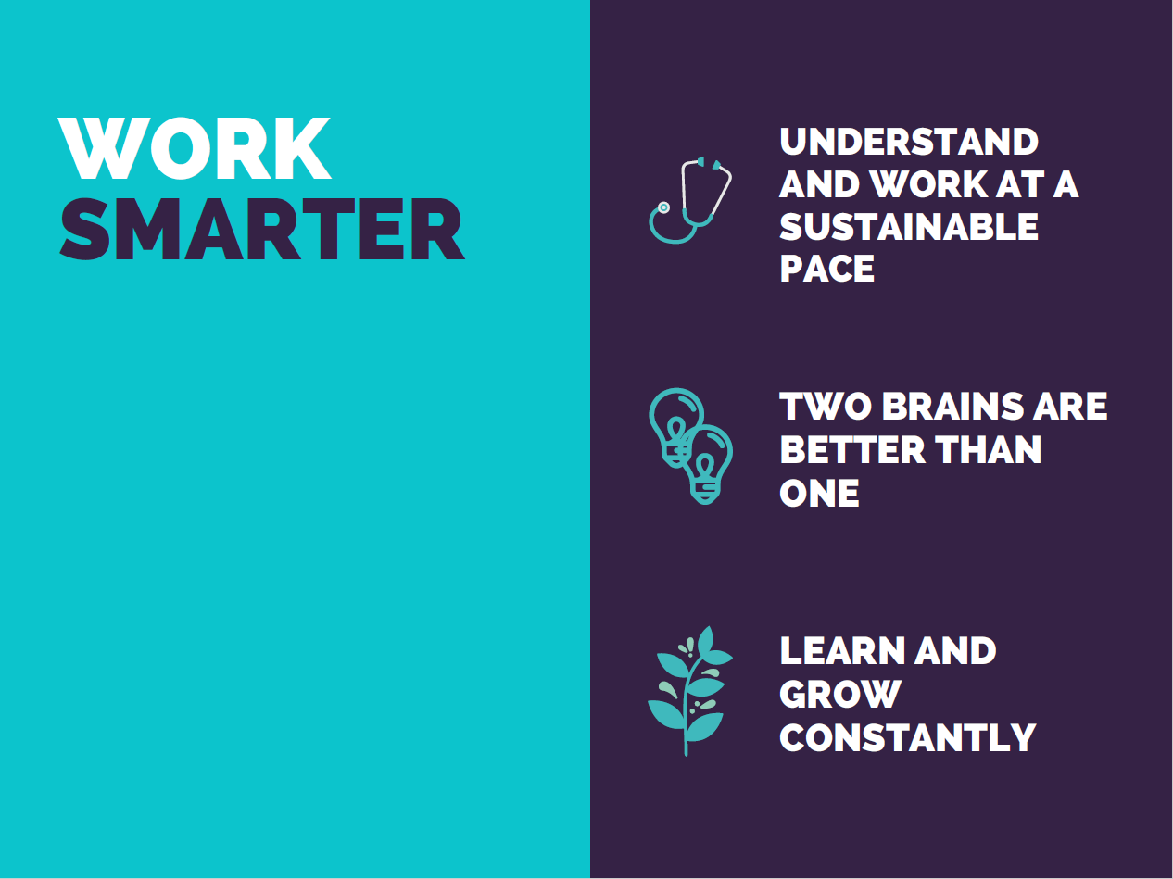

Slide 14
Let’s Review!
What did we achieve?
Does the work completed match the expectations of our stakeholders?
How does what we did this iteration feed into the bigger picture of our work?
SPRINT REVIEW
Notes:
For today’s purposes, what did we learn? Is it what we expected to learn? How will this relate back to our understanding of software development work overall?

Slide 15
Let’s improve!
What did we do well?
What could we improve?
What’s the most important thing to improve, and what’s something we can do about it?
SPRINT RETROSPECTIVE
Notes:
What did we like about today? Anything that could have been improved? What could we do to make that better for future presentations (whether this presentation specifically, or other monthly meetup presentations)?

