Slide 1

Passive Front End Redesign
The Logicals
Tiffany Morisak, Robert Wilhelm, Jason Korchuk, Cody Hutchins, April Freier
Sponsor: RTLogic—John Wiley
Faculty Sponsor: Dr. Darshika G Perera
2/24/17

Slide 2
Team
Cody Hutchins (Computer Engineer—Team Lead)
April Freier (Computer Engineer—Software Design)
Jason Korchuk (Computer Engineer—Circuit Modeling)
Robert Wilhelm (Electrical Engineer—Circuit Assembly)
Tiffany Morisak (Electrical Engineer—Circuit Modeling)

Slide 3
Introduction
Review: Specification
Proposed Solutions: Considerations
Literature Search
PCB Design
Design Progress
Test Plan
Demonstration Plan
Timeline
Budget
Conclusion

Slide 4
Inside Scope
Inputs
Signal Switch
Signal Pad
Signal Splitter
Connects to Script
Received and Transmitted Signals from RF Down Converter Box
Switches between received and transmitted signals using 5 V signals
Pad maintains 50 Ohm impedance but causes 4 DB loss
Splits signal and maintains impedance for ADC analyzation
All further signal processing for this project takes place in in script

Slide 5
Design Sections
Input Frequency Upgrade
Operating Temp Verification
Calibration Script Upgrade

Slide 6
Current Specifications
Specification | Value | Requirements
Input Frequency | 850 MHz to 2500 MHz | 850 MHz to 6000 MHz
Instantaneous Bandwidth | 54 MHz | 54 MHz
Typical Operating Input Power | -65 dBm to -25 dBm | -65 dBm to -25 dBm
Gain Stability Over 24 hours | ± 0.25 dB Over 24 hours at 25° C | ± 0.25 dB Over 24 hours at 25° C
Operating Temperature | 0° C to 50° C | 0° C to 50° C
Power | 500 mA@5V, 900 mA@3.3V, 50 mA@12V | 500 mA@5V, 900 mA@3.3V, 50 mA@12V
Size | 7.72”/5.65”/1.22” | 7.72”/5.65”/1.22”
AC Supply | 100-200V AC, 50/60 Hz | 100-200V AC, 50/60 Hz
DC Output | 20W Maximum | 20W Maximum

Slide 7
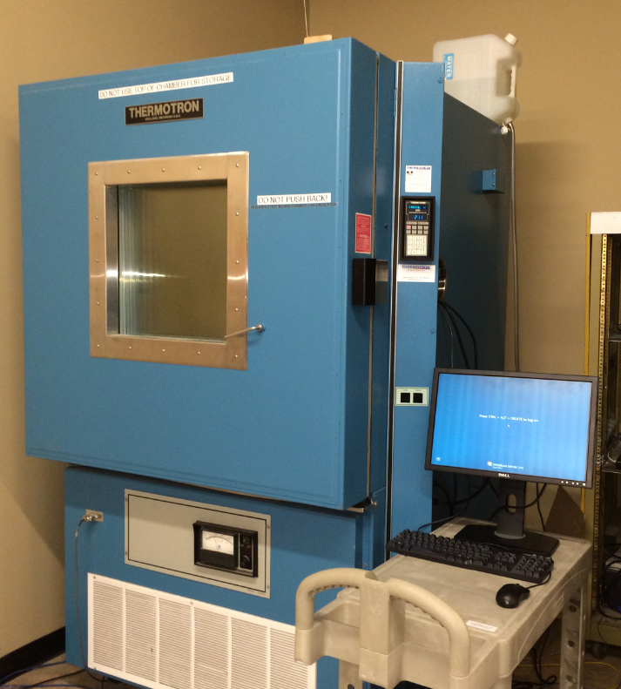
Temperature Performance
Per RT Logic’s request, current temperature performance of Saturn will be tested.
Test will give us information on the board’s original operation
Redesign will maintain this performance.
Thermotron 2800

Slide 8
Environmental Testing Process
Step | Action | Expected Result
1 | Setup Signal Generator CF – 2000 MHz, dBm -40 | Setup
2 | Launch dwell windows on both channels, switch display to frequency domain, continuous sweep | Two channels are displayed, accurately reflecting the signal generator output
3 | Run the Thermotron profile | Data logging is enabled
4 | Record baseline measurements at -50℃, 10-15 minutes into test. | Record log file of power at each frequency.
5 | Repeat Step 4 in 10℃ increments, up to 80℃. | Record log file of power at each frequency.

Slide 9
Software Design Process
Understand existing scripts
Determine what SPARQL does
Change SPARQL to SCPI
Testbed Setup
New Calibration Script Development

Slide 10
Calibration Scripts
Two scripts used to connect to the Saturn board for testing and final configuration in Octave (Matlab Variant)
First script will run a verification test on the board
Second script configures data on the board
Transition SPARQL to SCPI considering these points
Gain
Attenuation
DC_tracking
DC_offset

Slide 11
SPARQL Example
Subject: Prefix specifies data location on Saturn Board
HTML file location is the board’s local database
Predicate: “insert” command
Object: Set internal values on system
Gain, Attenuation, DC_tracking and DC_offset variables

Slide 12
Option 1: Wider Range Balun
Pro | Con
Similar to current design | Larger PCB footprint
Fewer components needed | Performance drops as bandwidth increases
Lower cost | Few to choose from

Slide 13
Literature Search: Broadband Balun
Magnetic coupling for <10MHz
Capacitive coupling for 1GHz+
Wire wound transmission line (mag/cap) for 500kHz-10GHz

Slide 14
Option 2: RF Switch-Multiple Baluns
Pro | Con
Better performance per balun | Much higher cost
More options available | More components on board

Slide 15
Literature Search: RF Switch
Property | PIN Diode | FET | Hybrid | Electromechanical
Frequency Range | From MHz | From DC | From kHz | From DC
Insertion Loss | Medium | High | High | Low
Roll Off | Low Frequencies | High Frequencies | High Frequencies | N/A
Isolation | High Frequencies | Low Frequencies | High Frequencies | Broad Range
Switching Speed | Fast | Average | Average | Slow
Power Consumption | High | Low | Moderate | Variable
Sensitivity | Temperature | Temperature | Temperature | Vibration

Slide 16
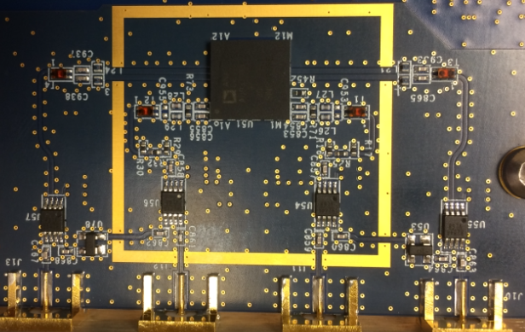
Goals: Update
Goal 1: Increase Input Range
Goal 2: Set Thermotron Value
Goal 3: Rewrite Scripts with SCPI
Stretch Goal 1: Produce functional PCB of either option
Stretch Goal 2: Retrofit new design to current Saturn board

Slide 17
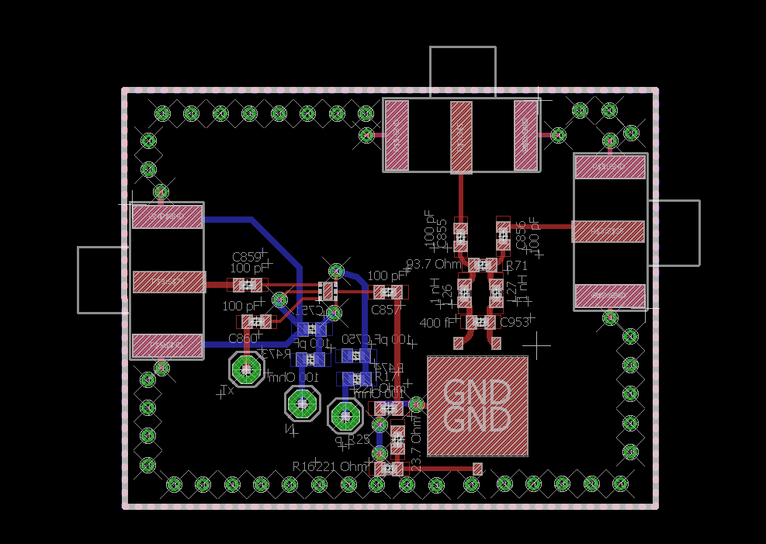
Layout of Redesigned PCB
Considered:
Trace Width
Trace Length
Component Orientation
Assistance:
Bogdan Crivin
John Wiley

Slide 18
Departure from Project Requirements
Didn't change many of the requirements, just some very small adjustments

Slide 19
Design Progress
PCB layouts completed/Submitted for approval
Original Layout
Revised Layout
Compare PFE test data to simulation output
SPARQL to SCPI transition nearing completion
Thermotron Testing Round 1: Complete!

Slide 20
Design Work Left Before Final
Compare existing script to new and improved script
Send eagle layout to OSHPark
Test the Redesign in the Thermatron
Test new passive front end

Slide 21
Test Plan
Reproduce Passive Front End (PFE) and compare to full Saturn
Spice simulations of current components
Compare Spice simulation to tests taken on Saturn boards
Build PFE and thermal test with Saturn
Redesign PFE
Spice simulations of new components
Compare new Spice output to old Spice output to determine success

Slide 22

Demonstration Plan: Spice
Simulate frequency sweep at output
Overlay current dBm plot with test data
Use Excel to convert from Vout-Iout to dBm
Overlay new dBm plots with current dBm plots

Slide 23
Demonstration Plan: Thermal
Thermal Test
Video of Thermal Chamber testing
Thermotron 2800

Slide 24
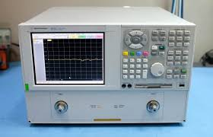
Demonstration Plan: Scripts
SCPI
Calibration video using new scripts

Slide 25
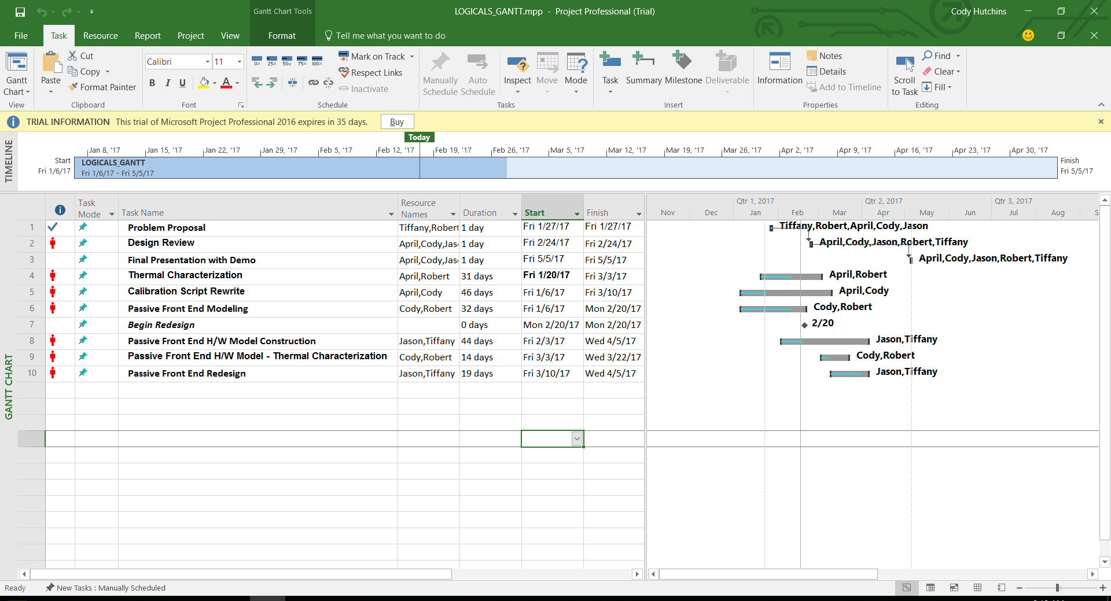
Gantt Chart

Slide 26
Budget (Original)
Item | Quantity | Price | Total Price
PCB Printout | 1 | 25 | 25
Connectors SMA JACK 50 OHM | 4 | 6.24 | 24.96
Resistor 100 OHM | 8 | .1 | .8
Resistor 221 OHM | 8 | .1 | .8
Resistor 23.7 OHM | 4 | .1 | .4
Resistor 93.1 OHM | 4 | .1 | .4
Capacitor 100pF | 28 | .52 | 14.56
IC Switch SPDT | 4 | 3.36 | 14.52
Wound Chip Balun | 4 | .75 | 3
Inductor 1nH | 8 | .75 | .8
 |  |  | 85.24

Slide 27
Budget (Redesign)
Item | Quantity | Price | Total Price
PCB Printout | 1 | 25 | 25
Connectors SMA JACK 50 OHM | 4 | 6.24 | 24.96
Resistor 100 OHM | 8 | .1 | .8
Resistor 221 OHM | 8 | .1 | .8
Resistor 23.7 OHM | 4 | .1 | .4
Resistor 93.1 OHM | 4 | .1 | .4
Capacitor 100pF | 28 | .52 | 14.56
IC Switch SP2T | 4 | 1.43 | 5.72
High Power Surface Mount Balun | 2 | 124 | 248
Inductor 1nH | 8 | .75 | .8
 |  |  | 321.44

Slide 28
Conclusion
Review: Specification
Proposed Solutions: Considerations
Literature Search
PCB Design
Design Progress
Test Plan
Demonstration Plan
Timeline
Budget
Conclusion

Slide 29


Questions

