Slide 1

Operating system- IT3070E
Dining Philosopher Problem
Members:
Chu Trung Anh 20225564
Tran Nam Tuan Vuong 20225540
Vu Minh Hieu 20225494
Supervisor:
Dr. Do Quoc Huy

Slide 2
Team assignment
Member | Role
Chu Trung Anh | Resource hierarchy, Semaphore
Vu Minh Hieu | Limit number of dinners
Tran Nam Tuan Vuong | Chandy - Misra
Slide and report are made by members with their corresponding task
Report link: https://typst.app/project/rZjfADUA7rh7weCDnGpC6m

Slide 3
Table of content
Problem
Challenge
Deadlock
Livelock
Starvation
Solution
Resource Hierarchy
Semaphore
Limit number of dinners
Chandy/Misra
Chandy/Misra

Slide 4

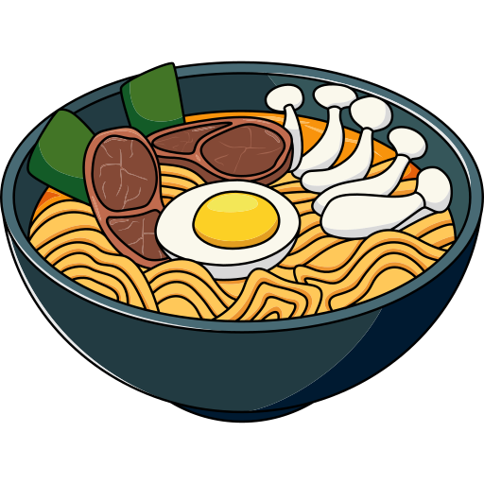

1. Problem

Slide 5
1. Problem
Think
Eat:
Two forks to eat, take the left fork then the right fork
Finish eating, return the fork to original place

Slide 6
1. Problem
no -> wait
left fork
no -> wait, (not return left fork)
yes -> right fork
yes -> eat

Slide 7
1. Problem
5 critical resources
sharing limit: 1
5 processes
Critical section: using fork

Slide 8
2. Challenge - deadlock

Slide 9
2. Challenge - deadlock

Slide 10
2. Challenge - livelock

Slide 11
2. Challenge - livelock
Notes:
Loop with previous slide to demonstrate the livelock situation

Slide 12
2. Challenge - starvation

Slide 13

2. Challenge - starvation

Slide 14
3. Solution - Resource hierarchy

Slide 15
3. Solution - Resource hierarchy
3
4
5
2
1

Slide 16
3. Solution - Resource hierarchy
3
4
5
2
1
Philosopher takes the lower-numbered fork first

Slide 17
3. Solution - Resource hierarchy
P3
- How this can prevent deadlock ?
3
4
P4
P2
2
5
1
P5
P1

Slide 18
3. Solution - Resource hierarchy
P3
- How this can prevent deadlock ?
3
4
P4
P2
2
5
P5 can not take fork 5 -> Not from circular -> prevent deadlock
1
P5
P1

Slide 19
3. Solution - Resource hierarchy
P3
- How this can prevent deadlock ?
3
4
P4
P2
2
5
1
P5
P1

Slide 20
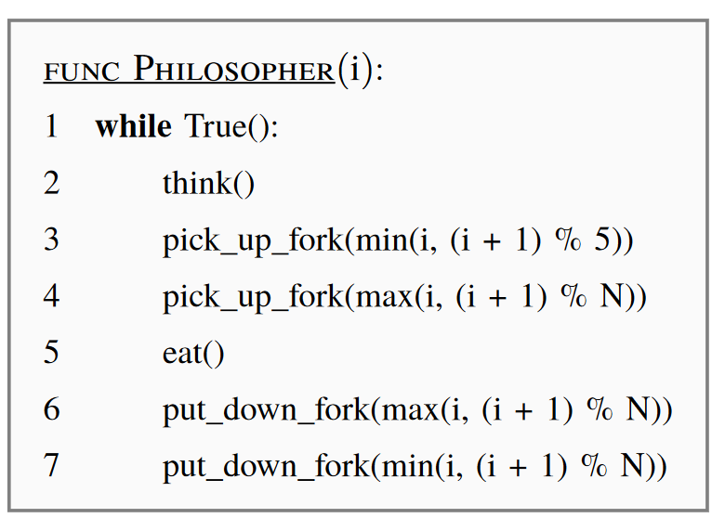
3. Solution - Resource hierarchy

Slide 21
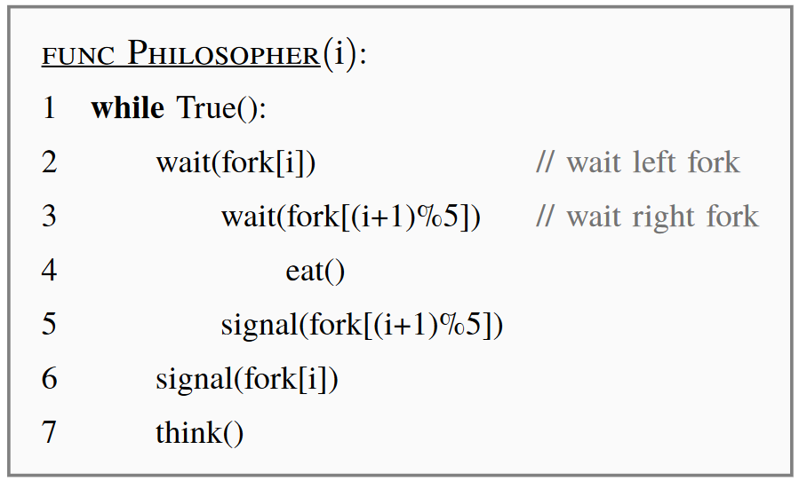
3. Solution - Semaphore

Slide 22
3. Solution - Semaphore
Still deadlock !!!

Slide 23
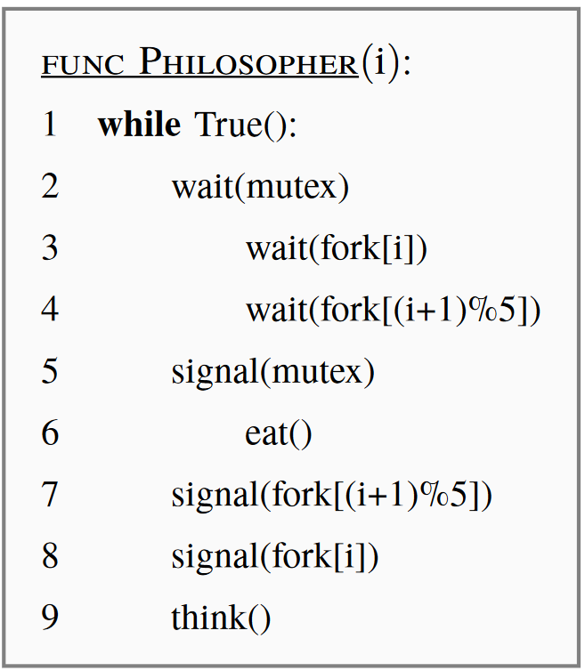
3. Solution - Semaphore
Use another semaphore mutex, which ensures that only one philosopher can attempt to pick up forks at a time

Slide 24
3. Solution – Limiting number of dinners
Limit the number of philosophers allowed to sit at the table at any given time to n-1.
Philosophers will take turn sitting and standing.

Slide 25
3. Solution – Limiting number of dinners
This make sures at least one philosophers will have two forks, effectively preventing deadlock.
4
3
5
2
1

Slide 26
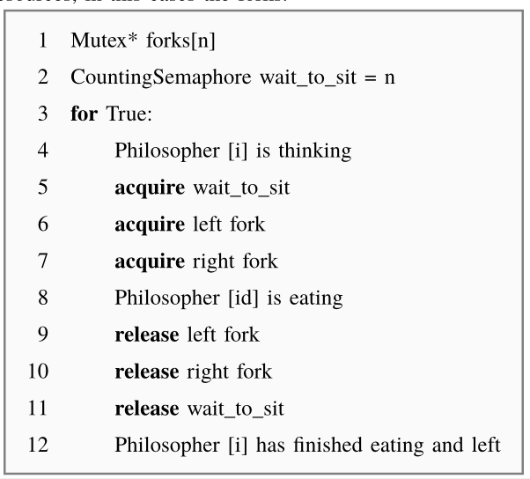
3. Solution – Limiting number of dinners
Use a Counting Semaphore to limit the number of concurrent dinners.
Mutex for each fork.

Slide 27
4. Solution – Chandy/Misra Approach
Chandy-Misra's algorithm can be explained using the concepts of "clean" and "dirty" forks.

Slide 28
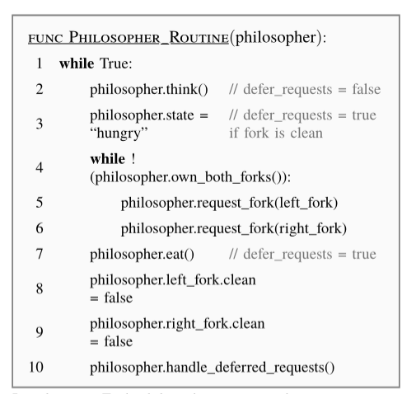
4. Solution – Chandy/Misra Approach
Initially, the fork is assigned to the philosopher with the lower ID (lower neighbor) and marked as "dirty."
Then, each philosopher acts in a routine with 4 states:
Thinking
Waiting (hungry)
Eating
Cleanup

Slide 29
THANK YOU !

