Slide 1

Research and Detection of Attacks on the Siemens S7Comm Protocol in ICS/OT Networks
Student: Chu Trung Anh 20225564
Supervisor: MSc. Bui Trong Tung

Slide 2
Outline
Objectives
Background theory
Problem analysis
System & methodology
Experimental results
Conclusion

Slide 3




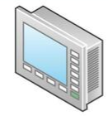


1. Objectives
ICS protocols are often proprietary (for reliability), not include encryption, authentication, or integrity mechanisms (for real-time performance) by designing purposes
Before
After
MES
Air-gap
Connected
SCADA
Increase attack surface in OT environments
Notes:
Due to specific OT environment condition, ICS protocols are often proprietary (for reliability since this ensure seamless communication between devices within a manufacture ecosystem.
Not include encryption, authentication and integrity mechanisms for real-time performance since these things requires extra package processing time.
At first, strong security was not required because the plant OT network was often isolated from the outside world, so the attack surface was almost zero for external attackers.
However, to manage increasingly complex production, the OT network nowadays must have more connectivity, such as connect to the Internet, to MES for manage product progress, to SCADA for centralized monitoring, to the enterprise IT net-work to coordinate production with other activities such as finance and supply chain, logistics, auditing, etc. This has changed the attack surface of OT environments. When connectivity is higher, attackers have more ways to reach the OT network.

Slide 4

1. Objectives
Challenges:
Increasing number of attacks with a tendency toward nation-state and political motivations
Factories operate continuously, making it impossible to redesign from scratch using a "secure by design" philosophy. Availability is the highest priority.
Intervening in industrial devices to install active monitoring agents is extremely risky (device lifespan, proprietary software, vendor diversity, etc.)
Building a passive monitoring solution specified for industrial protocol to minimize the impact on factory operations

Slide 5

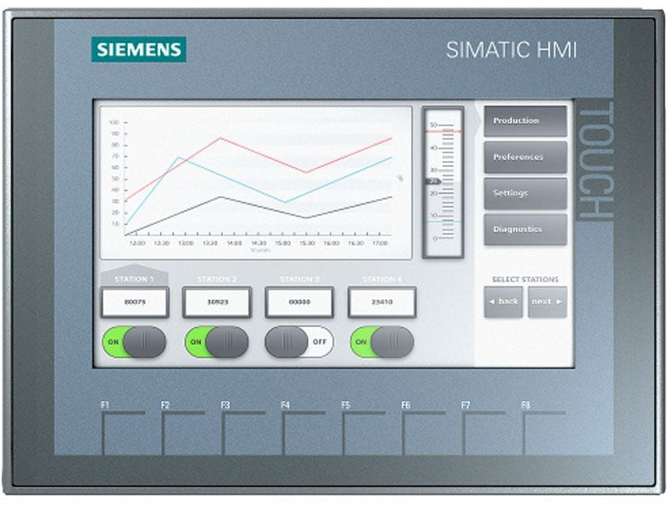
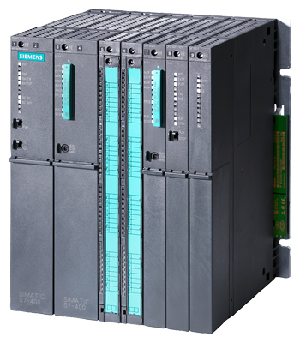

2. Background theory
Proprietary Siemens protocol for programming, monitoring, and control Siemens ecosystem over TCP port 102, using request –response model
S7 Comm: PLC S7-200/300/400 with no authentication, no authorization, no encryption
S7 Comm Plus: PLC S7-1200/1500
Level 1
S7 Comm
Level 0
S7 Comm in Purdue model IEC 62443

Slide 6
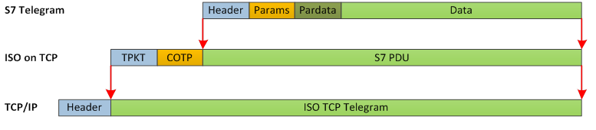
2. Background theory
Background
Runs on ISO-on-TCP over Profinet cable. Block-oriented protocol. Each block is called a PDU
COTP establishes logical connection (compatible with TCP connection-oriented)
TPKT wrapper fixed-length package (compatible with TCP stream-based)
6

Slide 7

2. Background theory
Background
IDS (Intrusion Detection System): monitor network traffic to alert on abnormal behaviors or unauthorize access.
Categorize by detection method:
Signatures-based: Using predefined rule ➡ Stable, low false positive
Anomaly-based: Compare again normal baseline ➡ Detect 0-day, high false positive
7

Slide 8
3. Problem analysis
Background
Problem | Impact | Proposed Response
OT networks prioritize availability and real-time operation; inline security controls may introduce operational risk. | PLC communication monitor is often ignored | Deploy Suricata IDS in passive mode on SPAN port without affecting normal network operation
Lack of authentication makes benign and malicious operation share the same protocol channel | PLC programs can be modified freely to disrupt process line without much effort | Combine packet content, direction, source address, and traffic rate in detection rules to minimize false positive rate
S7comm attacks are diverse. Limited docs due to the proprietary nature of the protocol. No sufficient public rulesets | General solutions/rulesets from IT side are not sufficient for S7comm behavior and industrial context | Build a scenario-based rule set covering some popular attack scenarios
8

Slide 9



4. System & methodology
Tools
Open PLC: open-source platform that simulates a physical PLC, supports 5 standard control programs under the IEC 61131-3
Open PLC Runtime V4
Open PLC Editor v4
FUXA: open-source, web-based HMI that supports Siemens S7comm protocol
Snap7: an open-source library developed to connect to, transmit data with, and control automation devices through popular industrial protocol, including S7 Comm.

Slide 10




4. System & methodology
Overview
Deploy simulation: deploy the simulation environment on VMware
Building attack modules: using Snap 7 and tools to build attack scenarios
Traffic collection and analysis: capture network traffic with Wireshark, analyze S7comm packet structure
Detection rule development: convert observed indicators into Suricata signatures based on byte offsets, function codes, frequency thresholds, and abnormal syntax.
IDS testing: run Suricata on traffic copies and compare alerts with each simulated scenario.
[1]
[2]
[3]
[4]
[5]

Slide 11
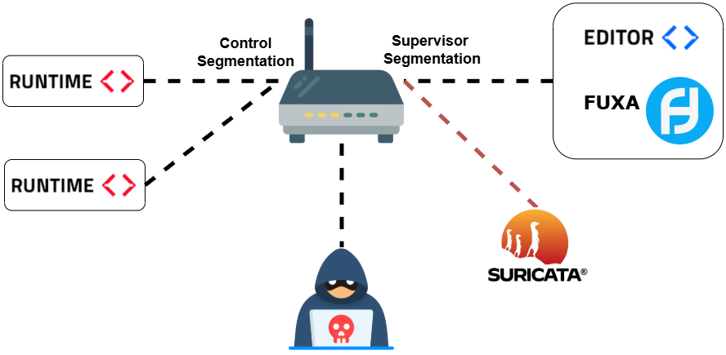
4. System & methodology
Deploy simulation
Simulation network topology

Slide 12
4. System & methodology
Building attack modules
Adversarial attacks represent common attack behaviors against typical OT networks
Attack categories:
Reconnaissance: discover PLC services through TCP/102 scanning, SZL reading, and block enumeration
Process manipulation: modify process variables using unauthorized WriteVar and spoofed ReadVar operations
Program transfer: unauthorized upload and download of PLC program blocks
Command injection: abuse PLC control functions by sending Start/Stop commands
Denial of Service: overload PLC communication using high-rate S7 functions and TCP SYN flooding
Malformed S7comm packets: Crafts structurally invalid TPKT/COTP/S7

Slide 13
4. System & methodology
Traffic collection and analysis

Slide 14
4. System & methodology
Detection rule development

Slide 15
4. System & methodology
IDS testing

Slide 16
5. Experimental results
Background
16

Slide 17
6. Conclusion
Background
17

Slide 18
THANK YOU !

