Slide 1
A2 - Neural Networks from Scratch
[Your Name Here]

Slide 2
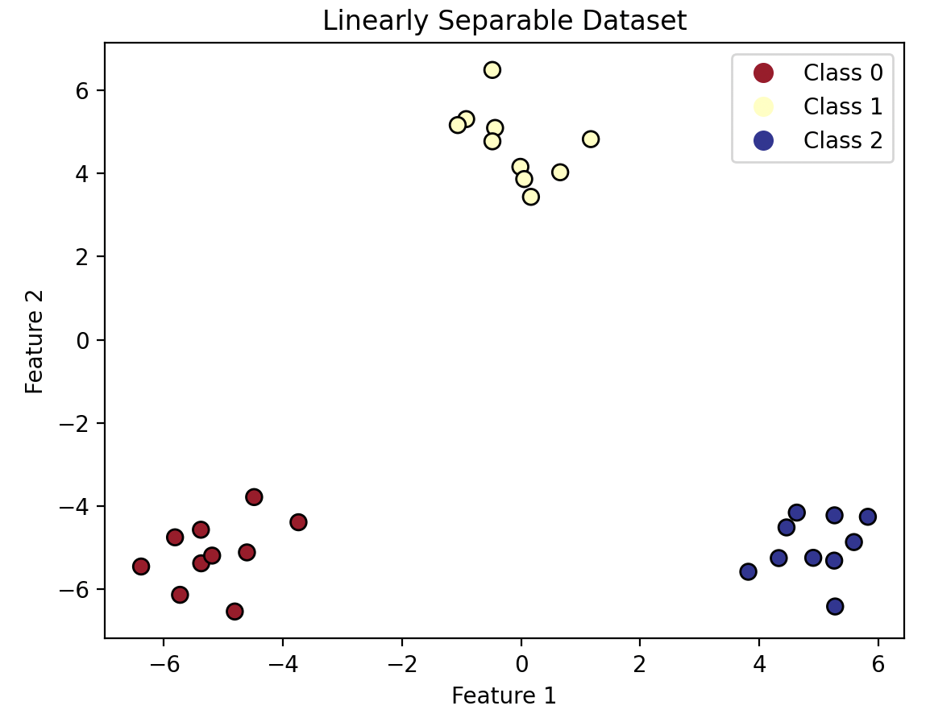
Part 1 - Linearly Separable Dataset
Decision Boundary Overlaid
on Training Dataset
Accuracy: ________

Slide 3
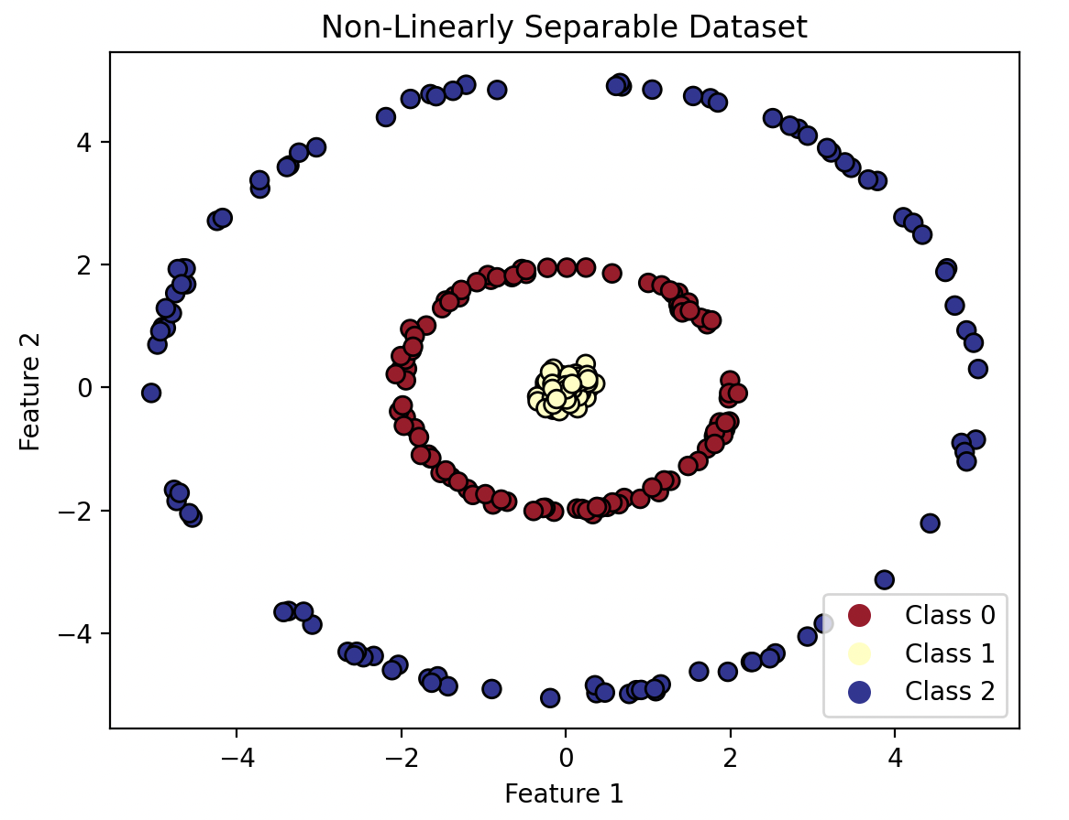
Part 2 - Learning Non-Linear Relationships
Model 1 Decision Boundary Overlaid on Training Dataset
Model 2 Decision Boundary Overlaid on Training Dataset
Model 3 Decision Boundary Overlaid on Training Dataset
Accuracy: _____
Accuracy: _____
Accuracy: _____
Written Analysis

Slide 4
Part 3 - Model Complexity
Written Analysis
Model 1 Decision Boundary Overlaid on Training Dataset
Model 2 Decision Boundary Overlaid on Training Dataset
Model 3 Decision Boundary Overlaid on Training Dataset
Model 4 Decision Boundary Overlaid on Training Dataset
Model 5 Decision Boundary Overlaid on Training Dataset
Model 6 Decision Boundary Overlaid on Training Dataset
Hidden Layer Size | # Parameters | Training Accuracy | Training Time (s)
0
2
4
8
16
32

Slide 5
Part 4 - Breast Cancer Classification
Prediction
Loss Curves
Malignant
Benign
Optimal Epoch: ______
Malignant
Training Accuracy: ______
Ground
Truth
Validation Accuracy: ______
Benign
Testing Accuracy: ______
Precision: ______
Recall: ______
F1-score: ______
Accuracy Curves
Written Analysis

