Slide 1
Understanding of SET game code
A Python Implementation Using Pygame
Chu Li 3210819012
Tongxin Hu 4734114

Slide 2
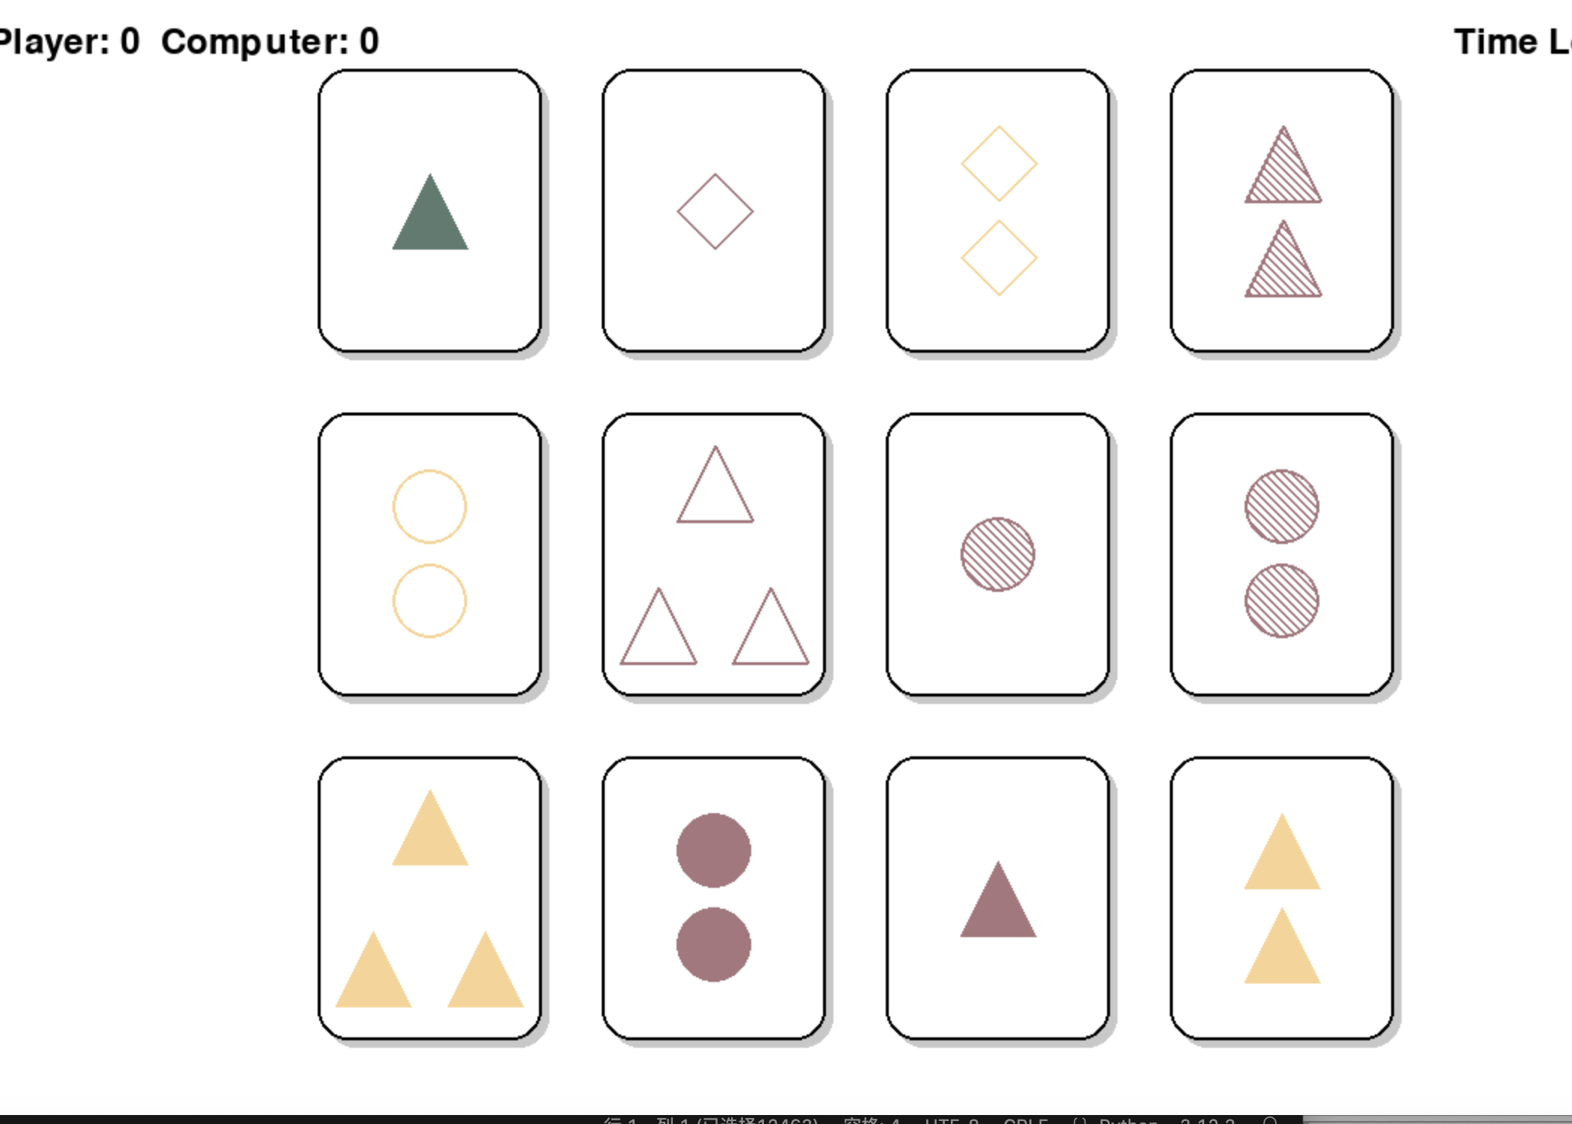
1.Overview of the SET Game
Select three out of 12 cards
Three different colors
Three different shapes
Three different numbers
Three different shading
In these three images, different colors, shapes, shading and fills must be accommodated.

Slide 3
How does game work?
A competitive game
At the beginning of the game, the player can choose the difficulty of the game, i.e. use 30s, 60s, or 90s to complete the game.
If a player picks the correct group within the time limit, the ‘players’ will get one point.
If a player does not select at least one group within the time limit, the ‘computer’ gets a point!
When time runs out, the game moves on to the next game

Slide 4
2. Game Logic and Loop
“Let‘s dive into the main game loop where we handle events like mouse clicks, draw the game state to the screen, and check for sets among the selected cards.”

Slide 5
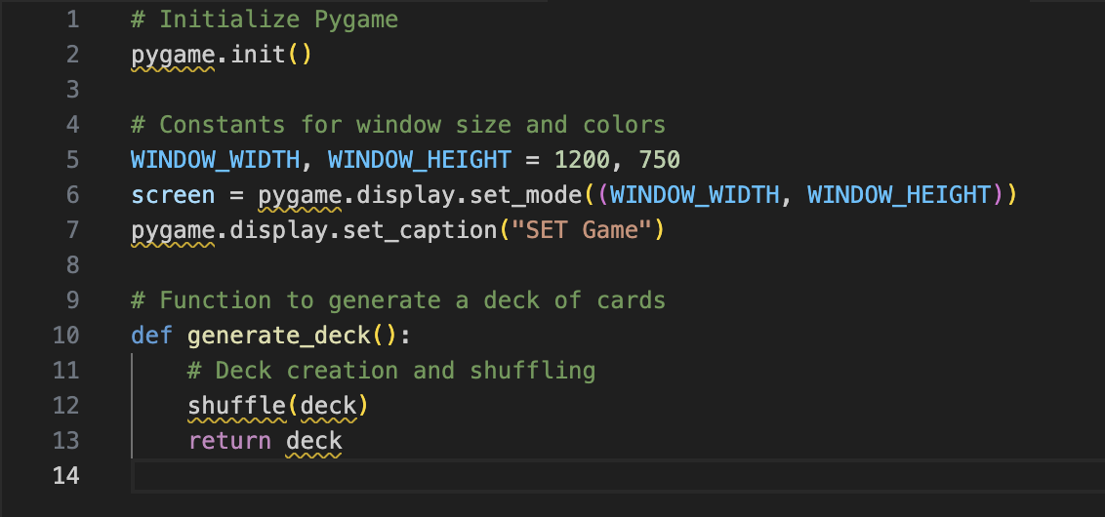
1）Game Initialization
Start with initializing Pygame and setting up the display window.

Slide 6
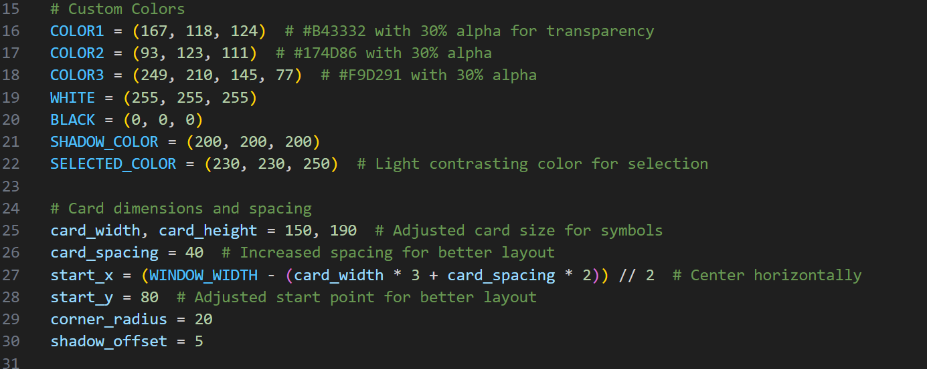
1）Game Initialization
Set up for colors
Set up for the window

Slide 7
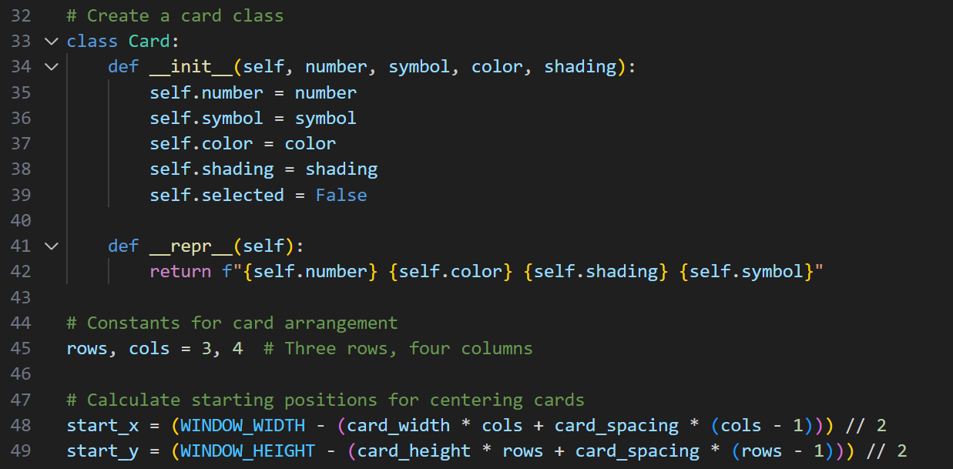
1）Game Initialization
Create a card class ( number, symbol, color, shading )
Card arrangement and how them placed

Slide 8
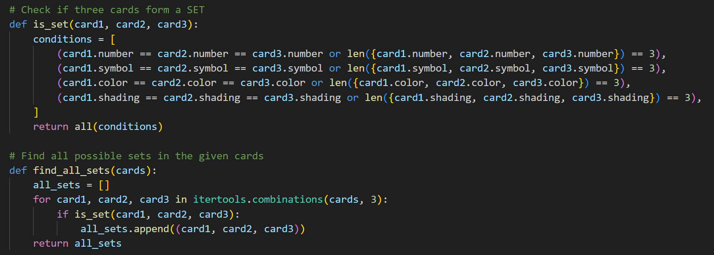
1）How SET?
Logic of a SET
All SET in 12 cards

Slide 9
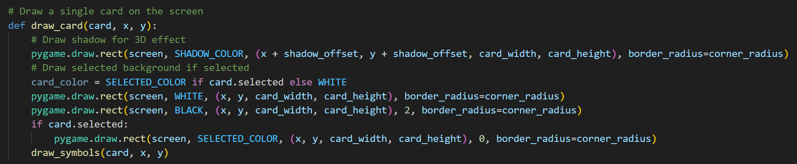
1）How SET?
Draw one card ( with 3D effect and selected background )

Slide 10
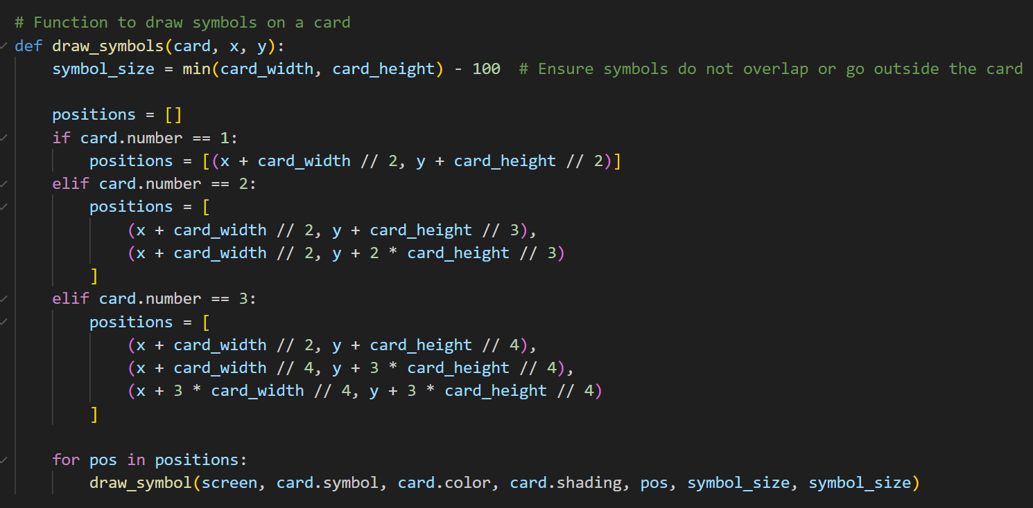
2) logic
Functions to draw symbols

Slide 11
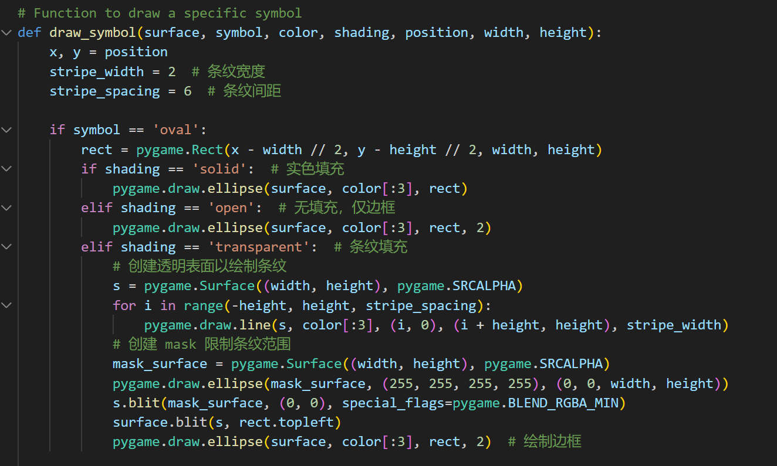
2) logic
Functions to draw specific symbol( using mask to Limit Stripe Range)
Same to 'triangle' and 'diamond'

Slide 12
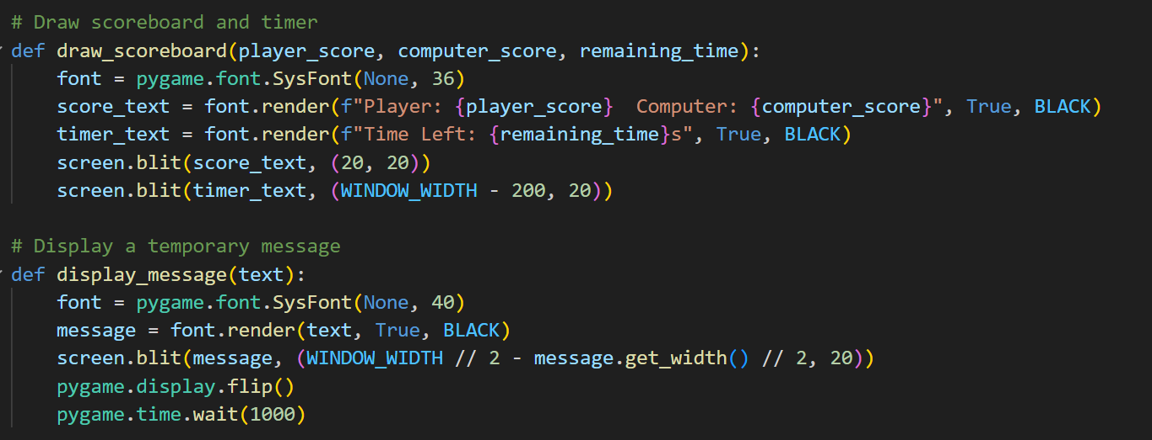
2) others
Scoreboard & timer
Clue (win or loss)

Slide 13
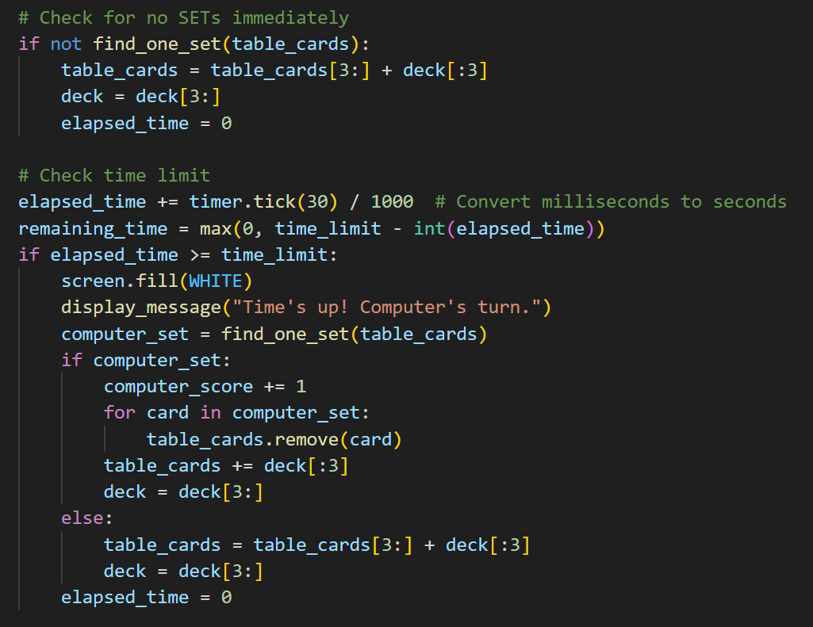
3) main logic
Main game logic
How to check SET
How to check time limit (print temporary message)

