Slide 1
Spatial transcriptomics
A hands-on introduction
Department of Anatomy & Embryology, LUMC · two mornings
Notes:
Welcome. Two mornings, 09:30-12:30. Everything is in the GitHub repo; the notebooks are the course and these slides are the connective tissue.
Ask on arrival: who has clustered scRNA-seq data before? Seat mixed pairs.
Set the frame immediately: the one question this workshop is built around is on the next slide.

Slide 2
What will you learn in two mornings
Central question: What can you learn from a tissue section that you fundamentally cannot learn from dissociated cells?
Everything we do maps back to this.
Day 1 — what the data is, and how much of it you should believe
Day 2 — using the coordinates for things scRNA-seq cannot do
You will leave able to design your own experiment, and to referee somebody else's.
Notes:
Do not skip this slide. The commonest failure mode in spatial transcriptomics is doing scRNA-seq with a scatter plot at the end.
Ask the room for their own tissue and question - you collected these in advance. Refer back to them all day.

Slide 3
What is the Xenium dataset?
Counts
5,101 features × cells. That's the 5,001-gene pan-tissue panel plus a 100-gene custom add-on. Alongside them, 649 negative controls and several thousand unassigned, genomic and deprecated codewords, all of which sit in the matrix and none of which are genes.
Cell table
one row per cell: centroid in microns, cell and nucleus area, per-class control counts. This is what makes it spatial; everything else is ordinary single-cell data.
Transcripts
one row per decoded molecule, with x, y, z and a decoding confidence. Tens of millions of rows for a full section. No scRNA-seq equivalent exists.
Segmentation
cell and nucleus polygons. Worth stating explicitly that the count matrix is derived from these, not measured directly.
Morphology images
DAPI plus boundary stains at ~0.2 µm/px, which is what the segmentation was drawn from.
Notes:
Keep this brief - 3 minutes. The detail that matters downstream is that decoding and segmentation are two separate, independently fallible steps, and the negative controls in notebook 02 measure them separately.
QV is Phred-style. 10x filters at QV>=20 before building the matrix.

Slide 4
The count matrix is a derived product
It exists because somebody drew polygons around nuclei and assigned molecules to them.
Typically 10–40% of transcripts are assigned to no cell at all
The unassigned fraction differs by gene — so segmentation loss is a gene-specific bias, not just lost sensitivity
A molecule on a boundary goes to whichever polygon the pipeline drew
Every layer below the matrix is closer to the measurement
If a result changes when you re-segment, it was a segmentation result
Notes:
This is the single most important idea of day 1. Say it slowly.
In notebook 01 they will plot transcripts with boundaries overlaid and see unassigned molecules with their own eyes. Come back to this slide afterwards.

Slide 5
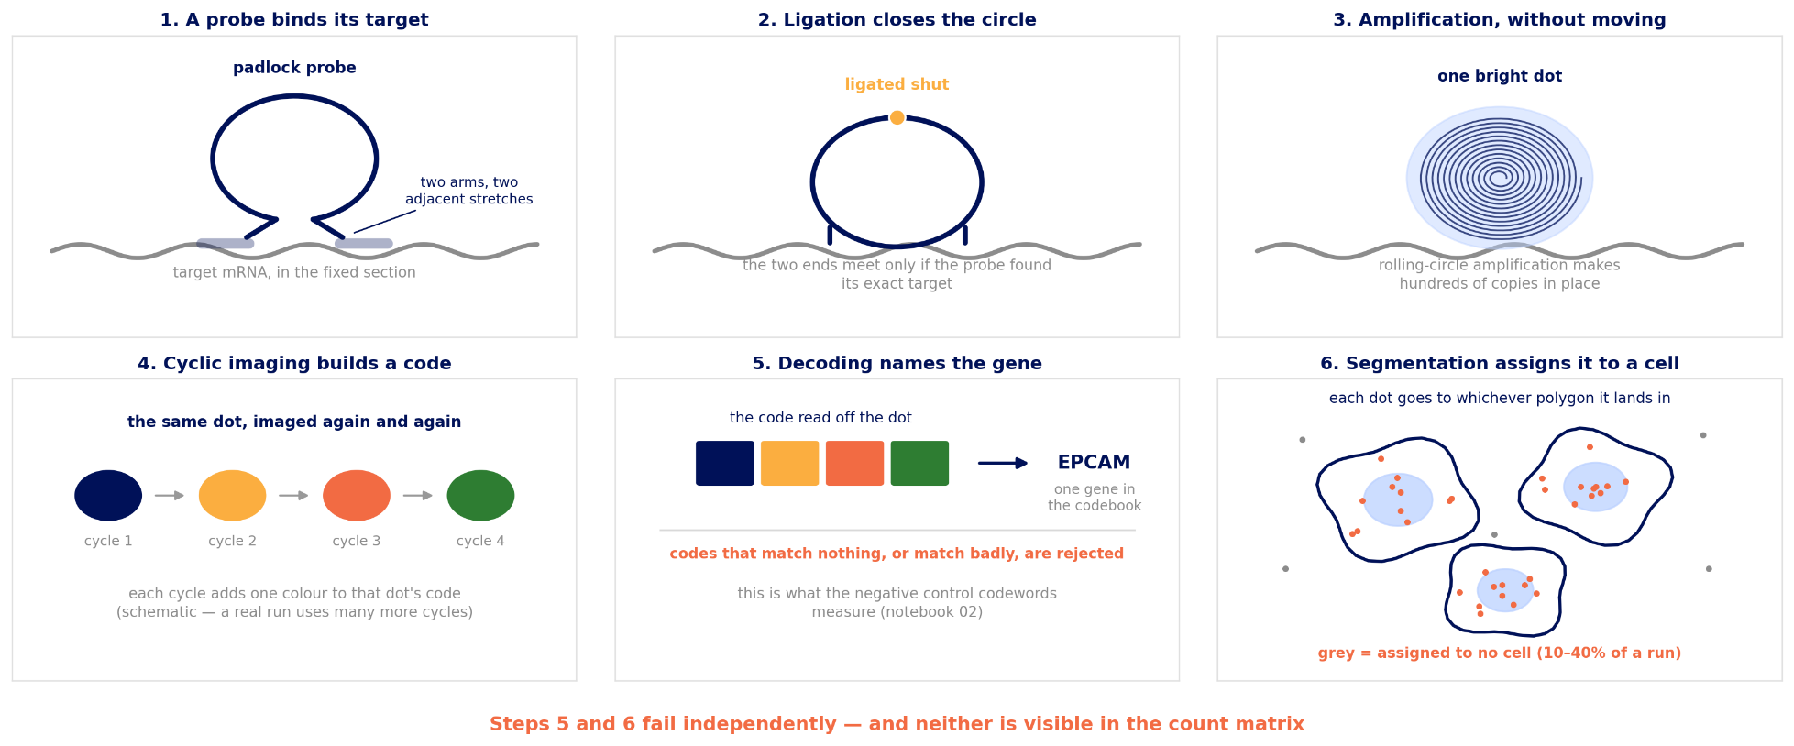
How Xenium measures a transcript
Steps 5 and 6 are where nearly every artefact is born.
Notes:
Keep this brief - 3 minutes. The detail that matters downstream is that decoding and segmentation are two separate, independently fallible steps, and the negative controls in notebook 02 measure them separately.
QV is Phred-style. 10x filters at QV>=20 before building the matrix.

Slide 6
Our dataset
Xenium Prime 5K — human ovarian cancer, FFPE
~5,000 gene panel plus several classes of control codeword
Multimodal segmentation: DAPI plus boundary stains (18S, ATP1A1, aCD45, E-cadherin)
You have a spatial crop, roughly 1.5 x 1.5 mm — a contiguous rectangle, not a random sample of cells
Why contiguous: every neighbourhood statistic on day 2 needs all the neighbours of every cell
The full run is tens of gigabytes and will not open on your laptop
Notes:
Show the full run in Xenium Explorer here - 5 minutes, live. Zoom from the whole section down to individual transcripts. Nothing on a slide communicates the scale of this data as well.
Point out where the teaching crop sits within the section.

Slide 7
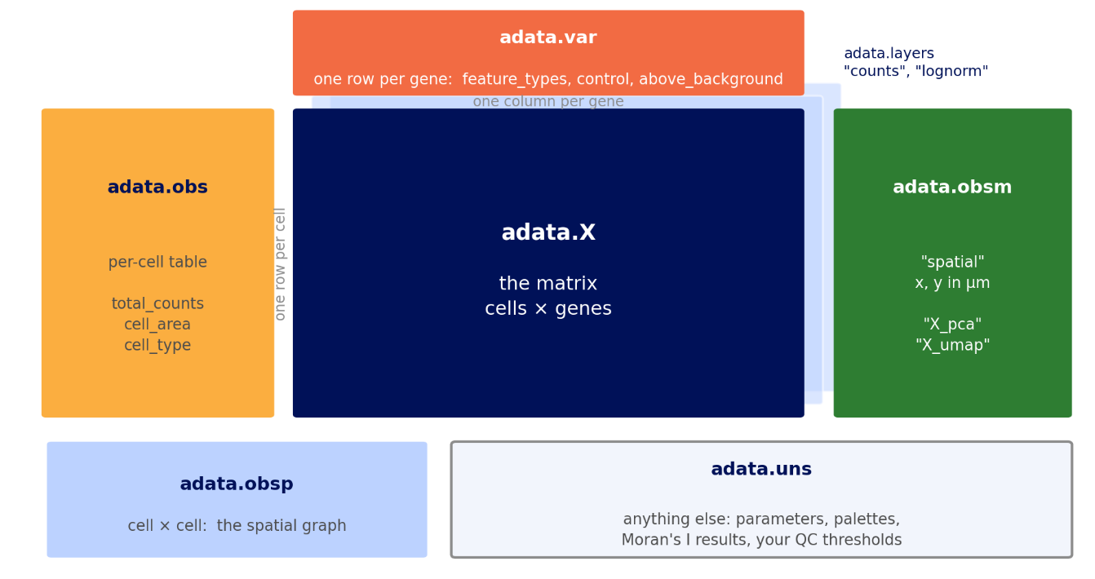
What is in the box? You will explore!
Adata object
The adata object is where all the data lives.
Notes:
The split matters: it tells you WHICH part of the pipeline is misbehaving.
The last bullet is the one that saves careers. Weakly expressed genes are the exciting ones - transcription factors, receptors - and the ones the controls tell you least to trust.

Slide 8
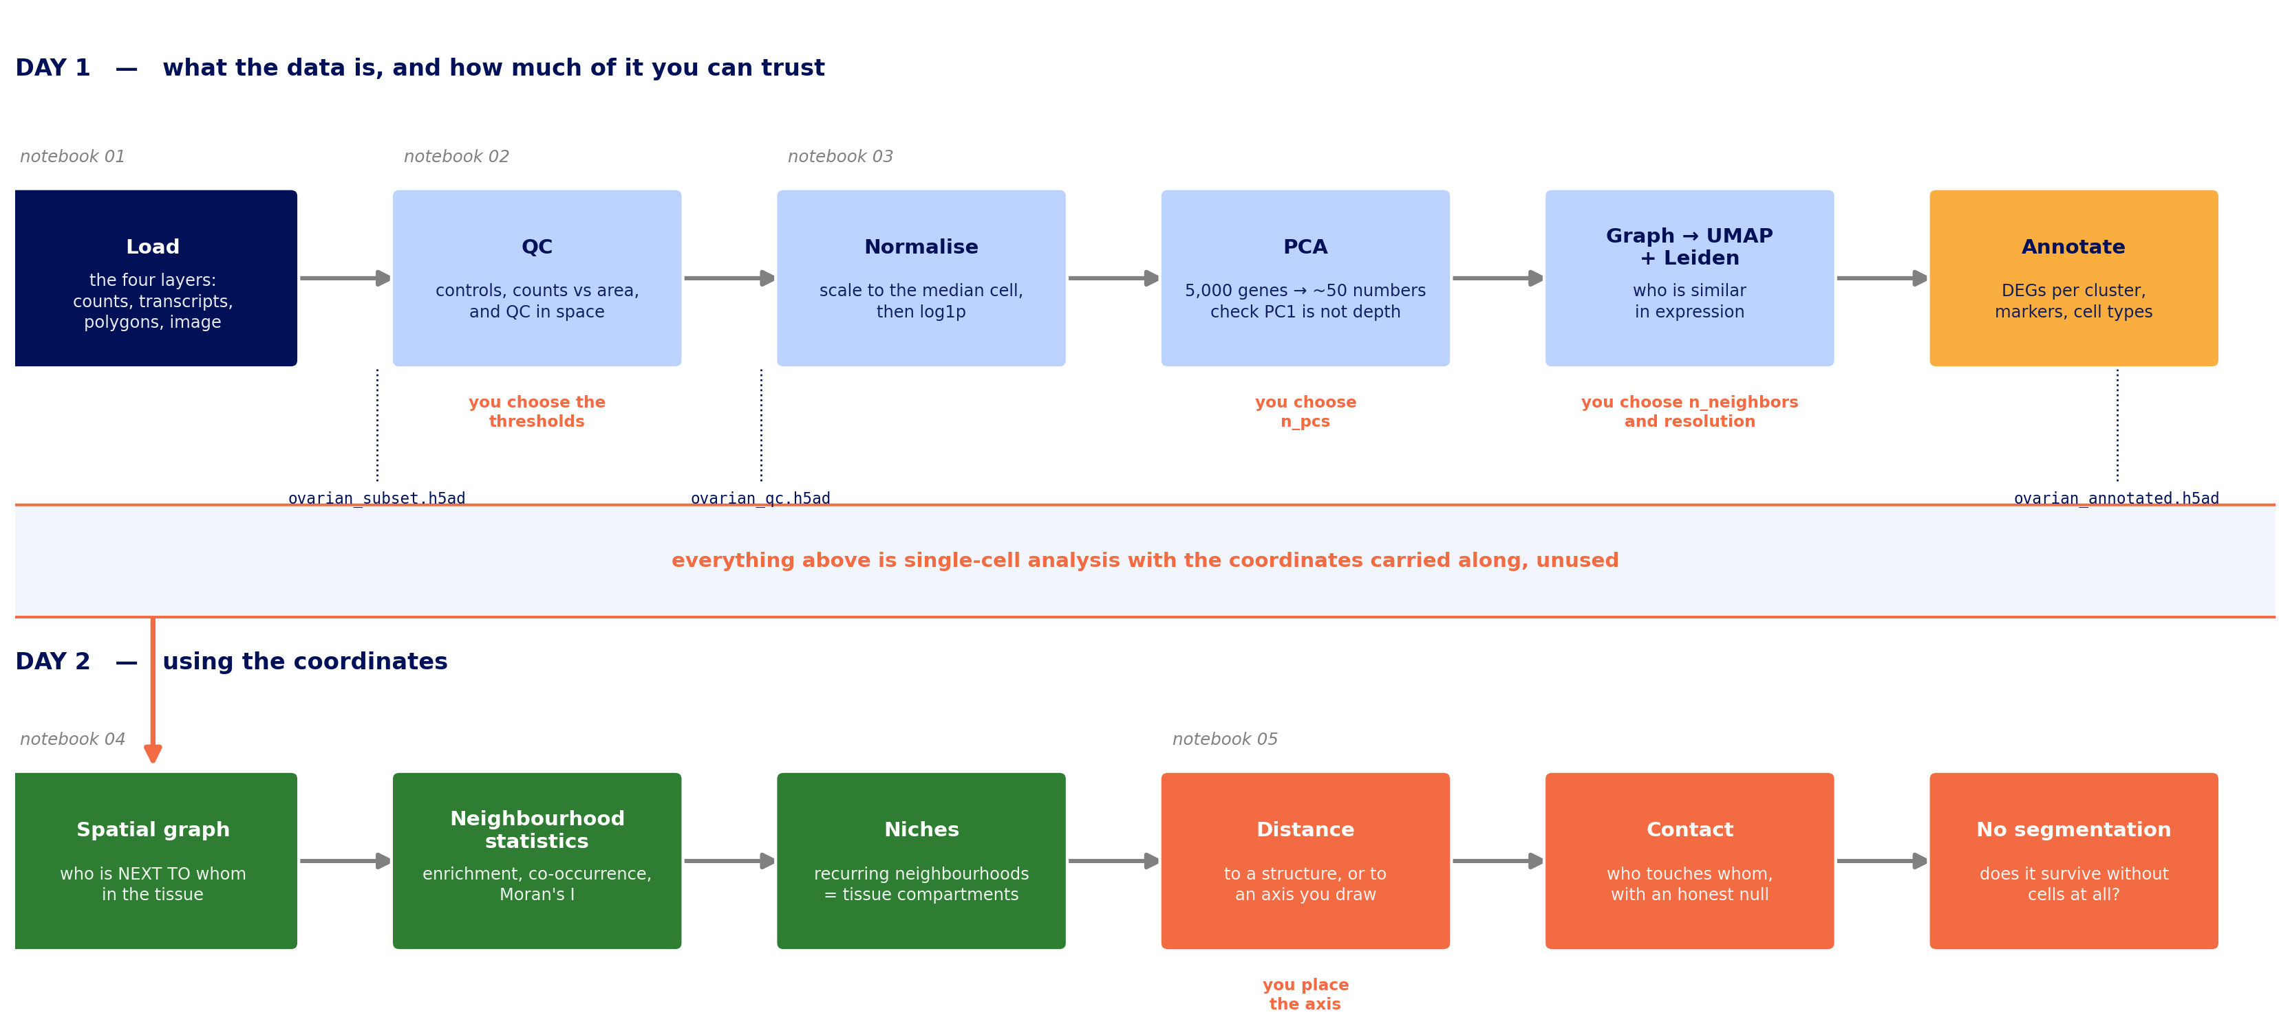
The whole workflow, on one slide
Notes:
Two minutes now, and come back to it at the start of day 2. People lose track of where they are in a two-morning workshop, and this is the map.
Three things to point at:
The file names on the dotted lines. 'Which file feeds what' is the question you will be asked most often, and it is answered here.
The orange labels: four places where THEY decide, not us. Thresholds, n_pcs, n_neighbors and resolution, and where to place the axis. That is deliberate - there is no correct value for any of them.
The band across the middle. Everything on the top row is single-cell analysis with the coordinates carried along but unused. Day 2 is the whole reason for the experiment. If you only make one point from this slide, make that one.

Slide 9
QC 1 — the controls measure your background
Negative control probe — targets a sequence not in the tissue. Fires only on non-specific binding → measures chemistry
Negative control codeword — a codeword no probe uses. Fires only on decoding error → measures optics
Unassigned codeword — decoded to something not on the panel
Compare per feature, not in total: there are far fewer controls than genes
A gene sitting inside the control distribution is not measurable in your dataset — no matter how much you want it to be
Notes:
The split matters: it tells you WHICH part of the pipeline is misbehaving.
The last bullet is the one that saves careers. Weakly expressed genes are the exciting ones - transcription factors, receptors - and the ones the controls tell you least to trust.

Slide 10
QC 2 — segmentation failure has a shape
Plot transcripts per cell against cell area, both on log scales
Small and empty → debris, or a nucleus clipped by the section plane
Large and rich → two cells in one polygon: the spatial doublet
Large and empty → a polygon drawn over extracellular space
Nucleus/cell area piling up at 1.0 → the segmentation gave that cell no cytoplasm
Do not run scrublet or DoubletFinder here. This is a geometric failure and the fix is geometric.
Notes:
Draw the four quadrants on the whiteboard while they run the hexbin cell.
The doublet point comes up every single time. scRNA-seq doublet tools model two transcriptomes summed in a droplet. Here you have a polygon problem, and unlike in scRNA-seq you can go and look at it.

Slide 11
QC 3 — the step everyone skips
Put every QC metric back on the tissue and look at it.
Straight edges, stripes, a grid → field-of-view stitching. Technical.
A smooth gradient across the section → focus, thickness, permeabilisation
A soft-edged blob of low counts → probably real: necrosis, dense collagen
Anything following a fold or tear → exclude the region explicitly, rather than letting a count threshold do it invisibly
Then ask the real question: do the cells my filter removed form a structure? If so, that is not a quality filter, it is a biology filter.
Notes:
This check has no scRNA-seq equivalent - there is nowhere to plot it.
Concrete example worth giving: raising min_counts from 10 to 25 preferentially deletes small, low-cytoplasm cells, i.e. lymphocytes. Every immune co-localisation result downstream then changes. This is a real source of disagreement between published studies.

Slide 12
Normalisation: one choice, stated once
A cell's total count mixes four things: how active it is, how big a polygon someone drew around it, how much leaked in from neighbours, and how well that part of the section was fixed and focused.
We use the standard approach — scale each cell to the median total, then log1p. It is what you will meet in other people's code.
No highly-variable-gene step. In scRNA-seq you pick 2,000 genes out of 20,000 to denoise the distance metric. Here the panel already made that choice; running HVG on top mostly selects the most abundant genes and discards the rare markers the panel was designed around.
One caveat, and we will see it directly in a moment: median scaling does not fully remove sequencing depth, and at a few hundred counts per cell the residue is larger than you are used to.
Alternatives exist — divide by cell area, Pearson residuals, regress depth out. Each fixes some artefacts and creates others. Appendix B works through them on this dataset.
Notes:
Deliberately one slide. The full argument is in appendix notebook A2, which has a diagnostic and an explorer that runs six remedies.
The HVG point is the one that changes what people do, so do not rush it.
Set up the caveat properly: this dataset HAS a depth artefact, and they will see PC1 tracking detection rate two slides from now. Better to promise it here and deliver than to explain it abstractly.

Slide 13
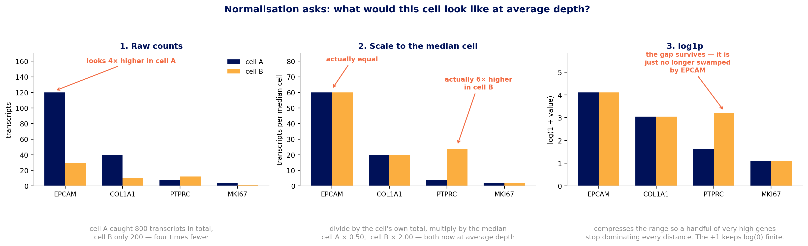
What normalisation is actually doing
Notes:
Two cells, four genes, and raw counts that mislead in both directions. Walk it left to right; three minutes.
Panel 1: cell A caught 800 transcripts, cell B only 200. EPCAM looks four times higher in A. Ask the room whether they believe it.
Panel 2: divide each cell by its own total, multiply by the median cell. EPCAM turns out equal - the apparent difference was entirely depth. And PTPRC, which looked about the same at 8 versus 12, is six times higher in cell B. Raw counts were wrong in both directions, which is the point.
Panel 3: log1p. Two reasons. Without it a handful of very abundant genes dominate every distance, so the neighbour graph is built almost entirely on them. And it makes ratios comparable: 1 to 2 and 100 to 200 become the same step, which is usually what you mean biologically. The +1 exists because log(0) is undefined and most entries are zero.
If someone asks why the median rather than a fixed number like 100: it keeps the values on the scale people are used to reading, and avoids inflating variance in sparse cells.

Slide 14
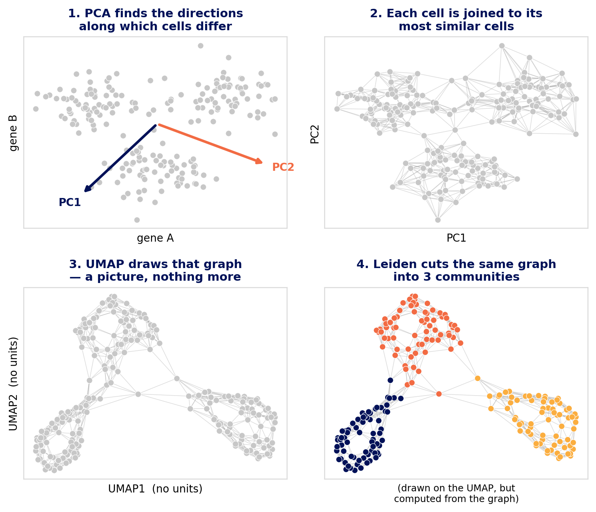
After that: PCA, UMAP and Leiden
PCA compresses 5,000 gene measurements per cell into ~50 numbers, keeping the directions along which cells differ most.
The neighbour graph links each cell to its most similar cells. This graph is the real object.
UMAP draws that graph on a page. It is a picture; nothing is computed from it.
Leiden cuts the same graph into communities.
UMAP and Leiden are siblings, not a sequence — Leiden never sees the UMAP.
Notes:
Walk the four panels in order; the room can follow the arrow of the argument without you reading the bullets.
Note the colours only appear in panel 4. Until Leiden runs, nothing has told you there are three groups - the grey is deliberate.
Two analogies that land: PCA is describing a face with a few measurements rather than every pixel. The graph is a social network - Leiden finds friendship groups, UMAP seats everyone so friends sit together.
The sibling point is the one to labour: people assume Leiden clusters the UMAP, and that assumption drives most of the misreadings on the next slide.

Slide 15
What PCA is actually doing
Each cell is a point in 5,000-dimensional space — one axis per gene. That space is mostly empty, and distances in it are dominated by noise.
PCA finds the directions along which cells differ most, and rewrites every cell as ~50 numbers instead of 5,000.
Each component is a weighted combination of genes. PC1 might be "epithelial genes up, stromal genes down" — one axis carrying a real biological contrast.
adata.varm["PCs"] holds those weights, so you can ask what any component is made of. Do that before you trust one.
Everything downstream — the neighbour graph, UMAP, Leiden — sees only these 50 numbers. If depth is in there, it is in all of them.
Notes:
Aim at the beginners. The one-axis-per-gene framing is what makes 'reduce dimensionality' concrete rather than a phrase people nod at.
The loadings point is practical: notebook 03 prints the top positive and negative loadings of PC1, and if the two lists look like two cell types then PC1 is biology and dropping it would be a mistake.
The last bullet is the bridge to the next two slides.

Slide 16
How many principal components?
The scree-plot elbow is much less informative for a targeted panel. Somebody already selected 5,000 informative genes, so variance is spread more evenly and there is often no clean elbow to find.
Practical starting points: 30–50 PCs for a 5K panel, 10–20 for a 300-gene panel. Scale with panel size, not cell number.
Better than the elbow: correlate each PC with total_counts and cell_area. A PC that is essentially depth means the normalisation is not done — and the notebook has a section that fixes it.
Too few → rare cell types collapse into their nearest neighbour
Too many → you add noise, but Leiden tolerates it. Erring high is the safer error.
Test it: re-run with 20 and with 50, and see whether your smallest cluster survives. That is more informative than any plot of eigenvalues. At some point it will stabilize, and that is what you pick.
Notes:
The PC-versus-QC correlation is the concrete diagnostic to demonstrate:
import numpy as np
for i in range(5):
r = np.corrcoef(adata.obsm['X_pca'][:, i],
adata.obs['total_counts'])[0, 1]
print(i, round(r, 2))
If PC1 correlates above ~0.6 with total_counts, go back to normalisation rather than tuning anything downstream.
OUR DATASET HAS THIS PROBLEM - use it. Notebook 03 has a fix-explorer that runs six remedies and reports how much depth each removes and how much it rearranges the embedding. The punchline is that no numerical criterion picks the winner: you cluster under two schemes and plot both on the tissue, and the one that looks like histology wins. That is the workshop thesis arriving in the middle of a normalisation discussion, so do not rush past it.

Slide 17
n_neighbors and resolution
n_neighbors builds the expression graph. Small (5–10) → fine structure, more clusters, noisier. Large (30–50) → smoother, fewer, more robust. 15 is a reasonable default from ~10,000 cells upward.
resolution decides how finely Leiden cuts that graph. It is not a number of clusters: doubling it does not double them.
Sweep resolution 0.3 → 2.0 and pick by two criteria: can you annotate every cluster with markers, and does it survive a change of random seed?
Careful — two different graphs in this workshop:
sc.pp.neighbors → who is similar in expression
sq.gr.spatial_neighbors → who is nearby in tissue
They are unrelated, both called "neighbours", and mixing them up is the commonest confusion of day 2.
Notes:
The expression-versus-spatial graph confusion catches almost everyone. Draw both on the whiteboard if you have time; it is worth two minutes.
On stability: adjusted Rand index across three random seeds. Below about 0.7 means the resolution is finer than the data supports.
Resist giving a single 'correct' resolution. The honest answer is that it depends on the question - immune subtypes need finer than tissue compartments.

Slide 18
Cheating with your UMAP: the three dials
n_neighbors — how far UMAP looks when deciding who is near whom. Small (5–10) preserves fine local structure and fragments the picture; large (30–50) preserves the global shape and smooths detail away.
min_dist — how tightly points may pack. Small (0.05) gives dense, well-separated clumps; large (0.8) spreads everything out.
spread — the overall scale the layout is drawn at.
Only the first also affects the clustering, because Leiden reads the same graph. min_dist and spread change the picture and nothing else.
So if a figure changes when you tune min_dist, nothing about your data changed. Notebook 03 has you verify exactly that: the cluster count does not move.
Notes:
The n_neighbors / min_dist distinction is the one worth being precise about. One is shared with the clustering; the other is purely cosmetic.
In notebook 03 they run min_dist=0.05 and min_dist=0.8 and watch the printed cluster count stay identical. That is a two-minute exercise that settles the argument better than this slide does.

Slide 19
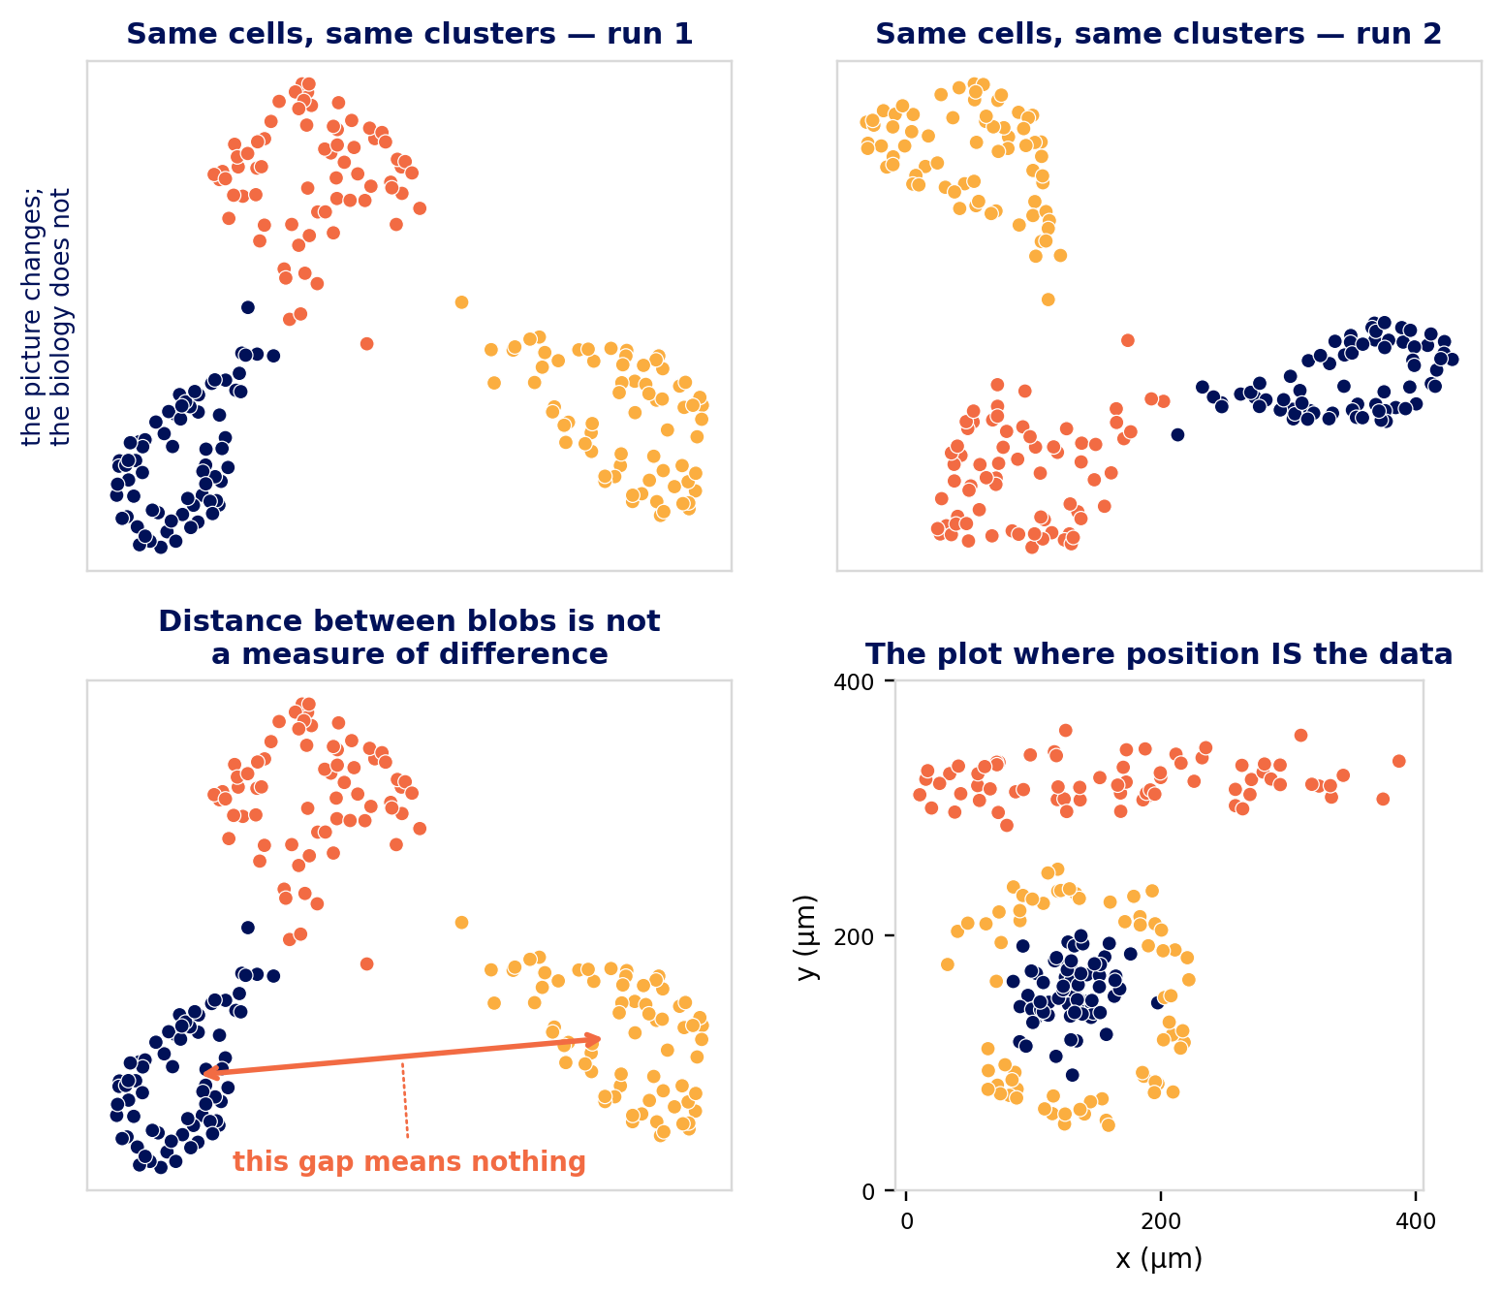
What a UMAP will not tell you
Distance between blobs is meaningless. Far apart is not more different.
Blob size and shape are meaningless.
The axes have no units. There is no "UMAP1 is differentiation".
It changes between runs and with parameters.
Never cluster on UMAP coordinates.
Good for: spotting a split, a batch effect, a gradient, or QC metrics tracking your clusters.
Notes:
Top row: identical cells, identical clusters, two runs of the layout. Ask the room which one is correct. Neither - and that is the point.
Bottom left: the first two points are what people quietly believe and then write into figure legends. Ask whether anyone has written 'cluster 3 sits between 1 and 2, suggesting an intermediate state'. That needs a trajectory method, not a UMAP.
Bottom right is the payoff and the workshop thesis in one panel: a nest, a band, a rim around the nest. Real axes, in microns, every distance a measurement. When you have this plot available, prefer it.

Slide 20
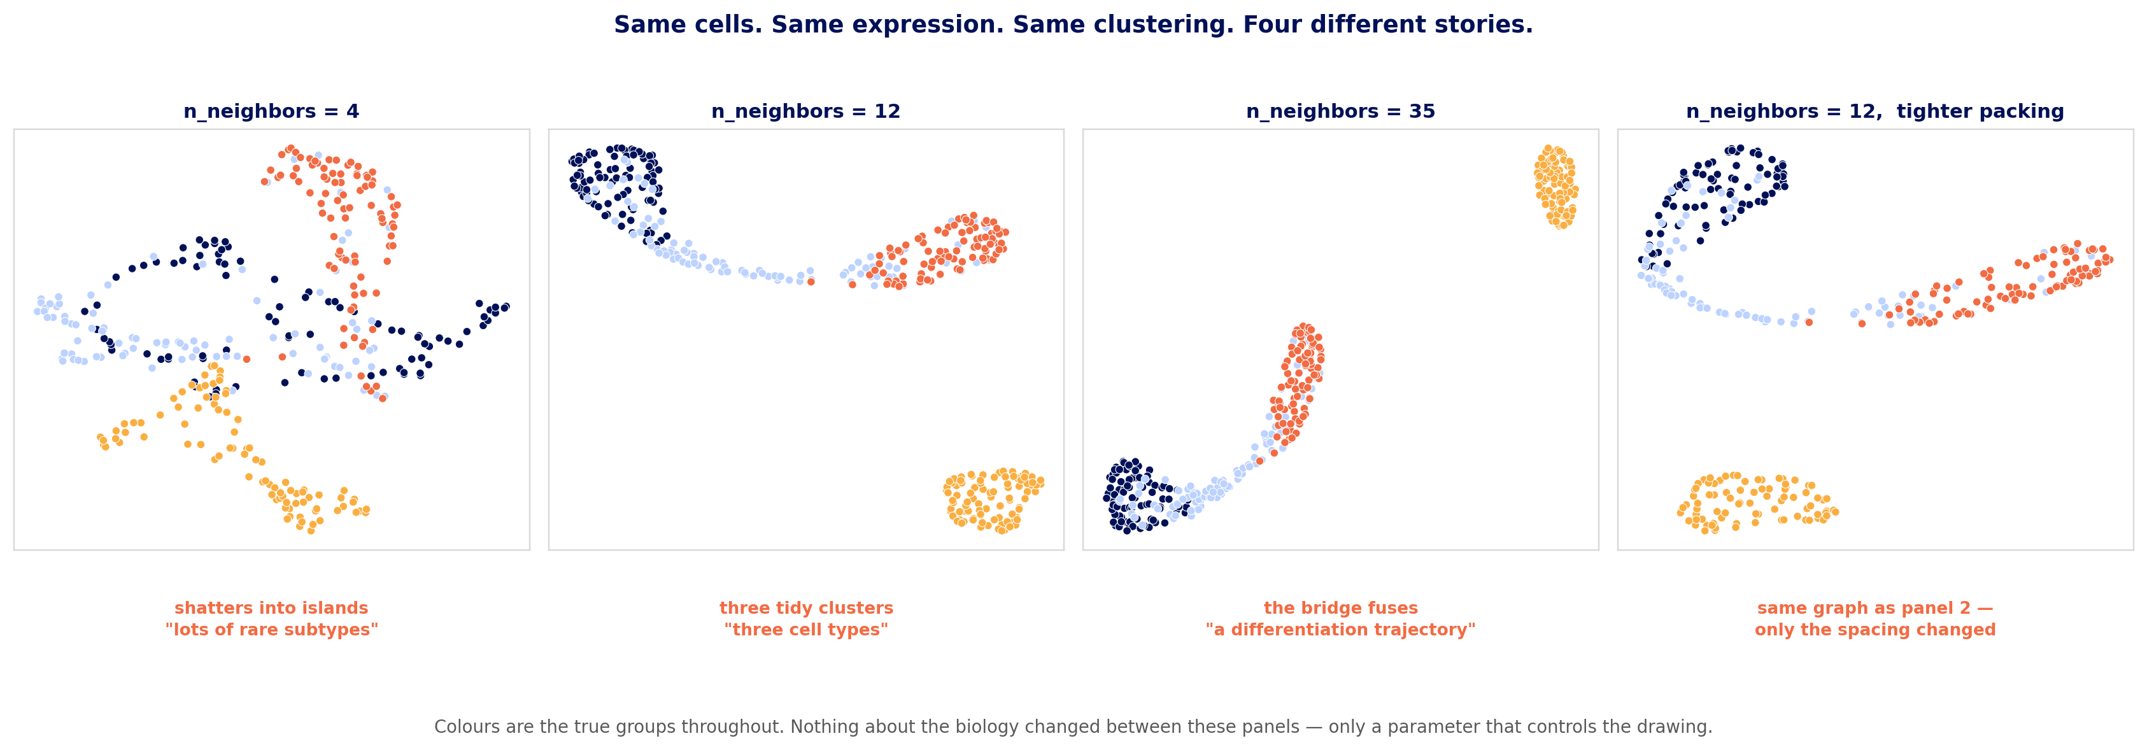
You can make a UMAP say almost anything
Notes:
This is the slide to spend time on. Same cells, same expression matrix, same clustering - four pictures that would support four different abstracts.
Panel 1 you could describe as rare subtypes. Panel 3 as a differentiation trajectory. Panel 4 is panel 2 with only the spacing changed, and the gaps look more convincing for it.
Ask the room directly: which of these is the correct picture? None of them. They are four drawings of one graph.
Then the constructive part, because this should not leave people cynical: report the parameters, do not tune them after seeing the result, and treat a UMAP as a way to look rather than as evidence. In this field you also have a better plot available - the tissue - where the axes are microns and every distance is a measurement.
Same hazard as choosing a QC threshold after seeing which cells it removes.

Slide 21
Cell type, or size artefact?
Colour the UMAP by total_counts and cell_area before you colour it by cluster. If a cluster lights up on those alone, it is technical.
Why it bites harder here than in scRNA-seq: counts per cell span a few hundred, not tens of thousands, so depth is a large fraction of the total variance rather than a nuisance you can regress away.
And cell_area is a segmentation output, not a measurement of the cell. A cluster of large cells may be a cluster of bad polygons.
Four checks, in order of how quickly they settle it:
1. Is the cluster at an extreme of counts or area? → suspicious
2. Are its markers a coherent lineage, or a grab-bag? → grab-bag is bad
3. Where is it in the tissue? Scattered → artefact. A structure → real.
4. Does it survive area-normalisation? If it vanishes, it was size.
Notes:
This is the single most common false discovery in imaging-based spatial data, and check 3 is the one your audience is best equipped to do.
Say clearly: a technical cluster is not a mistake to be ashamed of - it is information about your segmentation. The mistake is annotating it as a cell type and building a story on it.
Note that regressing out total_counts is NOT the automatic fix, because here it partly encodes cell size, which is partly biology.

Slide 22
The order, and what to re-check at each step
1. QC filter — then plot what you removed, in space
2. Normalise + log1p — no HVG step; the panel already chose
3. Scale — for PCA only; put log values back before markers
4. PCA — then correlate the first PCs with total_counts and cell_area
5. Neighbours (n_neighbors, n_pcs) — the expression graph
6. UMAP — for looking at, never for clustering on
7. Leiden (resolution) — then check stability across seeds
8. Markers — coherent lineage, or a grab-bag?
9. Plot the clusters on the tissue — the only external check you have
Every step inherits the ones above it. Change anything and re-run from that point down — including the checks.
Notes:
Step 6 needs saying out loud: never run clustering on UMAP coordinates. UMAP distances beyond the local neighbourhood are not meaningful, and people do this surprisingly often.
Step 9 is the payoff and the thing that makes this different from scRNA-seq. A clustering that produces a tissue map looking like static is wrong, no matter how clean the UMAP is.
If you are short of time, this slide alone is a usable summary of day 1's second half - it is the one to leave on screen during the exercises.

Slide 23
Thank you
.
Notes:
Collect feedback on paper, three questions: what will you do differently; what was too fast or too slow; what did you expect to learn and did not.
The third question is the one that improves the course.

