Slide 1
Spatial transcriptomics
A hands-on introduction
Department of Anatomy & Embryology, LUMC · two mornings
Notes:
Welcome. Two mornings, 09:30-12:30. Everything is in the GitHub repo; the notebooks are the course and these slides are the connective tissue.
Ask on arrival: who has clustered scRNA-seq data before? Seat mixed pairs.
Set the frame immediately: the one question this workshop is built around is on the next slide.

Slide 2
One question, two mornings
What can you learn from a tissue section that you fundamentally cannot learn from dissociated cells?
Everything we do maps back to this.
Day 1 — what the data is, and how much of it you should believe
Day 2 — using the coordinates for things scRNA-seq cannot do
You will leave able to design your own experiment, and to referee somebody else's.
Notes:
Do not skip this slide. The commonest failure mode in spatial transcriptomics is doing scRNA-seq with a scatter plot at the end.
Ask the room for their own tissue and question - you collected these in advance. Refer back to them all day.

Slide 3
Two families of technology
Sequencing-based
Visium, Visium HD, Slide-seq, Stereo-seq
Whole transcriptome, unbiased
Resolution is a spot or a bin, not a cell
Cell boundaries must be inferred
Good for: discovery, unknown biology
Imaging-based
Xenium, MERFISH / Vizgen, CosMx
Fixed panel — 300 to 5,000 genes
True single-cell, sub-cellular molecules
Cell boundaries segmented from stains
Good for: quantifying known biology in place
Notes:
The trade is always the same: transcriptome breadth versus spatial resolution. You cannot have both yet.
Practical rule for the room: if you cannot write down the genes that answer your question, you are not ready for a panel.

Slide 4
How Xenium measures a transcript
1. Padlock probes bind their target mRNA in the fixed section
2. Ligation, then rolling-circle amplification makes a bright dot
3. Cyclic fluorescence imaging reads out a colour sequence per dot
4. The colour sequence is decoded to a gene — with a confidence, QV
5. Nuclei and cell boundaries are segmented from DAPI and boundary stains
6. Each transcript is assigned to whichever polygon it falls inside
Steps 5 and 6 are where nearly every artefact is born.
Notes:
Keep this brief - 3 minutes. The detail that matters downstream is that decoding and segmentation are two separate, independently fallible steps, and the negative controls in notebook 02 measure them separately.
QV is Phred-style. 10x filters at QV>=20 before building the matrix.

Slide 5
Our dataset
Xenium Prime 5K — human ovarian cancer, FFPE
~5,000 gene panel plus several classes of control codeword
Multimodal segmentation: DAPI plus boundary stains (18S, ATP1A1, aCD45, E-cadherin)
You have a spatial crop, roughly 1.5 x 1.5 mm — a contiguous rectangle, not a random sample of cells
Why contiguous: every neighbourhood statistic on day 2 needs all the neighbours of every cell
The full run is tens of gigabytes and will not open on your laptop
Notes:
Show the full run in Xenium Explorer here - 5 minutes, live. Zoom from the whole section down to individual transcripts. Nothing on a slide communicates the scale of this data as well.
Point out where the teaching crop sits within the section.

Slide 6
What comes out of the instrument
Counts · cell_feature_matrix.h5 · one cell x gene count
Cell metadata · cells.parquet · centroid, area, control counts
Transcripts · transcripts.parquet · one row per decoded molecule: x, y, z, gene, QV, cell
Segmentation · cell_ and nucleus_boundaries.parquet · polygon vertices
Morphology · morphology_focus/*.ome.tif · ~0.2 µm per pixel
Plus experiment.xenium, gene_panel.json, metrics_summary.csv, and 10x's own clustering in analysis/ — a first look, never an answer
Notes:
Four layers, at three different resolutions. Most confusion in this field comes from not knowing which one you are holding.
Notebook 01 opens all of them.

Slide 7
The count matrix is a derived product
It exists because somebody drew polygons around nuclei and assigned molecules to them.
Typically 10–40% of transcripts are assigned to no cell at all
The unassigned fraction differs by gene — so segmentation loss is a gene-specific bias, not just lost sensitivity
A molecule on a boundary goes to whichever polygon the pipeline drew
Every layer below the matrix is closer to the measurement
If a result changes when you re-segment, it was a segmentation result
Notes:
This is the single most important idea of day 1. Say it slowly.
In notebook 01 they will plot transcripts with boundaries overlaid and see unassigned molecules with their own eyes. Come back to this slide afterwards.

Slide 8
Coming from single-cell RNA-seq?
What carries over
AnnData, scanpy, the whole pipeline shape
Normalise, reduce, cluster, find markers
Marker-based annotation
The habit of looking before believing
What does not
Whole transcriptome → a fixed panel
Thousands of counts per cell → hundreds
Droplet defines the cell → a polygon does
Doublet detection tools do not apply
Ambient soup → spillover, spatially structured
No highly-variable-gene step: the panel already chose
Notes:
The bottom-right point catches almost everyone. Running HVG selection on a curated 5K panel mostly selects the most abundant genes and discards the rare markers the panel was designed around.
The counts point is the deeper one: with a few hundred counts per cell, per-cell expression of one gene is nearly binary. Aggregate across space, not within cells.

Slide 9
QC 1 — the controls measure your background
Negative control probe — targets a sequence not in the tissue. Fires only on non-specific binding → measures chemistry
Negative control codeword — a codeword no probe uses. Fires only on decoding error → measures optics
Unassigned codeword — decoded to something not on the panel
Compare per feature, not in total: there are far fewer controls than genes
A gene sitting inside the control distribution is not measurable in your dataset — no matter how much you want it to be
Notes:
The split matters: it tells you WHICH part of the pipeline is misbehaving.
The last bullet is the one that saves careers. Weakly expressed genes are the exciting ones - transcription factors, receptors - and the ones the controls tell you least to trust.

Slide 10
QC 2 — segmentation failure has a shape
Plot transcripts per cell against cell area, both on log scales
Small and empty → debris, or a nucleus clipped by the section plane
Large and rich → two cells in one polygon: the spatial doublet
Large and empty → a polygon drawn over extracellular space
Nucleus/cell area piling up at 1.0 → the segmentation gave that cell no cytoplasm
Do not run scrublet or DoubletFinder here. This is a geometric failure and the fix is geometric.
Notes:
Draw the four quadrants on the whiteboard while they run the hexbin cell.
The doublet point comes up every single time. scRNA-seq doublet tools model two transcriptomes summed in a droplet. Here you have a polygon problem, and unlike in scRNA-seq you can go and look at it.

Slide 11
QC 3 — the step everyone skips
Put every QC metric back on the tissue and look at it.
Straight edges, stripes, a grid → field-of-view stitching. Technical.
A smooth gradient across the section → focus, thickness, permeabilisation
A soft-edged blob of low counts → probably real: necrosis, dense collagen
Anything following a fold or tear → exclude the region explicitly, rather than letting a count threshold do it invisibly
Then ask the real question: do the cells my filter removed form a structure? If so, that is not a quality filter, it is a biology filter.
Notes:
This check has no scRNA-seq equivalent - there is nowhere to plot it.
Concrete example worth giving: raising min_counts from 10 to 25 preferentially deletes small, low-cytoplasm cells, i.e. lymphocytes. Every immune co-localisation result downstream then changes. This is a real source of disagreement between published studies.

Slide 12
Why normalisation is harder here
In scRNA-seq, total counts per cell vary mostly with capture efficiency and RNA content. A droplet has no size.
Here a cell's total count is a mixture of at least four things:
how transcriptionally active the cell actually is
how big the polygon somebody drew around it is
how much signal leaked in from its neighbours
how well that part of the section was fixed, permeabilised and focused
The second one is new, and it is measured: cell_area sits in obs and correlates strongly with total_counts.
So the question is not just 'how do I scale' — it is 'which of these do I want to keep'. Cell size is partly biology.
Notes:
Spend a minute on the four-way list. The scRNA-seq reflex is to treat library size as pure nuisance and divide it out. Here part of it is a real biological property of the cell, and part of it is a drawing error.
The spillover component is the nastiest: it is proportional to the neighbours' expression, not the cell's, so it is spatially structured noise. No normalisation scheme removes it - only better segmentation does.

Slide 13
Four ways to normalise, and how each fails
Median-scaled counts — scanpy's normalize_total default. Assumes total count tracks activity. Familiar, safe, and what most papers do.
Breaks when the populations you compare differ in size.
Fixed target sum, e.g. 100 — makes values comparable across datasets and platforms.
With median counts in the low hundreds, cells below the target get scaled up, and their variance with them.
Divide by cell_area — transcripts per µm². Treats the measurement as a density: a bigger polygon really did sample more tissue.
Puts the segmentation error straight into the denominator.
Or model the counts directly — Pearson residuals (sc.experimental.pp), GLM-PCA, a negative binomial. Arguably the most principled at these depths, and increasingly common.
Notes:
Every one of these is defensible and every one is wrong in a specific way. Say that out loud - people want to be told the right answer and there isn't one yet.
Pearson residuals are worth flagging for the stronger participants: sc.experimental.pp.normalize_pearson_residuals. They handle low counts better than log1p and avoid the scaling question entirely. We do not use them in the notebooks only because the median-scaled path is the one they will meet in other people's code.

Slide 14
How to decide, in practice
Ask first: do the populations I am comparing differ in size? Lymphocytes versus tumour cells is the worst case; two fibroblast states is the easy one.
Run your main claim under two schemes. If it survives, say so in one sentence in the methods. If it flips, that is your result — you have learned the finding was about cell size.
Keep raw counts in a layer. Normalise, scale, cluster — then put the log-normalised values back before any marker or expression plot. Reporting numbers off a z-scaled matrix is a common and invisible error.
Take the control features out first. Otherwise your total_counts includes background, and you normalise by it.
log1p is still standard, but its variance-stabilising justification is weaker at a few hundred counts than at a few thousand.
Whatever you pick: state it, with the number. "Median-scaled, log1p" is a methods sentence. "Standard normalisation" is not.
Notes:
Exercise 3.1 makes them run the count-normalised and area-normalised clusterings and cross-tabulate. Do not give away the answer: size-discordant populations move, size-matched ones do not.
The 'keep raw counts in a layer' point saves more grief than anything else on this slide. Notebook 03 does it explicitly and calls attention to it.
Related question you will be asked: should I regress out total counts? Discuss - here it partly encodes cell size, which is biology, so regressing it out can remove the signal you came for.

Slide 15
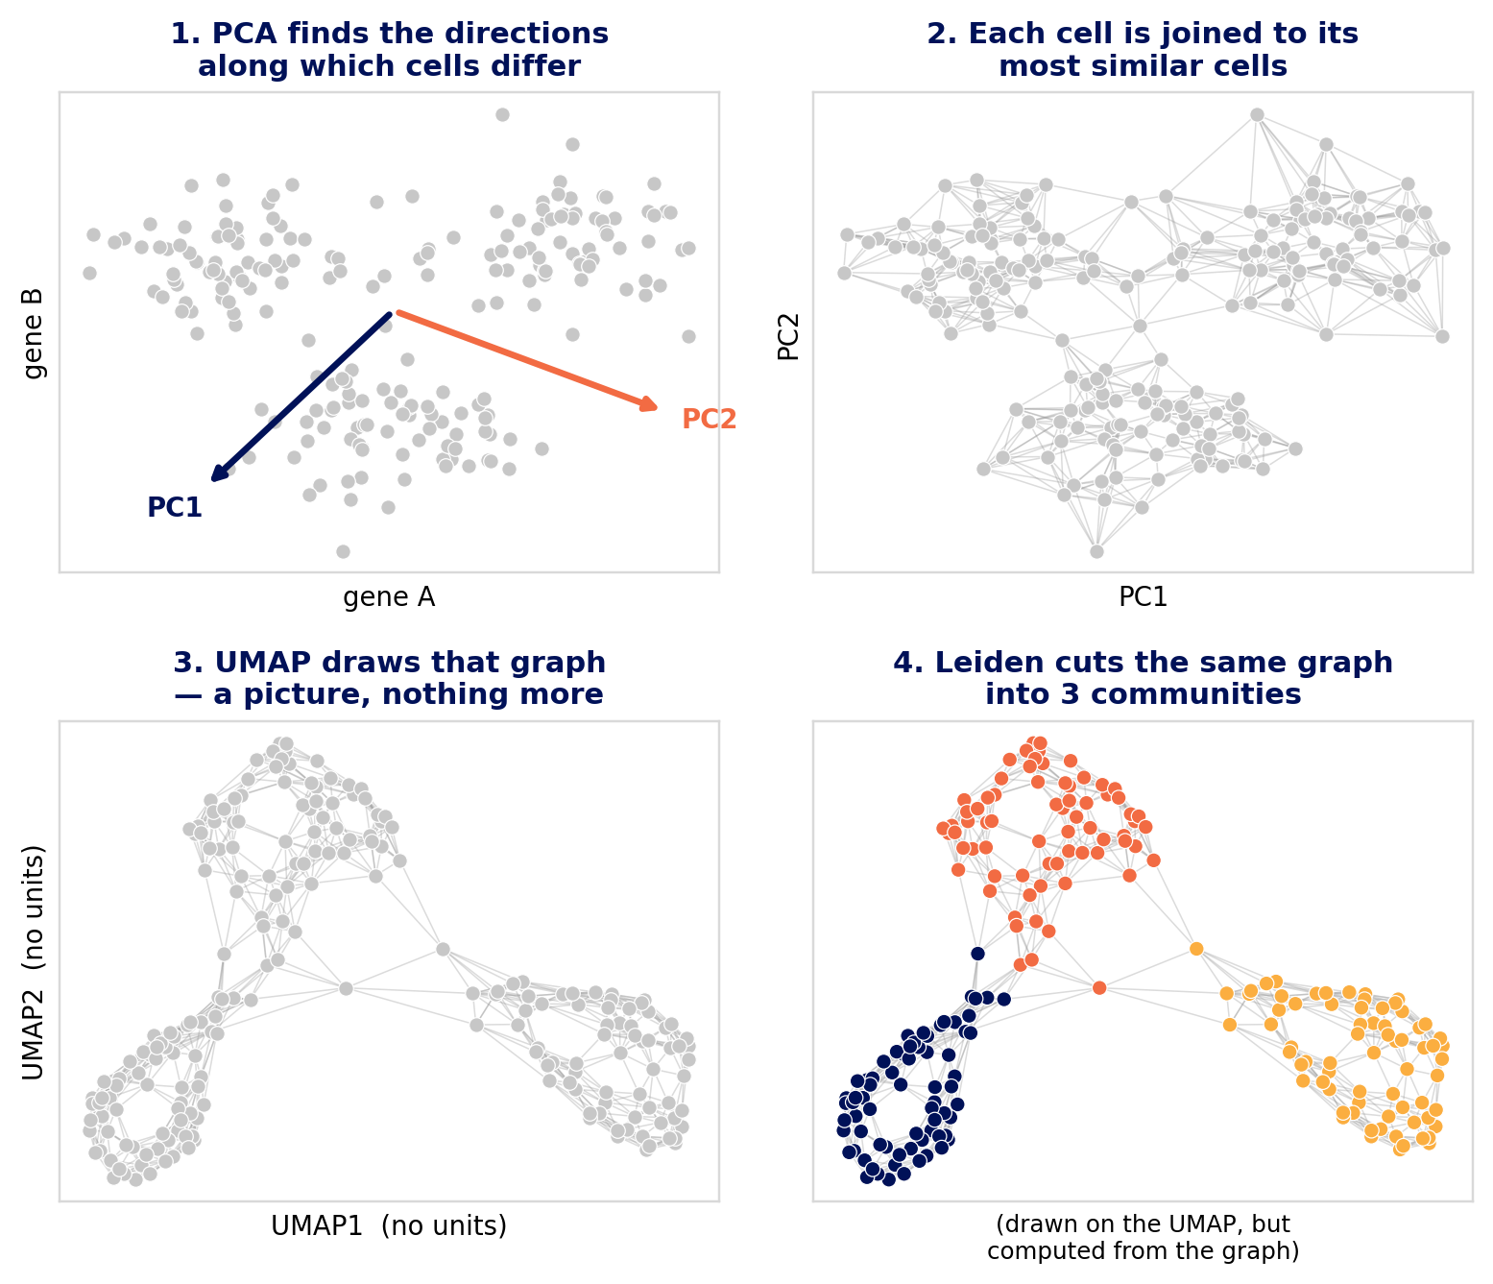
PCA, UMAP and Leiden
PCA compresses 5,000 gene measurements per cell into ~50 numbers, keeping the directions along which cells differ most.
The neighbour graph links each cell to its most similar cells. This graph is the real object.
UMAP draws that graph on a page. It is a picture; nothing is computed from it.
Leiden cuts the same graph into communities.
UMAP and Leiden are siblings, not a sequence — Leiden never sees the UMAP.
Notes:
Walk the four panels in order; the room can follow the arrow of the argument without you reading the bullets.
Note the colours only appear in panel 4. Until Leiden runs, nothing has told you there are three groups - the grey is deliberate.
Two analogies that land: PCA is describing a face with a few measurements rather than every pixel. The graph is a social network - Leiden finds friendship groups, UMAP seats everyone so friends sit together.
The sibling point is the one to labour: people assume Leiden clusters the UMAP, and that assumption drives most of the misreadings on the next slide.

Slide 16
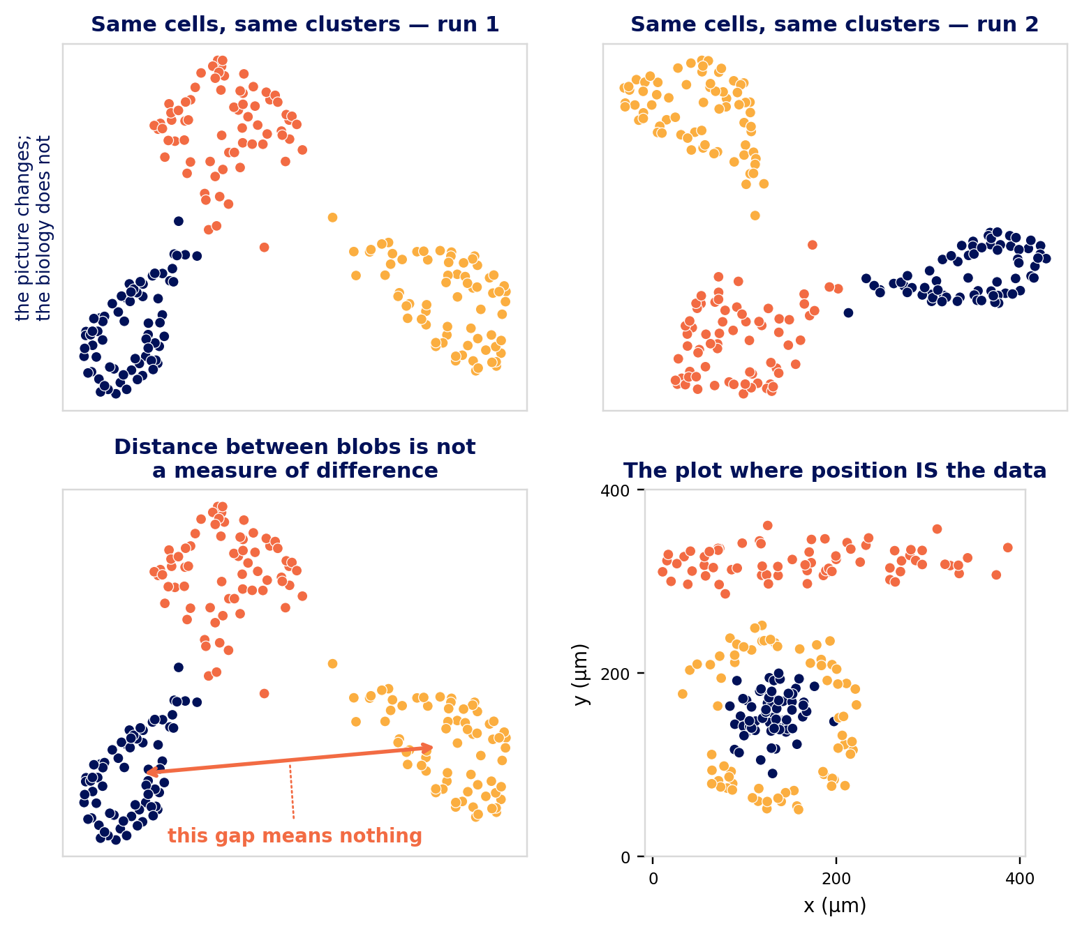
What a UMAP will not tell you
Distance between blobs is meaningless. Far apart is not more different.
Blob size and shape are meaningless.
The axes have no units. There is no "UMAP1 is differentiation".
It changes between runs and with parameters.
Never cluster on UMAP coordinates.
Good for: spotting a split, a batch effect, a gradient, or QC metrics tracking your clusters.
Notes:
Top row: identical cells, identical clusters, two runs of the layout. Ask the room which one is correct. Neither - and that is the point.
Bottom left: the first two points are what people quietly believe and then write into figure legends. Ask whether anyone has written 'cluster 3 sits between 1 and 2, suggesting an intermediate state'. That needs a trajectory method, not a UMAP.
Bottom right is the payoff and the workshop thesis in one panel: a nest, a band, a rim around the nest. Real axes, in microns, every distance a measurement. When you have this plot available, prefer it.

Slide 17
Cell type, or size artefact?
Colour the UMAP by total_counts and cell_area before you colour it by cluster. If a cluster lights up on those alone, it is technical.
Why it bites harder here than in scRNA-seq: counts per cell span a few hundred, not tens of thousands, so depth is a large fraction of the total variance rather than a nuisance you can regress away.
And cell_area is a segmentation output, not a measurement of the cell. A cluster of large cells may be a cluster of bad polygons.
Four checks, in order of how quickly they settle it:
1. Is the cluster at an extreme of counts or area? → suspicious
2. Are its markers a coherent lineage, or a grab-bag? → grab-bag is bad
3. Where is it in the tissue? Scattered → artefact. A structure → real.
4. Does it survive area-normalisation? If it vanishes, it was size.
Notes:
This is the single most common false discovery in imaging-based spatial data, and check 3 is the one your audience is best equipped to do.
Say clearly: a technical cluster is not a mistake to be ashamed of - it is information about your segmentation. The mistake is annotating it as a cell type and building a story on it.
Note that regressing out total_counts is NOT the automatic fix, because here it partly encodes cell size, which is partly biology.

Slide 18
How many principal components?
The scree-plot elbow is much less informative for a targeted panel. Somebody already selected 5,000 informative genes, so variance is spread more evenly and there is often no clean elbow to find.
Practical starting points: 30–50 PCs for a 5K panel, 10–20 for a 300-gene panel. Scale with panel size, not cell number.
Better than the elbow: correlate each PC with total_counts and cell_area. A PC that is essentially depth means the normalisation is not done — and the notebook has a section that fixes it.
Too few → rare cell types collapse into their nearest neighbour
Too many → you add noise, but Leiden tolerates it. Erring high is the safer error.
Test it: re-run with 20 and with 50, and see whether your smallest cluster survives. That is more informative than any plot of eigenvalues.
Notes:
The PC-versus-QC correlation is the concrete diagnostic to demonstrate:
import numpy as np
for i in range(5):
r = np.corrcoef(adata.obsm['X_pca'][:, i],
adata.obs['total_counts'])[0, 1]
print(i, round(r, 2))
If PC1 correlates above ~0.6 with total_counts, go back to normalisation rather than tuning anything downstream.
OUR DATASET HAS THIS PROBLEM - use it. Notebook 03 has a fix-explorer that runs six remedies and reports how much depth each removes and how much it rearranges the embedding. The punchline is that no numerical criterion picks the winner: you cluster under two schemes and plot both on the tissue, and the one that looks like histology wins. That is the workshop thesis arriving in the middle of a normalisation discussion, so do not rush past it.

Slide 19
n_neighbors and resolution
n_neighbors builds the expression graph. Small (5–10) → fine structure, more clusters, noisier. Large (30–50) → smoother, fewer, more robust. 15 is a reasonable default from ~10,000 cells upward.
resolution decides how finely Leiden cuts that graph. It is not a number of clusters: doubling it does not double them.
Sweep resolution 0.3 → 2.0 and pick by two criteria: can you annotate every cluster with markers, and does it survive a change of random seed?
Careful — two different graphs in this workshop:
sc.pp.neighbors → who is similar in expression
sq.gr.spatial_neighbors → who is nearby in tissue
They are unrelated, both called "neighbours", and mixing them up is the commonest confusion of day 2.
Notes:
The expression-versus-spatial graph confusion catches almost everyone. Draw both on the whiteboard if you have time; it is worth two minutes.
On stability: adjusted Rand index across three random seeds. Below about 0.7 means the resolution is finer than the data supports.
Resist giving a single 'correct' resolution. The honest answer is that it depends on the question - immune subtypes need finer than tissue compartments.

Slide 20
The order, and what to re-check at each step
1. QC filter — then plot what you removed, in space
2. Normalise + log1p — no HVG step; the panel already chose
3. Scale — for PCA only; put log values back before markers
4. PCA — then correlate the first PCs with total_counts and cell_area
5. Neighbours (n_neighbors, n_pcs) — the expression graph
6. UMAP — for looking at, never for clustering on
7. Leiden (resolution) — then check stability across seeds
8. Markers — coherent lineage, or a grab-bag?
9. Plot the clusters on the tissue — the only external check you have
Every step inherits the ones above it. Change anything and re-run from that point down — including the checks.
Notes:
Step 6 needs saying out loud: never run clustering on UMAP coordinates. UMAP distances beyond the local neighbourhood are not meaningful, and people do this surprisingly often.
Step 9 is the payoff and the thing that makes this different from scRNA-seq. A clustering that produces a tissue map looking like static is wrong, no matter how clean the UMAP is.
If you are short of time, this slide alone is a usable summary of day 1's second half - it is the one to leave on screen during the exercises.

Slide 21
Day 2 — now we use the coordinates
Everything so far was single-cell analysis with coordinates attached.
The organising idea for today:
Build a graph of which cells touch which, then ask questions of the graph.
Almost every method in this field is a variation on that sentence.
Neighbourhood enrichment · co-occurrence · Moran's I · niches · distance fields · sub-cellular localisation
Notes:
Start day 2 by answering yesterday's sticky notes.
At 10:10, everyone loads the shipped annotated object regardless of progress. Say it out loud: falling behind is expected and costs nothing.

Slide 22
Who counts as a neighbour?
k nearest neighbours — every cell gets the same number of contacts. Comparable statistics across regions.
Delaunay triangulation — neighbours share a Voronoi face. Closest to 'physically touching'. Usually the honest default.
Fixed radius — a physical scale, e.g. a signalling range. But behaves badly where density varies.
Trim long edges. Two cells 'touching' across a lumen or a tear are not touching.
The choice is a biological claim. Make it deliberately.
Notes:
The radius-graph warning is worth dwelling on: a cell in dense lymphoid tissue gets 40 neighbours, one in loose stroma gets 2, and every per-cell statistic is then confounded by density.
In notebook 04 they draw the graph on a 200 um patch. Make them look at it - it is the object every statistic that follows runs on.

Slide 23
Neighbourhood enrichment, and its too-easy null
Count contacts between each pair of cell types; compare with shuffled labels
Red on the diagonal = that type is clustered. Almost everything is. Not a finding.
Blue off-diagonal = segregation — often the more interesting direction. Immune exclusion is a blue square.
Trap 1: a global shuffle destroys tissue structure, so everything looks significant
Trap 2: z-scores scale with cell number. Never compare raw z across datasets.
Trap 3: one section, one patient. n = 1.
Notes:
When the first z-score of 300 appears on someone's screen, use it. Ask the room what the null was.
Notebook 05 builds a better null - shuffling within niche - and the z-scores collapse. That contrast is one of the most useful things in the whole workshop.

Slide 24
At what distance? Scale is the finding
Adjacency is one scale. Real biology has a length scale.
Juxtacrine signalling ~10 µm · chemokine gradients ~100 µm · tissue compartments ~mm
Co-occurrence: enrichment as a function of radius. Where the curve crosses 1 is the length scale of the interaction.
Ripley's L: is one cell type clustered or dispersed, and at what radius?
Regular spacing is rare and interesting — it means something is actively controlling position
Report the radius, in microns. That is a number you can compare between patients.
Notes:
'Enriched' is a weak claim. 'Enriched within 40 um and not beyond' is a strong one, and it is a number that transfers between studies.
Cut Ripley first if you are running behind.

Slide 25
Moran's I — structure without clusters
Everything above needs cell-type labels, and inherits every annotation mistake
Moran's I asks directly: are neighbouring cells more similar than distant ones, for this gene?
No clustering required. A genuinely different question from 'is this a marker'.
A gene can mark a cell type and not be spatially structured — if that type is scattered
And a gene can be spatially structured without marking any cluster — hypoxia near necrosis, interferon radiating from a focus, a proliferation gradient
These are exactly the genes a cluster-first analysis misses
Notes:
Exercise 4.2 asks for high Moran's I with low between-cluster variance. Answers: gradients that cut across cell types.
Warn them: technical gradients do this too. Check the pattern is not a stripe before getting excited.

Slide 26
Niches — the unit of tissue organisation
A cell type is a property of a cell. A niche is a property of a neighbourhood.
The recipe is three lines: 1) for each cell, the cell-type composition of its neighbourhood; 2) cluster those composition vectors; 3) each cluster is a niche
Tumour nest core · invasive front · vascular stroma · tertiary lymphoid structure — these are niches, and this is the level most tissue biology happens at
The niche map looks more like histology than the cell-type map does, because it describes compartments rather than cells
Then name them anatomically. A room full of anatomists has the advantage here — you already know what these structures are called.
Notes:
This is where this particular audience outperforms a bioinformatics room. Lean into it hard.
On choosing K: no statistically correct answer. Keep the largest K at which every niche is still nameable as a structure you could point to on a slide. Check stability across seeds with ARI.

Slide 27
What only spatial can do
Impossible in scRNA-seq
Which cells physically touch which
Expression as a function of distance to a structure
Sub-cellular localisation: nuclear vs cytoplasmic
Detecting cells stacked in the z dimension
Tissue compartments and niches
Cell types destroyed by dissociation
Still better in scRNA-seq
Whole transcriptome, far greater depth
Discovering unexpected cell states
Cost per cell, and therefore sample size
They answer different questions. The best studies use both — discovery dissociated, placement in situ.
Notes:
Anyone telling you one replaces the other is selling something.
This slide is the summary of notebook 05. If you only have time for one slide on day 2, it is this one.

Slide 28
Distance as a continuous covariate
Pick a reference structure, build a KD-tree, ask every cell how far it is
A categorical comparison becomes a dose–response curve
Same cell type, different position — so position is the only variable. This design does not exist in dissociated data.
Careful: distance to a cell type is not distance to a structure. One misclassified cell creates a false nest.
Use niches as the reference, not cell types — they are already smoothed over neighbourhoods
And fit correlated distances together. Vessels sit in stroma, so distance-to-vessel and distance-to-tumour are entangled.
Notes:
The last bullet is the most common analytical error in this style of paper: reporting a marginal association with one distance when two are correlated.
Protect this section - never cut it. It is the clearest demonstration of the workshop's central claim.

Slide 29
Below the cell
Each transcript is recorded as inside or outside the nucleus
Aggregate per gene: nuclear versus cytoplasmic localisation, in situ, for 5,000 genes at once
Nuclear-retained lncRNAs sit at the top; abundant secretory and structural mRNAs at the bottom
Why an anatomy department should care: this is a proxy for transcription timing. Nuclear-skewed means recently switched on.
A temporal axis, from a fixed section.
Caveats: the nucleus polygon has its own error, and a 2D section through a 3D nucleus mislabels transcripts at the top and bottom
Notes:
For a development or regeneration group this is often the slide that changes what they plan to do.
Treat it as comparative across genes, never as an absolute measurement.

Slide 30
Six ways to fool yourself
1. Trusting the segmentation. Repeat one key result on a raw transcript grid with no cells at all. If it disappears, it was a segmentation result.
2. Forgetting the section has thickness. Two cells stacked in z become one polygon with a mixed profile, and no amount of 2D re-segmentation fixes it. ovrlpy maps this directly.
3. A null that is too easy. Shuffling labels globally destroys architecture and makes everything significant.
4. Spillover read as biology. A fibroblast surrounded by tumour picks up tumour transcripts. Ask whether the difference is in genes the neighbours express.
5. Filtering out a structure. Always plot what you removed.
6. Confusing cells with replicates. 400,000 cells from two patients is an n of 2.
Notes:
Number 2 is the one this audience has never met: it is invisible in the DAPI image because one nucleus sits above the other. Section 4 of notebook 05 is optional and detects it.
Number 4 is subtle and worth ten minutes. The check: is the difference in genes the NEIGHBOURS express (spillover) or in genes the neighbours do not express (a real state change)? Only the second is convincing.
Number 1 is the cheapest sanity check in the field and almost nobody does it.

Slide 31
Designing your own experiment
Is the question actually spatial? If dissociated cells can answer it, do that — cheaper, deeper, better powered.
What is n? Cells are not replicates. n is sections, and really donors. Settle this at design, not at review.
Panel or whole transcriptome? If you cannot list the genes, you are not ready for a panel.
Check every marker against gene_panel.json. Missing markers are the commonest regret.
Section orientation is a decision, not an accident — and it is the thing this department is best placed in the building to get right
Budget storage and compute at the same time as instrument time. 20–100 GB per run.
Notes:
The n question is the one that sinks projects. Aggregate to a per-sample value, then test across samples. If that leaves n=3 per group, better to know now.
Point them at SASC and the Cell Observatory for study design consultation - before the experiment.

Slide 32
Where to go next
Xenium Explorer — free, from 10x. Browse the full run with the images. Use it constantly; it catches artefacts no plot will.
squidpy and SpatialData — the analysis and container libraries used here. Their tutorials are unusually good.
Baysor · Proseg · Segger — alternative segmentation. If a finding changes when you re-segment, it was a segmentation finding.
ovrlpy — vertical signal integrity: finds z-stacked doublets and tissue folds that 2D QC cannot see (Nat Biotech 2026)
CellCharter · Banksy · UTAG — niche and domain detection beyond the k-means recipe we used
Voyager (R) — spatial statistics on a proper geospatial foundation
Reading: Moses & Pachter 2022 (Nat Methods) · Palla, Fischer, Regev & Theis 2022 (Nat Biotech)
Locally: SASC and the Cell Observatory — talk to them before the experiment, not after
Notes:
Xenium Explorer is the one to push hardest. Ten minutes of browsing their own data will teach them more about artefacts than an hour of slides.
The SASC point matters: study design consultation is far cheaper before instrument time is booked.

Slide 33
Thank you
If figure 4 would look the same without the coordinates, redesign the analysis.
Notes:
Collect feedback on paper, three questions: what will you do differently; what was too fast or too slow; what did you expect to learn and did not.
The third question is the one that improves the course.

