Slide 1
Before the workshop
Installing Python and the workshop environment
Spatial transcriptomics · Anatomy & Embryology, LUMC
Notes:
Send this out at least two weeks before the workshop, with a deadline for reporting problems.
The single most important message: do this BEFORE day 1. There is no time to install software on the morning, and conda solves are slow.

Slide 2
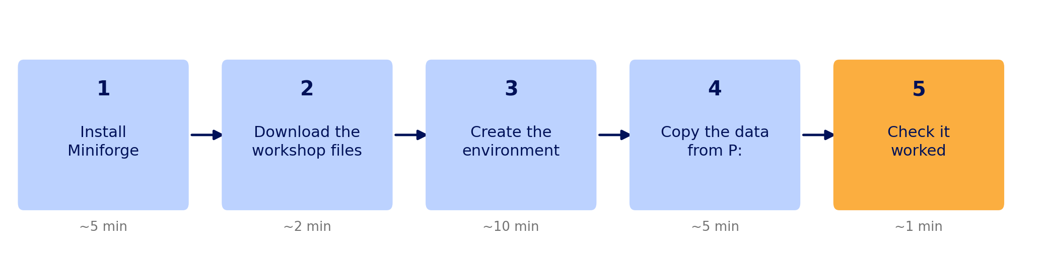
Five steps, about twenty minutes
Most of that time is waiting. Do it days ahead, not the night before.
Notes:
Twenty minutes of wall-clock time, of which maybe three are typing.
Stress the 'days ahead' point: if something fails, they need time to ask for help, and share permissions in particular can take a day or two.

Slide 3
What you need first
A laptop with 8 GB RAM (16 GB is comfortable) and 5 GB free disk
Access to the P: drive — if you cannot open it in File Explorer today, ask now, because permissions can take a day or two
The LUMC VPN, if you will be working from home
About twenty minutes, most of it waiting
You do not need to know Python. Every cell in the workshop runs as written.
Notes:
The P: drive point is the one that catches people. Getting share access is the only step with an external dependency and a multi-day lead time.
The last bullet matters for recruitment: a third of the room will have never used Python and should not self-select out.

Slide 4
Step 1 — install Miniforge
Download from github.com/conda-forge/miniforge and run the installer.
Accept the defaults. Install for your user only, not system-wide — you do not need admin rights that way.
Windows: afterwards you will have a Miniforge Prompt in the Start menu. Use that for every command in this guide, not PowerShell or CMD.
macOS: use the normal Terminal. On an M1/M2/M3/M4 Mac take the arm64 installer.
Already have Anaconda? It works too — skip to step 2 and use the Anaconda Prompt. Note that Anaconda's licence now requires a paid subscription for large organisations, which is why we suggest Miniforge.
Notes:
Miniforge is the same conda, defaulting to the conda-forge channel, with no licensing question. It is also a much smaller download than Anaconda.
If your department already has an Anaconda site licence, say so here and drop the last bullet - it only muddies things.
The Windows 'use the Miniforge Prompt' instruction prevents a whole class of 'conda is not recognised' emails.

Slide 5
Step 2 — get the workshop files
Everything lives at https://github.com/chuvalab/Workshop-Xenium-in-Python/
Click Code → Download ZIP on that page, then unzip it somewhere sensible.
Put it somewhere without spaces or accents in the path, and not inside OneDrive — syncing a folder full of large files while you work causes odd failures.
Notes:
The OneDrive warning is worth keeping. Many LUMC laptops sync Documents by default, and a 2 GB data folder inside it will both crawl and occasionally lock files mid-write.
Suggest something like C:\Users\<you>\spatialtx-workshop.

Slide 6
Step 3 — create the environment
In the Miniforge Prompt, from inside the workshop folder:
cd X:\path\to\the\githubdownload
conda env create -f environment.yml
conda activate spatialtx
This takes 5–15 minutes and prints a great deal. That is normal.
Then register it so Jupyter can see it:
python -m ipykernel install --user --name spatialtx --display-name "Python (spatialtx)"
If the solve is very slow, install mamba once and use it instead — it is the same thing, faster:
conda install -n base -c conda-forge mamba
mamba env create -f environment.yml
Notes:
The ipykernel line is the step people skip, and its symptom appears much later: the spatialtx kernel is missing from the Jupyter menu, and everything fails with import errors because they are in the base environment.
Warn them the solve prints pages of output and can appear to hang at 'Solving environment'. That is expected.

Slide 7
Step 4 — copy the data
The dataset is on the department share:
P:\PI\PI_Chuva_de_Sousa_Lopes\susana\SpatialTranscriptomicsWorkshop\data
Copy it — do not work directly off P:. The notebooks write their results back into the data folder, and reading large files over the network in every cell is painfully slow.
Notes:
About 1-2 GB. Ask them to do this at home or off-peak: twenty-five simultaneous copies from one share on the morning will crawl.
Re-running is safe - files already present are skipped, so an interrupted copy just resumes.

Slide 8
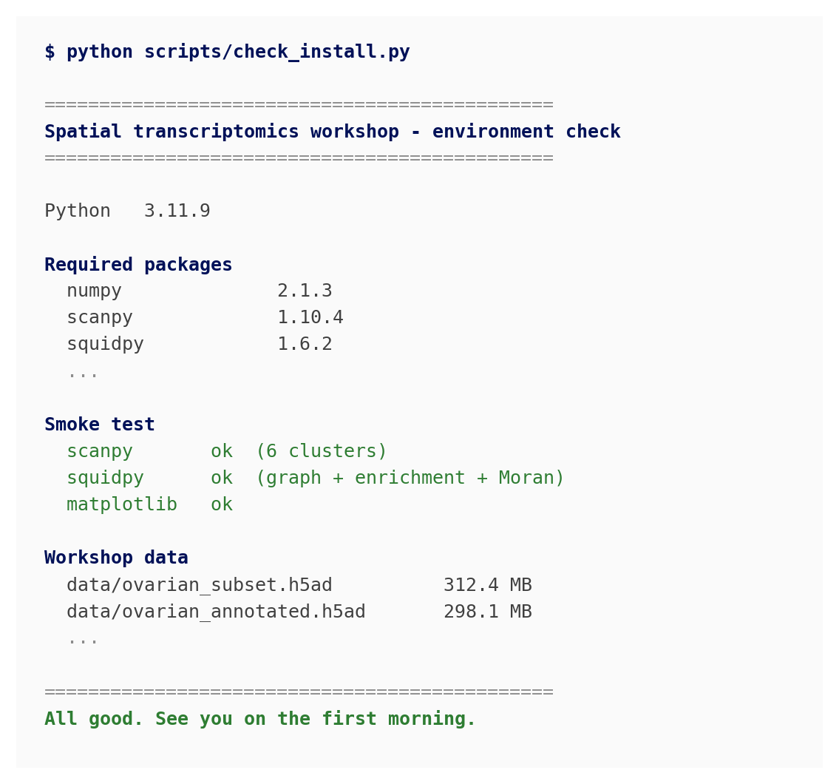
Step 5 — check it worked
python scripts/check_install.py
It prints a version table, runs a small end-to-end test, and confirms the data is present.
You want the last line to read All good.
Then open the notebook and run every cell:
jupyter lab
notebooks/00_setup_check.ipynb
Check the kernel says Python (spatialtx) in the top right.
Notes:
Tell them explicitly what success looks like, so they do not email asking whether a wall of version numbers is a problem.
Notebook 00 matters as well as the script: it is the only thing that confirms the Jupyter kernel is wired up correctly, which the script cannot test.

Slide 9
If something goes wrong
'conda' is not recognised — you are in the wrong terminal. Use the Miniforge Prompt from the Start menu.
Solving environment takes forever — normal up to about 15 minutes. Beyond that, install mamba and use it instead.
PackagesNotFoundError — a channel problem. Miniforge avoids it; if you are on Anaconda, run conda config --add channels conda-forge.
The spatialtx kernel is missing in Jupyter — you skipped the ipykernel line in step 3. Run it, then restart JupyterLab.
Could not find the data share — check P: is connected in File Explorer, and that you are on the VPN if working from home.
The kernel dies while loading data — out of memory. Close Chrome.
Fuller list with fixes: docs/INSTALL.md in the repository.
Notes:
These six cover almost every email you will get. The first and fourth together are probably half of them.
Point people at docs/INSTALL.md rather than expanding this slide - it has the platform-specific detail including Apple Silicon and imagecodecs.

Slide 10
Stuck? Ask early.
Notes:
Set an explicit deadline here - about three days before day 1 - so you have time to fix things and are not debugging conda in front of twenty-five people.
Add your own email address to this slide before sending it out.

