Slide 1

Chapter 2
Recognizing Opportunities and Generating Ideas
Bruce R. Barringer
R. Duane Ireland
Copyright ©2016 Pearson Education, Inc.
2-<number>

Slide 2
Chapter Objectives
1 of 2
Explain the difference between opportunities and ideas.
Describe the three general approaches entrepreneurs use to identify opportunities.
Discuss the personal characteristics of entrepreneurs that contribute to their ability to recognize business opportunities.
Identify and describe techniques entrepreneurs use to generate ideas.
Copyright ©2016 Pearson Education, Inc.
2-<number>

Slide 3
Chapter Objectives
1 of 2
Discuss actions to take to encourage continuous
development of new ideas in entrepreneurial firms.
Copyright ©2016 Pearson Education, Inc.
2-<number>

Slide 4
What is an Opportunity?
1 of 2
An opportunity is a favorable
set of circumstances that
creates a need for a new
product, service, or business.
Opportunity Defined
Copyright ©2016 Pearson Education, Inc.
2-<number>

Slide 5
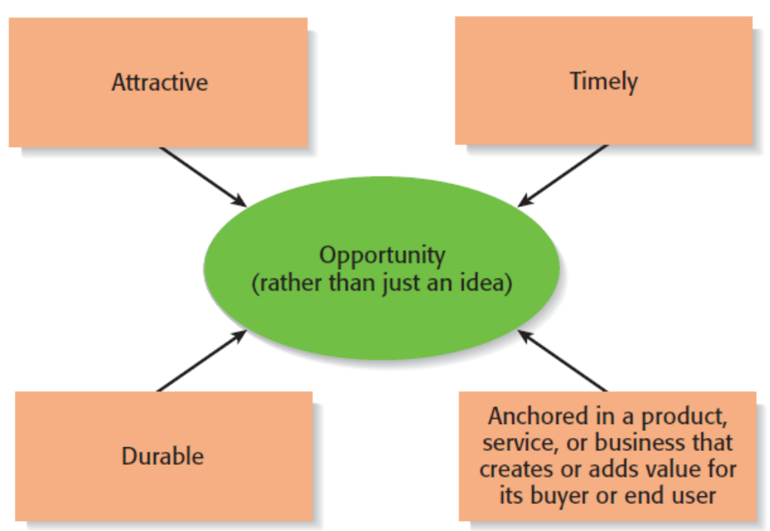
What is an Opportunity?
2 of 2
Four Essential Qualities of an Opportunity
Copyright ©2016 Pearson Education, Inc.
2-<number>

Slide 6
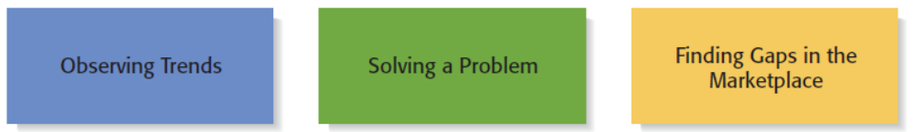
Three Ways to Identify an Opportunity
Copyright ©2016 Pearson Education, Inc.
2-<number>

Slide 7
First Approach: Observing Trends
1 of 2
Observing Trends
  Trends create opportunities for entrepreneurs to pursue.
  The most important trends are:
    Economic forces
    Social forces
    Technological advances
    Political and regulatory change
  It’s important to be aware of changes in these areas.
Copyright ©2016 Pearson Education, Inc.
2-<number>

Slide 8
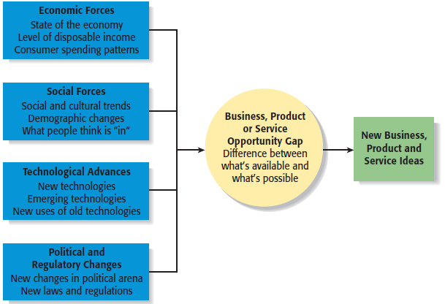
First Approach: Observing Trends
2 of 2
Environmental Trends Suggesting Business or Product Opportunity Gaps
Copyright ©2016 Pearson Education, Inc.
2-<number>

Slide 9
Trend 1: Economic Forces
Example of Economic Trend Creating a Favorable Opportunity
Economic trends help determine areas that are ripe for new start-ups and areas that start-ups should avoid.
A weak economy favors
start-ups that help consumers
save money.
An example is GasBuddy.com,
a company started to help
consumers save money on gas.
Copyright ©2016 Pearson Education, Inc.
2-<number>

Slide 10
Trend 2: Social Forces
Examples of Social Trends
Social trends alter how people and businesses behave and set their priorities. These trends provide opportunities for new businesses to accommodate the changes.
Aging of the population.
The increasing diversity of
the workplace.
Increased participation in
social networks.
Growth in the uses of mobile
devices.
An increasing focus on health
and wellness.
Copyright ©2016 Pearson Education, Inc.
2-<number>

Slide 11
Trend 3: Technological Advances
1 of 2
Examples of Entire Industries that Have Been Created as the Result of Technological Advances
Advances in technology frequently create business opportunities.
Computer industry
Internet
Biotechnology
Digital photography
Copyright ©2016 Pearson Education, Inc.
2-<number>

Slide 12
Trend 3: Technological Advances
2 of 2
Example: H20Audio
Once a technology is created, products often emerge to advance it.
An example is H20Audio, a company started by four former San Diego State University students, that makes waterproof housings and earbuds for the Apple iPhone.
Copyright ©2016 Pearson Education, Inc.
2-<number>

Slide 13
Trend 4: Political Action and Regulatory Changes
1 of 2
General Example
Political action and regulatory changes also provide the basis for opportunities.
Laws to protect the environment have created opportunities for entrepreneurs to start firms that help other firms comply with environmental laws and regulations.
Copyright ©2016 Pearson Education, Inc.
2-<number>

Slide 14
Trend 4: Political Action and Regulatory Changes
2 of 2
Specific Example
Company created to help other companies comply with the law.
OSHA is a government agency that formulates and enforces safety, health, and environmental regulations for the workplace. Safety Compliance Company was started to help other companies comply with OSHA regulations.
Copyright ©2016 Pearson Education, Inc.
2-<number>

Slide 15
Second Approach: Solving a Problem
1 of 2
Solving a Problem
  Sometimes identifying opportunities simply involves noticing a problem and finding a way to solve it.
  These problems can be pinpointed through observing trends and through more simple means, such as intuition, serendipity, or change.
  Many companies have been started by people who have experienced a problem in their own lives, and then realized that the solution to the problem represented a business opportunity.
Copyright ©2016 Pearson Education, Inc.
2-<number>

Slide 16

Second Approach: Solving a Problem
2 of 2
A problem facing the U.S. and
other countries is finding
alternatives to fossil fuels.
A large number of
entrepreneurial firms, like
this wind farm, are being
launched to solve this problem.
Copyright ©2016 Pearson Education, Inc.
2-<number>

Slide 17
Third Approach: Finding Gaps in the Marketplace
1 of 2
Gaps in the Marketplace
  A third approach to identifying opportunities is to find a gap in the marketplace.
  A gap in the marketplace is often created when a product or service is needed by a specific group of people but doesn’t represent a large enough market to be of interest to mainstream retailers or manufacturers.
Copyright ©2016 Pearson Education, Inc.
2-<number>

Slide 18
Third Approach: Finding Gaps in the Marketplace
2 of 2
Specific Example
Product gaps in the marketplace represent potentially viable business opportunities.
Tish Cirovolv realized there were no guitars on the market made specifically for females. To fill this gap, she started Daisy Rock Guitars, a company that makes guitars just for women and girls.
Copyright ©2016 Pearson Education, Inc.
2-<number>

Slide 19
Personal Characteristics of the Entrepreneur
Characteristics that tend to make some people better at recognizing opportunities than others
Prior Experience
Cognitive Factors
Social Networks
Creativity
Copyright ©2016 Pearson Education, Inc.
2-<number>

Slide 20
Prior Experience
Prior Industry Experience
  Several studies have shown that prior experience in an industry helps an entrepreneur recognize business opportunities.
    By working in an industry, an individual may spot a market niche that is underserved.
    It is also possible that by working in an industry, an individual builds a network of social contacts who provide insights that lead to recognizing new opportunities.
Copyright ©2016 Pearson Education, Inc.
2-<number>

Slide 21
Cognitive Factors
Cognitive Factors
  Studies have shown that opportunity recognition may be an innate skill or cognitive process.
  Some people believe that entrepreneurs have a “sixth sense” that allows them to see opportunities that others miss.
  This “sixth sense” is called entrepreneurial alertness, which is formally defined as the ability to notice things without engaging in deliberate search.
Copyright ©2016 Pearson Education, Inc.
2-<number>

Slide 22
Social Networks
1 of 3
Social Networks
  The extent and depth of an individual’s social network affects opportunity recognition.
  People who build a substantial network of social and professional contacts will be exposed to more opportunities and ideas than people with sparse networks.
  Research results suggest that between 40% and 50% of people who start a business got their idea via a social contact.
Strong Tie Vs. Weak Tie Relationships
  All of us have relationships with other people that are called “ties.” (See next slide.)
Copyright ©2016 Pearson Education, Inc.
2-<number>

Slide 23
Social Networks
2 of 3
Nature of Strong-Tie Vs. Weak-Tie Relationships
  Strong-tie relationships are characterized by frequent interaction and form between coworkers, friends, and spouses.
  Weak-tie relationships are characterized by infrequent interaction and form between casual acquaintances.
Result
  It is more likely that an entrepreneur will get new business ideas through weak-tie rather than strong-tie relationships. (See next slide.)
Copyright ©2016 Pearson Education, Inc.
2-<number>

Slide 24
Social Networks
3 of 3
Why weak-tie relationships lead to more new business ideas than strong-tie relationships
Strong-Tie Relationships
Weak-Tie Relationships
These relationships, which typically form between like-minded individuals, tend to reinforce insights and ideas that people already have.
These relationships, which form between casual acquaintances, are not as apt to be between like-minded individuals, so one person may say something to another that sparks a completely new idea.
Copyright ©2016 Pearson Education, Inc.
2-<number>

Slide 25
Creativity
1 of 2
Creativity
  Creativity is the process of generating a novel or useful idea.
  Opportunity recognition may be, at least in part, a creative process.
  For an individual, the creative process can be broken down into five stages, as shown on the next slide.
Copyright ©2016 Pearson Education, Inc.
2-<number>

Slide 26
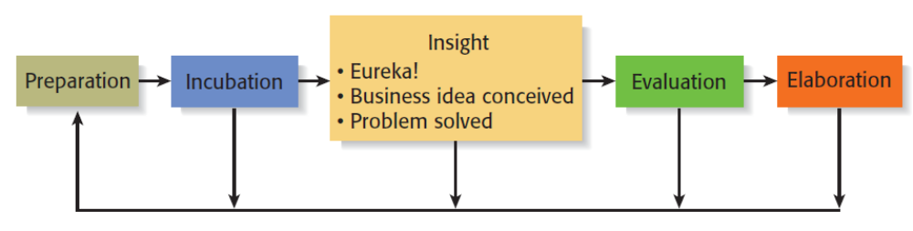
Creativity
2 of 2
Five Steps to Generating Creative Ideas
Copyright ©2016 Pearson Education, Inc.
2-<number>

Slide 27
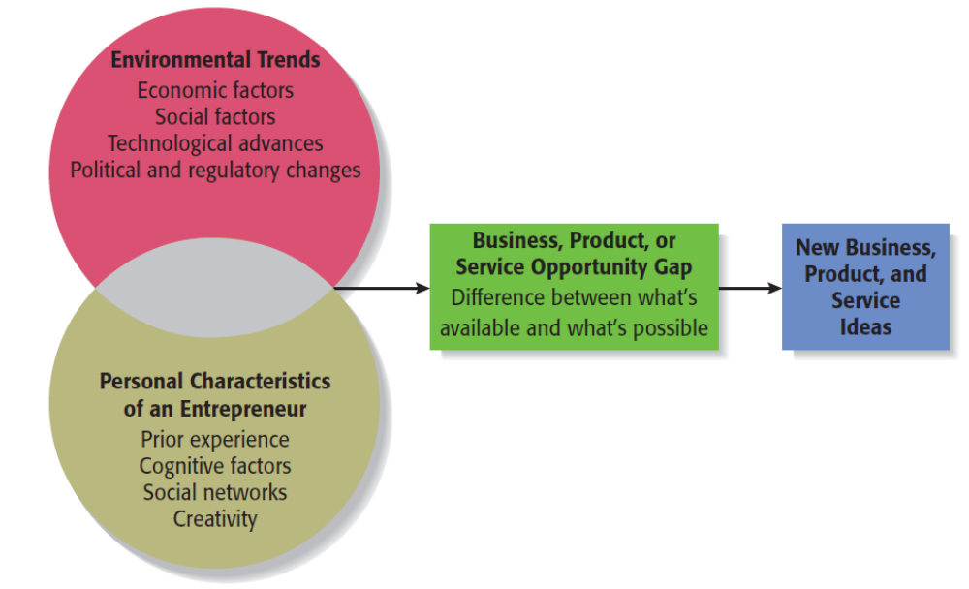
Full View of the Opportunity Recognition Process
Depicts the connection between an awareness of emerging trends and the personal characteristics of the entrepreneur
Copyright ©2016 Pearson Education, Inc.
2-<number>

Slide 28
Techniques for Generating Ideas
Brainstorming
Focus Groups
Library and
Internet Research
Copyright ©2016 Pearson Education, Inc.
2-<number>

Slide 29
Brainstorming
Brainstorming
  Is a technique used to generate a large number of ideas and solutions to problems quickly.
  A brainstorming “session” typically involves a group of people, and should be targeted to a specific topic.
  Rules for a brainstorming session:
    No criticism.
    Freewheeling is encouraged.
    The session should move quickly.
    Leap-frogging is encouraged.
Copyright ©2016 Pearson Education, Inc.
2-<number>

Slide 30
Focus Groups
Focus Group
  A focus group is a gathering of five to ten people, who have been selected based on their common characteristics relative to the issues being discussed.
  These groups are led by a trained moderator, who uses the internal dynamics of the group environment to gain insight into why people feel the way they do about a particular issue.
  Although focus groups are used for a variety of purposes, they can be used to help generate new business ideas.
Copyright ©2016 Pearson Education, Inc.
2-<number>

Slide 31
Library and Internet Research
1 of 3
Library Research
  Libraries are an often underutilized source of information for generating new business ideas.
  The best approach is to talk to a reference librarian, who can point out useful resources, such as industry-specific magazines, trade journals, and industry reports.
  Simply browsing through several issues of a trade journal or an industry report on a topic can spark new ideas.
Copyright ©2016 Pearson Education, Inc.
2-<number>

Slide 32
Library and Internet Research
2 of 3
Examples of Useful Search Engines and Industry Reports
Large public and university libraries typically have access to search engines and industry reports that would cost thousands of dollars to access on your own.
BizMiner
ProQuest
IBISWorld
Mintel
LexisNexis Academic
Copyright ©2016 Pearson Education, Inc.
2-<number>

Slide 33
Library and Internet Research
3 of 3
Internet Research
  If you are starting from scratch, simply typing “new business ideas” into a search engine will produce links to newspapers and magazine articles about the “hottest” new business ideas.
  If you have a specific topic in mind, setting up Google mail alerts will provide you with links to a constant stream of newspaper articles, blog posts, and news releases about the topic.
  Targeted searches are also useful.
Copyright ©2016 Pearson Education, Inc.
2-<number>

Slide 34
Other Techniques
Customer Advisory Boards
  Some companies set up customer advisory boards that meet regularly to discuss needs, wants, and problems that may lead to new ideas.
Day-In-The-Life Research
  A type of anthropological research, where the employees of a company spend a day with a customer.
Copyright ©2016 Pearson Education, Inc.
2-<number>

Slide 35
Encouraging New Ideas
Establishing a Focal Point for Ideas
  Some firms meet the challenge of encouraging, collecting, and evaluating ideas by designating a specific person to screen and track them—for if it’s everybody’s job, it may be no one’s responsibility.
  Another approach is to establish an idea bank (or vault), which is a physical or digital repository for storing ideas.
Encouraging Creativity at the Firm Level
  Creativity is the raw material that goes into innovation and should be encouraged at the organizational and individual supervisory level.
Copyright ©2016 Pearson Education, Inc.
2-<number>

Slide 36

Copyright ©2016 Pearson Education, Inc.
2-<number>

