Slide 1

Chapter 7
Preparing a Proper Ethical and Legal Foundation
Bruce R. Barringer
R. Duane Ireland
Copyright ©2016 Pearson Education, Inc.
7-<number>

Slide 2
Chapter Objectives
Discuss the actions founders can take to establish a strong ethical culture in their entrepreneurial ventures.
Describe actions taken in new firms to effectively deal with legal issues.
Provide an overview of the business licenses and permits that a start-up must obtain before it begins operating.
Identify and describe the different forms of organization available to new firms.
Copyright ©2016 Pearson Education, Inc.
7-<number>

Slide 3
Initial Ethical and Legal Issues Facing a New Firm
Establishing a strong ethical culture
Drafting a founder’s agreement
Choosing an attorney
Avoiding legal disputes
Obtaining business licenses and permits
Choosing a form of business organization
Copyright ©2016 Pearson Education, Inc.
7-<number>

Slide 4
Establishing a Strong Ethical Culture
1 of 2
Lead by Example
  The most important thing that any entrepreneur, or team of entrepreneurs, can do to build a strong ethical culture in their organization is to lead by example.
Establish a Code of Conduct
  A code of conduct (or code of ethics) is a formal statement of an organization’s values on certain ethical and social issues.
Copyright ©2016 Pearson Education, Inc.
7-<number>

Slide 5
Establishing a Strong Ethical Culture
2 of 2
Implement an Ethics Training Program
  Ethics training programs teach business ethics to help employees deal with ethical dilemmas and improve their overall ethical conduct.
  An ethical dilemma is a situation that involves doing something that is beneficial to oneself or the organization, but may be unethical.
Copyright ©2016 Pearson Education, Inc.
7-<number>

Slide 6
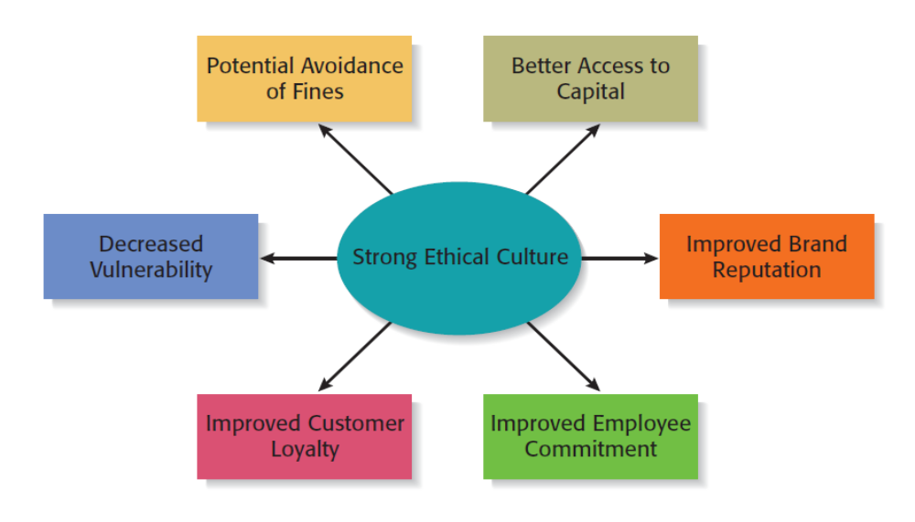
Potential Payoffs for Establishing a Strong Ethical Culture
Copyright ©2016 Pearson Education, Inc.
7-<number>

Slide 7
Choosing an Attorney for a Firm
Select an Attorney Early
  It is important for an entrepreneur to select an attorney as early as possible when developing a business venture.
  It is critically important that the attorney be familiar with start-up issues.
Intellectual Property
  For issues dealing with intellectual property (patents, trademarks, copyrights, and trade secrets), it is essential to use an attorney who specializes in this field.
Copyright ©2016 Pearson Education, Inc.
7-<number>

Slide 8
How to Select an Attorney
Contact the local bar association and ask for a list of attorneys who
specialize in start-ups in your area.
Interview several attorneys.
Select an attorney who is familiar with the start-up process.
Select an attorney who can assist you in raising money for your new
venture.
Make sure your attorney has a track record of completing his or her work
on time.
Talk about fees.
Select an attorney that you think understands your business.
Learn as much about the process of starting a business yourself as
possible.
Copyright ©2016 Pearson Education, Inc.
7-<number>

Slide 9
Drafting a Founders’ Agreement
Founders’ Agreement
  A founders’ agreement (or shareholders’ agreement) is a written document that deals with issues such as the relative split of the equity among the founders of the firm, how individual founders will be compensated for the cash or the “sweat equity” they put into the firm, and how long the founders will have to remain with the firm for their shares to fully vest.
  The items to include in the founders’ agreement are shown on the following slide.
Copyright ©2016 Pearson Education, Inc.
7-<number>

Slide 10
Partial List of Items to Include in a Founders’ Agreement
Nature of the prospective business.
Identity and proposed titles of the founders.
Legal form of business ownership.
Apportionment of stock (or division of ownership).
Consideration paid for stock or ownership share of each of the founders.
Identification of any intellectual property signed over to the business.
Description of how the founders will be compensated and how the profits
in the business will be divided.
Provisions for resolving disputes.
Buyback clause.
Copyright ©2016 Pearson Education, Inc.
7-<number>

Slide 11
Avoiding Legal Disputes
1 of 2
Avoiding Legal Disputes
  Most legal disputes are the result of misunderstandings, sloppiness, or a simple lack of knowledge of the law. Getting bogged down in legal disputes is something an entrepreneur should work hard to avoid.
  There are several steps that an entrepreneur can take to avoid legal disputes:
    Meet all contractual obligations.
    Avoid undercapitalization.
    Get everything in writing.
    Set standards.
Copyright ©2016 Pearson Education, Inc.
7-<number>

Slide 12

Avoiding Legal Disputes
2 of 2
Although it’s tempting to try
to show people you trust
them by not insisting on
written agreements, it’s not a
good practice.
One of the simplest ways to
avoid misunderstandings
and ultimately legal disputes
is to get everything in
writing.
Copyright ©2016 Pearson Education, Inc.
7-<number>

Slide 13
Nondisclosure and Noncompete Agreements
Legal Agreements that Many Firms Ask Their Employees to Sign
  A nondisclosure agreement binds an employee or other party (such as a supplier) to not disclose a company’s trade secrets.
  A noncompete agreement prevents an individual from competing against a former employer for a specific period of time.
Copyright ©2016 Pearson Education, Inc.
7-<number>

Slide 14
Obtaining Business Licenses and Permits
1 of 4
Business Licenses and Permits
  Depending on the nature of the business, the business may need local, state, and/or federal licenses and permits to operate.
Federal Licenses and Permits
  Most businesses do not require a federal license to operate, but some do.
  Examples of businesses that require federal licenses and/or permits to operate include businesses that sell (or provide)
    Alcohol, Tobacco, Firearms, Animal Transport Across State Lines, Commercial Fisheries, and Radio and Television Broadcasting.
Copyright ©2016 Pearson Education, Inc.
7-<number>

Slide 15
Obtaining Business Licenses and Permits
2 of 4
State Licenses and Permits
  In most states, there are three different categories of licenses and permits that you may need to operate a business.
    Business Registration Requirements. Some states require all new businesses to register with the state.
    Sales Tax Permits. Most states and communities require businesses that sell goods, and in some cases services, to collect sales tax and submit the tax to the proper state authorities.
    Professional and Occupational Licenses and Permits. In all states, there are laws that require people in certain professions to pass a state exam and maintain a professional license to conduct business. Examples includes barbers, nurses, and real estate agents.
Copyright ©2016 Pearson Education, Inc.
7-<number>

Slide 16
Obtaining Business Licenses and Permits
3 of 4
Local Licenses and Permits
  On the local level, there are two categories of licenses and permits that may be needed.
  The first is to operate a certain type of business.
    Examples include child care, barber shops and salons, automotive repair, and hotels and motels.
  The second category is permits for engaging in certain types of activities.
    Examples include building permit (required if you are building or remodeling), health permit (normally required if you are involved in preparing food), and signage permit (may be required to erect a sign).
Copyright ©2016 Pearson Education, Inc.
7-<number>

Slide 17
Obtaining Business Licenses and Permits
4 of 4
Additional Requirements
  If you plan to use a fictitious name for your business, in most cases you’ll need to obtain a fictitious business name permit (also called dba or doing business as).
    A fictitious name permit allows a business to operate under a fictitious name, like Gold Coast Sea Food or Red Rock Bakery.
  All businesses, other than sole proprietorships that do not have employees, are required to obtain a Federal Employee Identification Number (also called an EIN).
    The easiest way to obtain an EIN is to go to www.irs.com and click on Apply for an EIN online.
Copyright ©2016 Pearson Education, Inc.
7-<number>

Slide 18
Choosing a Form of Business Ownership
When a business is launched, a form of legal entity must be chosen. The most common legal entities are…
Sole Proprietorship
Partnership
Corporation
Limited Liability
Company
Copyright ©2016 Pearson Education, Inc.
7-<number>

Slide 19
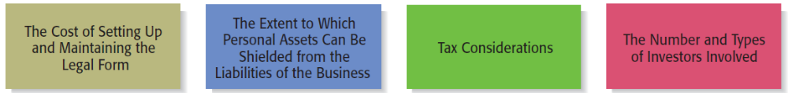
Issues to Consider in Choosing a Legal Form of Business Ownership
Copyright ©2016 Pearson Education, Inc.
7-<number>

Slide 20
Sole Proprietorship
Sole Proprietorship
  The simplest form of business entity is the sole proprietorship.
  A sole proprietorship is a form of business organization involving one person, and the person and the business are essentially the same.
  A sole proprietorship is not a separate legal entity. The sole proprietor is responsible for all the liabilities of the business, and this is a significant drawback.
Copyright ©2016 Pearson Education, Inc.
7-<number>

Slide 21
Advantages and Disadvantages of a
Sole Proprietorship
1 of 2
Advantages of a Sole Proprietorship
Creating one is easy and inexpensive.
The owner maintains complete control of the business and retains all of the
profits.
Business losses can be deducted against the sole proprietor’s other sources of
income.
It is not subject to double taxation (explained later).
The business is easy to dissolve.
Copyright ©2016 Pearson Education, Inc.
7-<number>

Slide 22
Advantages and Disadvantages of a
Sole Proprietorship
2 of 2
Disadvantages of a Sole Proprietorship
Liability on the owner’s part is unlimited.
The business relies on the skills and abilities of a single owner to be successful.
Of course, the owner can hire employees who have additional skills and abilities.
Raising capital can be difficult.
The business ends at the owner’s death or loss of interest in the business.
The liquidity of the owner’s investment is low.
Copyright ©2016 Pearson Education, Inc.
7-<number>

Slide 23
Partnerships
1 of 3
Partnerships
  If two or more people start a business, they must organize as a partnership, corporation, or limited liability company.
  Partnerships are organized as either general or limited liability partnerships.
Copyright ©2016 Pearson Education, Inc.
7-<number>

Slide 24
Partnerships
2 of 3
A form of business organization where two or more people pool their skills, abilities, and resources to run a business. The primary disadvantage is that all partners are liable for all the partnership’s debts and obligations.
General Partnership
Copyright ©2016 Pearson Education, Inc.
7-<number>

Slide 25
Partnerships
3 of 3
A modified form of general
partnership.
The major difference between
the two is that a limited
partnership includes two classes
of owners: general partners and
limited partners.
The general partners are liable
for the debts and obligations of
the partnership, but the limited
partners are only liable up to
the amount of their investment.
Limited Partnership
Copyright ©2016 Pearson Education, Inc.
7-<number>

Slide 26
Advantages and Disadvantages of a
General Partnership
1 of 2
Advantages of a General Partnership
Creating one is relatively easy and inexpensive compared to a corporation or
limited liability company.
The skills and abilities of more than one individual are available to the firm.
Having more than one owner may make it easier to raise funds.
Business losses can be deducted against the partners’ other sources of income.
It is not subject to double taxation (explained later).
Copyright ©2016 Pearson Education, Inc.
7-<number>

Slide 27
Advantages and Disadvantages of a
General Partnership
2 of 2
Disadvantages of a Partnership
Liability on the part of each general partner is unlimited.
The business relies on the skills and abilities of a fixed number of partners. Of
course, the owners can hire employees who have additional skills and abilities.
Raising capital can be difficult.
Because decision making among the partners is shared, disagreements can occur.
The business ends with the death or withdrawal of one partner unless otherwise
stated in the partnership agreement.
The liquidity of each partner’s investment is low.
Copyright ©2016 Pearson Education, Inc.
7-<number>

Slide 28
Corporations
Corporations
  A corporation is a separate legal entity organized under the authority of a state.
  Corporations are organized as either C corporations or subchapter S corporations.
  C corporations are what most people think of when they hear the word “corporation.” However, business startups are often organized as subchapter S corporations.
Copyright ©2016 Pearson Education, Inc.
7-<number>

Slide 29
C Corporation
1 of 2
Is a separate legal entity that, in the
eyes of the law, is separate from its
owners.
In most cases a corporation shields
its owners, who are called shareholders,
from personal liability for the debts of
the corporation.
A corporation is governed by a board
of directors, which is elected by the
shareholders.
A corporation is formed by filing
articles of incorporation.
C Corporation
Copyright ©2016 Pearson Education, Inc.
7-<number>

Slide 30
C Corporation
2 of 2
A corporation is taxed as a separate
legal entity.
A disadvantage of a C corporation is
that it is subject to double taxation.
This means that a corporation is taxed
on its net income, and when the same
income is distributed to shareholders
in the form of dividends, the income is
taxed again on the shareholders’
personal tax returns.
C Corporation
Copyright ©2016 Pearson Education, Inc.
7-<number>

Slide 31
Advantages and Disadvantages of a
C Corporation
1 of 2
Advantages of a C Corporation
Owners are liable only for the debts and obligations of the corporation up to
the amount of their investment.
The mechanics of raising capital is easier.
No restrictions exist on the number of shareholders, which differs from
subchapter S corporations.
Stock is liquid if traded on a major stock exchange.
The ability to share stock with employees through stock options or other
incentive plans can be a powerful form of employee motivation.
Copyright ©2016 Pearson Education, Inc.
7-<number>

Slide 32
Advantages and Disadvantages of a
C Corporation
2 of 2
Disadvantages of a C Corporation
Setting up and maintaining one is more difficult than for a sole proprietorship
or a partnership.
Business losses cannot be deducted against the shareholder’s other sources of
income.
Income is subject to double taxation, meaning that it is taxed at the corporate
and the shareholder levels.
Small shareholders typically have little voice in the management of the firm.
Copyright ©2016 Pearson Education, Inc.
7-<number>

Slide 33
Subchapter S Corporation
1 of 2
Combines the advantages of a
partnership and a C corporation.
Is similar to a partnership in that the
income of the business is not subject
to double taxation.
Is similar to a corporation in that the
owners are not subject to personal
liability for the debts or behavior of
the business.
A Subchapter S Corporation does not
pay taxes. Profits and losses are passed
through to the tax returns of the owners.
Subchapter S Corporation
Copyright ©2016 Pearson Education, Inc.
7-<number>

Slide 34
Subchapter S Corporation
2 of 2
There are strict standards that a business must meet to qualify for status as a subchapter S corporation. The standards are shown below:
The business cannot be a subsidiary of another corporation.
The shareholders must be U.S. citizens. Partnerships and C corporations may
not own shares in a subchapter S corporation. Certain types of trusts and estates
are eligible to own shares in a subchapter S corporation.
It can only have one class of stock issued and outstanding (either preferred
stock or common stock).
It can have no more than 100 members. Husbands and wives count as one
member, even if they own separate shares of stock.
All shareholders must agree to have the corporation formed as a subchapter
S corporation.
Copyright ©2016 Pearson Education, Inc.
7-<number>

Slide 35
Limited Liability Company
Is a form of business ownership that
is rapidly gaining popularity in the
U.S.
Along with the Subchapter S, it is a
popular choice for start-up firms.
The limited liability company combines
the limited liability advantage of the
corporation with the tax advantages of
a partnership.
A limited liability company does not
pay taxes. Profits and losses are passed
through to the tax returns of the owners.
Limited Liability Company
Copyright ©2016 Pearson Education, Inc.
7-<number>

Slide 36
Advantages and Disadvantages of a Limited Liability Company
1 of 2
Advantages of a Limited Liability Company
Members are liable for the debts and obligations of the business only up to the
amount of their investment.
The number of shareholders is unlimited.
An LLC can elect to be taxed as a sole proprietor, partnership, S corporation,
or corporation, providing much flexibility.
Because profits are taxed only at the shareholder level, there is no double
taxation.
Copyright ©2016 Pearson Education, Inc.
7-<number>

Slide 37
Advantages and Disadvantages of a Limited Liability Company
2 of 2
Disadvantages of a Limited Liability Company
Setting up and maintaining one is more difficult and expensive.
Tax accounting can be complicated.
Some of the regulations governing LLCs vary by state.
Because LLCs are a relatively new type of business entity, there is not as
much legal precedent available for owners to anticipate how legal disputes
might affect their business.
Some states levy a franchise tax on LLCs—which is essentially a fee the LLC
pays the state for the benefit of limited liability.
Copyright ©2016 Pearson Education, Inc.
7-<number>

Slide 38

Copyright ©2016 Pearson Education, Inc.
7-<number>

