Slide 1

Chapter 8
Assessing a New Venture’s Financial Strength and Viability
Bruce R. Barringer
R. Duane Ireland
Copyright ©2016 Pearson Education, Inc.
8-<number>

Slide 2
Chapter Objectives
1 of 2
Learn about the importance of understanding the financial management of an entrepreneurial firm.
Identify the four main financial objectives of entrepreneurial firms.
Describe the process of financial management as used in entrepreneurial firms.
Explain the difference between historical and pro forma financial statements.
Describe the different historical financial statements and their purpose.
Copyright ©2016 Pearson Education, Inc.
8-<number>

Slide 3
Chapter Objectives
2 of 2
Discuss the role of forecasts in projecting a firm’s future income and expenses.
Explain the purpose of pro forma financial statements.
Copyright ©2016 Pearson Education, Inc.
8-<number>

Slide 4
Financial Management
1 of 2
Financial Management
  Financial management deals with two things: raising money and managing a company’s finances in a way that achieves the highest rate of return
  Chapter 10 focuses on raising money. This chapter focuses primarily on:
    How a new venture tracks its financial progress through preparing, analyzing, and maintaining past financial statements.
    How a new venture forecasts future income and expenses by preparing pro forma (or projected) financial statements.
Copyright ©2016 Pearson Education, Inc.
8-<number>

Slide 5
Financial Management
2 of 2
The financial management of a firm deals with questions such as the following on an ongoing basis:
How are we doing? Are we making or losing money?
How much cash do we have on hand?
Do we have enough cash to meet our short-term obligations?
How efficiently are we utilizing our assets?
How do our growth and net profits compare to those of our industry peers?
Where will the funds we need for capital improvements come from?
Are there ways we can partner with other firms to share risk and reduce the
amount of cash we need?
Overall, are we in good shape financially?
Copyright ©2016 Pearson Education, Inc.
8-<number>

Slide 6
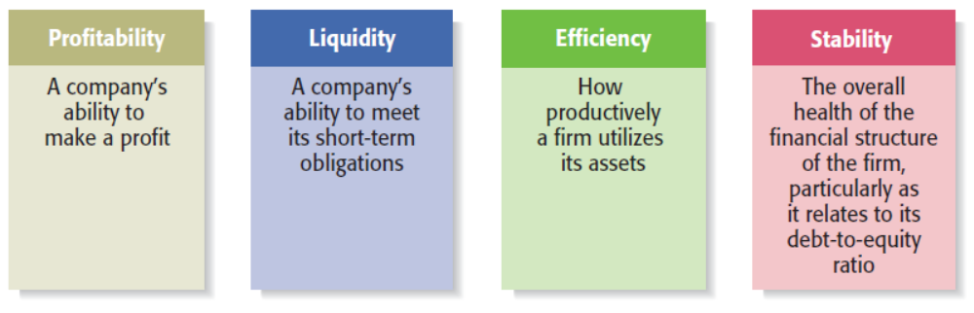
Financial Objectives of a Firm
1 of 3
Copyright ©2016 Pearson Education, Inc.
8-<number>

Slide 7
Financial Objectives of a Firm
2 of 3
Profitability
  Is the ability to earn a profit.
    Many start-ups are not profitable during their first one to three years while they are training employees and building their brands.
    However, a firm must become profitable to remain viable and provide a return to its owners.
Liquidity
  Is a company’s ability to meet its short-term financial obligations.
    Even if a firm is profitable, it is often a challenge to keep enough money in the bank to meet its routine obligations in a timely manner.
Copyright ©2016 Pearson Education, Inc.
8-<number>

Slide 8
Financial Objectives of a Firm
3 of 3
Efficiency
  Is how productively a firm utilizes its assets relative to its revenue and its profits.
    Southwest Airlines, for example, uses its assets very productively. Its turnaround time, or the time its airplanes sit on the ground while they are being unloaded and reloaded, is the lowest in the airline industry.
Stability
  Is the strength and vigor of the firm’s overall financial posture.
    For a firm to be stable, it must not only earn a profit and remain liquid but also keep its debt in check.
Copyright ©2016 Pearson Education, Inc.
8-<number>

Slide 9
The Process of Financial Management
1 of 4
Importance of Financial Statements
  To assess whether its financial objectives are being met, firms rely heavily on analysis of financial statements.
    A financial statement is a written report that quantitatively describes a firm’s financial health.
    The income statement, the balance sheet, and the statement of cash flows are the financial statements entrepreneurs use most commonly.
Forecasts
  Are an estimate of a firm’s future income and expenses, based on past performance, its current circumstances, and its future plans.
Copyright ©2016 Pearson Education, Inc.
8-<number>

Slide 10
The Process of Financial Management
2 of 4
Forecasts (continued)
  New ventures typically base their forecasts on an estimate of sales and then on industry averages or the experiences of similar start-ups regarding the cost of goods sold and other expenses.
Budgets
  Are itemized forecasts of a company’s income, expenses, and capital needs and are also an important tool for financial planning and control.
Copyright ©2016 Pearson Education, Inc.
8-<number>

Slide 11
The Process of Financial Management
3 of 4
Financial Ratios
  Depict relationships between items on a firm’s financial statements.
  An analysis of its financial ratios helps a firm determine whether it is meeting its financial objectives and how it stacks up against industry peers.
Importance of Financial Management
  Many experienced entrepreneurs stress the importance of keeping on top of the financial management of the firm.
Copyright ©2016 Pearson Education, Inc.
8-<number>

Slide 12
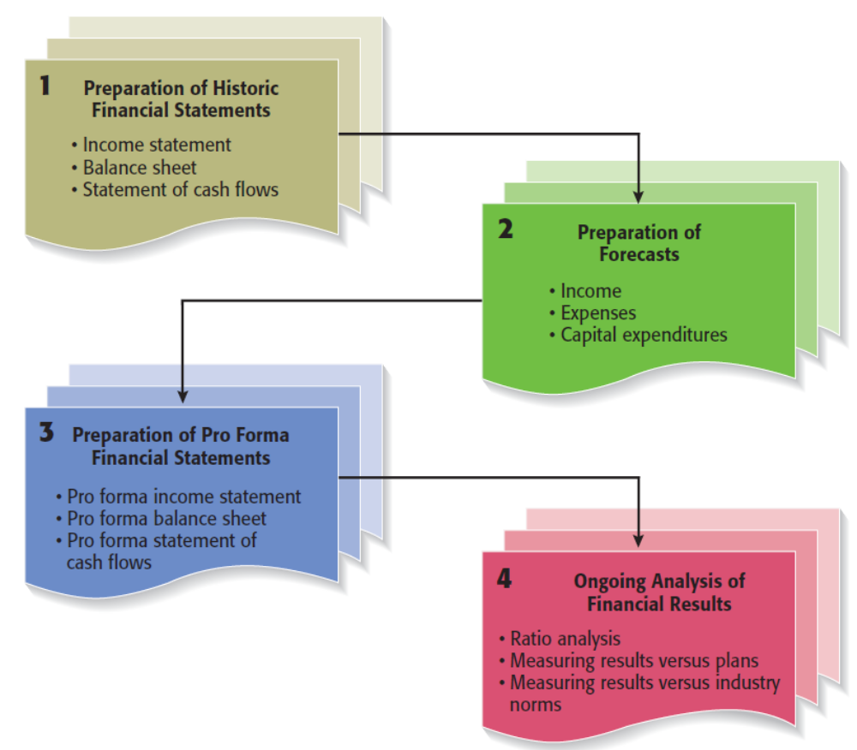
The Process of Financial Management
4 of 4
Copyright ©2016 Pearson Education, Inc.
8-<number>

Slide 13
Financial Statements
Historical Financial Statements
  Reflect past performance and are usually prepared on a quarterly and annual basis.
    Publicly traded firms are required by the SEC to prepare financial statements and make them available to the public.
Pro Forma Financial Statements
  Are projections for future periods based on forecasts and are typically completed for two to three years in the future.
    Pro forma financial statements are strictly planning tools and are not required by the SEC.
Copyright ©2016 Pearson Education, Inc.
8-<number>

Slide 14

Importance of Keeping Good Records
The first step toward prudent financial management is keeping good records.
Copyright ©2016 Pearson Education, Inc.
8-<number>

Slide 15
New Venture Fitness Drinks
New Venture Fitness Drinks
  To illustrate how financial statements are prepared, we used New Venture Fitness Drinks, the fictitious sports drink company introduced in Chapter 3.
    New Venture Fitness Drinks has been in business for five years.
    Targeting sports enthusiasts, the company sells a line of nutritional fitness drinks.
    The company’s strategy is to place small restaurants, similar to smoothie restaurants, near large outdoor sports complexes.
    The company is profitable and is growing at a rate of 25% per year.
Copyright ©2016 Pearson Education, Inc.
8-<number>

Slide 16
Historical Financial Statements
Three types of historical financial statements
Financial Statement
Purpose
Reflects the results of the operations of a firm over a specified period of time. It records all the revenues and expenses for the given period and shows whether the firm is making a profit or is experiencing a loss.
Income Statement
Balance Sheet
Is a snapshot of a company’s assets, liabilities, and owner’s equity at a specific point in time.
Summarizes the changes in a firm’s cash position for a specified period of time and details why the changes occurred.
Statement of cash flows
Copyright ©2016 Pearson Education, Inc.
8-<number>

Slide 17
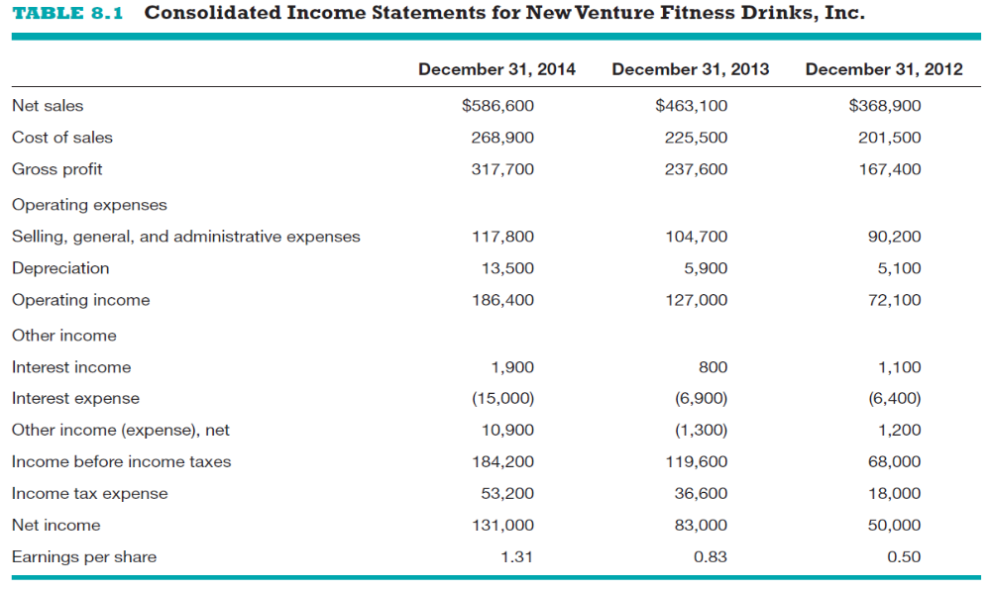
Historical Income Statements
Copyright ©2016 Pearson Education, Inc.
8-<number>

Slide 18
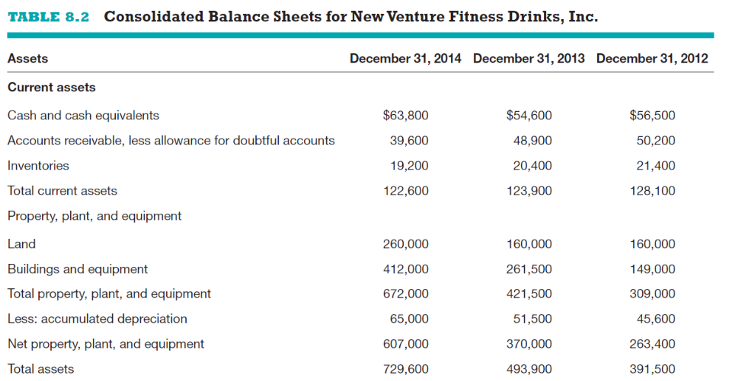
Historical Balance Sheets
1 of 2
Assets
Copyright ©2016 Pearson Education, Inc.
8-<number>

Slide 19
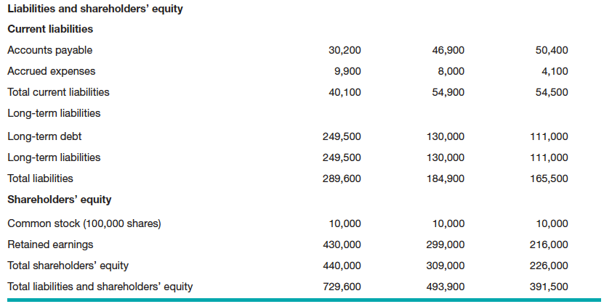
Historical Balance Sheets
2 of 2
Liabilities and Shareholders’ Equity
Copyright ©2016 Pearson Education, Inc.
8-<number>

Slide 20
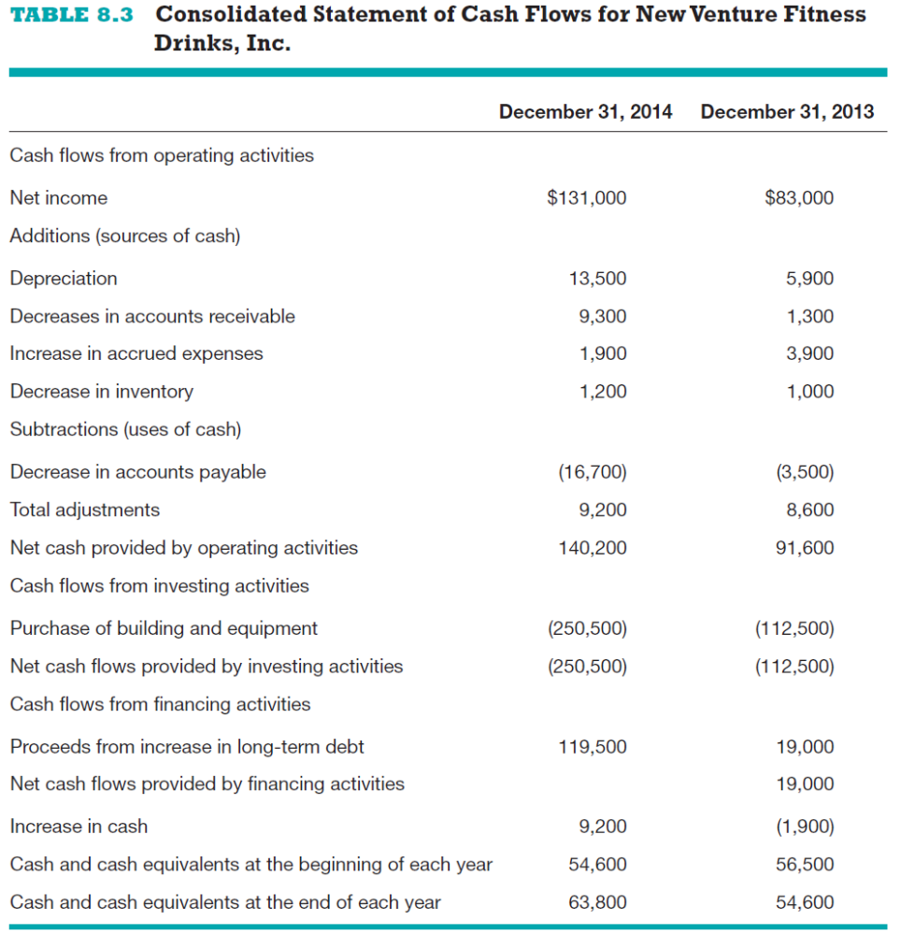
Historical Statement of Cash Flows
Copyright ©2016 Pearson Education, Inc.
8-<number>

Slide 21
Ratio Analysis
Ratio Analysis
  The most practical way to interpret or make sense of a firm’s historical financial statements is through ratio analysis, as shown in the next slide.
Comparing a Firm’s Financial Results to Industry Norms
  Comparing a firm’s financial results to industry norms helps a firm determine how it stacks up against its competitors and if there are any financial “red flags” requiring attention.
Copyright ©2016 Pearson Education, Inc.
8-<number>

Slide 22
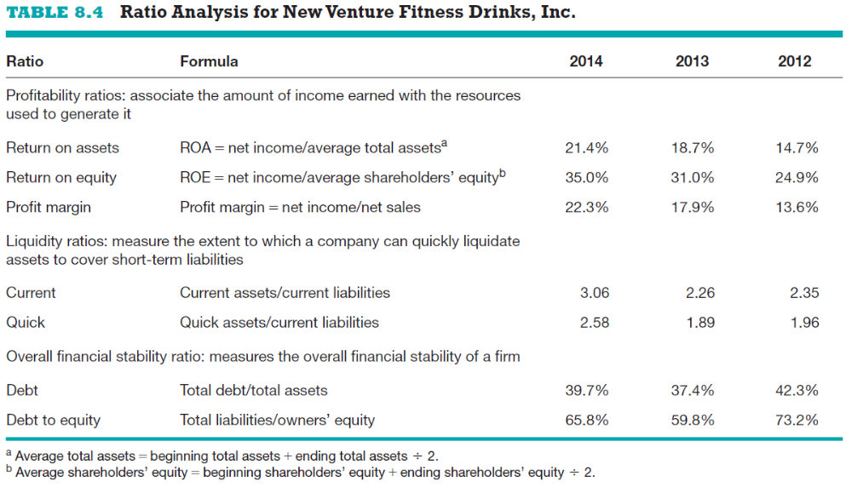
Historical Ratio Analysis
Copyright ©2016 Pearson Education, Inc.
8-<number>

Slide 23
Forecasts
1 of 4
Forecasts
  The analysis of a firm’s historical financial statements are followed by the preparation of forecasts.
  Forecasts are predictions of a firm’s future sales, expenses, income, and capital expenditures.
    A firm’s forecasts provide the basis for its pro forma financial statements.
    A well-developed set of pro forma financial statements helps a firm create accurate budgets, build financial plans, and manage its finances in a proactive rather than a reactive manner.
Copyright ©2016 Pearson Education, Inc.
8-<number>

Slide 24
Forecasts
2 of 4
Sales Forecast
  A sales forecast is a projection of a firm’s sales for a specified period (such as a year).
  It is the first forecast developed and is the basis for most of the other forecasts.
    A sales forecast for a new firm is based on a good-faith estimate of sales and on industry averages or the experiences of similar start-ups.
    A sales forecast for an existing firm is based on (1) its record of past sales, (2) its current production capacity and product demand, and (3) any factors that will affect its future product capacity and product demand.
Copyright ©2016 Pearson Education, Inc.
8-<number>

Slide 25
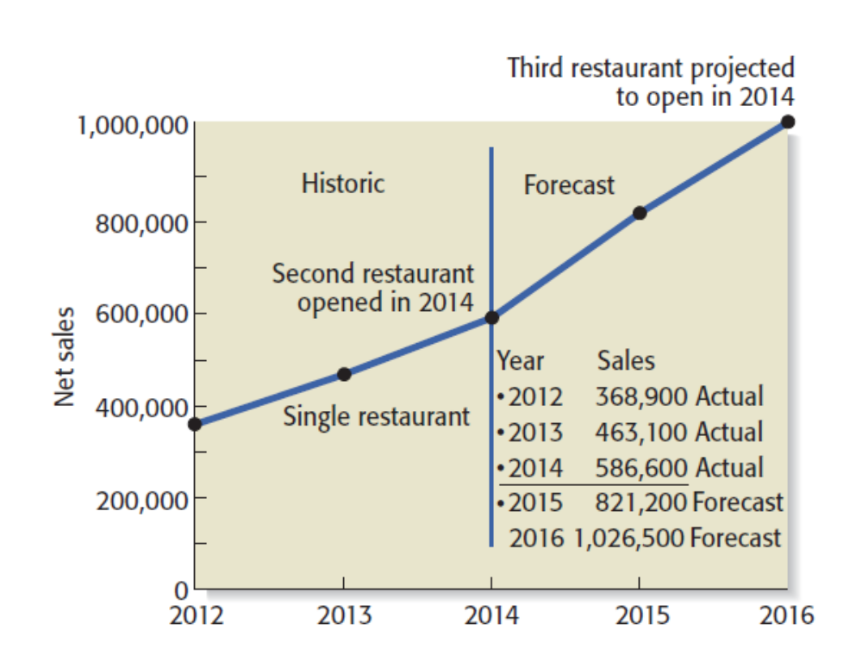
Forecasts
3 of 4
Historical and Forecasted Annual Sales for New Venture Fitness Drinks
Copyright ©2016 Pearson Education, Inc.
8-<number>

Slide 26
Forecasts
4 of 4
Forecast of Costs of Sales and Other Items
  Once a firm has completed its sales forecast, it must forecast its cost of sales (or cost of goods sold) and the other items on its income statement.
  The most common way to do this is to use the percentage-of-sales method, which is a method for expressing each expense item as a percentage of sales.
    If a firm determines that it can use the percent-of-sales method and it follows the procedures described in the textbook, then the net result is that each expense item on its income statement will grow at the same rate as sales (with the exception of items that can be individually forecast, such as depreciation).
Copyright ©2016 Pearson Education, Inc.
8-<number>

Slide 27
Pro Forma Financial Statements
Pro Forma Financial Statements
  A firm’s pro forma financial statements are similar to its historical financial statements except that they look forward rather than track the past.
  The preparation of pro forma financial statements helps a firm rethink its strategies and make adjustments if necessary.
  The preparation of pro forma financials is also necessary if a firm is seeking funding or financing.
Copyright ©2016 Pearson Education, Inc.
8-<number>

Slide 28
Types of Pro Forma Financial Statements
Financial Statement
Purpose
Pro Forma Income Statement
Shows the projected financial results of the operations of a firm over a specific period.
Shows a projected snapshot of a company’s assets, liabilities, and owner’s equity at a specific point in time.
Pro Forma Balance Sheet
Pro Forma Statement of Cash flows
Shows the projected flow of cash into and out of a company for a specific period.
Copyright ©2016 Pearson Education, Inc.
8-<number>

Slide 29
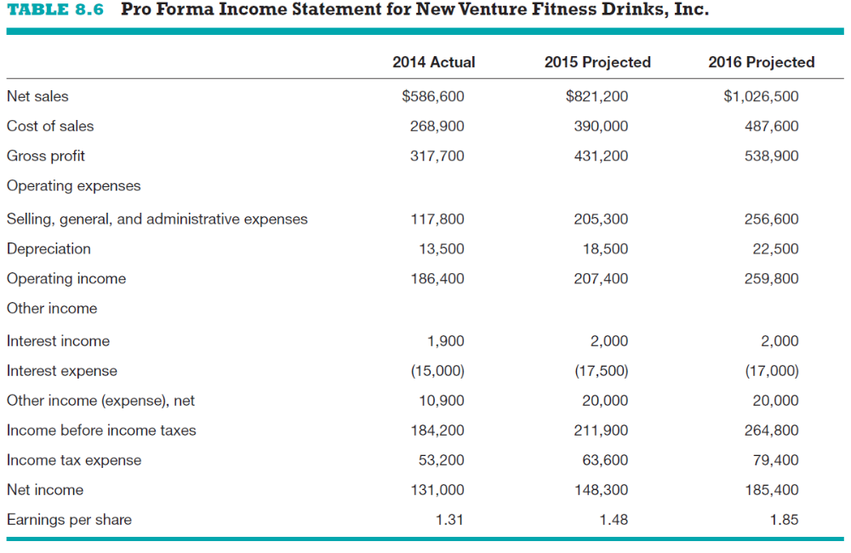
Pro Forma Income Statements
Copyright ©2016 Pearson Education, Inc.
8-<number>

Slide 30
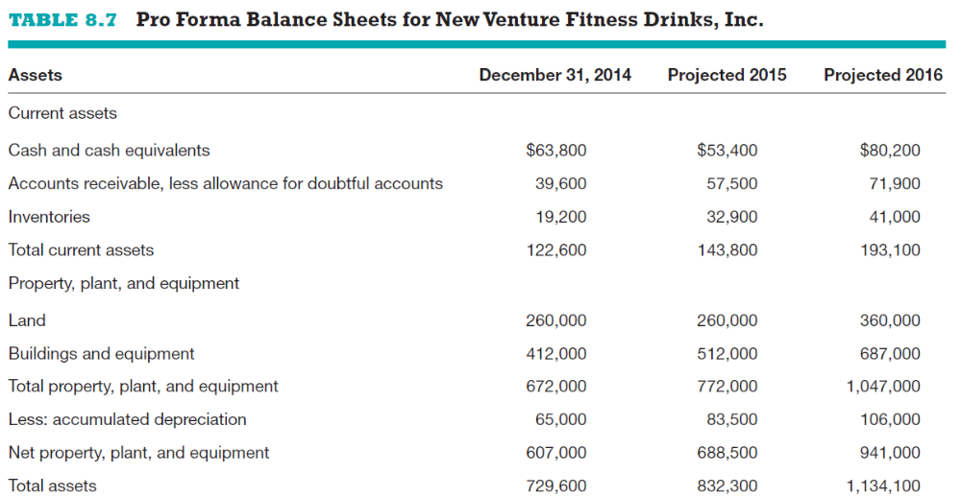
Pro Forma Balance Sheets
1 of 2
Assets
Copyright ©2016 Pearson Education, Inc.
8-<number>

Slide 31
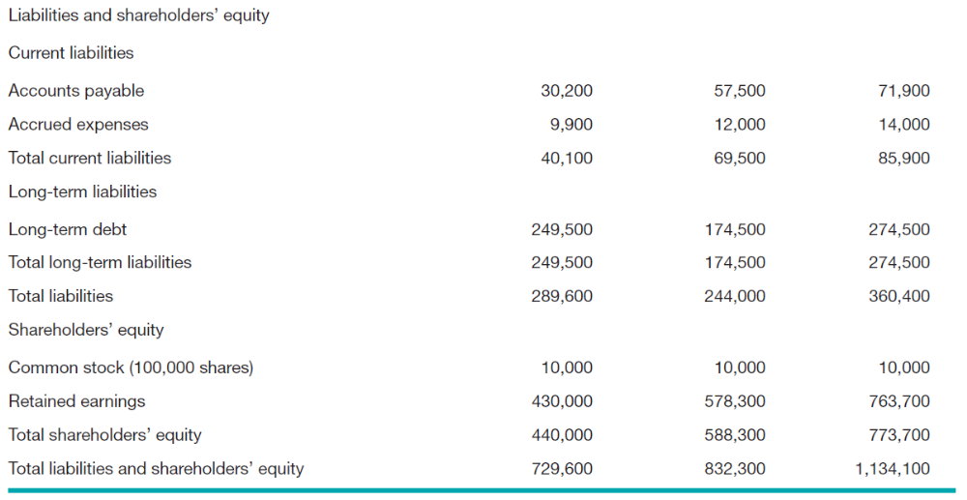
Pro Forma Balance Sheets
2 of 2
Liabilities and Shareholders’ Equity
Copyright ©2016 Pearson Education, Inc.
8-<number>

Slide 32
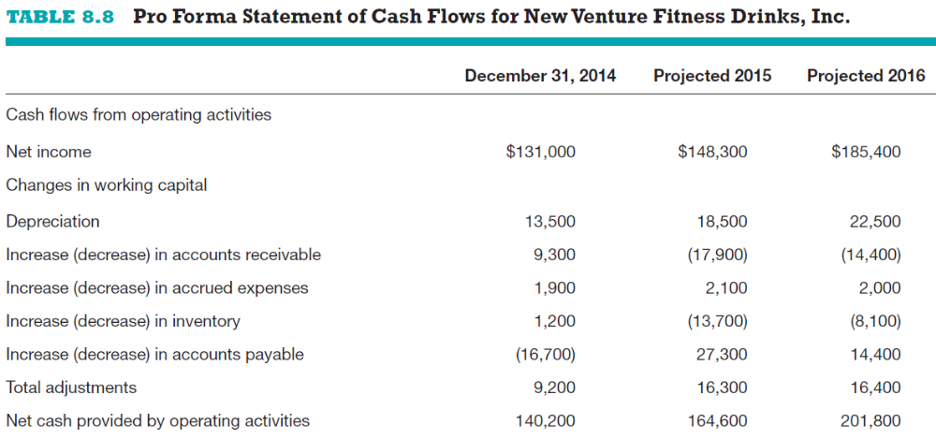
Pro Forma Statement of Cash Flows
1 of 2
Operating Activities
Copyright ©2016 Pearson Education, Inc.
8-<number>

Slide 33
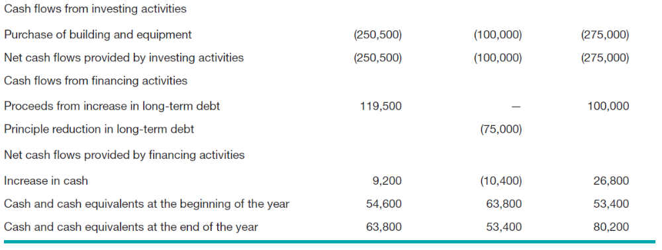
Pro Forma Statement of Cash Flows
2 of 2
Investing Activities and Financing Activities
Copyright ©2016 Pearson Education, Inc.
8-<number>

Slide 34
Ratio Analysis
Ratio Analysis
  The same financial ratios used to evaluate a firm’s historical financial statements should be used to evaluate the pro forma financial statements.
  This work is completed so the firm can get a sense of how its projected financial performance compares to its past performance and how its projected activities will affect its cash position and its overall financial soundness.
Copyright ©2016 Pearson Education, Inc.
8-<number>

Slide 35
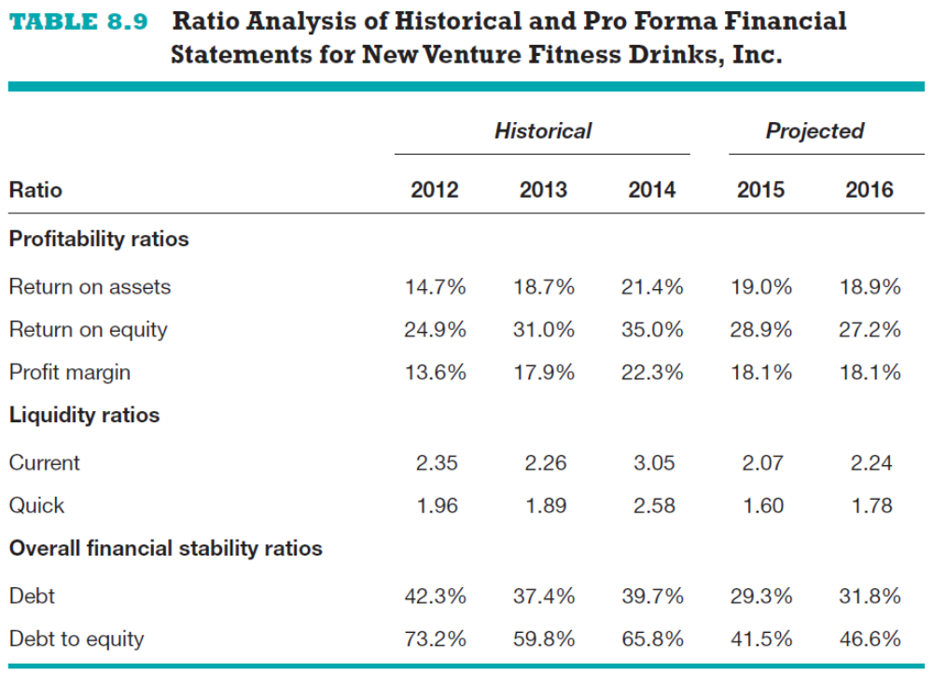
Ratio Analysis Based on Historical and Pro-Forma Financial Statements
Copyright ©2016 Pearson Education, Inc.
8-<number>

Slide 36

Copyright ©2016 Pearson Education, Inc.
8-<number>

