Slide 1
Chapter 1: Introduction

Slide 2

Overview
Importance of Leadership
Leadership Defined
- Ways of conceptualizing leadership
- Definition and components
Leadership Described
- Trait vs. process
- Assigned vs. emergent
- Leadership and power
- Leadership and coercion
- Leadership and management
Peter G. Northouse, Leadership: Theory and Practice, Seventh Edition. © 2016 SAGE Publications, Inc.

Slide 3
The Evolution of Leadership Definitions
1900-1929 – Control and centralization of power
1930s – Trait approach
1940s – Group approach
1950s – Group theory, shared goals, and effectiveness
1960s – Leadership as behavior
1970s – Organizational behavior
Peter G. Northouse, Leadership: Theory and Practice, Seventh Edition. © 2016 SAGE Publications, Inc.
Notes:
En dash in date, line 2; ital title at bottom throughout?

Slide 4
The Evolution of Leadership Definitions
1980s – Explosion of research
- Leader’s will
- Influence
- Traits
- Transformation
Peter G. Northouse, Leadership: Theory and Practice, Seventh Edition. © 2016 SAGE Publications, Inc.

Slide 5
The Evolution of Leadership
21st century – The process of leadership
- Authentic leadership
- Spiritual leadership
- Servant leadership
- Adaptive leadership
Peter G. Northouse, Leadership: Theory and Practice, Seventh Edition. © 2016 SAGE Publications, Inc.
Notes:
Add title

Slide 6
Conceptualizing Leadership
Some definitions view leadership as:
The focus of group processes
A personality perspective
An act or behavior
The power relationship between leaders & followers
A transformational process
A skills perspective
Peter G. Northouse, Leadership: Theory and Practice, Seventh Edition. © 2016 SAGE Publications, Inc.
Notes:
Leader at center of group change & activity – represents the “will” of the group
combo of special traits/characteristics - allows them to affect others to accomplish tasks.
3. Things leaders do that bring about change
4. Leaders have power and use it to cause change
5. In helping group members achieve their goals/meet needs

Slide 7
Leadership Defined
Leadership
a process whereby an individual influences a group of individuals to achieve a common goal.
Peter G. Northouse, Leadership: Theory and Practice, Seventh Edition. © 2016 SAGE Publications, Inc.

Slide 8
Components Central to the Phenomenon of Leadership
Leadership
Leaders
Is a process
Involves influence
Occurs within a group context
Attends to common goals
And followers are involved together
And followers need each other
Often initiate and maintain the relationship
Are not above or better than followers
Peter G. Northouse, Leadership: Theory and Practice, Seventh Edition. © 2016 SAGE Publications, Inc.

Slide 9
Leadership Described
Trait vs. Process Leadership
Assigned vs. Emergent Leadership
Leadership and Power
Leadership and Coercion
Leadership and Management
Peter G. Northouse, Leadership: Theory and Practice, Seventh Edition. © 2016 SAGE Publications, Inc.

Slide 10
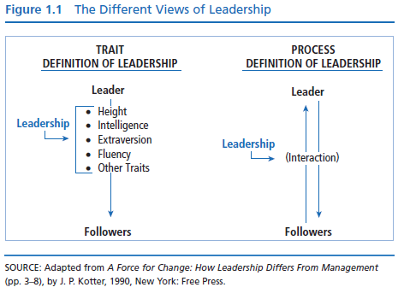
Trait vs. Process Leadership
Certain individuals have special innate characteristics or qualities that differentiate them from nonleaders.
Resides in select people
Restricted to those with inborn talent
Peter G. Northouse, Leadership: Theory and Practice, Seventh Edition. © 2016 SAGE Publications, Inc.

Slide 11
Trait vs. Process Leadership
Leadership is a property or set of properties possessed in varying degrees by different people (Jago, 1982).
Observed in leadership behaviors
Can be learned
Peter G. Northouse, Leadership: Theory and Practice, Seventh Edition. © 2016 SAGE Publications, Inc.

Slide 12
Assigned vs. Emergent Leadership
Assigned
Emergent
Leadership based on occupying a position within an organization
Team leaders
Plant managers
Department heads
Directors
An individual perceived by others as the most influential member of a group or organization regardless of the individual’s title
Emerges over time through communication behaviors
Verbal involvement
Being informed
Seeking others’ opinions
Being firm but not rigid
Affected by personality and gender

Slide 13
Leadership & Power
Power
Bases of Social Power
The capacity or potential to influence.
Ability to affect others’ beliefs, attitudes, & actions
Referent
Expert
Legitimate
Reward
Coercive
Information
Power is a relational concern for both leaders and followers.
French & Raven (1959), Raven (1965)
Peter G. Northouse, Leadership: Theory and Practice, Seventh Edition. © 2016 SAGE Publications, Inc.

Slide 14
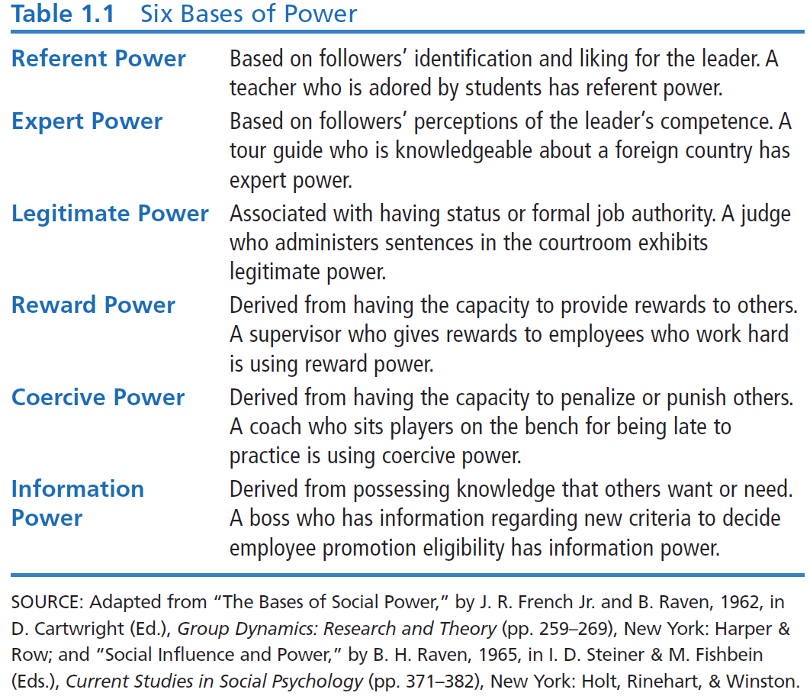

Slide 15
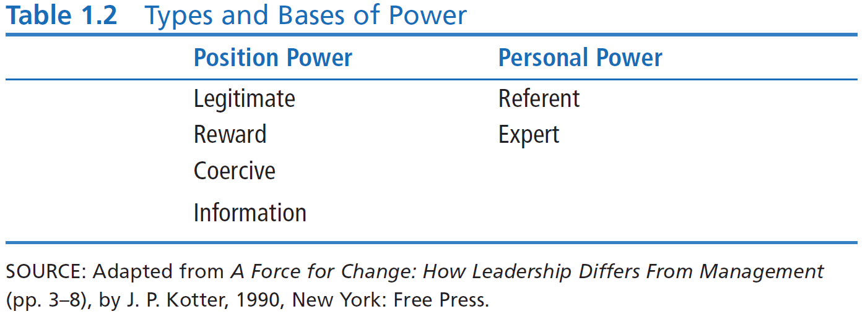
Leadership & Power
Position Power derived from office or rank in an organization
Personal Power is influence derived from being seen as likable & knowledgeable
Peter G. Northouse, Leadership: Theory and Practice, Seventh Edition. © 2016 SAGE Publications, Inc.

Slide 16
Shift in Leadership Power, Kellerman (2012)
Power no longer the domain of leaders
Followers demand more from leaders
Access to technology has empowered followers
Leaders more transparent
Decline in respect for leaders
Leadership as social contract between leaders and followers
Peter G. Northouse, Leadership: Theory and Practice, Seventh Edition. © 2016 SAGE Publications, Inc.

Slide 17
Leadership & Coercion
Coercion Involves
Examples of Coercive Leaders
Use of force to effect change
Influencing others to do something by manipulating rewards and penalties in the work environment
Use of threats, punishments, & negative rewards
Adolf Hitler
Jim Jones
Taliban leaders
Power & restraint used to force followers to
engage in extreme
behavior
Peter G. Northouse, Leadership: Theory and Practice, Seventh Edition. © 2016 SAGE Publications, Inc.

Slide 18
Leadership & Management, Kotter (1990)
Management
Activities
Leadership
Activities
“Produces order
and consistency”
“Produces change
and movement”
Planning & Budgeting
Organizing & Staffing
Controlling & Problem Solving
Establishing direction
Aligning people
Motivating/Inspiring
Major activities of management & leadership
are played out differently; BUT, both are essential
for an organization to prosper.
Peter G. Northouse, Leadership: Theory and Practice, Seventh Edition. © 2016 SAGE Publications, Inc.

Slide 19
Leadership & Management Zaleznik (1977)
Managers
Unidirectional Authority
Leaders
Multidirectional Influence
Are reactive
Prefer to work with people solving
Have low emotional involvement
Are emotionally active & involved
Shape ideas over responding to them
Act to expand available options
Change the way people think about what is possible
Peter G. Northouse, Leadership: Theory and Practice, Seventh Edition. © 2016 SAGE Publications, Inc.
Notes:
Zaleznik wf

