Slide 1
Chapter 2: Trait Approach

Slide 2

Overview
Great Person Theories
Historical Shifts in Trait Perspective
What Traits Differentiate Leaders From Nonleaders?
How Does the Trait Approach Work?
Peter G. Northouse, Leadership: Theory and Practice, Seventh Edition. © 2016 SAGE Publications, Inc.

Slide 3
Great Person Theories
Trait Approach: one of the first systematic
attempts to study leadership
“Great Man” Theories (early 1900s)
Focused on identifying innate qualities and characteristics possessed by great social, political, & military leaders
Peter G. Northouse, Leadership: Theory and Practice, Seventh Edition. © 2016 SAGE Publications, Inc.

Slide 4
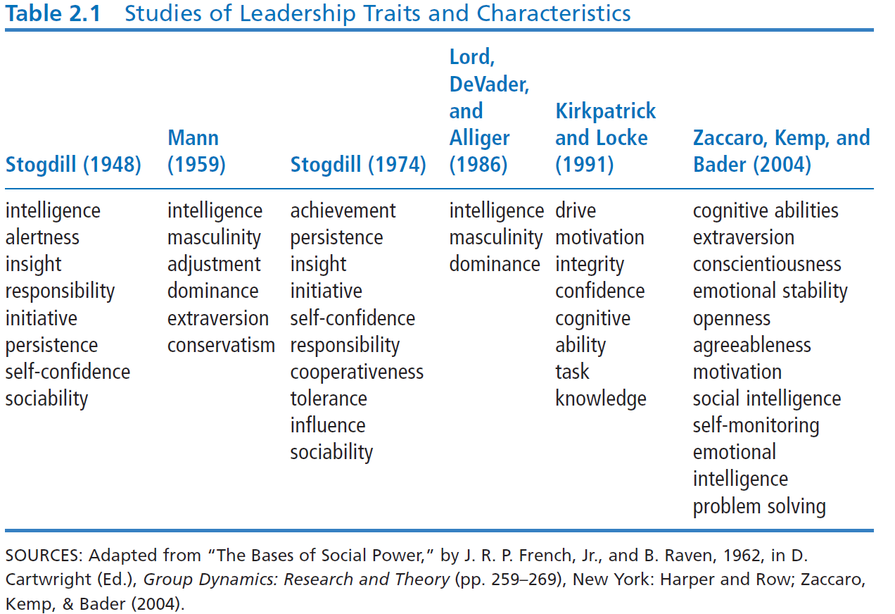
Historical Shifts in Trait Perspective
Peter G. Northouse, Leadership: Theory and Practice, Seventh Edition. © 2016 SAGE Publications, Inc.

Slide 5
Major Leadership Traits
Traits to possess or cultivate if one seeks to be
perceived by others as a leader:
Intelligence – Verbal, perceptual, and reasoning capabilities. Ex. Steve Jobs
Self-Confidence – Certainty about one’s competencies and skills. Ex. Steve Jobs
Determination – Desire to get the job done (i.e., initiative, persistence, drive). Ex. Dr. Paul Farmer
Peter G. Northouse, Leadership: Theory and Practice, Seventh Edition. © 2016 SAGE Publications, Inc.

Slide 6
Major Leadership Traits
Traits to possess or cultivate if one seeks to be
perceived by others as a leader:
Integrity – The quality of honesty and trustworthiness. Ex. Character Counts! program
Sociability – Leader’s inclination to seek out pleasant social relationships. Ex. Michael Hughes, university president
Peter G. Northouse, Leadership: Theory and Practice, Seventh Edition. © 2016 SAGE Publications, Inc.

Slide 7
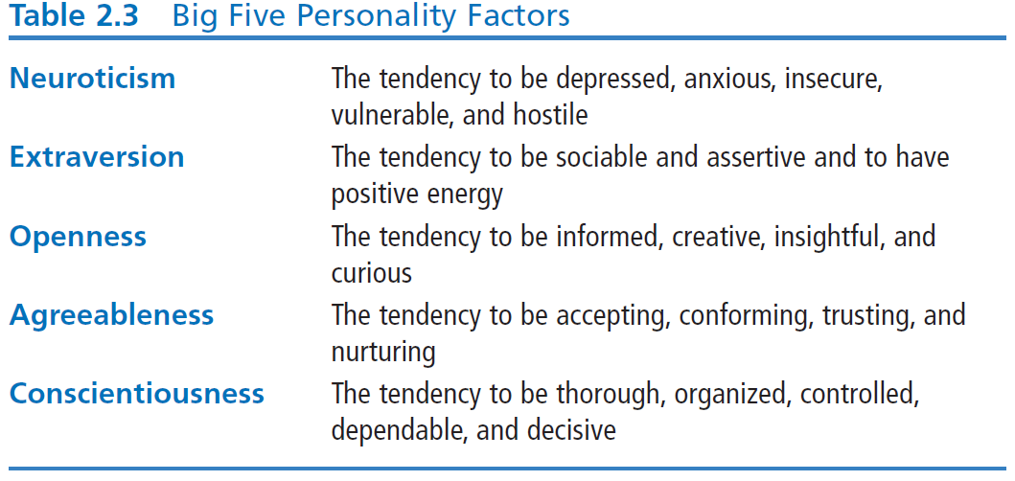
5-Factor Personality Model & Leadership
Peter G. Northouse, Leadership: Theory and Practice, Seventh Edition. © 2016 SAGE Publications, Inc.

Slide 8
5-Factor Personality Model & Leadership
Big Five & Leadership Study Using Meta-Analysis
(Judge et al., 2002)
Results – a strong relationship between personality traits and leadership
Extraversion – factor most strongly associated with leadership
Most important trait of effective leaders
Conscientiousness – second most related factor
Openness – next most related
Low Neuroticism
Agreeableness – only weakly related to leadership
Peter G. Northouse, Leadership: Theory and Practice, Seventh Edition. © 2016 SAGE Publications, Inc.

Slide 9
Emotional Intelligence & Leadership
Definition
Underlying Premise
Ability to perceive and:
apply emotions to life’s tasks
reason/understand emotions
express emotions
use emotions to facilitate thinking
manage emotions within oneself and relationships
people who are more sensitive to their emotions & their impact on others will be more effective leaders
Peter G. Northouse, Leadership: Theory and Practice, Seventh Edition. © 2016 SAGE Publications, Inc.

Slide 10
Different Ways to Measure EQ
MSCEIT: EQ as a set of mental abilities
to perceive, facilitate, understand, and manage emotion
Goleman (1995, 1998): EQ as a set of personal and social competencies
self-awareness, confidence, self-regulation, conscientiousness, and motivation
Shankman & Allen (2002): EQ as awareness of three aspects of leadership
context, self, and others
Peter G. Northouse, Leadership: Theory and Practice, Seventh Edition. © 2016 SAGE Publications, Inc.

Slide 11
How Does the Trait Approach Work?
Focus of Trait Approach
Strengths
Criticisms
Application
Peter G. Northouse, Leadership: Theory and Practice, Seventh Edition. © 2016 SAGE Publications, Inc.

Slide 12
Focus of Trait Approach
Leader
Personality Assessments
Focuses exclusively on leader
What traits leaders exhibit
Who has these traits
Organizations use personality assessments to find “right” people
Assumption - will increase organizational effectiveness
Specify characteristics/traits for specific positions
Personality assessment measures for “fit”
Instruments: LTQ, Myers-Briggs
Peter G. Northouse, Leadership: Theory and Practice, Seventh Edition. © 2016 SAGE Publications, Inc.

Slide 13
Strengths
Intuitively appealing
Perception that leaders are different in that they possess special traits
People “need” to view leaders as gifted
Credibility due to a century of research support
Highlights leadership component in the leadership process
Deeper level understanding of how leader/personality is related to leadership process
Provides benchmarks for what to look for in a leader
Peter G. Northouse, Leadership: Theory and Practice, Seventh Edition. © 2016 SAGE Publications, Inc.

Slide 14
Criticisms
Fails to delimit a definitive list of leadership traits
Endless lists have emerged
Doesn’t take into account situational effects
Leaders in one situation may not be leaders in another situation
List of most important leadership traits is highly subjective
Much subjective experience & observations serve as basis for identified leadership traits
Research fails to look at traits in relationship to leadership outcomes
Not useful for training & development
Peter G. Northouse, Leadership: Theory and Practice, Seventh Edition. © 2016 SAGE Publications, Inc.

Slide 15
Application
Provides direction as to which traits are good to have if one aspires to a
leadership position
Through various tests and questionnaires, individuals can determine whether they have the select leadership traits and can pinpoint their strengths and weaknesses
Leadership Traits
Intelligence
Self-Confidence
Determination
Integrity
Sociability
Can be used by managers to assess where they stand within their organization and what is needed to strengthen their position
Peter G. Northouse, Leadership: Theory and Practice, Seventh Edition. © 2016 SAGE Publications, Inc.

