Slide 1
Chapter 3: Skills Approach

Slide 2

Overview
Skills Approach Perspective
Three-Skill Approach (Katz, 1955)
Skills-Based Model (Mumford et al., 2000)
How Does the Skills Approach Work?
Peter G. Northouse, Leadership: Theory and Practice, Seventh Edition. © 2016 SAGE Publications, Inc.

Slide 3
Skills Approach Description
Perspective
Definition
Leader-centered perspective
Emphasis on skills and abilities that can be learned and developed
Leadership skills-The ability to use one’s knowledge and competencies to accomplish a set of goals and objectives
Peter G. Northouse, Leadership: Theory and Practice, Seventh Edition. © 2016 SAGE Publications, Inc.

Slide 4
Three-Skill Approach (Katz, 1955)
Technical Skill
Human Skill
Conceptual Skill
Peter G. Northouse, Leadership: Theory and Practice, Seventh Edition. © 2016 SAGE Publications, Inc.

Slide 5
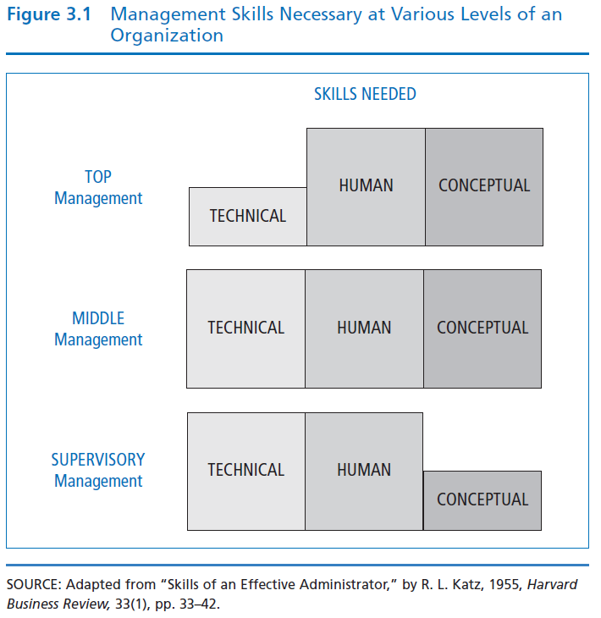
Basic Administrative Skills – Katz (1955)
Leaders need all three skills— but relative importance changes based on level of management
Peter G. Northouse, Leadership: Theory and Practice, Seventh Edition. © 2016 SAGE Publications, Inc.

Slide 6
Technical Skill
Having knowledge about and being proficient in a specific type of work or activity.
Specialized competencies
Analytical ability
Use of appropriate tools and techniques
Technical skills involve hands-on ability with a product or process
Most important at lower levels of management
Peter G. Northouse, Leadership: Theory and Practice, Seventh Edition. © 2016 SAGE Publications, Inc.

Slide 7
Human Skill
Having knowledge about and being able to work with people.
Being aware of one’s own perspective and others’ perspectives at the same time
Assisting group members in working cooperatively to achieve common goals
Creating an atmosphere of trust and empowerment of members
Important at all levels of the organization
Peter G. Northouse, Leadership: Theory and Practice, Seventh Edition. © 2016 SAGE Publications, Inc.

Slide 8
Conceptual Skill
the ability to do the mental work of shaping meaning of organizational policy or issues (what company stands for and where it’s going)
Works easily with abstraction and hypothetical notions
Central to creating and articulating a vision and strategic plan for an organization
Most important at top management levels
Peter G. Northouse, Leadership: Theory and Practice, Seventh Edition. © 2016 SAGE Publications, Inc.

Slide 9
Skills-Based Model
Skills Model Perspective
Competencies
Individual Attributes
Leadership Outcomes
Career Experiences
Environmental Influences
Peter G. Northouse, Leadership: Theory and Practice, Seventh Edition. © 2016 SAGE Publications, Inc.

Slide 10
Skills Model Description (Mumford, Zaccaro, Harding, Jacobs, & Fleishman, 2000)
Perspective
Skills-Based Model of Leadership
Research studies (1990s) goal: to identify the leadership factors that create exemplary job performance in an organization
Emphasizes the capabilities that make effective leadership possible rather than what leaders do
Capability model - Examines relationship between a leader’s knowledge & skills & the leader’s performance.
Suggests many people have the potential for leadership
Peter G. Northouse, Leadership: Theory and Practice, Seventh Edition. © 2016 SAGE Publications, Inc.

Slide 11
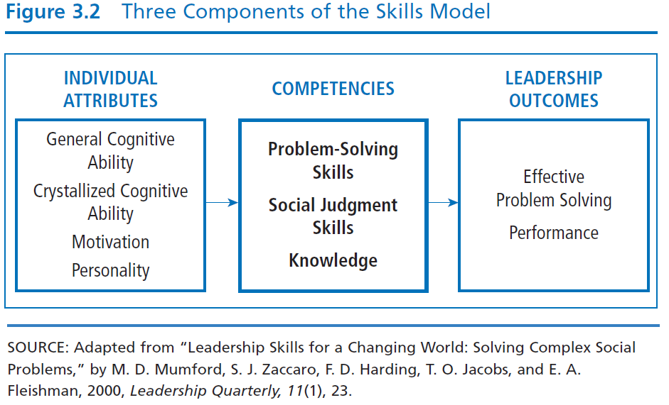
Peter G. Northouse, Leadership: Theory and Practice, Seventh Edition. © 2016 SAGE Publications, Inc.

Slide 12
Competencies Skills
Problem Solving
Social Judgment
Knowledge
Creative ability to solve new/unusual, ill-defined organizational problems
Capacity to understand people and social systems
- Perspective taking
- Social perceptiveness
- Behavioral flexibility
- Social performance
The accumulation of information & the mental structures to organize the information
Peter G. Northouse, Leadership: Theory and Practice, Seventh Edition. © 2016 SAGE Publications, Inc.

Slide 13
Individual Attributes
General Cognitive
Ability
Crystallized
Cognitive Ability
Motivation
Personality
Person’s intelligence
Perceptual processing
Information processing
General reasoning
Creative & divergent thinking
Memory
Intellectual ability learned or acquired over time
Three aspects of motivation
Willingness
Dominance
-Social good
Any characteristic
that helps people
cope with complex
organizational
situations is
probably related to leader performance
Peter G. Northouse, Leadership: Theory and Practice, Seventh Edition. © 2016 SAGE Publications, Inc.

Slide 14
Leadership Outcomes
Problem Solving
Performance
Criteria = originality & quality of solutions to problem situations – good problem solving involves creating solutions that are:
- Logical
- Effective
- Unique
- Go beyond given information
Degree to which a leader has successfully performed his/her assigned duties
Peter G. Northouse, Leadership: Theory and Practice, Seventh Edition. © 2016 SAGE Publications, Inc.

Slide 15
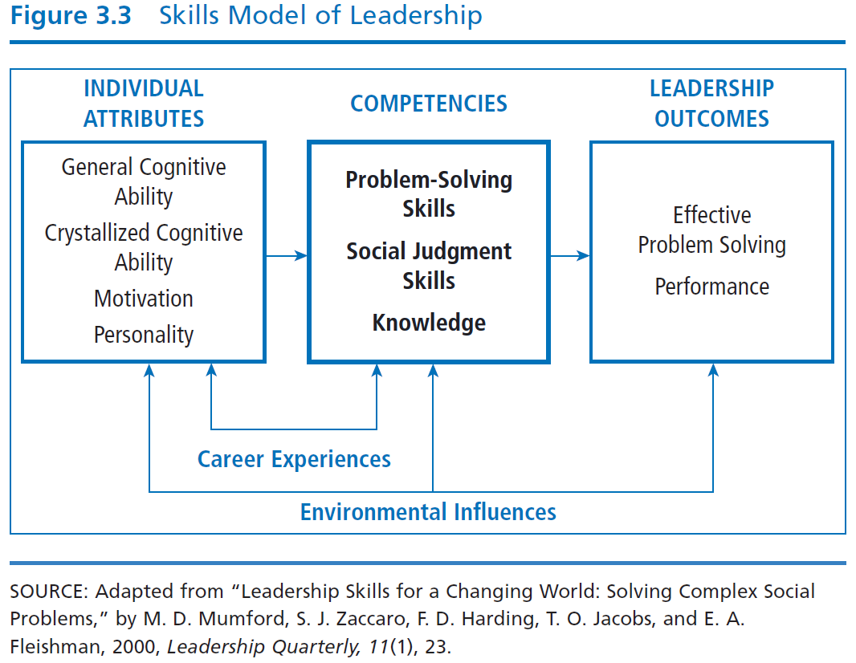
Peter G. Northouse, Leadership: Theory and Practice, Seventh Edition. © 2016 SAGE Publications, Inc.

Slide 16
Career Experiences
Challenging
Assignments
Mentoring
Appropriate
Training
Hands-on
Experience with
Novelty
Experience gained during career influences leader’s knowledge & skills to solve complex problems
Leaders learn and develop higher levels of conceptual capacity if they progressively confront more complex and long-term problems as they ascend the organizational hierarchy
Peter G. Northouse, Leadership: Theory and Practice, Seventh Edition. © 2016 SAGE Publications, Inc.

Slide 17
Environmental Influences
Factors in a leader’s situation that lie outside of his or her competencies, characteristics, and experiences
Internal environmental influences – Ex. Outdated technology, skill level of employees
External environmental influences – Ex. Economic, political, or social issues; natural disasters
Peter G. Northouse, Leadership: Theory and Practice, Seventh Edition. © 2016 SAGE Publications, Inc.

Slide 18
How Does the Skills Approach Work?
Focus of Skills Approach
Strengths
Criticisms
Application
Peter G. Northouse, Leadership: Theory and Practice, Seventh Edition. © 2016 SAGE Publications, Inc.

Slide 19
Skills Approach
Focus
Principal Research Perspectives
Focus is primarily descriptive – it describes leadership from skills perspective
Provides structure for understanding the nature of effective leadership
Katz (1955) suggests importance of particular leadership skills varies depending where leaders reside in management hierarchy
Mumford, Campion, & Morgeson, (2007) suggest higher levels of all skills needed at higher levels of hierarchy
Mumford, Zaccaro, Harding et al. (2000) suggest leadership outcomes are direct result of leader’s skilled competency in problem solving, social judgment, & knowledge
Peter G. Northouse, Leadership: Theory and Practice, Seventh Edition. © 2016 SAGE Publications, Inc.

Slide 20
Strengths
First approach to conceptualize and create a structure of the process of leadership around skills
Describing leadership in terms of skills makes leadership available to everyone
Provides an expansive view of leadership that incorporates wide variety of components (i.e., problem-solving skills, social judgment skills)
Provides a structure consistent with leadership education programs
Peter G. Northouse, Leadership: Theory and Practice, Seventh Edition. © 2016 SAGE Publications, Inc.

Slide 21
Criticisms
Breadth of the skills approach appears to extend beyond the boundaries of leadership, making it more general, less precise
Weak in predictive value; does not explain how skills lead to effective leadership performance
Skills model includes individual attributes that are trait-like
Peter G. Northouse, Leadership: Theory and Practice, Seventh Edition. © 2016 SAGE Publications, Inc.

Slide 22
Application
The Skills Approach provides a way to delineate the skills of a leader
It is applicable to leaders at all levels within the organization
The skills inventory can provide insights into the individual’s leadership competencies
Test scores allow leaders to learn about areas in which they may wish to seek further training
Peter G. Northouse, Leadership: Theory and Practice, Seventh Edition. © 2016 SAGE Publications, Inc.

