Slide 1
Chapter 6: Path-Goal Theory

Slide 2

Overview
Path–Goal Theory Perspective
Conditions of Leadership Motivation
Leader Behaviors & Follower Characteristics
Task Characteristics
How Does PGT Work?
Peter G. Northouse, Leadership: Theory and Practice, Seventh Edition. © 2016 SAGE Publications, Inc.

Slide 3
Path–Goal Theory (House, 1971) Description
Definition
Path–goal theory centers on how leaders motivate followers to accomplish designated goals
Emphasizes the relationship between
the leader’s style
the characteristics of the followers
the work setting
Peter G. Northouse, Leadership: Theory and Practice, Seventh Edition. © 2016 SAGE Publications, Inc.

Slide 4
Path–Goal Theory (House, 1971) Description
Perspective
Goal - To enhance employee performance and satisfaction by focusing on employee motivation
Motivational Principles (based on Expectancy Theory) - Followers will be motivated if they believe
they are capable of performing their work
that their efforts will result in a certain outcome
that the payoffs for doing their work are worthwhile
Peter G. Northouse, Leadership: Theory and Practice, Seventh Edition. © 2016 SAGE Publications, Inc.

Slide 5
Challenge to Leader
Use a leadership style that best meets followers’ motivational needs
choose behaviors that complement or supplement what is missing in the work setting
enhance goal attainment by providing information or rewards
provide followers with the elements they need to reach their goals
Peter G. Northouse, Leadership: Theory and Practice, Seventh Edition. © 2016 SAGE Publications, Inc.

Slide 6
Conditions of Leadership Motivation
Leadership generates motivation when
It increases the number and kinds of payoffs followers receive from their work
Makes the path to the goal clear and easy to travel through with coaching and direction
Removes obstacles and roadblocks to attaining the goal
Makes the work itself more personally satisfying
Peter G. Northouse, Leadership: Theory and Practice, Seventh Edition. © 2016 SAGE Publications, Inc.

Slide 7
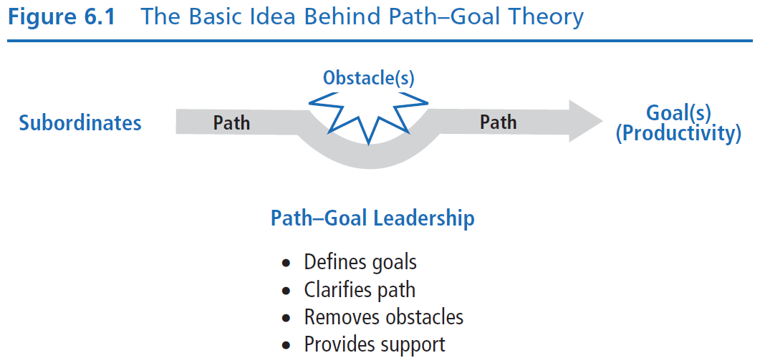
Peter G. Northouse, Leadership: Theory and Practice, Seventh Edition. © 2016 SAGE Publications, Inc.

Slide 8
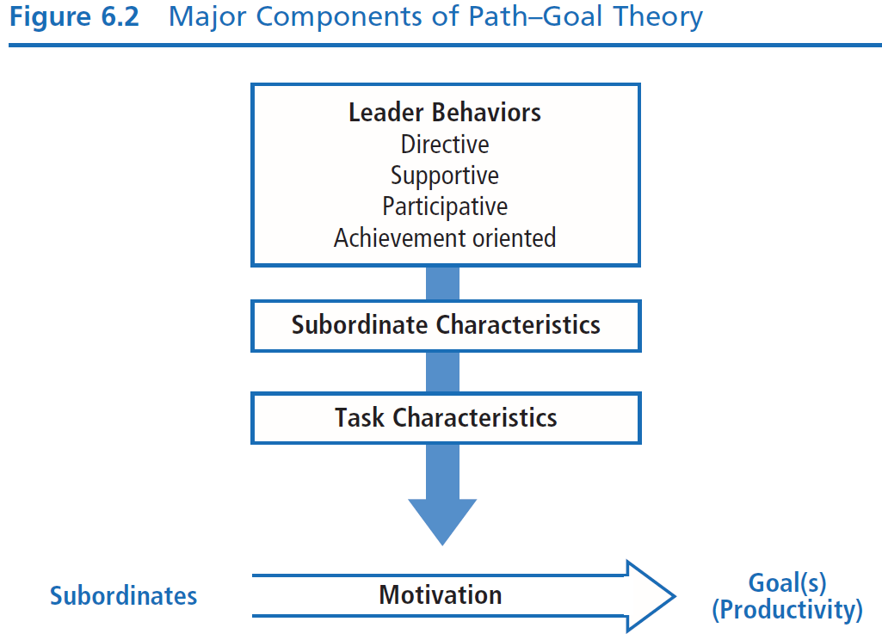
Peter G. Northouse, Leadership: Theory and Practice, Seventh Edition. © 2016 SAGE Publications, Inc.

Slide 9
Leader Behaviors
Directive Leadership
Leader who gives followers task instruction including:
What is expected of them
How task is to be done
Timeline for task completion
Clear standards of performance
Clear rules & regulations
Peter G. Northouse, Leadership: Theory and Practice, Seventh Edition. © 2016 SAGE Publications, Inc.

Slide 10
Leader Behaviors
Supportive Leadership
Leader who is friendly and approachable:
Attending to well-being & human needs of followers
Using supportive behavior to make work environment pleasant
Treating followers as equals & giving them respect for their status
Peter G. Northouse, Leadership: Theory and Practice, Seventh Edition. © 2016 SAGE Publications, Inc.

Slide 11
Leader Behaviors
Participative Leadership
Leader who invites followers to share in the decision making:
Consults with followers
Seeks their ideas & opinions
Integrates their input into group/organizational decisions
Peter G. Northouse, Leadership: Theory and Practice, Seventh Edition. © 2016 SAGE Publications, Inc.

Slide 12
Leader Behaviors
Achievement-Oriented Leadership
Leader who challenges followers to perform work at the highest level possible:
Establishes a high standard of excellence for subordinates
Seeks continuous improvement
Demonstrates a high degree of confidence in followers’ ability to establish & achieve challenging goals
Peter G. Northouse, Leadership: Theory and Practice, Seventh Edition. © 2016 SAGE Publications, Inc.

Slide 13
Follower Characteristics
Strong need for affiliation
Friendly and concerned leadership is a source of satisfaction
Supportive Leadership
Preference for Structure
Dogmatic & authoritarian
Leadership provides psychological structure, task clarity, & greater sense of certainty in work setting
Directive Leadership
Peter G. Northouse, Leadership: Theory and Practice, Seventh Edition. © 2016 SAGE Publications, Inc.

Slide 14
Follower Characteristics
Desire for Control
Internal locus of control
Leadership that allows followers to feel in charge of their work & makes them an integral part of the decision-making process
Participative Leadership
External locus of control
Leadership that parallels followers’ feelings that outside forces control their circumstances
Directive Leadership
Peter G. Northouse, Leadership: Theory and Practice, Seventh Edition. © 2016 SAGE Publications, Inc.

Slide 15
Follower Characteristics
Perception of their own ability – specific task
As perception of ability and competence goes up, need for highly directive leadership goes down
Directive leadership may become redundant, possibly excessively controlling
Peter G. Northouse, Leadership: Theory and Practice, Seventh Edition. © 2016 SAGE Publications, Inc.

Slide 16
Task Characteristics
Components
Design of followers’ task
Organization’s formal authority system
Primary work group of followers
Peter G. Northouse, Leadership: Theory and Practice, Seventh Edition. © 2016 SAGE Publications, Inc.

Slide 17
Task Characteristics
Task Situations Requiring Leader Involvement
Unclear and ambiguous - Leader needs to provide structure
Highly repetitive - Leader needs to provide support to maintain follower motivation
Weak formal authority - If formal authority system is weak, the leader needs to assist followers by making rules and work requirements clear
Nonsupportive/weak group norms - Leader needs to help build cohesiveness and role responsibility
Peter G. Northouse, Leadership: Theory and Practice, Seventh Edition. © 2016 SAGE Publications, Inc.

Slide 18
Task Characteristics
Obstacles
Anything in the work setting that gets in the way of followers
They create excessive uncertainties, frustrations, or threats for followers
Leader’s responsibility is to help followers by
Removing the obstacles
Helping followers around them
Assisting with obstacles will increase
Followers’ expectations to complete the task
Their sense of job satisfaction
Peter G. Northouse, Leadership: Theory and Practice, Seventh Edition. © 2016 SAGE Publications, Inc.

Slide 19
How Does the Path–Goal Theory Work?
Focus of Path–Goal Theory
Strengths
Criticisms
Application
Peter G. Northouse, Leadership: Theory and Practice, Seventh Edition. © 2016 SAGE Publications, Inc.

Slide 20
How Does the Path–Goal Theory Work?
The leader’s job is to help followers reach their goals by directing, guiding, and coaching them along the way
Leaders must evaluate task and follower characteristics and adapt leadership style to these
The theory suggests which style is most appropriate for specific characteristics
Peter G. Northouse, Leadership: Theory and Practice, Seventh Edition. © 2016 SAGE Publications, Inc.

Slide 21
Path–Goal Theory Approach
Focus
Overall Scope
Path–goal theory is a complex but also pragmatic approach
Leaders should choose a leadership style that best fits the needs of followers and their work
Path–goal theory provides a set of assumptions about how different leadership styles will interact with follower characteristics and the work situation to affect employee motivation
Peter G. Northouse, Leadership: Theory and Practice, Seventh Edition. © 2016 SAGE Publications, Inc.

Slide 22
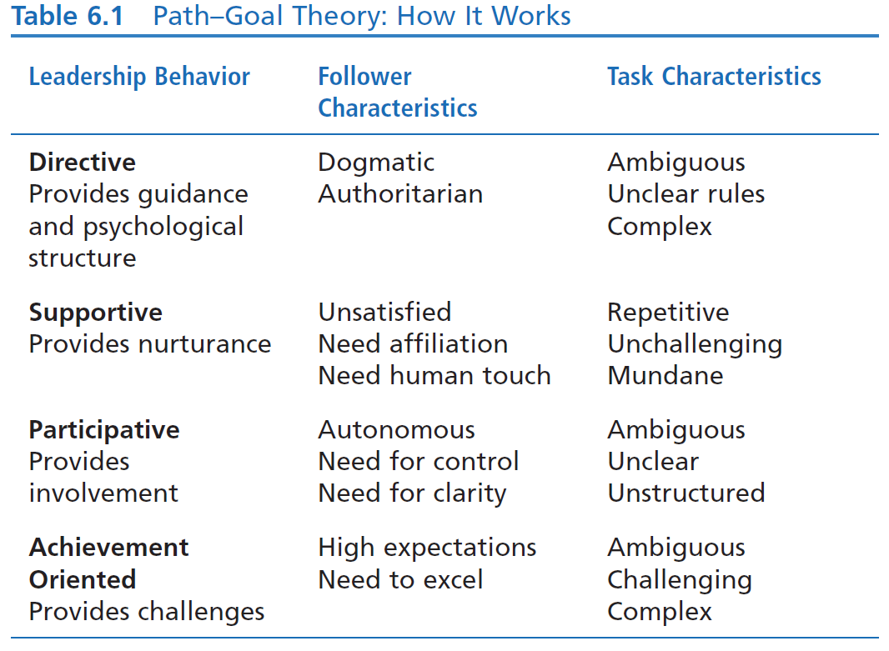

Slide 23
Strengths
Useful theoretical framework. Path–goal theory is a useful theoretical framework for understanding how various leadership behaviors affect the satisfaction of followers and their work performance.
Integrates motivation. Path–goal theory attempts to integrate the motivation principles of expectancy theory into a theory of leadership.
Practical model. Path–goal theory provides a practical model that underscores and highlights the important ways leaders help followers.
Peter G. Northouse, Leadership: Theory and Practice, Seventh Edition. © 2016 SAGE Publications, Inc.

Slide 24
Criticisms
Interpreting the meaning of the theory can be confusing because it is so complex and incorporates so many different aspects of leadership; consequently, it is difficult to implement.
Empirical research studies have demonstrated only partial support for path–goal theory.
It fails to adequately explain the relationship between leadership behavior and worker motivation.
The path–goal theory approach treats leadership as a one-way event in which the leader affects the follower.
Peter G. Northouse, Leadership: Theory and Practice, Seventh Edition. © 2016 SAGE Publications, Inc.

Slide 25
Application
PGT offers valuable insights that can be applied in ongoing settings to improve one’s leadership.
Informs leaders about when to be directive, supportive, participative, or achievement oriented.
The principles of PGT can be employed by leaders at all organizational levels and for all types of tasks.
Peter G. Northouse, Leadership: Theory and Practice, Seventh Edition. © 2016 SAGE Publications, Inc.

