Slide 1
Chapter 7: Leader-Member Exchange Theory

Slide 2

Overview
LMX Theory Description
LMX Theory Perspective
Early Studies
Later Studies
Phases in Leadership Making
How Does the LMX Approach Work?
Peter G. Northouse, Leadership: Theory and Practice, Seventh Edition. © 2016 SAGE Publications, Inc.

Slide 3
Definition
Leader–member exchange (LMX) theory:
conceptualizes leadership as a process
that is centered on the interactions between a leader and followers
Some theories focus on leaders:
trait approach, skills approach, and style approach
Other theories focus on the follower and the context:
situational leadership, contingency theory, and path–goal theory.
Peter G. Northouse, Leadership: Theory and Practice, Seventh Edition. © 2016 SAGE Publications, Inc.

Slide 4
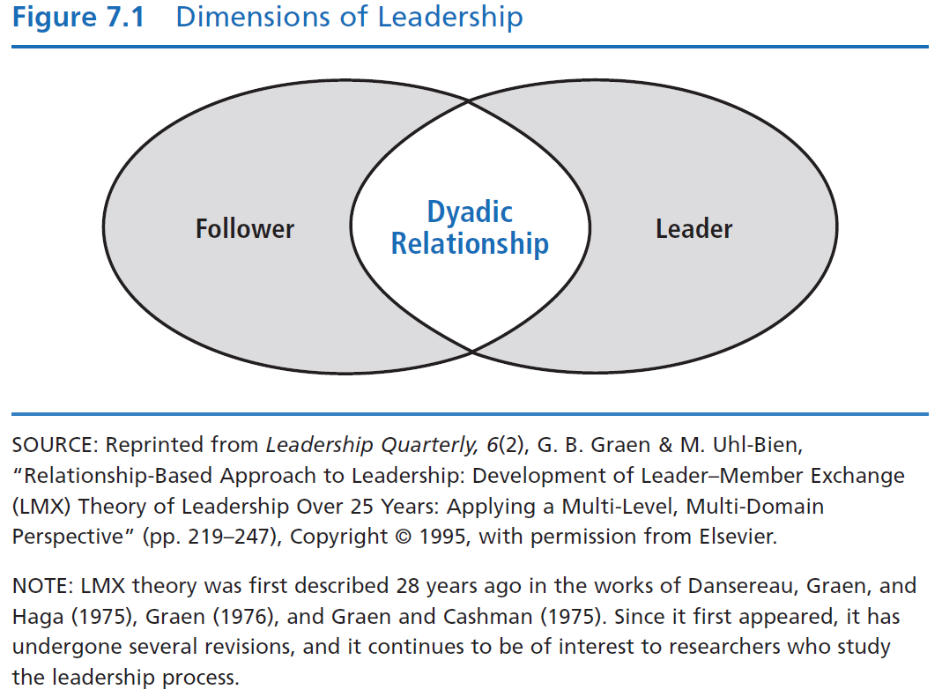
Dimensions of Leadership
LMX theory makes the dyadic relationship between leaders and followers the focal point of the leadership process
Peter G. Northouse, Leadership: Theory and Practice, Seventh Edition. © 2016 SAGE Publications, Inc.

Slide 5
LMX Theory Description
Perspective
Development - LMX theory first described by Dansereau, Graen, & Haga (1975); Graen & Cashman (1975); and Graen (1976)
Revisions - Theory has undergone a number of revisions since its inception and continues to be of interest to researchers
Assumption - LMX theory challenges the assumption that leaders treat followers in a collective way, as a group.
LMX - Directed attention to the differences that might exist between the leader and each of his/her followers
Peter G. Northouse, Leadership: Theory and Practice, Seventh Edition. © 2016 SAGE Publications, Inc.

Slide 6
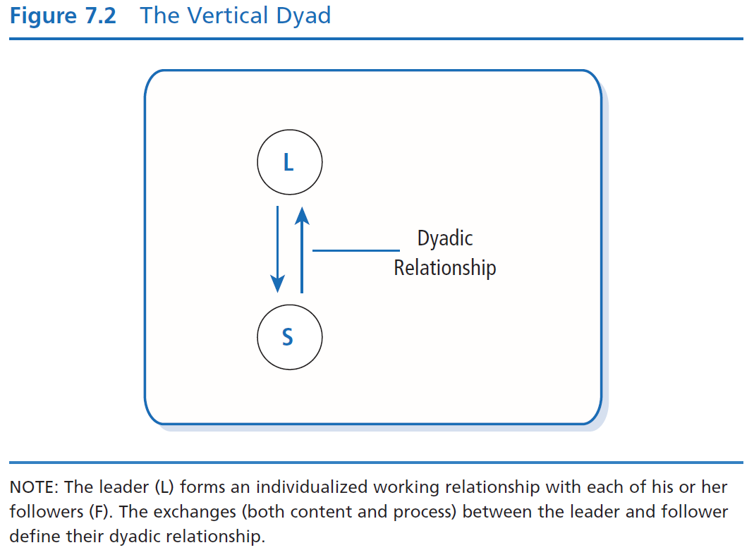
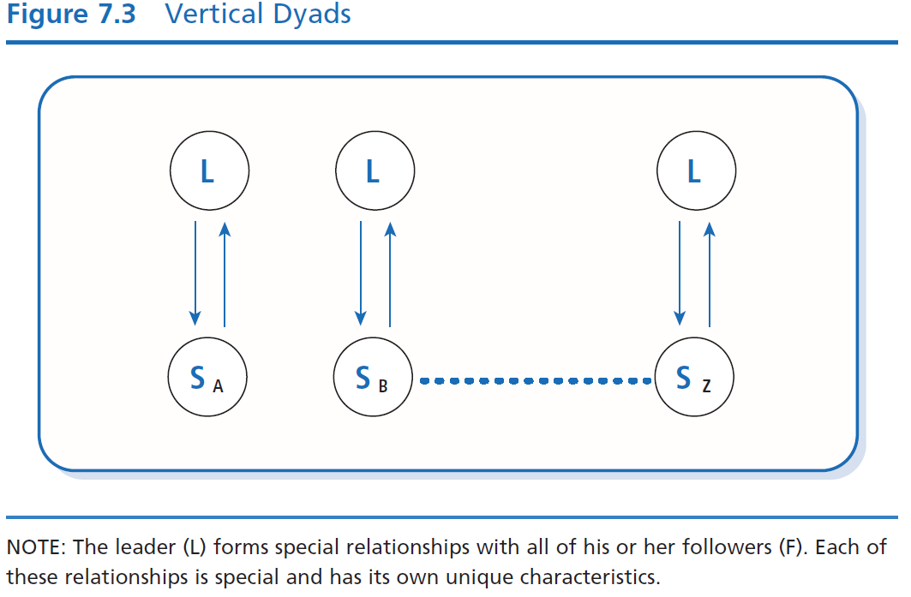
First studies of LMX called – Vertical Dyad Linkage (VDL)
Focus on the vertical linkages leaders formed with each of their followers
Leader’s relationship to a work unit viewed as a series of vertical dyads
Peter G. Northouse, Leadership: Theory and Practice, Seventh Edition. © 2016 SAGE Publications, Inc.

Slide 7
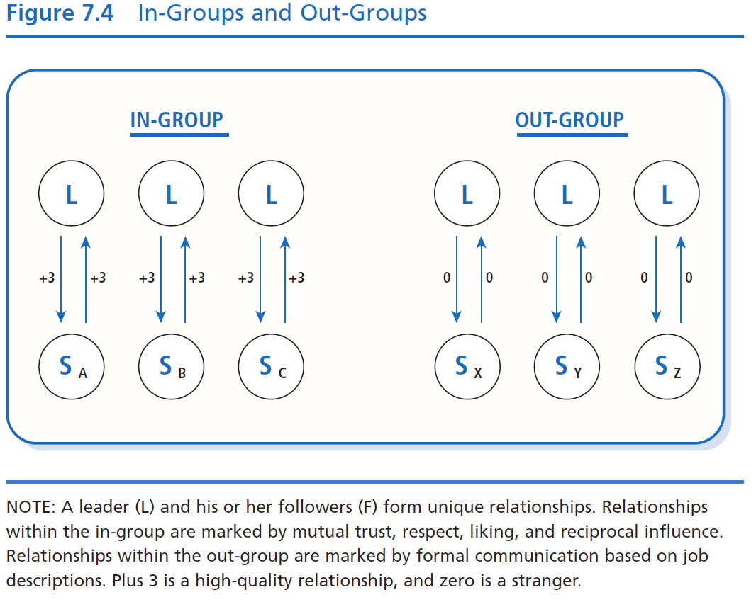
Early Studies
Leader’s work unit as a whole was viewed as a series of vertical dyads; leader forms unique relationship with each follower

Slide 8
Early Studies
Researchers found two general types of linkages (or relationships)—those based on
Expanded/negotiated role responsibilities (extra-roles) = in-group
Relationships marked by mutual trust, respect, liking, and reciprocal influence
Receive more information, influence, confidence, and concern than out-group members
Formal employment contract (defined-roles) = out-group
Relationships marked by formal communication based on job descriptions
Peter G. Northouse, Leadership: Theory and Practice, Seventh Edition. © 2016 SAGE Publications, Inc.

Slide 9
Early Studies
In-group/out-group status based on how well follower works with the leader and how well the leader works with the follower
How followers involve themselves in expanding their role responsibilities with the leader determines whether they become in-group or out-group participants
Becoming part of the in-group involves follower negotiations in performing activities beyond the formal job description
Peter G. Northouse, Leadership: Theory and Practice, Seventh Edition. © 2016 SAGE Publications, Inc.

Slide 10
In-Group & Out-Group Followers
S
F
In-Group
more information, influence, confidence, & concern from leader
more dependable, highly involved, & communicative than out-group
F
F
In-Group
Out-Group
Leader
F
F
F
F
F
Out-Group
less compatible with leader
usually just come to work, do the job, & go home
F
F
F
F
F
F
F
Follower
Peter G. Northouse, Leadership: Theory and Practice, Seventh Edition. © 2016 SAGE Publications, Inc.

Slide 11
Later Studies (Graen & Uhl-Bien, 1995)
Initial research primarily addressed differences between in-groups and out-groups; later research addressed how LMX theory was related to organizational effectiveness
Later research focus on the quality of leader–member exchanges resulting in positive outcomes for
Leaders
Followers
Groups
Organizations in general
Peter G. Northouse, Leadership: Theory and Practice, Seventh Edition. © 2016 SAGE Publications, Inc.

Slide 12
Later Studies (Graen & Uhl-Bien, 1995)
Researchers found that high-quality leader–member exchanges resulted in
Less employee turnover
More positive performance evaluations
Higher frequency of promotions
Greater organizational commitment
More desirable work assignments
Better job attitudes
More attention and support from the leader
Greater participation
Faster career progress
Peter G. Northouse, Leadership: Theory and Practice, Seventh Edition. © 2016 SAGE Publications, Inc.

Slide 13
Later Studies
Gerstner and Day (1997)
LMX consistently related to member job performance, overall satisfaction, supervisor satisfaction, commitment, role conflict and clarity, turnover intentions.
Support for psychometric properties of LMX Questionnaire
Ilies, Nahrang, and Morgeson (2007)
Meta-analysis of 51 research studies
Positive relationship between LMX quality and citizenship behaviors (discretionary employee behaviors that go beyond the prescribed role, job description, or reward system.
Peter G. Northouse, Leadership: Theory and Practice, Seventh Edition. © 2016 SAGE Publications, Inc.

Slide 14
Leadership Making (Graen & Uhl-Bien, 1995)
A prescriptive approach to leadership that emphasizes that a leader should develop high-quality exchanges with all of her or his followers, rather than just a few.
Three phases of leadership making which develop over time:
(a) stranger phase
(b) acquaintance phase
(c) mature partnership phase
Peter G. Northouse, Leadership: Theory and Practice, Seventh Edition. © 2016 SAGE Publications, Inc.

Slide 15
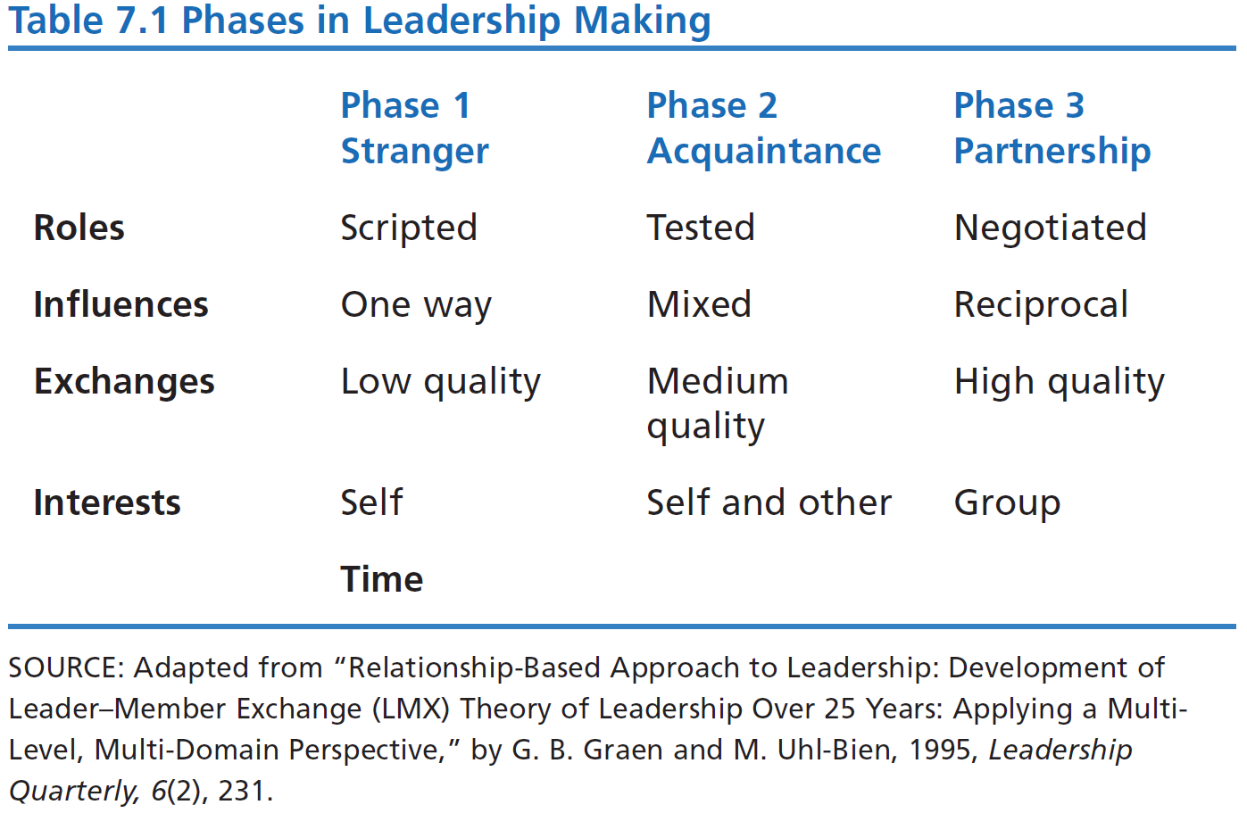
Scripted
One Way
Low Quality
Self

Slide 16
Leadership Making (Graen & Uhl-Bien, 1995)
Phase 1
Stranger
Interactions within the leader-follower dyad are generally rule bound
Rely on contractual relationships
Relate to each other within prescribed organizational roles
Experience lower-quality exchanges
Motives of follower directed toward self-interest rather than good of the group
Peter G. Northouse, Leadership: Theory and Practice, Seventh Edition. © 2016 SAGE Publications, Inc.

Slide 17
Leadership Making (Graen & Uhl-Bien, 1995)
Phase 2
Acquaintance
Begins with an “offer” by leader/follower for improved career-oriented social exchanges
Testing period for both, assessing whether
the follower is interested in taking on new roles
leader is willing to provide new challenges
Shift in dyad from formalized interactions to new ways of relating
Quality of exchanges improves along with greater trust & respect
Less focus on self-interest, more on goals of the group
Peter G. Northouse, Leadership: Theory and Practice, Seventh Edition. © 2016 SAGE Publications, Inc.

Slide 18
Leadership Making (Graen & Uhl-Bien, 1995)
Phase 3
Mature Partnership
Marked by high-quality leader–member exchanges
Experience high degree of mutual trust, respect, and obligation toward each other
Tested relationship and found it dependable
High degree of reciprocity between leaders and subordinates
May depend on each other for favors and special assistance
Highly developed patterns of relating that produce positive
outcomes for both themselves & the organization
Partnerships are transformational – moving beyond self-interest to accomplish greater good of the team & organization

Slide 19
How Does the LMX Theory Approach Work?
Focus of LMX Theory
Strengths
Criticisms
Application
Peter G. Northouse, Leadership: Theory and Practice, Seventh Edition. © 2016 SAGE Publications, Inc.

Slide 20
How Does LMX Theory Work?
LMX theory works in two ways: It describes leadership and it prescribes leadership
In both - the central concept is the dyadic relationship
Descriptively:
It suggests that it is important to recognize the existence of in-groups & out-groups within an organization
Significant differences in how goals are accomplished using in-groups vs. out-groups
Relevant differences in in-group vs. out-group behaviors
Peter G. Northouse, Leadership: Theory and Practice, Seventh Edition. © 2016 SAGE Publications, Inc.

Slide 21
How Does LMX Theory Work?
Prescriptively:
Best understood within the Leadership–Making Model
(Graen & Uhl-Bien, 1995)
Leader forms special relationships with all followers
Leader should offer each follower an opportunity for new roles/responsibilities
Leader should nurture high-quality exchanges with all followers
Rather than concentrating on differences, leader focuses on ways to build trust & respect with all followers, resulting in entire work group becoming an in-group
Peter G. Northouse, Leadership: Theory and Practice, Seventh Edition. © 2016 SAGE Publications, Inc.

Slide 22
Strengths
LMX theory validates our experience of how people within organizations relate to one another and the leader
LMX theory is the only leadership approach that makes the dyadic relationship the centerpiece of the leadership process
LMX theory directs our attention to the importance of communication in leadership
Solid research foundation on how the practice of LMX theory is related to positive organizational outcomes
Peter G. Northouse, Leadership: Theory and Practice, Seventh Edition. © 2016 SAGE Publications, Inc.

Slide 23
Criticisms
Inadvertently supports the development of privileged groups in the workplace; appears unfair and discriminatory
The basic theoretical ideas of LMX are not fully developed
How are high-quality leader–member exchanges created?
What are the means to achieve building trust, respect, and obligation? What are the guidelines?
Because of various scales and levels of analysis, measurement of leader–member exchanges is being questioned
Peter G. Northouse, Leadership: Theory and Practice, Seventh Edition. © 2016 SAGE Publications, Inc.

Slide 24
Application
Applicable to all levels of management and different types of organizations
Directs managers to assess their leadership from a relationship perspective
Sensitizes managers to how in-groups and out-groups develop within their work units
Can be used to explain how CEOs strategically develop special relationships with select individuals in upper management
Can be used to explain how individuals create leadership networks at various levels throughout an organization
Can be applied in different types of organizations—volunteer, business, education, and government settings
Peter G. Northouse, Leadership: Theory and Practice, Seventh Edition. © 2016 SAGE Publications, Inc.

