Slide 1
Chapter 8: Transformational Leadership

Slide 2

Overview
Transformational Leadership (TL) Perspective
A Model of Transformational Leadership
Transformational Leadership Factors
Full Range of Leadership Model
The Additive Effects of TL
Other Transformational Leadership Perspectives
How Does the Transformational Approach Work?
Peter G. Northouse, Leadership: Theory and Practice, Seventh Edition. © 2016 SAGE Publications, Inc.

Slide 3
Transformational Leadership
Description
Process - TL is a process that changes and transforms individuals
Influence - TL involves an exceptional form of influence that moves followers to accomplish more than what is usually expected
Core elements - TL is concerned with emotions, values, ethics, standards, and long-term goals
Encompassing approach – TL describes a wide range of leadership influence where followers and leaders are bound together in the transformation process
Peter G. Northouse, Leadership: Theory and Practice, Seventh Edition. © 2016 SAGE Publications, Inc.

Slide 4
Types of Leadership Defined (Burns, 1978)
TRANSACTIONAL
PSEUDO-TRANSFORMATIONAL
Focuses on the
exchanges
that occur
between leaders
and their followers
Focuses on the
leader’s
own interests rather than the interests of his or her followers
TRANSFORMATIONAL
Process of
engaging with others
to create a connection that increases
motivation and morality in both the leader and the follower
Peter G. Northouse, Leadership: Theory and Practice, Seventh Edition. © 2016 SAGE Publications, Inc.

Slide 5
Types of Leadership Defined (Burns, 1978)
No new taxes = votes.
Turn in assignments = grade.
Surpass goals = promotion.
The exchange dimension is so common that you can observe it at all walks of life.
Focuses on the
exchanges
that occur
between leaders
and their followers
TRANSACTIONAL
Peter G. Northouse, Leadership: Theory and Practice, Seventh Edition. © 2016 SAGE Publications, Inc.

Slide 6
Types of Leadership Defined (Burns, 1978)
Leaders who are
transforming but in a negative way
self-consumed, exploitive; power- oriented, with warped moral values
includes leaders like
Adolph Hitler
Saddam Hussein
Focuses on the
leader’s
own interests rather than the interests of his or her followers
PSEUDOTRANSFORMATIONAL
Peter G. Northouse, Leadership: Theory and Practice, Seventh Edition. © 2016 SAGE Publications, Inc.

Slide 7
Pseudotransformational (Christie, Barling, & Turner, 2011)
Four experimental studies => model of pseudotransformational leadership
Self-serving
Unwilling to encourage independent thought in followers
Exhibits little general caring for others
Uses inspiration and appeal to manipulate followers for his or her own ends
Peter G. Northouse, Leadership: Theory and Practice, Seventh Edition. © 2016 SAGE Publications, Inc.

Slide 8
Types of Leadership Defined Burns (1978)
Leader is attentive to the needs and motives of followers and tries to help followers reach their fullest potential.
Mohandas Gandhi raised the hopes and demands of millions of his people and in the process was changed himself
Ryan White raised people’s awareness about AIDS
Process of
engaging with others
to create a connection
that increases
motivation
and morality in both the
leader and the follower
TRANSFORMATIONAL
Peter G. Northouse, Leadership: Theory and Practice, Seventh Edition. © 2016 SAGE Publications, Inc.

Slide 9
Transformational Leadership & Charisma
Definition
Charisma - A special personality characteristic that gives a person superhuman or exceptional powers and is reserved for a few, is of divine origin, and results in the person being treated as a leader (Weber, 1947)
Charismatic Leadership Theory (House, 1976)
Charismatic leaders act in unique ways that have specific charismatic effects on their followers
Peter G. Northouse, Leadership: Theory and Practice, Seventh Edition. © 2016 SAGE Publications, Inc.

Slide 10
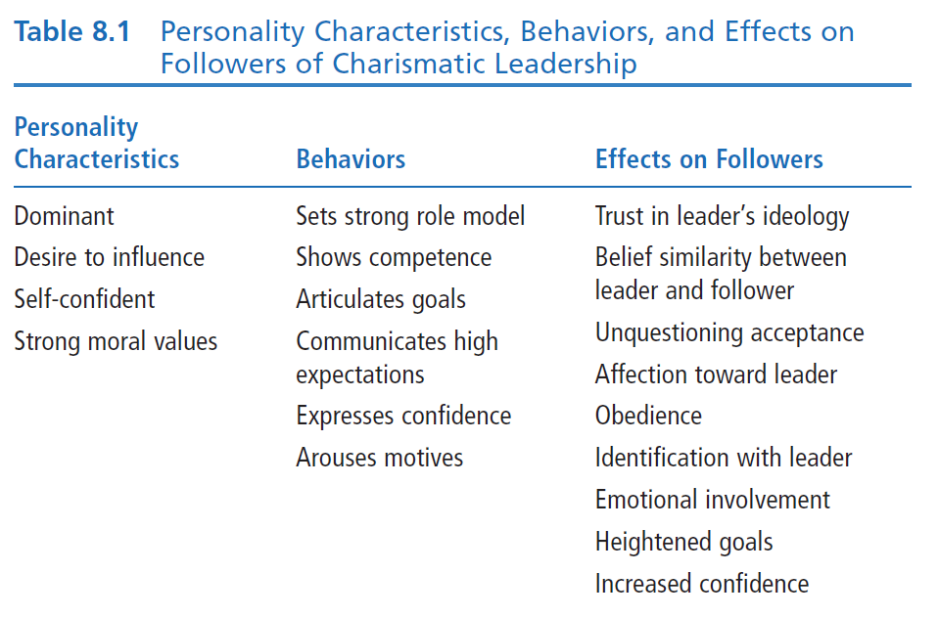
Theory of Charismatic Leadership
(House, 1976)

Slide 11
Theory of Charismatic Leadership (Shamir, House, & Arthur, 1993)
Later Studies
Charismatic Leadership –
Transforms follower’s self-concepts; tries to link identity of followers to collective identity of the organization
Forge this link by emphasizing intrinsic rewards & de-emphasizing extrinsic rewards
Throughout process, leaders
Express high expectations for followers
help followers gain sense of self-confidence and self-efficacy
Peter G. Northouse, Leadership: Theory and Practice, Seventh Edition. © 2016 SAGE Publications, Inc.

Slide 12
Model of Transformational Leadership (Bass, 1985)
Expanded and refined version of work done by Burns and House. It included
More attention to followers’ rather than leader’s needs
Suggested TL could apply to outcomes that were not positive
Described transactional and transformational leadership as a continuum
Extended House’s work by
Giving more attention to emotional elements & origins of charisma
Suggested charisma is a necessary but not sufficient condition for TL
Peter G. Northouse, Leadership: Theory and Practice, Seventh Edition. © 2016 SAGE Publications, Inc.

Slide 13
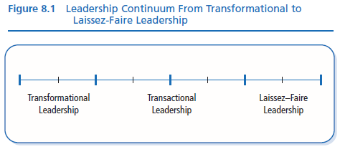
TL motivates followers beyond the expected by
raising consciousness about the value and importance of specific and idealized goals
transcending self-interest for the good of the team or organization
addressing higher-level needs
Peter G. Northouse, Leadership: Theory and Practice, Seventh Edition. © 2016 SAGE Publications, Inc.

Slide 14
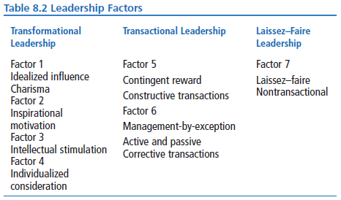
Transformational Leadership Factors
Peter G. Northouse, Leadership: Theory and Practice, Seventh Edition. © 2016 SAGE Publications, Inc.

Slide 15
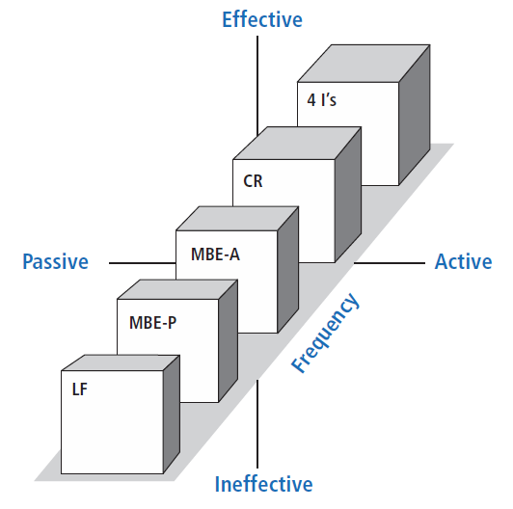
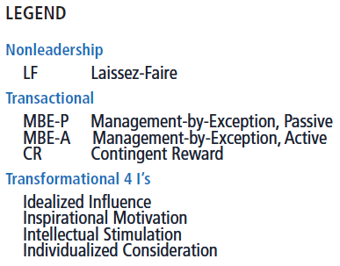
Full Range of Leadership Model

Slide 16
Transformational Leadership Factors: The 4 Is
Idealized Influence
Acting as strong role models
High standards of moral and ethical conduct
Making others want to follow the leader’s vision
Inspirational Motivation
Communicating high expectations
Inspiring followers to commitment and engagement in shared vision
Using symbols & emotional appeals to focus group members to achieve more than self-interest
Peter G. Northouse, Leadership: Theory and Practice, Seventh Edition. © 2016 SAGE Publications, Inc.

Slide 17
Transformational Leadership Factors: The 4 Is
Intellectual Stimulation
Stimulating followers to be creative and innovative
Challenging their own beliefs and valuing those of leader and organization
Supporting followers to
Try new approaches
Develop innovative ways of dealing with organization issues
Individualized Consideration
Listening carefully to the needs of followers
Acting as coaches to assist followers in becoming fully actualized
Helping followers grow through personal challenges
Ex. Showing optimism helps employees become more engaged in their work (Tims et al., 2011)
Peter G. Northouse, Leadership: Theory and Practice, Seventh Edition. © 2016 SAGE Publications, Inc.

Slide 18
Transactional Leadership Factors
Contingent Reward
The exchange process between leaders and followers in which effort by followers is exchanged for specified rewards
Management-by-Exception
Leadership that involves corrective criticism, negative feedback, and negative reinforcement
Two forms
Active - Watches follower closely to identify mistakes/rule violations
Passive - Intervenes only after standards have not been met or problems have arisen
Peter G. Northouse, Leadership: Theory and Practice, Seventh Edition. © 2016 SAGE Publications, Inc.

Slide 19
Nonleadership Factor
Laissez-Faire
The Absence of Leadership
A hands-off, let-things-ride approach
Refers to a leader who
abdicates responsibility
delays decisions
gives no feedback, and
makes little effort to help followers satisfy their needs
Peter G. Northouse, Leadership: Theory and Practice, Seventh Edition. © 2016 SAGE Publications, Inc.

Slide 20
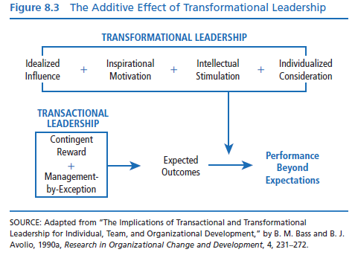

Slide 21
Bennis & Nanus (1985)
Four Leader Strategies in Transforming Organizations
Clear vision of organization’s future state
TL’s social architect of organization
Create trust by making their position known and standing by it
Creatively deploy themselves through positive self-regard
Peter G. Northouse, Leadership: Theory and Practice, Seventh Edition. © 2016 SAGE Publications, Inc.

Slide 22
Kouzes & Pozner (1987, 2002)
Model consists of five fundamental practices
Model the Way
Inspire a Shared Vision
Challenge the Process
Enable Others to Act
Encourage the Heart
Peter G. Northouse, Leadership: Theory and Practice, Seventh Edition. © 2016 SAGE Publications, Inc.

Slide 23
How Does the Transformational Leadership Approach Work?
Focus of Transformational Leadership
Strengths
Criticisms
Application
Peter G. Northouse, Leadership: Theory and Practice, Seventh Edition. © 2016 SAGE Publications, Inc.

Slide 24
Transformational Leadership
Overall Scope
Focus of Transformational
Leaders
Describes how leaders can initiate, develop, and carry out significant changes in organizations
TLs empower and nurture followers
TLs stimulate change by becoming strong role models for followers
TLs commonly create a vision
TLs require leaders to become social architects
TLs build trust & foster collaboration
Peter G. Northouse, Leadership: Theory and Practice, Seventh Edition. © 2016 SAGE Publications, Inc.

Slide 25
Strengths
Broadly researched. TL has been widely researched, including a large body of qualitative research centering on prominent leaders and CEOs in major firms.
Intuitive appeal. People are attracted to TL because it makes sense to them.
Process focused. TL treats leadership as a process occurring between followers and leaders.
Expansive leadership view. TL provides a broader view of leadership that augments other leadership models.
Emphasizes followers. TL emphasizes followers’ needs, values, and morals.
Effectiveness. Evidence supports that TL is an effective form of leadership.
Peter G. Northouse, Leadership: Theory and Practice, Seventh Edition. © 2016 SAGE Publications, Inc.

Slide 26
Criticisms
Lacks conceptual clarity
Dimensions are not clearly delimited
Parameters of TL overlap with similar conceptualizations of leadership
Measurement questioned
Validity of MLQ not fully established
Some transformational factors are not unique solely to the transformational model
TL treats leadership more as a personality trait or predisposition than a behavior that can be taught
No causal link shown between transformational leaders and changes in followers or organizations
TL is elitist and antidemocratic
Suffers from heroic leadership bias
Has the potential to be abused
Peter G. Northouse, Leadership: Theory and Practice, Seventh Edition. © 2016 SAGE Publications, Inc.

Slide 27
Application
Provides a general way of thinking about leadership that stresses ideals, inspiration, innovations, and individual concerns
Can be taught to individuals at all levels of the organization
Able to positively impact a firm’s performance
May be used as a tool in recruitment, selection, promotion, and training development
Can be used to improve team development, decision-making groups, quality initiatives, and reorganizations
The MLQ and Sosik and Jung (2010) guide help leaders to target areas of leadership improvement
Peter G. Northouse, Leadership: Theory and Practice, Seventh Edition. © 2016 SAGE Publications, Inc.

