Slide 1
Chapter 9: Authentic Leadership

Slide 2

Overview
Authentic Leadership Description
Authentic Leadership Defined
Approaches to Authentic Leadership
Practical
Theoretical
How does Authentic Leadership Theory Work?
Peter G. Northouse, Leadership: Theory and Practice, Seventh Edition. © 2016 SAGE Publications, Inc.

Slide 3
Authentic Leadership Description
Authentic Leadership – focuses on whether leadership is genuine
Interest in Authentic Leadership
Increasing in recent times due to social upheavals
People longing for trustworthy leaders
Identified earlier in transformational leadership research but not studied separately
Needed evidence-based research of construct
Peter G. Northouse, Leadership: Theory and Practice, Seventh Edition. © 2016 SAGE Publications, Inc.

Slide 4
Authentic Leadership Defined
Intrapersonal Definition:
Leadership based on self-concept and how self-concept relates to actions (Shamir & Eilam, 2005)
Relies on the life story of the leader
Three Authentic Leadership Characteristics:
ALs exhibit genuine leadership
ALs lead from conviction
ALs are originals, not copies
Peter G. Northouse, Leadership: Theory and Practice, Seventh Edition. © 2016 SAGE Publications, Inc.

Slide 5
Authentic Leadership Defined
Interpersonal Definition:
Leadership is created by leaders and followers together (Eagly, 2005)
It is a reciprocal process because leaders affect followers and followers affect leaders
Peter G. Northouse, Leadership: Theory and Practice, Seventh Edition. © 2016 SAGE Publications, Inc.

Slide 6
Authentic Leadership Defined
Developmental Definition:
Leadership can be nurtured and developed over a lifetime (Avolio & Gardner, 2005)
Can be triggered by major life events
Leader behavior is grounded in positive psychological qualities and strong ethics
Four authentic leadership components:
Self-awareness
Internalized moral perspective
Balanced processing
Relational transparency
Peter G. Northouse, Leadership: Theory and Practice, Seventh Edition. © 2016 SAGE Publications, Inc.

Slide 7
Practical Approaches to Authentic Leadership
Bill George (2003, 2007)
Leader characteristic model
Leaders have genuine desire to serve others
Five characteristics of authentic leaders
Understand their purpose
Strong values
Trusting relationships
Self-discipline
Act from the heart (mission)
Peter G. Northouse, Leadership: Theory and Practice, Seventh Edition. © 2016 SAGE Publications, Inc.

Slide 8
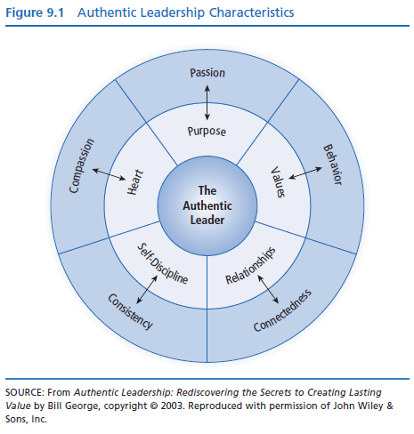

Slide 9
Theoretical Approaches to Authentic Leadership
Recent Research Spurred By
Leadership summit publications (2005)
Social upheaval and desire for leadership that serves the common good
Need to explore meaning of authentic leadership and create theoretical framework
Need to define the construct of authentic leadership
Peter G. Northouse, Leadership: Theory and Practice, Seventh Edition. © 2016 SAGE Publications, Inc.

Slide 10
Definition of Authentic Leadership
“A pattern that draws upon and promotes both positive psychological capacities and a positive ethical climate, to foster greater self-awareness, an internalized moral perspective, balanced processing of information, and relational transparency on the part of leaders working with followers, fostering positive self-development.”
-Walumbwa, Avolio, Gardner, Wernsing, & Peterson, 2008
Peter G. Northouse, Leadership: Theory and Practice, Seventh Edition. © 2016 SAGE Publications, Inc.

Slide 11
Basic Model of Authentic Leadership
FOUR COMPONENTS
Self-awareness
Reflecting on one’s core values, identity, emotions, motives
Being aware of and trusting one’s own feelings
Internalized moral perspective
Self-regulatory process using internal moral standards to guide behavior
Balanced processing
Ability to analyze information objectively and explore other people’s opinions before making a decision
Relational transparency
Being open and honest in presenting one’s true self to others
Peter G. Northouse, Leadership: Theory and Practice, Seventh Edition. © 2016 SAGE Publications, Inc.

Slide 12
Factors That Influence Authentic Leadership
Positive psychological capacities
Confidence
Hope
Optimism
Resilience
Moral Reasoning Capacities
Deciding right and wrong
Promoting justice, greater good of the organization or community
Peter G. Northouse, Leadership: Theory and Practice, Seventh Edition. © 2016 SAGE Publications, Inc.

Slide 13
Factors That Influence Authentic Leadership
Critical Life Events
Positive or negative
Act as a catalyst for change
People attach insights to their life experiences
When people tell life stories they gain clarity about who they are
Stimulate personal growth
Peter G. Northouse, Leadership: Theory and Practice, Seventh Edition. © 2016 SAGE Publications, Inc.

Slide 14
How Does Authentic Leadership Theory Work?
Strengths
Criticisms
Application
Peter G. Northouse, Leadership: Theory and Practice, Seventh Edition. © 2016 SAGE Publications, Inc.

Slide 15
How Does Authentic Leadership Theory Work?
AL is a complex, developmental process
The practical approaches are prescriptive:
George (2003) – Five characteristics leaders need to be authentic
Theoretical approach describes what accounts for AL:
Four attributes
Attributes developed over lifetime, often through critical events
Peter G. Northouse, Leadership: Theory and Practice, Seventh Edition. © 2016 SAGE Publications, Inc.

Slide 16
Strengths
Fulfills society’s expressed need for trustworthy leadership. Fills a void in an uncertain world.
Provides broad guidelines for those who want to become authentic leaders. Both practical and theoretical approaches provide a map.
Like transformational and servant leadership, AL has an explicit moral dimension.
Unlike traits that only some people exhibit, everyone can learn to be more authentic.
Can be measured using an established instrument (ALQ).
Peter G. Northouse, Leadership: Theory and Practice, Seventh Edition. © 2016 SAGE Publications, Inc.

Slide 17
Criticisms
The theory is still in the formative stages, so some concepts in the practical approaches are not fully developed or substantiated.
The moral component of AL is not fully explained. It’s unclear how higher values such as justice inform authentic leadership.
The rationale for including positive psychological capacities as a part of AL has not been clearly explained by researchers.
The link between authentic leadership and positive organizational outcomes is unclear. It is also not clear whether AL is sufficient to achieve organizational goals.
Peter G. Northouse, Leadership: Theory and Practice, Seventh Edition. © 2016 SAGE Publications, Inc.

Slide 18
Application
People have the capacity to become authentic leaders. It is a lifelong learning process.
Human resource departments may be able to foster authentic leadership behaviors in employees who move into leadership positions.
Leaders are always trying to do the “right” thing, to be honest with themselves and others, and to work for the common good.
Leaders are shaped by critical life events that lead to growth and greater authenticity.
Peter G. Northouse, Leadership: Theory and Practice, Seventh Edition. © 2016 SAGE Publications, Inc.

