Slide 1
Chapter 11: Adaptive Leadership

Slide 2

Overview
Adaptive Leadership Description
A Model of Adaptive Leadership
How Does Adaptive Leadership Work?
Strengths, Criticisms, Application
Peter G. Northouse, Leadership: Theory and Practice, Seventh Edition. © 2016 SAGE Publications, Inc.

Slide 3
Description
Adaptive Leadership:
Focuses on the adaptations required of people in response to changing environments
Stresses the activities of the leader in relation to the work of followers in the contexts in which they find themselves
Encourages effective change across multiple levels: self, organizational, community, and societal
Framework developed largely by Heifetz and associates
Peter G. Northouse, Leadership: Theory and Practice, Seventh Edition. © 2016 SAGE Publications, Inc.

Slide 4
Definition
“The practice of mobilizing people to tackle tough challenges and thrive.”
Adaptive leaders:
Mobilize
Motivate
Organize
Orient
Focus the attention of others
Peter G. Northouse, Leadership: Theory and Practice, Seventh Edition. © 2016 SAGE Publications, Inc.

Slide 5
Incorporates Four Different Viewpoints
Systems Perspective – Problems are complex with interconnected parts
Biological Perspective – People develop and evolve by having to adapt to internal cues and the external environment
Service Orientation – Leadership serves people by diagnosing their problems and prescribing possible solutions
Psychotherapy Perspective – People adapt successfully when they face problems directly, distinguish between fantasy and reality, resolve internal conflicts, and learn new attitudes and behaviors
Peter G. Northouse, Leadership: Theory and Practice, Seventh Edition. © 2016 SAGE Publications, Inc.

Slide 6
Subset of Complexity Leadership Theory
21st century organizations have knowledge and information as core commodities rather than production of goods
Theory includes administrative, adaptive, and enabling leadership
Focuses on strategies that encourage learning, creativity, and adaptation in complex organizations
Peter G. Northouse, Leadership: Theory and Practice, Seventh Edition. © 2016 SAGE Publications, Inc.

Slide 7
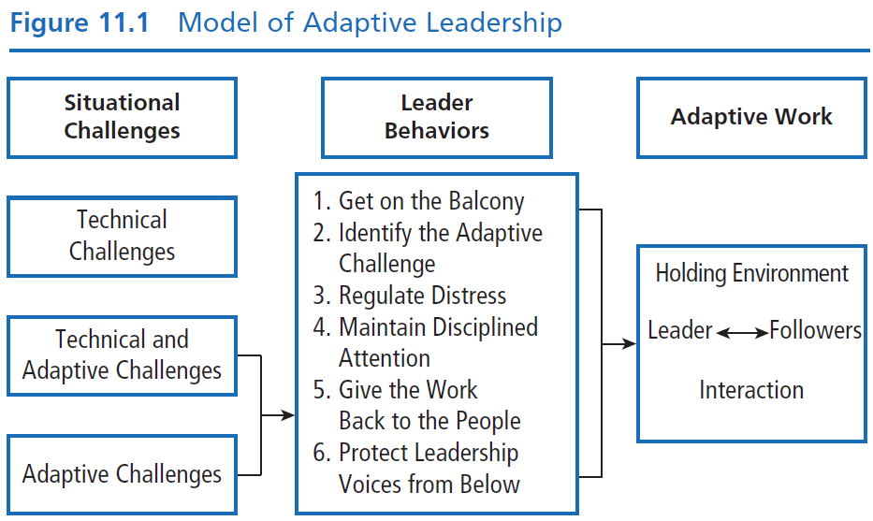
Peter G. Northouse, Leadership: Theory and Practice, Seventh Edition. © 2016 SAGE Publications, Inc.

Slide 8
Model of Adaptive Leadership
Situational Challenges
Technical : Problems that are clearly defined with known solutions that can be implemented through existing organizational procedures
Example: Issues with newly adopted software at accounting firm. Manager has authority to address the problem, contact the software company, and have program modified to meet accountants’ needs.
Peter G. Northouse, Leadership: Theory and Practice, Seventh Edition. © 2016 SAGE Publications, Inc.

Slide 9
Model of Adaptive Leadership
Situational Challenges
Technical and Adaptive: Challenges are clearly defined but do not have straightforward solutions. Leader and followers both tackle problem.
Example: Hospital wants to change from traditional approach to care to a patient-centered culture. Administration can offer training on how to involve patients in their own care. Medical staff , patients, and families need to accept the change and learn how to implement it.
Peter G. Northouse, Leadership: Theory and Practice, Seventh Edition. © 2016 SAGE Publications, Inc.

Slide 10
Model of Adaptive Leadership
Situational Challenges
Adaptive: Problems that are not clear- cut or easy to identify.
Example: Hospice care and uncertainty for patients and families about how and when the patient will die. Many questions about the dying process, what the loss means, how to prepare for it and cope with it.
Peter G. Northouse, Leadership: Theory and Practice, Seventh Edition. © 2016 SAGE Publications, Inc.

Slide 11
Model of Adaptive Leadership
Leader Behaviors
Get on the Balcony
Stepping out of the fray and finding perspective in the midst of a challenging situation, while still staying connected. Moving back and forth as participant and observer.
Identify Adaptive Challenges
Analyzing and diagnosing challenges. Distinguishing between technical and adaptive challenges.
Peter G. Northouse, Leadership: Theory and Practice, Seventh Edition. © 2016 SAGE Publications, Inc.

Slide 12
Model of Adaptive Leadership
Adaptive Challenges
Use adaptive leadership behaviors for adaptive challenges and technical leadership for technical challenges
Technical: Can be fixed with leader’s own expertise and authority
Adaptive: Value laden and stirs up people’s emotions
Peter G. Northouse, Leadership: Theory and Practice, Seventh Edition. © 2016 SAGE Publications, Inc.

Slide 13
Model of Adaptive Leadership
Four Archetypes of Adaptive Change
Gap between espoused values and behavior
When an organization espouses values that it doesn’t in reality support by its actions. Ex. Claiming to be family-friendly but not providing flextime.
Competing commitments
When an organization has numerous commitments and some conflict with each other. Ex. Wanting to expand services but cutting staff positions at the same time.
Peter G. Northouse, Leadership: Theory and Practice, Seventh Edition. © 2016 SAGE Publications, Inc.

Slide 14
Model of Adaptive Leadership
Speaking the unspeakable
When there are ideas or unpopular ideas or conflicting perspectives that people don’t dare to address. Ex. People afraid to discuss the failing skills of an aged, but likable company owner.
Work avoidance
Where people avoid addressing difficult issues by staying in their comfort zones or by using diversion. Ex. Refusing to confront a skilled employee whose performance is slacking because he feels the company suffers from institutional racism.
Peter G. Northouse, Leadership: Theory and Practice, Seventh Edition. © 2016 SAGE Publications, Inc.

Slide 15
Model of Adaptive Leadership
Leader Behaviors
Regulate Distress
Helping others recognize the need for change but not become overwhelmed. Monitoring stress and keeping it within a productive range.
Create a holding environment
Provide direction, protection, orientation, conflict management, productive norms
Regulate personal distress
Peter G. Northouse, Leadership: Theory and Practice, Seventh Edition. © 2016 SAGE Publications, Inc.

Slide 16
Model of Adaptive Leadership
Maintain Disciplined Attention
Encouraging people to focus on the tough work they need to do. Helping people address change and not avoid it.
Avoidance = ignoring the problem, blaming the problem on authority or co-workers, attacking those who want to address the problem, pretending the problem doesn’t exist, working hard in areas unrelated to the problem
Peter G. Northouse, Leadership: Theory and Practice, Seventh Edition. © 2016 SAGE Publications, Inc.

Slide 17
Model of Adaptive Leadership
Give the Work Back to the People
Too much leadership and authority can be debilitating, decrease people’s confidence to solve problems on their own, and suppress their creative capacities.
Leaders need to be attentive to when they should drop back and let the people do the work that they need to do.
Protect Leadership Voices from Below
Being open to the ideas of people who may be at the fringe, marginalized, or even deviant in the group or organization.
Peter G. Northouse, Leadership: Theory and Practice, Seventh Edition. © 2016 SAGE Publications, Inc.

Slide 18
Adaptive Work
The process toward which adaptive leaders direct their work.
Grows out of the communication between leaders and followers but is primarily the work of followers.
Adaptive work is conducted in the holding environment.
Followers are not submissive to leaders; they are the ones doing adaptive work
Peter G. Northouse, Leadership: Theory and Practice, Seventh Edition. © 2016 SAGE Publications, Inc.

Slide 19
How Does Adaptive Leadership Work?
Focus is on engaging individuals to do adaptive work
Leaders support followers during changes in the environment
Leader steps back from situation to gain fresh perspective.
Leader decides whether challenges are technical or adaptive.
If technical, leader uses authority and expertise to solve.
If adaptive, leader uses several prescribed behaviors to move the adaptive process forward.
Peter G. Northouse, Leadership: Theory and Practice, Seventh Edition. © 2016 SAGE Publications, Inc.

Slide 20
Strengths
In contrast to other leadership theories, AL takes a process approach; leadership is a complex transaction between leaders and followers.
AL is follower centered. Adaptive leaders mobilize people to engage in adaptive work.
Helps followers deal with conflicting values that emerge in changing work environments.
Prescribes useful leadership behaviors.
Contributes concept of a “holding environment” as an integral part of the leadership process.
Peter G. Northouse, Leadership: Theory and Practice, Seventh Edition. © 2016 SAGE Publications, Inc.

Slide 21
Criticisms
Very little empirical research has been conducted to test the claims of the theory.
Model needs to be refined; relationships between factors need to be clarified.
AL is too wide ranging and abstract.
Doesn’t directly explain how AL incorporates a moral dimension. Unclear how doing adaptive work leads to socially useful outcomes.
Peter G. Northouse, Leadership: Theory and Practice, Seventh Edition. © 2016 SAGE Publications, Inc.

Slide 22
Application
On individual level, the model provides a conceptual framework to help us determine types of challenges and strategies for managing them.
On organizational level, explains a variety of challenges. Widely used in nonprofits, faith-based organizations, and health care.
Peter G. Northouse, Leadership: Theory and Practice, Seventh Edition. © 2016 SAGE Publications, Inc.

