Slide 1
Chapter 13: Leadership Ethics

Slide 2

Overview
Leadership Ethics Perspective
Practical Ethical Theory
Ethical Theories
Principles of Ethical Leadership
Diverse Ethical Perspectives
How Does the Leadership Ethical Perspective Work?
Peter G. Northouse, Leadership: Theory and Practice, Seventh Edition. © 2016 SAGE Publications, Inc.

Slide 3
Leadership Ethics Description
Definition & Theory
Ethics
Is a derivative of the Greek word ethos, meaning customs, conduct, or character
Is concerned with the kinds of values and morals an individual or society ascribes as desirable or appropriate
Focuses on the virtuousness of individuals and their motives
Peter G. Northouse, Leadership: Theory and Practice, Seventh Edition. © 2016 SAGE Publications, Inc.
Notes:
Development of ethocal theory goes back to Plato and Aristotle.

Slide 4
Practical Ethical Theory
Kohlberg’s Stages of Moral Development
Level 1. Pre-conventional morality
Stage 1 – Obedience and Punishment: Rules are fixed and handed down by authority
Stage 2 – Individualism and Exchange: An action is right if it serves the individual
Level 2. Conventional Morality
Stage 3 – Interpersonal Accord and Conformity: Conforming to the expectations of others
Peter G. Northouse, Leadership: Theory and Practice, Seventh Edition. © 2016 SAGE Publications, Inc.

Slide 5
Kohlberg’s Stages of Moral Development
Stage 4 – Maintaining the Social Order: Moral decisions show concern for society as a whole
Level 3. Post-conventional Morality
Stage 5 – Social Contract and Individual Rights: Moral decisions based on what a good society should be like
Stage 6 – Universal Principles: Moral decisions based on internalized universal principles of justice that apply to everyone
Peter G. Northouse, Leadership: Theory and Practice, Seventh Edition. © 2016 SAGE Publications, Inc.

Slide 6
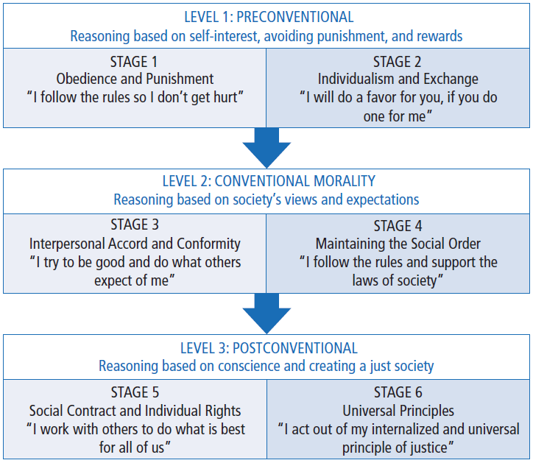
Notes:
Add table

Slide 7
Leadership Ethics Description
Definition & Theory
Ethical Theory
Provides a system of rules or principles as a guide in making decisions about what is right/wrong and good/bad in a specific situation
Provides a basis for understanding what it means to be a morally decent human being
Peter G. Northouse, Leadership: Theory and Practice, Seventh Edition. © 2016 SAGE Publications, Inc.
Notes:
Development of ethocal theory goes back to Plato and Aristotle.

Slide 8
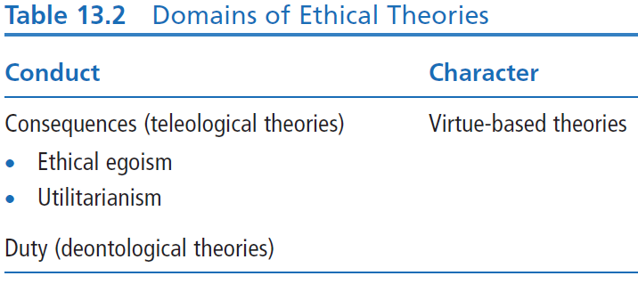
Ethical Theories
Two Broad Domains: Theories about leaders’ conduct and about leaders’ character
Peter G. Northouse, Leadership: Theory and Practice, Seventh Edition. © 2016 SAGE Publications, Inc.
Notes:
table number incorrect

Slide 9
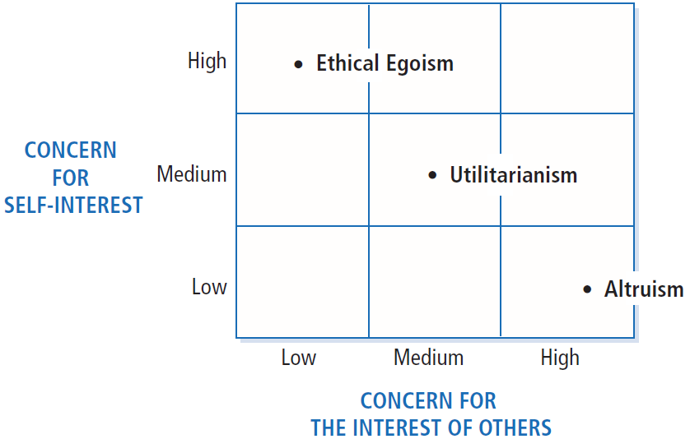
Notes:
Page 304 in text. Figure number incorrect?

Slide 10
Ethical Theories
Teleological Theories: focus on consequences of actions, results
CONDUCT
Ethical egoism (create greatest good for the leader)
Closely related to transactional leadership theories
Example: leader takes a political stand on an issue for no other reason than to get re-elected
Utilitarianism (create greatest good for greatest number)
Example: leader distributes scarce resources so as to maximize benefit to everyone, while hurting the fewest; preventive health care vs. catastrophic illnesses
Altruism (show concern for best interests of others)
Authentic transformational leadership is based on altruistic principles
Example: the work of Mother Teresa, who gave her entire life to help the poor
Notes:
Teleological – consequenses of

Slide 11
Ethical Theories
CONDUCT
Deontological Theories
duty driven, for example, relates not only to consequences but also to whether action itself is good
Focus on the actions of the leader and his/her moral obligation and responsibilities to do the right thing
Example: telling the truth, keeping promises, being fair
Peter G. Northouse, Leadership: Theory and Practice, Seventh Edition. © 2016 SAGE Publications, Inc.
Notes:
Teleological – consequenses of

Slide 12
Ethical Theories
CHARACTER
Virtue-based Theories: about leader’s character
Focus on who people are as people
Rather than tell people what to do, tell people what to be
Help people become more virtuous through training and development
Virtues are present within person’s disposition; practice makes good values habitual
Examples: courage, honesty, fairness, justice, integrity, humility
Peter G. Northouse, Leadership: Theory and Practice, Seventh Edition. © 2016 SAGE Publications, Inc.

Slide 13
Centrality of Ethics to Leadership
Influence dimension of leadership requires the leader to have an impact on the lives of followers
Power and control differences create enormous ethical responsibility for leaders
Respect for persons – sensitive to followers’ own interests and needs
Leaders help to establish and reinforce organizational values – an ethical climate
Peter G. Northouse, Leadership: Theory and Practice, Seventh Edition. © 2016 SAGE Publications, Inc.
Notes:
Ethics plays a central role in the leadership process.

Slide 14
Diverse Perspectives of Leadership
Heifetz’s Perspective
Emphasizes how leaders help followers to confront conflicting values & to effect change from conflict
Ethical perspective that speaks directly to
Values of workers
Values of organizations and the communities in which they work
Peter G. Northouse, Leadership: Theory and Practice, Seventh Edition. © 2016 SAGE Publications, Inc.
Notes:
Several prominent scholars – Heifetz, Burns and Greenleaf – they’ve made unique contributions to our understanding of ethical leadership –
The theme that is common to all 3 – is an ethic of caring - which pays attention to followers needs and the importance of leader-follower relationships.

Slide 15
Diverse Perspectives of Leadership
Heifetz’s Perspective
Leaders use authority to mobilize followers to
Get people focused on issues
Act as a reality test regarding information
Manage and frame issues
Orchestrate conflicting perspectives
Facilitate the decision-making process
Peter G. Northouse, Leadership: Theory and Practice, Seventh Edition. © 2016 SAGE Publications, Inc.
Notes:
Several prominent scholars – Heifetz, Burns and Greenleaf – they’ve made unique contributions to our understanding of ethical leadership –
The theme that is common to all 3 – is an ethic of caring - which pays attention to followers needs and the importance of leader-follower relationships.

Slide 16
Diverse Perspectives of Leadership
Heifetz’s Perspective
Leaders use authority to mobilize followers to
Get people focused on issues
Act as a reality test regarding information
Manage and frame issues
Orchestrate conflicting perspectives
Facilitate the decision-making process
Leader provides a holding environment, a supportive context in which there is
Trust, nurturance, & empathy
Leader’s duties
Assist the follower in struggling with change and personal growth
Peter G. Northouse, Leadership: Theory and Practice, Seventh Edition. © 2016 SAGE Publications, Inc.
Notes:
Several prominent scholars – Heifetz, Burns and Greenleaf – they’ve made unique contributions to our understanding of ethical leadership –
The theme that is common to all 3 – is an ethic of caring - which pays attention to followers needs and the importance of leader-follower relationships.

Slide 17
Diverse Perspectives of Leadership
Burns’s Perspective
Theory of Transformational Leadership
Strong emphasis on followers’ needs, values, & morals
Leaders help followers in their personal struggles concerning conflicting values
Stressing values such as liberty, justice, equality
Connection between leader & follower
Raises level of morality of both
Leader’s Role
Assist followers in assessing their values & needs
Help followers to rise to a higher level of functioning
Peter G. Northouse, Leadership: Theory and Practice, Seventh Edition. © 2016 SAGE Publications, Inc.
Notes:
Several prominent scholars – Heifetz, Burns and Greenleaf – they’ve made unique contributions to our understanding of ethical leadership –
The theme that is common to all 3 – is an ethic of caring - which pays attention to followers needs and the importance of leader-follower relationships.

Slide 18
The Dark Side of Leadership
Pseudotransformational leadership
Characterized by destructive behaviors, such as violating basic human rights (Lipman-Blumen, 2005)
Characterized by personal characteristics, such as lack of integrity, insatiable ambition, arrogance (Lipman-Blumen)
Associated with workplace outcomes such as negative attitudes in followers toward jobs and organization as a whole (Schyns and Schilling, 2013)
Peter G. Northouse, Leadership: Theory and Practice, Seventh Edition. © 2016 SAGE Publications, Inc.
Notes:
Add date to citation in 3rd bullet point

Slide 19

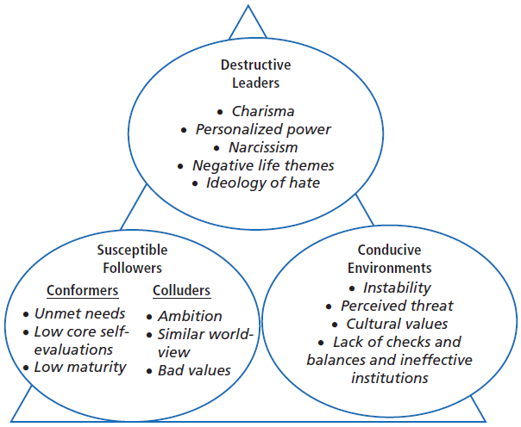
SOURCE: Padilla, A., Hogan, R., & Kaiser, R. B. (2007). The toxic triangle: Destructive leaders, susceptible followers, and conducive environments. The Leadership Quarterly, 18, 180.
Notes:
Add figure

Slide 20
The Toxic Triangle
Destructive Leaders
Charismatic, narcissistic, self-absorbed
Susceptible Followers
Conformers and colluders
Conducive Environments
Unstable environments may grant leader more authority
Peter G. Northouse, Leadership: Theory and Practice, Seventh Edition. © 2016 SAGE Publications, Inc.

Slide 21
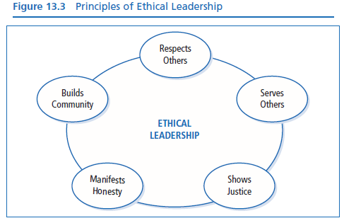
Ethics - is central to leadership because of
The process of influence
The need to engage followers to accomplish mutual goals
The impact leaders have on establishing the organization’s values
Peter G. Northouse, Leadership: Theory and Practice, Seventh Edition. © 2016 SAGE Publications, Inc.
Notes:
Discussion of 5 principles of ethical leadership – These principles provide a foundation for the development of sound ethical leadership
Incorrect figure number?
In addition I am emphasizing 3 points that reinforce the impact a leader has on followers, and the responsibility leaders have to be sensitive to how their leadership affects followers lives and why Ethics is central to leadership, because of -

Slide 22
Principles of Ethical Leadership
Treating others as ends (their own goals) rather than as means (to leaders’ personal goals)
Respects
Others
Leader shall:
Treat other people’s values and decisions with respect
Allow others to be themselves with creative wants and desires
Approach others with a sense of unconditional worth and value individual differences
Leader behaviors:
Listens closely to subordinates
Is empathic
Is tolerant of opposing viewpoints
Peter G. Northouse, Leadership: Theory and Practice, Seventh Edition. © 2016 SAGE Publications, Inc.

Slide 23
Principles of Ethical Leadership
Follower centered - Based on the altruistic principle of placing followers foremost in the leader’s plans
Leaders have
A duty to help others pursue their own legitimate interests and goals
To be stewards of the organization’s vision; in serving others they: clarify, nurture, and integrate the vision with, not for, organization members
An ethical responsibility to make decisions that are beneficial to their followers’ welfare
Serves
Others
Leader behaviors
Mentoring behaviors
Empowerment behaviors
Team-building behaviors
Citizenship behaviors
Peter G. Northouse, Leadership: Theory and Practice, Seventh Edition. © 2016 SAGE Publications, Inc.

Slide 24
Principles of Ethical Leadership
Ethical leaders are concerned with issues of fairness and justice; they place issues of fairness at the center of their decision making
Shows
Justice
Leaders shall:
Adhere to principles of distributive justice
Leader behaviors
All subordinates are treated in an equal manner
In special treatment/special consideration situations, grounds for differential treatment are clear, reasonable, and based on sound moral values
Peter G. Northouse, Leadership: Theory and Practice, Seventh Edition. © 2016 SAGE Publications, Inc.

Slide 25
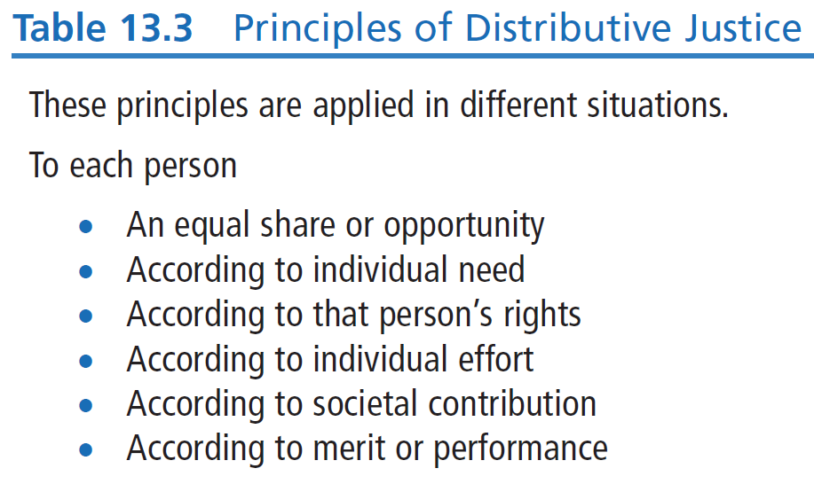
Principles of Ethical Leadership
Notes:
Incorrect table number?

Slide 26
Principles of Ethical Leadership
Manifests
Honesty
Honest leaders are authentic but also sensitive to the feelings and attitudes of others
Leaders:
Are not deceptive
Tell the truth with a balance of openness and candor while monitoring what is appropriate to disclose in a particular situation
Leader behaviors
Don’t promise what you can’t deliver
Don’t suppress obligations
Don’t evade accountability
Don’t accept “survival of the fittest” pressures
Acknowledge and reward honest behavior in the organization
Peter G. Northouse, Leadership: Theory and Practice, Seventh Edition. © 2016 SAGE Publications, Inc.

Slide 27
Principles of Ethical Leadership
Builds
Community
Concern for common good means leaders cannot impose their will on others; they search for goals that are compatible with everyone.
Leader behaviors
Takes into account purposes of everyone in the group
Is attentive to interests of the community and culture
Does not force others or ignore intentions of others
Ethical leaders & followers
take into account purposes of everyone in the group, and
reach out beyond their own mutually defined goals to wider community
Peter G. Northouse, Leadership: Theory and Practice, Seventh Edition. © 2016 SAGE Publications, Inc.

Slide 28
How Does the Ethical Leadership Perspective Work?
Strengths
Criticisms
Application
Peter G. Northouse, Leadership: Theory and Practice, Seventh Edition. © 2016 SAGE Publications, Inc.

Slide 29
Strengths
Provides a body of timely research on ethical issues
Provides direction on how to think about ethical leadership and how to practice it
Suggests that leadership is not an amoral phenomenon and that ethics should be considered as integral to the broader domain of leadership
Highlights principles and virtues that are important in ethical leadership development
Peter G. Northouse, Leadership: Theory and Practice, Seventh Edition. © 2016 SAGE Publications, Inc.

Slide 30
Criticisms
Lacks a strong body of traditional research findings to substantiate the theoretical foundations
Relies heavily on writings of just a few individuals that are primarily descriptive and anecdotal in nature, and are strongly influenced by personal opinion and a particular worldview
Peter G. Northouse, Leadership: Theory and Practice, Seventh Edition. © 2016 SAGE Publications, Inc.

Slide 31
Application
Can be applied to individuals at all levels of organization and in all walks of life
Because leadership has a moral dimension, being a leader demands awareness on our part of the way our ethics define our leadership
Managers and leaders can use information on ethics to understand themselves and strengthen their own leadership
Leaders can use ethical principles as benchmarks for their own behavior
Leaders can learn that leader-follower relationship is central to ethical leadership
Peter G. Northouse, Leadership: Theory and Practice, Seventh Edition. © 2016 SAGE Publications, Inc.

