Slide 1
Chapter 14: Team Leadership

Slide 2

Overview
Team Leadership Perspective
Team Leadership Model
Team Effectiveness
Leadership Decisions
Leadership Actions
How Does the Team Leadership Model Work?
Peter G. Northouse, Leadership: Theory and Practice, Seventh Edition. © 2016 SAGE Publications, Inc.

Slide 3
Descriptions and Perspectives
Team
Group of organizational members who are interdependent, share common goals, and coordinate activities to accomplish those goals
Can meet face-to-face or be virtual
“Team-based and technology enabled” = newer organizational structures
Outcomes of Effective Teams
Greater productivity
More effective use of resources
Better decisions and problem solving
Better-quality products and services
Greater innovation and creativity (Parker, 1990)
Peter G. Northouse, Leadership: Theory and Practice, Seventh Edition. © 2016 SAGE Publications, Inc.

Slide 4
Descriptions and Perspectives
Organizational culture needs to support employee involvement
Heterarchy: fluid power shifting in teams
Team leadership is process oriented
How do teams develop critical capabilities?
How do team leaders adjust to contingencies as they arise?
How do leader actions promote task and interpersonal development?
Shared or Distributed Leadership
When members of the team take on leadership behaviors to influence the team and maximize team effectiveness
Peter G. Northouse, Leadership: Theory and Practice, Seventh Edition. © 2016 SAGE Publications, Inc.

Slide 5
Team Leadership Model
Model provides leader or designated team member with a mental model to help
Diagnose team problems, and
Take appropriate action to correct team problems
Effective team performance begins with leader’s mental model of the situation
Mental model reflects
Components of the problem
Environmental & organizational contingencies
Peter G. Northouse, Leadership: Theory and Practice, Seventh Edition. © 2016 SAGE Publications, Inc.

Slide 6
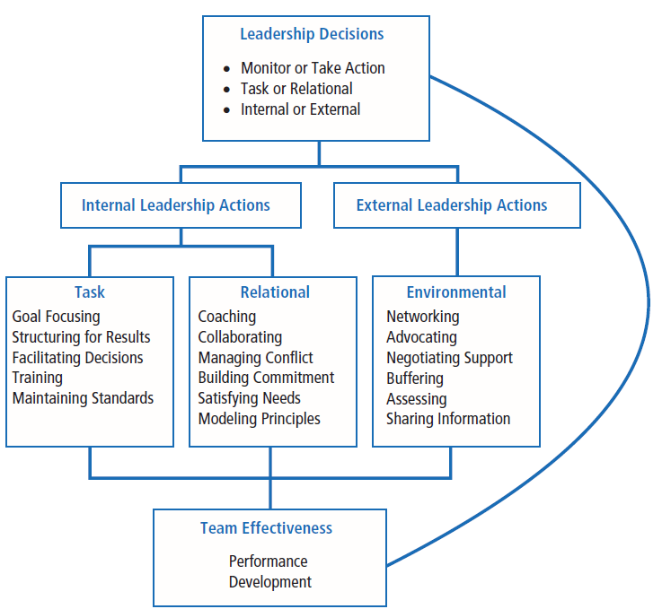

Slide 7
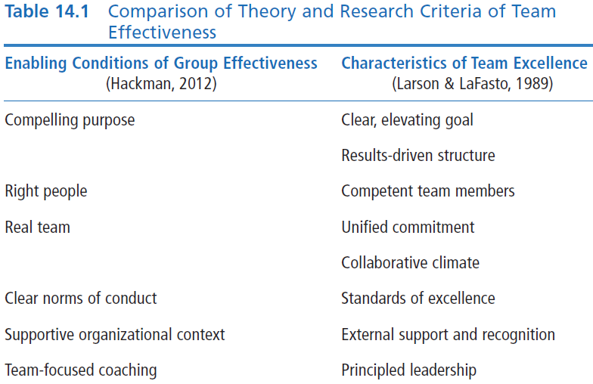
Team Effectiveness

Slide 8
Team Effectiveness
Clear, Elevating Goal
Clear so that one can tell whether performance objective has been met
Motivating or involving so that members believe it is worthwhile and important
Results-Driven Structure
Need to find the best structure to achieve goals
Clear team member roles
Good communication system
Methods to assess individual performance
An emphasis on fact-based judgments
Peter G. Northouse, Leadership: Theory and Practice, Seventh Edition. © 2016 SAGE Publications, Inc.

Slide 9
Team Effectiveness
Core Competencies
Ability to do the job well
Problem-solving ability
Competent Team Members
Components
Right number and mix of members
Members must be provided
Sufficient information
Education and training
Requisite technical skills
Interpersonal & teamwork skills
Team Factors
Openness
Supportiveness
Action orientation
Positive personal style
Peter G. Northouse, Leadership: Theory and Practice, Seventh Edition. © 2016 SAGE Publications, Inc.

Slide 10
Team Effectiveness
Unified Commitment
Teams need a carefully designed and developed sense of unity or identification (team spirit)
Collaborative Climate
Trust based on openness, honesty, consistency, and respect
Integration of individual actions
Teams contribute to collective success by
Coordinating individual contributions
Team leaders making communication safe
Team leaders demanding and rewarding collaborative behavior
Team leaders guiding the team’s problem-solving efforts
Team leaders managing their own control needs
Peter G. Northouse, Leadership: Theory and Practice, Seventh Edition. © 2016 SAGE Publications, Inc.

Slide 11
Team Effectiveness
Standards of Excellence
Regulated Performance
Facilitates task completion and coordinated action
Stimulates a positive pressure for members to perform at highest levels
How Accomplished
Requiring results (clear expectations)
Reviewing results (feedback/resolve issues)
Rewarding results (acknowledge superior performance)
Peter G. Northouse, Leadership: Theory and Practice, Seventh Edition. © 2016 SAGE Publications, Inc.

Slide 12
Team Effectiveness
External Support and Recognition
Regulated Performance
Teams supported by external resources are
Given the material resources needed to do their jobs
Recognized for team accomplishments
Rewarded by tying those rewards to team members’ performance, not individual achievement
Peter G. Northouse, Leadership: Theory and Practice, Seventh Edition. © 2016 SAGE Publications, Inc.

Slide 13
Team Effectiveness
Principled Leadership influences team effectiveness through four sets of processes (Zaccaro et al., 2001)
Cognitive - Facilitates team’s understanding of problems confronting them
Motivational - Helps team become cohesive & capable by setting high performance standards & helping team to achieve them
Affective - Assists team in handling stressful circumstances by providing clear goals, assignments, & strategies
Integrative - Helps coordinate team’s activities through matching member roles, clear performance strategies, feedback, & adapting to environmental changes
Peter G. Northouse, Leadership: Theory and Practice, Seventh Edition. © 2016 SAGE Publications, Inc.

Slide 14
Leadership Decision 1 Should I Monitor the Team or Take Action?
Leaders can
Diagnose, analyze, or forecast problems (monitoring) or take immediate action to solve a problem
Focus on problems within the group (internal) or which problems need intervention
Make choices about which solutions are the most appropriate
Effective leaders have the ability to determine what interventions are needed, if any, to solve team problems
All members of the team can engage in monitoring
Leaders differ in timing of taking action
Peter G. Northouse, Leadership: Theory and Practice, Seventh Edition. © 2016 SAGE Publications, Inc.

Slide 15
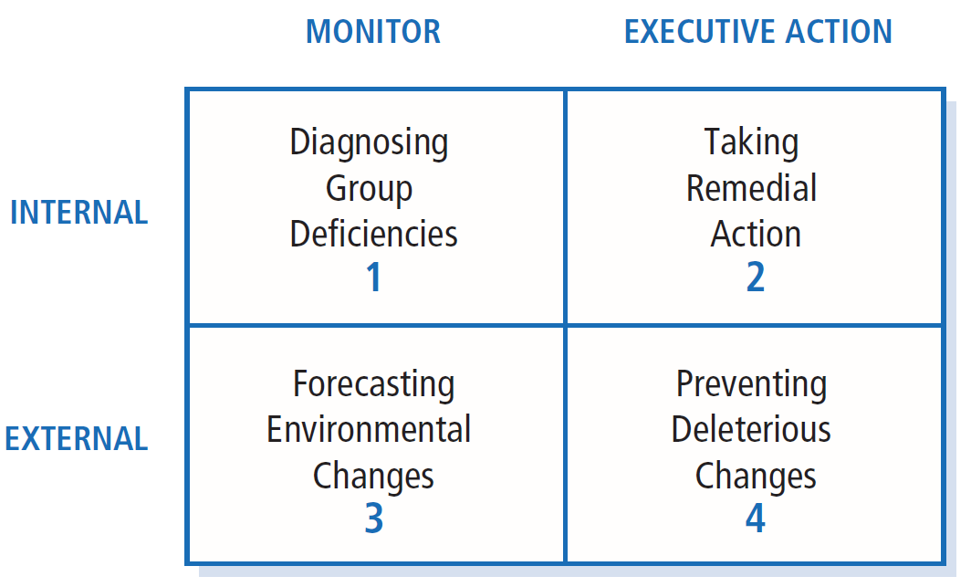
SOURCE: McGrath’s critical leadership functions as cited in “Leading Groups in Organizations,” by J. R. Hackman and R. E. Walton, 1986, in P. S. Goodman & Associates (Eds.), Designing Effective Work Groups (p. 76). San Francisco: Jossey-Bass.

Slide 16
Leadership Decision 2 Should I Intervene to Meet Task or Relational Needs?
Task
Getting job done
Making decisions
Solving problems
Adapting to change
Making plans
Achieving goals
Maintenance Functions
Developing positive climate
Solving interpersonal problems
Satisfying members’ needs
Developing cohesion
Even more challenging in virtual teams
Peter G. Northouse, Leadership: Theory and Practice, Seventh Edition. © 2016 SAGE Publications, Inc.

Slide 17
Leadership Decision 3 Should I Intervene Internally or Externally?
Leader must
Determine what level of team process needs leadership attention:
Use internal task or relational team dynamics, if
Conflict between group members
Team goals unclear
Use external environmental dynamics, if
Organization not providing proper support to team
Peter G. Northouse, Leadership: Theory and Practice, Seventh Edition. © 2016 SAGE Publications, Inc.

Slide 18
Leadership Actions
Leadership Functions – performed internally or externally
Internal Leadership Actions
External Leadership Actions
Task
Goal focusing
Structuring for results
Facilitating decision making
Training
Maintaining standards
Relational
Coaching
Collaborating
Managing conflict
Building commitment
Satisfying needs
Modeling principles
Environmental
Networking
Advocating
Negotiating support
Buffering
Assessing
Sharing information
Peter G. Northouse, Leadership: Theory and Practice, Seventh Edition. © 2016 SAGE Publications, Inc.

Slide 19
Internal Task Leadership Actions
Set of skills or actions leader might perform to improve task performance:
Goal focusing (clarifying, gaining agreement)
Structuring for results (planning, visioning, organizing, clarifying roles, delegating)
Facilitating decision making (informing, controlling, coordinating, mediating, synthesizing, issue focusing)
Training team members in task skills (educating, developing)
Maintaining standards of excellence (assessing team and individual performance, confronting inadequate performance)
Peter G. Northouse, Leadership: Theory and Practice, Seventh Edition. © 2016 SAGE Publications, Inc.

Slide 20
Internal Relational Leadership Actions
Set of actions leader needs to implement to improve team relationships:
Coaching team members in interpersonal skills
Collaborating (including, involving)
Managing conflict and power issues (avoiding confrontation, questioning ideas)
Building commitment and esprit de corps (being optimistic, innovating, envisioning, socializing, rewarding, recognizing)
Satisfying individual member needs (trusting, supporting, advocating)
Modeling ethical and principled practices (fair, consistent, normative)
Peter G. Northouse, Leadership: Theory and Practice, Seventh Edition. © 2016 SAGE Publications, Inc.

Slide 21
External Environmental Leadership Actions
Set of skills or behaviors leader needs to implement to improve environmental interface with team:
Networking and forming alliances in environment (gather information, increase influence)
Advocating and representing team to environment
Negotiating upward to secure necessary resources, support, and recognition for team
Buffering team members from environmental distractions
Assessing environmental indicators of team’s effectiveness (surveys, evaluations, performance indicators)
Sharing relevant environmental information with team
Peter G. Northouse, Leadership: Theory and Practice, Seventh Edition. © 2016 SAGE Publications, Inc.

Slide 22
How Does the Team Leadership Approach Work?
Focus of Team Leadership
Strengths
Criticisms
Application
Peter G. Northouse, Leadership: Theory and Practice, Seventh Edition. © 2016 SAGE Publications, Inc.

Slide 23
Team Leadership
Model provides a cognitive map to identify group needs and offers suggestions on appropriate corrective actions
Model assists leader in making sense of the complexity of groups and provides suggested actions to improve group effectiveness
Peter G. Northouse, Leadership: Theory and Practice, Seventh Edition. © 2016 SAGE Publications, Inc.

Slide 24
Strengths
Focus on real-life organizational group work; model is useful for teaching
Provides a cognitive guide that assists leaders in designing and maintaining effective teams
Recognizes the changing role of leaders and followers in organizations
Can be used as a tool in group leader selection
Peter G. Northouse, Leadership: Theory and Practice, Seventh Edition. © 2016 SAGE Publications, Inc.

Slide 25
Criticisms
Model is incomplete. Additional skills might be needed
May not be practical as the model is complex and doesn’t provide easy answers for difficult leader decisions
Fails to consider teams that have distributed leadership, where team members have a range of skills, and where roles may change
More focus required on how to teach and provide skill development in areas of diagnosis and action taking
Peter G. Northouse, Leadership: Theory and Practice, Seventh Edition. © 2016 SAGE Publications, Inc.

Slide 26
Application
Useful in leader decision making
Can be used as a team diagnostic tool
Peter G. Northouse, Leadership: Theory and Practice, Seventh Edition. © 2016 SAGE Publications, Inc.

