Slide 1
Chapter 15: Gender and Leadership

Slide 2

Overview
Women and Leadership Perspective
The Glass Ceiling Turned Labyrinth
Evidence of the Leadership Labyrinth
Understanding the Labyrinth
Gender Differences in Leadership Styles and Effectiveness
Navigating the Labyrinth
Peter G. Northouse, Leadership: Theory and Practice, Seventh Edition. © 2016 SAGE Publications, Inc.

Slide 3
Gender and Leadership Approach Description
Historical View
Gender and Leadership
Researchers ignored issues related to gender & leadership until the 1970s
Scholars started by asking “Can women lead?”
Changed by women in leadership
Presence of women in corporate & political leadership
Highly effective female leaders – PepsiCo’s CEO, Avon’s CEO, General Ann Dunwoody, etc.
Peter G. Northouse, Leadership: Theory and Practice, Seventh Edition. © 2016 SAGE Publications, Inc.

Slide 4
Gender and Leadership Approach Description
Historical View
Current research primary questions
Do men and women lead differently?
Are men more effective leaders than women?
Why are women underrepresented in elite leadership roles?
Peter G. Northouse, Leadership: Theory and Practice, Seventh Edition. © 2016 SAGE Publications, Inc.

Slide 5
The Glass Ceiling Turned Labyrinth
Women
Currently outnumber men in higher education - 57% of bachelor’s degrees, 60% of master’s degrees, more than 50% of doctorates, nearly half of professional degrees (Catalyst, 2014c)
Make up nearly half of the US labor force - 46.8%
Still are underrepresented in upper echelons of America’s corporations & political system
Peter G. Northouse, Leadership: Theory and Practice, Seventh Edition. © 2016 SAGE Publications, Inc.

Slide 6
The Glass Ceiling Turned Labyrinth
Women
Occupy more than half of all management and professional positions and a quarter of all CEO positions (U.S. Bureau of Labor Statistics, 2013)
Hold only 14.4% of highest titles in the Fortune 500
Represent only 4% of Fortune 500 CEOs (Catalyst, 2014c)
Hold only 16.9% of Fortune 500 board seats
Peter G. Northouse, Leadership: Theory and Practice, Seventh Edition. © 2016 SAGE Publications, Inc.

Slide 7
The Glass Ceiling Turned Labyrinth
Women in Politics
99 of the 535 seats in the US Congress = 18.5%
20%: Senate; 18.2%: House of Representatives
Women of color occupy just 30 seats (Center for Women and Politics, 2014 a,b)
World average of women’s representation in national legislatures or parliaments is 21.9%. The United States is ranked 84th out of 189 countries (Inter-Parliamentary Union, April 2014).
High-ranking US women military officers = 6.9%
(U.S. Dept. of Defense)
Peter G. Northouse, Leadership: Theory and Practice, Seventh Edition. © 2016 SAGE Publications, Inc.

Slide 8
The Gender Gap in Leadership
Global phenomenon whereby women are disproportionately concentrated in lower-level and lower-authority leadership positions than men. (Powell & Graves, 2003)
Three types of explanations
Peter G. Northouse, Leadership: Theory and Practice, Seventh Edition. © 2016 SAGE Publications, Inc.

Slide 9
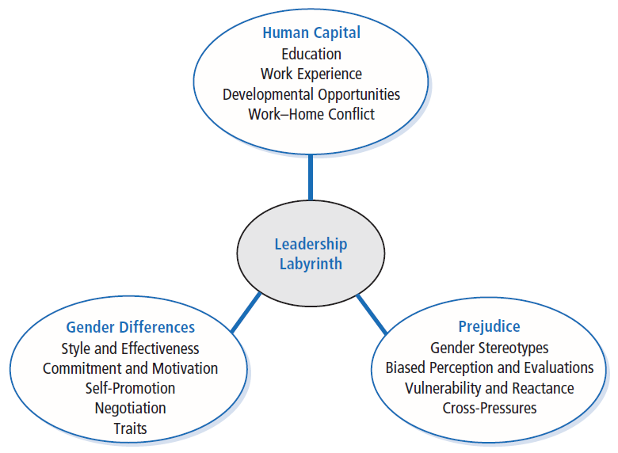

Slide 10
Understanding the Labyrinth
Human Capital Differences
Pipeline Problem – Women have less education, training, and work experience than men resulting in a dearth of qualified women.
Pipeline is not empty but leaking – Explanation that women haven’t been in managerial positions long enough for natural career progression to occur (Heilman, 1997) ; not supported by research.
Division of labor – Explanation that women self-select out of leadership tracks by choosing “mommy track” positions that do not funnel into leadership positions (Belkin, 2003; Ehrlich, 1989; Wadman, 1992); not supported by research (Eagly & Carli, 2004).
Peter G. Northouse, Leadership: Theory and Practice, Seventh Edition. © 2016 SAGE Publications, Inc.

Slide 11
Understanding the Labyrinth
Women
do have somewhat less work experience and continuity than men, largely due to disproportionate responsibility women assume for child rearing and domestic duties
respond to work-home conflicts by not marrying, not having children, becoming “superwomen,” taking leaves of absence or working part time
who use flextime and workplace leave are often marginalized; taking time off from a career makes reentry difficult (Williams, 2010)
Peter G. Northouse, Leadership: Theory and Practice, Seventh Edition. © 2016 SAGE Publications, Inc.

Slide 12
Understanding the Labyrinth
Women
occupy more than half of all management & professional positions (Catalyst, 2014c) but have fewer developmental opportunities
fewer responsibilities in the same jobs as men
are less likely to receive encouragement, be included in key networks, and receive formal job training than their male counterparts
confront greater barriers to establishing informal mentor relationships
Are more likely to be put in precarious leadership situations associated with greater risk and criticism
Peter G. Northouse, Leadership: Theory and Practice, Seventh Edition. © 2016 SAGE Publications, Inc.

Slide 13
Understanding the Labyrinth
Gender Differences in Leadership Styles and Effectiveness
Contrary to stereotypical expectations, women leaders aren’t less task oriented or more interpersonal than men leaders.
Women do lead in a more participative manner than men.
Adaptive style because women are devalued when they lead in a masculine manner, occupy a typically masculine role, or when evaluators are male
Peter G. Northouse, Leadership: Theory and Practice, Seventh Edition. © 2016 SAGE Publications, Inc.

Slide 14
Understanding the Labyrinth
Transformational leadership
Women’s styles tend to be more transforma-tional than men’s
Even as transformational leaders, they are valued less than men
Women engage in more contingent behavior than men
Peter G. Northouse, Leadership: Theory and Practice, Seventh Edition. © 2016 SAGE Publications, Inc.

Slide 15
Effectiveness of Male and Female Leaders
Men and women equally effective overall
Men and women more effective in roles congruent with their gender
Women less effective than men when role is masculinized (military), when supervising large numbers of men, or when rated by men
Somewhat more effective in education, government, social service; substantially more effective in middle management
Peter G. Northouse, Leadership: Theory and Practice, Seventh Edition. © 2016 SAGE Publications, Inc.

Slide 16
Commitment to Employment and Motivation to Lead
Men and women show same level of identification and commitment to paid employment roles
Men and women both view roles as workers as secondary to partner and parent roles
Women less likely to promote themselves for leadership positions
Women less likely to emerge as group leaders; more likely to serve as social facilitators
Men more likely to ask for what they want; Women less likely to negotiate or self-promote and receive more backlash when they do
Peter G. Northouse, Leadership: Theory and Practice, Seventh Edition. © 2016 SAGE Publications, Inc.

Slide 17
Understanding the Labyrinth
Prejudice
gender bias stemming from stereotyped expectations – “women take care and men take charge”
Stereotypes = cognitive shortcuts that influence the way people process information regarding groups and group members.
Gender stereotypes include beliefs about the attributes of men and women and prescribe how men and women ought to be.
Peter G. Northouse, Leadership: Theory and Practice, Seventh Edition. © 2016 SAGE Publications, Inc.

Slide 18
Understanding the Labyrinth
Gender Stereotypes
Pervasive, well documented, and highly resistant to change (Dodge, Gilroy, & Fenzel, 1995; Heilman, 2001)
Men are stereotyped with agentic characteristics
confidence, assertiveness, independence, rationality, & decisiveness
Women are stereotyped with communal characteristics
concern for others, sensitivity, warmth, helpfulness, & nurturance (Deaux & Kite, 1993; Heilman, 2001)
Peter G. Northouse, Leadership: Theory and Practice, Seventh Edition. © 2016 SAGE Publications, Inc.

Slide 19
Understanding the Labyrinth
Gender stereotypes explain numerous findings –
Women facing cross-pressures to be tough but not too “manly”
Greater difficulty for women to be viewed as effective in top leadership roles (Eagly & Karau, 2002)
Penalties for women who violate gender stereotypes (Ex. Price Waterhouse vs. Ann Hopkins; media coverage of 2008 Hillary Clinton presidential run)
Decision-makers influenced by homosocial reproduction, a tendency for a group to reproduce itself in its own image (Ex. Male leaders choosing male successors)
Peter G. Northouse, Leadership: Theory and Practice, Seventh Edition. © 2016 SAGE Publications, Inc.

Slide 20
Understanding the Labyrinth
How stereotypes affect women themselves
Pressure of tokenism (Kanter, 1977) and being scrutinized.
Women may assimilate to stereotype OR may counter the stereotype. Depends on
Leader’s self-efficacy
Explicitness of the stereotype
Type of task
Gender composition of the group
Power of the leader
Whether stereotype threats are combined
Peter G. Northouse, Leadership: Theory and Practice, Seventh Edition. © 2016 SAGE Publications, Inc.

Slide 21
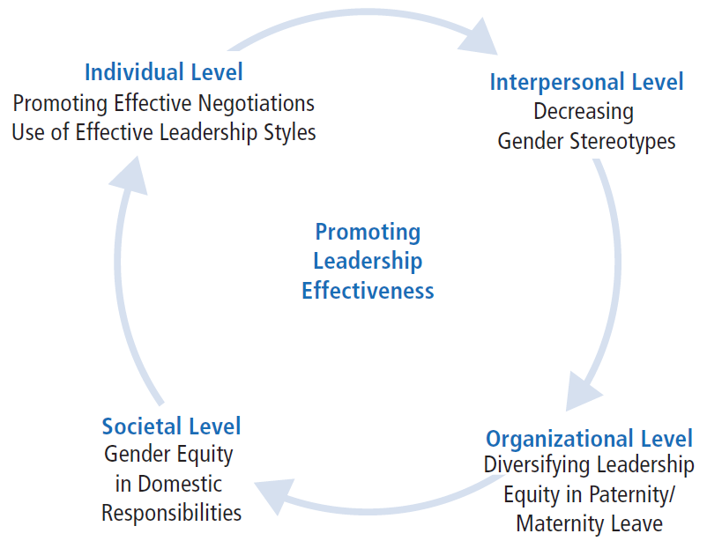

Slide 22
Navigating the Labyrinth
Factors contributing to leadership effectiveness & rise of female leaders
Culture of many organizations is changing
Gendered work assumptions are being challenged
Organizations valuing flexible workers & diversity of top managers & leaders
Developing effective & supportive mentoring relationships
Increasing parity in domestic responsibilities
Negotiating for valued positions and resources
Peter G. Northouse, Leadership: Theory and Practice, Seventh Edition. © 2016 SAGE Publications, Inc.

Slide 23
Navigating the Labyrinth
Factors contributing to leadership effectiveness & rise of female leaders
Women’s foray into entrepreneurship
Improving perceptions of women’s leadership by combining communal and agentic qualities
Adopting transformational leadership style
Becoming more assertive without losing their femininity
Peter G. Northouse, Leadership: Theory and Practice, Seventh Edition. © 2016 SAGE Publications, Inc.

Slide 24
Women and Leadership
Strengths
Criticisms
Application
Peter G. Northouse, Leadership: Theory and Practice, Seventh Edition. © 2016 SAGE Publications, Inc.

Slide 25
Strengths
Understanding the research in gender and leadership can help promote more women into upper echelons of leadership
Developing a more androgynous style of democratic leadership
Research on gender and leadership is productive in both dispelling myths about the gender gap and shining a light on aspects of the gender barrier that are difficult to see and therefore are overlooked
Understanding many components of the labyrinth will give us the tools necessary to combat this inequality from many perspectives
Research addresses larger, more significant considerations about gender and social systems
Peter G. Northouse, Leadership: Theory and Practice, Seventh Edition. © 2016 SAGE Publications, Inc.

Slide 26
Criticisms
Leadership researchers should put a greater emphasis on understanding the role of gender, ethnicity, and sexual orientation in leadership processes
Researchers should examine the differences in the impact of gender, ethnicity, and sexual orientation on leadership
Research in gender issues and leadership is predominantly in Western contexts and should be expanded into other global regions
Research on gender and leadership should be expanded to include closing the gender gap at home
Peter G. Northouse, Leadership: Theory and Practice, Seventh Edition. © 2016 SAGE Publications, Inc.

Slide 27
Application
Make it easier for women to reach top positions by
Understanding obstacles that make up the labyrinth
Initiating tactics to eradicate inequality
Prejudice still a factor and needs to be addressed with awareness
Women can manage biased perceptions of their leadership by enacting individualized consideration and inspirational motivation
Using effective negotiation techniques can enhance leadership advancement
Changes in organizational culture, women’s career development, mentoring opportunities, and increased numbers of women in strategic positions will increase presence of women in prominent leadership roles.
Peter G. Northouse, Leadership: Theory and Practice, Seventh Edition. © 2016 SAGE Publications, Inc.

