Slide 1

Culture and Leadership
Chapter 16
Chapter 16: Culture and Leadership

Slide 2
Overview
Culture and Leadership Description
Culture Defined
Related Concepts
Dimensions of Culture
Clusters of World Cultures
Characteristics of Clusters
Leadership Behavior & Culture Clusters
Universally Desirable & Undesirable Leadership Attributes
Culture and Leadership
Peter G. Northouse, Leadership: Theory and Practice, Seventh Edition. © 2016 SAGE Publications, Inc.

Slide 3
Culture & Leadership Description
Culture & Leadership – focuses on a collection of related ideas rather than a single unified theory
Globalization –
Increased after World War II
Increased interdependence between nations
Economic, social, technical, political
Has created many challenges
Need to design multi-national organizations
Identify and select leaders for these organizations
Manage organizations with culturally diverse employees

Slide 4
Culture & Leadership Description
Five cross-cultural competencies for Leaders (Adler Bartholomew, 1992)
Understand business, political, & cultural environments worldwide
Learn the perspectives, tastes, trends, & technologies of many cultures
Be able to work simultaneously with people from many cultures
Be able to adapt to living & communicating in other cultures
Need to learn to relate to people from other cultures from a position of equality rather than superiority
Peter G. Northouse, Leadership: Theory and Practice, Seventh Edition. © 2016 SAGE Publications, Inc.

Slide 5
Culture Defined
Culture:
learned beliefs, values, rules, norms, symbols, & traditions that are common to a group of people
shared qualities of a group that make them unique
is the way of life, customs, & scripts of a group of people
Terms related to culture –
Multicultural – approach or system that takes more than one culture into account
Diversity – existence of different cultures or ethnicities within a group or organization
Peter G. Northouse, Leadership: Theory and Practice, Seventh Edition. © 2016 SAGE Publications, Inc.

Slide 6
Ethnocentrism
The tendency for individuals to place their own group (ethnic, racial, or cultural) at the center of their observations of the world
Perception that one’s own culture is better or more natural than other cultures
Is a universal tendency, and each of us is ethnocentric to some degree
Ethnocentrism can be a major obstacle to effective leadership
Prevents people from understanding or respecting other cultures
Peter G. Northouse, Leadership: Theory and Practice, Seventh Edition. © 2016 SAGE Publications, Inc.

Slide 7
Prejudice
a largely fixed attitude, belief, or emotion held by an individual about another individual or group
based on faulty or unsubstantiated data
Involves inflexible generalizations that are resistant to change or evidence
Is self-oriented rather than other-oriented
Leaders face the challenge of dealing with their own prejudices and those of followers
Can be toward the leader or leader’s culture
Can face followers who represent culturally different groups, and they may have their own prejudices toward one another
A skilled leader needs to find ways to negotiate with followers from various cultural backgrounds
Peter G. Northouse, Leadership: Theory and Practice, Seventh Edition. © 2016 SAGE Publications, Inc.

Slide 8
Dimensions of Culture
Hall (1976) reported that a primary characteristic of cultures is degree of focus—on the individual (individualistic) or on the group (collectivistic)
Trompenaars (1994) classified an organization’s culture into two dimensions:
Egalitarian-hierarchical - degree to which cultures exhibit shared power vs. hierarchical power
Person-task orientation - extent to which cultures emphasize human interaction vs. focusing on tasks
Hofstede (1980, 2001) benchmark research identified five major dimensions on which cultures differ
Peter G. Northouse, Leadership: Theory and Practice, Seventh Edition. © 2016 SAGE Publications, Inc.

Slide 9
Dimensions of Culture
House et al.’s (2004) research on the relationship between culture and leadership resulted in the GLOBE research program
Initiated in 1991 – this program involved more than 160 investigators
Used quantitative methods to study the responses of 17,000 managers in more than 950 organizations, 62 different cultures
Developed a classification of cultural dimensions – identified nine cultural dimensions
Peter G. Northouse, Leadership: Theory and Practice, Seventh Edition. © 2016 SAGE Publications, Inc.

Slide 10
Nine Cultural Dimensions
Uncertainty Avoidance
extent to which a society, organization, or group relies on established social norms, rituals, and procedures to avoid uncertainty
Ex. United States promotes entrepreneurship; Middle Eastern countries value careful business negotiations built on long-term trusted relationships
Power Distance
degree to which members of a group expect and agree that power should be shared unequally
Ex. India caste system where everyone has his/her “rightful place”
Institutional Collectivism
degree to which an organization or society encourages institutional or societal collective action
Ex. North Korean Supreme Leader Kim Jong-II, who uses military to oversee development of cultural values of collective effort and non-material incentives

Slide 11
Nine Cultural Dimensions
In-Group Collectivism
degree to which people express pride, loyalty, and cohesiveness in their organizations or families
Ex. Some Middle Eastern cultures regard family and religious affiliation above all else; honor killings of family members who have disgraced or defied the paternal leader of the family
Gender Egalitarianism
degree to which an organization or society minimizes gender role differences and promotes gender equality
Ex. In Sweden, men and women share power equally. Extensive welfare system allows both sexes to balance work and family life
Peter G. Northouse, Leadership: Theory and Practice, Seventh Edition. © 2016 SAGE Publications, Inc.

Slide 12
Nine Cultural Dimensions
Assertiveness
degree to which people in a culture are determined, assertive, confrontational, and aggressive in their social relationships
Ex. German managers use straightforward and direct language; conflict and confrontational discussion are acceptable workplace behaviors
Future Orientation
extent to which people engage in future-oriented behaviors such as planning, investing in the future, and delaying gratification
Ex. Many Middle Eastern countries are concerned with traditional values and ways of doing things; North Americans believe they can plan and control the future and idealize change for the sake of changing
Peter G. Northouse, Leadership: Theory and Practice, Seventh Edition. © 2016 SAGE Publications, Inc.

Slide 13
Nine Cultural Dimensions
Performance Orientation
extent to which an organization or society encourages and rewards group members for improved performance and excellence
Ex. Standardized testing in US schools
Humane Orientation
degree to which a culture encourages and rewards people for being fair, altruistic, generous, caring, and kind to others
Ex. Switzerland’s helpfulness to others during and after WW I and WW II. The country espouses tolerance and responsibility as central educational goals
Peter G. Northouse, Leadership: Theory and Practice, Seventh Edition. © 2016 SAGE Publications, Inc.

Slide 14
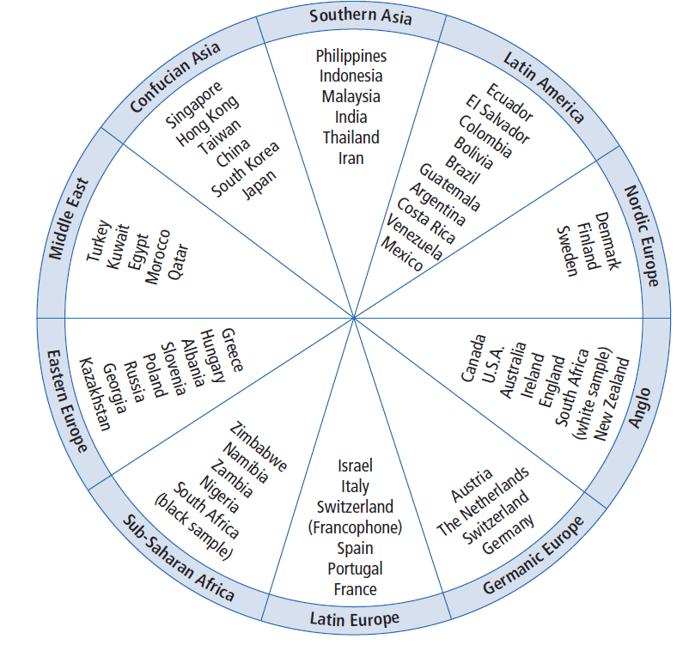
SOURCE: Adapted from House, R.J., Hanges, P.J., Javidan, M., Dorfman, P. W., & Gupta, V., Culture, Leadership, and Organizations: The GLOBE Study of 62 Societies, copyright © 2004, Sage Publications, Inc. Reprinted with permission.

Slide 15
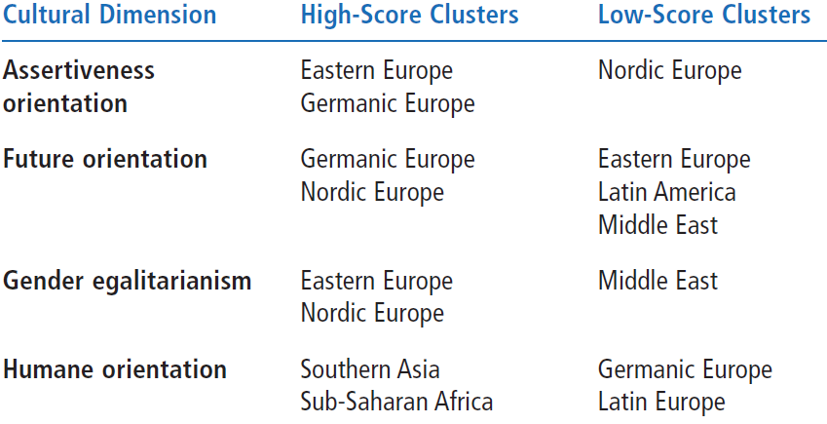
SOURCE: Adapted from House, R. J., Hanges, P. J., Javidan, M., Dorfman, P. W., & Gupta, V. (Eds.), Culture, Leadership, and Organizations: The GLOBE Study of 62 Societies, © 2004, SAGE Publications, Inc. Reprinted with permission.

Slide 16
Characteristics of Clusters
Characteristics include
Anglo – competitive and result oriented
Confucian Asia – result driven, encourage group working together over individual goals
Eastern Europe – forceful, supportive of co-workers, treat women with equality
Germanic Europe – value competition & aggressiveness and are more result oriented
Latin America – loyal & devoted to their families and similar groups
Peter G. Northouse, Leadership: Theory and Practice, Seventh Edition. © 2016 SAGE Publications, Inc.

Slide 17
Characteristics of Clusters
Characteristics include
Latin Europe – value individual autonomy
Middle East – devoted & loyal to their own people, women afforded less status
Nordic Europe – high priority on long-term success, women treated with greater equality
Southern Asia – strong family & deep concern for their communities
Sub-Sahara Africa – concerned & sensitive to others, demonstrate strong family loyalty
Peter G. Northouse, Leadership: Theory and Practice, Seventh Edition. © 2016 SAGE Publications, Inc.

Slide 18
Leadership Behavior & Culture Clusters
GLOBE research identified six global leadership behaviors
Charismatic/value-based leadership reflects the ability to inspire, to motivate, and to expect high performance from others based on strongly held core values.
Team-oriented leadership emphasizes team building and a common purpose among team members.
Participative leadership reflects the degree to which leaders involve others in making and implementing decisions.
Peter G. Northouse, Leadership: Theory and Practice, Seventh Edition. © 2016 SAGE Publications, Inc.

Slide 19
Leadership Behavior & Culture Clusters
Humane-oriented leadership emphasizes being supportive, considerate, compassionate, and generous.
Autonomous leadership refers to independent and individualistic leadership, which includes being autonomous and unique.
Self-protective leadership reflects behaviors that ensure the safety and security of the leader and the group.
Peter G. Northouse, Leadership: Theory and Practice, Seventh Edition. © 2016 SAGE Publications, Inc.

Slide 20
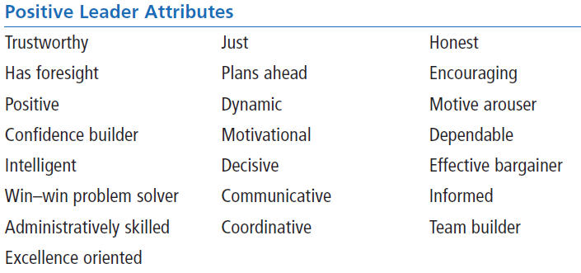
SOURCE: Adapted from House, R.J., Hanges, P.J., Javidan, M., Dorfman, P. W., & Gupta, V., Culture, Leadership, and Organizations: The GLOBE Study of 62 Societies, copyright © 2004, Sage Publications, Inc. Reprinted with permission.

Slide 21
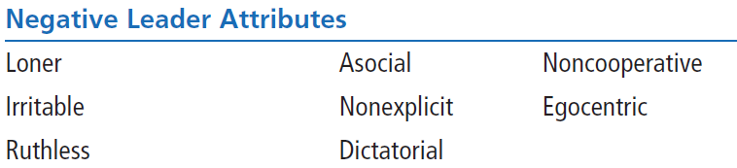
SOURCE: Adapted from House, R.J., Hanges, P.J., Javidan, M., Dorfman, P. W., & Gupta, V., Culture, Leadership, and Organizations: The GLOBE Study of 62 Societies, copyright © 2004, Sage Publications, Inc. Reprinted with permission.

Slide 22
Culture and Leadership
Strengths
Criticisms
Application

Slide 23
Strengths
GLOBE study is a major study and, to date, the only study to analyze how leadership is viewed by cultures in all parts of the world.
Findings from GLOBE are valuable because they emerge from a well-developed, quantitative research design.
GLOBE studies provide a classification of cultural dimensions that is more expansive than the commonly used Hofstede classification system.
GLOBE studies provide useful information about what is universally accepted as good and bad leadership.
The study of culture and leadership underscores the complexity of the leadership process and how it is influenced by culture.

Slide 24
Criticisms
Research does not provide a clear set of assumptions and propositions that can form a single theory about the way culture relates to leadership or influences the leadership process.
Labels and definitions of cultural dimensions and leadership behaviors are somewhat vague, difficult at times to interpret or to fully comprehend the findings about culture and leadership.
This study focuses on what people perceive to be leadership and ignores a large body of research that frames leadership in terms of what leaders do (e.g., transformational leadership, path–goal theory, skills approach).
Peter G. Northouse, Leadership: Theory and Practice, Seventh Edition. © 2016 SAGE Publications, Inc.

Slide 25
Criticisms
Researchers in the GLOBE study measured leadership with subscales that represented a very broad range of behaviors and as a result compromised the precision and validity of the leadership measures.
The GLOBE studies tend to isolate a set of attributes that are characteristic of effective leaders without considering the influence of the situational effects.
Peter G. Northouse, Leadership: Theory and Practice, Seventh Edition. © 2016 SAGE Publications, Inc.

Slide 26
Application
The findings about culture can help leaders understand their own cultural biases and preferences.
Different cultures have different ideas about what they want from their leaders, and these findings help our leaders adapt their styles to be more effective in different cultural settings.
The findings can help global leaders communicate more effectively across cultural and geographic boundaries.
Information on culture and leadership can be used to build culturally sensitive websites, design new employee orientation programs, conduct programs in relocation training, and improve global team effectiveness.

