Slide 1
Coordinate transformations
SlicerIGT Tutorial Series

Slide 2
Coordinate systems
Most problems in navigation systems are due to incomplete documentation of coordinate systems!
Define a coordinate system for each object in your scene. E.g. needle, patient, CT image, etc.
Draw schematics of coordinate systems. You must explicitly define for each coordinate system:
Name (e.g. "NeedleTip", or "PatientMri")
Origin, the (0,0,0) point?
Direction of X, Y, Z axes?
Unit of measure (e.g. millimeter)?

Slide 3
Coordinate transformations
Coordinate transformations are defined between two coordinate systems (the From and the To coordinate system)
Draw transformations as arrows from their From to their To coordinate system
A chain of transformations is the same as one transformation from the first From to the last To
NeedleToReference
Y
Y
Y
Needle
X
Reference
X
Z
Z
X
Tracker
TrackerToReference
Z
NeedleToTracker

Slide 4
Best practices
Start new systems by writing down the coordinate transformations on paper. Keep this schematics up-to-date as the system develops.
Always follow naming conventions. All transformations should be named AlphaToBeta where Alpha and Beta are explicitly defined.
There is no special coordinate system! Avoid the use of a "World" coordinate system. All coordinate systems are equal, and it often makes work easier if the system is examined from different coordinate systems.

Slide 5
The RAS coordinate system
3D Slicer defines a coordinate system, called RAS, which is used for graphics visualization.
RAS origin is the center of the visualization views
RAS axes point towards the R, A, and S letters in Slicer
RAS units are millimeters
Since objects in 3D Slicer are visualized in RAS, you need to transform tracked objects to RAS to visualize them in correct positions.
Sometimes it is necessary to visualize objects in another coordinate system, e.g. Reference in which case RAS effectively becomes Reference in Slicer.

Slide 6
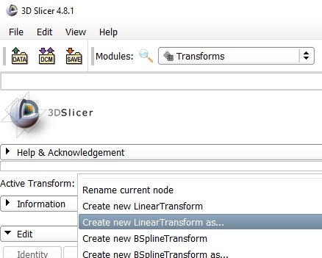
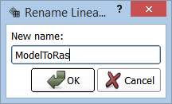
Create a transformation
Select the Transforms module
From the Active Transform dropdown menu, select “Create new LinearTransform as...”
Give the name ModelToRas to your new transform
The Edit section of Transforms module now offers sliders to move and rotate your transform. But it doesn’t transform anything yet.
1.
2.
3.

Slide 7
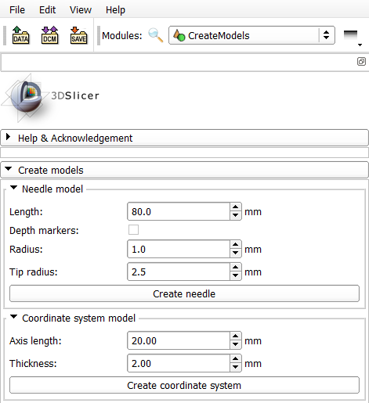
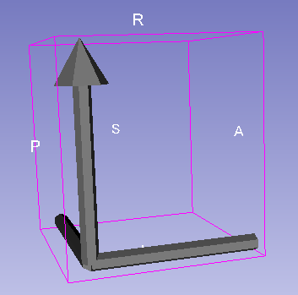
Create a model to be transformed
1.
Select IGT/CreateModels.
Press Create coordinate system to create a coordinate system model.
Observe a model created in the 3D view. Drag the 3D background with your mouse to rotate the view.
2.

Slide 8
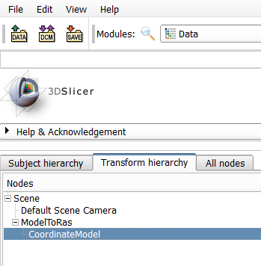
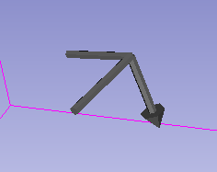
Apply the transform on the model
Select Data module and Transform hierarchy tab
Drag and drop the CoordinateModel on ModelToRas.
As a result, the position of CubeModel will be transformed by ModelToRas.
Go back to Transforms module, and change the ModelToRas transform using the sliders. This should move the model.
1.
2.
3.

Slide 9
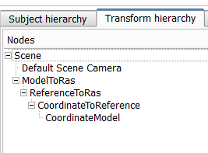
About transformations
Transforms can be stacked in a multi-level hierarchy. Name transforms correctly, and place them on each other based on their names.
A hierarchy should be read from the leaf to the root of the tree graph. Name endings should connect.
If the leaf is a visible object, the last transform should end in “Ras” to bring all visual objects in the RAS coordinate system.
Scene = RAS

Slide 10
Transforms are relative
A transform e.g. StylusToReference only reports on the positiong of Stylus relative to Reference
When StylusToReference changes, Stylus or Reference or both can be moving relative to the "room"
To illustrate this, load SlicerIGT-Data\PivotRelative.mrb scene, select PivotRelative sequence browser in the Sequences / Sequence browser module

Slide 11
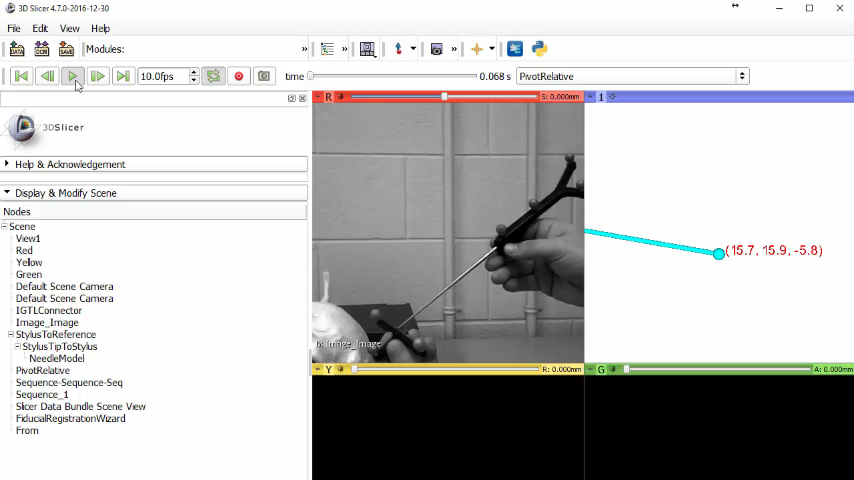
PivotRelative scene replay

