Slide 1
Pivot calibration
SlicerIGT Tutorial Series

Slide 2
Introduction
A pointer tool is used in almost every medical navigation systems. It can be a tracked stylus, needle, or any tracked object that has a pointy part.
A position marker (e.g. electromagnetic sensor, or optical marker) is used to track the position of the pointer tool.
But the marker cannot be at the very tip of the pointer. Therefore, we need to determine where is the pointer tip relative to the pointer marker.
The names Pointer, Stylus, and Needle. Are used interchangeably in this tutorial.

Slide 3
Stylus coordinate systems
There are two coordinate systems associated with a stylus tool:
Stylus
Origin: center of the position marker
StylusTip
Origin: tip of the stylus.
The StylusTipToStylus transformation is computed using the Pivot Calibration algorithm.
Y
Stylus
Y
X
Z
StylusTipToStylus
StylusTip
X
Z
: position marker

Slide 4
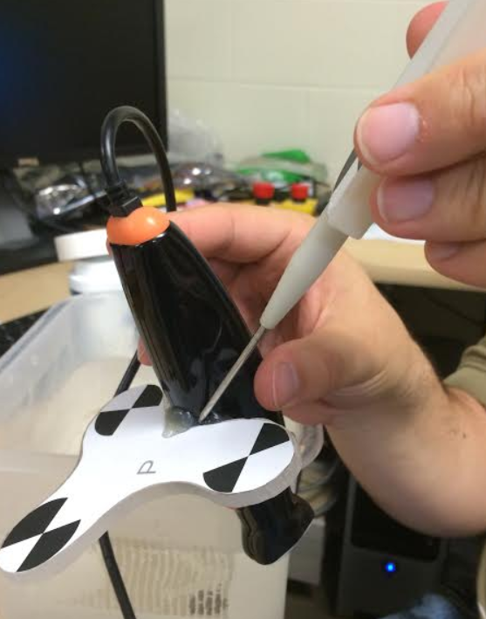
Pivot Calibration in a Real Hardware Setup
When performing a pivot calibration with a tracked needle
Find a secure position to pivot in the Reference coordinate system
You must not shift the tip of the needle, only the shaft of the needle may move relative to the tip while you pivot

Slide 5
Example 1.

Slide 6


Load example data
Load SlicerIGT-Data/Skull_StylusCalibration.mrb
In Data module, right click on StylusToReference, Insert transform
Rename new transform to StylusTipToStylus
Create a needle model
In Data module Drag-and-drop needle model on StylusTipToStylus
Make sure the Sequences toolbar is visible

Slide 7
Pivot calibration
In IGT / Pivot Calibration module select Input: StylusToReference, Output: StylusTipToStylus
In the Sequences toolbar, select PivotCalibration and start playback with the play button
2.
1.
Press Start Pivot Calibration and wait until message at the botton of module widget displays Root-mean-square error value.
This value should be under 1 mm

Slide 8
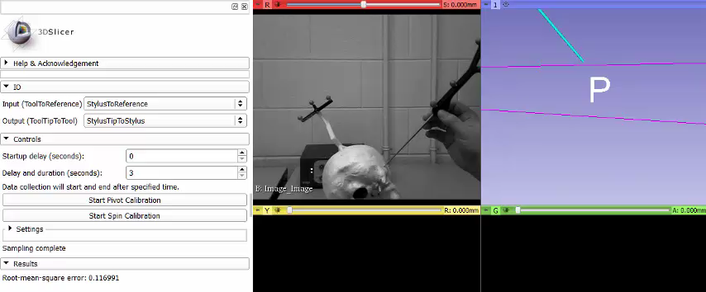
Pivot calibration

Slide 9
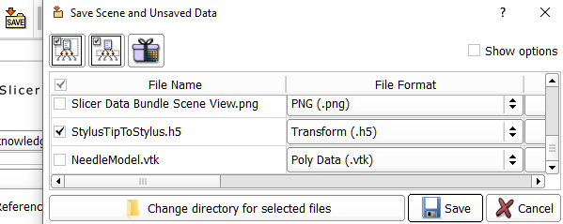
Spin calibration
Press Start Spin Calibration
Wait until Root-mean-square error value updated
With this particular stylus design, StylusTipToStylus transform does not change significantly
Save StylusTipToStylus transform into a .h5 file
1.
2.
3.
4.

Slide 10
Example 2. (PLUS required. This is method is getting obsolete.)

Slide 11
Pivot calibration in Slicer
There is a data sequence in SlicerIGT-Data which was recorded using a pivoting stylus: PivotCalibration.mha
The stylus tip was pivoting relative to a tracked Reference object. Therefore we need StylusToReference transformation to find the StylusTip (as the pivot point).
Run PivotCalibrationExtend.bat to get PivotCalibration-Extended.mha the /data folder of your PLUS installation. E.g. in c:\users\you\PlusApp-2.1.2.3392-Win64\data\

Slide 12
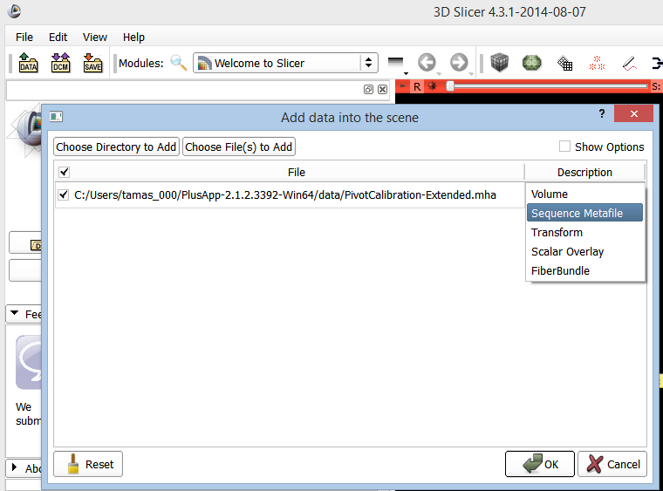
Load pivot calibration sequence
1.
Drag and drop PivotCalibration-Extended.mha on Slicer
2.
3.

Slide 13
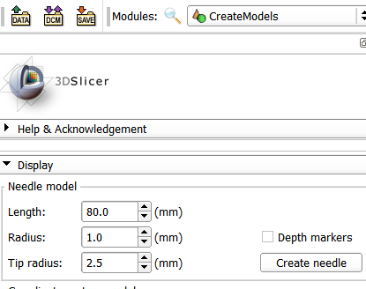

Example: Pivot calibration in Slicer
1.
Create a needle model using IGT/Create Models to represent the stylus tool.
A needle model should appear in the scene that looks like this:
2.

Slide 14
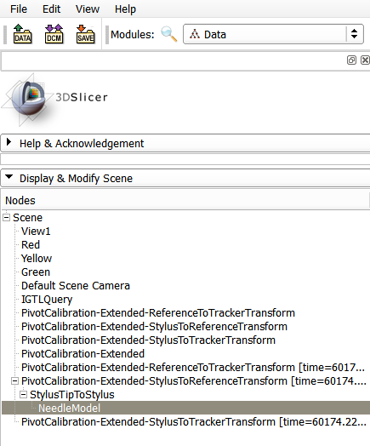
Example: Pivot calibration in Slicer
Create the transform hierarchy for the scene:
Select the Transforms module and create a new transform, named StylusTipToStylus.
Set up the transform hierarchy in the Data module as seen in the figure.

Slide 15
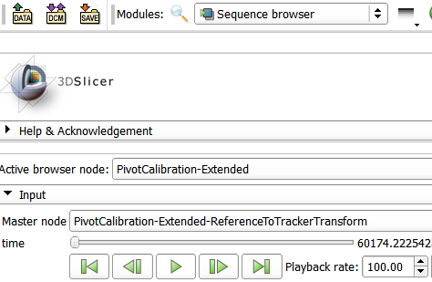
Play the recorded sequence
1.
2.

Slide 16
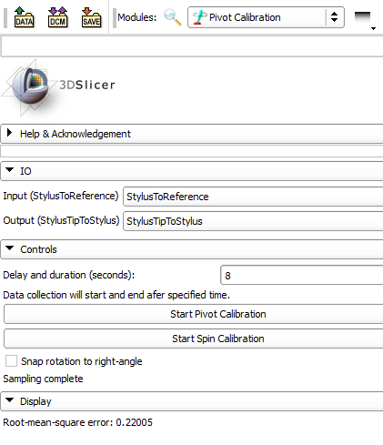
Example: Pivot calibration in Slicer
Initially, you should see the tip of the stylus swinging.
Follow the steps shown in red.
After pivot calibration, the tip of the stylus should be relatively stable (within about 0.5 mm)
1.
2.
3.
4.
5. Wait until sampling complete

Slide 17
Saving the result
Save the Slicer scene to save your StylusTipToStylus calibration transformation.
The .mrml file in the scene folder contains a human-readable format of the transformation matrix.
The StylusTipToStylus.h5 file in the scene folder contains encrypted numbers, but if you drag and drop it on Slicer, it will recover your calibration transformation.

