Slide 1
SlicerIGT tutorial 2017
brain surgery navigation with live tractography
for 3D Slicer version 4.8

Slide 2
Prerequisites
This tutorial can be completed without any previous tutorials, but these tutorials are recommended
Slicer4 Minute Tutorial from https://www.slicer.org/wiki/Documentation/4.8/Training
Diffusion Tensor Imaging tutorial from https://www.slicer.org/wiki/Documentation/4.8/Training#Slicer4_Diffusion_Tensor_Imaging_Tutorial
Pervious SlicerIGT tutorials from http://www.slicerigt.org/wp/user-tutorial/

Slide 3
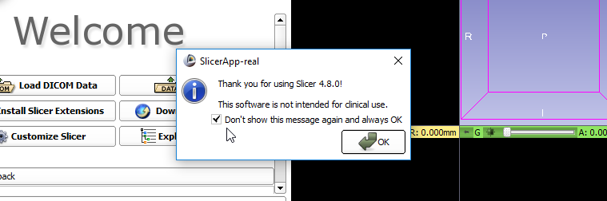
Install Slicer
Visit http://download.slicer.org/
Download Slicer version 4.8 (blue buttons) for your operating system
Run the downloaded installer
Start up Slicer
1

Slide 4
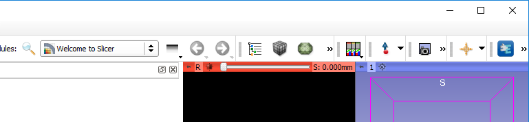

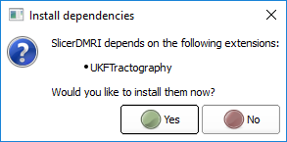
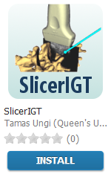
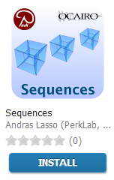
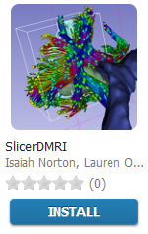

Install Slicer extensions
1. click
2. Find and install these extensions: SlicerIGT, Sequences, SlicerDMRI
6. click
3. click
4. click
5. click
7. click

Slide 5
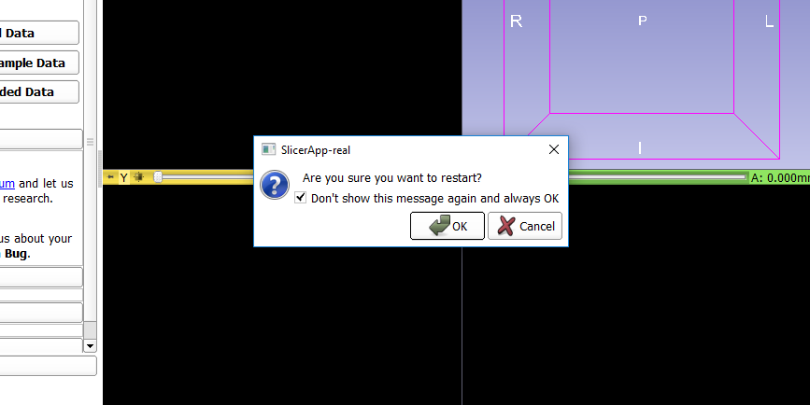
Approve restart of Slicer (if asked)
1. check
2. click

Slide 6
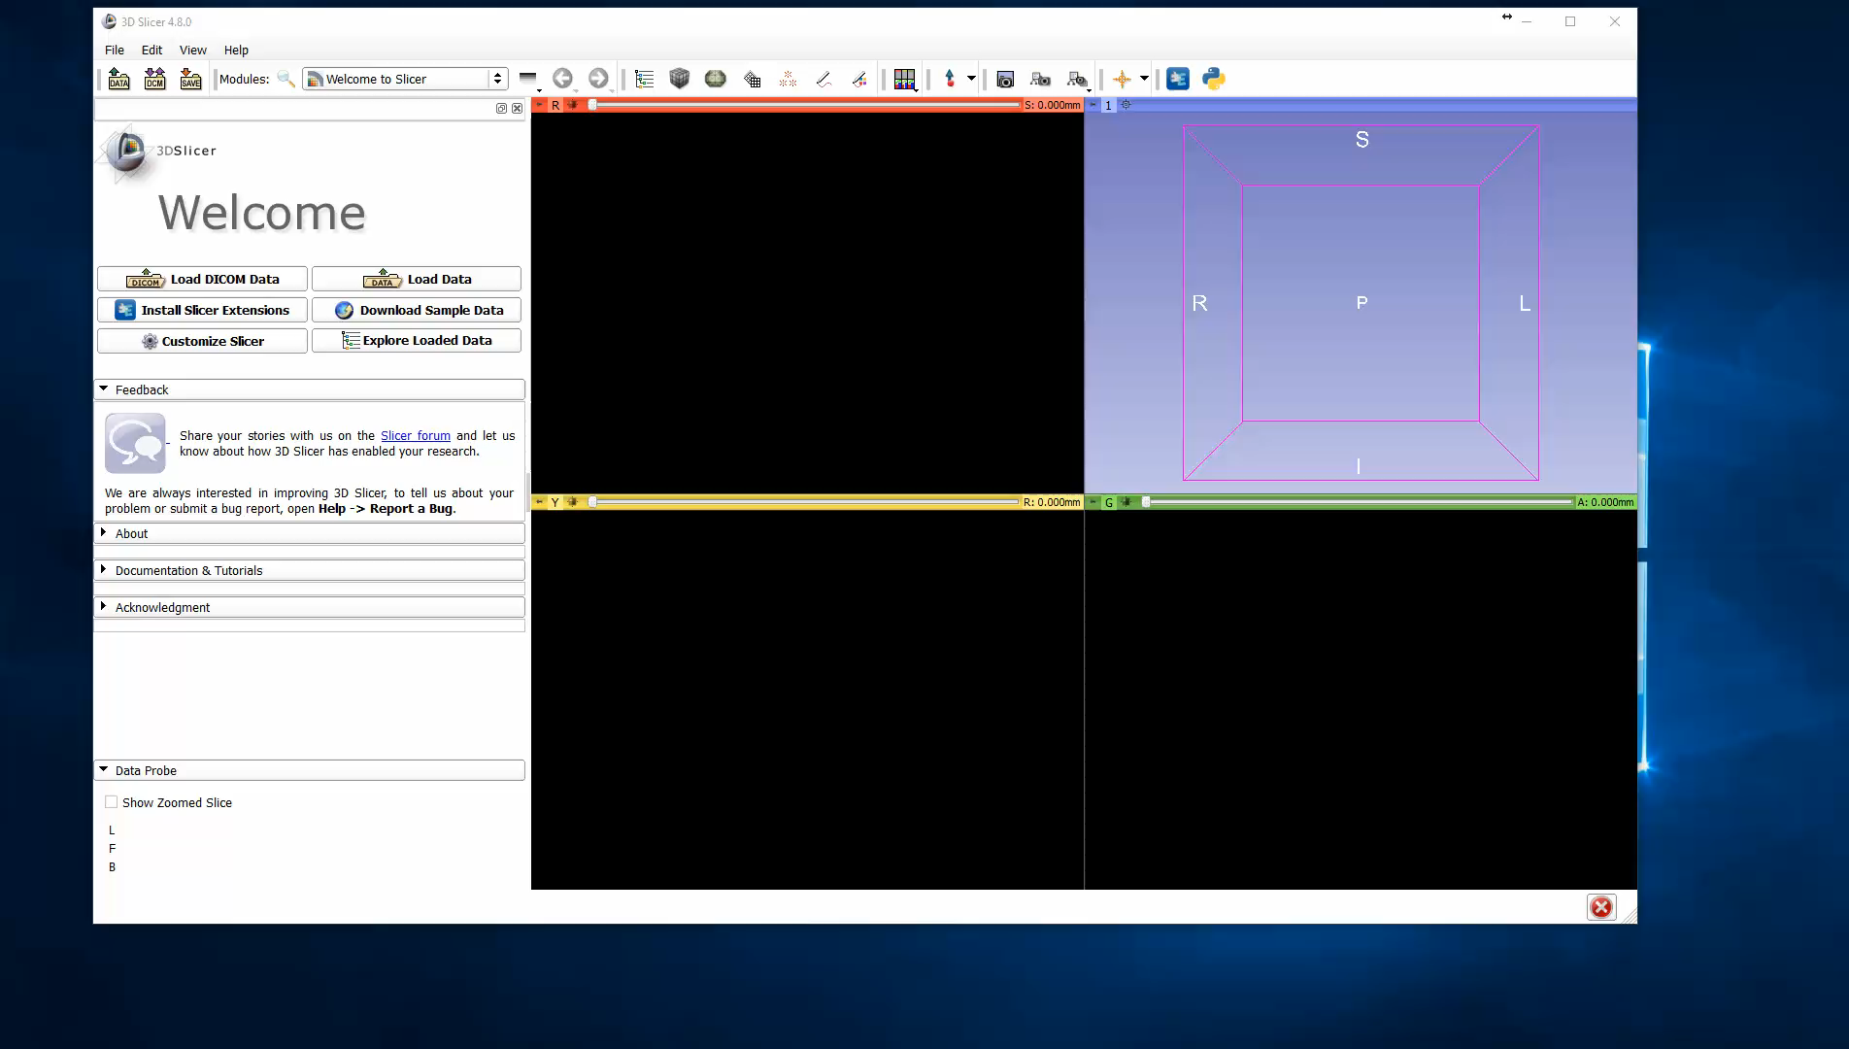
Verify extensions installed

Slide 7
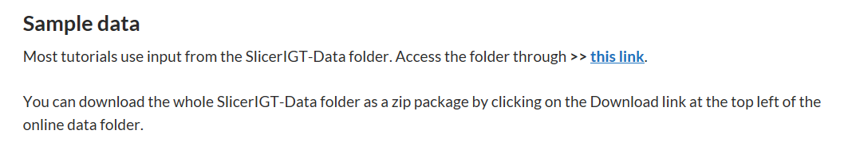
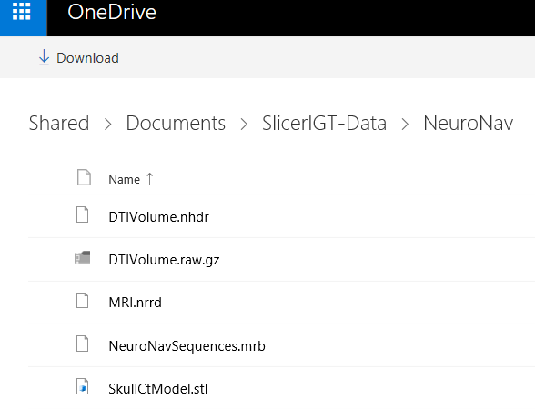
Download tutorial data
Visit the tutorial website: http://www.slicerigt.org/wp/user-tutorial/
Go to the SlicerIGT-Data folder
Go to NeuroNav folder
Download all files
The Download button downloads a zip file that contains all files of the folder

Slide 8
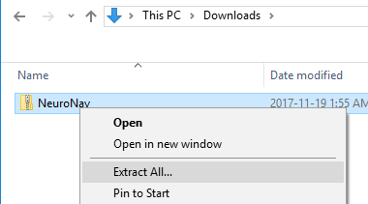
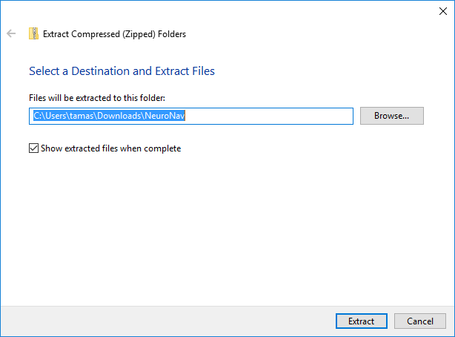
Unzip tutorial data folder
1. click
2. click

Slide 9
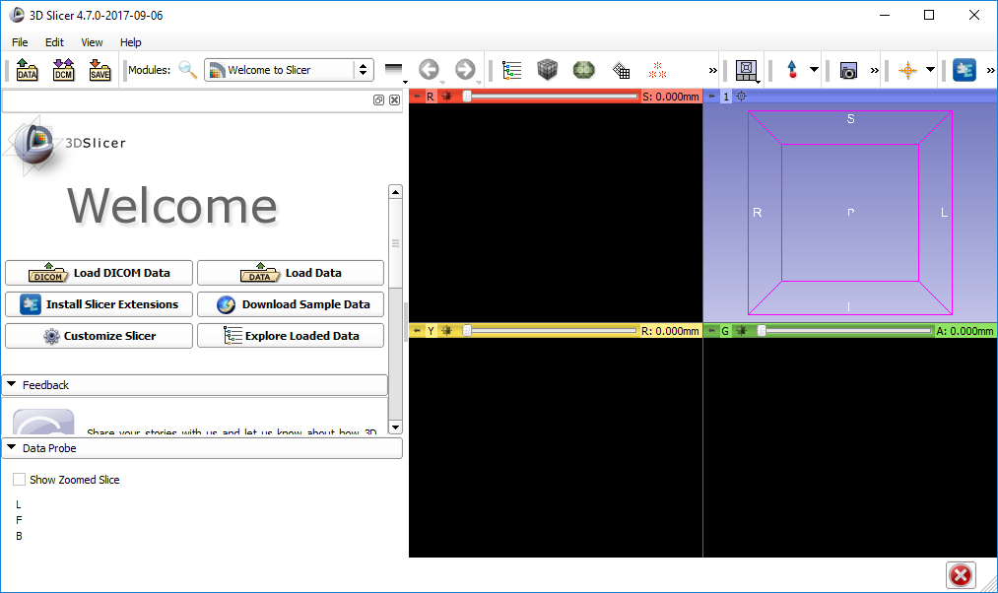
Open dialog

Slide 10
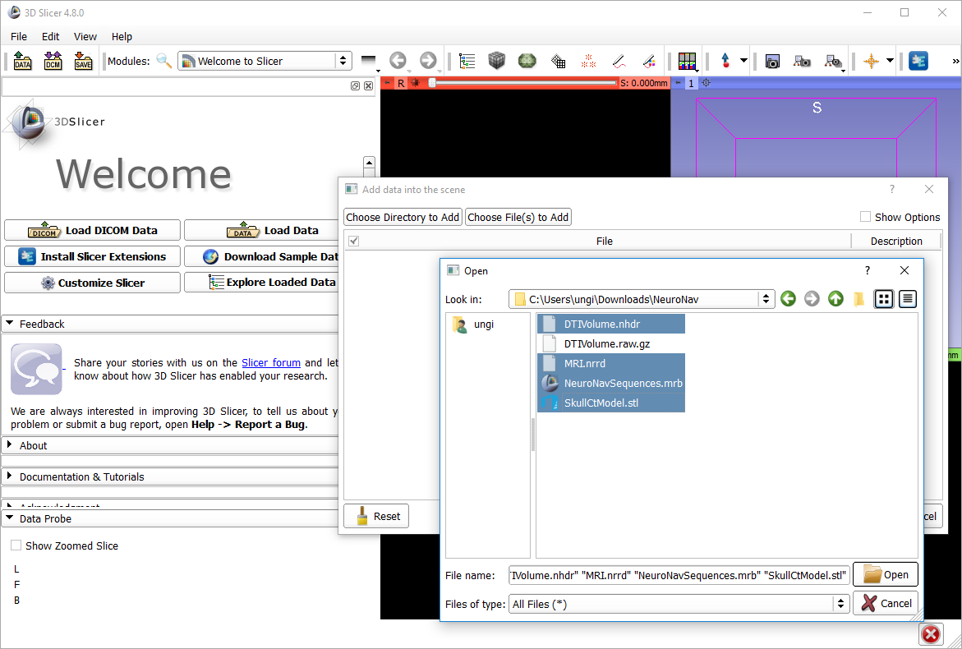
1
2
2
2
2
3

Slide 11
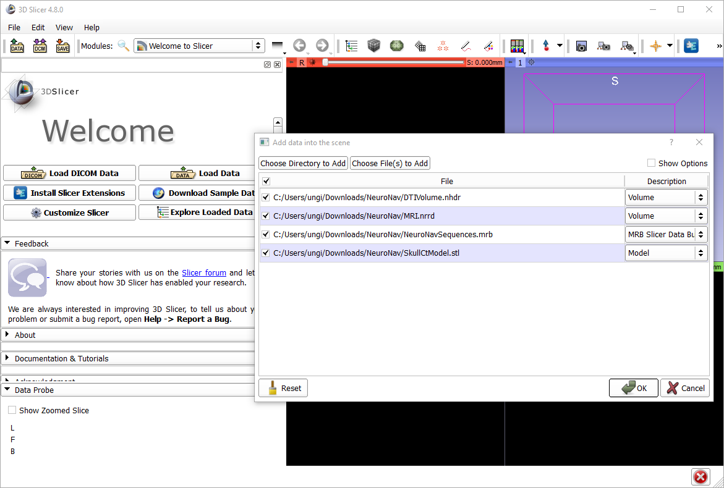
1

Slide 12
About the loaded data
SkullCtModel.stl: Segmentation from CT scan of the plastic skull model
MRI.nrrd: Magnetic resonance image of a person. (not the same one the plastic model was based on)
DTIVolume.nhdr: Diffusion tensor image (from a third person)
NeuroNavSequences.mrb: Time sequences for replaying tool motions
All image volumes are already registered roughly (they more or less overlap, but they come from different patients, so the overlap is not perfect)

Slide 13
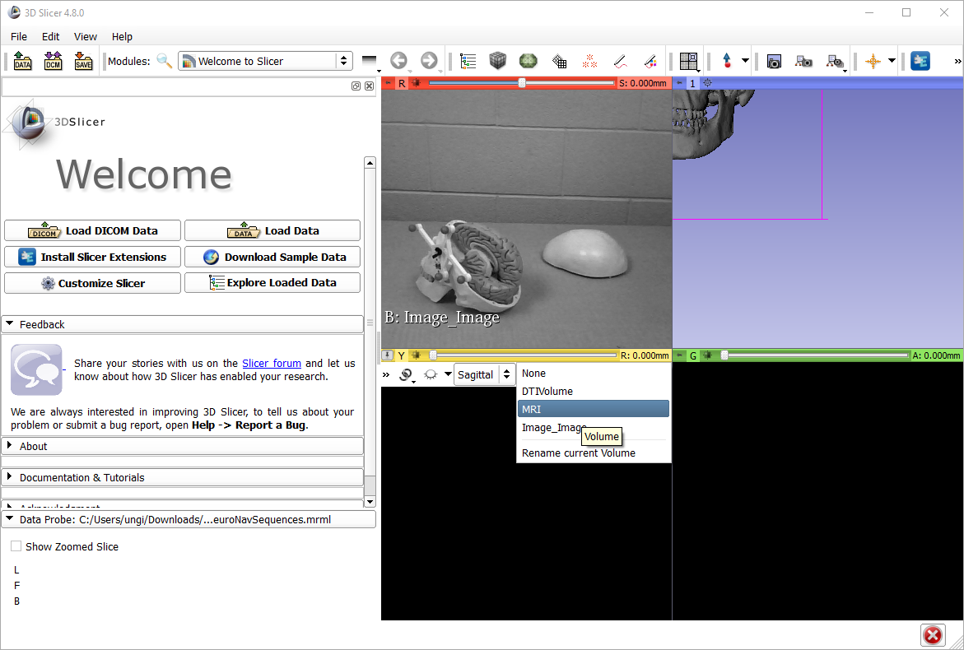
1
2. open selector
3

Slide 14
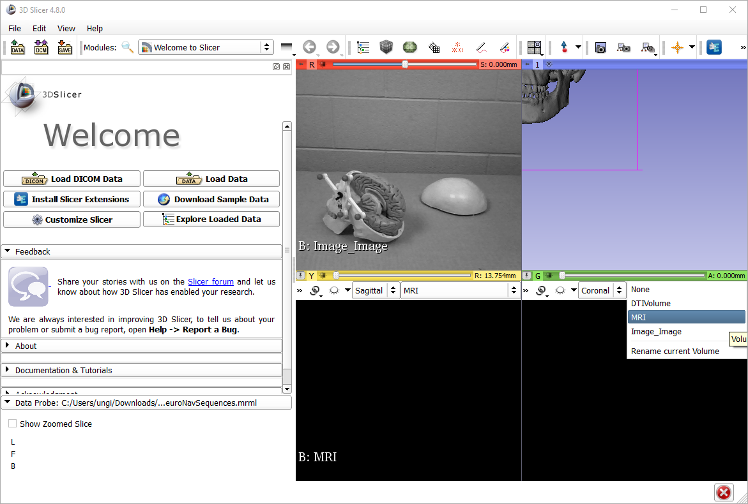
1
2. open selector
3

Slide 15
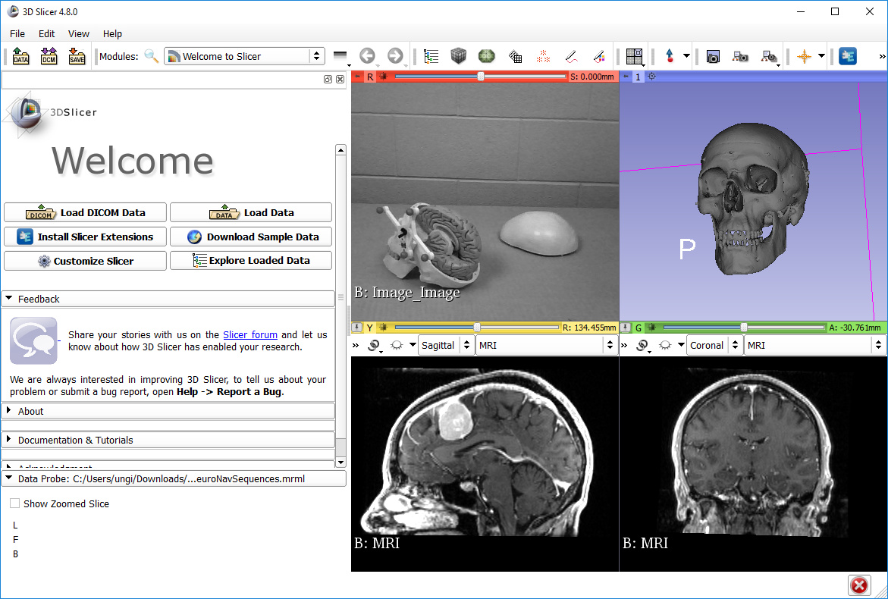
3
1
2

Slide 16
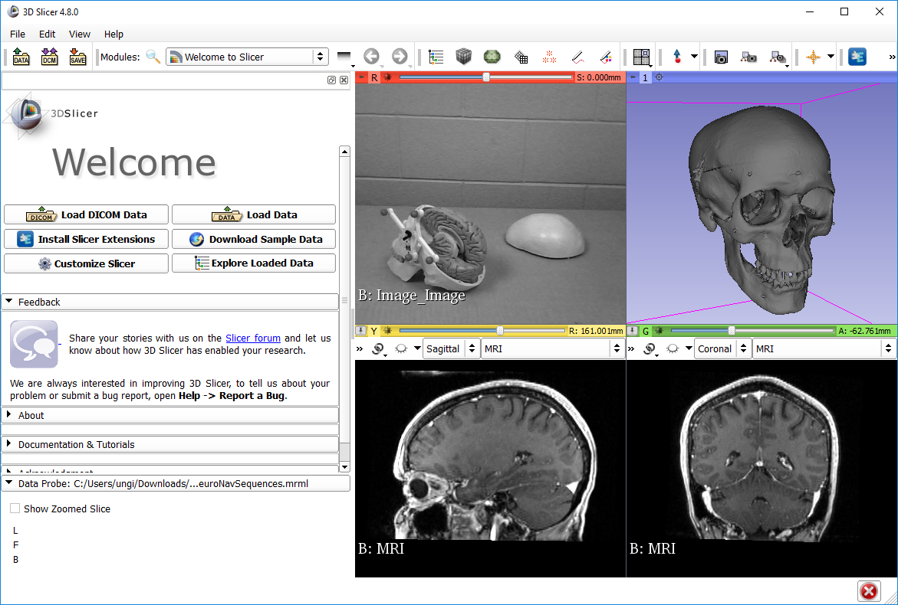
Try 3D interactions
Mouse left button drag – rotations
Mouse wheel – zoom
Mouse middle button drag – panning
Try 2D interactions
Mouse wheel – change slice
Mouse right button drag – zoom
Mouse middle button drag – panning
Mouse left button drag – intensity windowing

Slide 17
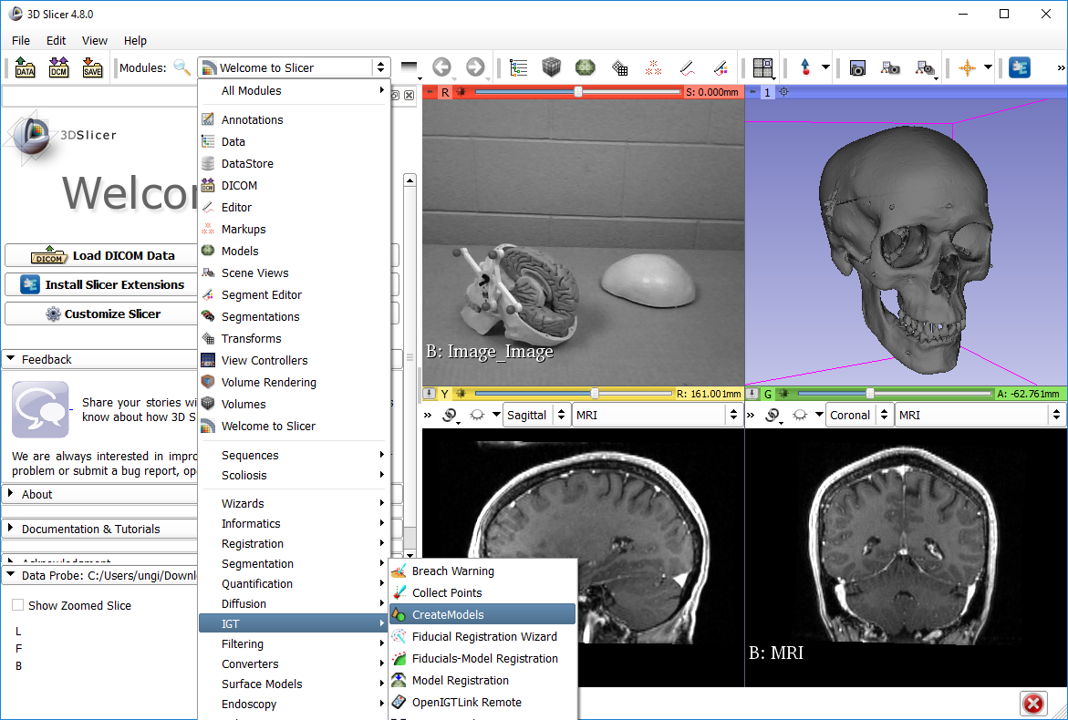
1
2
select

Slide 18
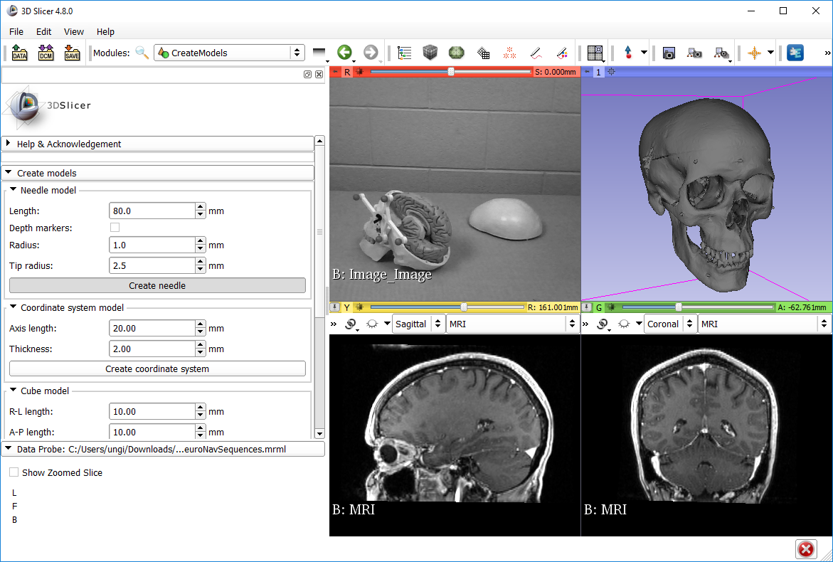
1. see
2. Press once
You won’t see anything when you click, but don’t worry, the needle model is created.

Slide 19
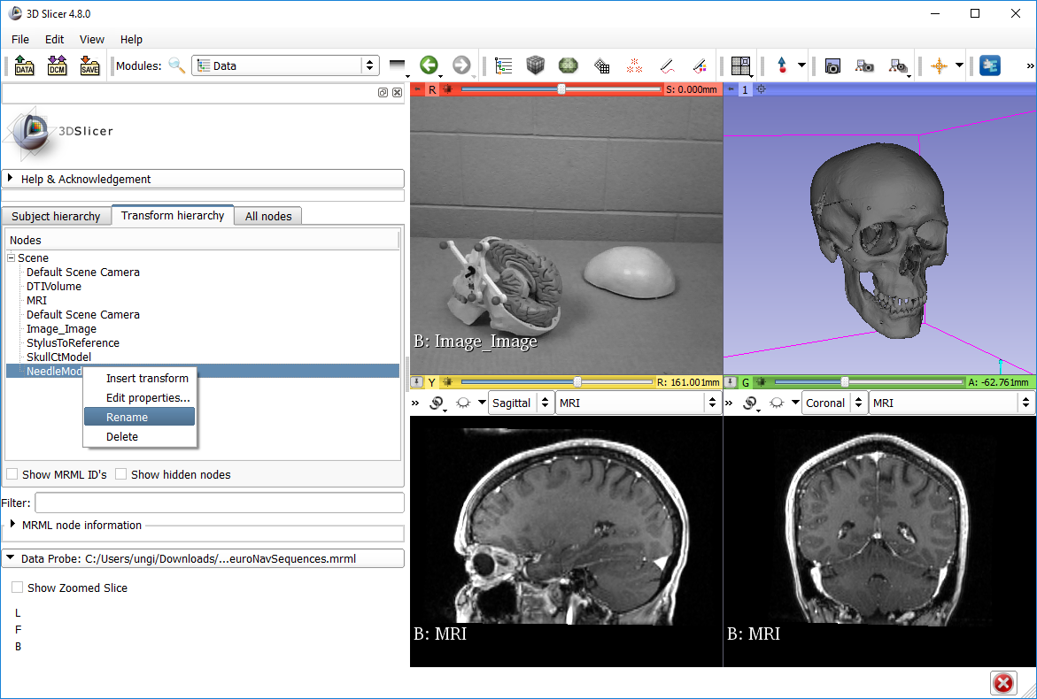
2. see
1
3
4. Right click
5
6. Rename to “StylusTip”

Slide 20
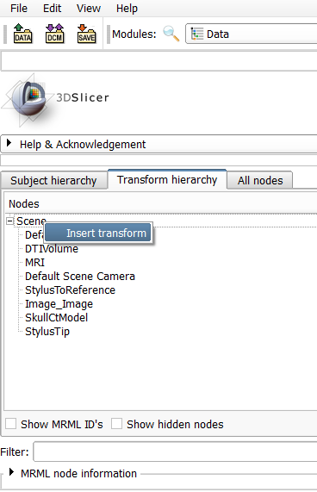
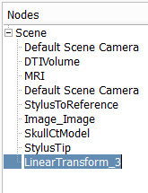
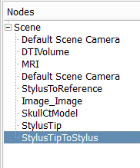
3. Double-click to rename new transform
1. Right-click on Scene
2
4. Name it StylusTipToStylus

Slide 21
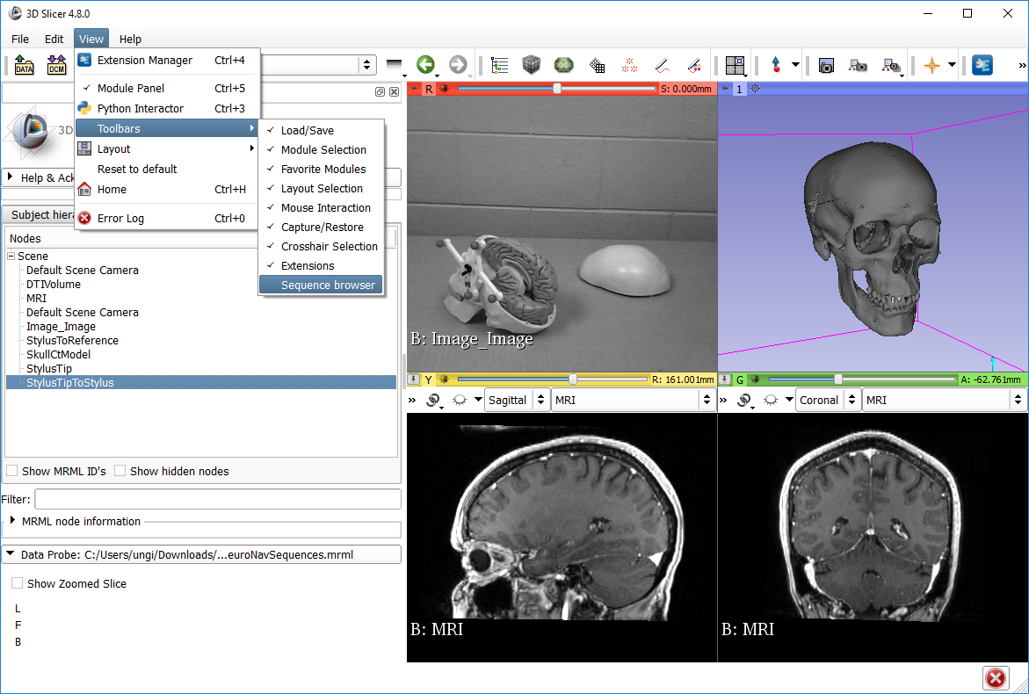
1
2
3

Slide 22
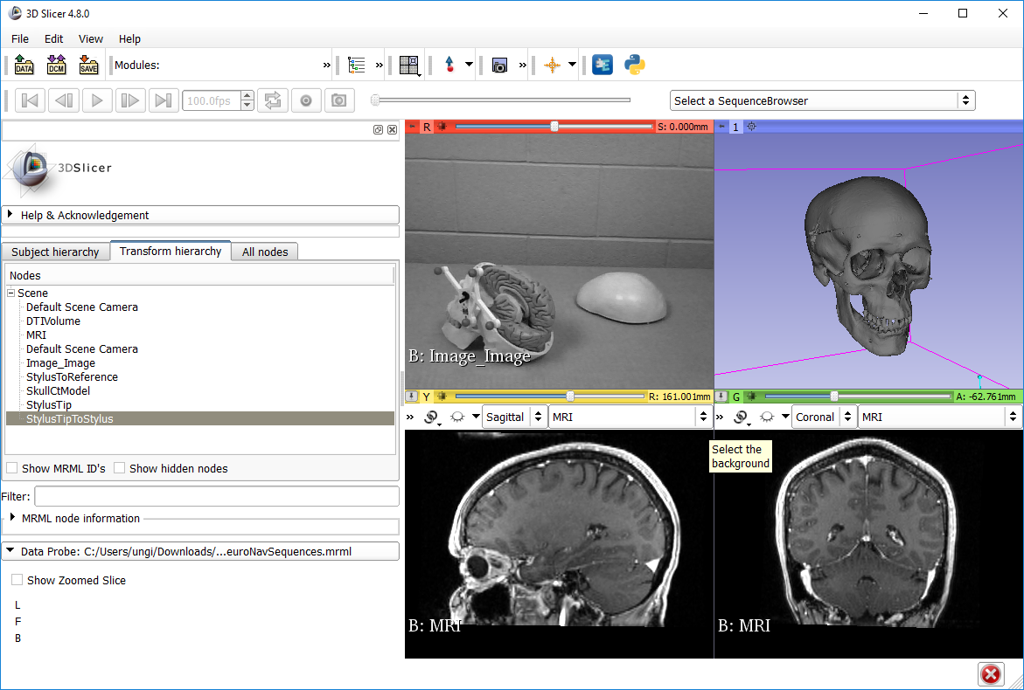
You can drag and drop the position of the toolbar grabbing this grey vertical bar. Putting it in a new line gives it more space.

Slide 23
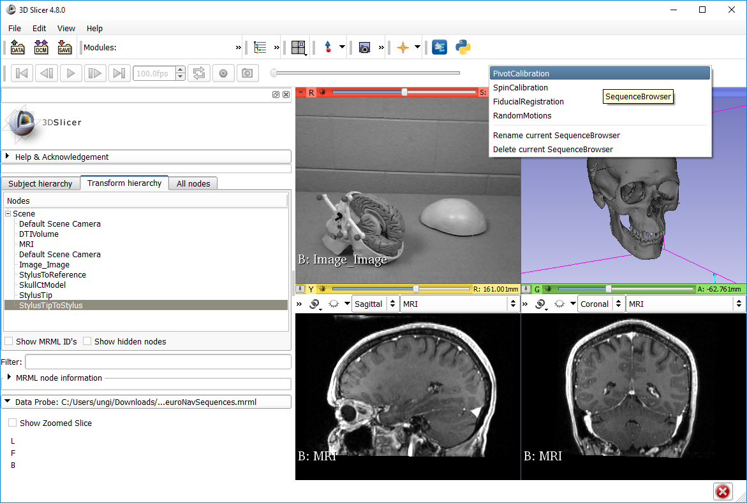
1

Slide 24
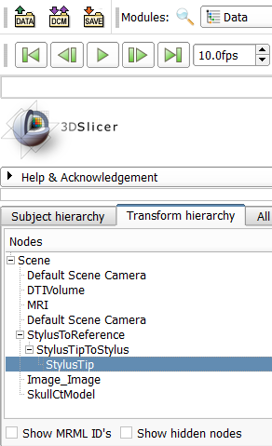
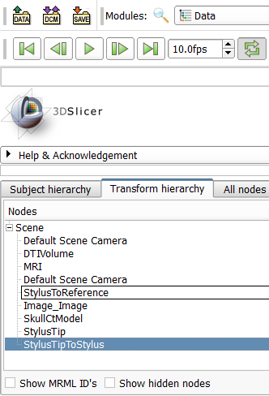
2. Drag and drop until the transform hierarchy looks like this
1. Drag and drop transformable nodes to create transform hierarchy

Slide 25
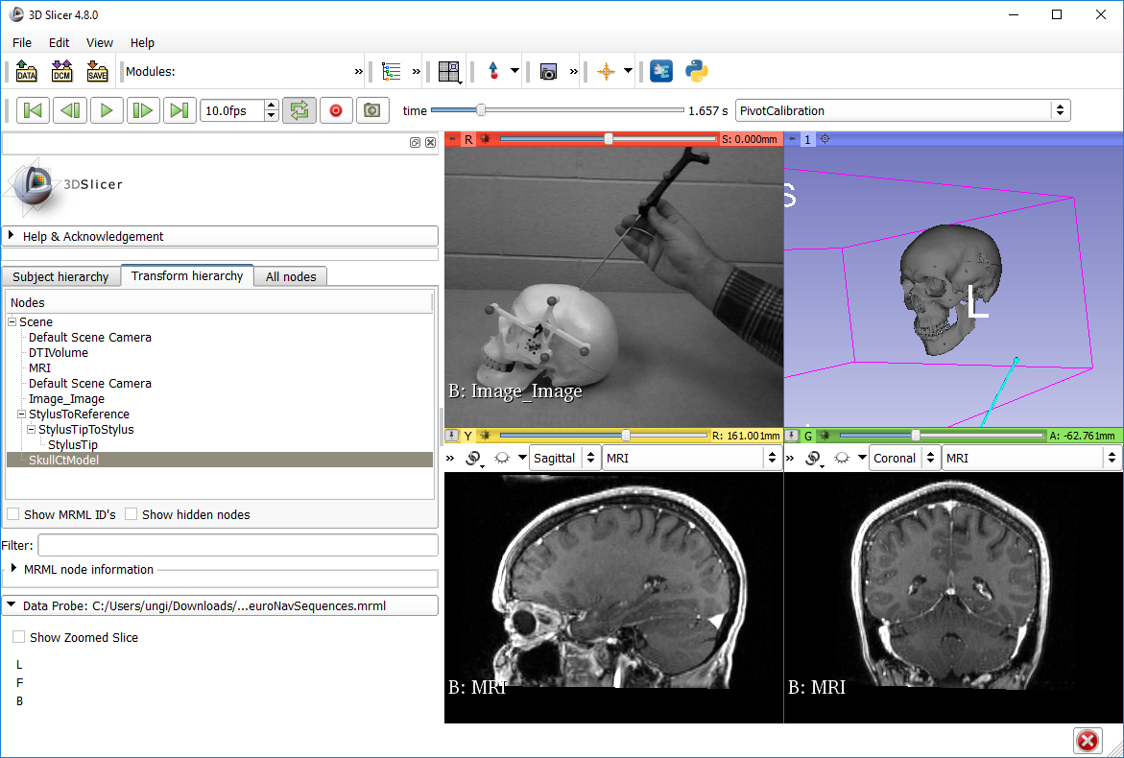
1
2. Zoom out and rotate to see the blue stick (StylusTip) move

Slide 26
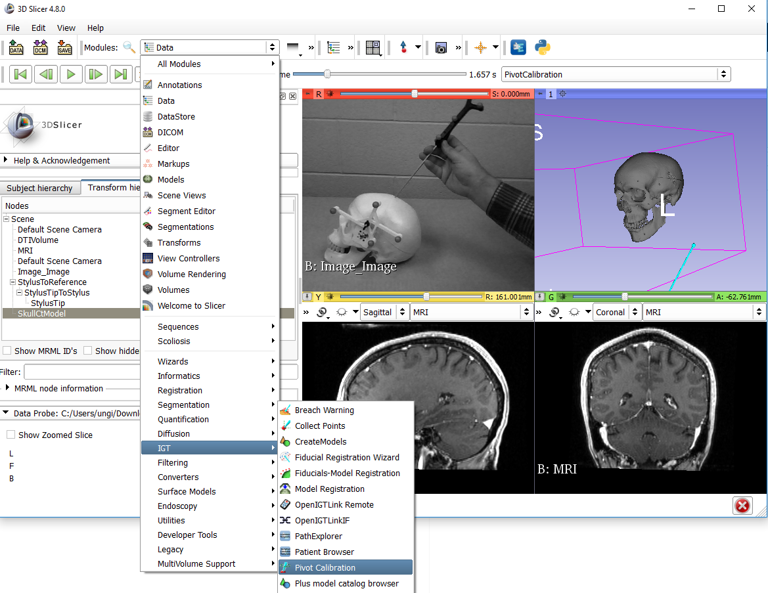
1
2
3. select

Slide 27
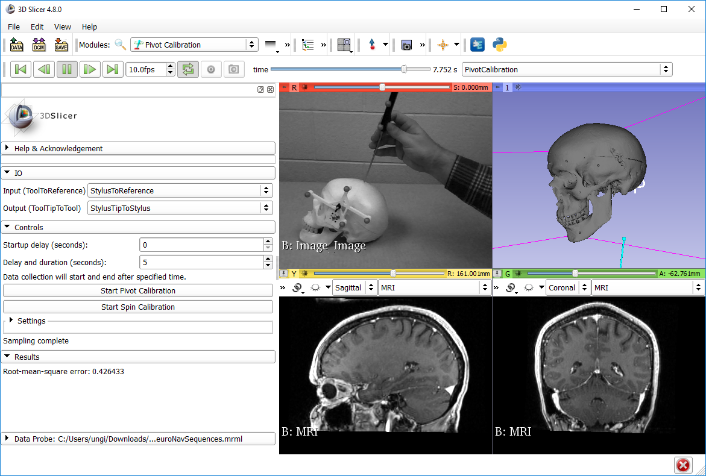
1
2
5. see: tip position should remain roughly stable
3. (optional)
4. then wait 5 seconds
7. Check RMSE
6. collapse (this tab is not needed now)

Slide 28
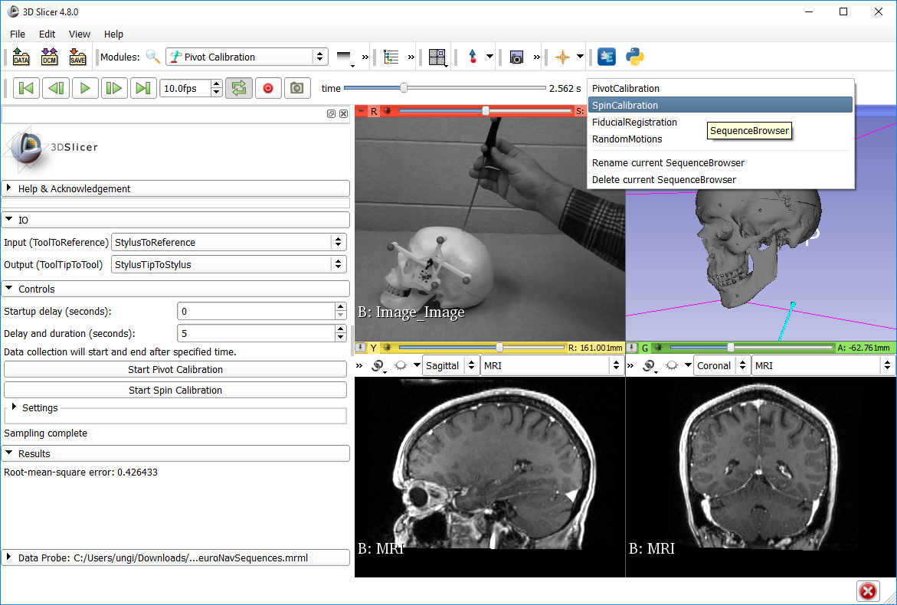
1. pause
2

Slide 29

1. play
3. StylusTip direction remain roughly stationary
2
4. Check RMSE

Slide 30
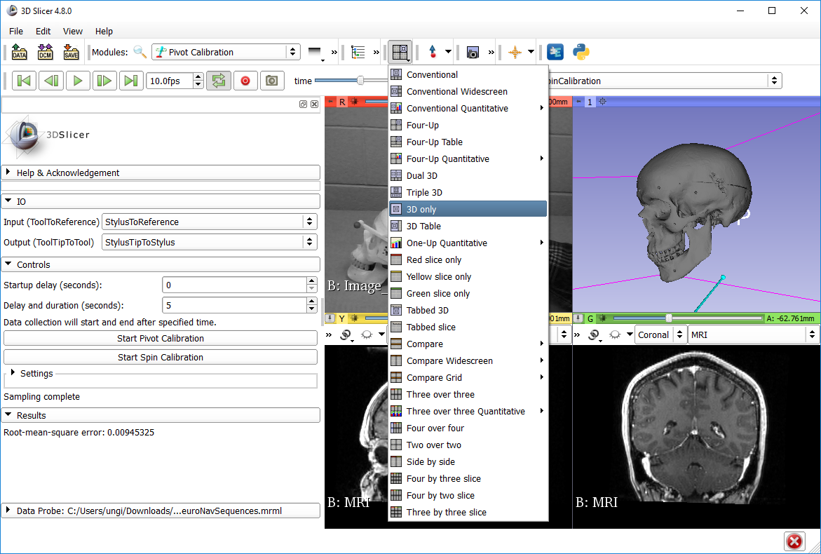
1. pause
1

Slide 31
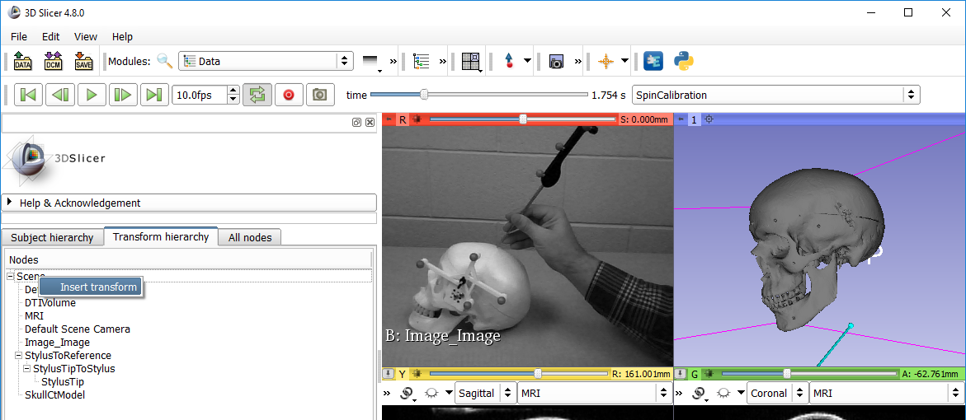
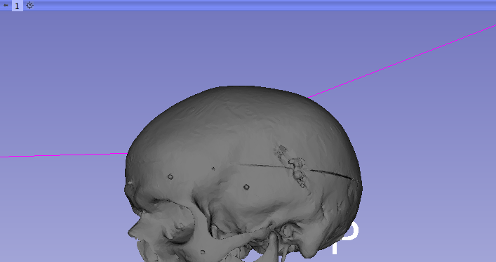
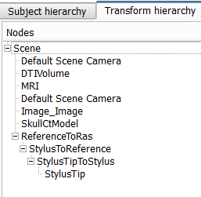
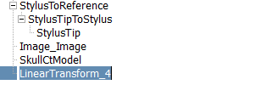
1
2 right-click
3
6. Drag and drop StylusToReference to create this new hierarchy
4. Double-click to rename to “ReferenceToRas”
RAS is the coordinate system of the Slicer views

Slide 32
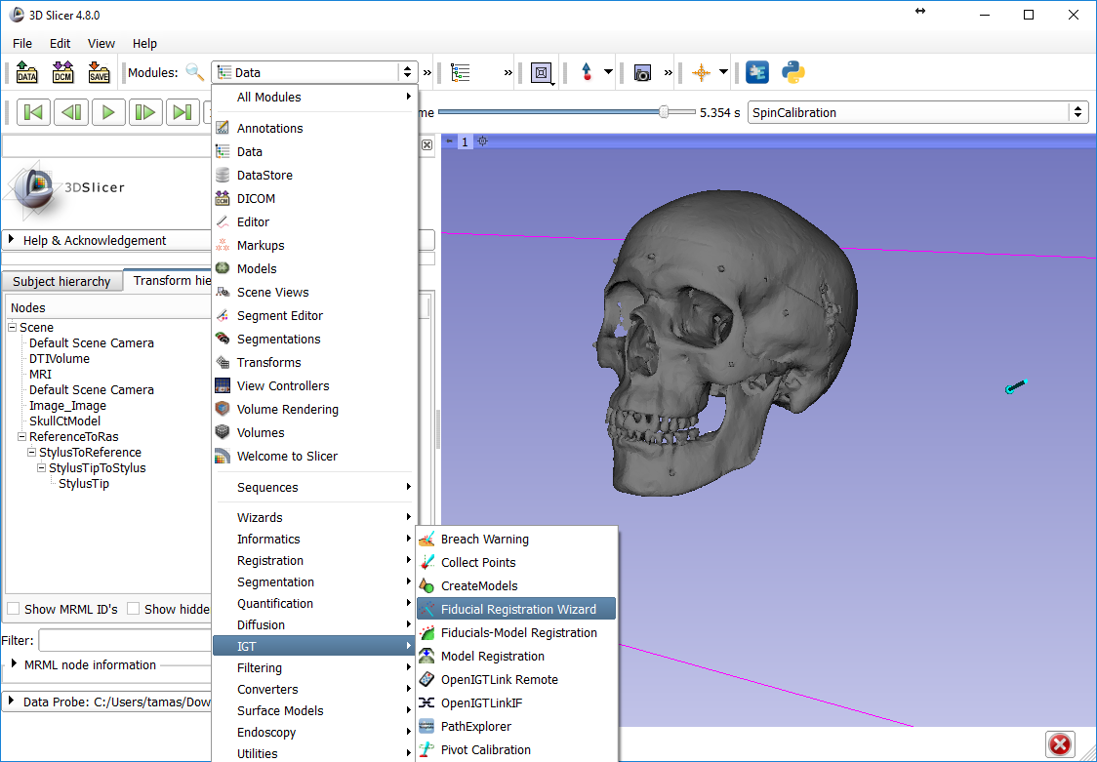
1
3. select
2

Slide 33
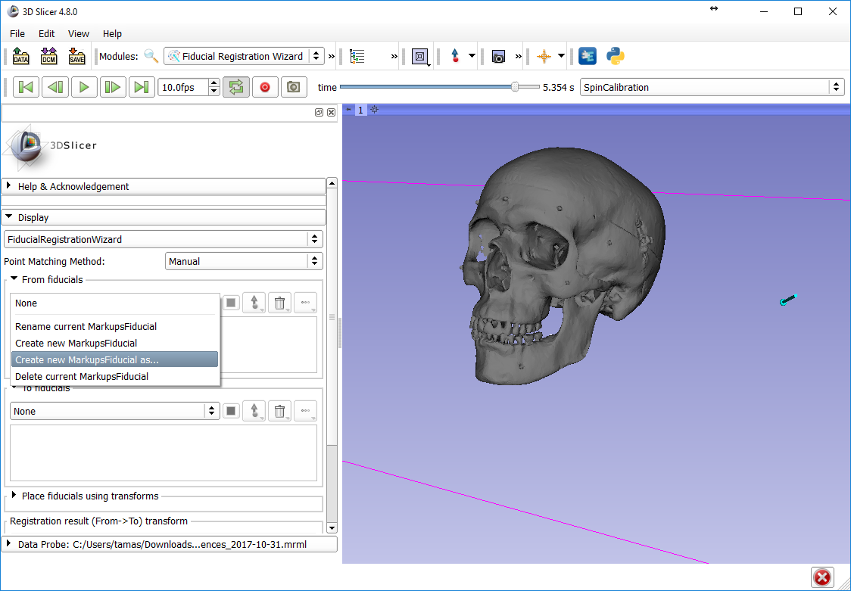
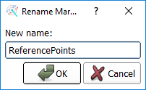
1
2
3
4

Slide 34
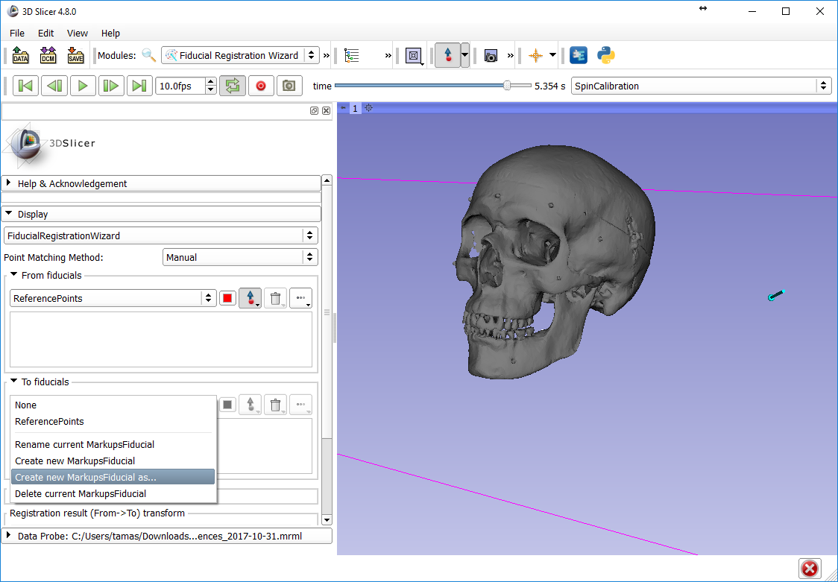
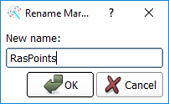
1
3
4
2

Slide 35
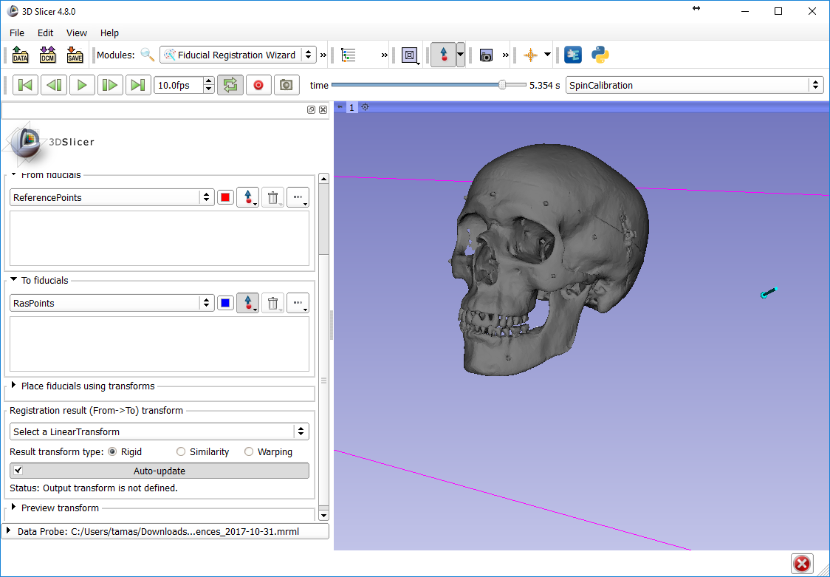
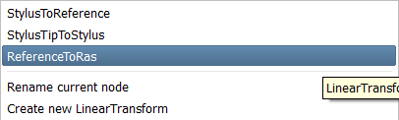
1. Maybe need to scroll down to see “result”
2
3. select ReferenceToRas

Slide 36
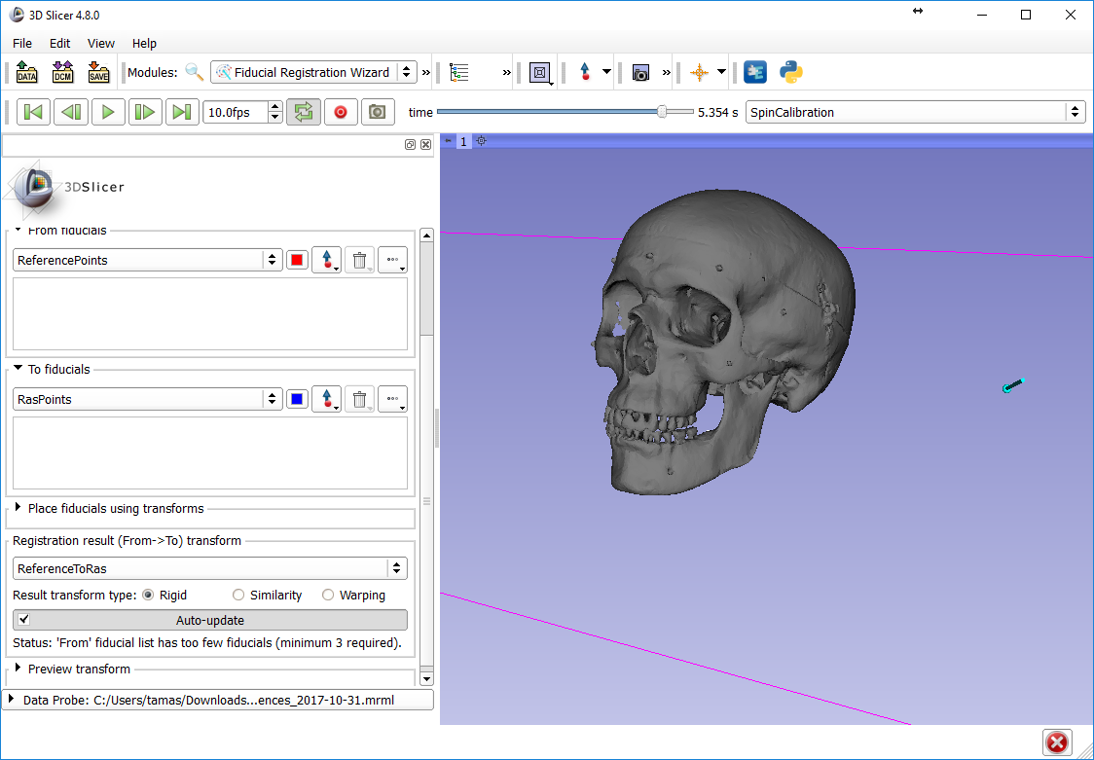
Make sure this button is unchecked when interacting with 3D viewer!
1

Slide 37
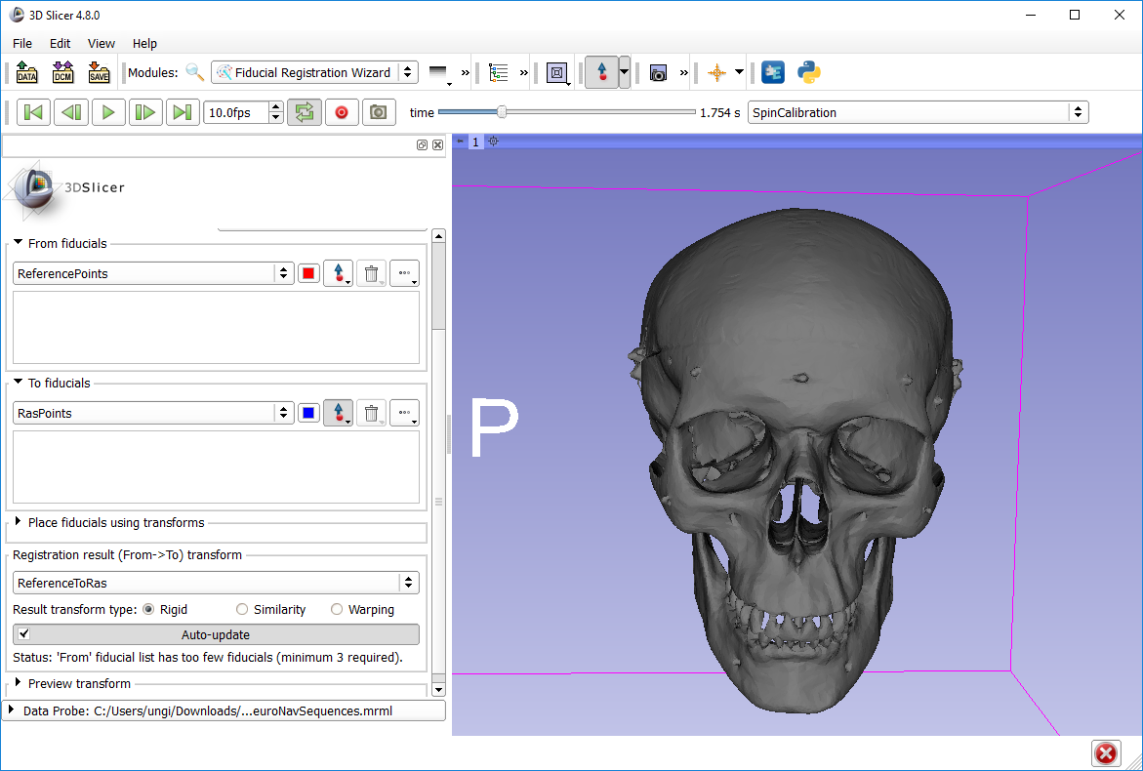
1. Set up 3D viewer like this to see the right side of the skull
2
3. click here

Slide 38
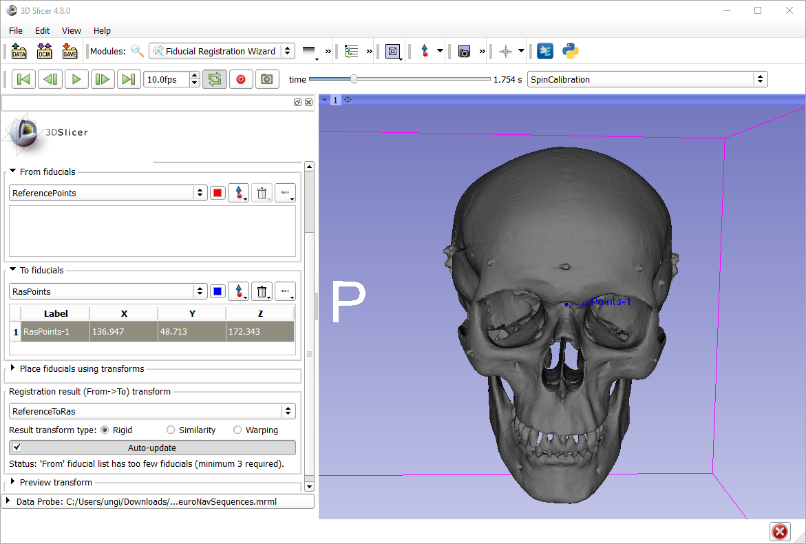
Notice blue point created
Notice point added to list

Slide 39
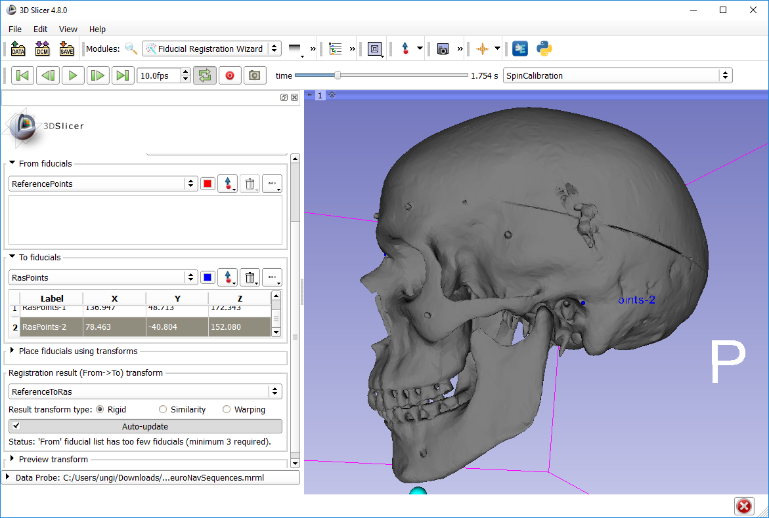
1. Similarly, create the second point here

Slide 40

1. And the third one here

Slide 41


Note: When you press Place ‘From’,
a new point will be created in
the From list at the position of the StylusTip
1. Expand Place box
2. Select StylusTipToStylus in upper (From) selector

Slide 42

1

Slide 43

1. Select Four-up

Slide 44

1
Scroll time to the point where the stylus on the video points to the first registration point
3. see
1
2

Slide 45

1
1
3. see
2

Slide 46

1
4. see
1
3. see
2
5. uncheck

Slide 47



Troubleshooting
How to redo one point (before registration completed)
Delete
How to reset registration (after a completed registration)
2. see
1
Very important to reset to Identity before starting a new registration!
3

Slide 48

2. Volume Reslice Driver

Slide 49

1. select yellow driver node

Slide 50

1. select green driver node

Slide 51

4. Move
3
1
2

Slide 52

1
2. select
4. see
4. see
3. scroll down to see this option and check it

Slide 53

1. module history
2. Back to Volume Reslice Driver

Slide 54

These advanced view options are used to set up viewers in a way that navigation is intuitive for the surgeon. E.g. stylus movement to the left results stylus model movement to the left in the viewers
2
3
1

Slide 55

1
2

Slide 56

1
2. click anywhere
3. double-click each coordinate and set to zero

Slide 57

1
2. drag and drop “F” here
Result: overlapping red point

Slide 58

1
2. double-click
3
4

Slide 59

1 double-click
2

Slide 60

Tractography Seeding

Slide 61

4
see result
1
2
3

