Slide 1
Single Cell Sequencing
2022-02-18
Yi-Jun Kim

Slide 2
Process
Cell Ranger → Seurat
Cell Ranger
Generate fastq file from bcl file : mkfastq
If you have fastq file already, skip this process…
Generate count matrix from fastq file : count
You can use the results as input data of Seurat package DIRECTLY.

Slide 3
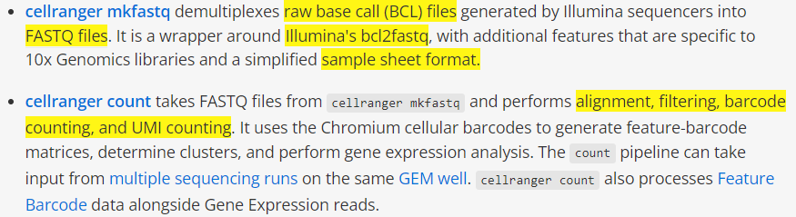
https://support.10xgenomics.com/single-cell-gene-expression/software/pipelines/latest/what-is-cell-ranger

Slide 4
Installing Cell Ranger
https://support.10xgenomics.com/single-cell-gene-expression/software/pipelines/latest/using/tutorial_in
Linux based installation

Slide 5
Cellranger – mkfastq, count, (aggr)

Slide 6
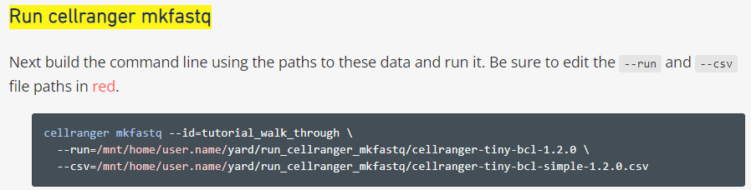
mkfastq
https://support.10xgenomics.com/single-cell-gene-expression/software/pipelines/latest/using/tutorial_fq

Slide 7
Cell ranger sample sheet
https://support.10xgenomics.com/single-cell-gene-expression/software/pipelines/latest/using/mkfastq#simple_csv

Slide 8
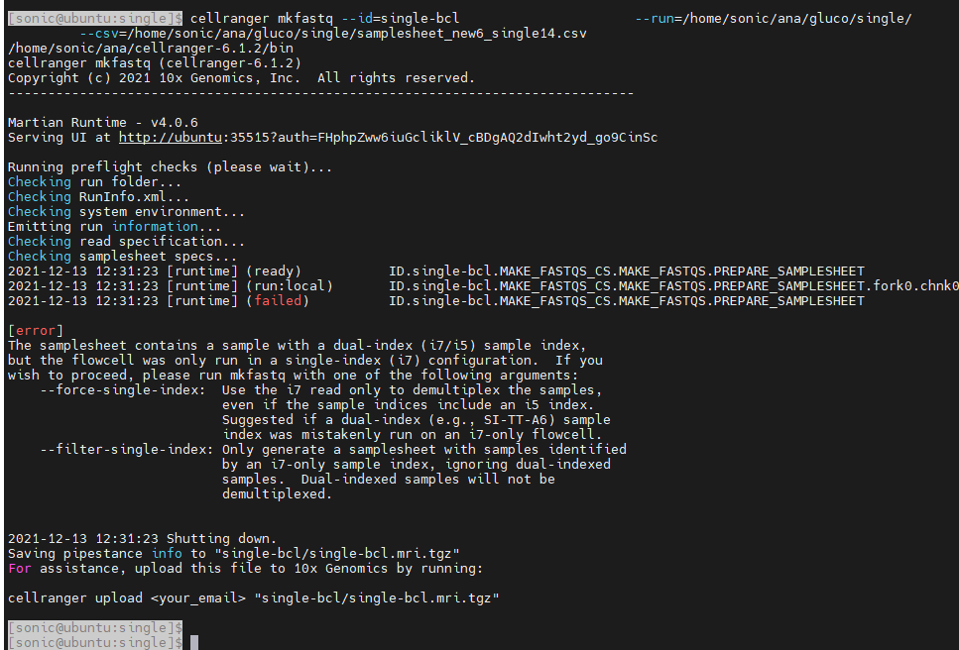
Error…
That means to include --force-single-index in the coding...

Slide 9
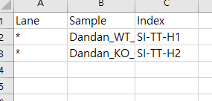
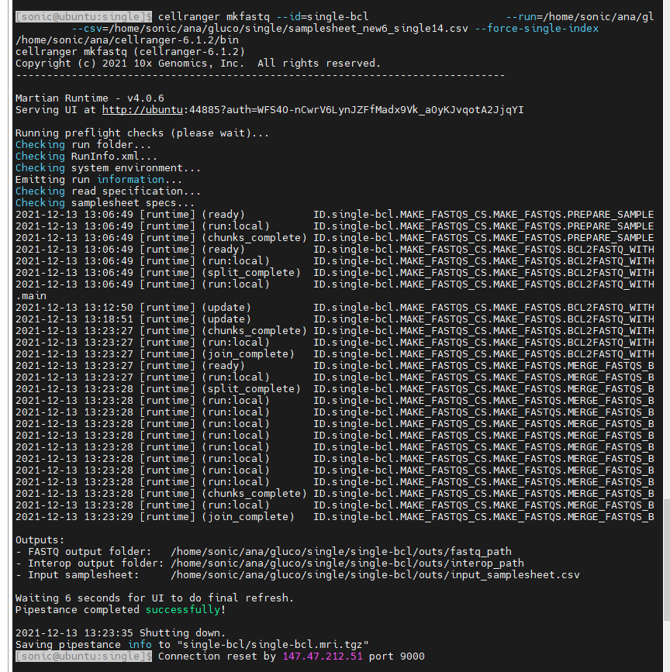
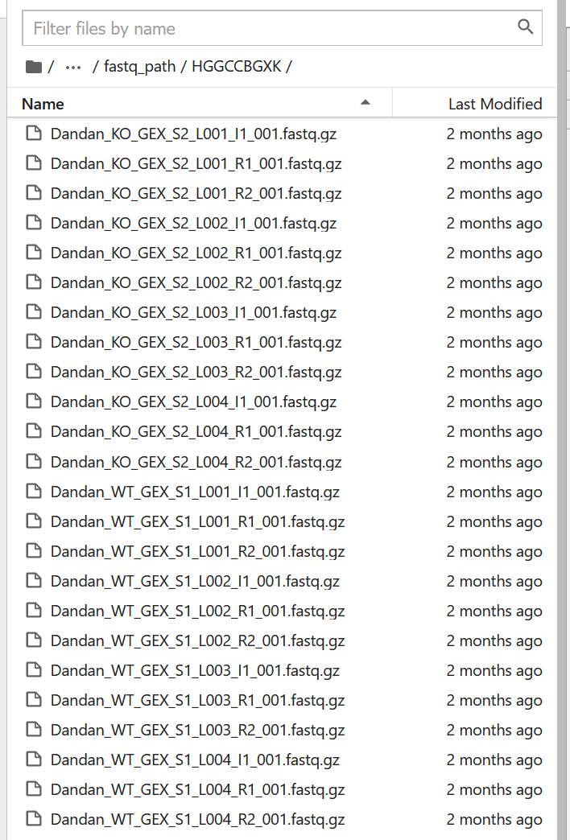
The above sample sheet worked fine.
Results…
Folder
Single-bcl/out/fastq_path_HGGCCBGXK

Slide 10
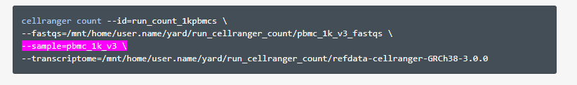
count
https://support.10xgenomics.com/single-cell-gene-expression/software/pipelines/latest/using/tutorial_ct

Slide 11
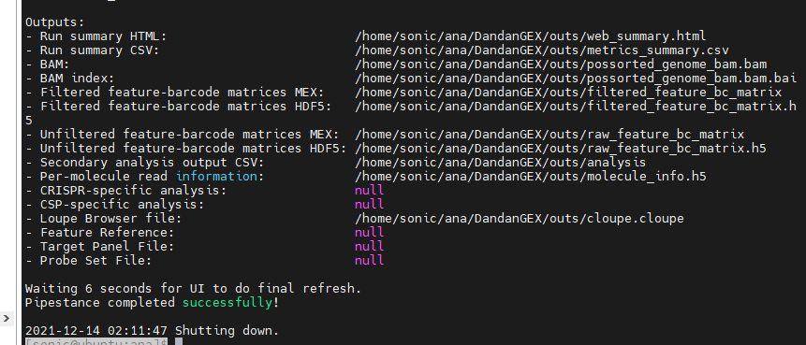

Slide 12
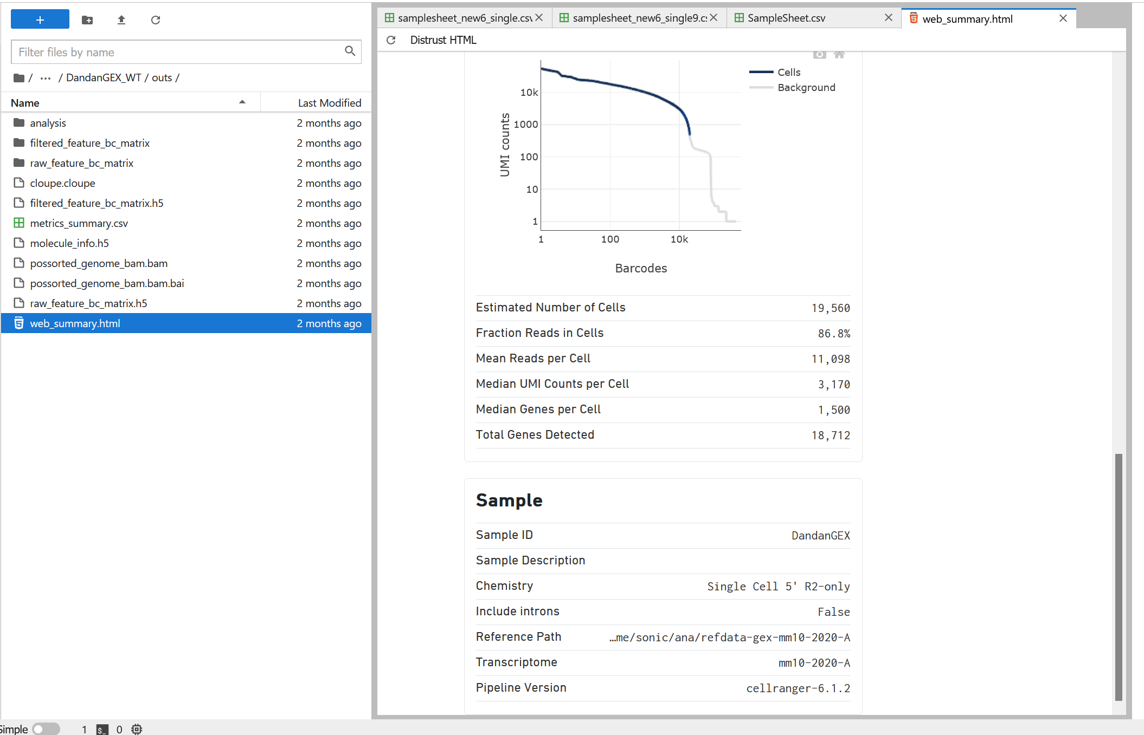
Data for the next step of Seurat

Slide 13
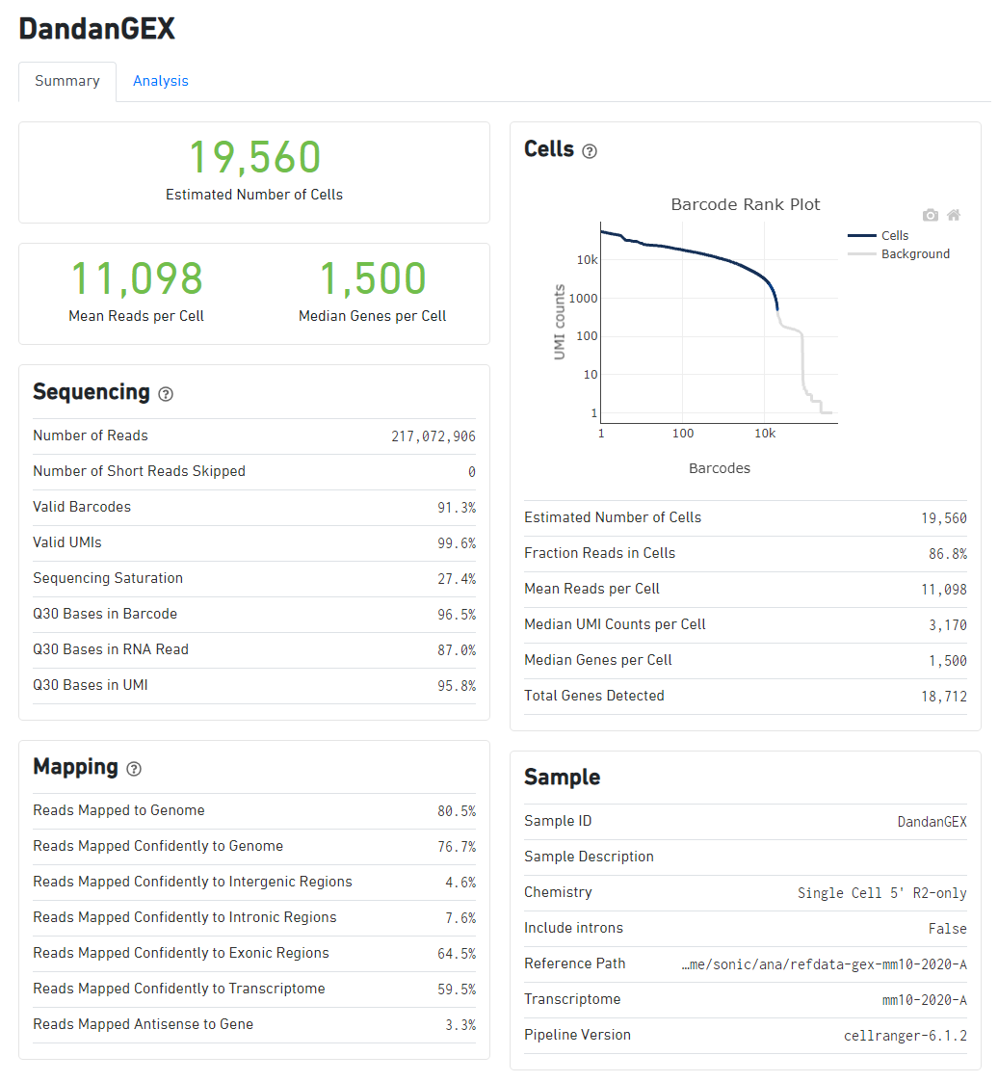
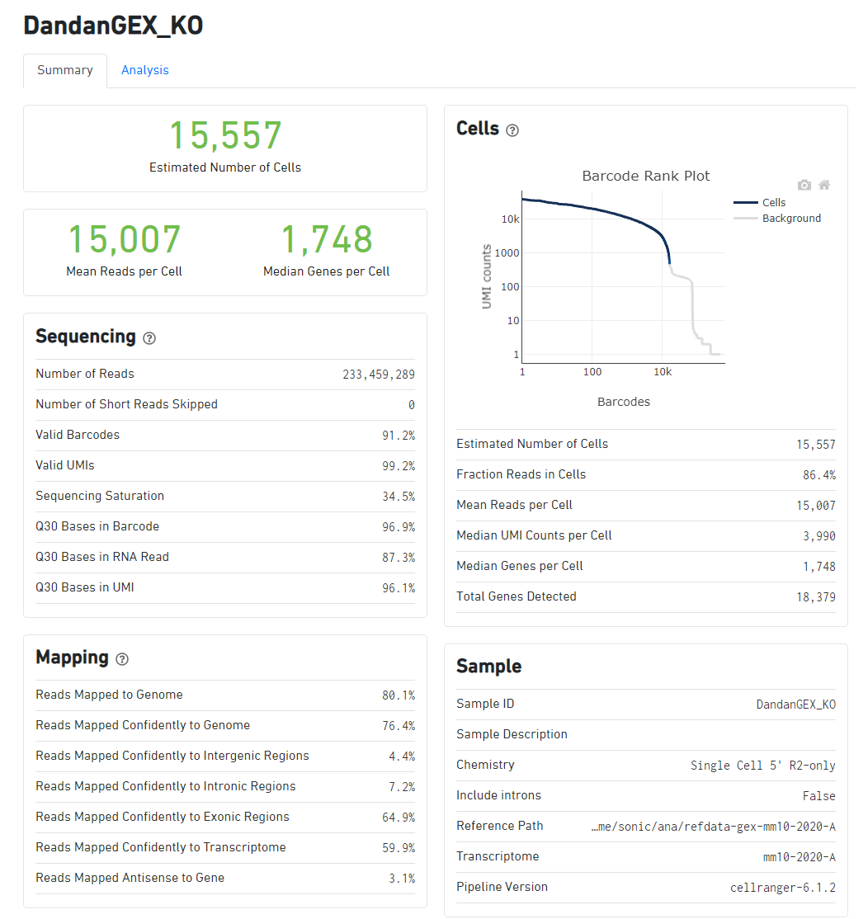

Slide 14
aggr
https://support.10xgenomics.com/single-cell-gene-expression/software/pipelines/latest/using/tutorial_ag
Simple merging of data
No need for now
If you want to compare between WT and KO samples, you should combine data using the Seurat package (integrated analysis)

Slide 15
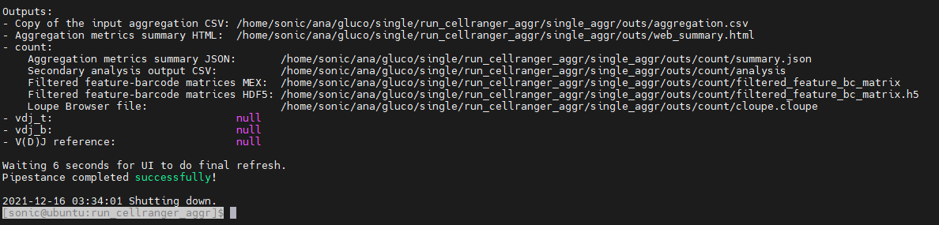
sample_id, molecule_h5
Dandan_WT_GEX,/home/sonic/ana/gluco/single/DandanGEX_WT/outs/molecule_info.h5
Dandan_KO_GEX,/home/sonic/ana/gluco/single/DandanGEX_KO/outs/molecule_info.h5

Slide 16
Seurat

Slide 17
Seurat package
https://satijalab.org/seurat/articles/pbmc3k_tutorial.html
You need the lastest version of R (version >=4.0)
https://www.linkedin.com/pulse/how-upgrade-r-3x-new-4x-linux-ubuntu-henrique-gomide/
R studio Session 에서 restart

Slide 18
Standard pre-processing workflow
These represent the selection and filtration of cells based on
QC metrics
Data normalization and scaling
The detection of highly variable features.

Slide 19
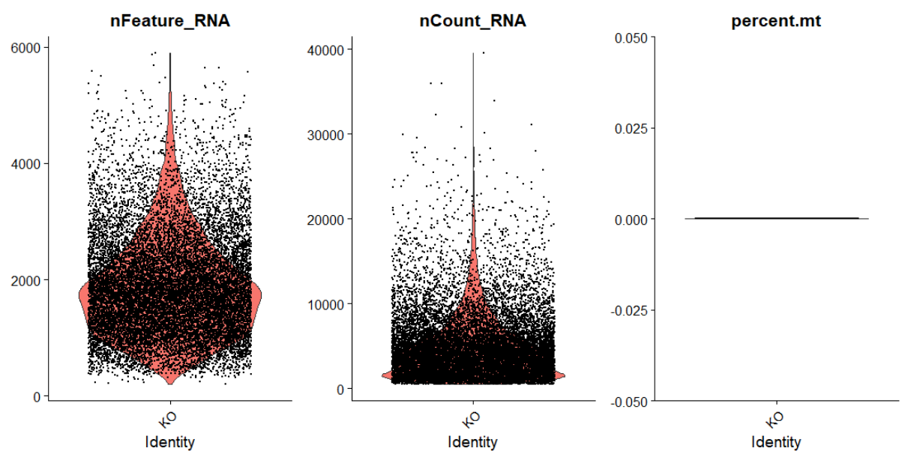
QC matrics – KO

Slide 20
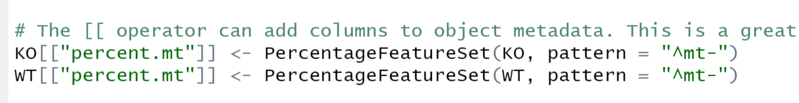
Mitochondria removal
Mouse → “mt-”

Slide 21
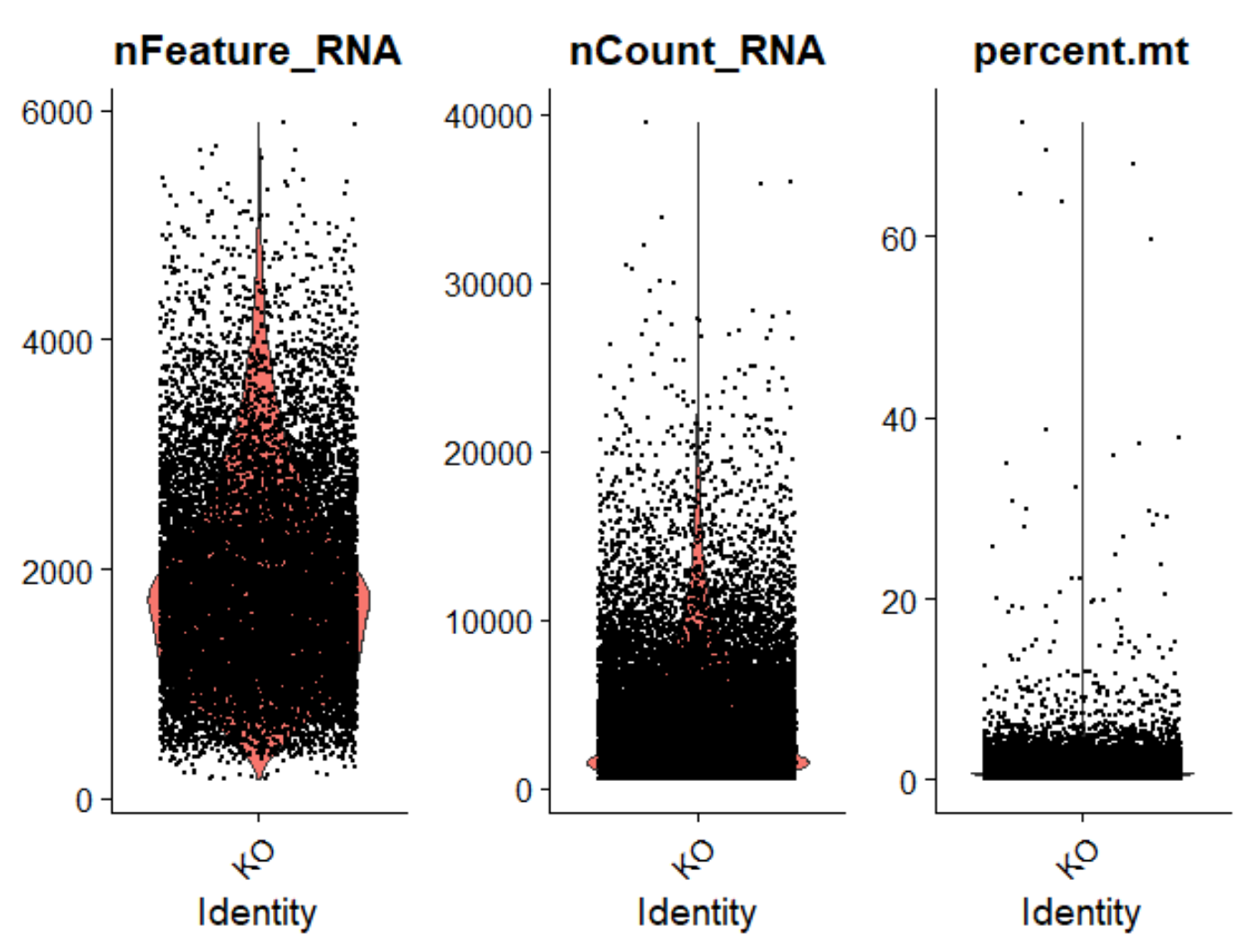
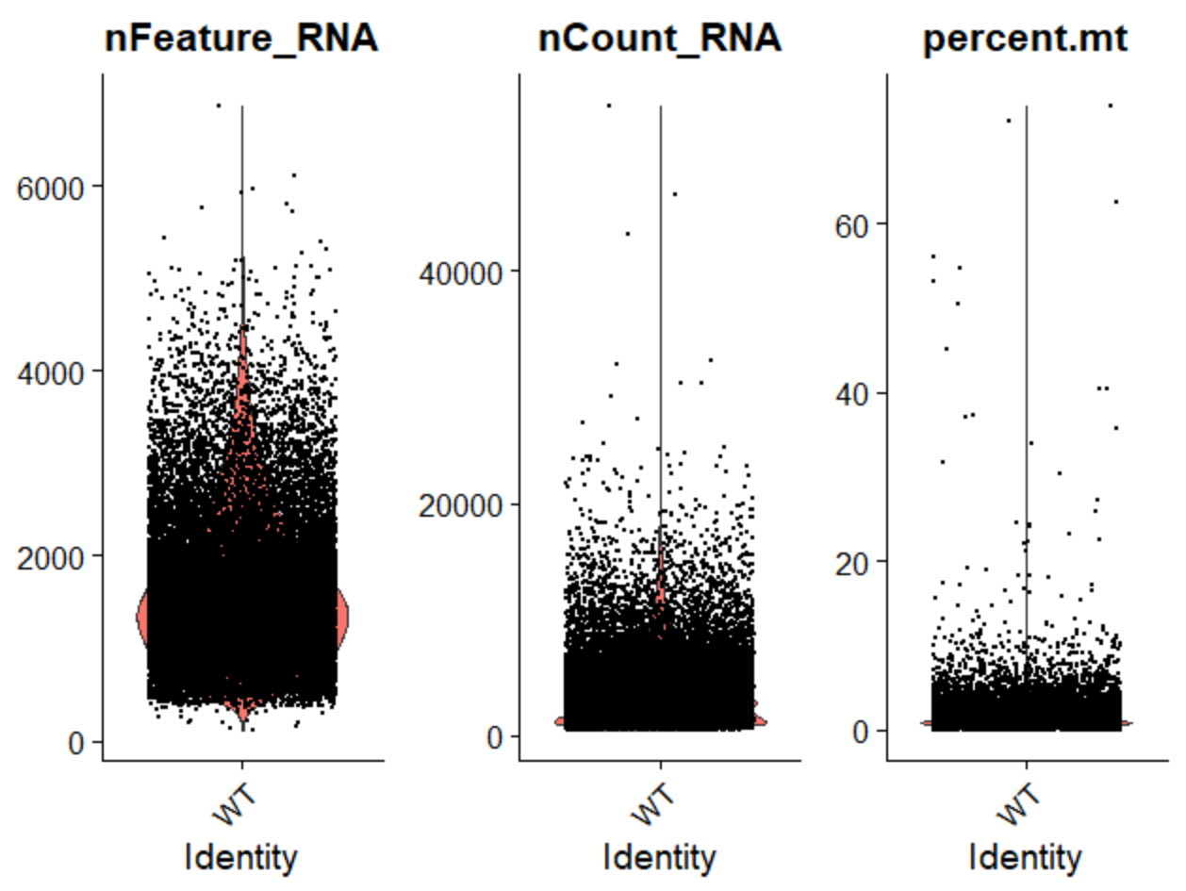

Slide 22
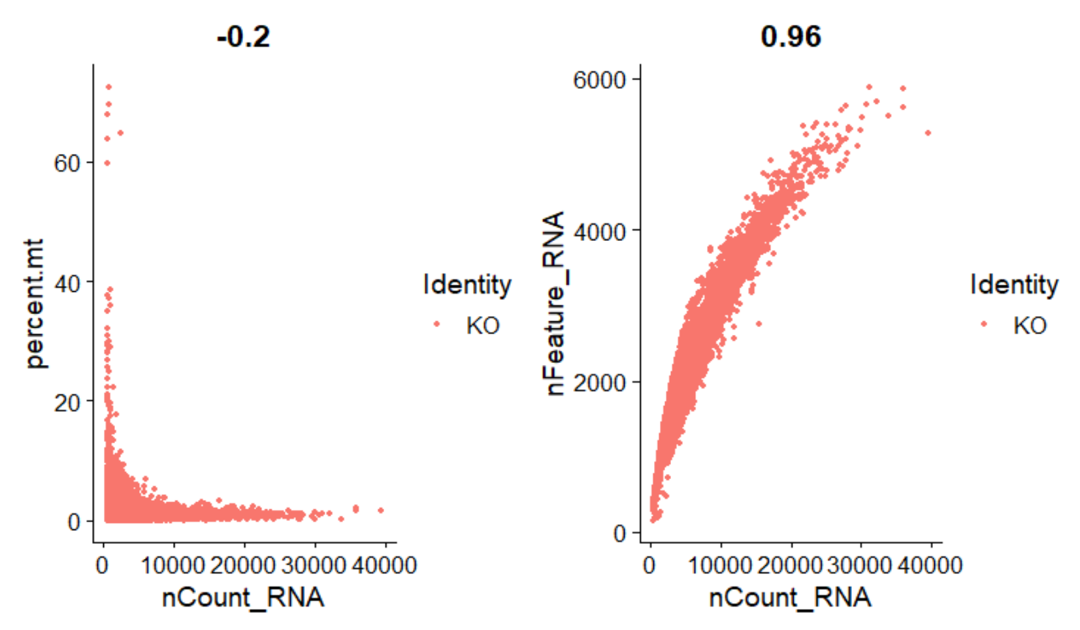

Slide 23
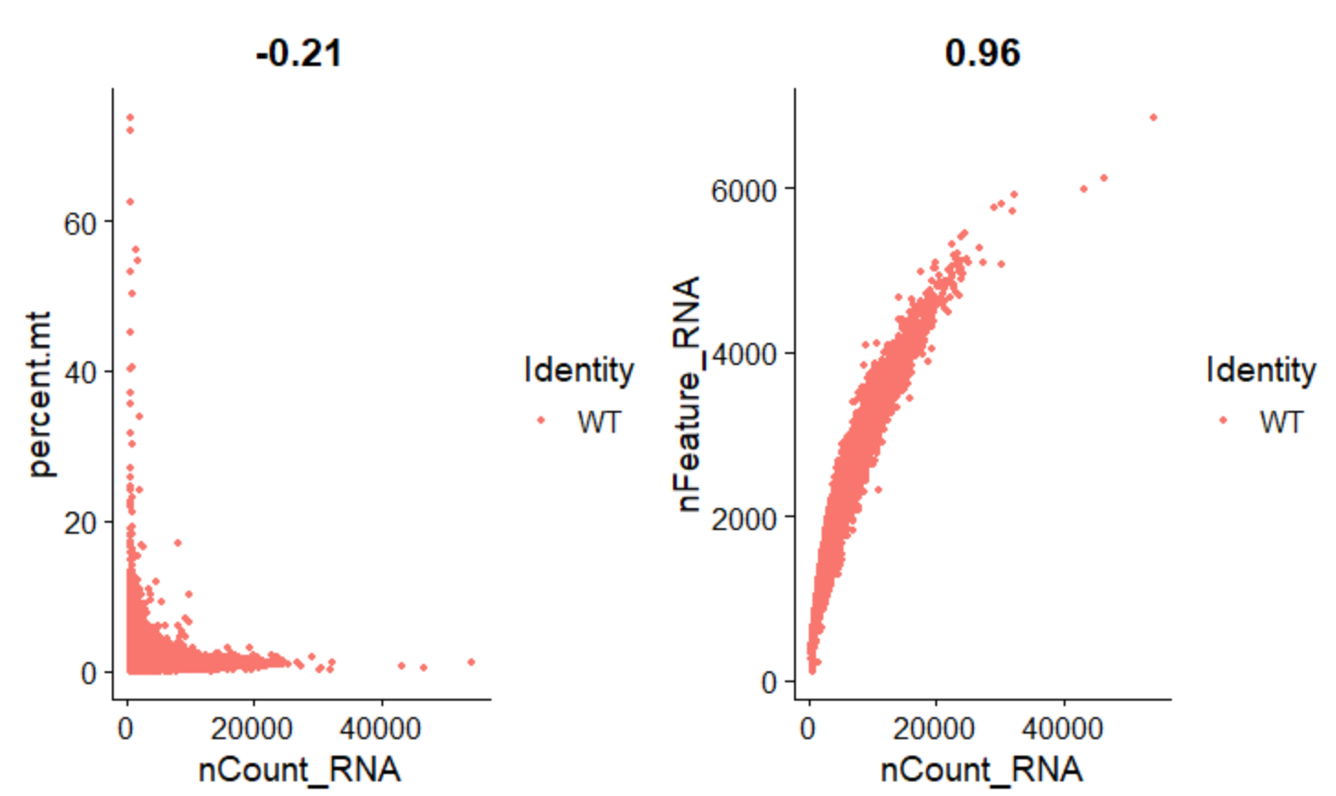

Slide 24
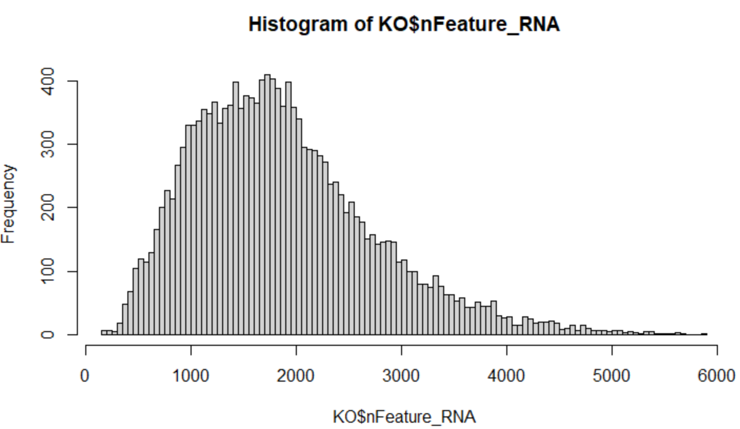
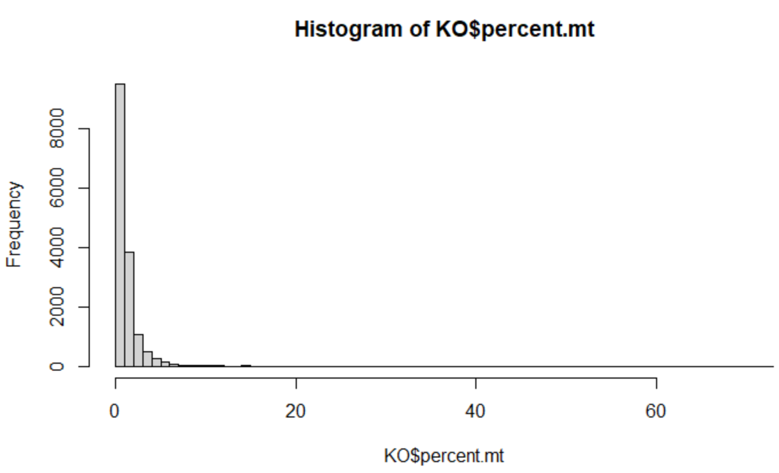
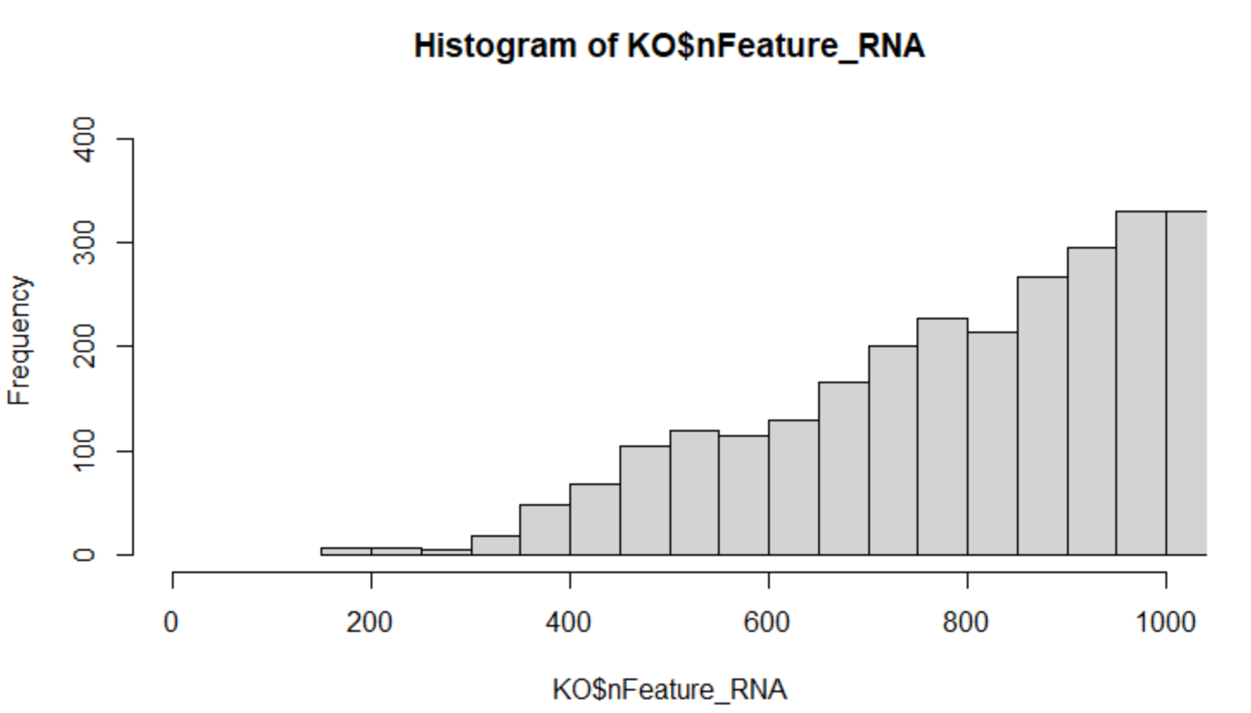
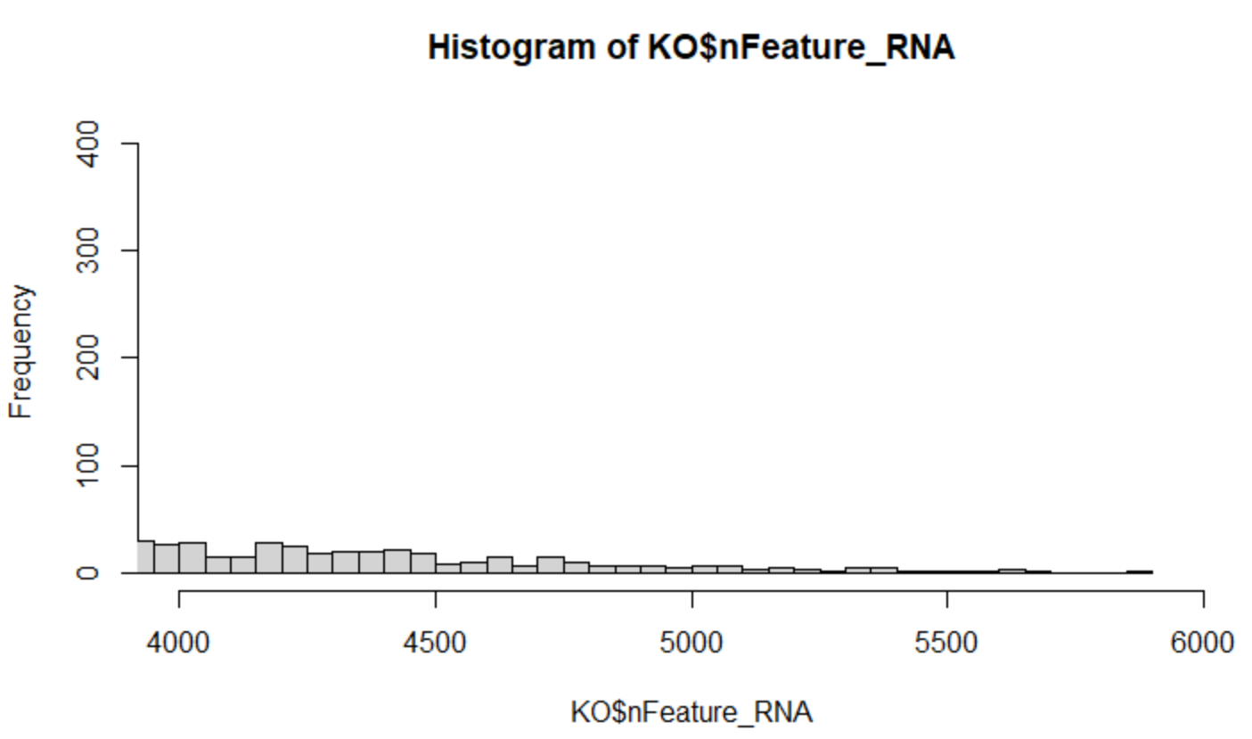

Slide 25
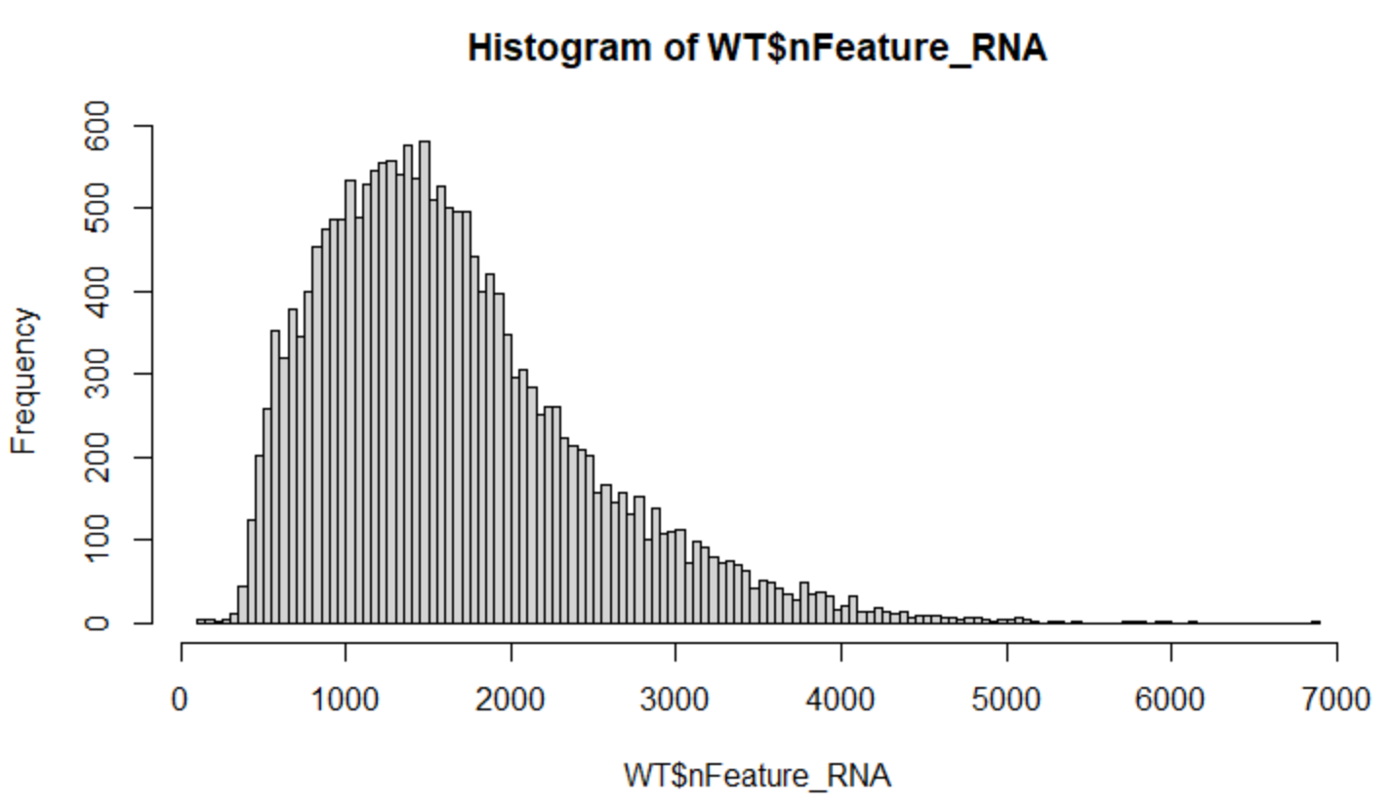
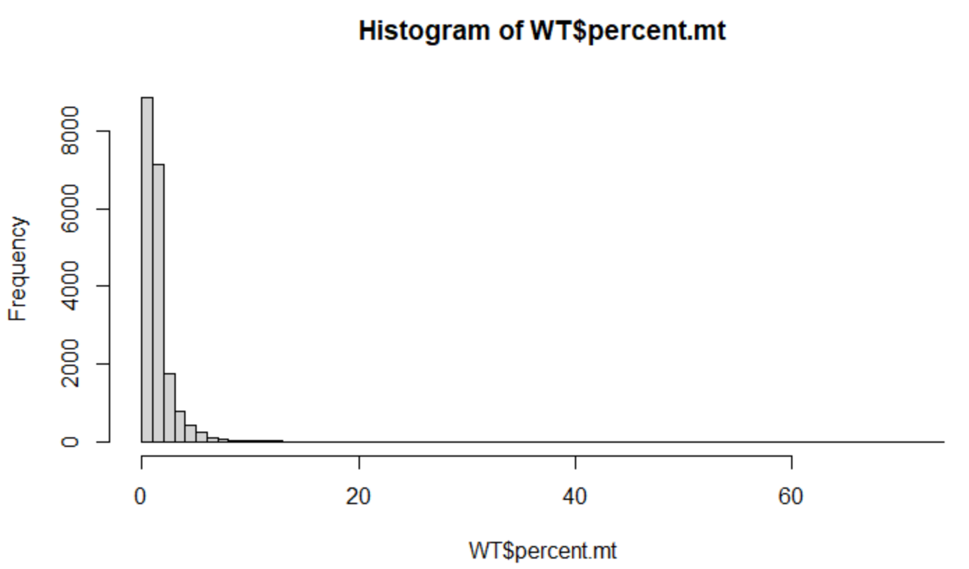
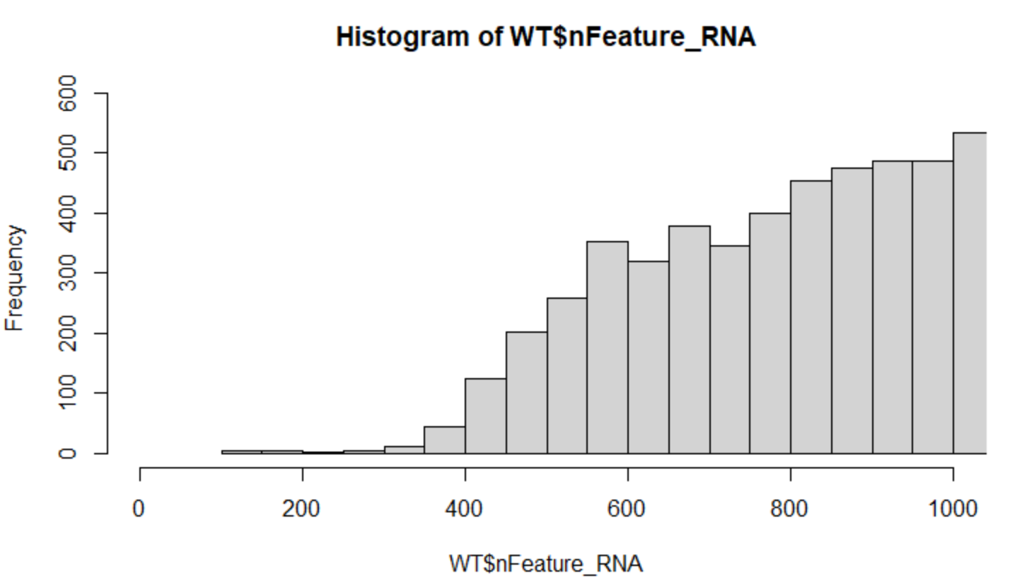
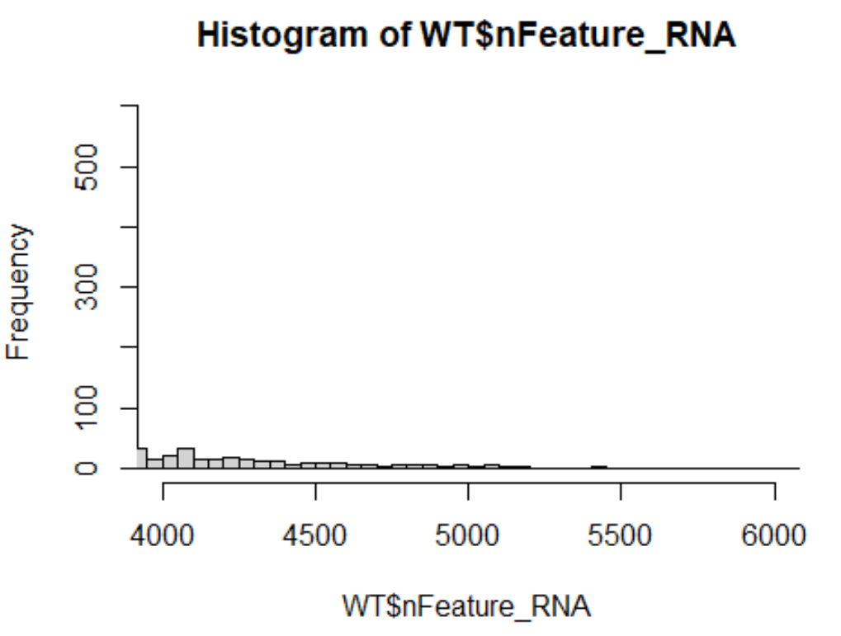

Slide 27
Thank you!

