Slide 1
The iot platform for everyone
Hands-on with azure iot hub
Catalin Huzum
catalin-ioan.huzum@accenture.com
November 16, 2017

Slide 2
Prerequisites
Microsoft Azure subscription
https://azure.microsoft.com/en-us/free/
Free subscription:
30 days trial, then Pay-As-You-Go Subscription
$200 credit
Many free-tier products and services

Slide 3
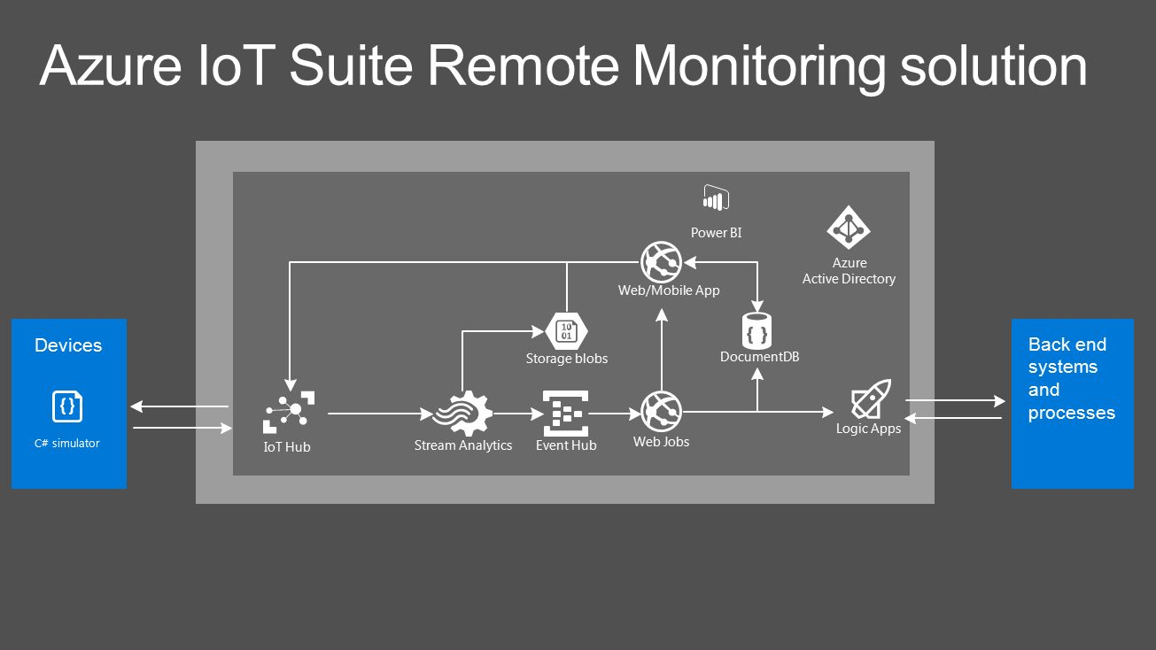
Azure IoT Suite
Notes:
This is an overview of Microsoft Azure’s offering in the IoT space. Although this is a bit older diagram, as some of the components have expanded (for example instead of Web/Mobile Apps and Web Jobs we can also use Azure Container Service, or DocumentDB was transformed to CosmosDB), this shows the main components available to work with in IoT scenarios. This workshop will focus mainly on IoT Hub. We will also touch Event Hub, as, although it is offered as a separate service, it is also a component of IoT Hub.

Slide 4
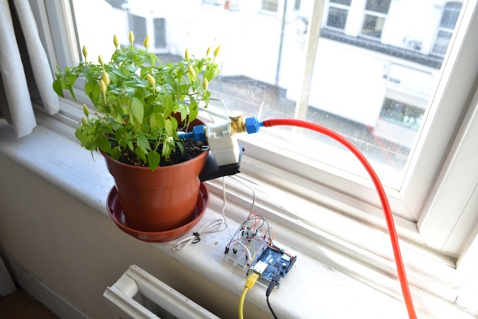
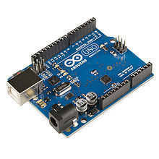
Use case
Automatic flower watering system
Azure IoT Hub
Application

Slide 5

What is Azure IoT Hub?
Fully managed service that enables management and communication between IoT devices and applications
Features
Device management (provisioning, access control, etc…)
Message management
SDK’s for various platforms: https://github.com/Azure/azure-iot-sdks
Multiple communication protocols: HTTPS, AMQP, MQTT
Built-in security
Built-in monitoring
Highly scalable
Only available in the cloud, no on-premise option

Slide 6
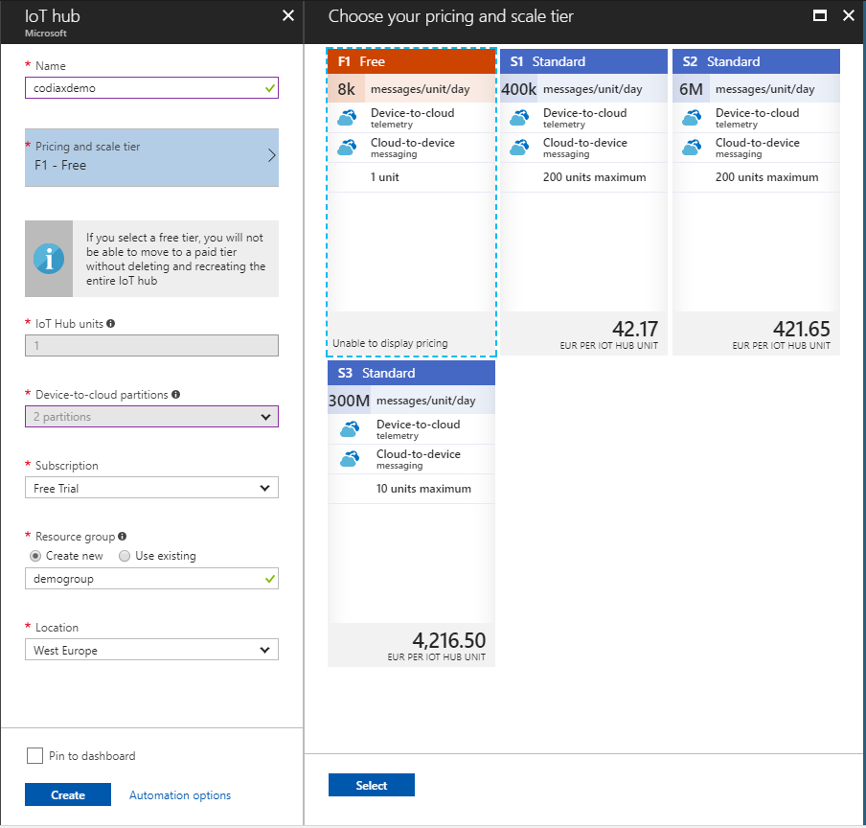
IoT Hub Pricing
Free: 8k messages/day
S1 - $50: 400k messages/unit/day
S2 - $500: 6M messages/unit/day
S3 - $5000: 300M messages/unit/day
*Prices are per month and IoT Hub unit

Slide 7
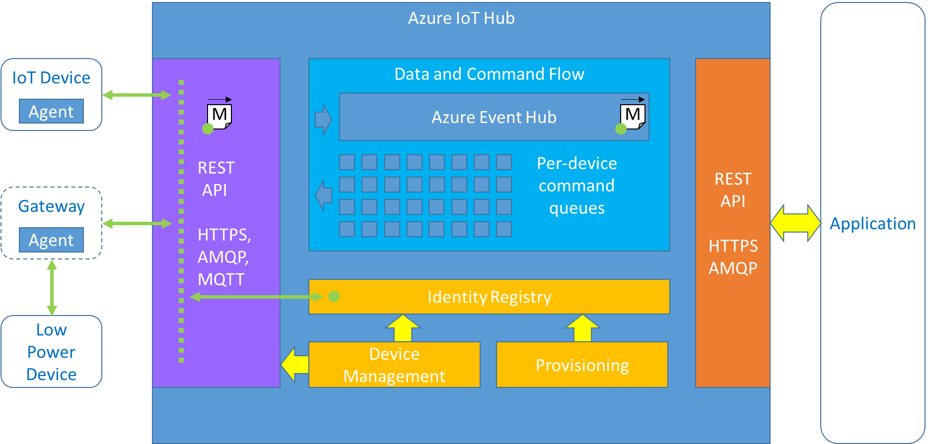
Azure IoT Hub high-level overview

Slide 8
Getting started
Go to https://portal.azure.com
Hit the “+ New” button
Find “IoT Hub” in the service list
Fill the required fields
Hit the “Create” button
Your IoT Hub is online ☺

Slide 9
Configuring storage
Hit the “+ New” button
Find “Storage account” in the service list
Fill the required fields
Hit the “Create” button
Notes:
This storage account is needed for consuming events sent by devices, we will explore this later in the workshop.

Slide 10
Configuring the service
Overview
Shared access policies
Pricing and scale
Operations monitoring
Messaging:
Cloud-to-device
Device-to-cloud

Slide 11
SDK’s
For IoT Devices
C: https://github.com/Azure/azure-iot-sdk-c
Node.js: https://github.com/Azure/azure-iot-sdk-node/tree/master/device
Python: https://github.com/Azure/azure-iot-sdk-python/tree/master/device
.NET: https://github.com/Azure/azure-iot-sdk-csharp/tree/master/device
Java: https://github.com/Azure/azure-iot-sdk-java/tree/master/device
For backend services
.NET: https://github.com/Azure/azure-iot-sdk-csharp/tree/master/service
Java: https://github.com/Azure/azure-iot-sdk-java/tree/master/service
Node.js: https://github.com/Azure/azure-iot-sdk-node/tree/master/service

Slide 12
Provisioning devices
There are multiple ways to do this:
Programmatically using the API/SDK
Built-in device management functionality in Azure portal
IoT Hub Device Provisioning Service (Preview)
Using DeviceExplorer desktop app
https://github.com/Azure/azure-iot-sdk-csharp/tree/master/tools/DeviceExplorer

Slide 13
Device-to-cloud communication
Device-to-cloud messages – high frequency
All protocols, up to 256KB/message (pricing 4KB/message), temporary storage (up to 7 days) in Event Hub
Device twin’s reported properties – medium frequency
AMQP&MQTT, 8KB/property, permanent storage
File uploads – low frequency
Large files, stored in Azure Storage account

Slide 14
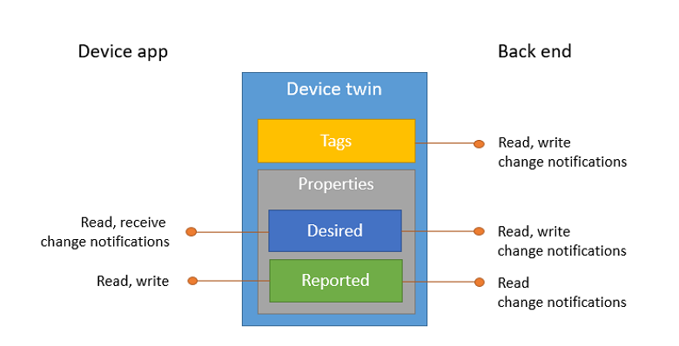
Device Twins
JSON structure
One per registered device
Contains:
Connection state
Tags
Properties
Metadata (version, last update)
Optimistic concurrency
Change notifications

Slide 15
Cloud-to-device communication
Cloud-to-device messages – low frequency
All protocols, up to 64KB/message, retained up to 48h to deliver, one-way
Device twin’s desired properties – medium frequency
AMQP&MQTT, 8KB/property, preserved in device twin, notification send to device
Direct methods – high frequency
AMQP&MQTT, 8KB/request, 8KB/response, no durability, two-way

Slide 16

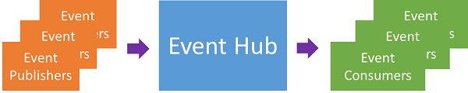
What is Azure Event Hub?
Highly scalable data ingress and event processing service
Acts as an event “pipeline”
Very useful when implementing the Event Sourcing pattern
Partitioned consumers model
Publish/subscribe mechanism to consume events

Slide 17
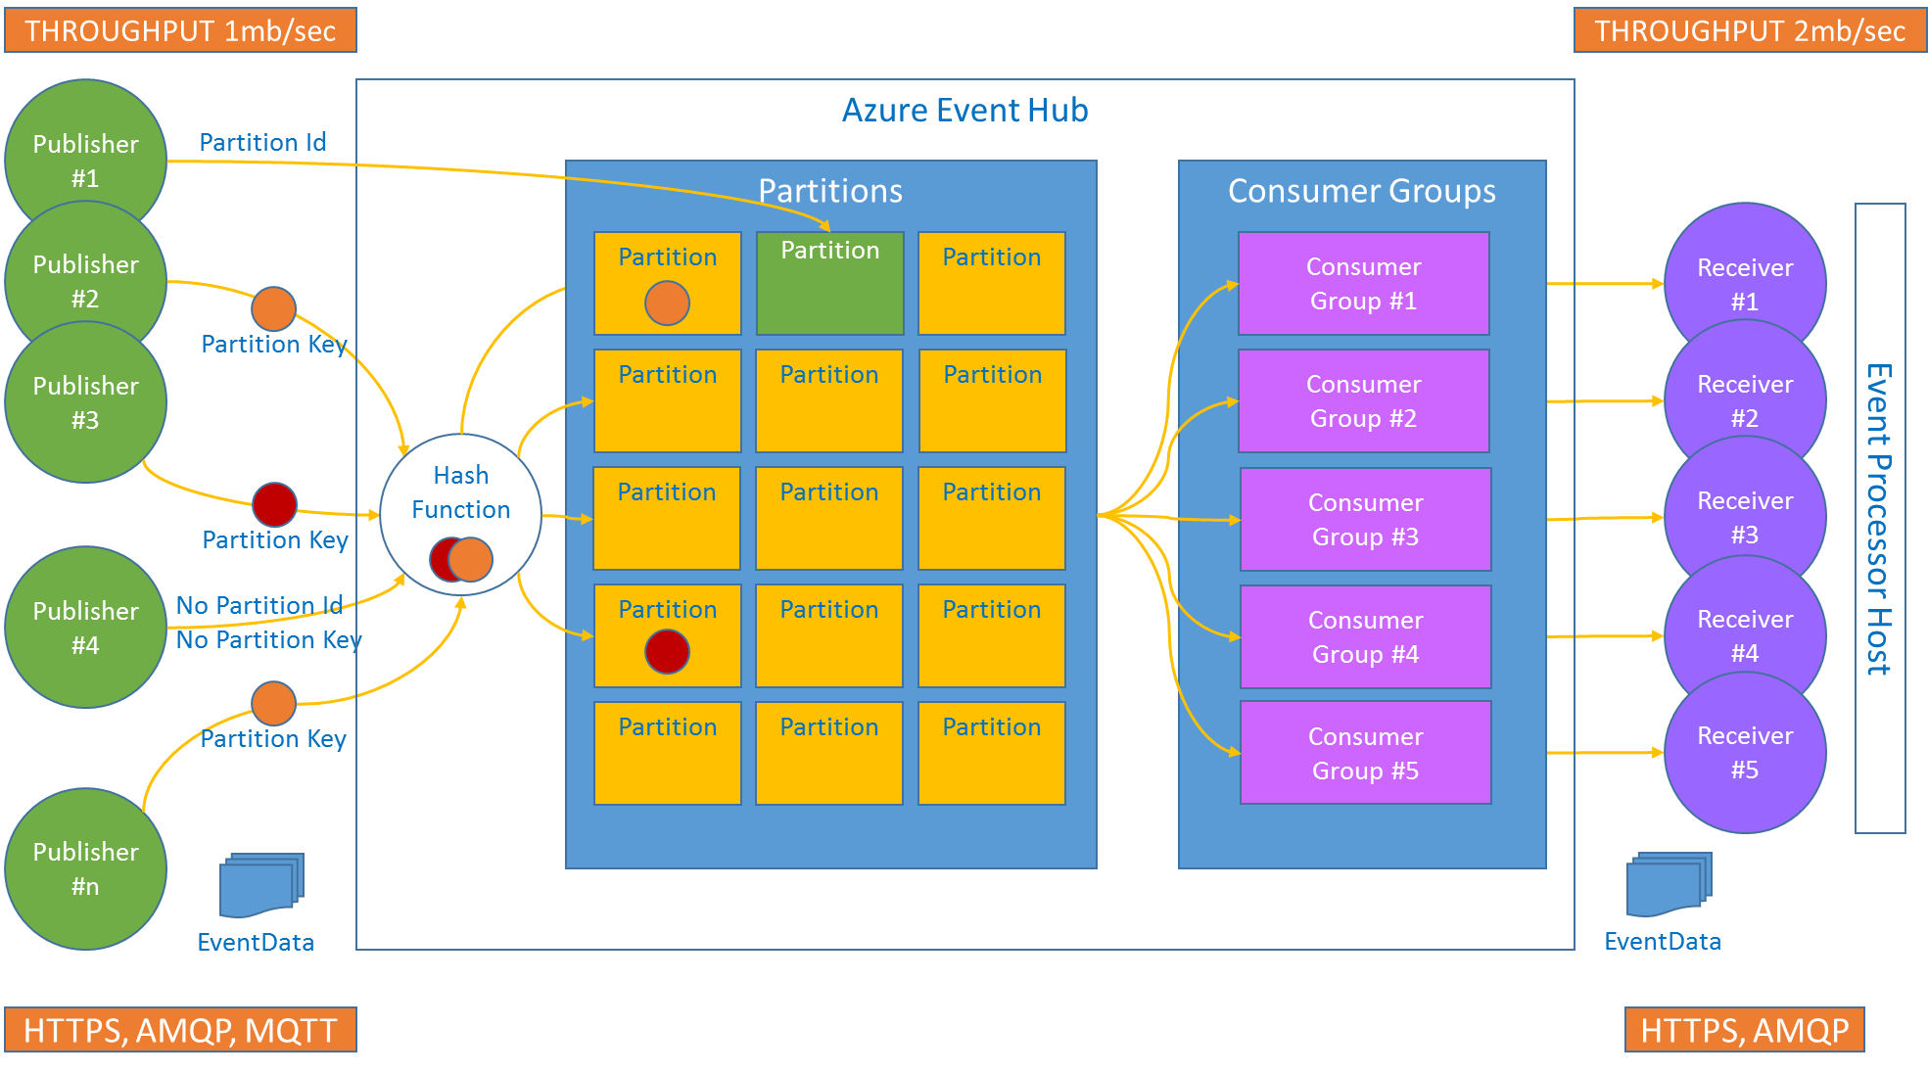
Azure Event Hub high-level overview

Slide 18
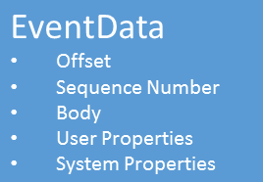
Event Streaming
JSON format
Stream of data (message order preservation)
Replay functionality
Retention up to 7 days
Body can be any serializable format
Custom properties (type, version, etc…)

Slide 19
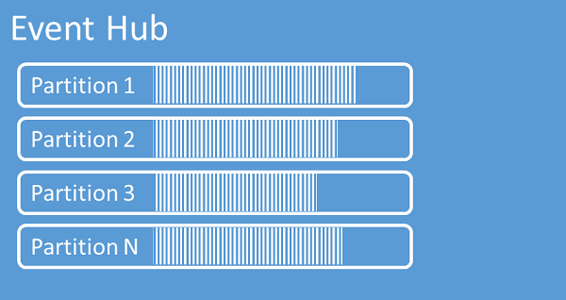
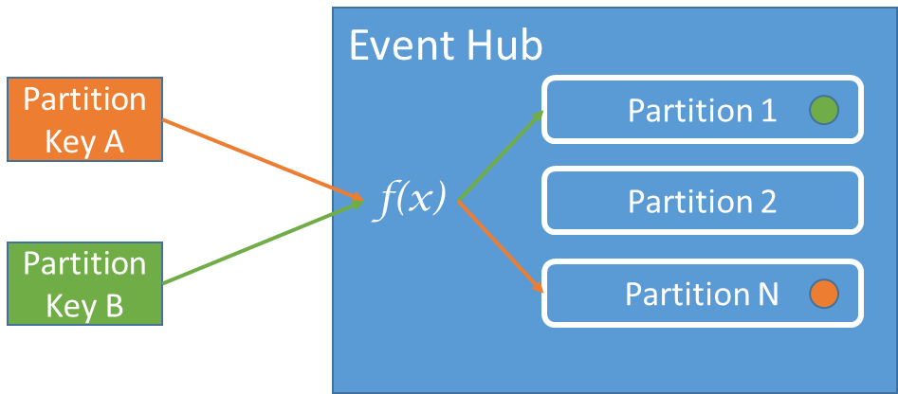
How partitioning works
Partition assignment:
Partition ID
Partition Key with hash function
Round robin

Slide 20
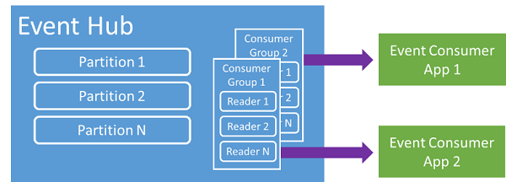
Consuming events
Partitioned consumers model implemented with consumer groups
Each consumer group has it’s own view of the data stream
EventProcessorHost: part of the Event Hub SDK
Connects to one consumer group
Reads data from all partitions
Event Hub pushes events (no polling)
Event Hub handles multiple event processors connected to the same consumer group

Slide 21
References
https://docs.microsoft.com/en-us/azure/iot-hub/
https://github.com/Azure/azure-iot-sdks
https://azure.microsoft.com/en-us/develop/iot/
Presentation and code samples available:
https://github.com/chuzumcodiaxdemo/iothub.git

Slide 22
Thank
You

