Slide 1
2.5 FRACTIONS

Slide 2
1. Which is greater?
(i) 0.5 or 0.05
Sol: By comparing whole number, 0 = 0
By comparing the tenths place digit, 5 > 0
So, 0.5 > 0.05
(ii) 0.7 or 0.5
Sol: By comparing whole number, 0 = 0
By comparing the tenths place digit, 7 > 5
So, 0.7 > 0.5
(iii) 7 or 0.7
Sol: By comparing whole number, 7 > 0
So, 7 > 0.7

Slide 3
(iv) 1.37 or 1.49
Sol: By comparing whole number, 1 = 1
By comparing the tenths place digit, 3 < 4
So, 1.37 < 1.49
Bit (v), (vi) as H.W

Slide 4
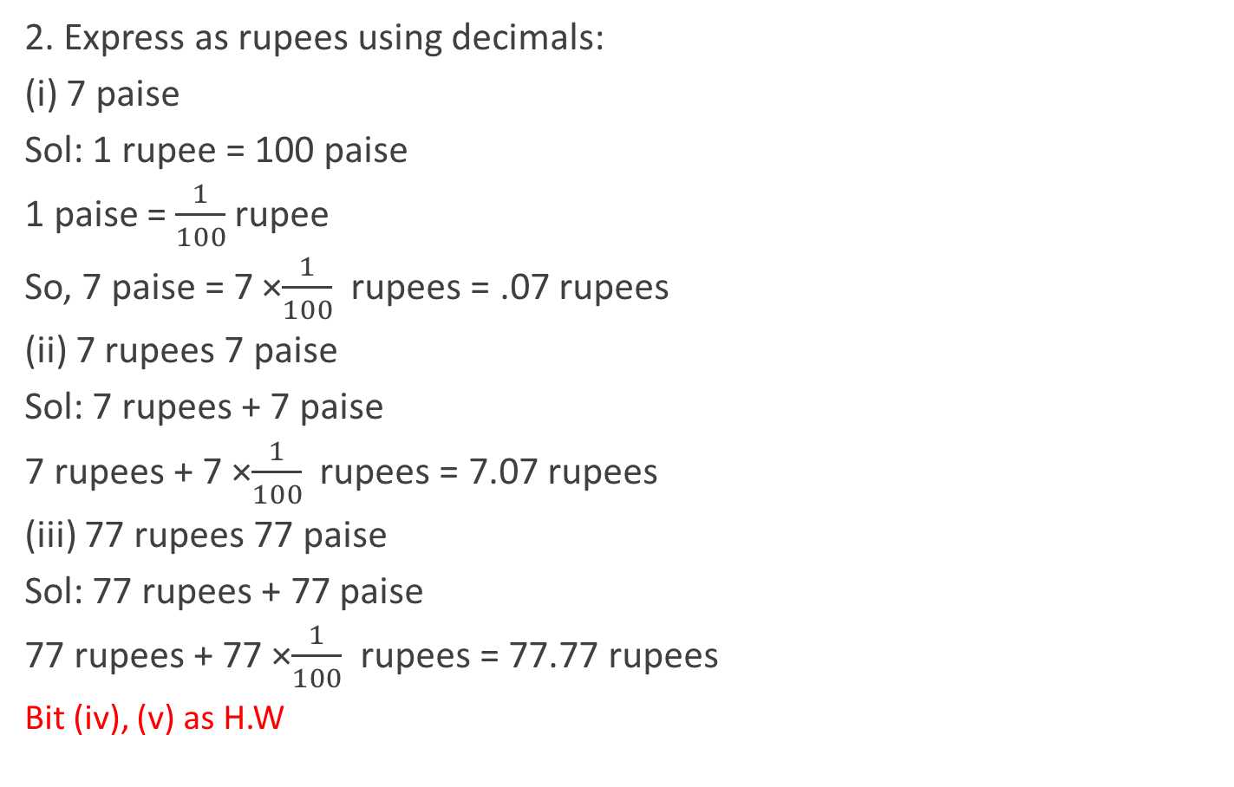
2. Express as rupees using decimals:
(i) 7 paise
Sol: 1 rupee = 100 paise
1 paise = $\frac{1}{100}$rupee
So, 7 paise = 7 ×$\frac{1}{100}$ rupees = .07 rupees
(ii) 7 rupees 7 paise
Sol: 7 rupees + 7 paise
7 rupees + 7 ×$\frac{1}{100}$ rupees = 7.07 rupees
(iii) 77 rupees 77 paise
Sol: 77 rupees + 77 paise
77 rupees + 77 ×$\frac{1}{100}$ rupees = 77.77 rupees
Bit (iv), (v) as H.W

Slide 5
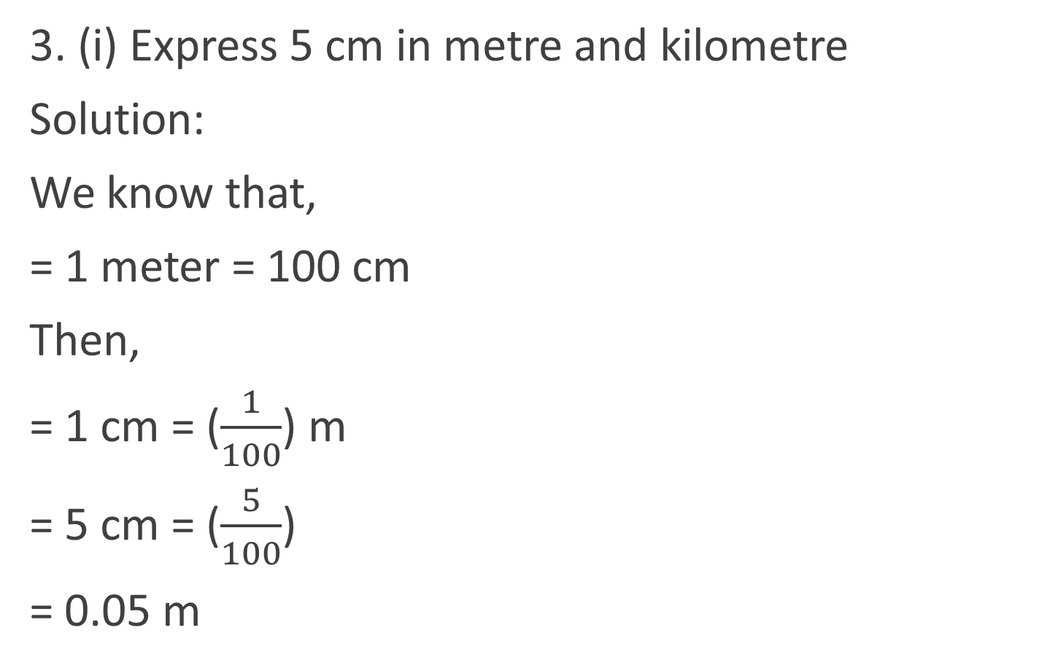
3. (i) Express 5 cm in metre and kilometre
Solution:
We know that,
= 1 meter = 100 cm
Then,
= 1 cm = ($\frac{1}{100}$) m
= 5 cm = ($\frac{5}{100}$)
= 0.05 m

Slide 6

Now,
1 km = 1000 m
Then,
= 1 m = ($\frac{1}{1000}$) km
= 0.05 m = ($\frac{0.05}{1000}$) km
= 0. 00005 km
Bit (ii) as H.W.

Slide 7
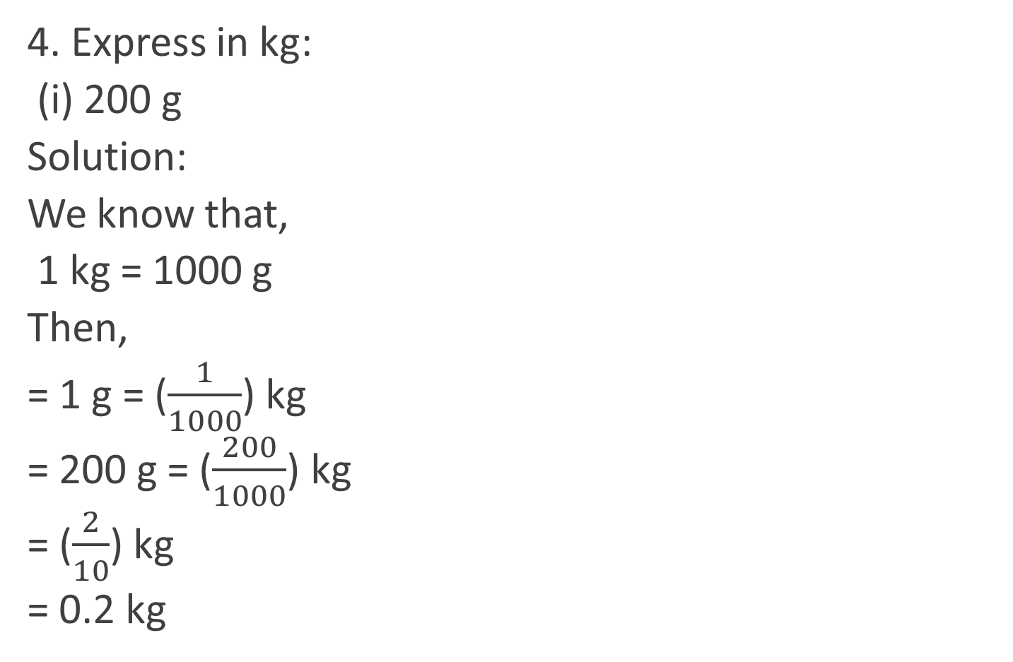
4. Express in kg:
(i) 200 g
Solution:
We know that,
1 kg = 1000 g
Then,
= 1 g = ($\frac{1}{1000}$) kg
= 200 g = ($\frac{200}{1000}$) kg
= ($\frac{2}{10}$) kg
= 0.2 kg

Slide 8
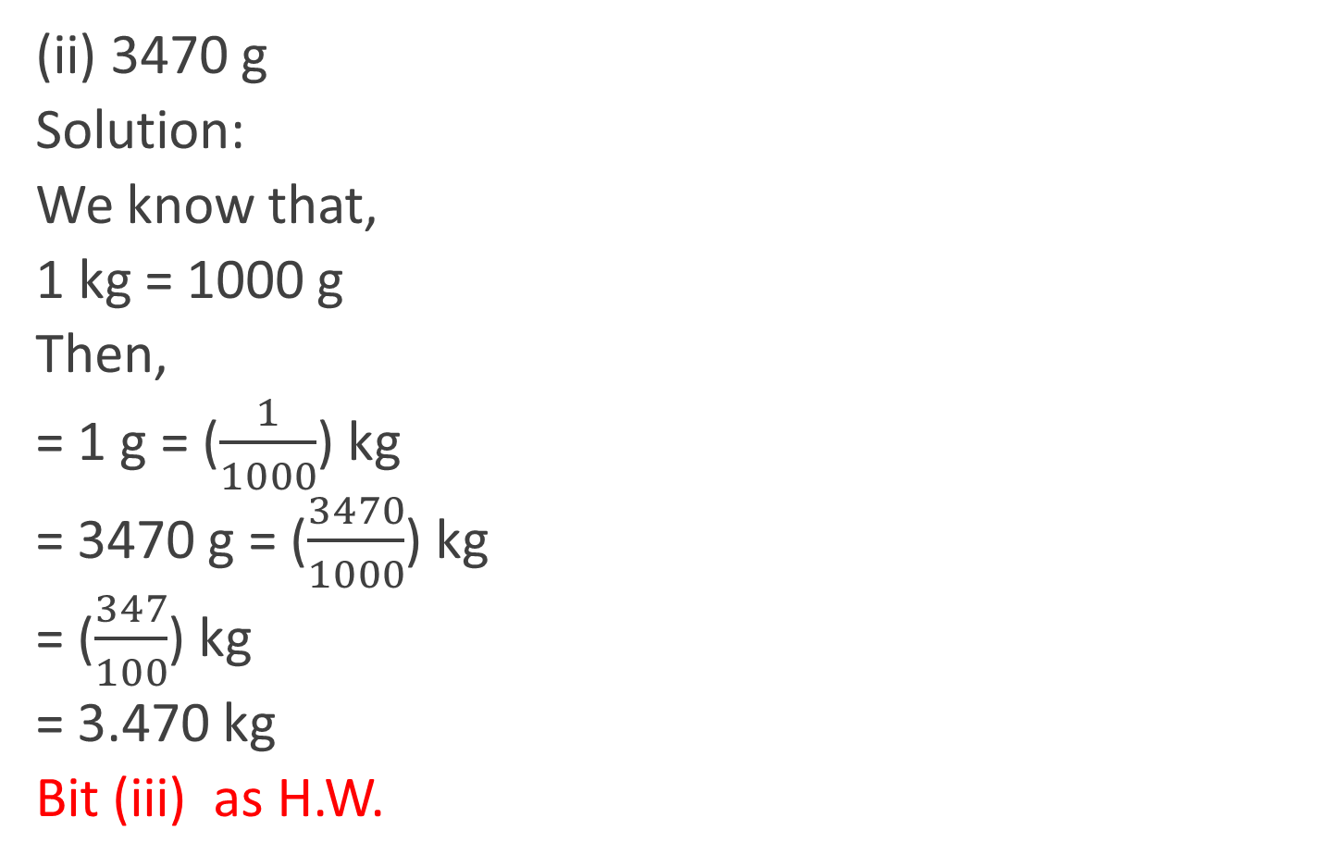
(ii) 3470 g
Solution:
We know that,
1 kg = 1000 g
Then,
= 1 g = ($\frac{1}{1000}$) kg
= 3470 g = ($\frac{3470}{1000}$) kg
= ($\frac{347}{100}$) kg
= 3.470 kg
Bit (iii) as H.W.

Slide 9
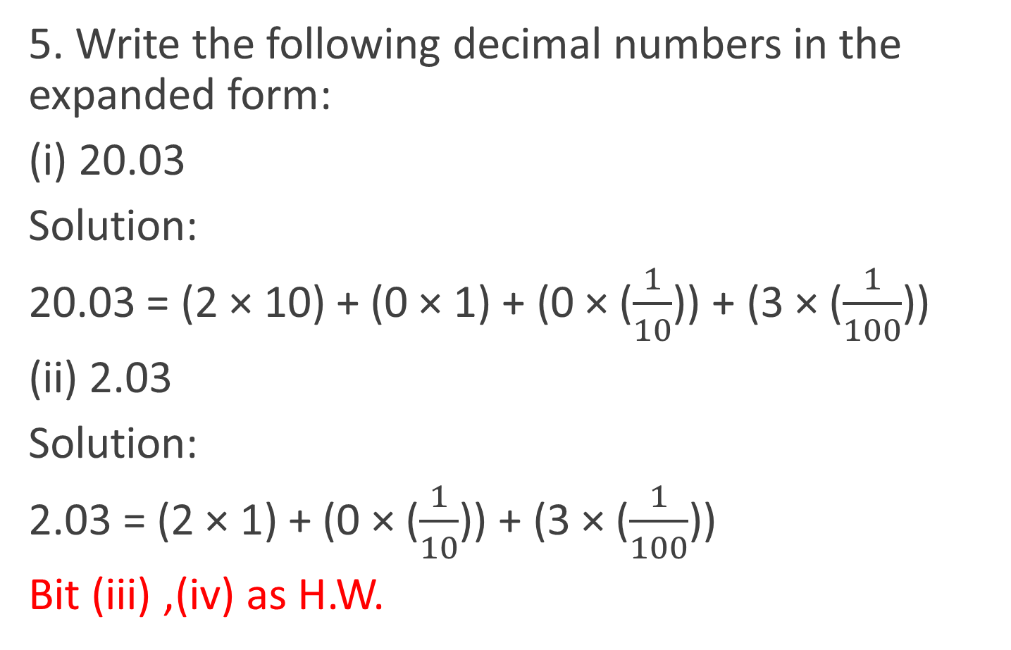
5. Write the following decimal numbers in the expanded form:
(i) 20.03
Solution:
20.03 = (2 × 10) + (0 × 1) + (0 × ($\frac{1}{10}$)) + (3 × ($\frac{1}{100}$))
(ii) 2.03
Solution:
2.03 = (2 × 1) + (0 × ($\frac{1}{10}$)) + (3 × ($\frac{1}{100}$))
Bit (iii) ,(iv) as H.W.

Slide 10
6. Write the place value of 2 in the following decimal numbers:
(i) 2.56
The place value of 2 in 2.56 is ones
(ii) 21.37
The place value of 2 in 21.37 is tens
(iii) 10.25
The place value of 2 in 10.25 is tenths
Bit (iv) ,(v) as H.W.

Slide 11
7. Dinesh went from place A to place B and from
there to place C. A is 7.5 km from B and B is
12.7 km from C. Ayub went from place A to place
D and from there to place C. D is 9.3 km from A
and C is 11.8 km from D. Who travelled more
and by how much?

Slide 12
Solution:-
From the question, it is given that,
Distance travelled by Dinesh = AB + BC
= 7.5 + 12.7
= 20.2 km
Dinesh travelled 20.2 km
Distance travelled by Ayub = AD + DC
= 9.3 + 11.8
= 21.1 km
Ayub travelled 21.1km
Clearly, Ayub travelled more distance by = (21.1 – 20.2)
= 0.9 km
Ayub travelled 0.9 km more than Dinesh.

Slide 13
8. Shyama bought 5 kg 300 g apples and 3 kg 250 g mangoes. Sarala bought 4 kg 800 g
oranges and 4 kg 150 g bananas. Who bought more fruits?
Sol: Fruits bought by Shyama = 5 kg 300 g + 3 kg 250 g
= 5 kg + (300/1000) kg + (3 + (250/1000))
= 5 kg + 0.3 kg + (3 + .250) kg
= 5.3 kg + 3.25kg
= 8.55 kg
Fruits bought by Sarala = 4 kg 800 g + 4 kg 150 g
= (4 + (800/1000)) + (4 + (150/1000))
= (4 + 0.8) kg + (4 + .150) kg
= 4.8 kg + 4.150kg
= 8.950 kg
So, Sarala bought more fruits.

Slide 14
9.How much less is 28 km than 42.6 km?
Sol:
Solution:-
Now, we have to find the difference of 42.6 km and 28 km
42.6
-28.0
14.6
So, 14.6 km less is 28 km than 42.6 km.

Slide 15
Now,
1 km = 1000 m
Then,
= 1 m = ($\frac{1}{1000}$) km
= 0.05 m = ($\frac{0.05}{1000}$) km
= 0. 00005 km
Bit (ii) as H.W.

Slide 16
Now,
1 km = 1000 m
Then,
= 1 m = ($\frac{1}{1000}$) km
= 0.05 m = ($\frac{0.05}{1000}$) km
= 0. 00005 km
Bit (ii) as H.W.

