Slide 1
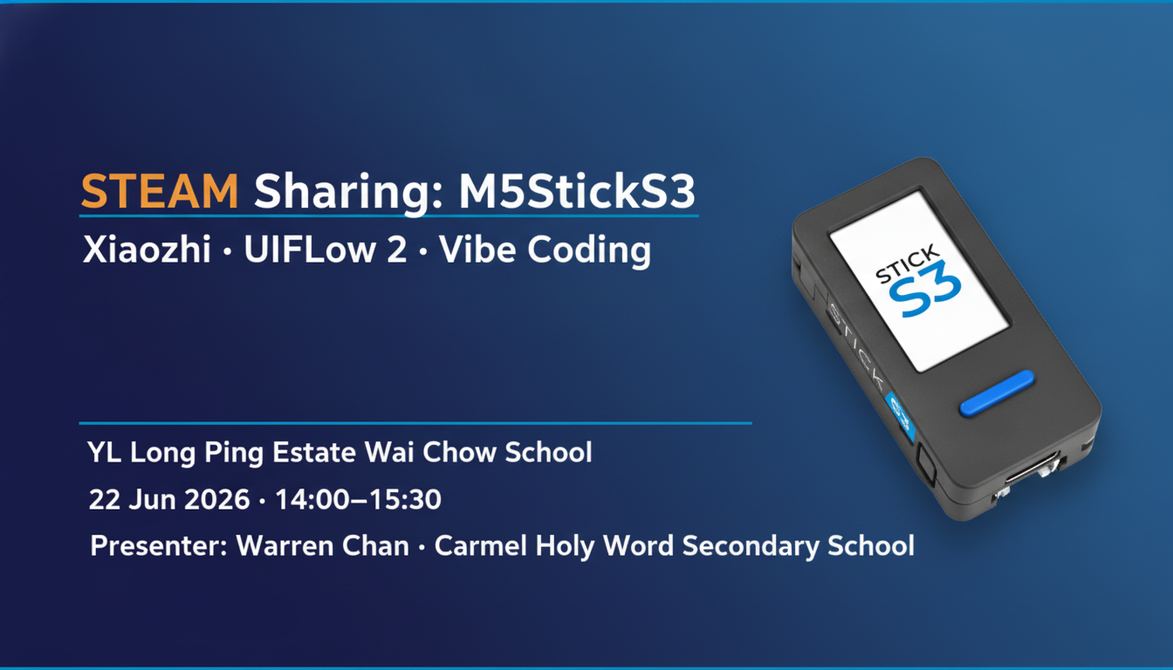

Slide 2
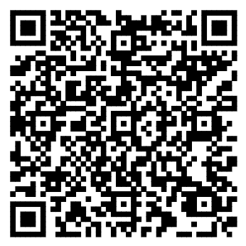
立即加入 Google Classroom
課程內容：Task 3 Sample Prompt · 跟做筆記 · Feedback Form · 有用連結
① 開手機 / 電腦 Google Classroom App 或瀏覽器
② 按「+」→「以代碼加入課程」
③ 輸入代碼：zgabqpbr
④ 或直接掃描左邊 QR Code
Class Code：zgabqpbr
https://classroom.google.com/c/ODU1MjQ4NzE0OTg1?cjc=zgabqpbr

Slide 3
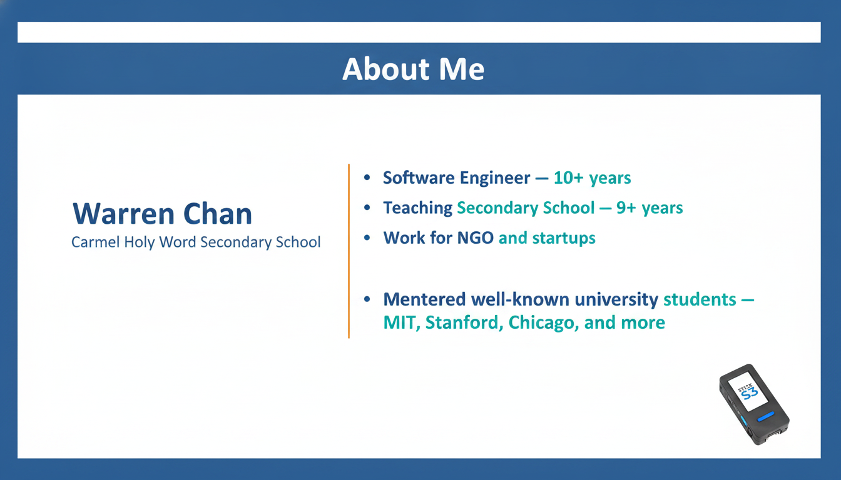

Slide 4
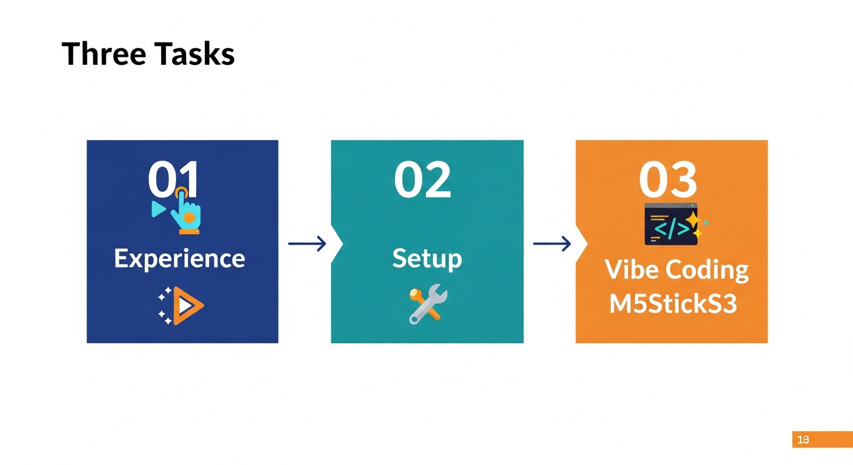

Slide 5
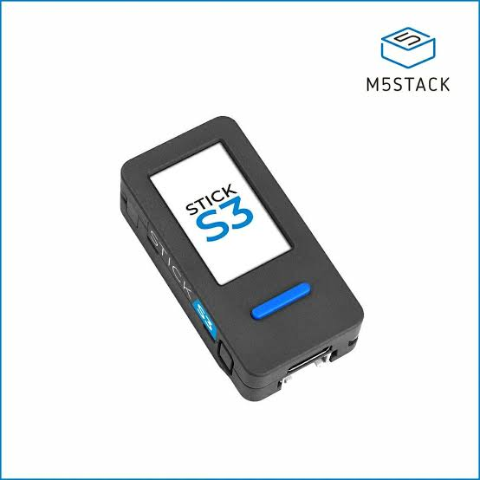
Know These Three Buttons
Power Button
Single press to power ON
Double press to sleep Hold 6 seconds to download mode (DON’T DO THAT)
Button A
Blue button (blue)
Normally means enter/select
Button B
Right side button
Single press means next. Double press means previous.

Slide 6
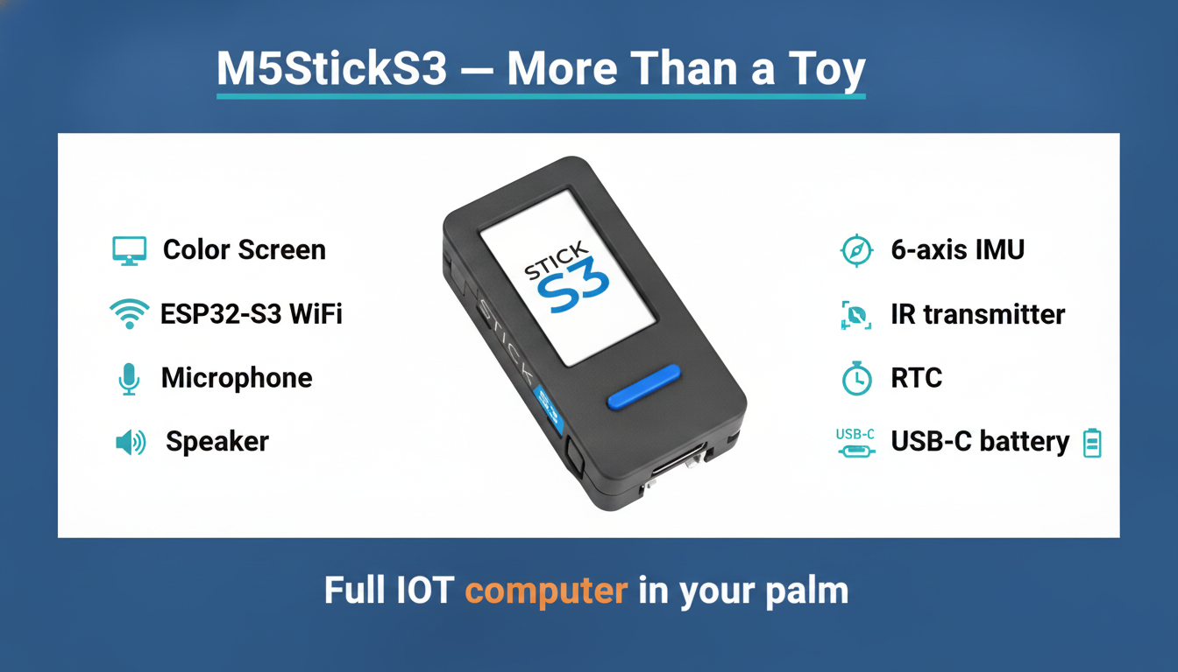

Slide 7
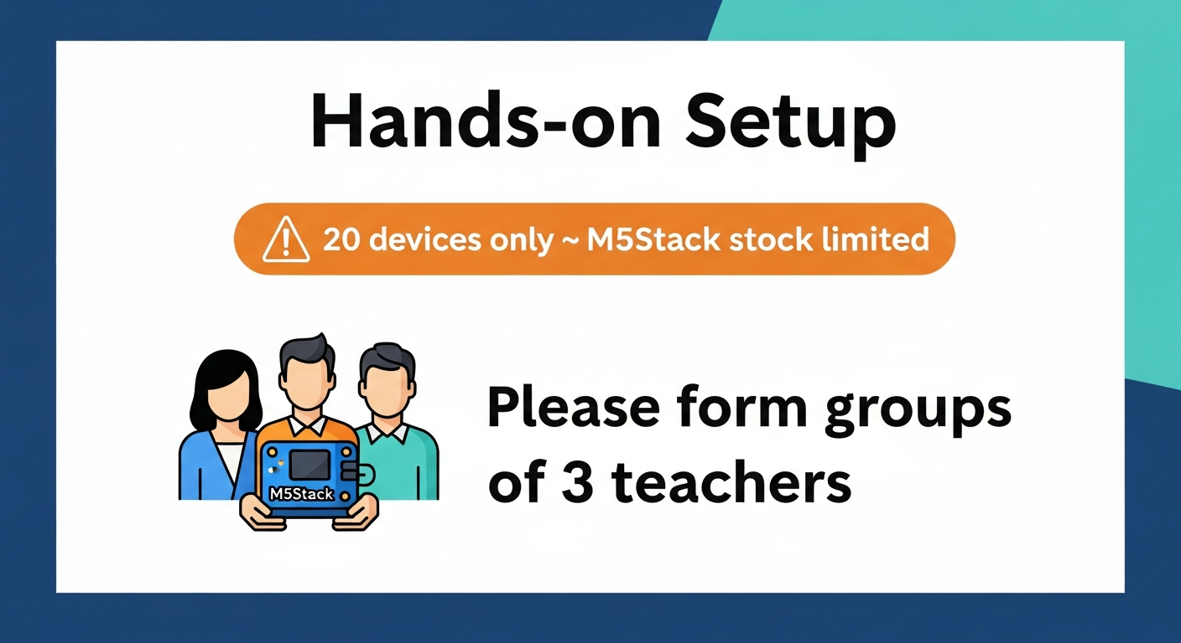

Slide 8
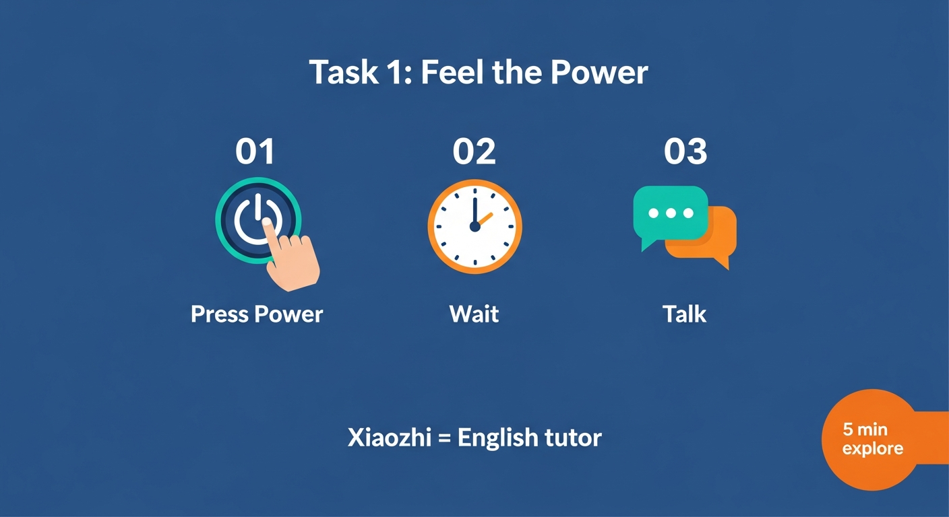

Slide 9
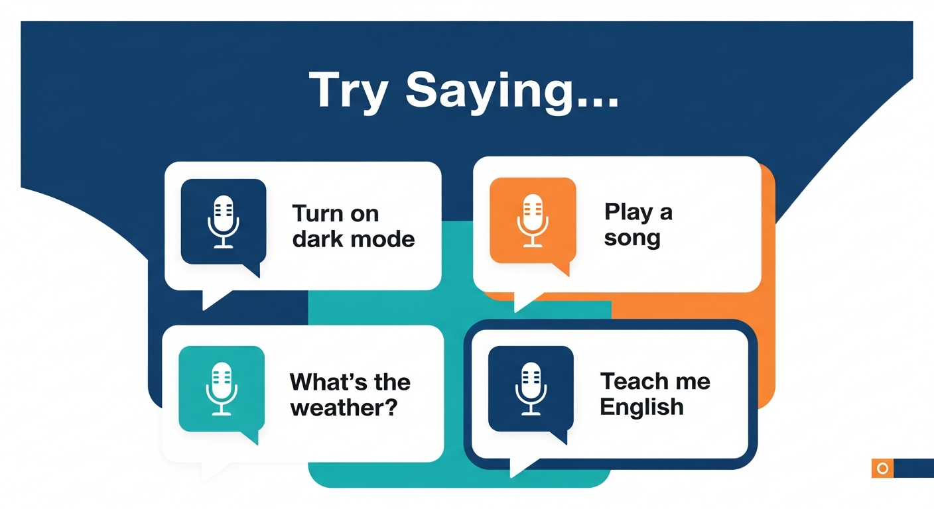

Slide 10
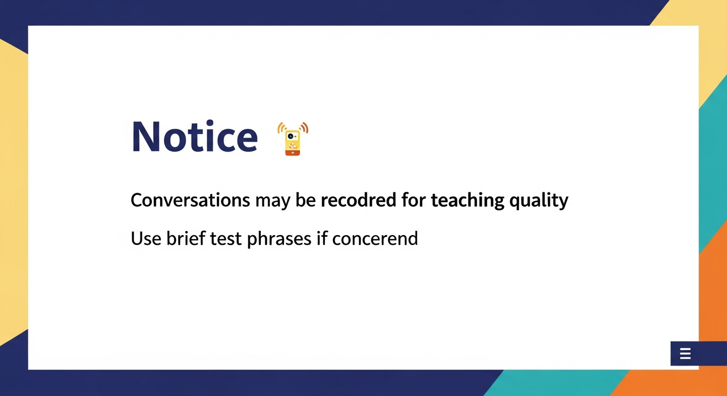

Slide 11
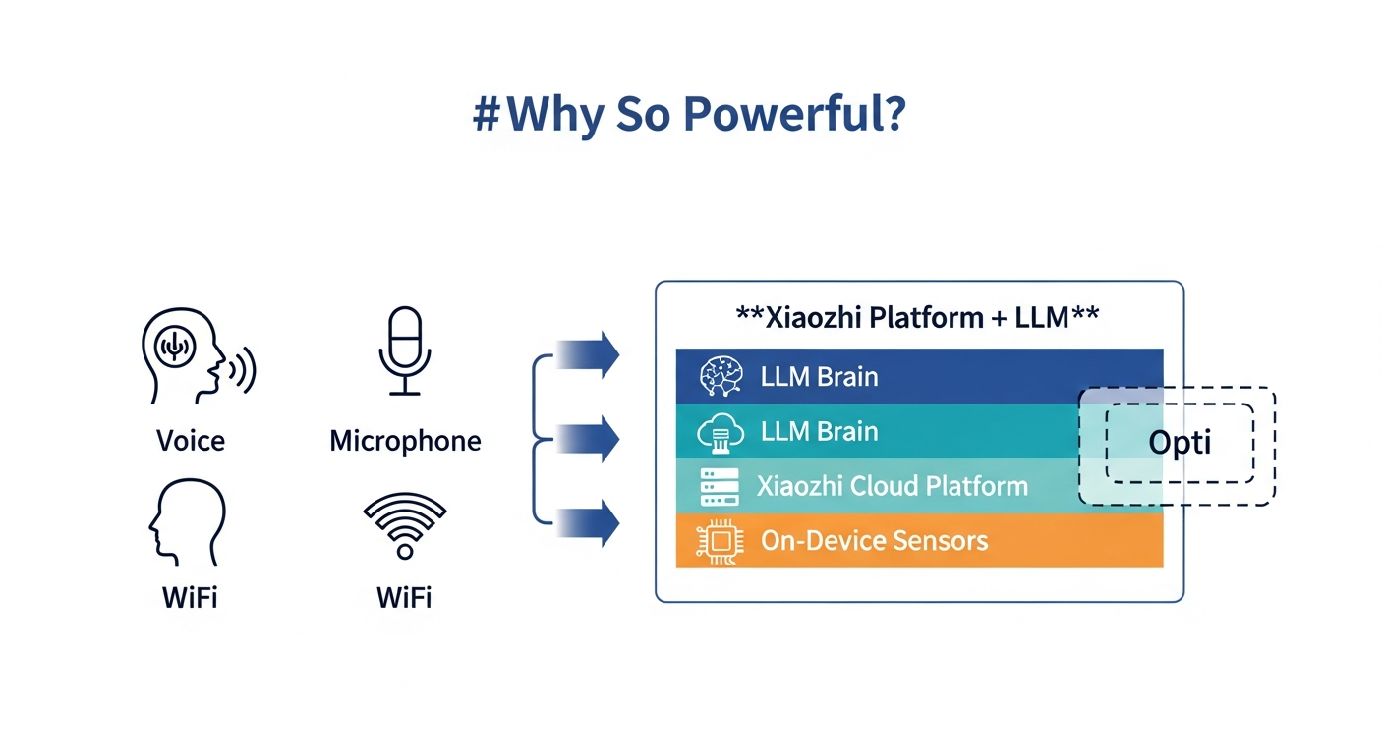

Slide 12
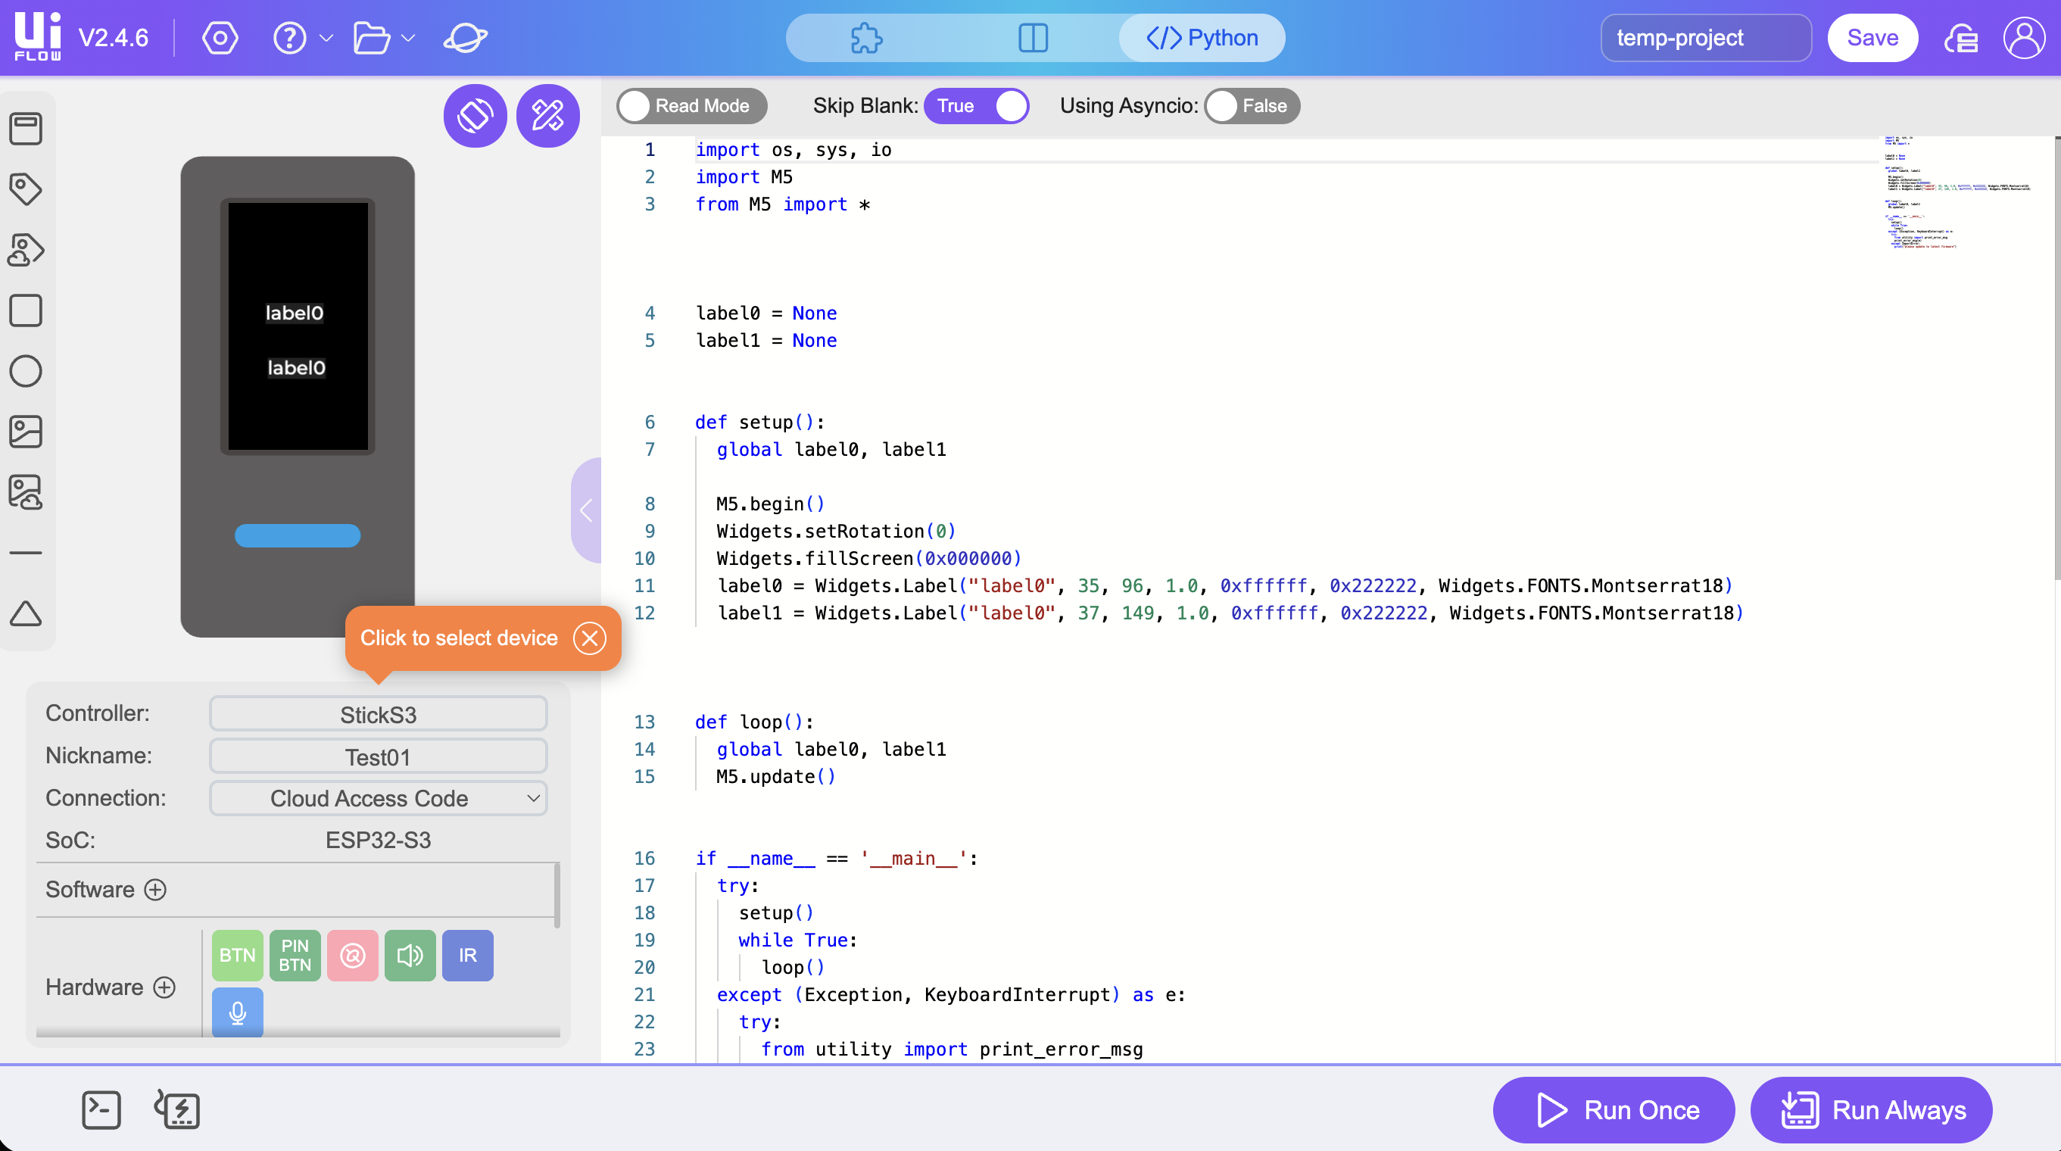
Live Demo: xiaozhi.me
xiaozhi.me
Open browser → go to xiaozhi.me → log in
Show the Xiaozhi device management dashboard
Point out: Knowledge Base · MCP · Voice model settings
UIFlow 2 IDE — used in Task 2 & 3

Slide 13
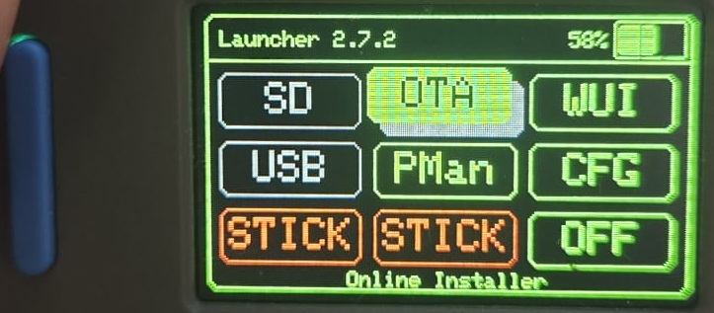
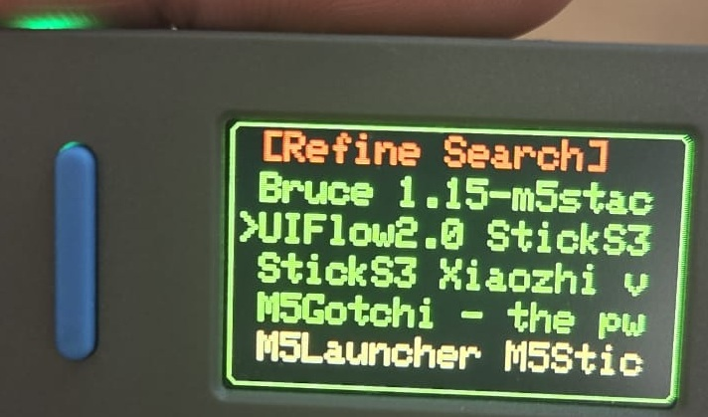
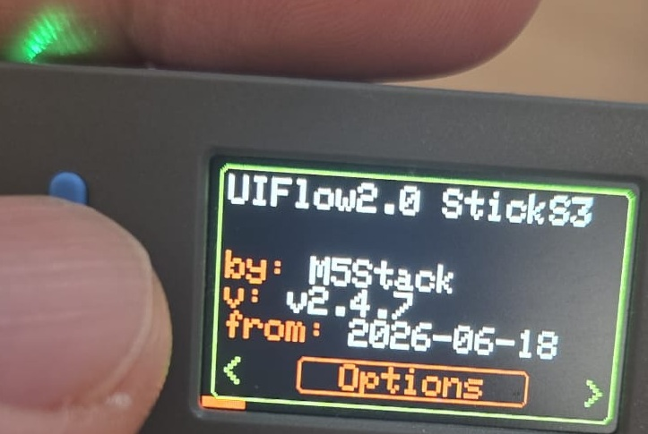
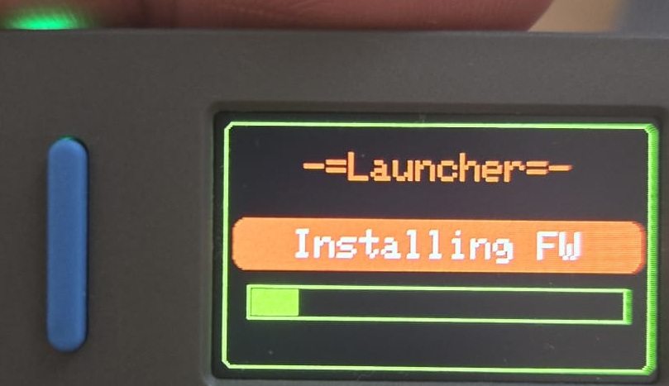
Task 2: Install UIFlow 2
① Power ON → M5Launcher appears
② Press Button B immediately
③ Select OTA in menu
④ Choose UIFlow 2 from list
⑤ Wait for install to complete
① M5Launcher
③ OTA list
④ UIFlow 2
⑤ Installing…
⏱ Takes about 1–2 minutes

Slide 14
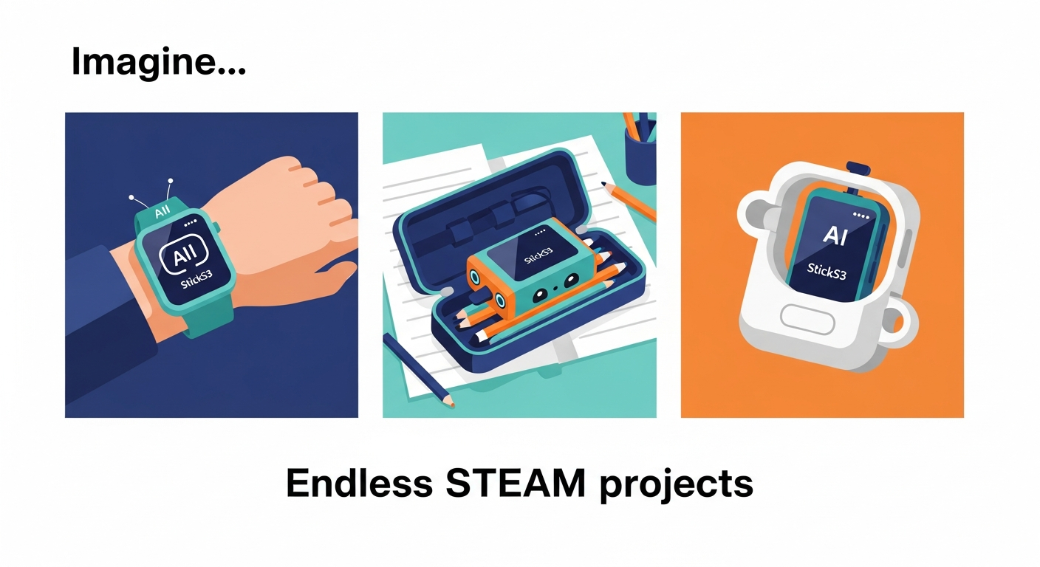

Slide 15
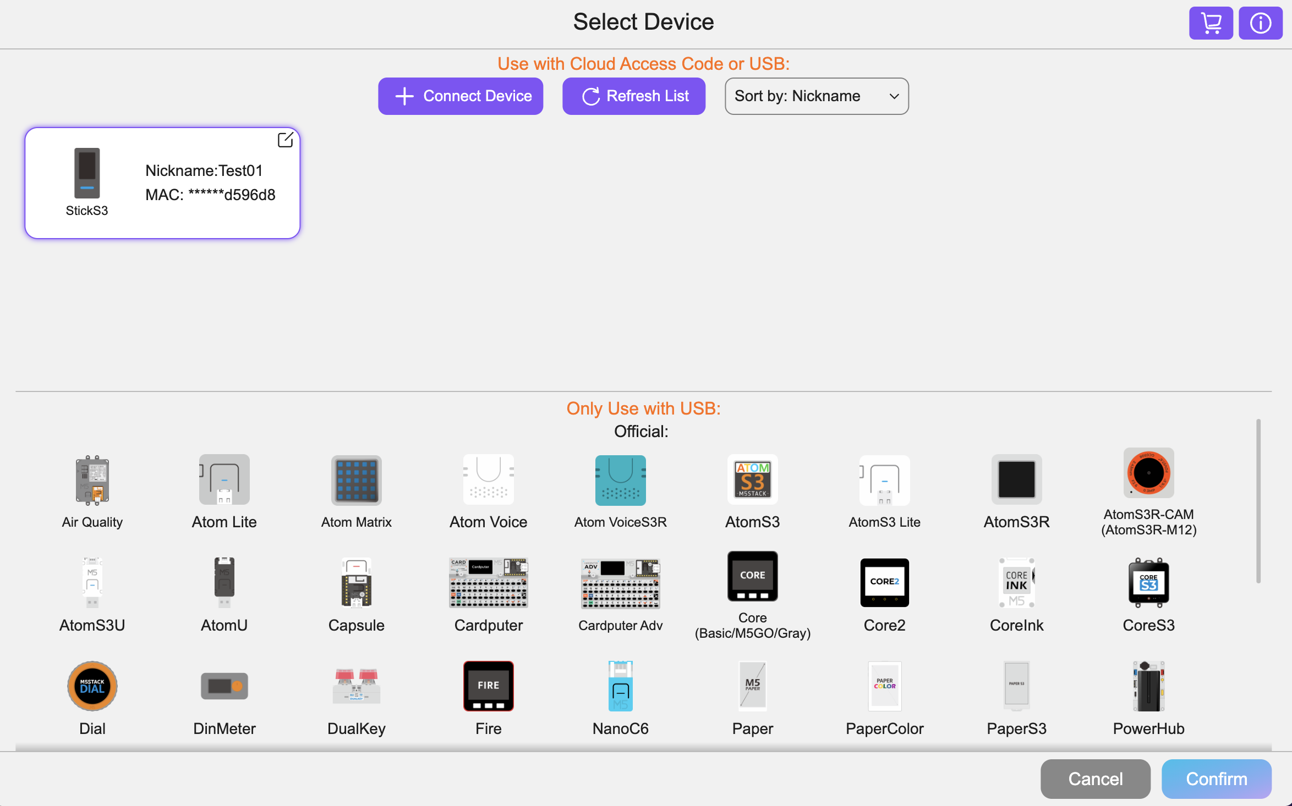
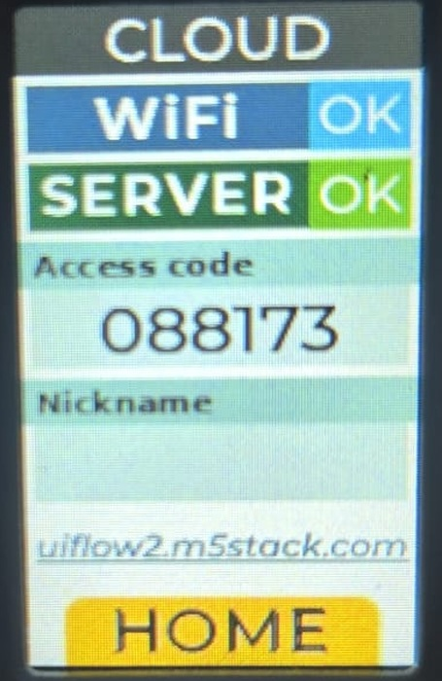
Pair with UIFlow 2
① On device: press Cloud icon
② Note the 6-digit Access Code
③ Open uiflow2.m5stack.com
④ Click Connect Device → enter code
⑤ Click Run Once to test
② Device shows Access Code
uiflow2.m5stack.com
④ UIFlow 2: Connect Device

Slide 16
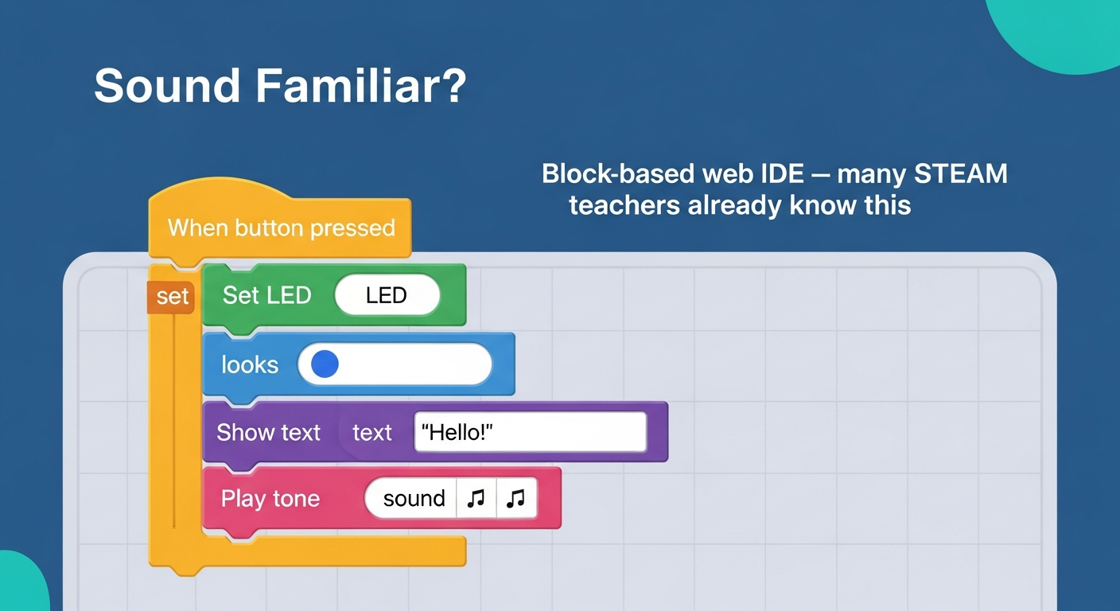

Slide 17


Slide 18
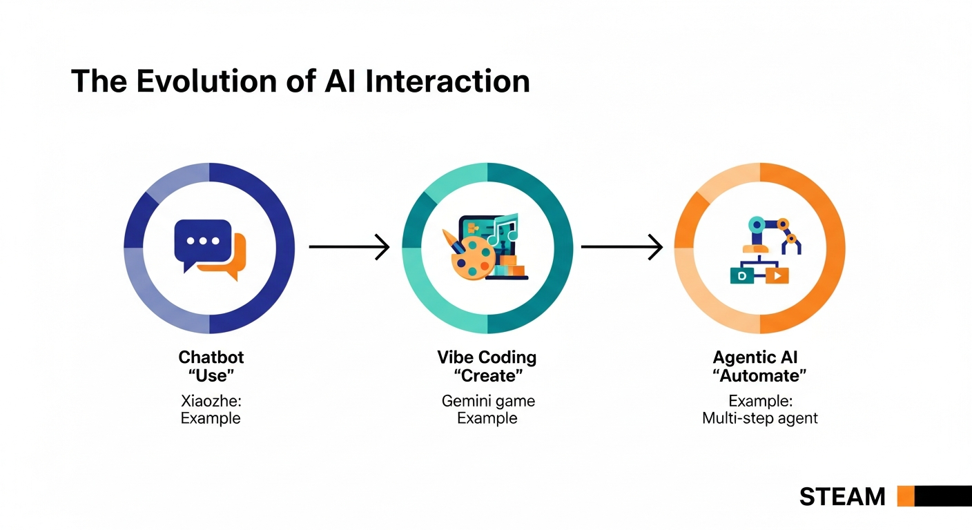

Slide 19
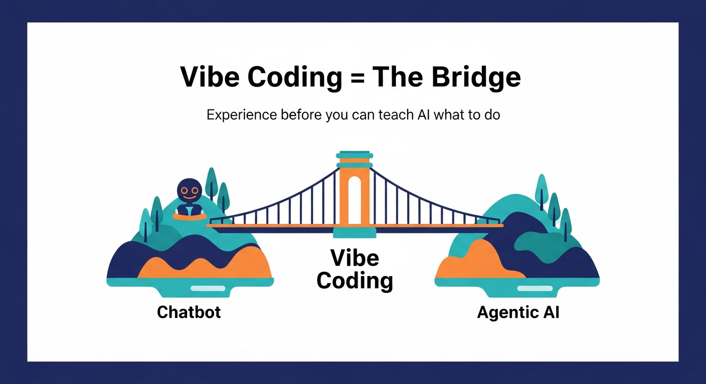

Slide 20
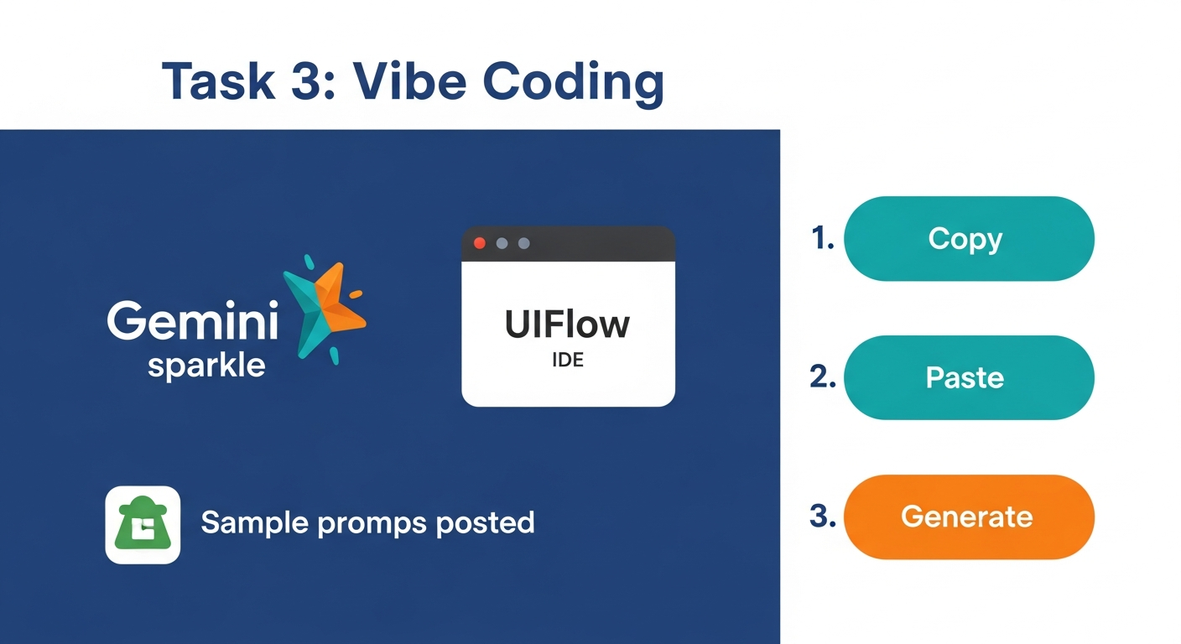

Slide 21
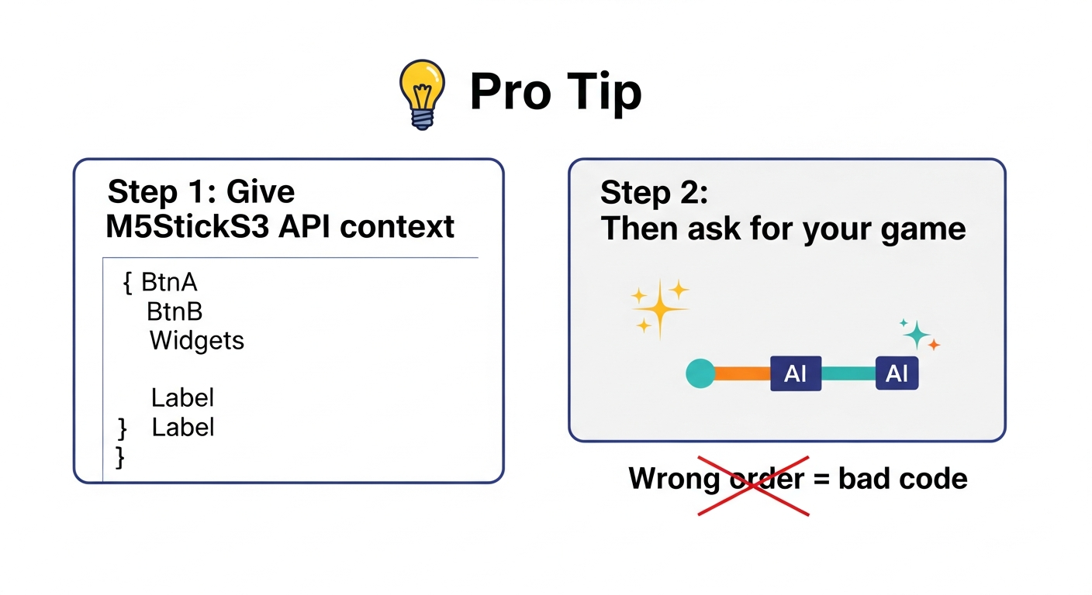
請參考 M5StickS3 的官方 UIFlow2 MicroPython API 文件：
https://uiflow-micropython.readthedocs.io/en/latest/controllers/sticks3.html
我需要製作一個「考反應的遊戲」

Slide 22
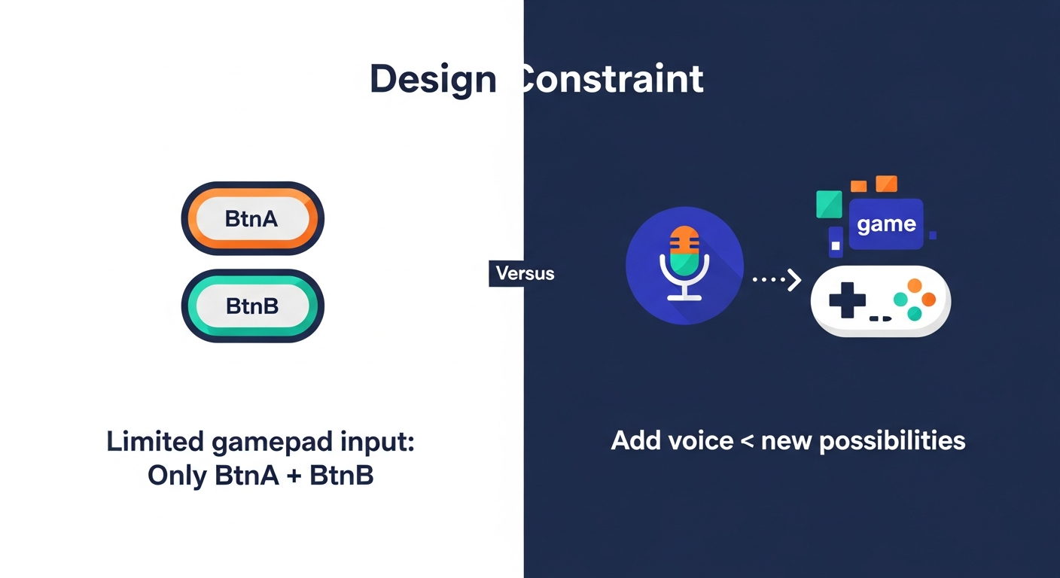

Slide 23
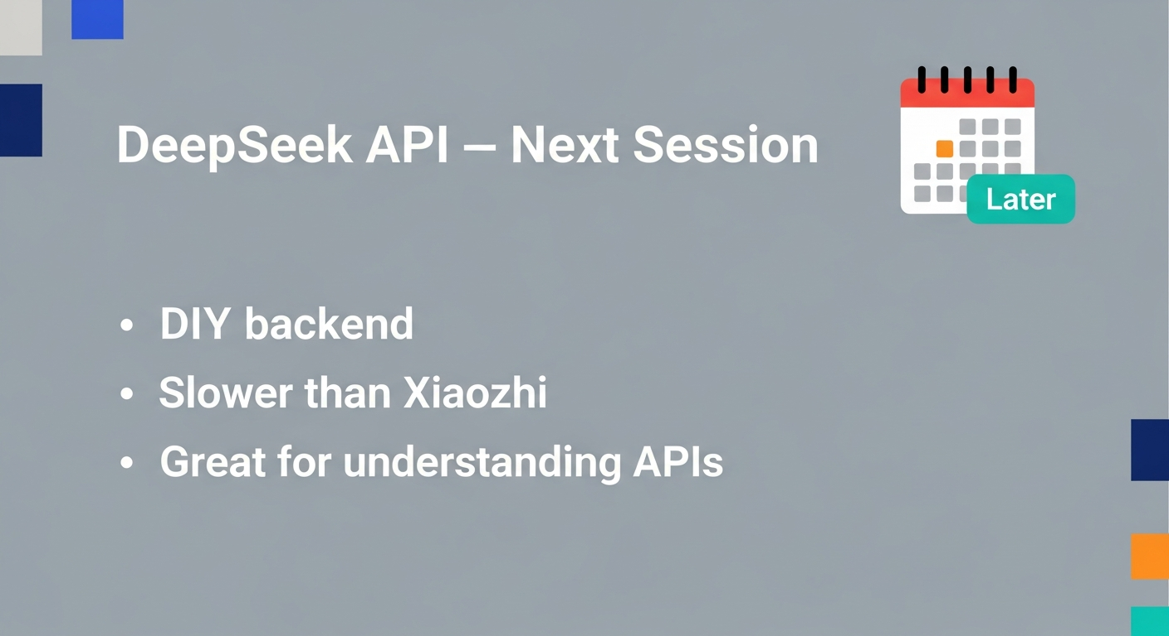

Slide 24
Want to Go Deeper?
My next workshop: Agentic AI for Educators
① Chatbot
今日已做 ✓
小智
Ready-made AI
Use it in class
② Vibe Coding
今日已做 ✓
Gemini + UIFlow
Describe → AI codes
You review & run
③ Agentic AI
下一步 →
Claude · Cursor
Give a goal →
AI plans & acts
→
→
業界已唔人手逐行寫 code — 你定目標，AI 計劃並執行。有興趣？歡迎聯絡 Warren Chan。

Slide 25
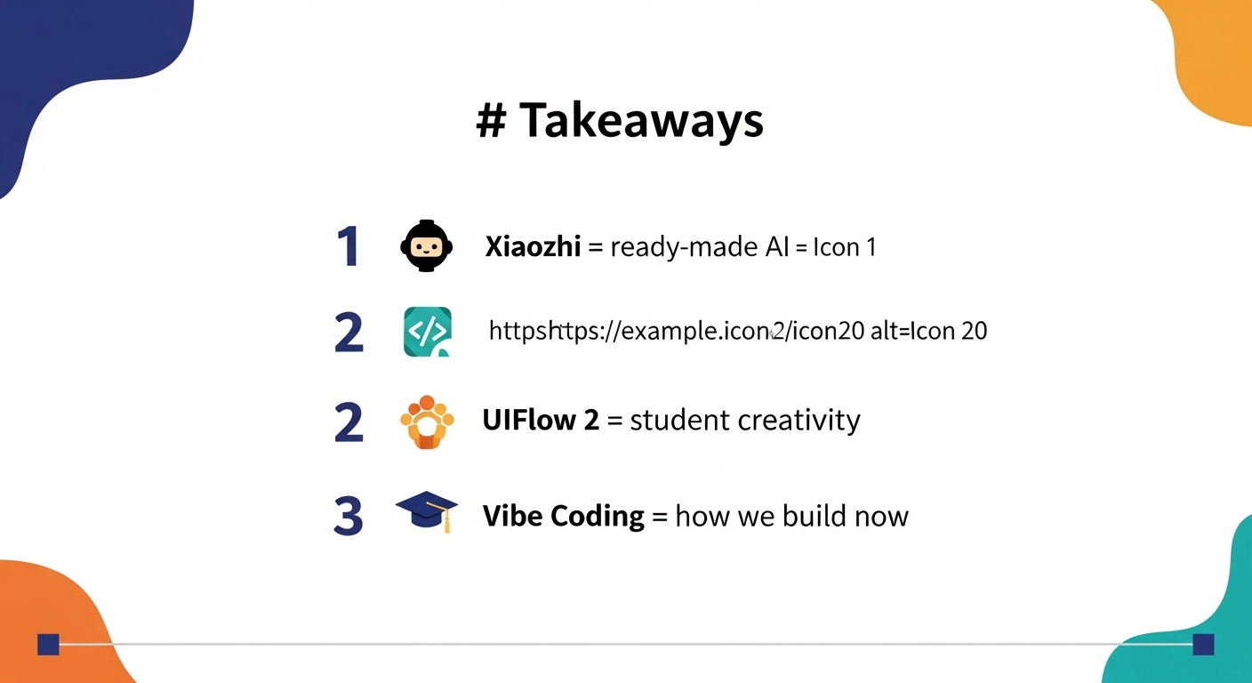
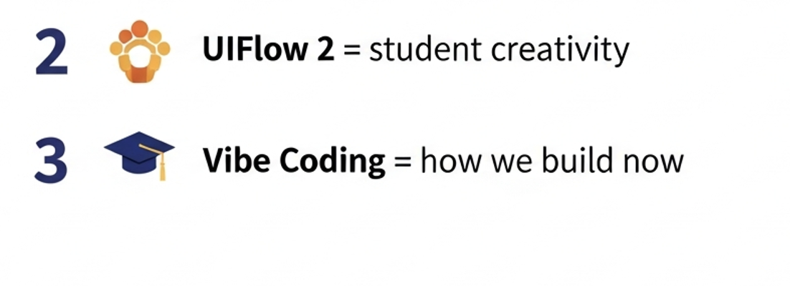
M3StickS3

Slide 26
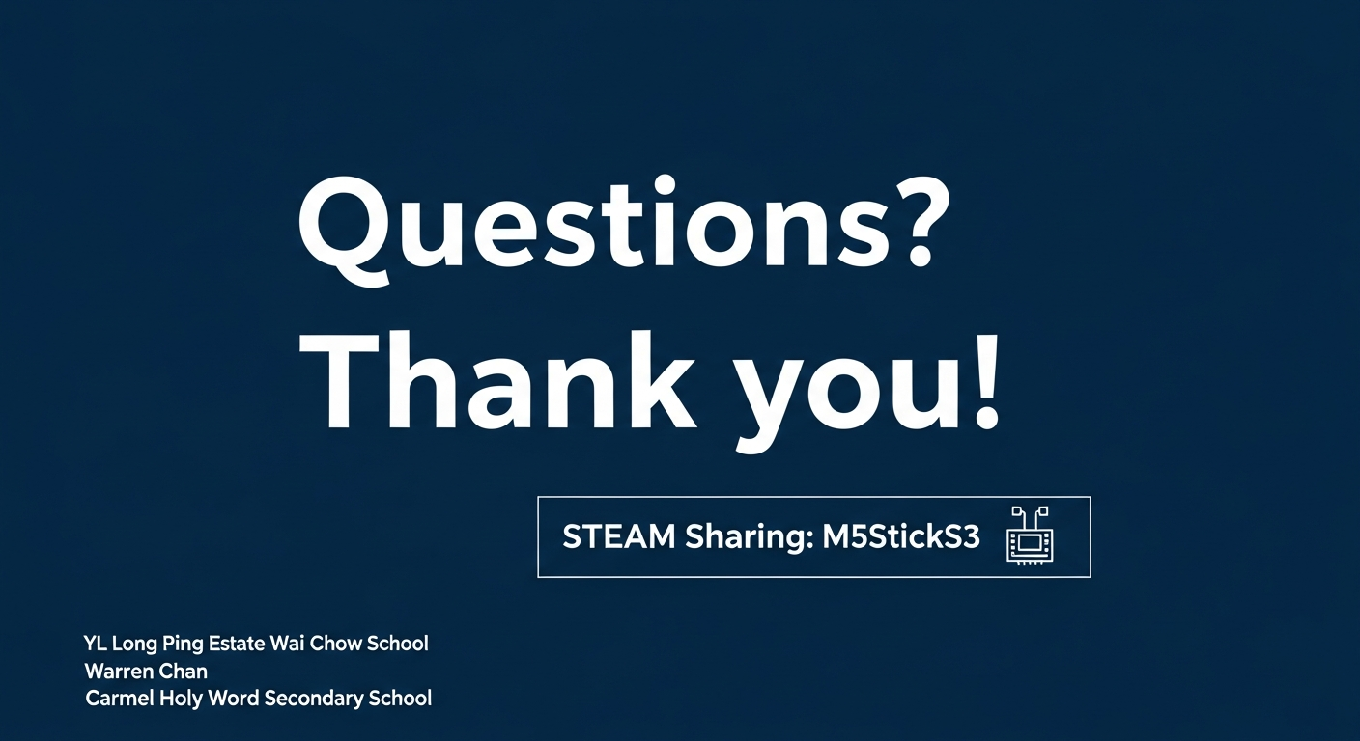

Slide 27
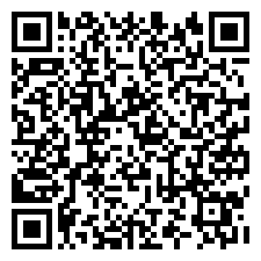
課後 Feedback — 請掃 QR Code
STEAM 分享：M5StickS3 · 2026 年 6 月 22 日 · 約 3–5 分鐘
用手機掃描左邊 QR Code
填寫工作坊 feedback form
或喺 Google Classroom
搵「課後 Feedback」連結
多謝各位同事！
有問題歡迎聯絡 Warren Chan
https://docs.google.com/forms/d/e/1FAIpQLSff43JQ-OeTZiGcfMKEM-Pyq_ByyzZ88Tekn4Y1kgGgcDYihw/viewform

