Slide 1
AI with Reinforcement Learning
A Tutorial

Slide 2
Configuration
Install Visual Studio Code.
Install Anaconda Python 3.7.
https://www.anaconda.com/distribution/#download-section
Create a simple .py file. VC will prompt you to install the python extension. Select "Install".
It will install the "Linting, Debugging," etc. extension
Click on the python text in the lower left corner of Visual Studio Code
Select the Anaconda version of Python just installed
You’ll need to run pip later. Run pip by running <install location>/anaconda/bin/pip
On Windows, this must be done from an administrative prompt.
Using the provided Ubuntu VM:
User: da
Password: password

Slide 3
Definitions
Artificial Intelligence – Computer algorithms that appear to mimic reasoning normally attributed to humans and animals, often derived by studying animal cognition, achieving results with sophisticated statistics and vast datasets
Reinforcement Learning – A subset of artificial intelligence where an application consisting of algorithms performs actions based on states, evaluates the outcomes as positive or negative, applies the outcome to its dataset, learns from the results and improves its actions over time, known as training. Once trained, the dataset may be used outside the lab to correctly take actions based on similar states.
A positive outcome is applied as a reward
A negative outcome is applied as a, well, negative reward

Slide 4
Supervised or unsupervised?
Reinforcement Learning: An Introduction by Richard S. Sutton and Andrew G. Barto states: “Reinforcement learning is different from supervised learning...Reinforcement learning is also different from what machine learning researchers call unsupervised learning....”
https://web.stanford.edu/class/psych209/Readings/SuttonBartoIPRLBook2ndEd.pdf
Sutton, Richard S. and Barto, Andrew G., Reinforcement Learning: An Introduction, Second edition, in progress, 1.1 Reinforcement Learning, Hardcover: A Bradford Book; second edition, November 13, 2018, Web: https://web.stanford.edu/class/psych209/Readings/SuttonBartoIPRLBook2ndEd.pdf, July 12, 2019
Not supervised: As a computer plays millions of games of chess, nobody is telling the application whether any given move or outcome is good or bad. It is programmatically built in as the rules of chess
Not unsupervised: Unsupervised learning deals with finding patterns. While finding patterns is an artifact of reinforcement learning, reinforcement learning is attempting to achieve a goal identified by a high numerical reward

Slide 5
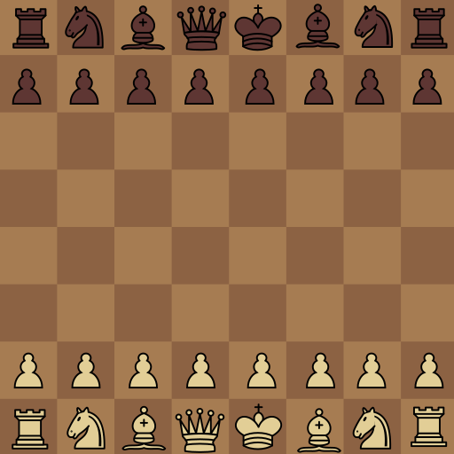
Examples
Attribution: JohnPablok and Cburnett, see https://commons.wikimedia.org/wiki/File:Chess_pieces_and_board_improved.svg

Slide 6
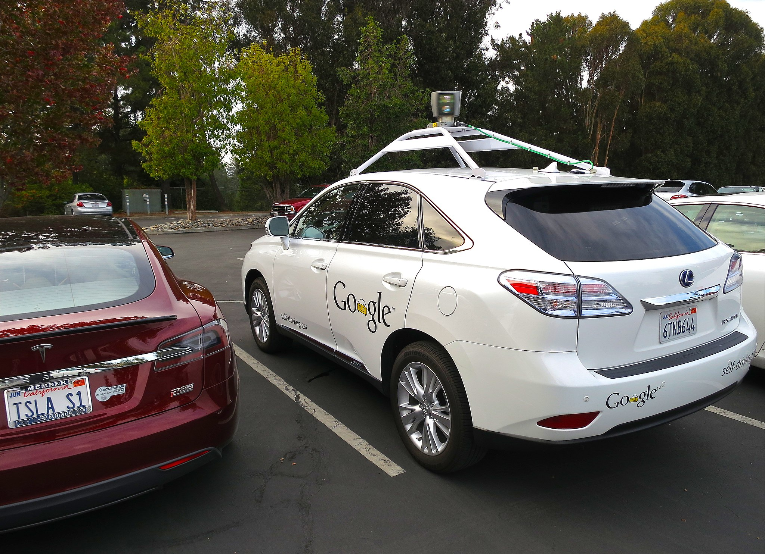
Attribution: Steve Jurvetson, https://commons.wikimedia.org/wiki/File:Driving_Google_Self-Driving_Car.jpg

Slide 7
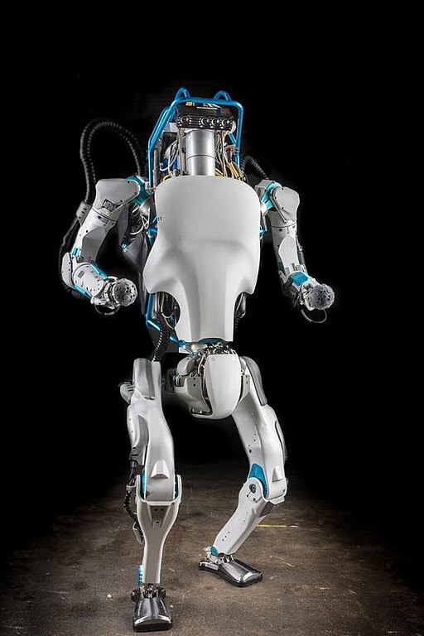
Youtube link: https://www.youtube.com/watch?v=xWe58WGWmlk, 2:26
Attribution: https://commons.wikimedia.org/wiki/File:Atlas_from_boston_dynamics.jpg and http://www.kansascity.com/news/business/technology/917xpi/picture62197987/ALTERNATES/FREE_640/atlas%20from%20boston%20dynamics

Slide 8

Attribution: https://www.maxpixel.net/Batter-Ball-Softball-Hitting-Bat-Female-Action-1623562

Slide 9

Attribution: https://picryl.com/media/baby-cute-child-people-7d1e12

Slide 10
Cat Pawing Floor
Image here

Slide 11
…and most impressively
The application we will be working on

Slide 12
Anatomy
Obstacles
(Boulders)
Car
Curbs

Slide 13
States
A state
A different state
Yet another, different state

Slide 14
Actions

Slide 15
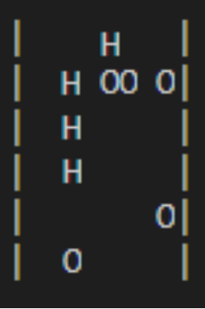
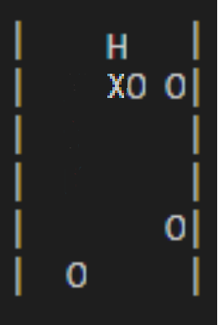
Rewards
4 moves = +1 (4 is arbitrary)
Crash = -1

Slide 16
Recap
Reinforcement Learning – A subset of artificial intelligence where an application consisting of algorithms performs actions based on states, evaluates and applies a positive or negative reward to its dataset, learns from the results and improves its actions over time, known as training. Once trained, the dataset may be used outside the lab to correctly take actions based on similar states.

Slide 17
Let’s Code!

Slide 18
Bellman Equation
Q(s,a) = (1 - α)Q’(s,a) + α(r + γ^{T}maxQ(s,a))
1. Find the last q value for this state and call it Q’(s,a)
2. Look at all previous q values for this state and call it maxQ(s,a)
3. Choose the step size, α. We will use 0.2
Modifying this value is a good place to start to increase performance
4. Choose a discount, γ. Take its value to the exponent for number of steps, T
5. Choose a positive and negative reward, r

Slide 19
Bellman Equation
Q(s,a) = (1 - α)Q’(s,a) + α(r + γ^{T}maxQ(s,a))
(α = step size, Q’ = last q, r = reward, γ^{T} = discount, maxQ = max q)
Heart of Reinforcement Learning
Derivation based on maximizing total future reward of a policy
Earlier moves valued higher
Think about chess
Q values are generally increasing (in a working model)
Handles missteps as well as correct steps

Slide 20
Limitations
Memory: 16 Gb
Run time: 4.5 days
5: 581
6: 2135
7: 10439
8: 31903
9: 126435
10: 424392
11: 1304488
12: 3711543
13: 13937492
14: ran for 2 days without completing
And this is a simple application…

Slide 21
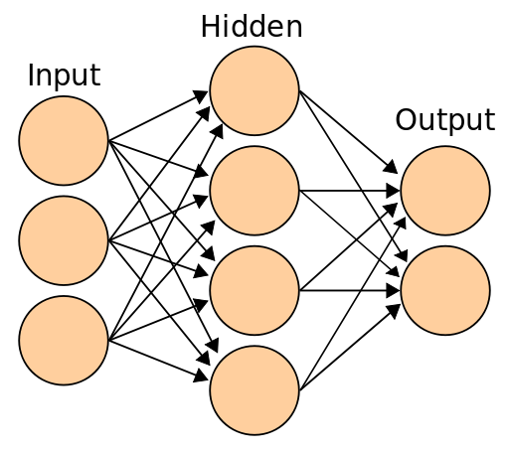
Neural Networks
…or The Great Calculus Machines
Attribution: Cburnett, https://commons.wikimedia.org/wiki/File:Artificial_neural_network.svg

Slide 22

Motivation
Tabular Limitations: Memory, CPU and Time
Amazingly, neural nets learn what’s important and what’s not.

Slide 23
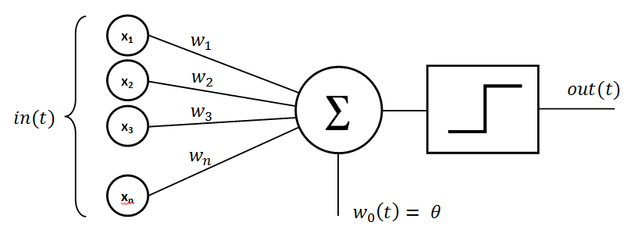
Perceptron
If the inputs (weights) are high, the perceptron fires a high signal to the next perceptron
Attribution: Mayranna, https://commons.wikimedia.org/wiki/File:Perceptron_moj.png

Slide 24
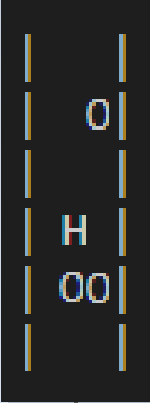
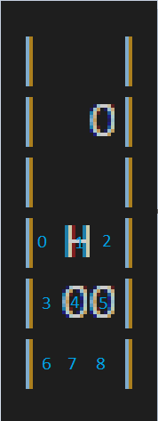



Inputs
0
1
0
Car Position
0
0
0
0
1
Road State
1
0
0
0

Slide 25
Forward Pass
0
1
0
0
2-layer neural net
The weights and activations determine the action
Weights are persistent
Activations change
0
0
.72
Selects action 0, or move left
.2
.9
0
.9
.23
.3
.9
.41
1
.5
1
0
0
0

Slide 26
Hidden Layers
0
1
0
0
0
0
.72
…
…
.23
0
.41
1
1
0
0
0

Slide 27
Backpropagation
Define a loss function
A simple one subtracts expected output from actual output, squared
Take the derivative over the entire function representing the neural network
Function easily exists in a thousand-dimensional space
The derivative represents the minimum (in this case)
The process is called gradient descent
Layer by layer, modify the weights so that the next forward pass of this activation (i.e. state) has less loss
If, after many iterations, the net gets to a point where the loss is nearly zero, that means it will give us the correct answer

Slide 28
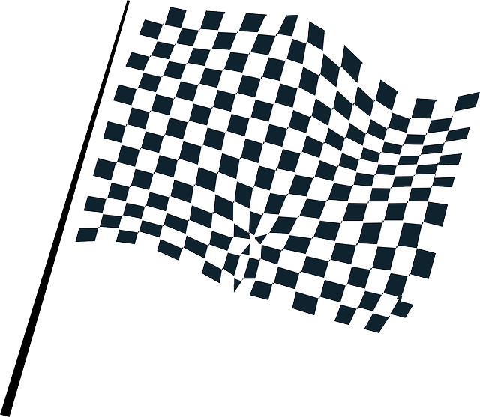
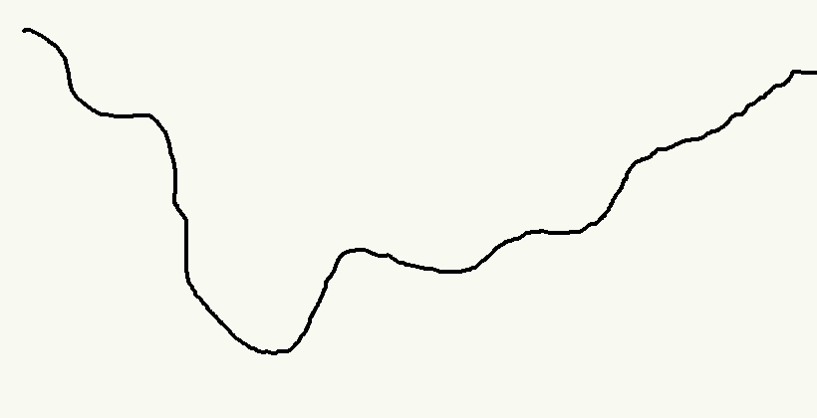
Gradient Descent
Start
Finish

Slide 29
Step too big
Start
Finish

Slide 30
Better step size
Start
Finish

Slide 31
Backpropagation, recap
Takes some study
The takeaway
Data comes in
With RL, a state comes in
Prediction comes out
With RL, an action comes out
Correctness of prediction determined
Weights are updated
If the prediction was correct, the neural net will become more confident
If the prediction was incorrect, the neural net will move towards a different prediction
Input
Prediction
Correction

Slide 32
That works?
Sharing neurons for different inputs is non-intuitive (for me, anyway)
Splash different colors of paint around, get a mess
From neural nets, patterns emerge
Every step has mechanisms in place to create order

Slide 33
Motivation
Amazingly, neural nets learn what’s important and what’s not.

Slide 34
0
1
w₀
w₀ + Δ
Car Position
1
w₁
1
w₁ + Δ
w₂
w₂ + Δ
0
Top Obstacles
Top Obstacles
1
W₁
1
W₁ + Δ
…
1
0
W₂
Correct Action!
0
W₂
Top Obstacles
1
0
1
W₃
1
W₃ + Δ
…
Bottom Obstacles
Bottom Obstacles
1
0
W₄
0
W₄
Bottom Obstacles
0
W₅
0
W₅
0
0

Slide 35
1
W₀ + 2Δ
1
W₀ + 3Δ
Top Obstacles
Top Obstacles
1
W₁ + 2Δ
1
W₁ + 3Δ
0
W₂
0
W₂
Correct!
Correct!
0
W₃ + Δ
0
W₃ + Δ
Bottom Obstacles
Bottom Obstacles
1
W₄ + Δ
0
W₄ + Δ
0
W₅
1
W₅ + Δ
The top obstacles will likely matter 3 times more than the bottom obstacles
Over time, the top obstacles’ weights will increase towards max, the bottom obstacles’ weights will decrease towards 0

Slide 36
Takeaway
Amazingly, neural nets learn what’s important and what’s not
The neural net will give lots of space to the relevant and little space to the irrelevant
It has effectively “compressed” logic
Our neural net will not encounter the resource limitations the tabular method did

Slide 37
Let’s Code!

Slide 38
Deep Q
Loss: (y – Qθ)²
y = r + γpreviousQ
Qθ Is the value fed through the neural network

