Slide 1
Responsible AI
Notes:
Good morning, everyone. Today we're starting a new topic that's going to run through the rest of this module, and it's one that I think matters more than almost anything else we'll cover this semester, and that's Responsible AI.
Now, you've all been using AI tools already, probably every week, maybe every day. ChatGPT, Copilot, image generators, recommendation systems. So this isn't an abstract topic for you. What we're going to unpack over the next several slides is what it actually means to build and use these systems responsibly, and why that's harder than it sounds.
Let's get into it.

Slide 2
What is Responsible AI?
It is the practice of developing and using AI systems in a way that benefits society while minimizing the risk of negative consequences.
It’s about creating AI technologies that not only advance our capabilities, but also address ethical concerns – particularly regarding bias, transparency and privacy.
Responsible AI is an approach to developing and deploying artificial intelligence from both an ethical and legal standpoint.
The goal is to employ AI in a safe, trustworthy and ethical way.
Notes:
So let's start with a definition. What do we actually mean when we say Responsible AI? At its core, it's the practice of developing and using AI systems in a way that benefits society while minimizing the risk of negative consequences. Notice that phrase, minimizing risk, not eliminating it. We'll come back to that idea a lot, because with AI there's rarely a perfect, risk-free solution.
It's also worth noticing that this isn't just a technical exercise. It's not only about making the algorithm more accurate. It's about addressing ethical concerns, particularly around bias, transparency, and privacy. You can have a model that performs beautifully on accuracy metrics and still be deeply irresponsible if it discriminates against certain groups or if nobody can explain how it reached its decision.
Responsible AI sits at the intersection of ethics and law. That's an important pairing. Ethics asks what should we do, law asks what must we do, and increasingly the two are converging as governments catch up with the technology.
Ultimately, the goal is simple to state and hard to achieve, we want AI that is safe, trustworthy, and ethical. Keep those three words in your head, safe, trustworthy, ethical, because they're going to recur throughout this whole unit.

Slide 3
AI Ethics, AI Governance & Responsible AI
AI Governance
Responsible AI
AI Ethics
the Why?
the How?
the Who & What?
Notes:
Now, before we go further, I want to give you a mental map, because these next few topics can start to blur together if we're not careful. We're going to look at three related but distinct ideas, AI Ethics, Responsible AI, and AI Governance.
I like to frame them as three questions. AI Ethics answers the why, why should we care about any of this in the first place. Responsible AI answers the who and the what, who is doing this work and what does it actually look like in practice. And AI Governance answers the how, how do we structure rules, oversight, and accountability to make sure it actually happens.
Keep this three-part structure in mind as we move through the next slide, because it'll help you see how these pieces fit together rather than feeling like disconnected buzzwords.

Slide 4
AI Ethics, Responsible AI, AI Governance?
AI Ethics
  Moral principles and values (e.g., respect human rights, inclusivity, societal goods, environment protection, etc. ) that guide the development and use of AI.
Responsible AI
  Practical implementation of ethical principles into AI systems and practices.
AI Governance
  The framework of rules, policies, and procedures for managing AI development and deployment
Notes:
So let's define these three terms properly, because they get used interchangeably in the media all the time, and that's a bit sloppy.
AI Ethics refers to the moral principles and values that guide the development and use of AI, things like respecting human rights, being inclusive, protecting the environment, contributing to societal good. This is the philosophical layer, the foundation of beliefs about what's right and wrong.
Responsible AI is what happens when you take those abstract principles and actually implement them into real systems and real practices. It's the bridge between philosophy and engineering. An ethicist can say bias is wrong, but a responsible AI practitioner is the one actually running fairness audits on a dataset.
And AI Governance is the framework of rules, policies, and procedures that manage all of this, at an organizational level or even a national level. Think of governance as the scaffolding, the accountability structures, that make sure ethics and responsible practice don't just depend on individual goodwill.
If you want to go deeper on this, UNESCO's Recommendation on the Ethics of Artificial Intelligence is genuinely worth a read. It was adopted by essentially every member state, so it's about as close as we get to a global consensus document, and it does a nice job of laying out exactly this kind of distinction.

Slide 5
Why is Responsible AI important?
As AI becomes more business-critical for organizations, achieving responsible AI should be considered a highly relevant topic.
It helps create and maintain strong brand reputation.
It helps to build trust among stakeholders.
Stay ahead of regulations that relate to AI.
Notes:
Okay, so why should any of this matter to you, especially if you're heading into industry rather than research? Let's talk about why Responsible AI is important from a practical, business standpoint, not just an idealistic one.
First, AI is becoming business-critical. It's not a side project anymore, it's embedded in core decision-making, credit approvals, hiring, healthcare diagnostics. When something is that central to your operations, getting it wrong isn't a minor bug, it's an existential risk.
Second, think about brand reputation. You've all seen the headlines when a company's AI system does something embarrassing or discriminatory, it goes viral, and the damage to trust can take years to repair. Responsible AI is, frankly, good risk management.
Third, it builds trust among stakeholders, your customers, your employees, your regulators, your investors. Trust is the currency that lets people actually adopt and rely on your technology instead of being suspicious of it.
And finally, practical point, regulation is coming, fast. The EU AI Act, various national frameworks, they're all rolling out. Organizations that build responsible practices in now are staying ahead of the curve, rather than scrambling to retrofit compliance later.

Slide 6

Responsible AI Principles
No universally agreed-upon set of principles for responsible AI
Inclusiveness
Fairness
Robustness
Transparency
Accountability
Safety
Explainability
Non-malificence
Notes:
So now let's talk about the actual principles that tend to show up under this responsible AI umbrella. And here's the first honest thing I need to tell you, there is no single, universally agreed-upon set of principles. That might surprise you. You'd think something this important would have one definitive checklist, but it doesn't.
What you'll find instead is a cluster of recurring ideas, inclusiveness, fairness, transparency, robustness, accountability, safety, explainability, non-maleficence. That's a mouthful, non-maleficence just means, essentially, do no harm, borrowed straight from medical ethics.
Now here's the tricky part, different organizations use different words for overlapping ideas. One framework's transparency is another framework's explainability. One calls it fairness, another calls it non-discrimination. So when you're comparing frameworks later, don't get hung up on exact terminology, look for the underlying concept.
We're going to spend the next few slides looking at how specific organizations, ISO, OECD, and a military-specific initiative called REAIM, have each tried to codify their own version of these principles. Then we'll zoom into three of them in more depth, fairness, transparency, and robustness.

Slide 7
ISO – Key Responsible AI Principles
Notes:
This next slide shows you how ISO, the International Organization for Standardization, has framed its own set of responsible AI principles. ISO's angle tends to be quite practical and standards-driven, because that's their whole business, creating standards that organizations worldwide can actually certify against and audit.
What's useful about the ISO approach is that it isn't just aspirational language, it's designed to eventually plug into management systems and certification processes, similar to how ISO 9001 works for quality management. So when a company says it's ISO-aligned on AI ethics, that's meant to carry some real, auditable weight, not just be a marketing statement.
If you're curious to see the full detail, ISO's website has a dedicated page laying out their responsible AI and ethics principles, worth bookmarking if you ever end up working on AI compliance or standards work.

Slide 8
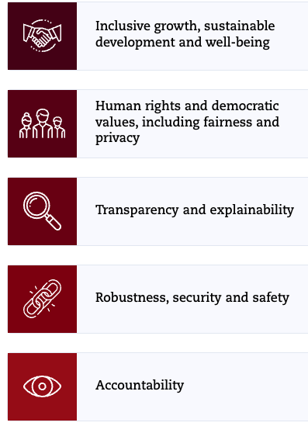
OECD AI Principles
Source: https://oecd.ai/en/ai-principles
Notes:
Now let's look at the OECD AI Principles, and this one's actually historically significant, because the OECD, that's the Organisation for Economic Co-operation and Development, adopted these back in 2019, and they were the first intergovernmental standard on AI, later adopted by even more countries including non-OECD members through the G20.
If you look at the diagram, you'll typically see the principles organized around a few key pillars, things like inclusive growth and sustainable development, human-centred values and fairness, transparency and explainability, robustness and safety, and accountability. There's also a complementary set of recommendations for governments themselves, around investing in AI research, fostering an enabling policy environment, building human capacity, and international cooperation.
What makes the OECD framework important isn't just the content, it's the reach. Because it was adopted at government level across dozens of countries, it's shaped a lot of the national AI strategies you'll see referenced later, including in places like Singapore. It's a good one to actually go read on the OECD.AI website if you want to see how principles at the philosophical level get translated into policy recommendations.

Slide 9

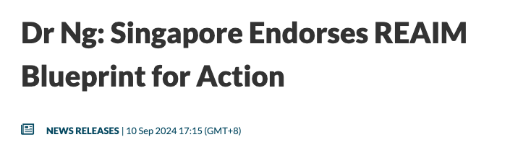
Responsible AI in Military Domain (REAIM)
REAIM is a platform for global discussion with all stakeholders on ways to ensure responsible military application of AI.
Released Blueprint for Action in Sep 2024, endorsed by 61 countries including USA, UK, Sweden, South Korea, Japan and Singapore.
Blueprint for Action
Ethical Compliance
Human Oversight
Bias Mitigation
Transparency
Robustness
Source: https://www.reaim2024.kr/
Notes:
This slide takes us into a more specific and, frankly, higher-stakes domain, military applications of AI. This is REAIM, which stands for Responsible AI in the Military Domain.
REAIM is essentially a global platform, a summit and ongoing dialogue, bringing together governments, militaries, industry, and civil society to talk through how AI should and shouldn't be used in military contexts. Think autonomous weapons, decision-support systems, surveillance, all the applications where getting it wrong isn't just a bad customer experience, it can literally cost lives.
In September 2024, REAIM released a Blueprint for Action, and this was endorsed by 61 countries, including major military powers like the United States, the UK, and interestingly Singapore too. That's a meaningful number of countries to get aligned on something this sensitive.
Looking at the blueprint's core areas, ethical compliance, human oversight, bias mitigation, transparency, and robustness, you'll notice these aren't wildly different from the general responsible AI principles we've already discussed. What's different is the context. Human oversight, for instance, takes on a much sharper edge when we're talking about a system that might be involved in a decision to use lethal force. If you want the primary source, the REAIM 2024 website has the full blueprint document.

Slide 10
Key Responsible AI Principle - Fairness
AI systems should treat everyone equally and provide the same recommendations to all individuals.
Fairness in AI systems prevents discrimination based on personal characteristics.
Important to prevent perpetuating or amplifying biases.
AI models are trained on datasets, often scraped from the Internet, and these data often reflect our our own established human bias
Ensuring fairness requires diverse training data, rigorous bias testing, and ongoing performance monitoring across different subpopulations.
Notes:
Alright, let's zoom into our first individual principle in depth, fairness. And on the surface this sounds simple, right, treat everyone equally, don't discriminate. But let's dig into why this is actually one of the hardest problems in AI.
Fairness means an AI system shouldn't give systematically different outcomes to people based on characteristics like race, gender, age, or other protected attributes, when those characteristics aren't actually relevant to the decision. Sounds straightforward. Here's the catch.
AI models learn from data, and where does that data usually come from? Often scraped from the internet, or from historical records of human decisions. And human decisions, historically, have not been fair. If you train a hiring model on ten years of a company's past hiring decisions, and that company historically favored one demographic, the model doesn't invent bias out of nowhere, it learns and often amplifies the bias that was already baked into the data. It's a mirror, and sometimes a magnifying mirror.
So this isn't a problem you fix once and move on from. Ensuring fairness requires diverse training data to begin with, rigorous bias testing before deployment, and then ongoing monitoring of performance across different subpopulations after deployment, because a model can drift or reveal new blind spots over time as it encounters real-world data it wasn't tested on.

Slide 11
Key Responsible AI Principle - Transparency
As AI systems grow complex, mechanisms must be in place to understand and evaluate their outputs.
There needs to have clear explanations of AI decisions and the ability for users to question those decisions.
Transparency is an enabler of trust in the AI systems that we’re producing and operating, and trust in turn can foster faster adoption of those capabilities
Notes:
Next principle, transparency. As AI systems get more complex, particularly with deep learning and large language models, we've kind of lost the ability to just open up the model and read off why it made a particular decision. That's the so-called black box problem, and transparency is our attempt to deal with it.
Concretely, this means two things. First, there need to be clear explanations available for AI decisions, not necessarily the full mathematical internals, but something a human affected by the decision can actually understand. Second, and this is easy to overlook, users need the ability to question those decisions. Transparency without a channel to challenge or appeal a decision is honestly just theater.
Why does this matter so much? Because transparency is really the enabler of trust. Think about it from a user's perspective, would you trust a loan rejection, or a medical diagnosis, from a system that can't tell you why it decided what it decided? Probably not.
And here's the business case tied into it, trust isn't just a nice ethical bonus, it actually accelerates adoption. Organizations and individuals adopt technology faster when they understand and trust it. So transparency isn't just the right thing to do, it's often the thing that determines whether your AI system actually gets used at all.

Slide 12
Key Responsible AI Principle - Robustness & Veracity
Robustness and veracity ensure AI systems produce reliable outputs, even with unexpected inputs.
Techniques like adversarial training, input validation, and anomaly detection enhance AI robustness.
Verify the accuracy of training data and model outputs.
  Tests can be designed to check outputs against facts (e.g., Amazon Science's RefChecker Framework allows fact-checking of an LLM’s output)
Notes:
Last principle for today, robustness and veracity. Let's take these one at a time, because they're related but distinct. Robustness is about reliability under pressure, does your AI system keep producing sound outputs even when it encounters inputs it wasn't quite expecting. Veracity is more about truthfulness, is what the system is telling you actually accurate.
On the robustness side, there are specific engineering techniques that help. Adversarial training, deliberately exposing the model to tricky or malicious inputs during training so it learns to handle them gracefully. Input validation, catching obviously malformed or out-of-range inputs before they even reach the model. And anomaly detection, flagging when something looks unusual so a human can step in.
On the veracity side, this is where we get into the very current problem of AI hallucination, especially with large language models that can state falsehoods with total confidence. So you need to verify both the accuracy of your training data, garbage in, garbage out, still applies, and the accuracy of your model's outputs.
There's actually some interesting applied research here worth knowing about. Amazon Science built something called the RefChecker Framework, which is designed to fact-check an LLM's output against reference sources. Tools like that are becoming increasingly important as we deploy these language models into contexts where factual accuracy genuinely matters, medical information, legal advice, education, exactly the kind of contexts you'll likely be working in.

Slide 13
Key Responsible AI Principle - Accountability
Organisations and individuals developing, deploying or operating AI systems should be held accountable for their proper functioning
AI developers should ensure traceability, including in relation to datasets, processes and decisions made during the AI system lifecycle, to enable analysis of the AI system’s outputs and responses to inquiry
AI actors should apply a systematic risk management approach to each phase of the AI system lifecycle on an ongoing basis and adopt responsible business conduct to address risks related to AI
Notes:
So let's talk about accountability, because this is really the "who's on the hook" principle. The idea is simple: if you build it, deploy it, or run it, you own what happens with it. You can't just shrug and say "well, the algorithm did it" — that's not an acceptable answer anymore, not to regulators, not to the public, and honestly, not to your own conscience as a practitioner.
Traceability is the practical backbone of accountability. Think about it this way — if something goes wrong with an AI system, you need to be able to reconstruct what happened. What data was it trained on? What process decisions were made along the way? Who signed off on what? Without that paper trail, you can't actually investigate a failure, and you definitely can't answer to a regulator or an angry customer who wants to know why they got denied a loan or flagged as a fraud risk.
Notice also that this isn't a one-time check at launch. The principle talks about risk management at every phase of the lifecycle, on an ongoing basis. That's because AI systems don't stay static — they get retrained, they encounter new data, their behavior can drift. So accountability means continuous vigilance, not a box you tick once during development and forget about.
And there's a broader piece here too — responsible business conduct. This connects AI governance to conduct standards that already exist in the business world, things like corporate responsibility and ethical sourcing. AI isn't governed in some special separate universe; it's an extension of how organisations are already expected to behave responsibly.

Slide 14
Key Responsible AI Principle - Privacy
AI systems should respect privacy and maintain security by protecting private and confidential information.
They should also resist attacks and attempts to corrupt or compromise the system.
Mechanism should be developed for individuals to control how their data is collected and used.
Notes:
Now, privacy — probably the principle that feels most familiar to you already, but it takes on new dimensions in AI systems. At the core, it's about protecting private and confidential information, which sounds obvious, but AI systems often need huge amounts of personal data to work well, so there's an inherent tension baked in from the start.
Beyond just protecting data from misuse, notice the second point — resisting attacks and attempts to corrupt or compromise the system. This is where privacy overlaps with security. AI models can actually leak information about their training data if you're not careful — there are known attack techniques where someone can probe a model and extract sensitive details it was trained on. So privacy in AI isn't just "don't share the data," it's also "don't let the model itself become a backdoor to that data."
The last point is about control — giving individuals a say in how their data is collected and used. This is the spirit behind things like consent mechanisms, opt-outs, and data subject rights that you might have heard about in the context of laws like GDPR or Singapore's PDPA. The point is, people shouldn't just be passive data sources for an AI system; they should have some agency over what happens to their information.
So when you put accountability and privacy together with the other principles we've covered, you start to see the full picture — it's not just "build something that works," it's "build something that works and that you can stand behind, and that respects the people whose data made it possible."

Slide 15
Building Trustworthy AI
Foster collaboration across all disciplines, engaging experts from policy, technology, ethics and social advocacy to ensure multifaceted perspectives
Prioritize ongoing education on AI best practices at all levels to maintain awareness and adaptability
Implement AI ethics throughout the technology’s design, building them into AI solutions from the ground up
Notes:
Alright, let's shift gears a bit. We've gone through the individual principles — fairness, accountability, privacy, and so on — but now the question is, how do you actually make this real inside an organisation? This slide starts getting into practices for building trustworthy AI, not just principles to admire from a distance.
First up, collaboration across disciplines. This is a point I really want to stress — responsible AI is not just an engineering problem. If you only have data scientists in the room, you're going to miss things. You need policy people who understand regulation, ethicists who can spot value tradeoffs, and social advocates who represent communities that might be affected. Each of these perspectives catches different blind spots.
Second, ongoing education. AI moves fast — what was best practice two years ago might be outdated now. So this isn't a "train everyone once at onboarding" kind of thing. It has to be continuous, and it has to reach people at all levels, not just the technical team. Your managers, your compliance staff, even your executives need enough literacy to ask the right questions.
And third — this one's important — ethics has to be built in from the ground up, not bolted on at the end. Think of it like security: nobody thinks it's a good idea to build a system and then "add security later." Same logic applies to ethics. If you wait until the model is already deployed to start thinking about fairness or bias, you're already too late; the design choices that created the problem are baked in.

Slide 16
Building Trustworthy AI
Establish clear oversight mechanisms, such as ethics committees or review Boards, to monitor compliance and guide ethical decision making
Protect end-user privacy and sensitive data through strong AI governance and data usage policies
Encourage transparency in AI processes, enabling accountability and trust from stakeholders and the public
Design for humans by using a diverse set of users and use-case scenarios and incorporating this feedback before and throughout the project’s development.
Notes:
This is really part two of the same list — continuing on from the last slide about practical ways to build trustworthy AI into an organisation. So keep the same mindset: these aren't abstract ideals, they're operational habits.
Oversight mechanisms come first here — things like ethics committees or review boards. Why does this matter? Because individual engineers or product managers often don't have the full picture, or they might be under pressure to ship quickly. Having a formal body that reviews AI systems before and during deployment creates a checkpoint where someone can say "wait, have we thought about this risk?" It's a bit like an institutional review board in research, if any of you have encountered that.
Then we circle back to privacy again, but now from a governance angle — strong policies and governance structures to actually protect user data in practice, not just in principle. And transparency ties directly into accountability from earlier — if your processes are transparent, stakeholders and the public can actually verify that you're doing what you say you're doing. Trust isn't given automatically; it's earned through that kind of visibility.
Finally, "design for humans" — and I like this one because it pushes back against a common trap in tech development, where you design for an idealized average user and then get surprised when real people with real diverse needs interact with the system differently. Testing with a genuinely diverse set of users and scenarios, and actually incorporating their feedback throughout development — not just at the end — catches problems you'd never predict sitting in a room of like-minded engineers.

Slide 17
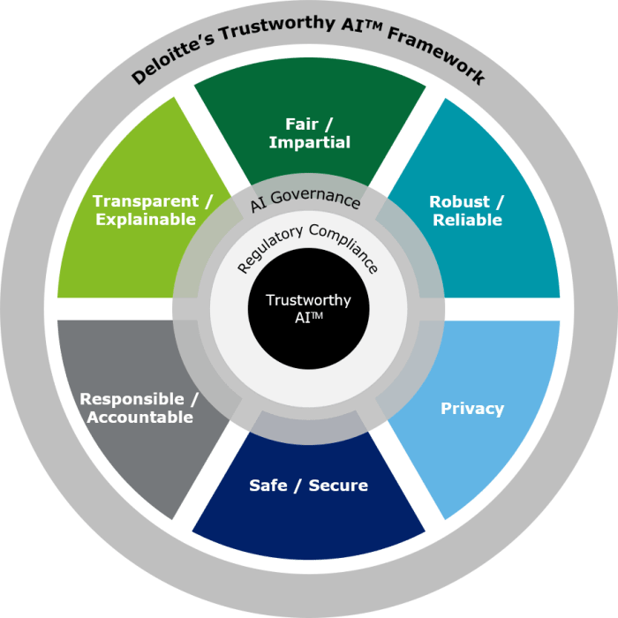
Trustworthy AI Framework
Notes:
So this slide shows what's typically called a Trustworthy AI framework — and if you're looking at a diagram like this, you'll usually see a set of principles or pillars arranged around a central hub, often things like fairness, transparency, robustness, accountability, and privacy, all feeding into that central idea of "trustworthy AI." The visual is meant to show that trust isn't one thing — it's the sum of several dimensions working together.
The key message underneath the diagram is the one in the note here — you need AI governance to actually ensure trustworthy AI. And this is the pivot point of the lecture, in a way. Up until now we've talked about principles and practices almost like personal or team commitments. But principles alone don't stick without structure behind them.
Think of it like this — a company can have wonderful values printed on a poster in the lobby, but if there's no governance structure enforcing them, they're just words. Governance is what turns "we believe in fairness" into "here is the process that checks for fairness before we deploy."
So this diagram is really a bridge. It's saying: everything we've discussed so far about trustworthy AI needs a governance backbone to actually happen consistently, at scale, across an organisation — which is exactly what we're going to dig into next.

Slide 18
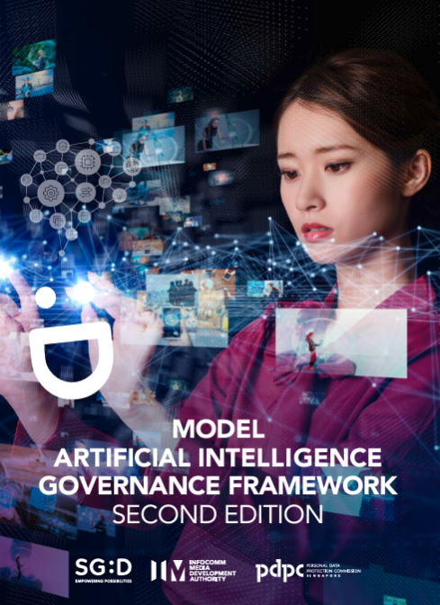
Model AI Governance Framework
Notes:
Okay, so we're now moving into a new section — Model AI Governance Frameworks. This slide is essentially a divider, a chance to reset before we go deeper into what governance frameworks actually look like in practice.
Up to this point we've been building the conceptual foundation — what responsible AI means, what principles underpin it, what practices support it. Now we're going to get more concrete and talk about actual frameworks that organisations and governments have put together to operationalise all of this.
If there's a diagram on this slide, it's likely setting the stage visually — maybe showing layers of governance, or icons representing policy, process, and oversight coming together. The exact visual isn't as important as the transition it represents.
So hold onto everything we've covered so far, because it's about to get applied. We're moving from "what should we value" to "how do we actually structure an organisation to make sure those values show up in practice."

Slide 19
Why we need AI governance framework? AI Governance?
AI governance puts in place the rules, policies, processes, and procedures to realize responsible AI principles
Notes:
So, why do we even need an AI governance framework? Let's break down what governance actually means here, because it's a word that gets thrown around a lot without much precision.
Governance, in this context, is the machinery — the rules, policies, processes, and procedures — that actually realizes those responsible AI principles we spent the last several slides on. Notice the direction of that relationship. Principles are the "what" — fairness, accountability, privacy, transparency. Governance is the "how" — the concrete mechanisms that make sure those principles actually show up in day-to-day operations rather than just living in a values statement.
Without governance, principles are aspirational. You can say "we value fairness" all day long, but if there's no process requiring a bias audit before a model goes live, nothing forces that value to actually happen. Governance is what closes that gap between intention and practice.
And this is a theme you'll see across basically every serious AI ethics initiative worldwide — whether it's the EU's approach, Singapore's approach, or any large tech company's internal framework. They all eventually converge on the same insight: good principles need enforcement structures, or they're just nice words.

Slide 20
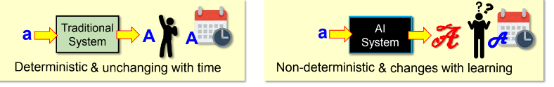
Do we need another Governance Framework for AI?
Most organisations already have processes and systems in place for governance, planning, budgeting, risk management and technology audit.
But there are two key differences between conventional IT and AI-based systems.
  AI models are non-deterministic and its operation is often opaque
  AI models learns from data and evolves over time.
Organisations should pay equal attention to the model code and training dataset.
Governance issues like “how was it trained?” & continuous monitoring are important.
Notes:
Now here's a question worth sitting with for a second — don't organisations already have governance? Most of you, if you've worked in or studied any reasonably mature organisation, know they already have processes for planning, budgeting, risk management, technology audits. So why do we need a whole separate thing for AI?
The answer comes down to two fundamental differences between AI systems and conventional IT systems. First, AI models are often non-deterministic and opaque. With traditional software, if you give it the same input, you get the same output, every time, and you can usually trace the logic line by line. With many AI models — especially deep learning models — you might not get identical results each run, and even the developers often can't fully explain why the model produced a particular output. That's a fundamentally different risk profile than a normal IT system.
Second, AI models learn from data and evolve over time. A traditional piece of software doesn't change its behavior on its own after deployment — but a machine learning model might be retrained, fine-tuned, or exposed to new data streams that shift how it behaves. That means governance can't be a one-time approval at launch; it has to be continuous monitoring.
This is why the slide emphasizes paying attention to both the model code and the training dataset. In traditional software audits, you'd mostly scrutinize code. But for AI, the data is just as important a governance object as the code — questions like "how was it trained?" and "what's in the data?" become central governance questions, not afterthoughts. So existing governance structures aren't useless — they're a starting point — but they need meaningful extensions to actually handle these unique characteristics of AI.

Slide 21
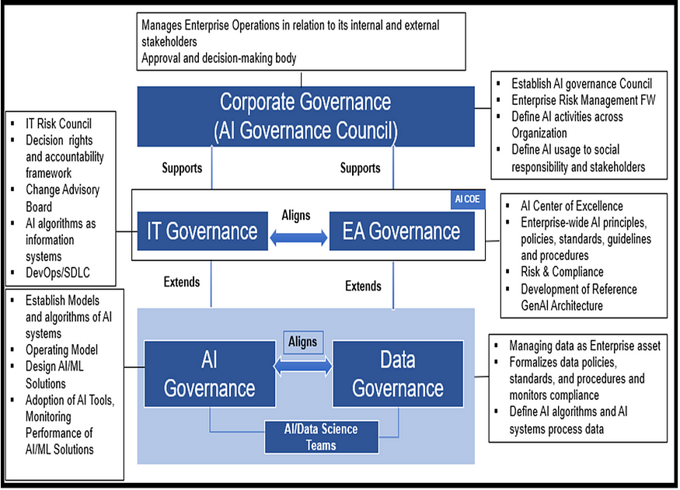
Where AI governance fits?
Notes:
This slide is about where AI governance actually sits relative to everything else an organisation already has going on — because AI governance doesn't exist on some isolated island; it has to fit into a pre-existing landscape of governance structures.
Most organisations of any size already have IT governance, and many have some form of data governance, enterprise architecture governance — often shortened to EA governance, which just means the structures and standards that govern how technology systems and data are architected and integrated across the whole organisation — and broader corporate governance sitting above all of that. The point this diagram is making is that AI governance shouldn't be built as some brand-new, disconnected silo. It needs to align with and plug into those existing structures.
In fact, the most practical way to think about it is that AI governance is often best treated as an extension of your existing IT governance, while also aligning closely with your data governance practices — since, as we just discussed, data is such a central piece of what makes AI systems behave the way they do. If you already have a data governance committee, for instance, it makes sense for AI-specific data questions to flow through that same structure rather than creating a parallel, competing one.
Why does this matter practically? Because if AI governance is bolted on separately, disconnected from everything else, you get duplication, confusion about who's accountable for what, and gaps where issues fall through the cracks between the "AI governance team" and the "IT governance team." Integration avoids that mess.

Slide 22
Singapore Model AI Governance Framework
In 2019, Singapore launched our Model AI Governance Framework (“Model Framework”) at the World Economic Forum in Davos,
Model AI governance Framework refreshed in 2020
Model AI governance Framework for Generative AI released in 2024
The Governance framework aims to translate ethical principles into practical recommendations that organisations could readily adopt to deploy AI responsibly.
Notes:
Now let's get concrete and look at a real-world example — Singapore's Model AI Governance Framework. This is actually a nice case study because Singapore was quite early and quite influential in this space internationally.
Back in 2019, Singapore launched this framework at the World Economic Forum in Davos — which tells you something about the ambition here. This wasn't just a domestic policy document; it was positioned as a contribution to the global conversation on AI governance, and it's been referenced by other countries and organisations since.
It's not a static document either — it was refreshed in 2020 as understanding of AI matured, and then, notably, a version specifically for generative AI was released in 2024. That's a really important detail, because it shows how governance frameworks need to evolve alongside the technology. The generative AI boom — think large language models, image generators — raised governance questions that the original 2019 framework, built in a pre-ChatGPT world, simply didn't anticipate. Things like hallucination, intellectual property in training data, and misuse for deepfakes needed fresh guidance.
The overall aim, stated plainly, is to translate ethical principles into practical recommendations that organisations can actually adopt. And I want you to notice that word "practical" — this isn't meant to be a philosophy document. It's meant to be something a compliance officer or a product team can actually pick up and use to guide real decisions.

Slide 23

Guiding Principles
The Model Framework is based on two high-level guiding principles that promote trust in AI and understanding of the use of AI technologies
Helps to build trust and confidence in AI.
Helps to amplify human capabilities, protection of the interests of human beings, including their well-being and safety
Notes:
So what's the Model Framework actually built on? At its foundation are two high-level guiding principles, and if you look at the diagram, you'll typically see these presented side by side as the twin pillars the whole framework rests on.
The first principle is about decision-making — essentially, that AI-augmented decisions should be explainable, transparent, and fair. This is what helps build trust and confidence in AI. Think about why this matters practically — if a bank uses AI to decide on loan approvals, customers and regulators need some confidence that the process is sound, not a black box spitting out arbitrary judgments.
The second principle is about human-centricity — that AI systems should be designed and used in ways that amplify human capabilities, and that protect the interests of human beings, including their well-being and safety. This is a really important framing, because it positions AI as something that should augment human judgment and wellbeing, not replace human agency or run roughshod over human interests in the name of efficiency.
Together, these two principles set the tone for everything else in the framework. One is about the quality and trustworthiness of the decision-making process itself, and the other is about keeping human welfare at the center of why we're building these systems in the first place. Everything else in the framework — the specific measures and recommendations — flows from these two anchors.

Slide 24
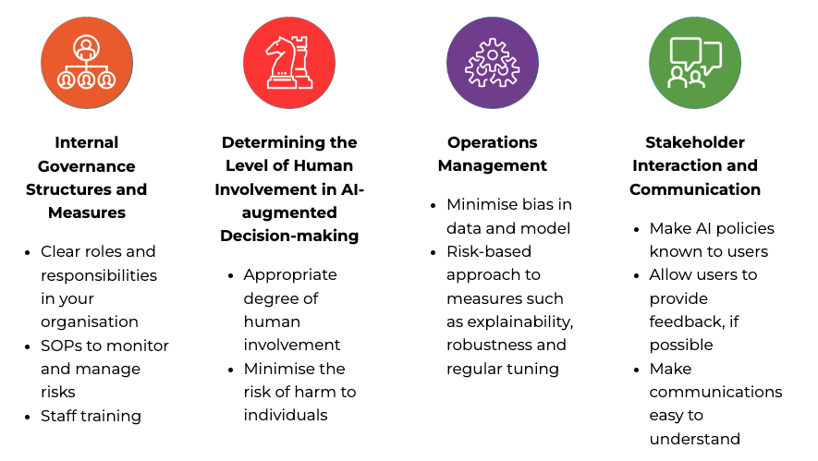
4 Key Areas
Guidance on measures promoting the responsible use of AI that organisations should adopt in the following key areas:
Notes:
Now we get into the operational heart of the framework — the four key areas where the framework actually gives organisations concrete guidance on responsible AI practices. Let's walk through what these typically cover, because this is where the framework moves from principle to practice.
The first area is internal governance structures and measures — basically, how do you organize your own house internally? This covers things like establishing clear roles and responsibilities, and setting up internal risk management processes specifically for AI, echoing what we discussed earlier about oversight mechanisms and ethics committees.
The second is about determining the level of human involvement in AI-augmented decision-making — essentially, figuring out when a human needs to be in the loop, when a human should review an AI's decision before it's acted on, and when it might be acceptable for AI to act more autonomously. This is a risk-calibration question — the higher the stakes, generally the more human oversight you'd want.
The third area is operations management — this is about the nuts and bolts of how you actually manage an AI system across its lifecycle, from data quality and model selection through to testing and monitoring after deployment. And the fourth is stakeholder interaction and communication — how do you communicate with the people affected by your AI system? This covers things like being transparent that AI is being used at all, and providing channels for feedback or recourse if someone feels they've been treated unfairly.
So notice how these four areas map neatly onto the concepts we've built up throughout the lecture — internal governance echoes accountability, human involvement echoes the human-centricity principle we just covered, operations management echoes the lifecycle risk management point, and stakeholder communication echoes transparency. It all ties back together into one coherent system.

Slide 25
Internal Governance Structures
Internal governance structures allows organisations to have appropriate oversight over how AI technologies are brought into their operations and/or products and services.
Existing governance structures can be adapted to incorporate values, risks, and responsibilities relating to algorithmic decision-making.
  E.g., risks associated with the use of AI can be managed within the enterprise risk management structure, ethical concerns of AI can be managed through existing Institutional Review Boards
Notes:
So we've talked about principles and frameworks at a high level — now let's get practical. How does an organisation actually make sure AI is being governed properly day to day? The answer usually isn't "build something brand new from scratch." It's "adapt what you already have."
Most companies already have governance structures in place for things like risk management, data privacy, and ethics review. The key insight here is that you don't necessarily need a whole separate AI bureaucracy — you can extend your existing enterprise risk management framework to cover algorithmic risk, or route ethical questions about AI through the same Institutional Review Board that already handles, say, research ethics or clinical trials.
Why does this matter? Because standing up entirely new governance bodies is slow, expensive, and often redundant. If your risk committee already knows how to assess and escalate risk, you just need to teach it to recognise AI-specific risks — things like bias, explainability, and model drift — rather than reinventing the wheel.
Think of it as retrofitting rather than rebuilding. The structures — who reports to whom, who has sign-off authority, how issues get escalated — those don't need to change. What changes is the content of what's being reviewed. That's a much more realistic starting point for most organisations, especially smaller ones that can't afford a dedicated AI ethics division.
We're about to look at a real example of this — Mastercard — so keep this idea of "adapting existing structures" in mind as we go through it.

Slide 26

Case Study - Master Card
A Governance Council is established to review and approve implementations of AI applications that are determined to be high risk
  Members include Executive VP of AI Centre of Excellence, Chief Data Officer, Chief Privacy Officer, Chief Information Security Officer, Data Scientists, and Reps from business teams
Risk management
  Conduct initial risk scoring, high risk project will be referred to governance council
  Identify potential mitigants as part of the risk management review
Notes:
Let's ground this in a real case. Mastercard is a good example because they didn't just write a policy document and call it done — they built an actual governance mechanism with teeth: a Governance Council.
Notice what this council does — it doesn't review every single AI project the company runs. It specifically steps in for applications that are flagged as high risk. That's an important design choice. You don't want to bottleneck every minor AI use case through a committee of executives; that would kill innovation. Instead, there's a triage step first, and only the risky stuff gets escalated to this senior level.
Look at who's actually sitting on this council — the Executive VP of the AI Centre of Excellence, the Chief Data Officer, Chief Privacy Officer, Chief Information Security Officer, data scientists, and business representatives. Why this mix? Because AI risk isn't just a technical problem or just a legal problem or just a security problem — it cuts across all of them. You need data expertise, privacy expertise, security expertise, and business context all in the room together.
Then there's the risk management process itself — every AI project gets an initial risk score. Think of this like a screening test. If it scores high enough, it gets referred up to the governance council for deeper scrutiny. And critically, the process isn't just "approve or reject" — it's also about identifying mitigants, meaning ways to reduce the risk so the project can still move forward safely.
So the big takeaway here is that governance isn't a single gate — it's a graduated process. Low-risk stuff flows through quickly, high-risk stuff gets real scrutiny, and even then the goal is usually to fix the risk rather than just kill the project.

Slide 27
Case Study – Master Card
  Defined Clear Roles & Responsibilities
Chief Data Officer & Chief Privacy Officer
Review AI implementation to ensure:
Data is fit for purpose of AI
AI used for ethical purpose
Impact to individual is appropriate and potential harm is sufficiently mitigated
Chief Information Security Officer
Ensure security by design is implemented
Data Science Teams
- Build and implement AI
- continual information sharing with CDO & CPO regarding the required governance
Notes:
Now let's zoom into the roles a bit more, because a governance structure is only as good as the clarity of who's responsible for what. Vague accountability is basically the enemy of good governance — if everyone's a little bit responsible, nobody really is.
Look at the Chief Data Officer and Chief Privacy Officer — they're paired together here, and their job is essentially a three-part check. First, is the data actually fit for the purpose this AI is being used for? Second, is the AI being used ethically? And third, if there's an impact on individuals, has that potential harm been sufficiently mitigated? Notice that this isn't just a technical data quality check — it's explicitly asking ethical and human-impact questions too.
Then you've got the Chief Information Security Officer, whose job is to make sure security is designed in from the start, not bolted on afterward. This is the "security by design" principle — you don't build the system and then think about security; security considerations shape the build from day one.
And finally, the data science teams — the people actually building and implementing the AI. Their responsibility isn't just to build good models. It's also to keep communicating with the CDO and CPO throughout the process. So governance here isn't a one-time approval at the start of a project — it's an ongoing conversation as the project develops.
The pattern across all three roles is the same — clear ownership, and continuous engagement rather than a single checkbox exercise.

Slide 28
Case Study Exercise
Has your company already established an internal governance structure?
What are the different roles & responsibilities?
Notes:
All right, this is a good moment to pause and actually talk to each other rather than me talking at you. Take a few minutes — in pairs or small groups — and think through these two questions in relation to your own organisation, or an organisation you've worked at or interned with.
First question — does your company already have some kind of internal governance structure, even if it's not called an "AI governance council"? Remember what we just said about Mastercard — governance can be an adaptation of existing structures. So think broadly here. Maybe it's a data governance committee, an IT risk board, or even just a compliance function that reviews new systems before rollout.
Second — if such a structure exists, what are the actual roles and responsibilities? Who has the authority to say no to a project? Who gets consulted versus who gets to make the final call?
While you're discussing, I want you listening for a few things. Some of you will say "we don't really have anything formal" — and that's a valid and common answer, don't be shy about it. Others might realise that governance exists but it's scattered — maybe privacy sits in legal, security sits in IT, and nobody's really talking to each other. That fragmentation is itself an interesting finding, and it maps directly onto why Mastercard's model — pulling all those functions into one council — is actually a meaningful design choice, not just bureaucracy for its own sake.
Let's take a few minutes, and then I'll ask a couple of groups to share what they found.

Slide 29
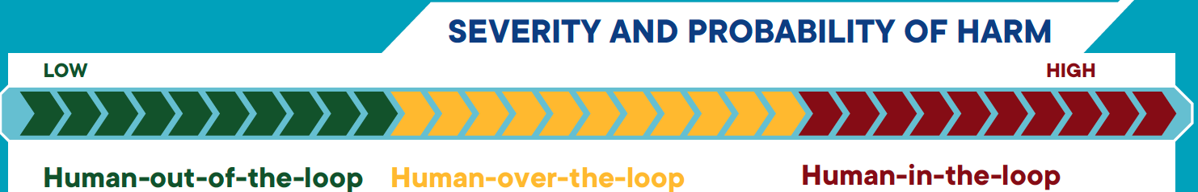
Human Involvement in AI-augmented Decision Making
Degrees of human oversight
  Human-in-the-loop
  Human-out-the-loop
  Human-over-the-loop
Risk impact assessment should be carried out to determine the level of human oversight.
Notes:
So we've been talking about organisational governance — committees, councils, roles. Now let's zoom in to a different level of governance — the level of an individual decision being made by an AI system. Specifically, how much say does a human have in that decision?
This is really a question about where the human sits relative to the AI's decision-making loop. And there isn't one right answer — it depends on the risk involved. We're going to look at three degrees of human oversight: human-in-the-loop, human-out-of-the-loop, and human-over-the-loop. The names are similar, so pay attention to the prepositions — "in," "out," and "over" — because that small difference in wording maps to a very different level of human control.
The diagram on this slide gives you the general shape of it — think of a loop that starts with data going into an AI system, the AI doing something with that data, and an outcome coming out the other end. What differs between the three models is where — and whether — a human is inserted into that loop.
The last point on this slide is really the key organising idea for the next few slides — you don't just pick one of these arbitrarily. You carry out a risk impact assessment first, and that assessment tells you how much human oversight is actually warranted. High risk, high-stakes decisions generally need more human control. Lower risk, repetitive decisions can often tolerate less.
Keep that risk-based thinking in mind, because we're going to apply it directly in the case studies coming up.

Slide 30
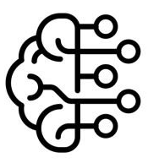

Human-in-the-Loop
Human oversight is active and involved, with the human retaining full control and the AI only providing recommendations or input.
Decisions cannot be exercised without affirmative actions by the human, such as a human command to proceed with a given decision.
Recommendation of actions, context and evidence
Make Decision
Data
Outcome
Notes:
Let's start with human-in-the-loop, because this is the model with the most human control. Look at the diagram flow — data comes in, the AI processes it and produces a recommendation, along with context and evidence to support that recommendation. But notice it stops there — the AI does not make the decision. It hands things off to a human, who is the one that actually makes the decision, and only then do we get an outcome.
So the AI's role here is essentially advisory. It's saying, "here's what I think you should do, and here's why." But the human has to actively affirm that action before anything happens. Nothing executes automatically.
This is important — decisions cannot be exercised without an affirmative action by the human. That word "affirmative" matters. It's not that the human could theoretically stop it if they noticed something wrong. It's that the human must actively say "yes, proceed" before the decision goes live.
Where would you use this? Think high-stakes, high-consequence situations — medical diagnoses that lead to treatment decisions, loan approvals that significantly affect someone's life, criminal justice risk assessments. In all these cases, you want a human accountable for the final call, with the AI acting purely as a decision-support tool.

Slide 31
Human-out-of-the-loop
There is no human oversight over the execution of decisions.
The AI system has full control without the option of human override.
Data
Make decision
Outcome
Notes:
Now the opposite end of the spectrum — human-out-of-the-loop. And the diagram here tells the story immediately, just by what's missing. Data goes in, the AI makes the decision, and out comes the outcome. There's no human step at all in that loop.
This means the AI has full control over that decision, and there's no option for a human to override it — not even after the fact, in this immediate execution sense. The system runs end-to-end without a person checking or approving each individual decision.
Now, before you think this sounds alarming, remember — this isn't inherently bad. It depends entirely on the stakes involved. Think about something like a spam filter, or a product recommendation engine, or Netflix suggesting what to watch next. If the AI gets it wrong, the consequence is mild — an annoying email in your inbox, or a bad movie suggestion. Nobody's harmed in a serious way, so full automation is perfectly reasonable, and honestly, necessary — you couldn't have a human manually approving every single recommendation shown to millions of users.
So the trade-off with human-out-of-the-loop is speed and scale in exchange for giving up individual case-by-case human control. That trade-off only makes sense when the potential harm from a wrong decision is low.

Slide 32
Human-over-the-loop
Human is in a monitoring or supervisory role, with the ability to take over control when the AI model encounters unexpected or undesirable events (such as model failure)
Data
Make decision
Outcome
Exception
Review outcome, make decision
Notes:
And now the middle ground — human-over-the-loop. This one's a bit more nuanced, so let's walk through the diagram carefully. Data comes in, the AI makes the decision, and normally that flows straight to an outcome, similar to out-of-the-loop. But notice there's a human positioned off to the side, in a monitoring role, reviewing the outcome. And crucially, there's an "exception" path that loops back — if something unexpected or undesirable happens, the human can step in and take over.
So the difference from human-out-of-the-loop isn't that a human approves every decision — most of the time, the AI is just running autonomously. The difference is that a human is watching, ready to intervene when things go wrong. It's supervision rather than approval.
The GPS example on the slide is a really good one to hold onto. Think about how a GPS app plans your route — it gives you several route options from Point A to Point B, and you pick one. But once you're driving, if there's unexpected road congestion, you as the driver can deviate — take a different turn — without having to stop and reprogram the whole system. The AI is continuously operating, offering guidance, but the human retains the ability to override in real time when circumstances change.
So think of the three models on a spectrum — in-the-loop means the human must approve before anything happens, over-the-loop means the human is watching and can intervene if needed, and out-of-the-loop means the AI just runs, full stop. That spectrum is going to help you a lot in the case studies coming up.

Slide 33
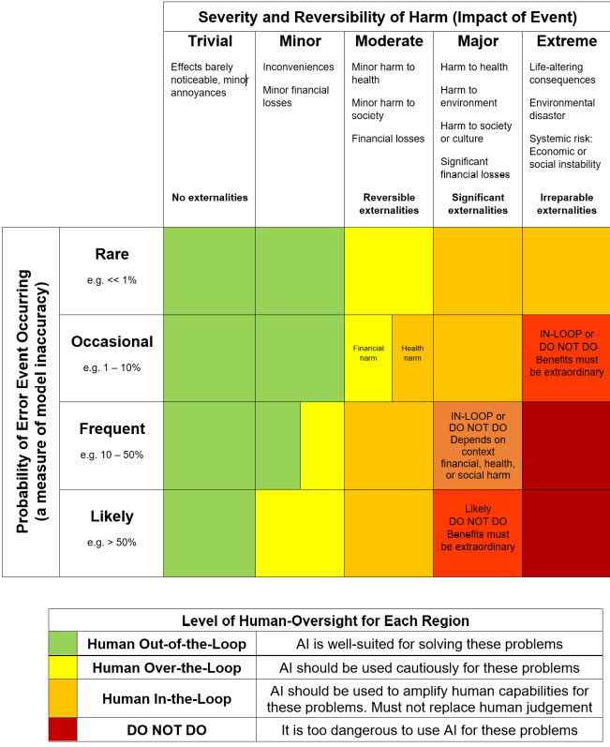
Probability-Severity of Harm Matrix
Notes:
So now the natural question is — how do you actually decide which of these three models to use for a given AI application? This is where the probability-severity of harm matrix comes in, and it's a pretty intuitive tool once you see it.
Picture a two-by-two, or really a graded matrix — one axis is the probability that something goes wrong, how likely is a harmful error to actually occur. The other axis is the severity of harm if it does go wrong — is this a minor inconvenience, or is this life-altering, even life-threatening?
The logic follows naturally from that. If both probability and severity are low — say, a movie recommendation being slightly off — you can comfortably sit in human-out-of-the-loop territory, full automation. But as you move up either axis — the harm becomes more likely, or more severe, or both — you should be dialling up human involvement. Medium risk situations might call for human-over-the-loop, where a person is supervising and ready to step in. And when you're in that high-probability, high-severity corner — things like medical treatment decisions, or decisions that could deprive someone of liberty — that's squarely human-in-the-loop territory, where a human must explicitly approve before anything happens.
So this matrix isn't just a nice diagram — it's actually a decision-making tool. When you're designing or evaluating an AI system in your own work, you can use something like this to justify, in a structured way, why you chose the level of human oversight you did. That's a much stronger position than just guessing.
Keep this matrix in your head, because we're about to run through three real case studies, and I want you actively applying this logic — probability and severity — to figure out the answer, rather than just guessing at the label.

Slide 34

Case study
An online retail store wishes to use AI to fully automate the recommendations of products to individuals based on their browsing behaviours and purchase history.
Human-out-of-the-loop
Human-in-the-loop?
Human-over-the-loop
Notes:
Okay, let's put this into practice. Here's the scenario — an online retail store wants to use AI to fully automate product recommendations based on someone's browsing behaviour and purchase history. Think Amazon, Shopee, that kind of "customers who bought this also bought..." feature.
I want you to actually think about this for a second before I give you the answer — using the matrix we just discussed, where would you place this? What's the probability of harm, and what's the severity if the AI gets a recommendation wrong?
We'll use Mentimeter for this one, so go ahead and submit your answer on your phones.
The answer here is human-out-of-the-loop, and hopefully the reasoning is becoming intuitive now. If the AI recommends a product you don't want, what actually happens? Nothing much — you simply ignore it, maybe you're mildly annoyed, and you scroll past. There's no real harm to a person's safety, finances, or rights. Given that low severity — regardless of how often it's wrong — full automation makes complete sense. You wouldn't want a human manually reviewing every single recommendation shown to potentially millions of shoppers; that would defeat the entire purpose of using AI here.
So notice the reasoning process — it's not about how sophisticated the AI is, it's about the consequence of a bad decision. That's the mental model I want you carrying forward.

Slide 35

Case Study
Singapore Eye Lesion Analyser (SELENA+) is a deep-learning AI software system that can detect potential threatening eye conditions accurately and efficiently.
It can detect abnormal fundus images, and in particular, signs of diabetic retinopathy disease.
Human-out-of-the-loop
Human-in-the-loop?
Human-over-the-loop
Notes:
Now let's raise the stakes considerably. This case is SELENA+, a Singapore-developed deep learning system that analyses eye images — fundus images — to detect diabetic retinopathy and other threatening eye conditions. This is a real, deployed system, not a hypothetical.
Same question — human-out-of-the-loop, human-in-the-loop, or human-over-the-loop? Take a moment to think about it using the matrix. This is a medical diagnostic tool, so severity of harm if it's wrong is clearly much higher than a product recommendation — potentially someone's eyesight, someone's health.
The answer given here is human-out-of-the-loop, which might surprise some of you given how high-stakes this sounds. But here's the nuance worth flagging — in actual clinical deployment, SELENA+ typically operates more like a human-in-the-loop or human-over-the-loop system. It's used as a screening tool that flags potentially concerning images, and those flagged cases still get reviewed by a clinician before any treatment decision is made. So the AI isn't single-handedly deciding a patient's diagnosis or treatment in practice.
This is a good teaching moment about how these classifications aren't always clean-cut in the real world. The exact framing can depend on which specific step in the process you're evaluating — the initial screening step, which might run fairly autonomously to triage large volumes of images, versus the final diagnostic and treatment decision, which absolutely should involve a human doctor. So when you're doing this kind of assessment yourself, be precise about which decision point you're actually analysing.

Slide 36

Case Study
Suade Labs provides an AI-enabled solution that allows financial institutions to process large volumes of granular data and generate the required regulatory data, calculations, and reports with the necessary controls and governance.
Human-out-of-the-loop
Human-in-the-loop?
Human-over-the-loop
Notes:
Last case study — Suade Labs. This is a fintech example, quite different domain from the last two. Suade provides an AI-enabled solution that helps financial institutions process huge volumes of granular data and generate the regulatory reports and calculations they're required to submit, along with the necessary controls and governance built in.
Think about what this system is actually doing — it's crunching large datasets and producing standardised outputs, regulatory reports, calculations that follow defined rules and formulas. Ask yourselves — where does this sit on the probability-severity matrix?
The answer here is human-out-of-the-loop. And the reasoning connects back to something we haven't emphasised as much yet — this isn't just about severity of harm, it's also about the nature of the task itself. Regulatory reporting calculations are largely rules-based and deterministic — there's less room for the kind of ambiguous, ethically loaded judgment calls you'd see in medical diagnosis. And note that the system explicitly says it has "necessary controls and governance" built in — meaning oversight has effectively been engineered into the system's design itself, rather than requiring a human to intervene in real time on each individual report.
That's actually a nice point to close this section on — human oversight doesn't only mean a person sitting there watching every decision happen. It can also mean that governance, checks, and controls are designed into the system architecture from the start. So when you're assessing these cases, think not just about "is a human present," but "has appropriate oversight been built in, whether by a person in the loop or by design choices in the system itself."

Slide 37

Case Study
Google map helps user to navigate the routes from Point A to Point B.
Human-out-of-the-loop
Human-in-the-loop?
Human-over-the-loop
Notes:
So here's a quick one to test your intuition. Google Maps takes you from Point A to Point B — it calculates the route, it tells you to turn left in two hundred metres, it reroutes you if there's traffic. Where does the human sit in that loop?
Think about the three categories we've been using. Human-in-the-loop means a person is actively part of the decision at every step. Human-over-the-loop means the human is supervising and can intervene, but the system runs mostly on its own. Human-out-of-the-loop means the system just executes, full stop, no human checkpoint in the operational decision itself.
For Google Maps, the answer we're going with is human-out-of-the-loop. Why? Because once you type in your destination, the app just calculates and gives you turn-by-turn instructions — it's not pausing to ask you "do you approve this next turn?" You're free to ignore it, sure, but the system itself isn't built with a human checkpoint baked into each routing decision.
Now, is this risky? Not really — and that's the point of the exercise. The level of human oversight you design into a system should match the stakes involved. Getting a suboptimal route to the mall is a low-consequence error. Compare that to, say, an autonomous vehicle's collision-avoidance system, where you'd want a very different oversight architecture. So keep asking yourselves this question as we go: what's the harm if this particular AI gets it wrong, and does the human oversight level actually match that harm?

Slide 38
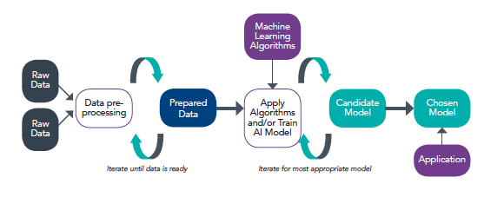
Operations Management
Model development process
Data
Model
Notes:
Let's zoom out for a second and talk about how these models actually get built, because everything we're about to cover for the rest of this section hangs off this one idea.
Modern AI, in its simplest possible form, is just two ingredients: data and model. That's it. You feed data into a training process, and out comes a model — a set of learned parameters that can make predictions on new, unseen inputs.
Why does this matter for responsible AI? Because it tells you where things can go wrong. If your data is flawed — incomplete, unrepresentative, biased — your model inherits those flaws no matter how sophisticated your algorithm is. And separately, even with clean data, the algorithm and modelling choices you make introduce their own risks around explainability, robustness, and so on.
So as we go through the next few slides, I want you to keep this DATA plus MODEL framing in your head. We're basically going to walk through the responsible AI considerations for each half — starting with data accountability, and then moving into the model and algorithm side.

Slide 39
Ensure Good Data Accountability Practices
Understand Lineage of Data
to ascertain the quality of the data based on its origin and subsequent transformation
Ensure Data Quality
Accuracy
Minimising inherent bias
Selection bias
Measurement bias
Completeness
Veracity of data
Relevance
Integrity
Trace potential sources of errors
Notes:
Let's dig into the data side first, because honestly, most AI fairness problems trace back to data, not clever algorithms gone rogue. The first big category is what we call selection bias.
Selection bias happens when the data you used to train your model doesn't actually represent the real-world population or environment the model is going to operate in. There are two flavours of this worth knowing by name. The first is omission bias — where certain characteristics are simply missing from your dataset. Classic example: you train a facial recognition system entirely on Asian faces, and then deploy it in a population that includes non-Asian faces. The model has literally never seen those patterns, so of course it underperforms on them. It's not malicious, it's just... nobody was in the room to notice the gap.
The second flavour is stereotype bias, which is subtler. This is where your data isn't completely missing a category, but it's skewed — overrepresenting some things and underrepresenting others in a way that reflects a stereotype rather than reality. The example here: if you collect data on vehicle types in the central business district on a weekday, you're going to see tons of cars, buses, motorcycles. But bicycles? Underrepresented in that snapshot. If you then use that dataset to model "modes of transportation in Singapore" more broadly, you've baked in a skew that doesn't reflect the full picture.
Now the second major category is measurement bias, and this one is more about your equipment than your sampling strategy. It happens when the actual device you use to collect data systematically skews the data in some direction. The example given is almost comical if you think about it — imagine training data collected using a camera where the colour filter had been switched off. Every image comes out with a colour cast, and your model learns patterns based on that artifact rather than the true signal. It's a good reminder that bias isn't always about who you sampled — sometimes it's about how you measured them.
So the takeaway here: before you even get to modelling, ask hard questions about your data pipeline. Who's missing? What's overrepresented? Is your sensor or collection method itself introducing distortion? These questions cost you very little time upfront and save you enormous headaches later.

Slide 40
Model & Algorithms
The choice of the algorithms for the model you build needs to consider various aspects such as explainability, repeatability, robustness, regular tuning, reproducibility, traceability, and auditability
  Contributes towards building a Trustworthy AI system
  Consider what is the most essential aspects for your business or stakeholders
Notes:
Moving to the model and algorithm side of things. Once you've got your data sorted, you still have to choose how you're going to model it, and that choice is not just a technical decision — it's a responsibility decision.
Look at this list: explainability, repeatability, robustness, regular tuning, reproducibility, traceability, auditability. That's a lot of "-abilities," I know. But each one maps to a real-world concern. Can you explain why the model made a decision? Can you reproduce the same result if you rerun the process? Can someone audit the model later and trace back how a particular output was reached?
Here's the thing — you're rarely going to get top marks on all seven simultaneously. There are trade-offs. A highly complex deep learning model might be incredibly accurate and robust, but terrible on explainability. A simple linear model might be very interpretable and easy to audit, but might not capture the nuance in your data as well.
So this becomes a genuine design conversation with your stakeholders. If you're in a highly regulated space like finance or healthcare, traceability and auditability might dominate your decision. If you're building a recommendation engine for entertainment, maybe robustness and reproducibility matter more than deep explainability. There's no universal right answer — the point is that you actually have this conversation deliberately, rather than defaulting to "let's just use the fanciest model" without thinking about what your business or your users actually need.

Slide 41
Biasness/Fairness
Identify any bias in the dataset and models that emerged during testing
  Remove protected or discriminatory features. Such as gender and ethnicity should not be fed into the model if it irrelevant for solving the underlying problem
  Features that seem not harmful or offensive may turn out to be highly correlated, biased or discriminatory. Gender, ethnicity and socioeconomic status can often be inferred from names, addresses and location data
  Bias can result from an incomplete representation of a minority class. Increase diversity in data. Inclusion of view from stakeholder that are affected.
  Sometimes a metric may not be an accurate or well-generalised proxy for the underlying problem
Notes:
Now we get to one of the meatier topics — bias and fairness in the model itself, not just the raw data. This is really about what you do during testing and development to catch problems before they go live.
First step: you actually have to go looking for bias. It's not going to announce itself. That means testing your dataset and your model outputs deliberately, checking whether certain groups are getting systematically different treatment.
A natural instinct is to just remove protected attributes — gender, ethnicity, and so on — if they're not relevant to the problem you're solving. Fair enough. But here's the trap: removing the obvious protected feature doesn't necessarily solve the problem, because other seemingly harmless features can act as proxies. Someone's name, their address, their location data — these can all be highly correlated with gender, ethnicity, or socioeconomic status. So a model can still discriminate on ethnicity even after you've deleted the "ethnicity" column, simply because postal code is doing the same job by proxy. That's a subtle but really important point.
Another source of bias is incomplete representation of minority classes — this connects back to what we just discussed with selection bias. Say you're building a facial recognition system — you'd want to make sure your data includes different races and different nationalities, not just whoever was easiest to collect. And beyond just the data, it also helps to bring in the actual voices of stakeholders who'd be affected by the system — they'll often spot blind spots that a purely technical team would miss.
And then there's a more conceptual issue — sometimes the metric you're optimising for isn't actually a good proxy for what you care about. Here's a concrete example: in a classification problem, accuracy tells you how well the model does overall, across everything. But recall tells you how well the model performs on each individual label, independent of the others. So imagine a model that's ninety-five percent accurate overall but performs terribly on one small minority class — accuracy alone would hide that completely, while recall broken down by class would expose it immediately. This is exactly why picking the right evaluation metric matters as much as picking the right algorithm.
So the overarching message: you need actual AI governance processes in place — not just good intentions — to systematically test data and models for these issues throughout development and after deployment, because bias has a way of creeping back in even after you think you've dealt with it.

Slide 42
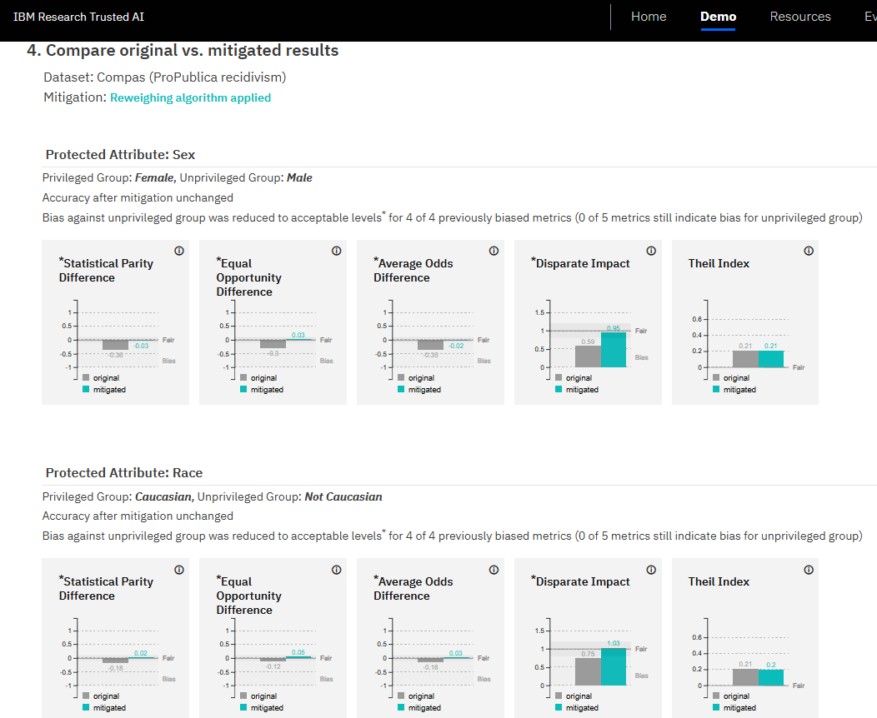
Biasness/Fairness
https://aif360.res.ibm.com/
Notes:
So if all of that sounds great in theory but you're wondering "okay, how do I actually go and check for this stuff in practice" — this is where tooling comes in.
This is a screenshot from IBM's AI Fairness 360 toolkit, or AIF360 for short. It's an open-source library, freely available, and it bundles together a whole suite of fairness metrics alongside bias-mitigation algorithms you can actually apply to your dataset or your model.
What I like about pointing you to this is that it turns an abstract ethical conversation into something concrete and measurable. Instead of just saying "we think our model might be biased," you can actually run quantitative fairness metrics against your model and get numbers back — disparate impact ratios, equal opportunity differences, things like that.
You don't need to memorise every metric in this toolkit for this course, but I do want you to walk away knowing that these tools exist, they're free, and there's really no excuse for a serious AI project not to at least run through a fairness check like this before deployment.

Slide 43
Data Privacy
The PDPA recognises both the need to protect individuals’ personal data and the need of organisations to collect, use or disclose personal data for legitimate and reasonable purposes.
  Consent Obligation
  Purpose Limitation Obligation
  Protection Obligation
  Retention Limitation Obligation
  Transfer Limitation Obligation
  Accuracy Obligation
https://www.pdpc.gov.sg/Overview-of-PDPA/The-Legislation/Personal-Data-Protection-Act/Data-Protection-Obligations
Notes:
Let's shift gears now to data privacy, and specifically Singapore's legal framework for this — the Personal Data Protection Act, or PDPA.
The philosophy behind the PDPA is actually a balancing act. On one hand, individuals have a right to have their personal data protected. On the other hand, organisations have legitimate, reasonable business needs to collect, use, and disclose personal data. The PDPA doesn't try to eliminate data collection — that would be unworkable in a modern economy — it tries to set guardrails around it.
There are six obligations you should know. The consent obligation means you can only collect, use, or disclose someone's data for purposes they've actually consented to — you can't quietly repurpose it for something else. The purpose limitation obligation is closely related — whatever you're doing with the data has to be relevant and reasonable, not just technically consented to.
Then there's the protection obligation, which requires reasonable security arrangements so data doesn't leak or get accessed by people who shouldn't have it. The retention limitation obligation says you can't just hoard data forever — once you no longer need it for the purpose you collected it for, you're expected to dispose of it properly.
The transfer limitation obligation kicks in when data crosses borders — if you're sending personal data overseas, the receiving party needs to maintain a standard of protection comparable to the PDPA's. And finally, the accuracy obligation — you need to make a reasonable effort to keep the data accurate and complete, which becomes especially important when that data is going to be used to make decisions that actually affect the individual. Think about it — if you're using stale or wrong data to decide something like a loan or a job application, that's a real harm to a real person.
So notice how these six obligations map almost directly onto the AI lifecycle we've been discussing — collection, purpose, security, retention, transfer, accuracy. It's not a coincidence. Responsible AI and data protection law are pulling in the same direction.

Slide 44
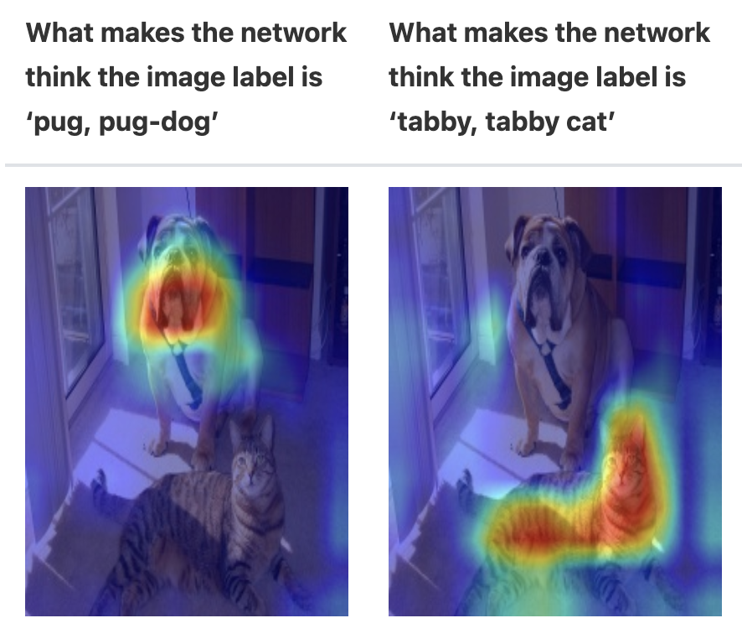
Explainability
Explainability is achieved by explaining how deployed AI model’s algorithm functions and/or how the decision-making process incorporates model predictions.
Some practices:
  Document model training and selection process
  Document why certain features are selected over others for training
  For ‘black box’ model, some supplementary explanation tool can be help to visualize what the model is focusing when making a prediction or decision
Notes:
Let's talk about explainability now, which we've touched on already but deserves its own proper treatment.
At its core, explainability is about being able to explain how your deployed model's algorithm actually functions, and how its predictions feed into the final decision-making process. It sounds simple, but in practice this is one of the hardest things to do well, especially as models get more complex.
So what does good practice actually look like? First, document your model training and selection process — don't just keep that knowledge in one engineer's head, write it down. Second, document why you chose certain features over others. This seems like paperwork, but when someone questions a model's decision six months later, you want a paper trail showing your reasoning wasn't arbitrary.
And then there's the trickier case — what do you do with "black box" models, the ones that are inherently hard to interpret directly, like deep neural networks? For those, there are supplementary explanation tools that can help visualise what the model is actually focusing on when it makes a prediction. You'll see some examples of these visualisation tools on the slide — things that highlight which parts of an input the model paid attention to.
The point is, explainability doesn't have to mean redesigning your whole model to be simple. Sometimes it means wrapping your complex model with the right tooling and documentation so that a human being can still make sense of what it's doing.

Slide 45
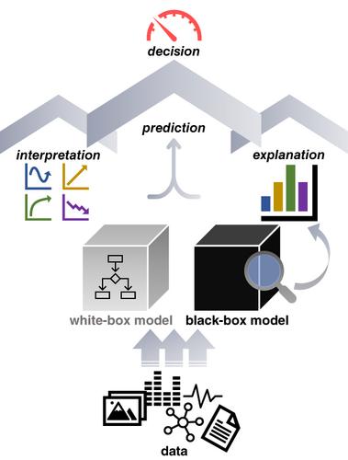
Explainability vs Interpretability
Explainable AI describes why the AI model made a prediction.
Interpretable AI describes how it makes the prediction.
Example: an AI model used to improve employee health and productivity. The health of employees may depend on factors including their age, demographics, department and business function, past health conditions, and additional factors.
A fully explainable AI system will help the HR to discover the exact cause-and-effect of their decision controls on the corresponding employee health attributes.
A fully interpretable model will help them discover the inner logic of this cause-and-effect.
Notes:
Now here's a distinction that trips a lot of people up, because these two words sound almost interchangeable in everyday English, but in AI they mean genuinely different things: explainability versus interpretability.
Explainable AI answers the question "why did the model make this particular prediction?" It's about the outcome — given this specific input, here's the reasoning behind this specific output.
Interpretable AI answers a different question — "how does the model make predictions in general?" It's about the mechanism itself — the internal logic, the actual structure of how inputs get transformed into outputs across the board, not just for one case.
Let's ground this with the example on the slide. Imagine an AI model used to improve employee health and productivity, using factors like age, demographics, department, past health conditions, and so on. A fully explainable system would let HR say, "for this specific outcome, here's the exact cause-and-effect chain that led to it" — like being able to point to exactly why one employee's risk score came out the way it did. A fully interpretable system goes further and lets HR actually see and understand the inner logic of the model itself — the general rules or relationships it learned, not just a single case explanation.
So think of explainability as case-by-case justification, and interpretability as understanding the whole machine. Ideally you'd want both, but in practice, the more complex and powerful a model is, the harder it usually is to get full interpretability — which is exactly why those visualisation and explanation tools we just talked about become so important.

Slide 46
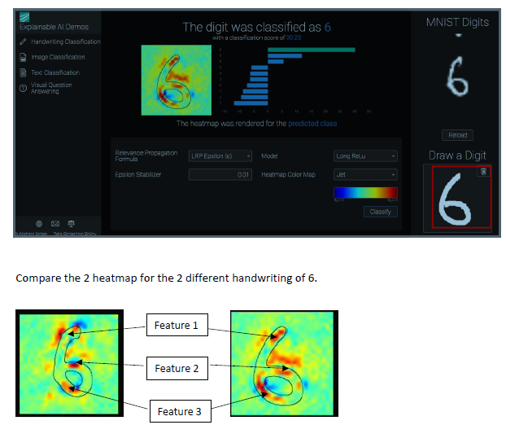
Explainability
Http://www.heatmapping.org/
Notes:
Here's another concrete tool to make this less abstract — this is from heatmapping.org, which is associated with techniques like layer-wise relevance propagation, or LRP for short.
The basic idea behind these heatmap or saliency-map techniques is visual and intuitive. Say you've got an image classification model that says "this is a cat." A heatmap technique will overlay a colour map on the original image showing which pixels actually drove that decision — maybe it's lighting up around the ears and whiskers, which is reassuring, or maybe it's lighting up on some background object, which tells you your model learned the wrong thing entirely.
This is a really powerful sanity check. I've seen real cases in the literature where a model that seemed to perform brilliantly at classifying, say, wolves versus huskies turned out to just be detecting snow in the background, because all the wolf training photos happened to have snow. A heatmap would expose that instantly, whereas an accuracy score never would.
So tools like this bridge the gap between "the model works" and "the model works for the right reasons" — and in responsible AI, that distinction really matters, because a model that's right for the wrong reasons is a model that's going to fail unpredictably the moment conditions change.

Slide 47
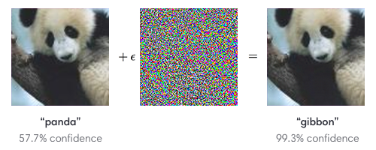

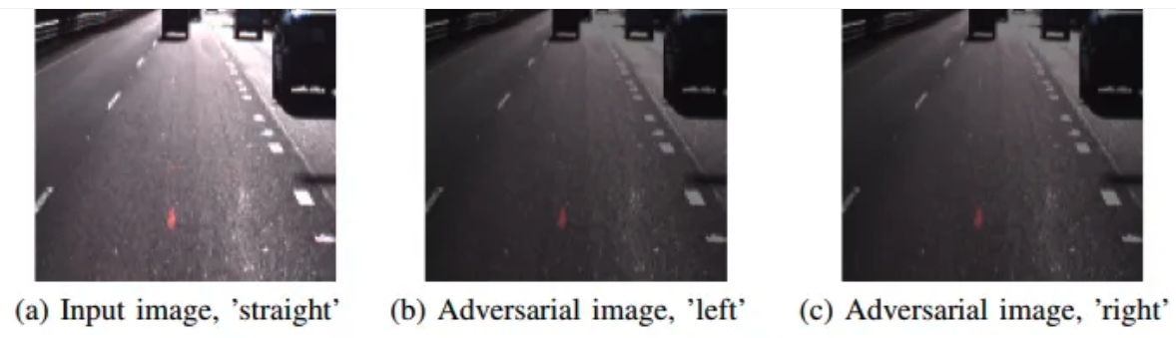
Testing for Robustness of Model
Model can produce unexpected results even with minor (even not perceptible to human) modifications to input
Physical Adversarial Attacks
Notes:
Let's move to our final major theme — robustness. And I want to open with a slightly unsettling fact: AI models can produce wildly unexpected results from modifications to the input that are so small a human wouldn't even notice them.
This is the world of adversarial attacks. You've probably seen the classic image examples — add a tiny, imperceptible amount of noise to a picture of a panda, and suddenly a state-of-the-art classifier confidently says it's a gibbon. To your eyes and mine, nothing has changed. To the model, everything has changed.
And it's not just digital tricks in a lab — the slide points to physical adversarial attacks. There's research showing that specially designed stickers placed on a stop sign can cause a self-driving car's vision system to misclassify it as a speed limit sign. That's not a hypothetical anymore, that's a real safety concern once AI is out in the physical world making decisions with consequences.
Now, the natural response is "well, let's just test for all of this exhaustively." But here's the catch — adversarial testing is genuinely resource intensive. You can't feasibly test every possible perturbation against every possible model. So the practical guidance is to take a risk-based approach — put your adversarial testing effort where the stakes are highest, rather than spreading it thin everywhere equally.

Slide 48
Testing for Robustness of Model
Consider adversarial testing (red teaming) on model to ensure that it can handle a broader range of unexpected input variables
Consider risk-based approach to decide what AI-powered features requires adversarial testing
  Adversarial testing is a resource-intensive exercise
Notes:
So continuing from where we left off — if adversarial testing is expensive, how do you actually decide what to do about it in practice? This slide is really the "so what do we do" companion to the last one.
The core technique here is what's often called red teaming — deliberately trying to attack your own model, essentially playing the adversary against yourself before someone else does it for real. The goal is to make sure your model can handle a broader range of unexpected or maliciously crafted inputs, not just the clean, well-behaved test set you trained and validated on.
But again, we come back to that resource constraint. You can't red-team every single feature of every single AI system to the same exhaustive degree — it's simply too costly in time and expertise. So the practical answer is a risk-based approach: look at your AI-powered features and ask which ones carry the highest consequence if they fail or get manipulated. A recommendation engine suggesting the wrong movie is low stakes. A vision system on an autonomous vehicle misreading a stop sign is extremely high stakes. Put your adversarial testing budget where the potential harm is greatest.
This is really the theme that's been running through this whole section, if you think about it — from bias testing, to explainability tooling, to now robustness testing. Responsible AI isn't about doing everything perfectly for every system; it's about being deliberate and proportionate, matching your governance effort to the actual risk the system poses. That's a much more sustainable way to operationalise these principles than trying to apply maximum scrutiny to everything equally.

Slide 49
Regular tuning
Establish an internal policy and process to perform regular model tuning
  Changes to customer behaviour over time.
  Changes in commercial objectives, risks, or corporate values
Notes:
So this one's about maintenance, which honestly gets overlooked a lot. People love talking about how to build a fair, transparent AI system, but almost nobody wants to talk about what happens to it a year later. And the reality is, a model that's fair and accurate at launch doesn't stay that way forever just because you built it well once.
Think about why. Your customers change. The way people behave, what they buy, how they interact with your app — that shifts over time, sometimes gradually, sometimes really fast. If your model was trained on last year's behaviour patterns, it's essentially looking at the world through an outdated lens. That's the technical term you'll hear for this, by the way — model drift or data drift.
But it's not just about the customers changing. Your own organisation changes too. Maybe your commercial objectives shift — you're targeting a different market segment now. Maybe your risk appetite changes, or your corporate values evolve, especially after, say, a public incident or new regulation comes into force. A model tuned for yesterday's priorities might actively work against today's.
So the practical takeaway here is to establish an actual internal policy — not just an ad hoc "we'll fix it when it breaks" approach — for regular model tuning and review. Put a cadence on it. Assign ownership. Treat it the same way you'd treat, say, patching software or renewing a licence, as a routine governance obligation rather than a one-off project.

Slide 50
Stakeholder Communication
A good communication with the stakeholders is essential in building trust in the AI system
Information Need
Audience
Context
Purpose
Notes:
Alright, we're moving into a new section now, stakeholder communication. And I want you to notice this sits right alongside fairness and transparency as a pillar of responsible AI, not as an afterthought bolted on at the end.
Here's the underlying idea. You can build the most technically sound, fair, well-tested AI system in the world, but if the people affected by it don't trust it, none of that matters. Trust isn't something you can just assert — you have to earn it, and communication is really the main tool you have for earning it.
Think about it from the perspective of a customer who gets rejected for a loan, or an employee whose performance is partly assessed by an algorithm. If they have no idea an AI was even involved, let alone how it worked, that's going to breed suspicion the moment something goes wrong. Good communication is what turns a black box into something people can actually engage with.
So over the next few slides we're going to unpack what good stakeholder communication actually looks like in practice — what you disclose, how you disclose it, and what channels you give people to push back or ask questions.

Slide 51
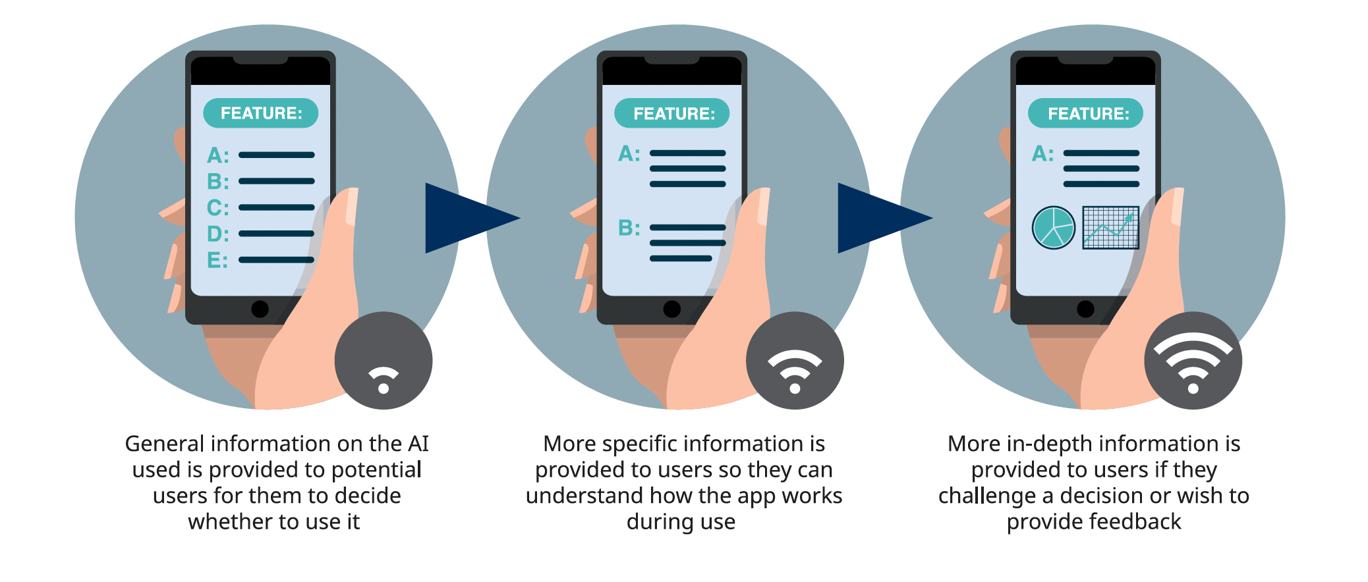
Stakeholder communication
General Disclosure
  Provide info on whether AI is used in the product or service
  Info such as how AI is used in decision-making, what are the benefits, what steps are taken to mitigate risks, how it can affect the end-user, will be helpful to instil confidence and trust
Notes:
Let's start with the most basic form of communication, general disclosure. At minimum, organisations should tell people, plainly, whether AI is being used in a product or service at all. That sounds almost too obvious to state, but you'd be surprised how often it's buried in page 40 of a terms-of-service document nobody reads.
But disclosure isn't just a yes-or-no flag. Good disclosure goes further and explains how the AI is actually being used in decision-making. Is it recommending, or is it deciding? Is a human reviewing the output, or is it fully automated? That distinction matters enormously to how much trust people are willing to extend.
Beyond that, you want to communicate the benefits — why are we even using AI here, what does it do better or faster or more consistently than the alternative. And critically, you want to be upfront about the steps taken to mitigate risks. What happens if it gets something wrong? What safeguards exist?
And finally, think about how the AI might affect the end-user directly. Does it affect pricing, eligibility, the content they see? People are far more forgiving of a system's limitations when they feel like they were told the truth about it upfront. That's really the psychology underneath all of this — disclosure isn't a legal formality, it's the foundation that everything else, including trust, gets built on top of.

Slide 52
Stakeholder communication
Option to opt-out
  Depends on the degree of risk/harm to individuals, reversibility of AI decision, cost of alternate way of decision making, technical feasibility, complexity of maintaining two parallel system
Communication channels
  Feedback channels
    Raise feedback or queries, e.g. if inaccuracies spotted by user
  Decision review channels
    For user to raise request to review material AI decision
Notes:
Now, disclosure alone isn't enough. The next question is, what agency do you actually give people once they know AI is involved? And that's where this idea of an opt-out option comes in.
Should users be allowed to say "no thanks, I don't want the AI-driven version, give me the human-driven process instead"? Well, it depends. The framework here gives you several factors to weigh. First, the degree of risk or harm to the individual — an AI recommending a song is very different from an AI deciding on a medical diagnosis or a loan. Second, is the decision reversible? If someone can easily appeal or undo a bad outcome, the pressure to offer an opt-out is lower.
Then there are more practical, operational considerations. What's the cost of maintaining an alternate way of making the same decision? Is it even technically feasible to run two parallel systems, a human path and an AI path, side by side? And how complex does that make your operations? These aren't just ethical questions, they're genuine business trade-offs, and organisations have to weigh all of them together rather than treating opt-out as an automatic requirement.
The second half of this slide is about communication channels, and I'd say there are really two distinct types you need. First, feedback channels — a simple, accessible way for a user to say "hey, this seems wrong" if they spot an inaccuracy. That's your early warning system, honestly; users often catch problems before your internal monitoring does.
Second, and this is a bit more formal, decision review channels. This is where a user can specifically request that a material AI decision affecting them be reviewed, ideally by a human. Notice the distinction — feedback is more general and informal, review is a specific, structured request tied to an actual decision. Having both gives stakeholders multiple ways to engage depending on how serious the issue is.

Slide 53
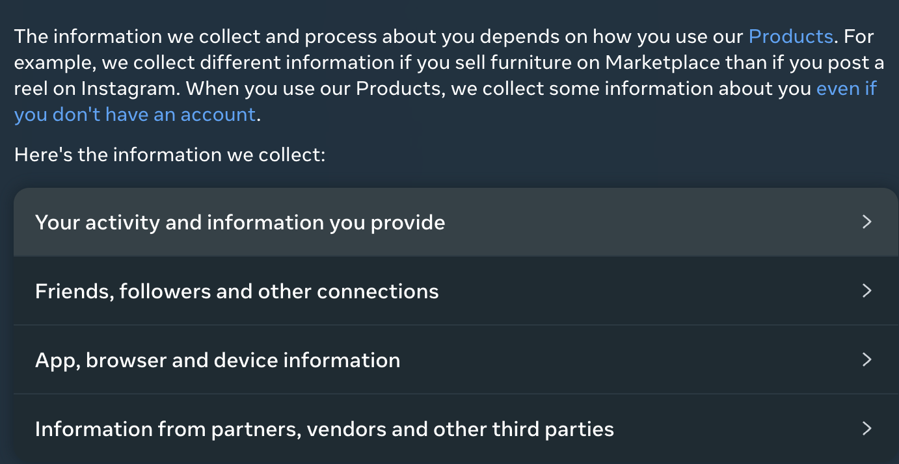
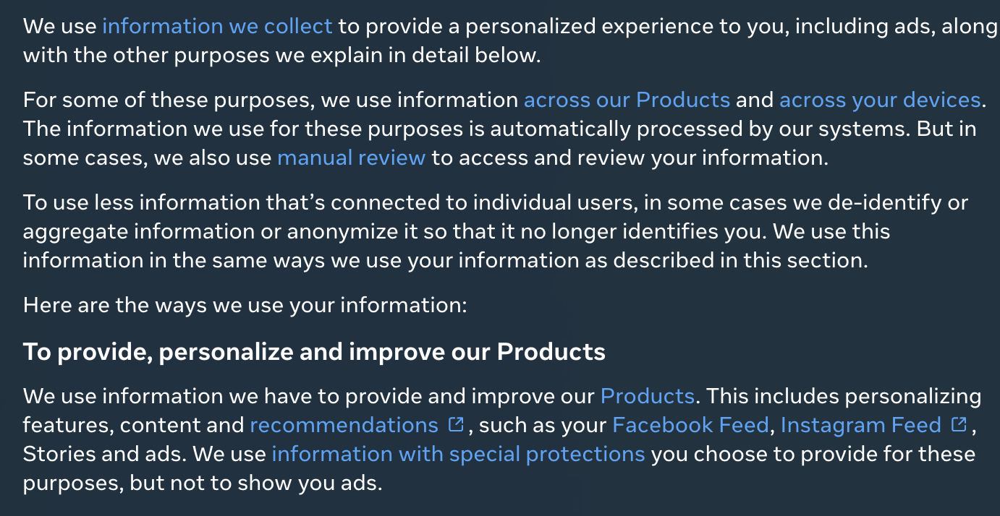
Case study - Facebook
Disclosure on information collected
Disclosure on information use
Notes:
So let's ground all this in a real example, Facebook. And I picked this one because it's a case that a lot of you will have personally experienced, even if you didn't think about it in these terms — logging into Facebook and seeing some kind of privacy or data-use disclosure screen.
The first piece is disclosure on information collected. If you've ever gone digging through Facebook's settings, you'll find surprisingly granular detail about what they gather — your location data, your device information, your browsing behaviour even off the platform, the ads you click, who you interact with. The point isn't whether you personally read all of it, it's that the information is available and itemised rather than hidden behind vague language like "we may collect certain data."
The second piece is disclosure on information use — and this is arguably the more important one, because knowing what's collected doesn't tell you much if you don't know what it's used for. Facebook explains, at least on paper, how your data feeds into ad targeting, content ranking, friend suggestions, and so on. This is where the "why" gets connected to the "what."
Now, I'll be honest with you, this case study cuts both ways. Facebook has also faced enormous criticism and regulatory scrutiny, Cambridge Analytica being the obvious example, for gaps between what was disclosed and what was actually happening with user data. So the lesson here isn't "Facebook did it perfectly," it's more that this shows both the structure of what good disclosure practice can look like on paper, and a cautionary tale about the gap that can exist between disclosure and actual practice.

Slide 54
Sector-specific Regulations and Guidelines
Monetary Authority of Singapore published the Principles to Promote Fairness, Ethics, Accountability and Transparency in the Use of Artificial Intelligence and Data Analytics in Singapore’s Financial Sector (the “FEAT Principles”)
Notes:
Let's zoom out from general principles now and talk about sector-specific regulation, because responsible AI doesn't exist in a vacuum — different industries have very different risk profiles, and regulators have responded accordingly.
Finance is a great example of a heavily regulated sector, and in Singapore, the Monetary Authority of Singapore, or MAS, has published something called the FEAT Principles — Fairness, Ethics, Accountability and Transparency in the use of AI and data analytics in the financial sector.
Why does finance get its own dedicated framework? Well, think about what's at stake. Credit scoring, loan approvals, insurance underwriting, fraud detection — these are decisions that directly affect someone's financial life and livelihood, often with very limited recourse if something goes wrong. Financial institutions also sit on enormous amounts of sensitive personal data, so the potential for harm, whether through bias, opacity, or misuse, is genuinely higher here than in a lot of other applications.
So FEAT isn't meant to replace the broader responsible AI principles we've been discussing, it's really a sector-specific translation of them — take fairness, ethics, accountability, transparency, and interpret them specifically through the lens of financial services. You'll see this pattern repeat across other industries too, healthcare, for instance, has its own frameworks, because a one-size-fits-all approach to AI governance tends to be either too vague to be useful or too rigid to fit every context.

Slide 55
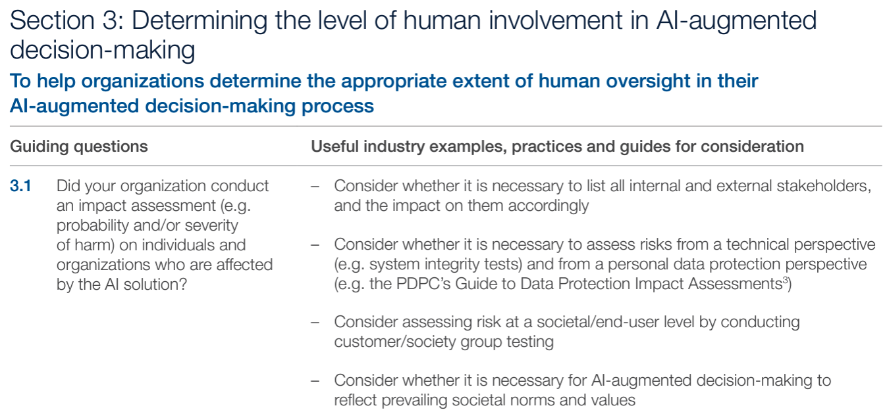
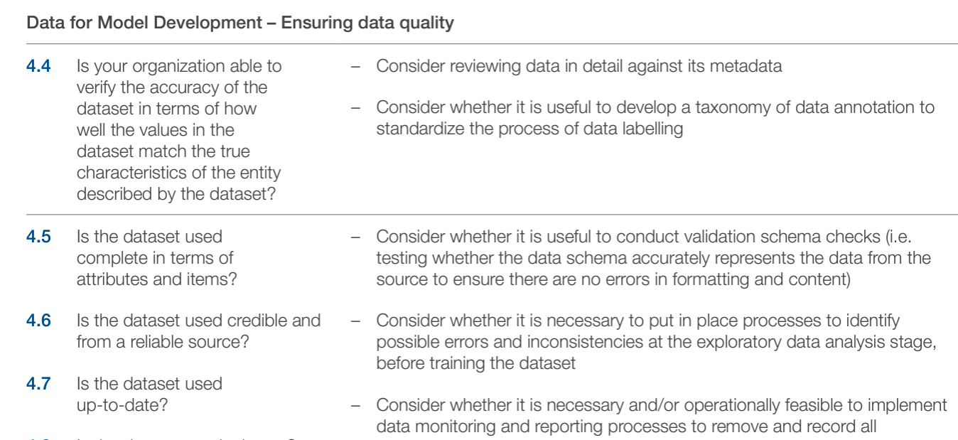
Implementation and Self-Assessment Guide for Organizations (ISAGO)
provides a set of questions and practical examples to enable organizations to assess the alignment of their AI governance practices with the Model Framework
Notes:
Now, having a set of principles like FEAT is great, but principles on paper don't help much if organisations don't know how to actually check whether they're meeting them. That's the gap ISAGO is designed to fill — the Implementation and Self-Assessment Guide for Organizations.
Think of ISAGO as a practical companion document. Where the Model Framework we discussed earlier lays out the "what" — what good AI governance should look like — ISAGO is much more about the "how do I know if I'm actually doing this." It gives organisations a structured set of questions to walk through, almost like a checklist or a diagnostic tool.
And importantly, it doesn't just leave you with abstract questions floating in space, it pairs them with practical examples. So if a question asks something like "how do you ensure your model is regularly reviewed for drift," ISAGO will often show what that looks like in practice for a real organisation, which makes it much easier to translate principle into action.
This is a really common pattern in governance generally, by the way — you'll often see a high-level framework paired with a self-assessment or implementation guide. It's the difference between being told the destination and being handed an actual map to get there. Self-assessment tools like this also let organisations benchmark themselves honestly before a regulator or auditor comes knocking, which is a much better position to be in.

Slide 56
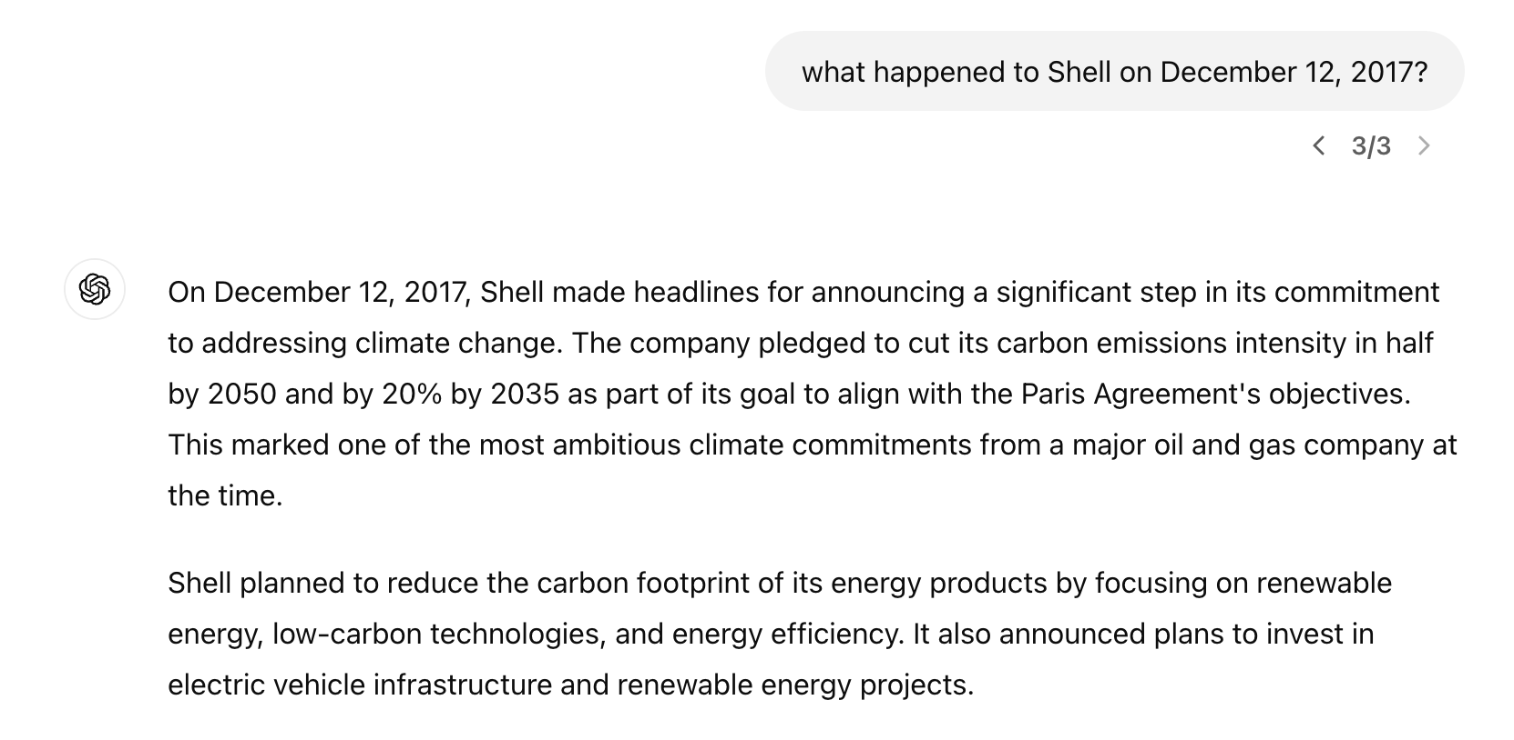
New Risks with Generative AI
Mistakes And “Hallucinations”
Notes:
Okay, we're shifting gears now into a really important section, new risks that come specifically with generative AI. Everything we've covered so far has largely applied to what you'd call traditional or predictive AI — systems that classify, score, or predict. Generative AI, think large language models, image generators, is a different beast, and it introduces risks that simply didn't exist, or existed in much smaller forms, before.
The first one is mistakes and hallucinations. Now, "hallucination" is a slightly odd word choice if you think about it, but it's become the standard term for when a generative model confidently produces information that's completely fabricated, wrong dates, invented citations, fake case law, non-existent facts, but stated with total fluency and confidence.
And that confidence is really the dangerous part. A traditional system that's uncertain might flag low confidence, or refuse to answer. A generative model will often just make something up and present it exactly as fluently as it would present something true. There's no built-in "I don't know" signal unless you specifically design for one.
So why does this matter for responsible AI? Because it directly undermines two things we've talked about already, trust and reliability. If users start treating AI-generated output as authoritative when it isn't, the consequences can range from mildly embarrassing to genuinely harmful, think about a student citing a fake academic paper, or worse, a professional relying on fabricated legal or medical information.

Slide 57
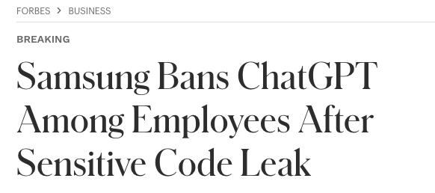
New Risks with Generative AI
Privacy And Confidentiality
Generative AI tends to have a property of “memorisation”, posing risks to privacy
  Adversaries may find out if a certain individual is part of a training set by querying the trained model or even reconstruct training data by querying the model.
Memorisation property also poses copyright and confidentiality issues for enterprises and companies
Notes:
Next up, privacy and confidentiality risks, and this one's a bit more technical, so let's slow down. Generative models have a property researchers call memorisation. Instead of purely learning generalised patterns from their training data, they can sometimes retain, almost verbatim, specific pieces of that training data.
Why does that matter for privacy? Well, imagine a model was trained on a dataset that included personal information, medical records, private emails, whatever it might be. An adversary, someone with malicious intent, could potentially query the model in clever ways to figure out whether a specific individual's data was part of that training set. That's called a membership inference attack, if you want the technical term. Even more concerning, in some cases attackers have been able to reconstruct actual training data just by probing the model with the right prompts.
Now think about what this means for companies deploying these models. If you're a business and you fine-tune a generative model on your proprietary or confidential documents, there's a real risk that a cleverly crafted query could extract snippets of that supposedly confidential information back out. So this isn't just a consumer privacy issue, it's a genuine enterprise risk, trade secrets, internal strategy documents, or client data could potentially leak through the model itself.
This is a fundamentally different kind of privacy risk than what we discussed with traditional AI. With traditional predictive models, the privacy concern is usually about what data goes in and how it's used. Here, the concern is that the model itself becomes a kind of leaky container for the data it was trained on.

Slide 58

New Risks with Generative AI
Scaling Disinformation, Toxicity And Cyber-threats
Dissemination of false content such as fake news is becoming increasingly hard to identify due to convincing but misleading text, images and videos, potentially generated at scale by generative AI.
Notes:
Now let's talk about scale, because that's really the theme of this next risk, scaling disinformation, toxicity, and cyber-threats. None of these problems — fake news, harmful content, cyberattacks — are new. What's new is the sheer scale and quality at which generative AI can now produce them.
Think about disinformation before generative AI became widespread. Creating convincing fake news required real effort, writing skill, maybe some basic photo editing. That was a natural bottleneck that limited how much fake content could flood the internet. Generative AI removes that bottleneck almost entirely. Now you can produce large volumes of text, images, even video, that are convincing enough to fool a casual viewer, and you can do it fast and cheap.
And it's not just volume, it's quality too. Early deepfakes were often obviously fake if you looked closely. That's becoming less and less true. The line between real and synthetic content is blurring, which makes it genuinely harder for platforms, fact-checkers, and honestly just ordinary people scrolling through their feeds, to tell what's real.
This connects to a broader societal risk too, beyond just individual pieces of fake content. When it becomes hard to trust anything you see online, that erodes trust in information itself, sometimes called the "liar's dividend," where even real content gets dismissed as fake because people have become so skeptical. That's a pretty profound risk to public discourse, and it's a direct consequence of how easily generative AI can produce convincing content at scale.

Slide 59

New Risks with Generative AI
An Era of Copyright Challenges
  Concerns of copyrighted materials used for training the generative model such as GPT and Stable Diffusion
  Rising concern in the creative community regarding AI that explicitly creates the style and expression of authors, artists or musicians.
Notes:
This next one is a topic that's honestly still being fought out in courtrooms as we speak, copyright. Generative models like GPT for text or Stable Diffusion for images are trained on enormous datasets scraped largely from the internet, and a lot of that content, articles, artwork, code, was created by real people who never explicitly consented to having their work used to train a commercial AI model.
So the first concern is about the training data itself. Was it legal, or at least ethical, to use copyrighted material without permission or compensation to train these models? Different jurisdictions are answering this differently, and honestly, the law hasn't fully caught up with the technology yet.
But there's a second, arguably more emotionally charged concern, and it comes from the creative community specifically. It's one thing for a model to learn general patterns of language or image composition. It's another thing entirely when a model can be prompted to generate something explicitly "in the style of" a particular living artist, author, or musician. Imagine you're an illustrator who's spent twenty years developing a distinctive visual style, and now anyone can type your name into a prompt and get imitations of your work, without paying you, crediting you, or asking you.
So this isn't just an abstract legal question about data licensing, it touches on livelihood, identity, and the value of human creative labour. That's why you're seeing artists, musicians, and authors organising, filing lawsuits, and lobbying for new regulation specifically around this issue.

Slide 60

New Risks with Generative AI
Embedded Biases Which Echo In Downstream Applications
Foundation models capture the inherent biases present in the training dataset (e.g. corpus of the web).
Especially problematic as these biases spread to downstream models trained from them, as well as the applications developed based on them
Notes:
Last risk in this section, embedded bias, and I want you to connect this back to the fairness discussion we had earlier in the course, because it's really the same underlying problem, just amplified by scale.
Here's the mechanism. Foundation models, the big underlying models like GPT or similar, are trained on massive datasets, often scraped from a large chunk of the internet. And the internet, as we all know, is not a neutral, unbiased reflection of humanity, it reflects whoever writes the most online content, which skews in various ways, by language, by region, by gender, by socioeconomic status, and so on. Whatever biases exist in that corpus get absorbed into the model during training.
Now here's what makes this particularly concerning compared to bias in a single traditional AI system. A foundation model isn't used just once, for one application. It becomes the base layer that dozens, sometimes hundreds, of downstream applications get built on top of, through fine-tuning or direct API use. So a bias baked into that one foundation model doesn't stay contained, it echoes outward into every single application built on top of it.
Think of it like a contaminated water source feeding many different pipes. You could have a hiring tool, a customer service chatbot, and a content recommendation system all built on the same foundation model, and if that base model has, say, a gender or racial bias baked in, all three downstream applications inherit it, often without the developers of those applications even realising it's there.
And that's really the core challenge with generative AI bias, it's not just about auditing one model anymore, it's about recognising that biases can propagate silently through an entire ecosystem of applications that all trace back to the same underlying foundation model.

Slide 61
New Risks with Generative AI
Values, Alignment, And The Difficulty Of Good Instructions
An objective function for AI assistants needs to prioritise between the assistant being “helpful” or “harmless”.
However, it is difficult to define and specify what these concepts are, and how to trade-off between them
  Insistence on avoiding harm can lead to “safe” responses that might not be valuable to the user.
Helpful
Harmless
Notes:
So this is where things get genuinely thorny. Every AI assistant you've ever talked to is optimizing for some objective function, and buried in that function is a tension between two goals that sound compatible but often aren't: be helpful, and be harmless. Easy to say. Try to actually define "harmless" in a way that covers every context, every culture, every user's intent, and you'll see the problem pretty quickly.
Think about it this way. If I ask an AI assistant for information on a sensitive medical topic, or a controversial historical event, or even just a slightly edgy joke, where's the line between "protecting the user" and "being unhelpfully cautious"? There isn't a clean formula for that. Different people, different companies, even different cultures draw that line in different places.
And here's the practical consequence you've probably experienced yourselves — you ask a chatbot something completely reasonable, and it gives you this hedge-everything, refuse-to-engage, "I can't provide advice on that" kind of answer. That's the safety-over-helpfulness tradeoff playing out in real time. The system was tuned to avoid any possible harm, and in doing so, it became less useful to you, the actual person trying to get something done.
So why does this matter for responsible AI as a discipline? Because it tells us that alignment isn't just a technical problem of "make the model behave." It's a values problem. Whose definition of harm are we using? Whose definition of helpfulness? These aren't things you can fully solve with more training data — they require ongoing human judgment, transparency about tradeoffs, and honestly, some humility about the fact that we won't get it perfect.

Slide 62
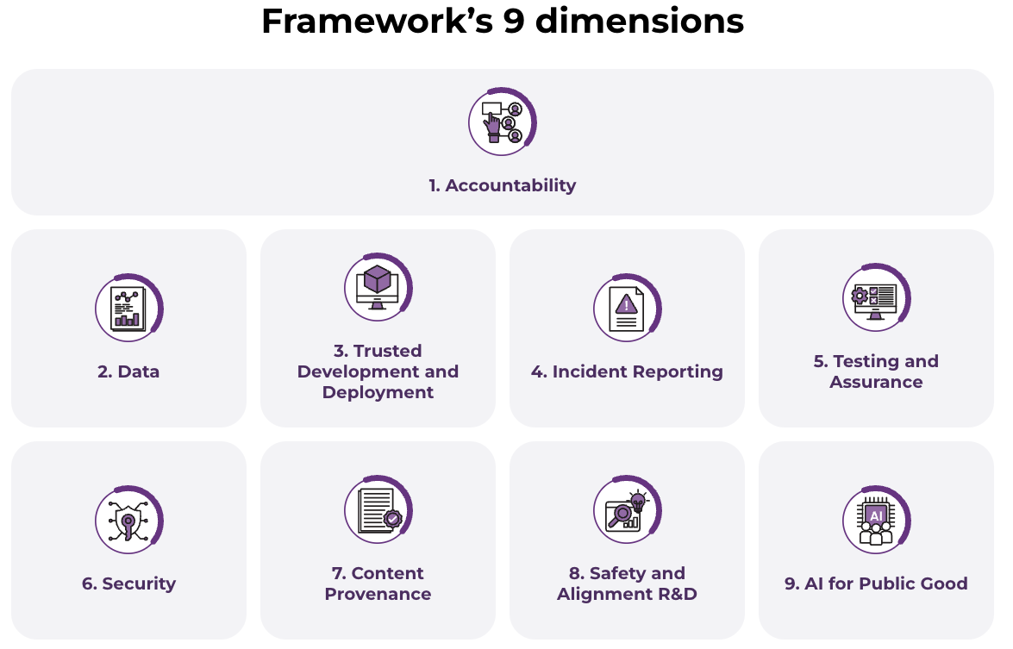
Model Framework for Generative AI (2024)
Notes:
Now let's zoom into Singapore's response to exactly these kinds of generative AI risks. Back when the original Model AI Governance Framework came out, generative AI as we know it — ChatGPT-style systems — didn't really exist yet. So in 2024, Singapore's regulators went back and extended that framework specifically to deal with what generative AI introduces that's new.
Why does generative AI need its own treatment? Because the risks are qualitatively different from traditional predictive AI. We're not just talking about a model that scores your loan application anymore. We're talking about systems that can generate convincing text, images, even fabricate entirely plausible-sounding but false information at scale. That's a different risk profile entirely.
This framework isn't just theory sitting in a government report either — it's meant to be a practical reference point for industry, for developers, for anyone deploying these systems, to think through what "trustworthy" actually looks like in this new generative context. Over the next few slides we're going to walk through the key dimensions this framework identifies, one by one.

Slide 63
Key Dimensions of a Trusted AI Ecosystem
Accountability
  Shared responsibility across the AI development chain
  Practical steps to allocate accountability
Data
  Data quality and ethical sourcing
  Clear guidelines for using personal data and copyrighted material
Trusted Development and Deployment
  Transparency around safety and hygiene measures
  Industry adoption of best practices and disclosure
Notes:
Let's start unpacking these dimensions, and first up is accountability. The core idea here is simple to state but hard to implement: when something goes wrong with a generative AI system, who's responsible? Is it the company that built the foundation model? The company that fine-tuned it for a specific product? The business that deployed it to customers? In practice, it's usually a chain of different parties, and the framework pushes for practical steps to actually allocate that responsibility clearly, rather than everyone pointing fingers at everyone else.
Next, data. You've heard the phrase "garbage in, garbage out," and it applies here more than almost anywhere. Generative models are trained on enormous datasets, often scraped from the internet. So immediately you've got two big questions — is this data actually good quality, and was it ethically sourced? That second one is a live legal and ethical battleground right now, think about all the lawsuits around AI companies training on copyrighted books, images, and articles without clear consent. The framework calls for clear guidelines on using personal data and copyrighted material, precisely because this has been such a mess in practice.
And then trusted development and deployment. This is about transparency — not vague promises of "trust us, it's safe," but actual visible safety and hygiene measures that companies can be held to. It also pushes for industry-wide adoption of best practices and disclosure, so that safety isn't just one company's internal secret sauce, but something the whole ecosystem can benchmark against.
Notice the pattern across all three of these — accountability, data, and trusted development are all about building the foundational trust layer before you even get to flashy AI capabilities. Without these, everything else is built on sand.

Slide 64
Key Dimensions of a Trusted AI Ecosystem
Incident Reporting
  Establishing structures for monitoring and reporting incidents
  Continuous improvement of AI systems
Testing and Assurance
  Third-party testing and assurance
  Development of common standards for AI testing
Security
  Addressing new security risks posed by generative AI
  Adapting existing information security frameworks
Notes:
Continuing on, let's talk about incident reporting. Here's a useful way to think about it — every mature safety-critical industry, aviation is the classic example, has structures for reporting when things go wrong, learning from it, and preventing recurrence. AI is starting to catch up to that same maturity. The idea is you need structures to actually monitor for incidents and report them, not just hope nothing bad happens and stay silent if it does. And crucially, this feeds back into continuous improvement — each incident becomes a lesson.
Then there's testing and assurance. Right now, a lot of AI testing happens internally, the company that built the model tests its own model. See the obvious issue there? It's a bit like grading your own exam. So the push here is toward third-party testing and assurance, an independent check, plus the development of common standards so that "this model passed testing" actually means something consistent across the industry, rather than every company inventing its own bar.
And security — generative AI actually introduces brand new attack surfaces that older systems didn't have. Think prompt injection, where someone tricks a model into ignoring its instructions, or data poisoning, where bad actors slip malicious data into training sets. These aren't things your traditional cybersecurity playbook was built for, so this dimension is about adapting existing information security frameworks to address these genuinely new risks.
So notice something across incident reporting, testing, and security — they're all fundamentally about admitting that things will go wrong, and building the infrastructure to catch it, verify it, and defend against it, rather than assuming a perfect system out of the gate.

Slide 65
Key Dimensions of a Trusted AI Ecosystem
Content Provenance
  Transparency about content origin
  Leveraging technologies like digital watermarking and cryptographic provenance
Safety and Alignment R&D
  Accelerated investment in R&D to improve model safety and alignment
  Global cooperation among AI safety R&D institutes
AI for Public Good
  Democratising AI access
  Improving public sector AI adoption
  Upskilling workers and developing AI sustainably
Notes:
Now, content provenance — this one's become really pressing with how good generative AI has gotten at producing realistic images, audio, and video. If you can no longer tell by looking whether something is real or AI-generated, how do you maintain any kind of shared trust in what you see online? The framework points to technologies like digital watermarking and cryptographic provenance, essentially embedding a kind of verifiable signature into content so it can be traced back to its origin, human-made or AI-generated.
Next, safety and alignment R&D. This is really an acknowledgment that we don't yet fully know how to make these systems reliably safe and aligned with human values, that's still an open research problem. So the framework calls for accelerated investment in that research, and importantly, global cooperation among AI safety institutes. Why global? Because AI models don't respect national borders, a safety breakthrough or a safety failure in one country's models affects everyone using them.
And finally here, AI for public good. This is the more optimistic, opportunity-focused dimension, don't just focus on risk mitigation, actively work on democratizing access to AI so it's not just the wealthy and the big tech companies who benefit, improving how the public sector adopts AI for citizen services, and upskilling workers so people aren't just displaced by these technologies but can actually work alongside them, and doing all this sustainably given the real energy and compute costs of running these models.
So across content provenance, safety R&D, and AI for public good, you can see the framework isn't purely defensive, it's also asking, how do we make sure the benefits of this technology are broadly and fairly shared?

Slide 66
Key Dimensions of a Trusted AI Ecosystem
A trusted AI ecosystem requires a collective effort from policymakers, industry, researchers, and the public.
By addressing these key dimensions, we can harness the potential of generative AI while mitigating its risks.
Continuous adaptation and innovation are essential to keep pace with the rapidly evolving AI landscape.
Notes:
So let's step back and pull all of this together. What should be really clear at this point is that no single group can make generative AI trustworthy on its own. Not government alone through regulation, not companies alone through self-policing, not researchers alone through technical fixes. It genuinely requires policymakers, industry, researchers, and the public all pulling in the same direction, each bringing something the others can't.
The second big takeaway is that these dimensions aren't a checklist you complete once and forget. Addressing accountability, data governance, testing, security, and all the others we've covered isn't about eliminating risk entirely, that's probably not even possible, it's about harnessing the genuine potential of this technology while keeping the risks manageable and visible.
And the last point, which I think is easy to underestimate, this is a moving target. The AI landscape today looks quite different from even two years ago, and it'll look different again in another two years. So continuous adaptation isn't a nice-to-have, it's baked into what responsible governance of this technology actually requires. A framework that doesn't evolve will quickly become irrelevant.
With that framework in mind, I want to move into something much heavier, a real case study that shows what happens when some of these principles, particularly around accountability and human oversight, aren't upheld.

Slide 67
Case Study – Use of AI in Israel’s war on Gaza
In the past wars, Israeli defined ”human targets” to kill as senior military commanders after carefully marked them so. However, after 7th Oct 2023 attack (where Hamas Hamas-led militants launched a deadly assault on southern Israeli communities), the army decided to designate all operatives of Hamas’ military wing as human targets, regardless of ranks.
In previous wars, to authorize assassination of single human target, an officer had to go through a complex and lengthy cross-checking of evidence that the person was indeed a senior member of Hamas’ military wing. However, once the list was expanded to include tens of thousands of lower-ranking operatives, the Israeli army figured it had to rely on artificial intelligence – Lavender.
Lavender learns to identify characteristics of known Hamas operatives, whose information was fed to the machine as training data, and then to locate these same characteristics — also called “features” — among the general population.
After manually checking that the AI system achieve 90% accuracy with a random test sample targets, sweeping order was given to treat Lavender decision as order, with no independent verification of the choice and examination of the raw intelligence data on which the decision is based on.
Notes:
I want to preface this next case by saying we're going to look at this as a critical case study for discussion, not to make a political statement about the conflict itself, but because it's one of the most consequential real-world examples we have of what happens when an AI decision-support system gets used in the highest-stakes context imaginable, life and death decisions, with reduced human oversight. This is drawn from investigative reporting by +972 Magazine, an Israeli publication, along with an RSIS opinion piece discussing the oversight implications.
So some background. In prior conflicts, Israel's approach to targeting was narrow and painstaking, they defined human targets as senior military commanders, and identifying someone as a legitimate target involved careful, deliberate verification. But after the October 7th 2023 attacks, where Hamas-led militants killed and abducted civilians in southern Israel, the reported policy shifted dramatically, now, according to this reporting, essentially any operative of Hamas' military wing, regardless of rank, could be designated a target.
Here's where the scale problem comes in. When your target list was a small number of senior commanders, doing rigorous cross-checking of evidence for each one was feasible. But once that list reportedly expanded to potentially tens of thousands of lower-ranking individuals, that kind of manual, careful verification becomes essentially impossible to sustain at speed. So the army reportedly turned to an AI system called Lavender to do this identification at scale, the system was trained to recognize patterns and characteristics associated with known Hamas operatives, and then it scanned the broader population looking for people who matched those same features.
Now here's the part that should really give you pause as students of responsible AI. According to the reporting, the system was checked for accuracy on a random sample and found to be about 90 percent accurate, that sounds high, until you think about what it means at scale, and in this context. If you're running this against tens of thousands of people, ninety percent accuracy still means a substantial number of errors, real people wrongly flagged, embedded within decisions with lethal consequences. And despite that, the reporting says a sweeping order was given to treat Lavender's outputs as if they were direct orders, with no independent human verification of individual decisions and no examination of the underlying raw intelligence that the AI's conclusion was based on.
So I want you to sit with that for a moment and think critically, not about the politics of the conflict, but about the AI governance failure being described here. What does it mean to remove meaningful human oversight from a high-stakes, irreversible AI decision? What does "90% accurate" actually mean when the cost of the errors is human lives, and there's no second check? This is really the accountability and human-in-the-loop principles we discussed earlier taken to their most extreme, highest-stakes test case, and it's worth discussing in your groups, where exactly would you have insisted a human check remain in this pipeline, and why did that check reportedly disappear here?

Slide 68
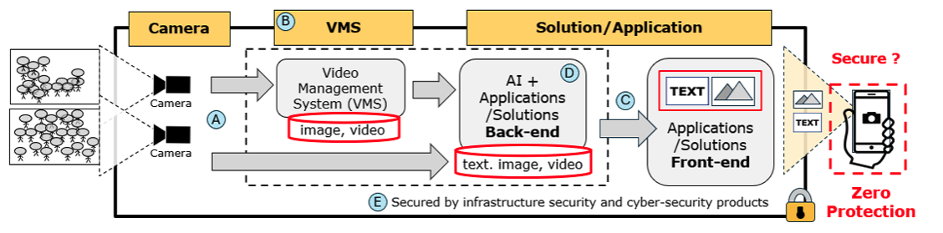
Case Study Discussion – Video surveillance
CCTV systems are deployed across a variety of settings, from healthcare facilities and retail spaces to banks and public transportation, to protect the safety and security of people within these premises. These surveillance systems are monitored by surveillance officers who work in shifts, following pre-defined protocols to respond to incidents.
Discuss some design consideration of such as system in the context of Responsible AI principles.
Notes:
Let's shift now into some more grounded, discussion-oriented case studies, and this first one is something you've all experienced without probably thinking much about it, video surveillance. CCTV is everywhere, hospitals, shopping malls, banks, the MRT, and increasingly these systems aren't just passively recording, they're being layered with AI for things like anomaly detection or automated alerts. There are human surveillance officers monitoring feeds in shifts, following protocols when something looks off.
So the discussion question for you is, what design considerations would you build into a system like this if you're applying responsible AI principles? I want you to actually think this through before I give you directions, because there isn't one single right answer.
Some threads worth pulling on, if we think about privacy by design, that usually starts with data minimization, do you really need to collect and retain every second of footage from every angle, or can the system be designed to only capture what's actually necessary. There's also the question of how the data is secured, footage sitting in a video management system is sensitive, it needs protection against unauthorized access, and integrity has to be maintained as it moves through the system so nobody can tamper with it undetected.
Then there's transparency and accountability, are people even aware they're being monitored, and is it crystal clear why the data is being processed and by whom? And a more technical angle you might not have thought of, privacy-enhancing technologies like dynamic privacy masking, where the system can automatically blur or obscure faces and other personal identifiers unless there's a specific, justified reason to reveal them. Put all that together, plus end-to-end security against both external hackers and insider misuse, and you start to get a picture of what a genuinely responsible surveillance system looks like, versus one that just works technically but ignores the human beings being watched.

Slide 69
Case Study Discussion – Fraud Detection
To improve the operational efficiency and effectiveness of its current anti money laundering surveillance, DBS developed an AI model - the Anti-Money Laundering (AML) Filter Model.
The AML Filter Model identifies predictive indicators of suspicious transactions to reduce the number of false positives generated by the non-AI system, thereby reducing the number of alerts that require manual review.
Suggest some of the possible risks and how relevant AI governance practices can be implemented by the bank to address the risks
Notes:
Now let's look at a financial services example, because this is a domain where AI governance really has teeth, given the regulatory stakes involved. DBS built something called the AML Filter Model, AML meaning anti-money-laundering, and the problem it's solving is one you'll see across a lot of compliance functions, the existing non-AI surveillance system was flagging a huge number of transactions as suspicious, and a lot of those flags turned out to be false positives, meaning real staff had to manually review transactions that weren't actually suspicious at all.
So the AI model's job is to get smarter about which transactions are genuinely worth flagging, learning predictive indicators of actual suspicious activity, and thereby cutting down the noise so human reviewers can focus their limited time on the alerts that actually matter. Sounds efficient, and it is, but I want you to think about what could go wrong here, and what governance needs to be in place around it.
So the discussion prompt is, what risks do you see, and how might a bank actually implement governance to address them? A few directions that typically come up, first, you'd want some kind of overarching committee overseeing AI development, and it shouldn't just be data scientists in the room, you want legal, HR, banking operations, compliance, a genuinely cross-functional group so you get diverse perspectives on what could go wrong, not just a technical view.
That committee's job would include reviewing compliance with legal, security, and data quality standards, and actually digging into things like the exploratory data analysis, how the model was trained and evaluated, and how the underlying data was collected in the first place. And that data question really matters here, financial transaction data can easily encode bias, certain customer segments might get flagged more than others for reasons that have nothing to do with actual money laundering risk, so the bank needs an explicit plan to detect and correct that. And then there's a genuinely hard question that doesn't have an easy answer, how much do you disclose about how the model works? Too little, and you lose trust and auditability, too much, and you potentially give bad actors a roadmap for how to evade detection.

Slide 70


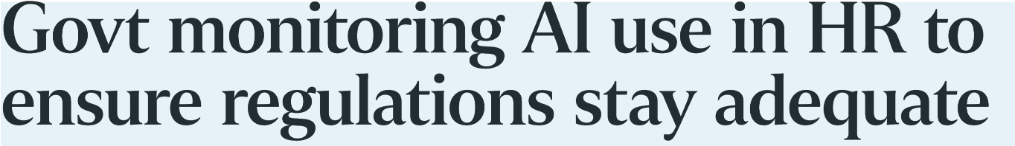
Case Study Discussion - AI-assisted HR tools
AI use in HR tools for hiring or promotion decision
Applying the responsible AI principles, what are the steps you can take to mitigate the risks?
Notes:
Here's a case that probably feels the most personally relevant to you, since many of you will be on the receiving end of this exact kind of system when you're job hunting, or the ones building or deploying it later in your careers. AI is increasingly used in HR for things like screening resumes, ranking candidates, even in some cases assisting with promotion decisions.
Now, this is a space with a well-documented history of things going wrong, you may have heard of the Amazon hiring tool that was found to be biased against women because it had learned from historical hiring patterns that skewed male. So the discussion question here is, applying the responsible AI principles we've covered throughout this course, what concrete steps would you take to mitigate the risks in a tool like this?
I'll let you work through this in your groups, but as you think about it, consider the full lifecycle, not just the algorithm itself. What data is the model trained on, and does that historical data bake in past discrimination? Who's accountable if a qualified candidate gets unfairly screened out, the recruiter, the vendor who built the tool, the company that deployed it? What kind of human review sits on top of the AI's recommendation before a hiring or promotion decision is finalized? And critically, how would you even test for bias here, disparate outcomes across gender, race, age, and would you be transparent with candidates that AI was involved in evaluating them at all? These are the kinds of questions I want you bringing into the discussion.

Slide 71
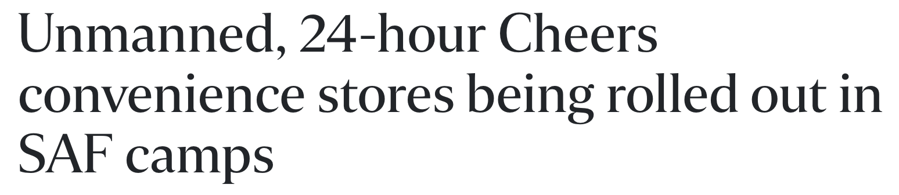
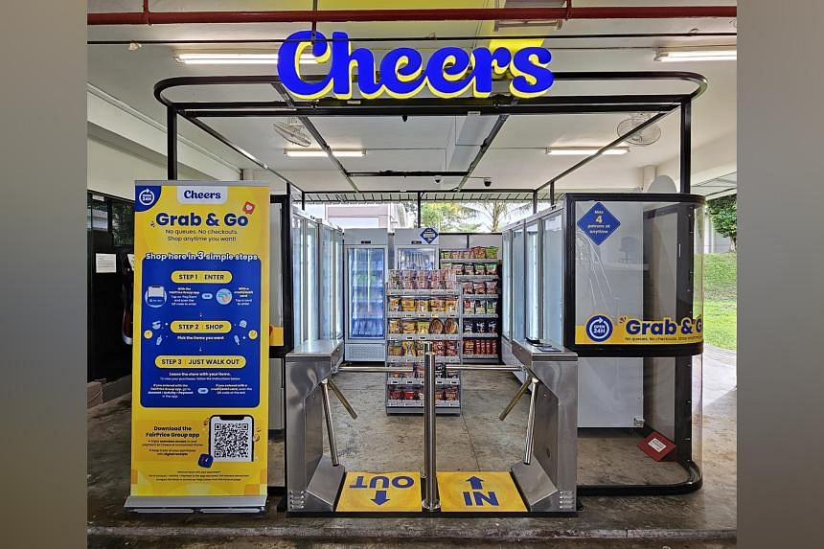
Case Study Discussion – Smart Retail Shop
In the unmanned stores, customers can walk in, grab the items they need and walk out without having to whip out their phone, credit card or cash to make payment.
Before entering, they will have to scan their FPG app’s Pay/Earn QR code, or tap their debit or credit card, at the store gantry.
An advanced artificial intelligence (AI) system in the outlet tracks customers’ actions, while items removed from shelves are recorded automatically.
The customers’ virtual baskets are updated accordingly, and their digital accounts are automatically and securely charged within 10 seconds of them exiting the store.
Discuss some AI governance practices that can be applied here.
Notes:
Last case study, and this one's a fun one to picture because a lot of you have probably walked into one of these unmanned convenience stores. You scan a QR code or tap your card at the gantry to get in, no cashier, no checkout line, you just grab what you want off the shelves, and an AI vision system is watching what you pick up and put back, updating your virtual shopping basket in real time. Walk out, and within about ten seconds your account gets automatically charged for exactly what you took.
It's slick technology, genuinely impressive computer vision and sensor fusion working together. But think about what's actually happening from a governance standpoint, there's a system continuously tracking your physical movements and actions inside that store, and it's making an automatic financial decision, charging your account, without you confirming anything at the point of exit.
So the discussion question is, what AI governance practices would you want to see applied here? Think about it from a few angles, what happens when the system gets it wrong, misidentifies an item, double-counts something, or fails to register you putting something back on the shelf, is there a dispute or correction mechanism, or are you just stuck with whatever the AI decided you took? There's also a significant privacy dimension, continuous tracking of your movement and behavior inside a store is a lot of data about you, so where is that footage and behavioral data stored, for how long, and who can access it? And then there's the transparency question, do customers clearly understand, before they walk in, exactly what's being tracked and how the charging decision gets made? I'll let you discuss in your groups what a genuinely responsible version of this smart retail system would need to include.

