Slide 1
Generative AI
MultiAgents

Slide 2
Learning Outcomes
Upon completion of this session, the learners should be able to:
Explain the principles and benefits of multi-agent systems, including role specialization, task decomposition, communication protocols, and coordination strategies.
Implement multi-agent workflows using advanced frameworks (e.g.CrewAI, LangGraph, AutoGen), incorporating shared memory management, orchestration, and failure recovery mechanisms.

Slide 3
Why we need to have Agents?
Complex decision-making:
  Workflows involving nuanced judgment, exceptions, or context-sensitive decisions, for example refund approval in customer service workflows.
Difficult-to-maintain rules:
  Systems that have become unwieldy due to extensive and intricate rulesets, making updates costly or error-prone, for example performing vendor security reviews.
Heavy reliance on unstructured data:
  Scenarios that involve interpreting natural language, extracting meaning from documents, or interacting with users conversationally, for example processing a home insurance claim.
Before committing to building an agent, validate that your use case can meet these criteria clearly

Slide 4
What is a Generative AI MultiAgent?
Why Use Multiple Agents?
Single-agent limitation: One LLM agent trying to solve everything often struggles with:
  Context overload (too many instructions at once).
  Weak specialization (generalist vs. expert).
  Lack of modularity (hard to scale or debug).
Multi-agent benefits:
  Role specialization → different agents act as experts (e.g., planner, coder, reviewer).
  Parallelism → tasks can be split among agents for faster execution.
  Modularity → easier to upgrade or swap out one agent without redesigning the whole system.
  Human-like teamwork → mirrors real-world collaboration.

Slide 5
Multi-Agent Planning & Task Decomposition
Hierarchical breakdown:
  Planner agent → breaks down the big problem into steps.
  Worker agents → execute individual tasks.
  Reviewer agent → checks correctness and quality.
Decomposition example: Build a website with product recommendations
  Planner: Defines steps → Data collection → Recommendation engine → Web design.
  Data Agent: Retrieves product info.
  ML Agent: Builds recommendation model.
  UI Agent: Designs frontend.
  Reviewer: Validates correctness.

Slide 6
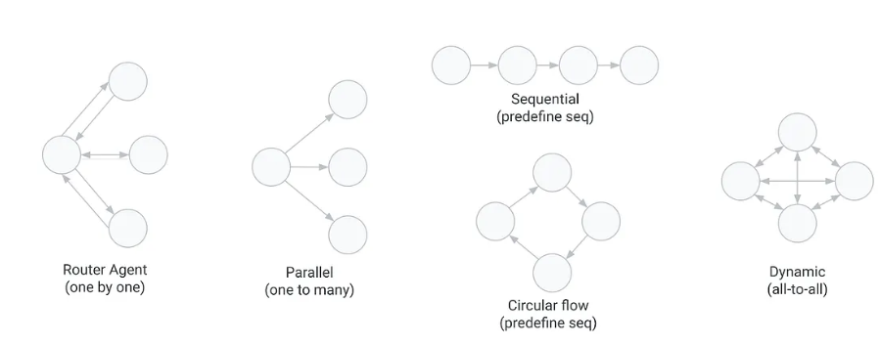
Multiagent Pattern
In the Router pattern, the router agent is using other agents as specialized tools, calling them one by one as needed.
In the Parallel pattern, the initial agent is using multiple agents as tools simultaneously to speed up the process.
In the Sequential and Circular Flow patterns, agents are used as tools in a predefined pipeline or loop.
In the Dynamic pattern, agents are interacting more like a team, with each agent acting as both a user and a tool for other agents, depending on the situation.
These patterns provide different ways to structure multi-agent interactions, allowing developers to choose the most appropriate approach based on the specific requirements of their application

Slide 7
Message Passing & Communication Protocols
Direct messaging: Agent A sends structured text to Agent B.
Shared memory: Agents post updates in a shared space.
Protocols:
  JSON-based structured messages
  Tool invocation signals (like OpenAI’s function calling)
  Pub/Sub messaging (subscribe to updates on a task)
Key challenges:
  Ensuring clarity (avoid ambiguous prompts).
  Preventing infinite loops (agents endlessly asking each other).
  Controlling cost (token usage increases with more agents).

Slide 8
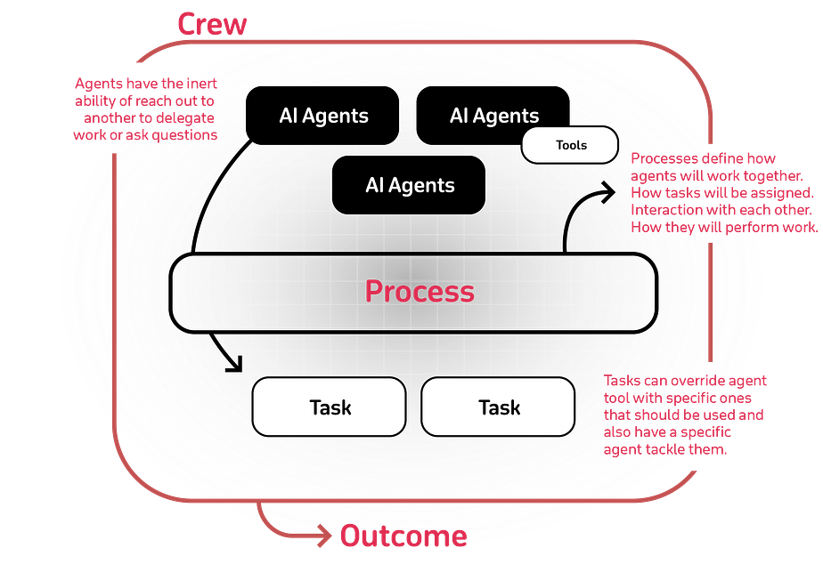
Frameworks & Tools
CrewAI
Purpose: Organize teams of agents with defined roles and collaboration.
Example roles: Researcher, Analyst, Writer, Critic.
Supports task delegation + team workflows.
Example use case: Generate a market report with multiple specialized agents.

Slide 9
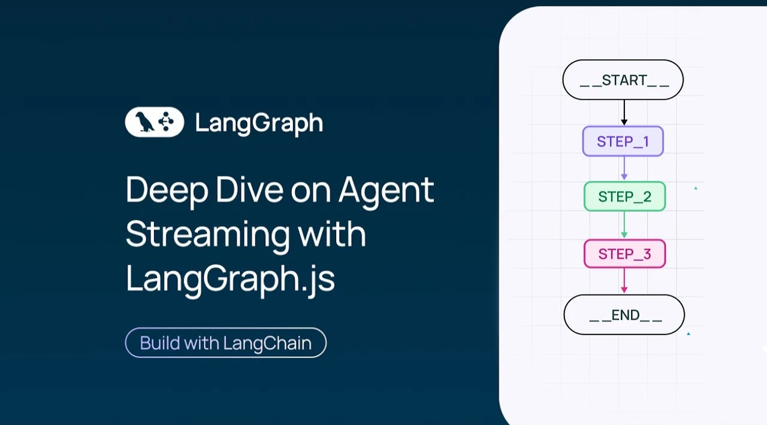
Frameworks & Tools
LangGraph
Model agent workflows as state machines / graphs.
Nodes = agents or functions.
Edges = transitions (who speaks next, what condition triggers a move).
Good for deterministic orchestration (avoids chaos of “agents talking freely”).
Example: Chatbot that can switch between Sales Agent → Technical Agent → Escalation Agent based on user intent.

Slide 10
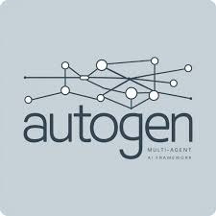
Frameworks & Tools
AutoGen (Microsoft)
Multi-agent conversation framework.
Agents can:
  Collaborate (e.g., Coder ↔ Reviewer loop).
  Autonomously call tools.
  Escalate to human-in-the-loop.
Supports “GroupChat” pattern for open discussion among multiple agents.

Slide 11
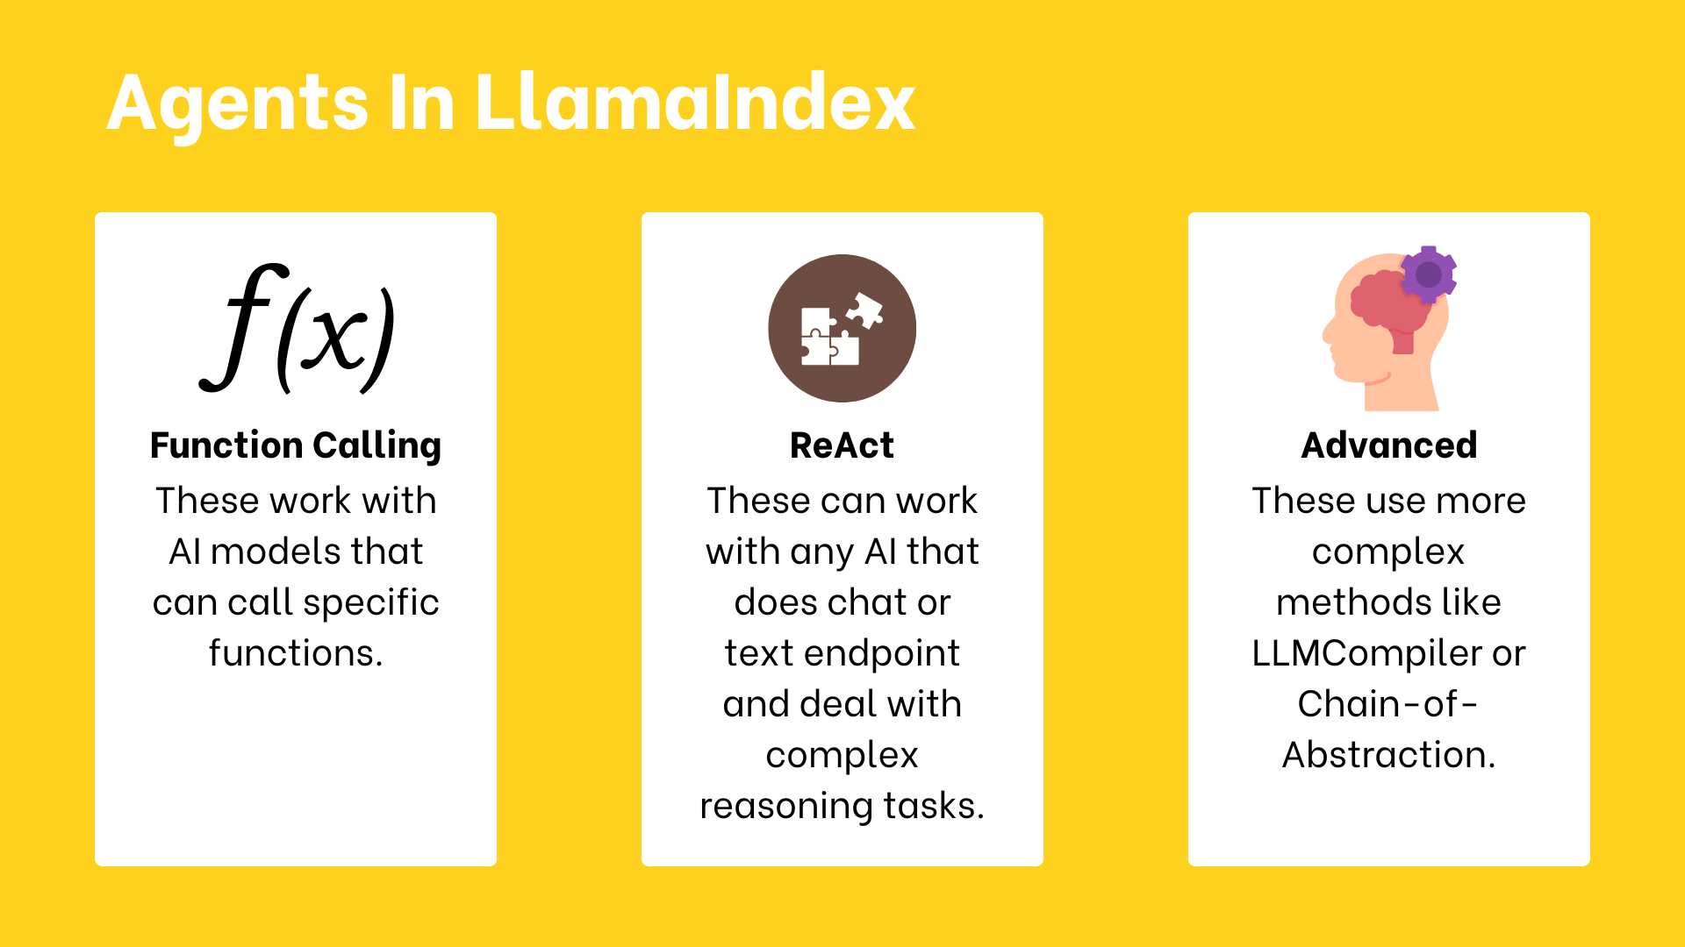
Frameworks & Tools
LlamaIndex Agent
Builds data-aware agents that can reason over structured + unstructured data.
Uses indexes (vector, keyword, graph) for memory and context grounding.
Supports tool integration (DB queries, APIs, Firecrawl, etc.).
Works well as the Knowledge Agent inside multi-agent workflows.
Example: Research Assistant agent that searches documents, summarizes results, and shares insights with a Planner or Reviewer agent.

Slide 12
Control & Coordination
Agent Orchestration
Centralized orchestration: One “controller” agent assigns tasks.
Decentralized orchestration: Agents coordinate via rules/messages, no single leader.
Orchestration prevents chaos and ensures progress.
Managing Shared Memory or Knowledge
Options:
  Centralized memory store (vector DB, JSON file, blackboard).
  Agent-specific memory (each agent has its own log/history).
  Hybrid: Agents keep local context but sync key insights to global memory.
Example: Planner maintains global plan, workers only store their progress.

Slide 13
Control & Coordination
Stopping Conditions & Failure Recovery
Stopping conditions:
  Goal achieved (final output validated).
  Time/cost exceeded (budget control).
  Deadlock detected (agents stop responding meaningfully).
Failure recovery:
  Retry mechanism with backoff.
  Escalate to human (human-in-the-loop).
  Replace failed agent with fallback.

Slide 14
References
https://www.voicespin.com/glossary/voice-activity-detection/
https://www.youtube.com/watch?v=xWhI8RkRSGQ&t=60s

