Slide 1
每周报告
陳文俊 Tran Van Tuan – V1047876
Jan. 16, 2025

Slide 2
Weekly Report
Owner: 陳文俊
Difficulty rating 技術難度：🌟🌟🌟🌟🌟🌟🌟🌟🌟🌟
I. Problems 问题
Exploring lightweight language models suitable for mobile and embedded systems 探索适合移动设备和嵌入式系统的轻量级语言模型。
Understanding the deployment process of Llama3.2-3B-Instruct on mobile devices 了解如何在移动设备上部署 Llama3.2-3B-Instruct 模型。
II. Technical difficulties 技術難點：
Setting up the Linux Kernel Computer for working environment 设置用于工作环境的 Linux 内核计算机。
Finding and understanding documentation for using and deploying Llama models.查找并理解有关使用和部署 Llama 模型的文档。
Adapting Llama3.2-3B-Instruct to run efficiently on a mobile device (Xiaomi 11T, Snapdragon 888, 8GB RAM).使 Llama3.2-3B-Instruct 高效运行于移动设备（小米 11T，Snapdragon 888，8GB 内存）。

Slide 3
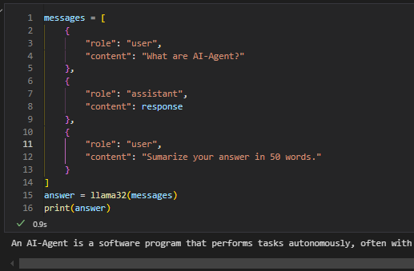
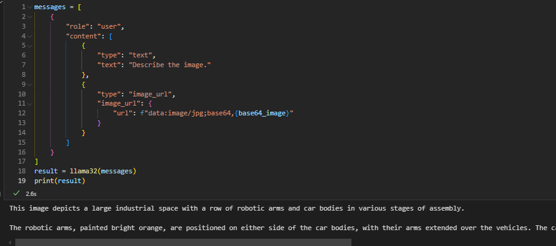
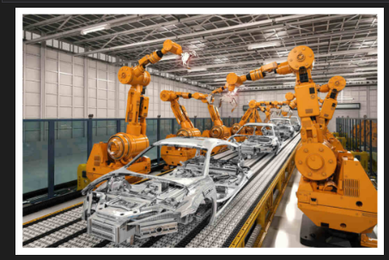
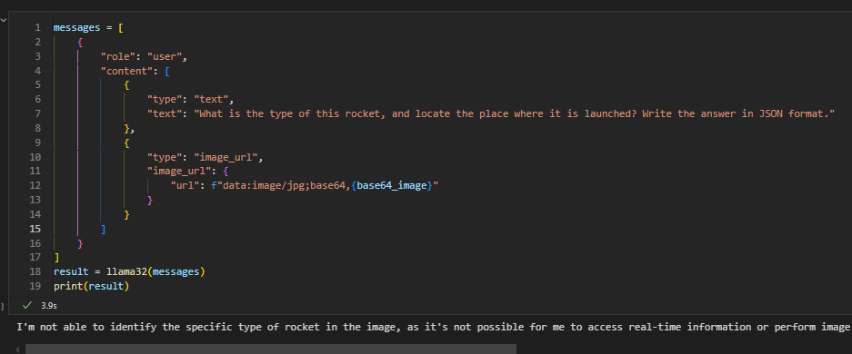
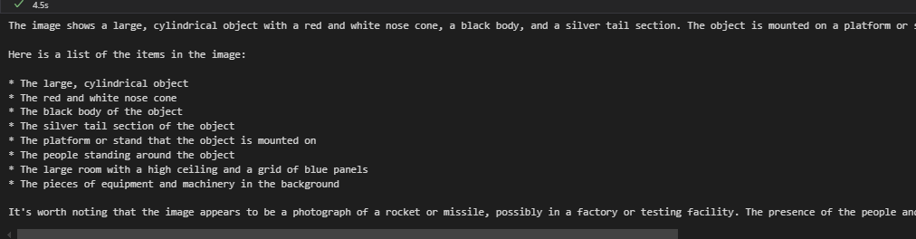
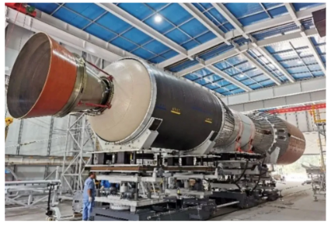
Weekly Report
Owner: 陳文俊
III. Solution 解決方案：
Successfully configured and set up the development environment on the company computer.成功配置并在公司电脑上设置开发环境。
Found and studied official documentation for Llama3.2-3B-Instruct.找到了 Llama3.2-3B-Instruct 的官方文档并进行了学习。
Ran and tested the Llama3.2-3B-Instruct model on computer and performed inference. 在电脑上运行并测试了 Llama3.2-3B-Instruct 模型，并完成了推理任务。
Deploying the model on a Xiaomi 11T, ensuring compatibility with the device's hardware.将模型成功部署到 小米 11T，并确保与设备硬件兼容。

Slide 4
Weekly Report
Owner: 陳文俊
IV. Solution effects 解決效果：
Fully operational development environment ready for further tasks.完整的开发环境已准备好，能够进行后续任务。
Acquired knowledge of using and deploying Llama models.掌握了使用和部署 Llama 模型的相关知识。
IV. Next steps 下一步
Deploy the model Llama3.2-3B-Instruct on mobile devices 将 Llama3.2-3B-Instruct 模型部署到移动设备上。
Explore methods like quantization and pruning to reduce resource consumption.探索量化和剪枝等方法以降低资源消耗。
=> Summary of Completed Tasks 已完成任务总结
Fully operational development environment ready for further tasks.完整的开发环境已准备好，能够进行后续任务。
Acquired knowledge of using and deploying Llama models.掌握了使用和部署 Llama 模型的相关知识。

Slide 5
Thank you

