Slide 1

Lighthouse 服务器降本专案
单位：Fii-CNSBG-CPEG-AI
报告人：陈文俊
2026年03月02日

Slide 2
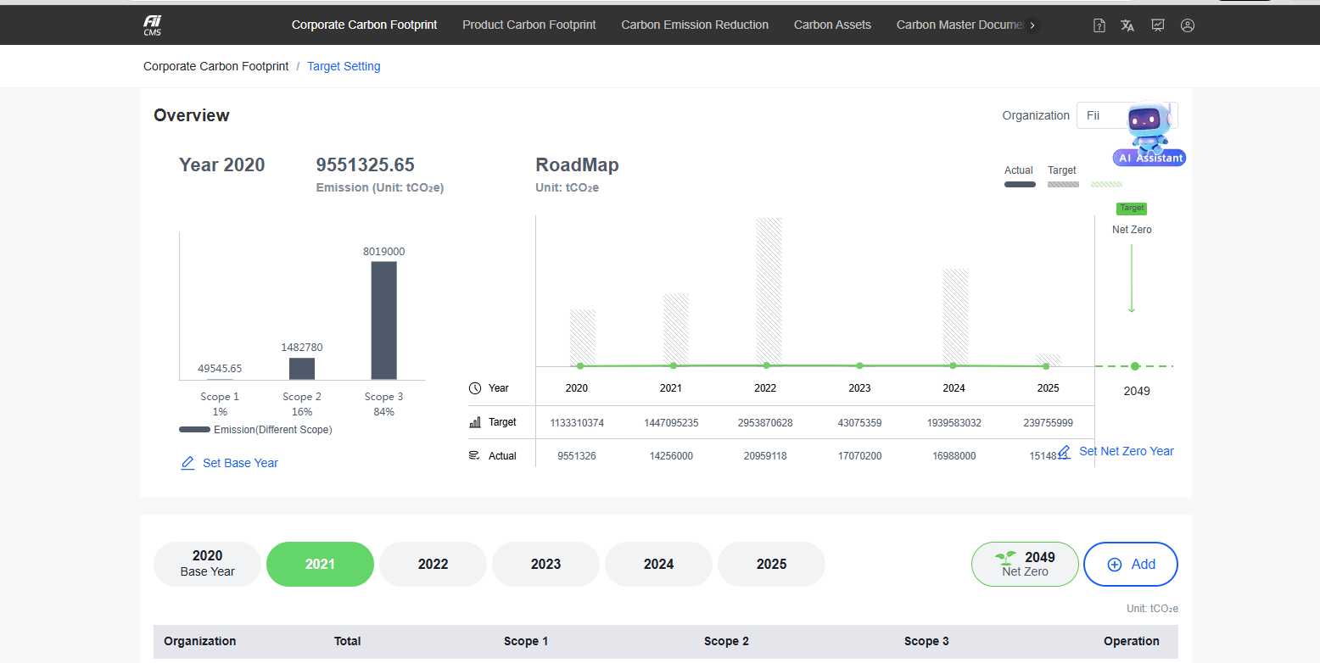
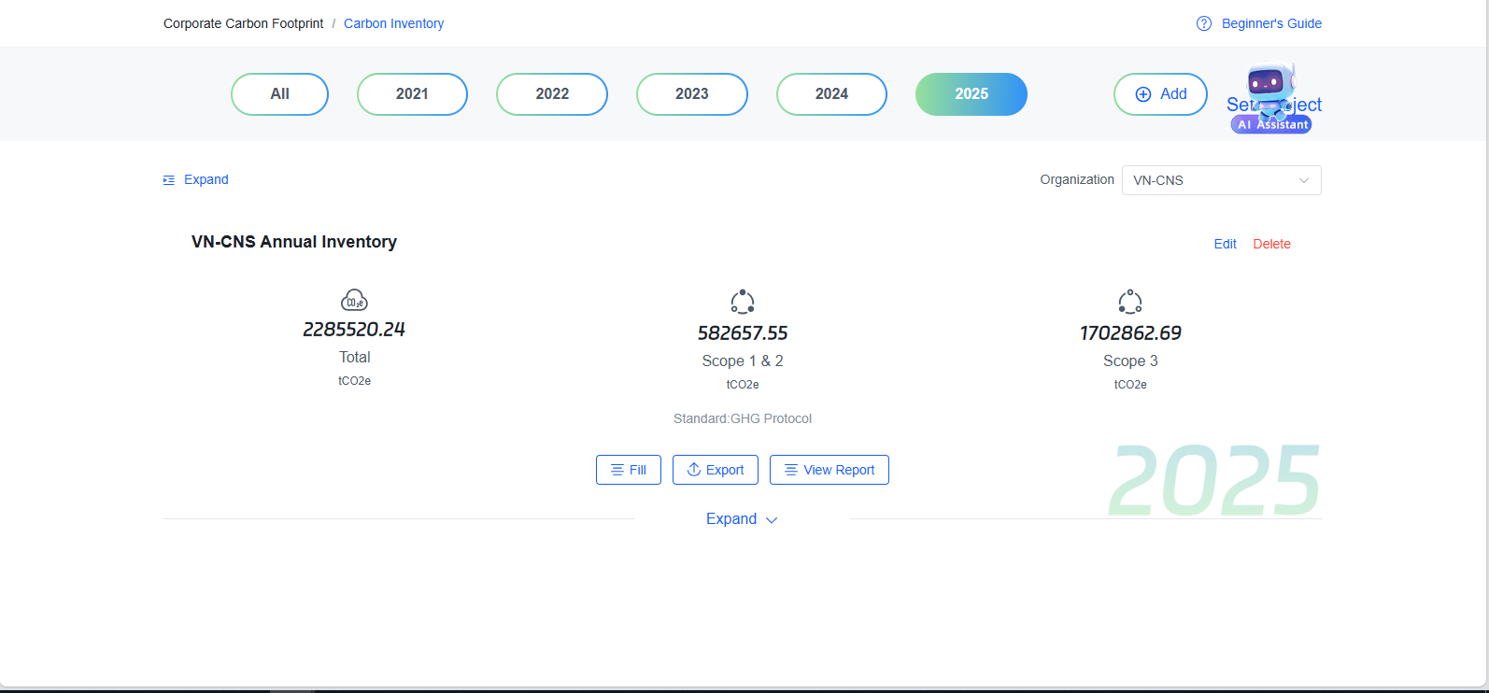
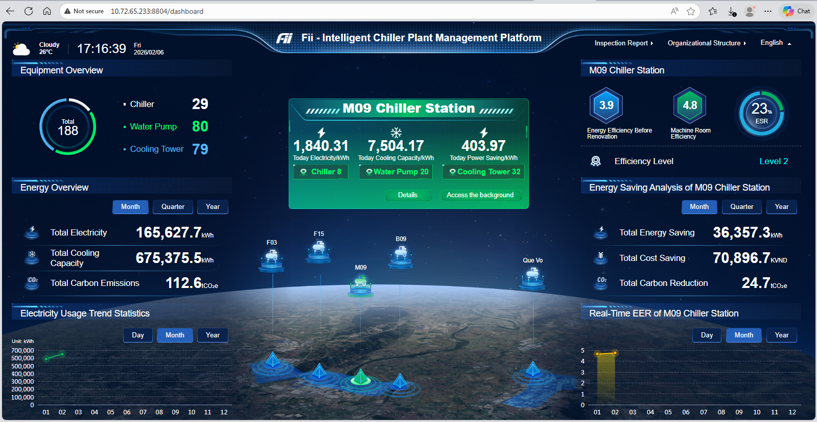
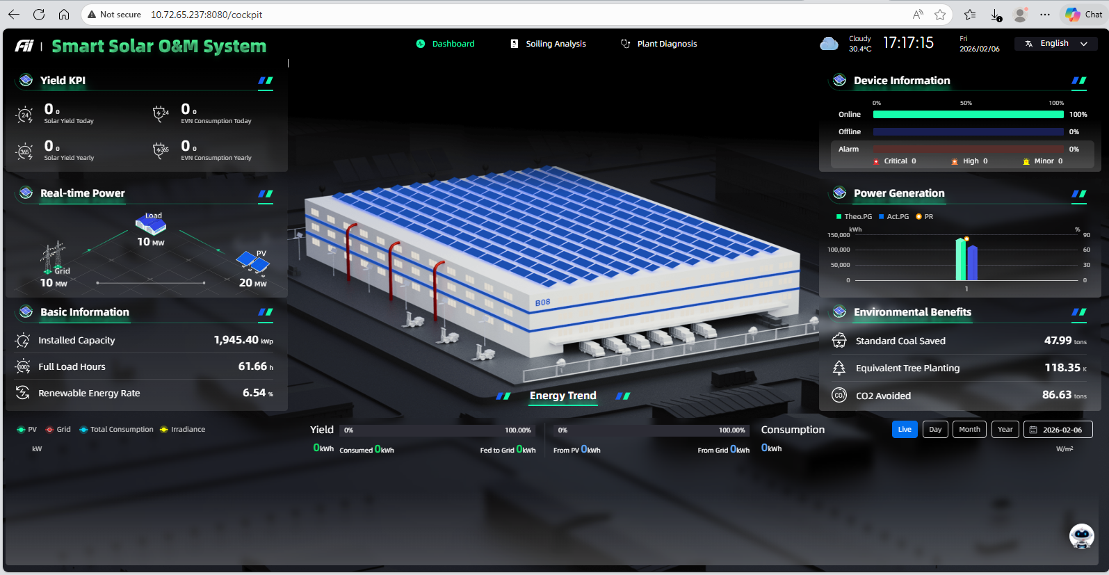
AI算法团队报告-Project 3: Lighthouse 服务器降本专案（租用改为内部部署）PHASE 1 CLOSED: Installed on Server_10.72.65.250 (2x GPU-A5000)
OT: CBD；AT: AI陈文俊
PLAN PHASE 1 | 25/12/18 | 25/12/20 | 25/12/22 | 25/12/23 | 26/01/08 | 26/01/13 | 26/02/20 | 26/03/15 | 26/03/22
 | Project Start | Requirement Analysis | IT Form Submit | Server Preparation | Operating System Server Setup | Model Transfers | Configure 5 System | Testing | Service Deploy
 | Closed | Closed | Closed | Closed | Closed | Closed | Closed | Closed | Closed
No | Execution Plan | Issues Summary (Green: Done/Closed; Yellow: Ongoing; Blue: Feedback/Improve; Other color: Open) | Owner | Date | Status
1 | Requirement Analysis | Implement carbon emission management system, aiming for sustainable development goals. 1. Usecase 1: Target Carbon Limits 2. Usecase 2: Cooling Management Platform 3. Usecase 3: Carbon inventory 4. Usecase 4&5: Smart Solar O&M System | 陈文俊 | 25/12/20 | Closed
2 | IT Form Submit | Request IT assistance for computer relocation. - Done-陈文俊-25/12/22 Request IT assistance for downloading models larger than 128 GB. - Done-陈文俊-25/12/22 | 陈文俊 | 25/12/22 | Closed
3 | Server Preparation | Discuss with AI工程师 & find a server suitable for the application. Submit an IT request for operating system Proxmox & Rocky-Linux installation for server. - Done-陈文俊, 阮功俊英-25/12/23 | 陈文俊 | 25/12/23 | Closed
4 | Operating System Server Setup | Setup Server Operating System 1: Proxmox - Done-陈文俊, 阮功俊英-26/01/08 Setup Server Operating System 2: Rocky Linux - Done-陈文俊, 阮功俊英-26/01/08 | 陈文俊 | 26/01/08 | Closed
5 | Model Transfers | Transfers large language model externally, then transfer to Asus A5000 server - Done-AI鄧潘英, TARG-26/01/12 | 鄧潘英 | 26/01/13 | Closed
6 | Configure 5 System | Install use-case 1&3: Config (1) dist, (2) deploy.sh, (3) Dockerfile, (4) nginx.conf files to the Asus A5000 server, modify the configurations, update the backend APIs, and proceed with the deployment. - Done-AI: 阮功俊英-26/01/29 Install use-case 5: Config (1) cp.env, (2) docker_srm.sh, (3) xxl-job files on the Asus A5000 server, (4) update backend APIs.-Done-阮功俊英-26/02/06 Install use-case 2&4: proceed to install use-cases 2 and 4 after finish use-case 5.- Done-阮功俊英-26/02/06 | 阮功俊英 | 26/02/20 | Closed
7 | Testing | Testing: The LLM Assistant features usecase 1&3 is currently not working, and is under improvement. - Closed-阮功俊英-26/02/19 | 陈文俊 | 26/03/15 | Closed
8 | Service Deploy | Service Deployment: Deploy the model as an internal service and expose APIs for access - Closed-阮功俊英-26/02/21 Access Control: Restrict access to internal network with proper authentication - Closed-阮功俊英-26/02/21 | 阮功俊英 | 26/03/22 | Closed
NOTE: Phase 1 of the project was completed 30 days ahead of schedule. Technically, the system was installed on server_10.72.65.250. However, this server is being reclaimed by TARG-Pengjun for other purposes, so the project will be moved to Phase 2 to be installed on server_10.72.92.47 (DT department).
1

Slide 3
AI算法团队报告-Project 3: Lighthouse 服务器降本(租用改为内部部署) PHASE 2 ONGOING: Install on DT's Server_10.72.92.47 (2x GPU-PRO6000)
OT: CBD; AT: AI陈文俊
PLAN PHASE 2 | 26/02/25 | 26/02/26 | 26/02/27 | 26/03/10 | 26/03/15 | 26/03/20 | 26/03/31
 | IT Form Submit | Server Preparation | Operating System Server Setup | Model Transfers | Configure 5 System | Test | Service Deploy
 | Close | Close | Close | Ongoing | Open | Open | Open
No | Execution Plan | Issues Summary (Green: Done/Closed; Yellow: Ongoing; Blue: Feedback/Improve; Other color: Open) | Owner | Date | Status
1 | IT Form Submit | 1. Application to install ProxMox+RockyLinux operating system for Server_10.72.92.47 - Done-阮功俊英-26/02/25 2. Application for bandwidth request to transfer 128GB of large data from (10.72.65.250->10.72.92.47) - Done-阮功俊英-26/02/24 3. Application to enable network access for Server_10.72.92.47 - Done-阮功俊英-26/02/27 | 阮功俊英 | 26/02/25 | Close
2 | Server Preparation | Work with the DT department engineers to back up data and programs for Server_10.72.92.47. - Done-阮功俊英-26/02/24 | 阮功俊英 | 26/02/26 | Close
3 | Operating System Server Setup | 1. Setup Server Operating System 1: Proxmox - Done-阮功俊英-26/02/27 2. Setup Server Operating System 2: Rocky Linux -Done-阮功俊英-26/02/27 | 阮功俊英 | 26/02/27 | Close
4 | Model Transfers | 1. Move all the AI models from Server_10.72.65.250 (AI部门 server) to Server_10.72.92.47 (DT部门 Server) - Ongoing-阮功俊英 2. Application for proxy for real-time data sent from Longhua to Server_10.72.92 .47 - Ongoing-阮功俊英 | 潘洛興 | 26/03/10 | Ongoing
5 | Configure 5 System | 1. Install use-case 1&3: Config (1) dist, (2) deploy.sh, (3) Dockerfile, (4) nginx.conf files to Server_10.72.92.47, modify the config files, update the backend APIs, and proceed with the deployment. - Open-阮功俊英 2. Install use-case 2&4: proceed to install use-cases 2 and 4 after finish use-case 5. - Open-阮功俊英 3. Install use-case 5: Config (1) cp.env, (2) docker_srm.sh, (3) xxl-job file on Server_10.72.92.47, (4) update backend APIs. - Open-阮功俊英 | 鄧潘英 | 26/03/15 | Open
6 | Test | Test all features: Test the LLM assistant functions, & the real-time data collection and display functions for 5 use-cases. - Open-阮功俊英 | 潘洛興 | 26/03/20 | Open
7 | Service Deploy | 1. Service Deployment: Deploy the model as an internal service and expose APIs for access - Open-阮功俊英 2. Access Control: Restrict access to internal network with proper authentication - Open-阮功俊英 | 鄧潘英 | 26/03/31 | Open
NOTE: Phase 1 was completed on server A5000 (IP address: 10.72.65.250). However, this server is currently being (1) revoked by TARG-Pengjun; (2) has low GPU performance and is not sufficient to run LLM. Therefore, the project will need Phase 2 to reinstall the program on the DT (A-Fu) department's server (IP address: 10.72.92.47).
2

Slide 4
AI算法团队报告-Project 3: Lighthouse 服务器降本专案（租用改为内部部署）
OT: CBD；AT: AI陈文俊
Result: 5 Website Use Case of Lighthouse Application was online
Use-case 1: Target Carbon Limits - LLM assistant feature
Use-case 3: Carbon Inventory - LLM assistant feature
Use-case 2: Cooling Management Platform
Use-case 4 & 5: Smart Solar O&M System
3

Slide 5
AI算法团队报告-Project 3: Lighthouse 服务器降本专案（租用改为内部部署）
OT: CBD；AT: AI陈文俊
PROFIT & BENEFIT
CPEG-AI Install on Local Server at Fulian Factory-Bac Ninh-Vietnam
No | Item | Unit Price (USD) | Calculation | Annual Cost (USD)
1 | DT Server Purchase Cost | $29,000/Server |  | $29,000
Total Cost |  |  |  | $29,000
Calculate Profit Over Time
Timeline | CPEG-AI (USD) | TARG-LongHua (USD)
5 Year | $29,000 | $125,000
Profit = $125,000 - $29,000 = $96,000
TARG Install on Cloud Server at Longhua Factory-Shenzhen-China
No | Item | Unit price (USD) | Calculation | Annual Cost (USD)
1 | Server Rental Costs | $12,353 / 6 Month | $12,353 * 2 | $24,800/Year
Longhua-TARG Total Cost |  |  |  | $24,800/Year
Conclusion Benefit: For this project, AI Department helped save a total of $96,000
4

Slide 6
AI算法团队报告-Project 3: Lighthouse 服务器降本专案（租用改为内部部署）
OT: CBD；AT: AI陈文俊
QUOTATION by CPEG-AI Deparment
No | Category | Items | Detail
1 | Number of Engineers | 5 people | 陈文俊，鄧潘英，潘洛興，阮功俊英，阮氏云英
2 | Labor Cost | $4000 USD/people/quarter | IE stipulates 4000/person/quarter
3 | Project Duration | 4 months | Phase 1 was completed in 2 months. However, the server was recalled by TARG-Pengjun. Phase 2 (migrating to DT's server) took another 2 months. The total project time was 4 months.
Total cost |  | 27,000 USD | Equivalent Quarters = 4 months / 3 months = 4/3 => 1 person cost/4 months = 4,000 × 4/3 = 5,333.33 USD => Total Labor Cost (5 people, 4 months) = 5 × 5,333.33 = 26,666.67 USD (≈ 26,667 USD)
4

