Slide 1
Hierarchical Bayes for Agricultural/Ecological Sciences in Stan: Overview and Agenda
Chris H. Wilson

Slide 2
What is the fundamental goal of statistics?
To learn about an uncertain world with imperfect measurements
3 challenges of statistics (Andrew Gelman):
Generalizing from sample to population, and from past to future
Generalizing from control to treatment groups
Generalizing from observed measurements to the underlying constructs of interest

Slide 3
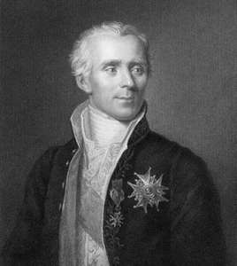
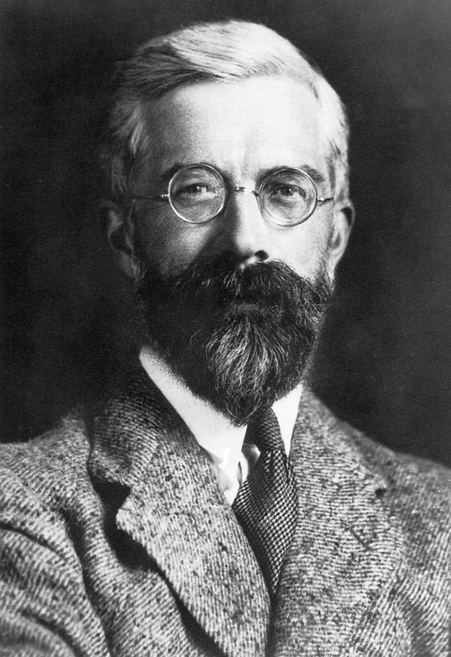
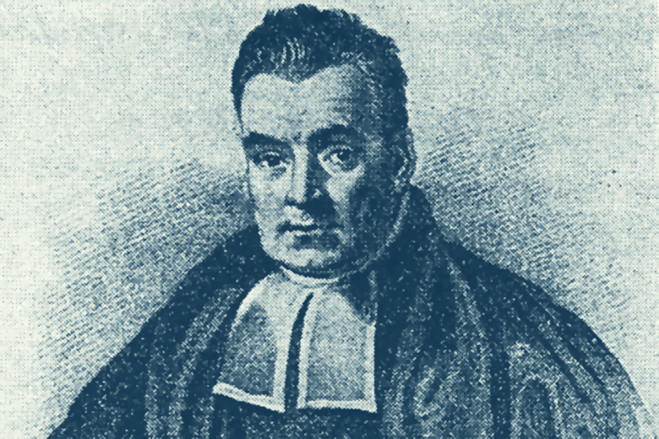
Frameworks for statistics
Rev. Thomas Bayes
Pierre Simon de Laplace
Sir Ronald Fisher

Slide 4
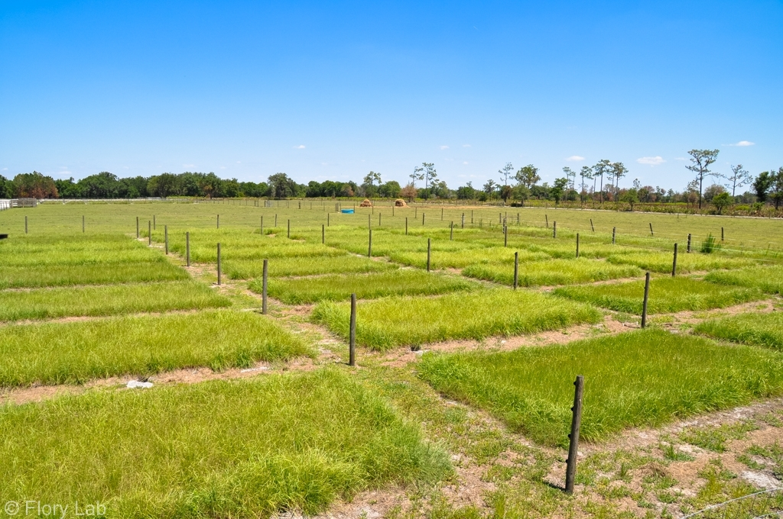
“Classical Statistics”
Null Hypothesis Significance Testing (NHST)
Usually performed in an ad hoc mixture of Fisherian and Neyman-Pearson methods (those guys started the whole Type I/Type II error thing, alpha levels and whatnot)
Dichotomous thinking: is there an effect? Yes/no
What does p-value tell you about effect?

Slide 5
6 Questions about an observed p-value
Your randomized trial of N/no-N reveals an odd result- the no-N plants grew better than the +N plants ! Your analysis shows p = 0.01 (null hypothesis is that growth does not differ with N). Mark the following as True or False:
You have absolutely disproved the null hypothesis (i.e. mean growth does not differ)
You have found probability of null hypothesis being true
You have absolutely proved your experimental hypothesis (difference in growth)
You can deduce probability of experimental hypothesis being true.
You know, if you decide to reject the null, the probability that you are making the wrong decision.
You have a reliable experimental finding in the sense that if, hypothetically, the experiment were repeated a great number of times, you would obtain a significant result on 99% of occasions.
Adapted from Gigerenzer (2018)

Slide 6
(Aside) My take on NHST + p-values
Not that anyone is asking, but here is what I currently think:
Neither Fisher, nor Neyman and Pearson, recommended against automatic reject/not-reject decisions based on any arbitrary threshold for p-values!
Treat the p-value as one, potentially noisy, continuous measure of discrepancy between data and model (null hypothesis + all of the steps in collecting data and setting up model)
Shift focus from “tests” to estimates
Ultimately, this is part of the widespread “replication crisis” in biomedical and social sciences. Journal editing and scientific culture needs to change.
Sander Greenland has a neat transformation called “Surprisal” or S-value: S = -log₂(p-value)

Slide 7
But what about more substantive models?

Slide 8
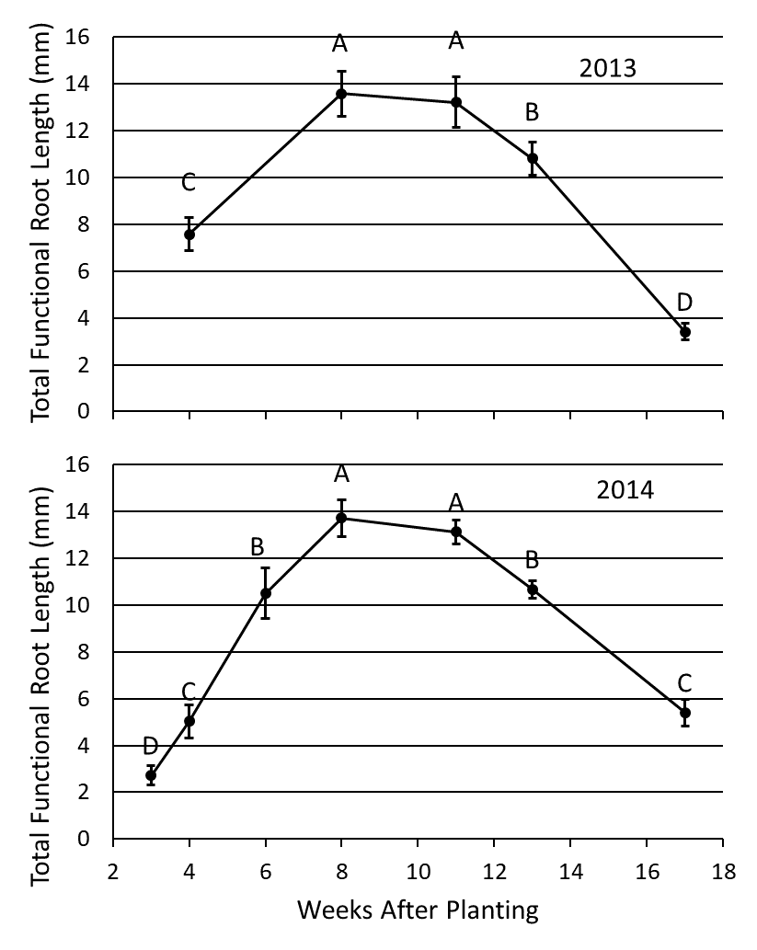
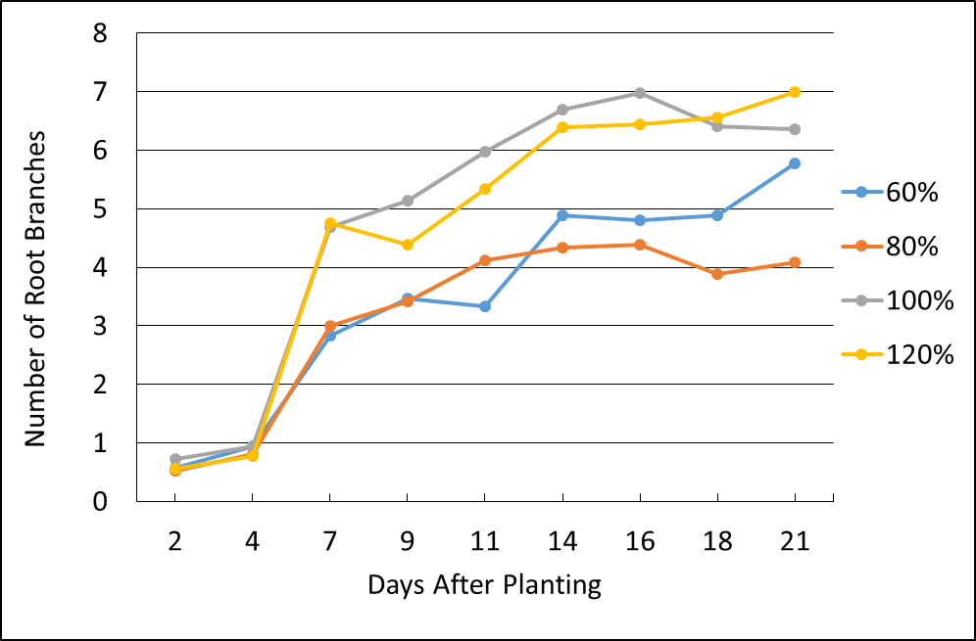
Sesame Root Data
We know there are differences by date and treatment, but what other
questions might be want to ask?
Images courtesy of Romain Gloaguen

Slide 9
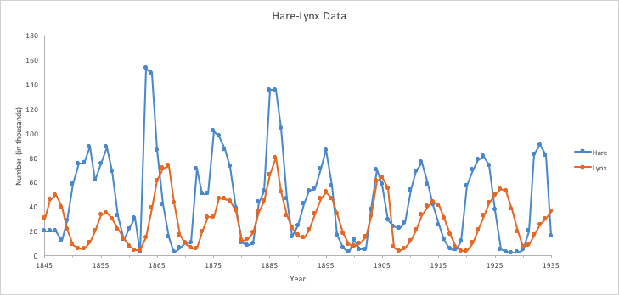
Classic Ecological Dataset
Graph courtesy of: http://www2.nau.edu/lrm22/lessons/predator_prey/predator_prey.html

Slide 10
Interesting versus uninteresting questions
Is there an “effect” of lynxes on hares? We kind of already know the answer so what would an ANOVA-style analysis add?
Given noisy time series of past {y,z}, can we forecast future {y,z} ? How to quantify our uncertainty?
Can we infer the strength of biological interactions linking lynxes and hares?

Slide 11
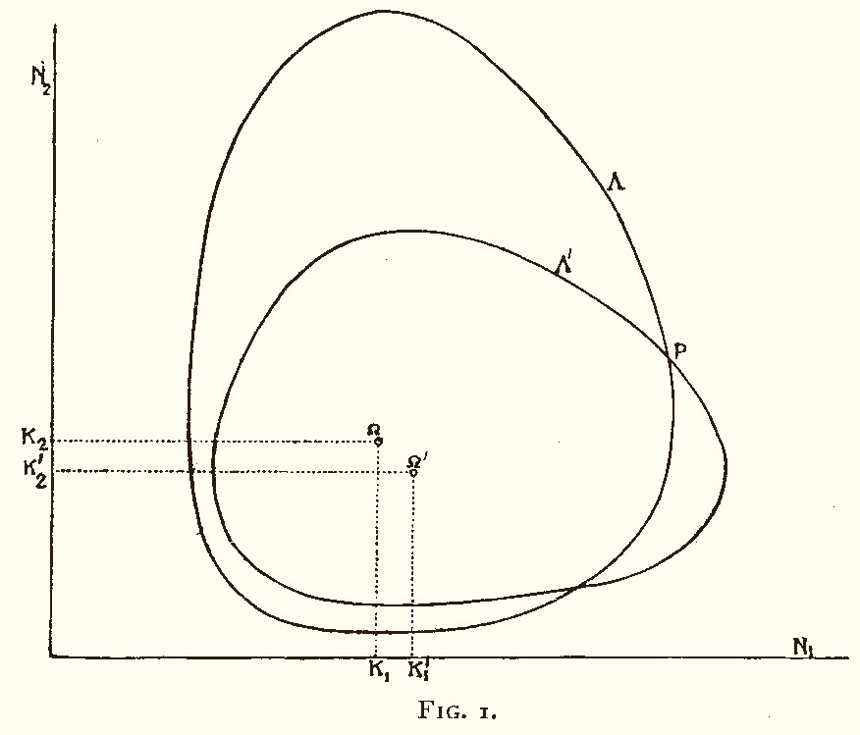
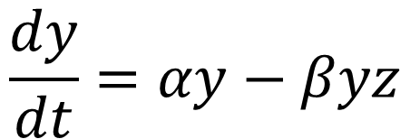
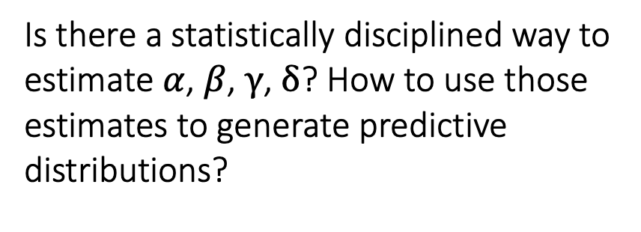
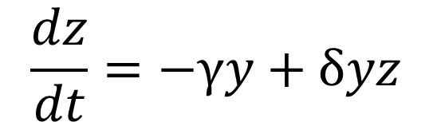
Confronting Models and Data
Classic Model: Lotka-Volterra Equations
$$\frac{dy}{dt}=αy−βyz$$
$$\frac{dz}{dt}=−γy+δyz$$
Is there a statistically disciplined way to estimate $α$, $β$, $γ$, $δ$? How to use those estimates to generate predictive distributions?
Volterra 1926: Stable Limit Cycles

Slide 12
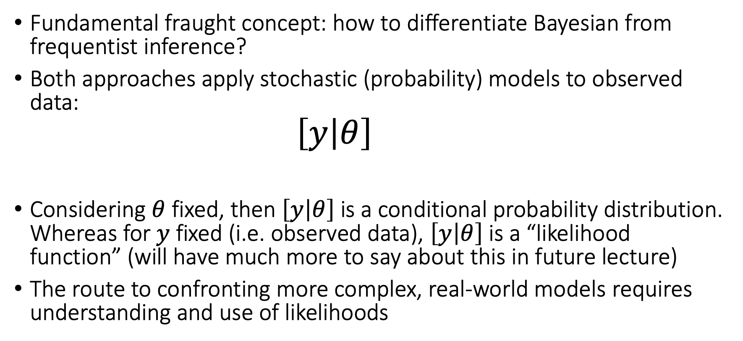
Likelihood: Bayesian and Frequentist Inference
Fundamental fraught concept: how to differentiate Bayesian from frequentist inference?
Both approaches apply stochastic (probability) models to observed data:
$$\left[y | θ\right]$$
Considering $θ$ fixed, then $\left[y | θ\right]$is a conditional probability distribution. Whereas for $y$ fixed (i.e. observed data), $\left[y | θ\right]$is a “likelihood function” (will have much more to say about this in future lecture)
The route to confronting more complex, real-world models requires understanding and use of likelihoods

Slide 13
Misconceptions about Bayesian Statistics
In frequentism parameters are “fixed”, but in Bayes they are “random”
Bayesian models are inherently “subjective”
Bayesian models are just maximum likelihood + priors
The essence of Bayesian statistics is this: apply probability in full generality to all quantities of interest – data and parameters.
The line between data and parameters not as clear as seems – perhaps better to think of unobserved and observed quantities

Slide 14
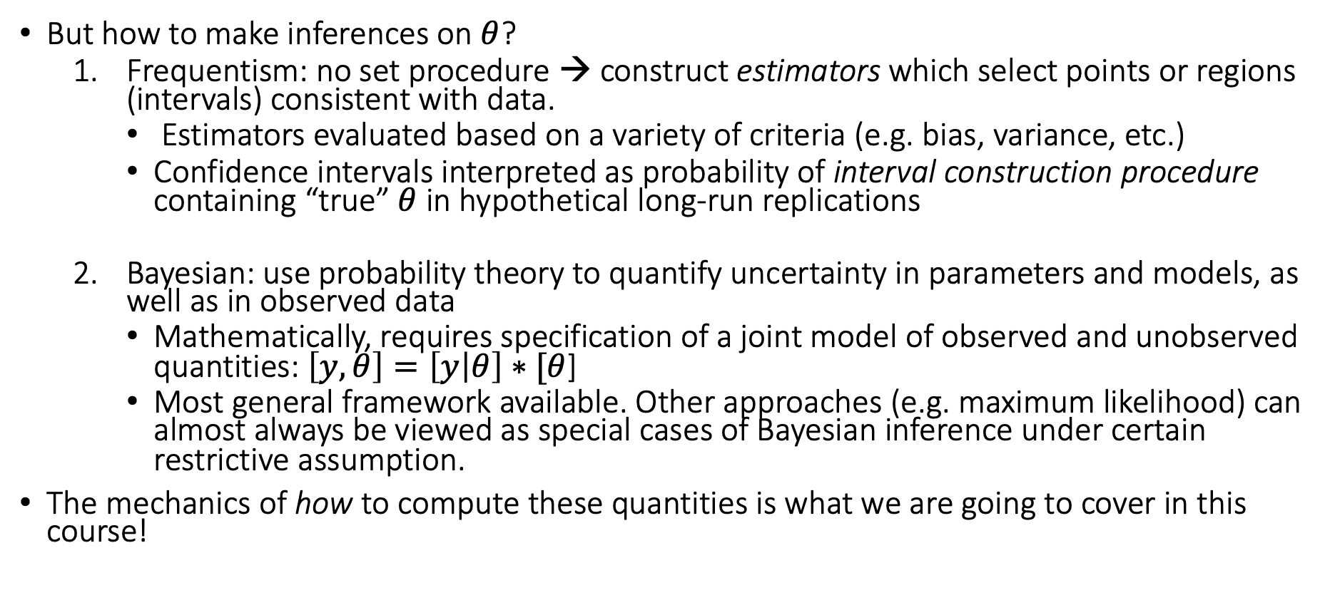
Bayesian and Frequentist Inference, Cont’d
But how to make inferences on $θ$?
Frequentism: no set procedure → construct estimators which select points or regions (intervals) consistent with data.
Estimators evaluated based on a variety of criteria (e.g. bias, variance, etc.)
Confidence intervals interpreted as probability of interval construction procedure containing “true” $θ$ in hypothetical long-run replications
Bayesian: use probability theory to quantify uncertainty in parameters and models, as well as in observed data
Mathematically, requires specification of a joint model of observed and unobserved quantities: $\left[y,θ\right]=\left[y | θ\right]∗[θ$]
Most general framework available. Other approaches (e.g. maximum likelihood) can almost always be viewed as special cases of Bayesian inference under certain restrictive assumption.
The mechanics of how to compute these quantities is what we are going to cover in this course!

