Slide 1
Statistical Inference for Ecologists and Agricultural Scientists
Chris H. Wilson

Slide 2
What is the fundamental goal of statistics?
To learn about an uncertain world with incomplete theories and imperfect measurements
3 challenges of statistics (Andrew Gelman):
Generalizing from sample to population, and from past to future
Generalizing from control to treatment groups
Generalizing from observed measurements to the underlying constructs of interest

Slide 3
The Fundamental Role of Probability

Slide 4
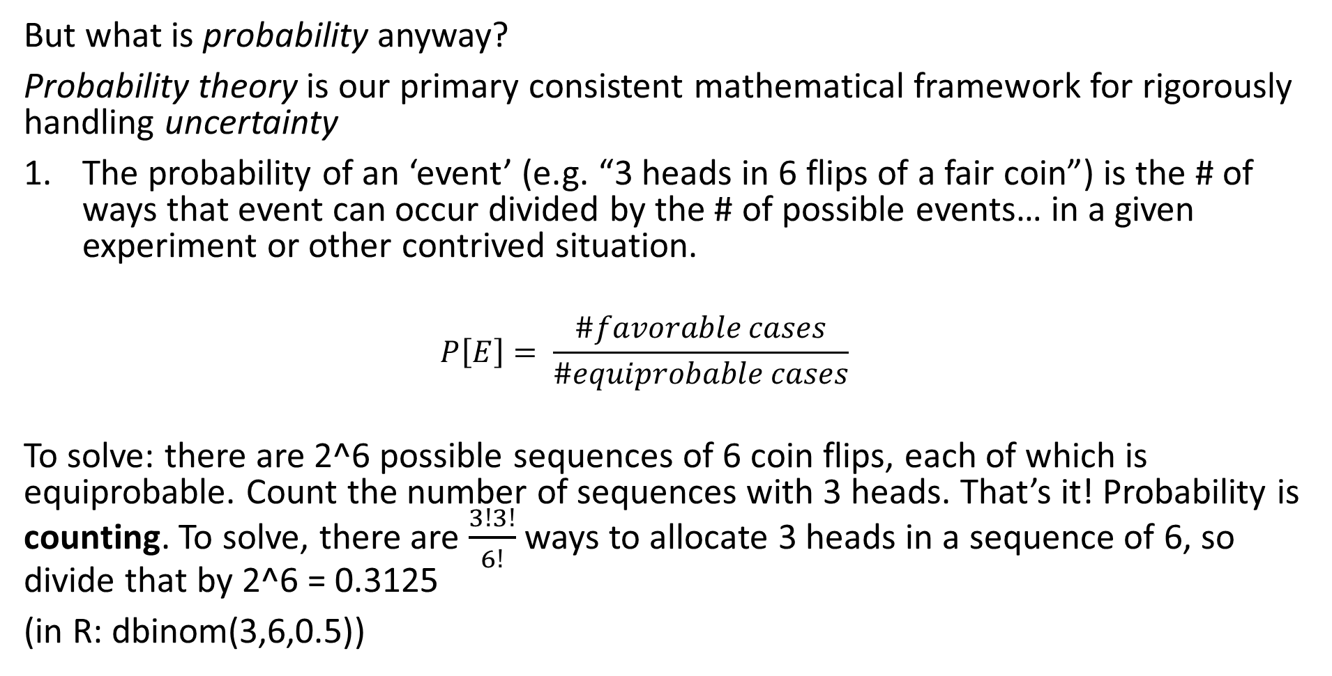
Probability
But what is probability anyway?
Probability theory is our primary consistent mathematical framework for rigorously handling uncertainty
The probability of an ‘event’ (e.g. “3 heads in 6 flips of a fair coin”) is the # of ways that event can occur divided by the # of possible events… in a given experiment or other contrived situation.
$$P\left[E\right]= \frac{\#favorable cases}{\#equiprobable cases}$$
To solve: there are 2^6 possible sequences of 6 coin flips, each of which is equiprobable. Count the number of sequences with 3 heads. That’s it! Probability is counting. To solve, there are $\frac{3!3!}{6!}$ ways to allocate 3 heads in a sequence of 6, so divide that by 2^6 = 0.3125
(in R: dbinom(3,6,0.5))

Slide 5
Probability
But what is probability anyway?
Probability theory is our primary consistent mathematical framework for rigorously handling uncertainty
The probability of an ‘event’ is its long-term relative frequency in a hypothetical series of repetitions as the number of repetitions goes to infinity (frequentism)
e.g.: 000011100101101010111110000110110000011100000000110…

Slide 6
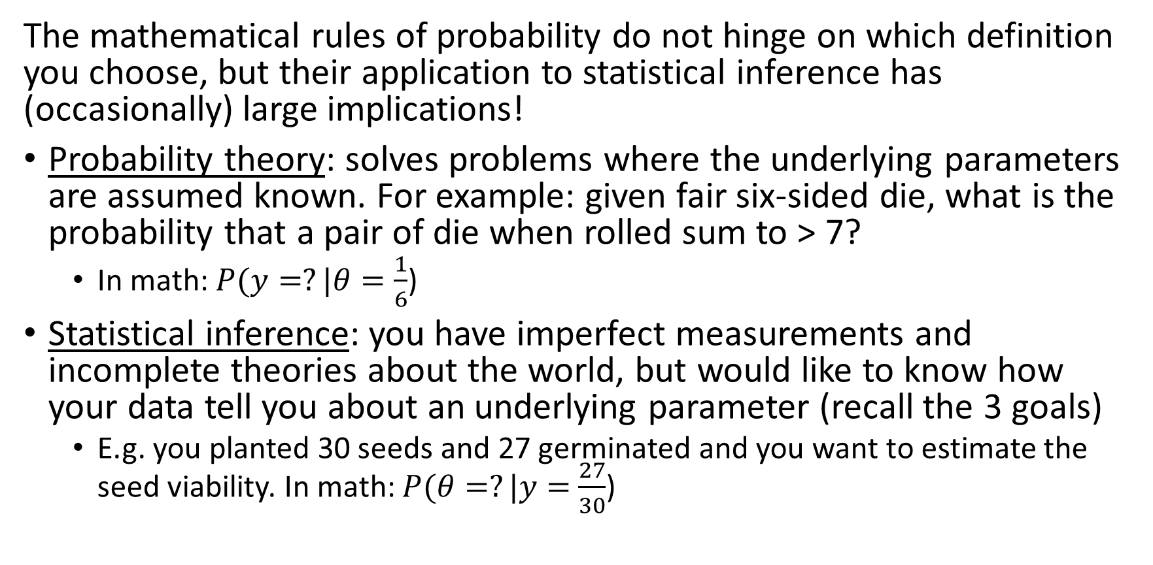
Probability
The mathematical rules of probability do not hinge on which definition you choose, but their application to statistical inference has (occasionally) large implications!
Probability theory: solves problems where the underlying parameters are assumed known. For example: given fair six-sided die, what is the probability that a pair of die when rolled sum to > 7?
In math: $P(y=?|θ=\frac{1}{6}$)
Statistical inference: you have imperfect measurements and incomplete theories about the world, but would like to know how your data tell you about an underlying parameter (recall the 3 goals)
E.g. you planted 30 seeds and 27 germinated and you want to estimate the seed viability. In math: $P(θ=?|y=$ $\frac{27}{30}$)

Slide 7
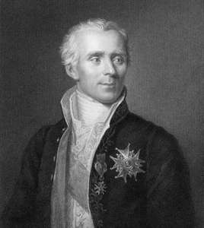
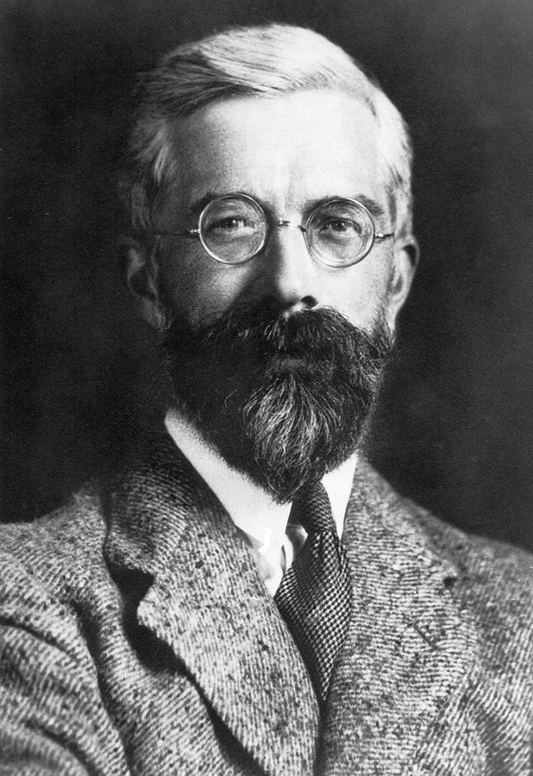
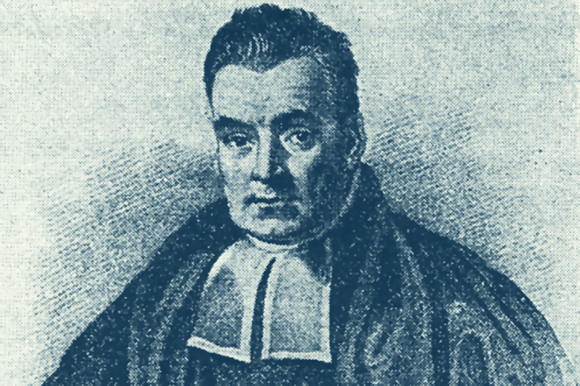
Frameworks for statistics
Rev. Thomas Bayes
Pierre Simon de Laplace
Sir Ronald Fisher

Slide 8

“Classical Statistics”
Null Hypothesis Significance Testing (NHST)
ad hoc mixtures of Fisherian and Neyman-Pearson methods (alpha levels, type I/II error, etc.)
Dichotomous thinking: is there an effect? Yes/no
What does p-value tell you about effect?

Slide 9
6 Questions about an observed p-value
Your randomized trial of N/no-N reveals an odd result- the no-N plants grew better than the +N plants ! Your analysis shows p = 0.01 (null hypothesis is that growth does not differ with N). Mark the following as True or False:
You have absolutely disproved the null hypothesis (i.e. mean growth does not differ)
You have found probability of null hypothesis being true
You have absolutely proved your experimental hypothesis (difference in growth)
You can deduce probability of experimental hypothesis being true.
You know, if you decide to reject the null, the probability that you are making the wrong decision.
You have a reliable experimental finding in the sense that if, hypothetically, the experiment were repeated a great number of times, you would obtain a significant result on 99% of occasions.
Adapted from Gigerenzer (2018)

Slide 10
(Aside) My take on NHST + p-values
Not that anyone is asking, but here is what I currently think:
Neither Fisher, nor Neyman and Pearson, recommended automatic reject/not-reject decisions based on any arbitrary threshold for p-values!
Treat the p-value as one, potentially noisy, continuous measure of discrepancy between data and model (null hypothesis + all of the steps in collecting data and setting up model)
Shift focus from “tests” to estimates
Ultimately, this is part of the widespread “replication crisis” in biomedical and social sciences. Journal editing and scientific culture needs to change.
Sander Greenland has a neat transformation called “Surprisal” or S-value: S = -log₂(p-value). What does this mean? It translates an observed p-value into a form that compares how unlikely it is to observed a certain number of heads in a row given a fair coin flip. P = 0.05 turns out to be about as unlikely as 4 in a row (i.e. not all THAT unlikely)

Slide 11
Where we go from here?
OK, so calculating p-values and ANOVA tables and all that jazz isn’t really what we want. What do we do?
Learn to fit and interpret linear models really really well
Learn to fit non-linear and process-based models to data
While my main interest is in #2, the first objective is the more multi-purpose, accessible goal. The class of linear models is actually quite broad and flexible and you can learn to fit and interpret a variety of kinds of data, both normal and non-normal.

