Slide 1


Modeling Styles in Ecology and Agronomy
Chris H. Wilson

Slide 2
White on black – so good ☺
Key concepts:
Turn hypotheses into models
Represent mechanisms in math
Three cultures:
Theoretical
Empirical
Simulation

Slide 3
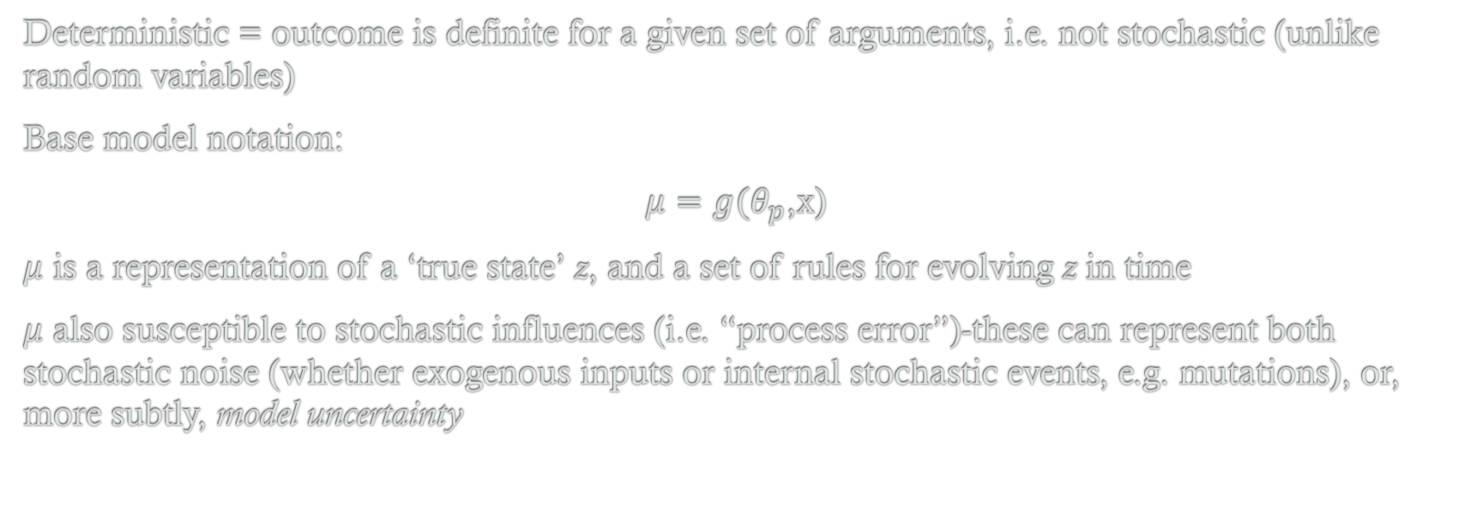
Core Deterministic Models
Deterministic = outcome is definite for a given set of arguments, i.e. not stochastic (unlike random variables)
Base model notation:
$μ=g(θ_{p}$,x)
$μ$ is a representation of a ‘true state’ z, and a set of rules for evolving z in time
$μ$ also susceptible to stochastic influences (i.e. “process error”)-these can represent both stochastic noise (whether exogenous inputs or internal stochastic events, e.g. mutations), or, more subtly, model uncertainty

Slide 4
Linear Models I
Used to model additive effects
Interactions and curvilinearity subsumed under linear models
Ubiquitous in statistics as a kind of default base model – since they represent little more than asserting a generic association between variables
Connecting linear models with correlation/R^2
The causal interpretation is only justified by design of experiment/data-collection

Slide 5
Linear Models II
BUT
Can also think about linear models as approximations of any arbitrary model
(On board): Taylor Series expansion
What are the assumptions needed here?

Slide 6
Exponential Models
On board

Slide 7
Saturating Response Models
On board

Slide 8
Change Point Models
On board

