Slide 1
Lecture 3: Probability distributions and their properties
Chris H. Wilson

Slide 2
Where we are at
Finishing textbook Chapters 1 and 3
Next up is 2 and 4 ☺

Slide 3
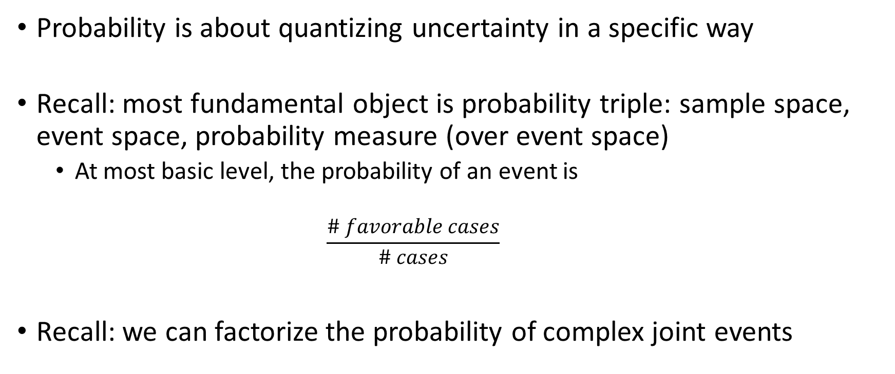
Recap
Probability is about quantizing uncertainty in a specific way
Recall: most fundamental object is probability triple: sample space, event space, probability measure (over event space)
At most basic level, the probability of an event is
$$\frac{\# favorable cases}{\# cases}$$
Recall: we can factorize the probability of complex joint events

Slide 4
From probability triple to probability distributions
For simple discrete cases, it is often easy to work out or derive the probabilities of interest by counting (or combinatorics)
Example: let’s derive the binomial distribution (on board)

Slide 5
Back to Bayesian modeling I
Construct a giant joint distribution over everything: observed and unobserved variables
Premise: represent all unobserved quantities as random variables (described by probability distributions)
Premise: Observed variables (“data”) are given sampling distributions
In base they enter the inference only via the likelihood (one instance of so-called “Likelihood Principle”)
Manipulate the joint distribution via rules of probability to derive quantities of interest (e.g. sum and product rule yield Bayes’ rule,etc.)

Slide 6
What toolkit do we need?
Working familiarity with a bestiary of probability distributions
Fluency in whatever models are relevant to your science (linear and/or non-linear)
Ability to combine 1 and 2 productively and
Computational ability to estimate/fit your models

Slide 7
Important properties of probability distributions I
Probability mass versus density
Density properties (on board):
Non-negative
Total probability
Finitely additive – means that we sum or integrate over a domain to get a probability measure

Slide 8
More Properties: Moments
Let’s take a moment…
A fundamental concept in modeling that we are going to return to often: we relate variates to covariates through constrained functions of the parameters of distributions
e.g. : Y ~ Normal(u=f(X),sigma)
On board: Illustrate symmetry of the Gaussian, and rewriting the linear regression model multiple ways
Link to generalized linear models

Slide 9
Moments
On board: show two forms of moment definition
Aside: moment-generating functions are a powerful way to represent probability distributions
In practice, we will be working more often than not with posterior distributions from which we have numerical samples, but no analytical form. So we will need to estimate the moments numerically (or software does it for us)
But knowing how to work with moments gives us a way to reparameterize our likelihoods and priors to facilitate modeling

Slide 10
Quantiles
On board
Key takeaway: quantile function is inverse of cumulative distribution function

Slide 11
Marginal and Conditional Distributions
Recall definitions of marginal and conditional distributions (on board)
Age/#Offspring | 1 | 2 | 3
1 | 0.1 | 0 | 0
2 | 0.13 | 0.12 | 0.02
3 | 0.23 | 0.36 | 0.04
Problem 1: For this species, we have measured two discrete attributes: age and # offspring. Assign symbols and derive marginal distributions for both age and # offspring:
Write out symbolic function
Do the computations and find these particular marginals
Verify that probability axioms are obeyed
From discrete to continuous (on board)
Problem 2: with file “demo_xy.csv” 1. write a short R script that numerically calculates the marginal distributions of x and y. 2. How would you think about [y|x]?

Slide 12
Binomial Distro
On board: density, moments
Random walk property
https://www.statisticshowto.datasciencecentral.com/galton-board/
Use curve() function to study convergence of binomial to normal as N increases (fix p = 0.5 for simplicity)

Slide 13
Poisson Distro
Can be derived from Binomial distribution (on board)
Density, moments
Problem #1: Plot P(z=k) for lambda = (0.5,5,50)
Problem #2: a certain disease has a rate of 1 per 10^4 per year. Simulate 40 counties, 20 with population 10^3 and 20 with population 10^5 for one year. Compute an empirical estimate of rate (#cases/population) for each county and compare to the simulated ‘truth’. What pattern do you notice?

Slide 14
Negative Binomial
Relax assumptions that first two moments are equal in a Poisson.
Derivation from marginalization with gamma distribution over lambda

Slide 15
Normal Distro
On board

Slide 16
Exponential
On board

Slide 17
Gamma
On board

