Slide 1
A Brief Tour of Likelihood
Chris H. Wilson
AGR 6932

Slide 2
Notes from last class
Clarification:
Marginal computation
Exponential is special case of gamma with alpha = 1 (I believe I said 2)
Convergence under Central Limit Theorem:
Different parts of distribution converge at different speeds (extreme value theory deals with max(x)/min(x) rather than mean(x))
Random variables with infinite variance (sufficiently fat-tailed, i.e. Pareto with exponent < 2) do not converge

Slide 3
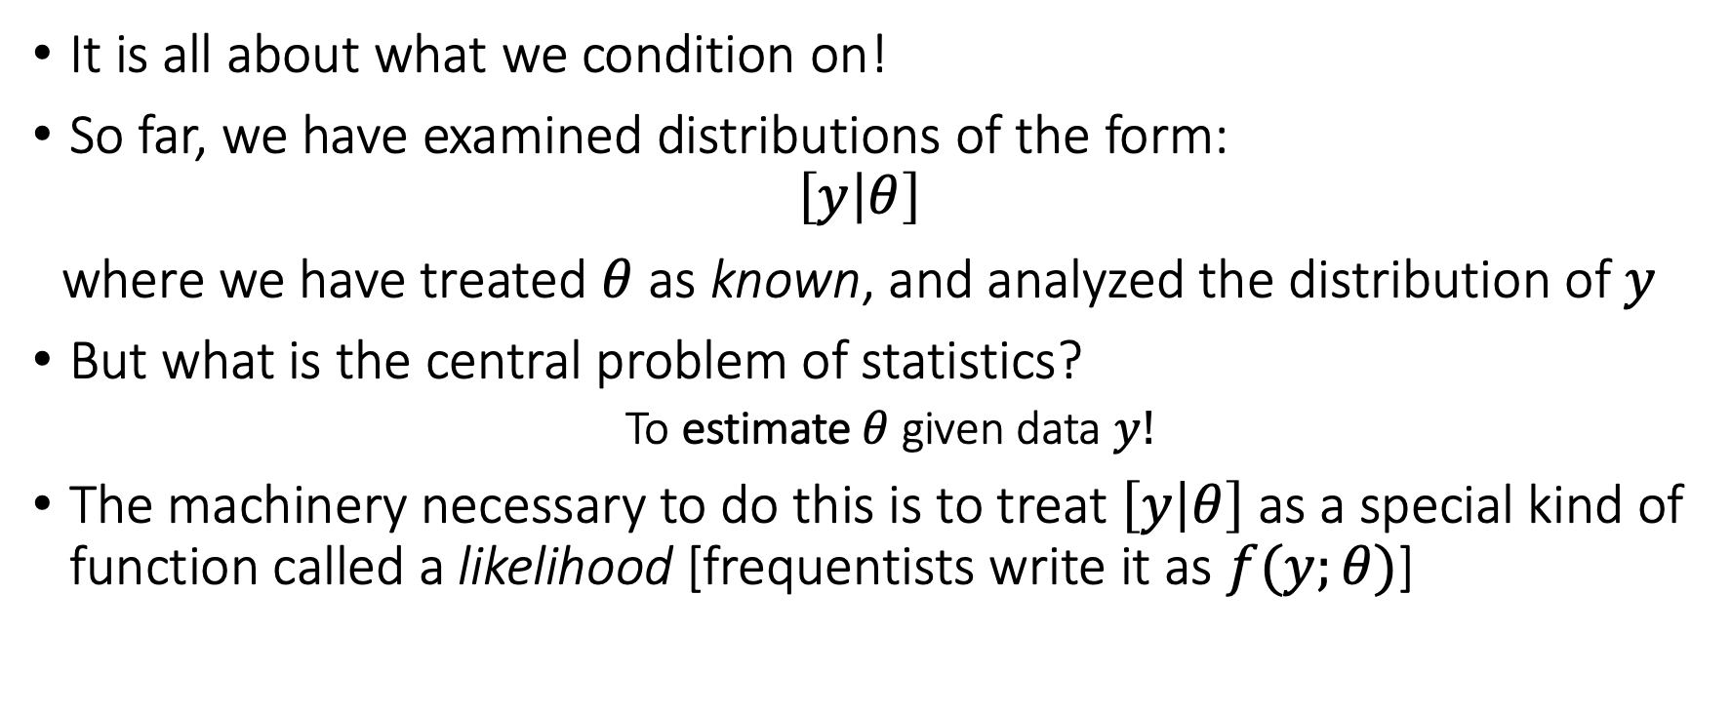
How do we learn from data?
It is all about what we condition on!
So far, we have examined distributions of the form:
$$\left[y | θ\right]$$
where we have treated $θ$ as known, and analyzed the distribution of $y$
But what is the central problem of statistics?
To estimate $θ$ given data $y!$
The machinery necessary to do this is to treat $\left[y | θ\right]$ as a special kind of function called a likelihood [frequentists write it as $f(y;θ)$]

Slide 4
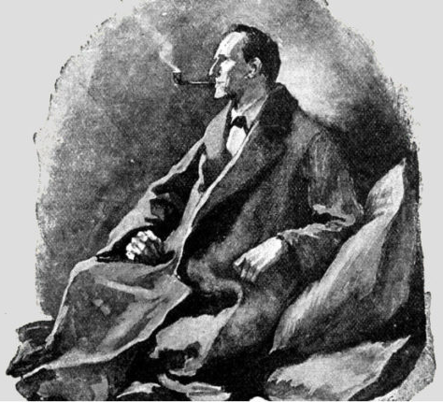
Sherlock Holmes and Statistics
Sir Arthur Conan Doyle’s inimitable character popularized what is known as abductive reasoning
NOT formal deductive logic!
Given the observed evidence, what is the most plausible explanation?
Likelihoods are the mathematical encapsulation of this style of reasoning

Slide 5
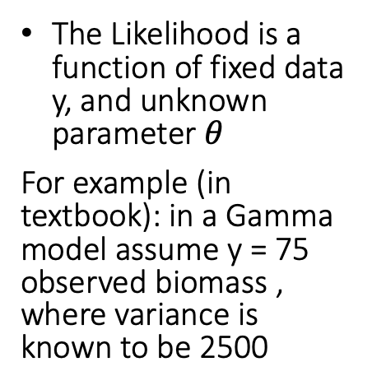
The Likelihood Curve
The Likelihood is a function of fixed data y, and unknown parameter $θ$
For example (in textbook): in a Gamma model assume y = 75 observed biomass , where variance is known to be 2500
Is this a probability measure?

Slide 6
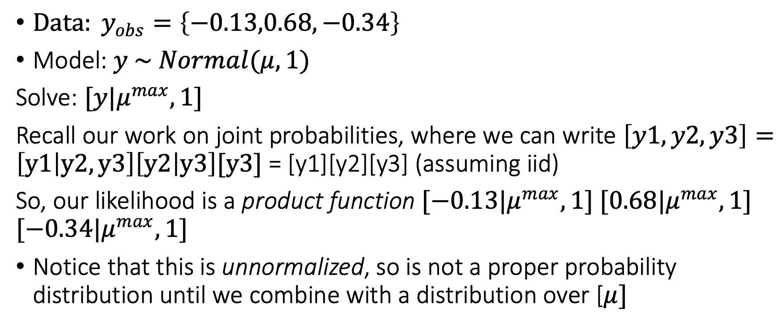
What parameter values make observed data most likely?
${Data: y}_{obs}=\left\{−0.13,0.68,−0.34\right\}$
Model: $y \sim Normal(μ,1)$
Solve: $[y|μ^{max},1]$
Recall our work on joint probabilities, where we can write $\left[y1,y2,y3\right]=\left[y1 | y2,y3\right]\left[y2 | y3\right][y3]$ = [y1][y2][y3] (assuming iid)
So, our likelihood is a product function $[−0.13|μ^{max},1]$ $[0.68|μ^{max},1]$ $[−0.34|μ^{max},1]$
Notice that this is unnormalized, so is not a proper probability distribution until we combine with a distribution over [$μ]$

Slide 7
Likelihood Profiles
N=3
N=3,30
N=3,300

Slide 8
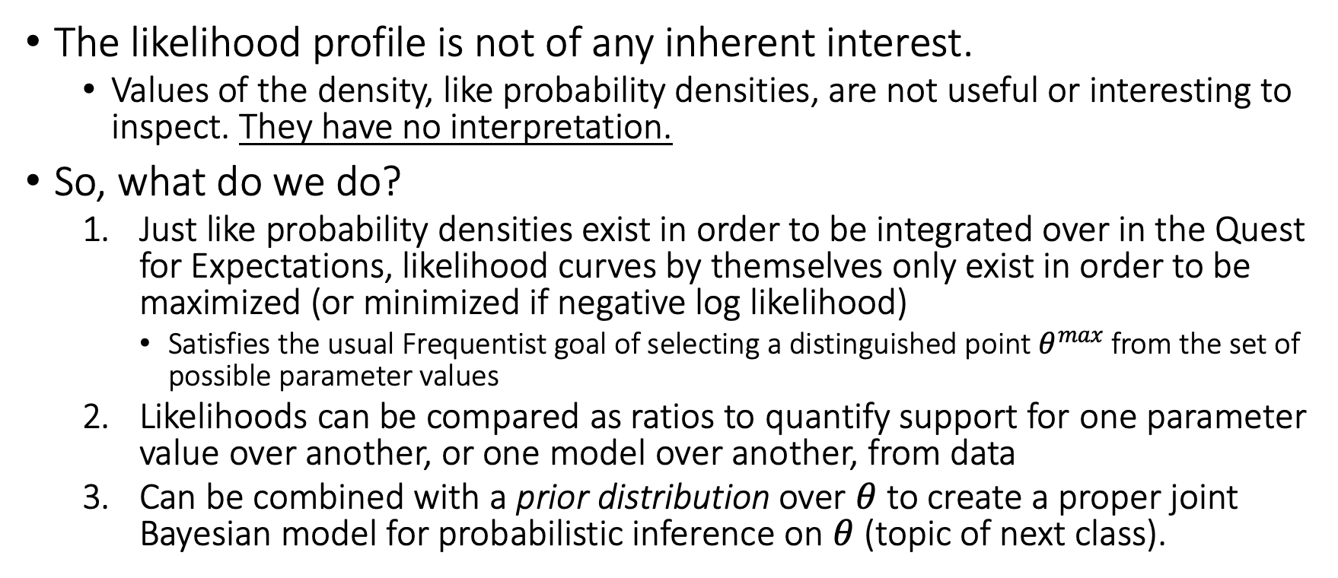
What do you do with likelihoods?
The likelihood profile is not of any inherent interest.
Values of the density, like probability densities, are not useful or interesting to inspect. They have no interpretation.
So, what do we do?
Just like probability densities exist in order to be integrated over in the Quest for Expectations, likelihood curves by themselves only exist in order to be maximized (or minimized if negative log likelihood)
Satisfies the usual Frequentist goal of selecting a distinguished point $θ^{max}$ from the set of possible parameter values
Likelihoods can be compared as ratios to quantify support for one parameter value over another, or one model over another, from data
Can be combined with a prior distribution over $θ$ to create a proper joint Bayesian model for probabilistic inference on $θ$ (topic of next class).

Slide 9
Maximum Likelihood
Analytical example for Binomial parameter p (on board)
Analytical example for Normal distribution mu (on board)

