Slide 1
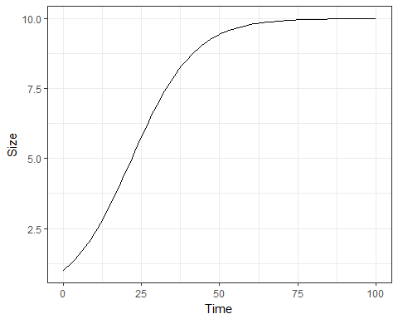
Convex Zone
Concave Zone
Approximately Exponential
Approximately Linear

