Slide 1

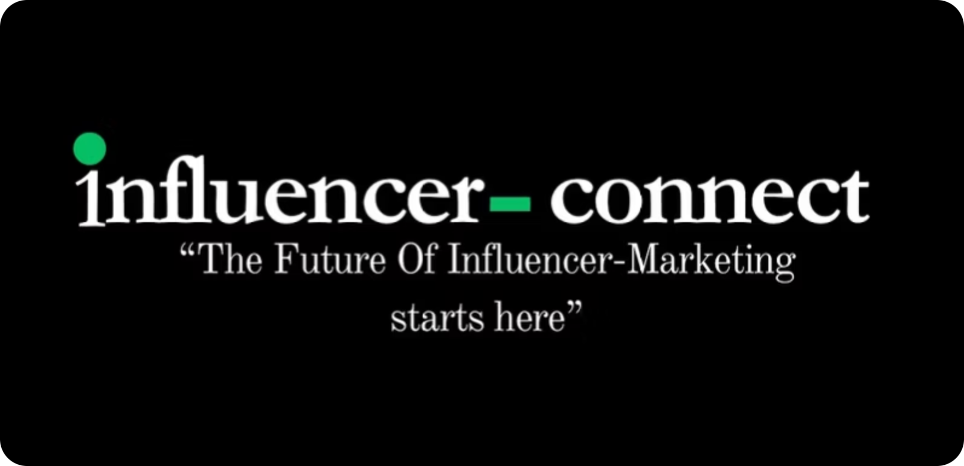
Influencer Connect Media
Previously known as Convogue Media
The Future of Influencer Marketing starts here.
Done-for-you influencer growth for modern brands

Slide 2

The New Reality of Marketing
Creators as New Media Channels
Trust in Authentic Voices
Performance Through Community
Audiences increasingly trust people, not just advertisements. Authentic creator content builds credibility that traditional ads often lack.
Influencers have become powerful media channels, reshaping how brands connect with their audiences and deliver messages.
Today’s performance marketing stems from strong communities and engaging content, driving impactful results far beyond typical campaigns.

Slide 3
CHAPTER 2
The Problems Brands Face
Finding High-Quality Creators
Identifying genuinely impactful creators amidst a vast landscape is a constant challenge for brands.
Fake Followers & Engagement
The prevalence of fraudulent metrics undermines campaign effectiveness and wastes valuable marketing budgets.
Low ROI from Random Collaborations
Without strategic planning, collaborations often yield minimal returns, failing to meet performance objectives.
Manual Outreach & Messy Workflows
Managing influencer campaigns manually is time-consuming, prone to errors, and hinders scalable growth.
Lack of Scalable Systems
Many brands struggle to implement repeatable systems for influencer marketing, limiting their growth potential.

Slide 4
OUR APPROACH
Our Solution: End-to-End Agency Management
Creator Sourcing & Outreach
Strategy Development
Our experts identify and engage authentic, high-performing creators that align with your brand.
We craft data-driven strategies tailored to your brand's unique goals and audience.
Performance Reporting
Seamless Execution
Comprehensive analytics and actionable insights ensure continuous optimisation and demonstrable ROI.
From content briefs to legal agreements, we manage every aspect of campaign implementation.
We handle every detail, allowing you to focus on your core business while we drive performance.

Slide 5




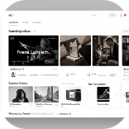

SERVICES
What We Do: Our Core Services
Influencer Discovery
Campaign Strategy & Brief Creation
Creator Outreach & Negotiation
Content Coordination
Focused on identifying high-engagement nano and micro-creators who genuinely connect with their audiences.
Expertly managing communication and securing favourable terms with creators to ensure seamless collaborations.
Overseeing content creation from concept to delivery, ensuring brand alignment and quality standards.
Developing precise campaign objectives, target audience insights, and detailed content briefs for optimal results.
Paid Ads Using Creator Content
Performance Tracking & ROI Reporting
Transforming high-performing organic creator content into targeted paid advertisements for amplified reach.
Providing transparent, data-driven reports to measure campaign success and demonstrate clear return on investment.

Slide 6
OUR FOCUS
Why Nano & Micro Creators Win
Higher Engagement Rates
Cost-Effective Campaigns
Authenticity & Trust
Scalability & Reach
Accessing powerful influence at a fraction of the cost compared to macro-influencers.
Perceived as more genuine, fostering greater trust and credibility with their followers.
Leveraging a large volume of micro-creators can achieve significant collective reach and impact.
Their smaller, more intimate audiences lead to deeper connections and more meaningful interactions.
Optimised Paid Ad Performance
Their authentic content naturally resonates better in paid amplification, driving stronger results.

Slide 7

PROCESS
Our Process: How We Partner With You
Creator Profile
Onboarding
Sourcing & Vetting
Execute & Amplify
Our structured approach ensures transparency, efficiency, and continuous improvement throughout your influencer marketing journey.

Slide 8
IMPACT
How We Drive ROI: Paid Ads with Creators
Creator Content for Performance Ads
Scale Winning Creatives
Lower Customer Acquisition Cost (CAC)
Always Performance-Focused
Identify top-performing content and amplify its reach through strategic paid media budgets.
We transform authentic creator content into high-converting paid social advertisements.
Leverage trusted voices to significantly reduce your CAC compared to traditional ad creatives.
Every paid ad campaign is optimised for tangible results, driving conversions and measurable growth.

Slide 9
PARTNERS
Who We Work With👜
Direct-to-Consumer (DTC)/ Business-to-business Brands
Consumer Brands
Established brands looking to inject fresh, relatable content into their marketing mix and reach new audiences.
Brands seeking to build authentic communities and drive direct sales through performance-focused influencer campaigns.
High-Volume Campaign Needs
Beyond SMMA Agencies
Brands requiring the execution of multiple influencer campaigns per month, demanding efficiency and scalability.
Brands ready to move beyond generic social media management to a specialised, results-driven influencer strategy.

Slide 10
OUR EDGE
Who We Don't Work With
Gambling Brands
Drugs/Prescription Brands
Due to ethical considerations and to uphold our brand-safe environment, we do not engage in promotions for gambling-related services or products.
We adhere to strict regulatory guidelines and ethical standards, ensuring we do not work with pharmaceutical or prescription drug brands.
Adult Content Creators
To maintain a professional and brand-safe ecosystem for our clients, we do not partner with creators primarily associated with adult content platforms.
Our commitment is to foster responsible and high-quality partnerships that align with our values and those of our clients.

Slide 11
OUR EDGE
What Makes Us Different
Performance-First Influencer Marketing
Dedicated Nano/Micro Creator Niche
Our specialisation in high-engagement, cost-effective creators unlocks unparalleled authentic reach.
Every campaign is engineered for measurable results, focusing on ROI rather than vanity metrics.
Integrated Paid Amplification Strategy
Systematic Approach, Not Random Collaborations
We don't just find creators; we supercharge their content with targeted paid ads for maximum impact.
Our methodical framework ensures consistent quality, scalability, and predictable outcomes for your brand.

