Slide 1
HAPPIEST HEALTH DIGITAL TWIN CHALLENGE 2026 · PHASE 1
GlycoTwin
A type 2 diabetes digital twin that fuses the health record with a glucose sensor
and warns two hours before glucose leaves the safe range
Team Snack Overflow · RV College of Engineering, Bengaluru
Yash Saraogi (lead) · Tallam Sri Sai Subramanyam · Yash Gautam
github.com/chxmq/SnackOverflow_RVCE

Slide 2
THE PROBLEM
Between two clinic visits a doctor sees one HbA1c; the patient lives through 8,640 glucose readings
101 million Indians live with diabetes and 136 million with prediabetes (ICMR-INDIAB, Lancet Diabetes & Endocrinology, 2023).
HbA1c is a three-month average. It cannot say when glucose went high, or how low it fell at 3 am.
A 15-minute CGM records 96 readings a day: 8,640 per quarter. No clinician can read that raw.
Hypoglycaemia on insulin or sulfonylureas is the acute danger; repeated post-meal spikes are the slow one.
What is missing
A model of this one patient that:
1. reads the record AND the live stream
2. learns how this person responds to meals
3. says, two hours early, which way
glucose is about to leave range
4. shows a doctor why it thinks so
That is our digital twin, scoped to one
condition: type 2 diabetes.
GlycoTwin · Team Snack Overflow, RVCE
2

Slide 3
HEALTHCARE USE CASE
Use case: a diabetes team watches a panel of CGM-wearing patients and acts before the excursion, not after
What the twin does
What the clinician can do
Who
Endocrinologist, diabetes educator, ward nurse
Inpatient ward or remote monitoring
Input
Record at admission + live CGM + meal and dose logs
No new hardware beyond a CGM
Hyper alert
Rise above 180 mg/dL within 2 h
Check meal, correction dose, walk
Hypo alert
Fall below 70 mg/dL within 2 h
Snack, hold sulfonylurea / insulin
Twin view
Personal post-meal rise, usual meal times
Tailor dose and diet advice
Explanation
Top 5 drivers per alert
Doctor can overrule a wrong reason
The twin does not dose or prescribe. It is decision support: it ranks who needs attention in the next two hours and explains why.
GlycoTwin · Team Snack Overflow, RVCE
3

Slide 4
DATA AND SANDBOX RULES
We used real, anonymised patient data: 100 people with type 2 diabetes, 1170 patient-days of CGM
Size
Detail
Dataset
ShanghaiT2DM (Zhao et al., Scientific Data 10:35, 2023), CC BY 4.0
Patients / periods
100 / 109
Some patients were monitored in more than one period
CGM points
112,287
15-min interval, 3 to 14 days per period
Static (EHR)
33 fields
Age, sex, BMI, smoking, diabetes years, complications, comorbidities, drugs
Labs
16 tests
FPG, 2 h PPG, C-peptide, insulin, HbA1c, glycated albumin, lipids, eGFR, uric acid
Dynamic logs
4 kinds
Meals with grams, s.c. insulin, pump bolus and basal, oral agents
Why not only synthetic data: a model trained on our own simulator would learn our simulator. Real CGM keeps us honest.
Sandbox rules: the data is public, de-identified and openly licensed. No identifiable patient data is used anywhere (DPDP Act and HIPAA).
GlycoTwin · Team Snack Overflow, RVCE
4

Slide 5
SYSTEM DESIGN
Architecture: two streams in, one twin state every 15 minutes, three predictions out
LightGBM, one model per head
Static stream: EHR
one row per monitoring period:
age, sex, BMI, years with T2D,
complications, comorbidities,
16 labs (HbA1c, C-peptide, eGFR...),
drugs, past hypoglycaemia
Twin state at time t
CGM features: level, lags, trends,
2 h and 6 h windows, time of day
Event features: time since meal, food
in last 2 h, insulin on board, oral agent
Twin memory (learned per patient):
personal mean, time above range,
post-meal rise, usual meal times
EHR profile: 33 static fields
Hyper head
P(rise above 180 mg/dL
within 2 h)
Ingest and align
regular 15-min grid per patient
gap fill only up to 30 min
parse meals (g), insulin (IU)
EHR fields to numbers,
HOMA-IR derived
causal: nothing after t
Hypo head
P(fall below 70 mg/dL
within 2 h)
Dynamic stream: sensor + logs
CGM every 15 min (mg/dL)
meals (free text, grams)
s.c. insulin, pump bolus/basal,
oral agents
Trajectory head
glucose at +30, +60,
+90, +120 min
Planned, not in this PoC
FHIR R4 / ABDM records
Apple Health, Google Fit: HR, steps, sleep
Clinician dashboard
EHR card · twin memory · CGM with forecast · 2 h risk timeline · alert threshold per ward · top-5 drivers (tree SHAP)
GlycoTwin · Team Snack Overflow, RVCE
5

Slide 6
THE TWIN
What makes it a twin and not just a forecaster: it keeps a memory of this patient and updates it as data arrives
Twin memory item
How it is learned
Available
Personal mean glucose
Running mean of every CGM reading so far
starts after 2 h
Personal time above range
Share of readings ≥ 180 mg/dL so far
starts after 2 h
Personal post-meal rise
Mean peak rise in the 2 h after each past meal
after first meal + 2 h
Usual meal in next 2 h
Share of past days with a meal logged in this clock window
from day 2
EHR profile
HbA1c, C-peptide, HOMA-IR, drugs, complications
fixed per period
Each item is computed only from data before time t. A meal counts toward the post-meal rise only once its 2-hour window has fully passed, so the label never leaks into the feature.
The twin replays forward: drag the dashboard cursor and the memory grows exactly as it would have at the bedside.
GlycoTwin · Team Snack Overflow, RVCE
6

Slide 7
METHOD
Evaluation protocol: every number in this deck is on patients the model never saw
Targets
Hyper: glucose now < 180, and any reading ≥ 180 in the next 2 h.
Hypo: glucose now ≥ 70, and any reading < 70 in the next 2 h.
Splits
5-fold GroupKFold by patient. A patient's periods never straddle train and test.
Alert threshold
Fixed at p ≥ 0.5 before looking at any test fold. Not tuned.
Uncertainty
95% confidence intervals by bootstrapping patients (500 resamples), not windows, because windows from one patient are correlated.
Baselines
Trend rule: current glucose plus twice the last 30-min change, what a nurse would eyeball.
Ablations: EHR only, CGM only, CGM + events, + twin memory, + EHR.
Windows
Hyper: 90,105 windows, 15% positive. Hypo: 109,020 windows, 2.8% positive.
GlycoTwin · Team Snack Overflow, RVCE
7

Slide 8
RESULTS
On patients it never saw, the twin flags highs at AUROC 0.878 and lows at 0.907, well above a nurse's trend rule
Model (5-fold, patient-held-out)
Hyper AUROC
Hyper AUPRC
Hypo AUROC
Hypo AUPRC
Trend rule (no ML)
0.746
0.388
0.828
0.182
EHR only
0.776
0.381
0.584
0.042
CGM only
0.865
0.570
0.901
0.311
CGM + events
0.867
0.581
0.892
0.274
Personal twin: CGM + events + twin memory
0.878
0.603
0.907
0.296
Personal twin + 9 core EHR fields
0.875
0.601
0.898
0.270
Full twin: + all 33 EHR fields (dashboard)
0.873
0.593
0.900
0.270
Full twin minus trend rule, AUROC, 95% CI over patients: highs [+0.107, +0.144], lows [+0.048, +0.100].
Chance level for AUPRC is the prevalence: 0.152 for highs, 0.028 for lows.
GlycoTwin · Team Snack Overflow, RVCE
8

Slide 9
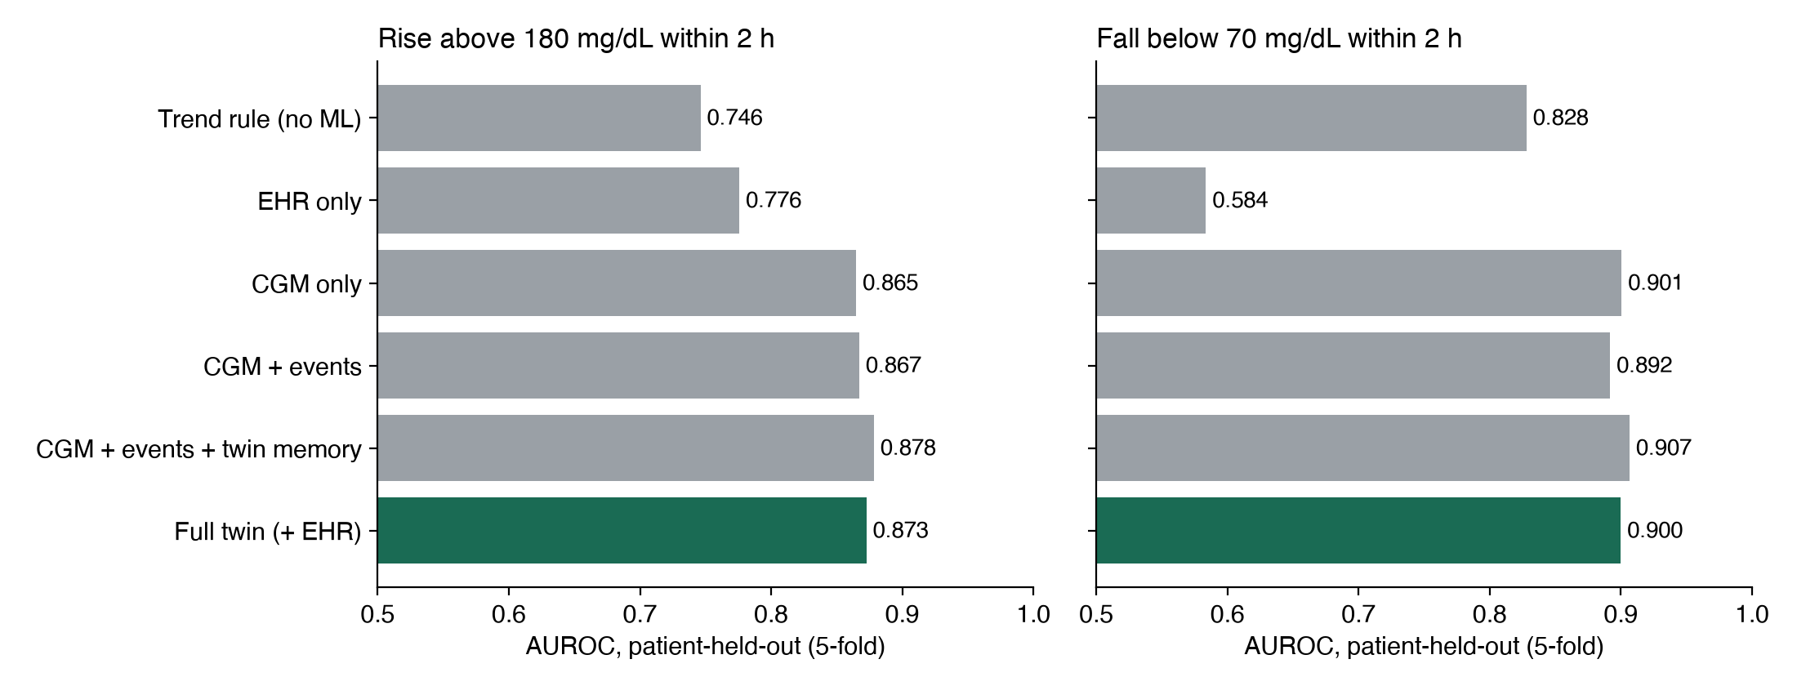
ABLATION
The timing comes from the live sensor, the twin's memory of the patient adds to it, and the record alone cannot time an event
GlycoTwin · Team Snack Overflow, RVCE
9

Slide 10
WHAT FUSION WITH THE RECORD BOUGHT US
Honest finding: once the twin has a few hours of glucose, the static record adds no measurable accuracy
AUROC gain over CGM only, 95% CI
Highs
Lows
Day-1 highs
Day-1 lows
Personal twin (memory, no EHR)
[+0.007, +0.020]
[-0.004, +0.015]
0.808
0.883
+ 9 core EHR fields
[+0.002, +0.018]
[-0.015, +0.009]
0.813
0.888
+ all 33 EHR fields
[+0.001, +0.015]
[-0.013, +0.010]
0.807
0.866
CGM only (reference)
0
0
0.815
0.907
Highs: the memory gain excludes zero. Lows: every interval includes zero, so we claim no gain there.
Why the record adds nothing here: the twin's learned mean glucose and time above range are a current, personal version of what HbA1c summarises over three months. With 100 patients, 33 static fields mostly let trees memorise who is who.
The record still carries population risk on its own (EHR-only AUROC 0.776 for highs), and the clinician needs it beside every alert. In the dashboard it is context, not the source of the timing.
Day 1 = the first calendar day of monitoring, before the memory has filled. Even there the record did not add accuracy in this cohort.
GlycoTwin · Team Snack Overflow, RVCE
10

Slide 11
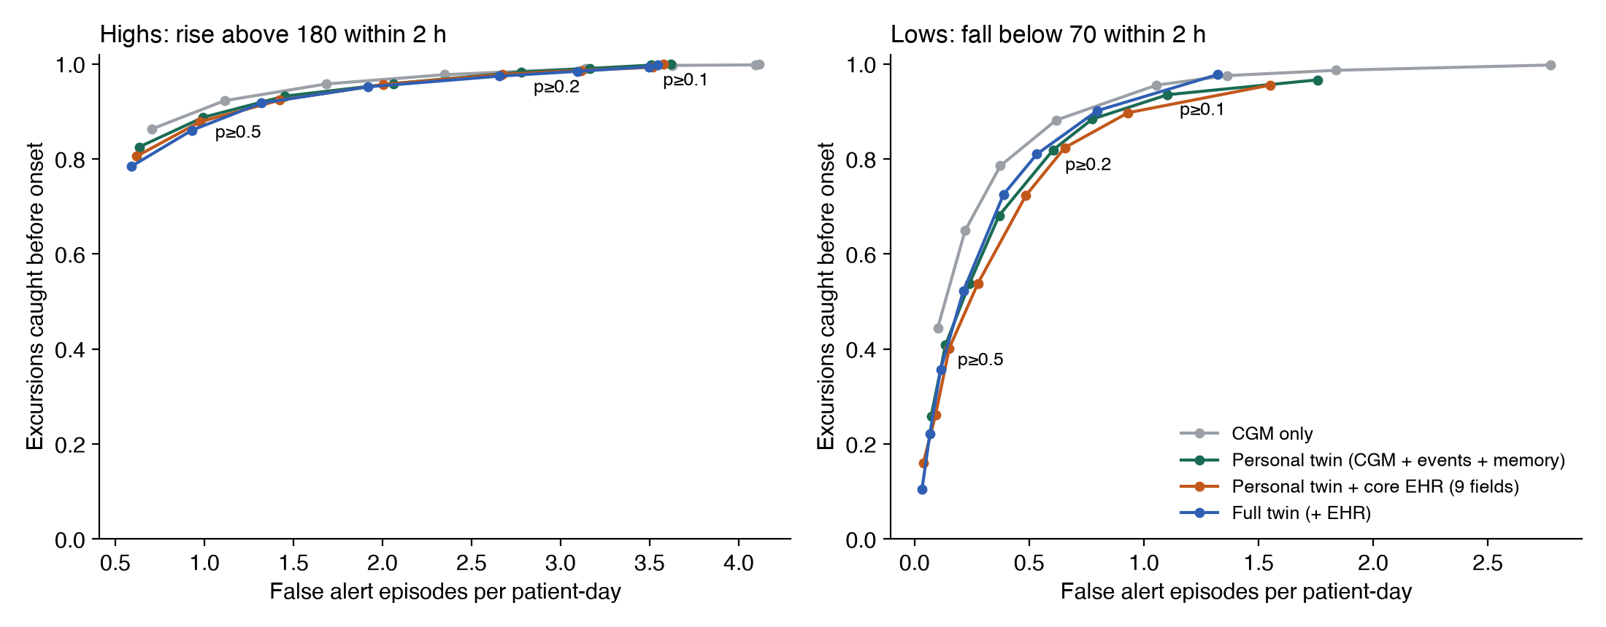
ALERT TRADE-OFF
What a ward would see: at p ≥ 0.5 the twin catches 89% of highs before onset; lows are rarer and need a lower threshold
Personal twin
Caught
Lead min
False/day
Highs 0.5
89%
60
0.99
Highs 0.3
96%
90
2.06
Lows 0.5
41%
30
0.14
Lows 0.2
82%
60
0.60
Lows 0.1
94%
75
1.10
Excursions: 1,991 highs, 448 lows in held-out data. Caught = an alert in the 2 h before the crossing. False = an alert run with no crossing in the next 2 h.
0.5 was fixed in advance. The other rows are read off the same curve to show the cost, not tuned results.
GlycoTwin · Team Snack Overflow, RVCE
11

Slide 12
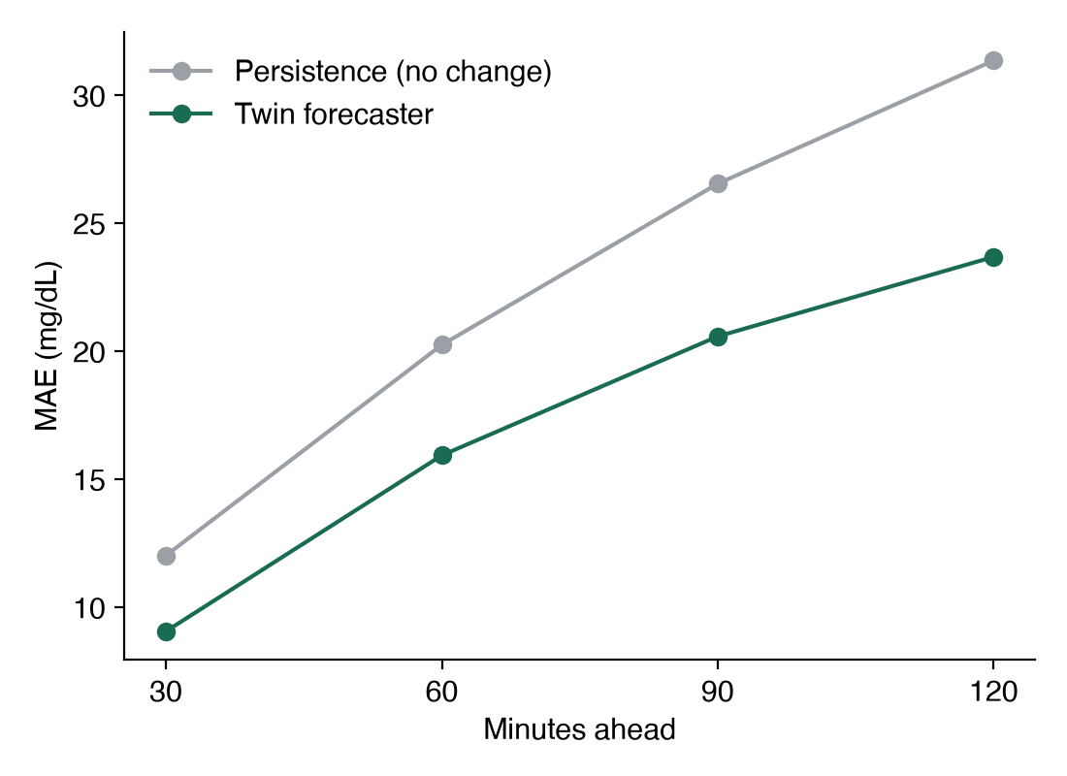
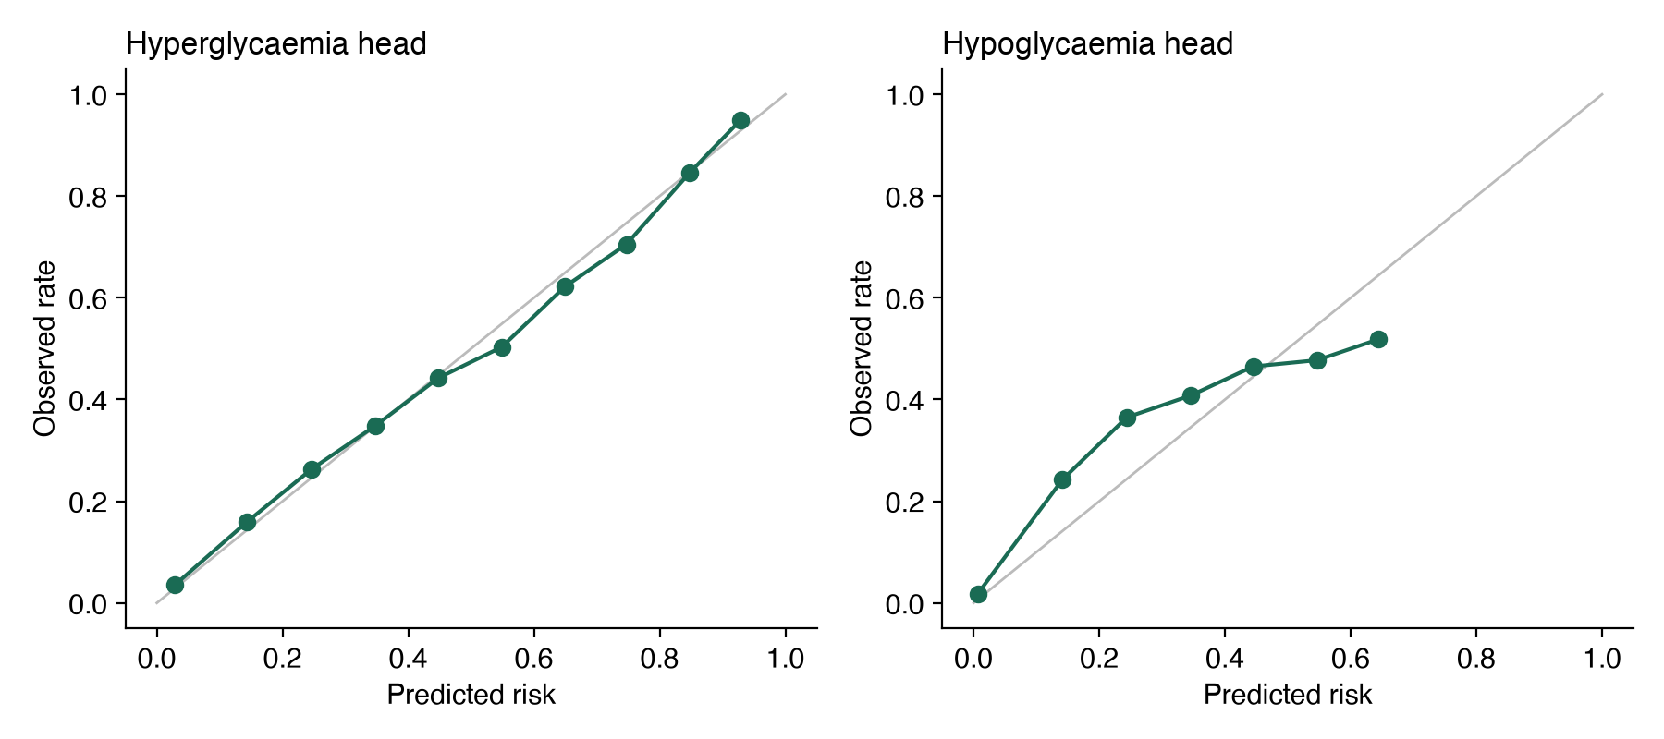
TRAJECTORY AND CALIBRATION
The twin also forecasts the trajectory: 15.9 mg/dL mean error at 60 min versus 20.2 for 'no change'
Calibration (right): predicted risk against the observed rate in held-out patients. Points near the diagonal mean a 30% alert really means about 30%.
Per-patient AUROC for the hyper head: median 0.87 (IQR 0.82 to 0.90) across 98 patients with events.
GlycoTwin · Team Snack Overflow, RVCE
12

Slide 13
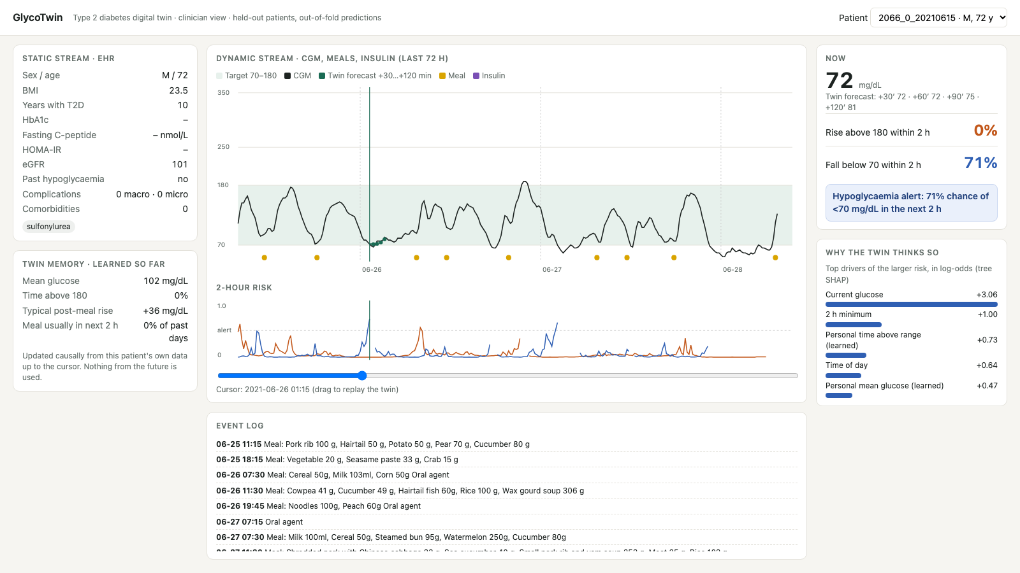
CLINICIAN DASHBOARD
The doctor's view: one screen per virtual patient, replayable, with the reason for every alert
Live: chxmq.github.io/SnackOverflow_RVCE · every number shown is an out-of-fold prediction for a held-out patient
GlycoTwin · Team Snack Overflow, RVCE
13

Slide 14
EXPLAINABILITY
What drives the twin: glucose now and its trend, the clock, and what the twin has learned about this patient
Hyper head: feature
mean |SHAP|
Hypo head: feature
mean |SHAP|
Time of day
1.163
Current glucose
0.472
Current glucose
0.453
Personal mean glucose (learned)
0.385
Personal mean glucose (learned)
0.236
Personal variability (learned)
0.303
15-min trend
0.191
2 h minimum
0.233
60-min trend
0.148
60-min trend
0.194
Time since last meal
0.147
15-min trend
0.193
Personal post-meal rise (learned)
0.145
Personal time above range (learned)
0.168
Personal time above range (learned)
0.120
2 h glucose variability
0.164
Time of day ranks high for highs because this is a hospital cohort with fixed meal times. In outpatients we expect logged meals to take that role.
Mean absolute tree-SHAP contribution in log-odds on held-out predictions (full twin). The dashboard shows the same values per alert.
GlycoTwin · Team Snack Overflow, RVCE
14

Slide 15
LIMITATIONS, STATED PLAINLY
What this proof of concept does not show yet
One cohort: Chinese adults, mostly monitored in hospital. Indian diets, outpatient life and Indian CGM users need their own validation.
Short memory: 3 to 14 days per period, so the twin learns habits from at most two weeks.
No heart rate, steps or sleep in this dataset. The wearable adapters are designed but untested, so we make no claim about them.
Meal size comes from logged grams of food, not carbohydrate counts.
Retrospective only. No prospective or silent-mode trial yet, and not a medical device.
Associations, not causes: the twin warns and explains, but it does not simulate the effect of a dose change.
GlycoTwin · Team Snack Overflow, RVCE
15

Slide 16
NEXT STEPS
Path to an Indian deployment
Step
What
Success measure
Wearables
Add HR, HRV, steps and sleep from Apple Health / Google Fit as dynamic features
Measure the AUROC gain
Records
Read EHR through FHIR R4 / ABDM instead of a spreadsheet
Same twin, live input
Indian cohort
Retrain and recalibrate on Indian CGM data with consent under DPDP
Calibration per site
Silent trial
Run beside a ward for 4 weeks; compare alerts with what happened
Alert burden, lead time
Mechanistic core
Pair with a physiological glucose model for what-if dose simulation
True counterfactuals
GlycoTwin · Team Snack Overflow, RVCE
16

Slide 17
Summary
Real data: 100 patients with type 2 diabetes, EHR plus 15-min CGM, fused into one twin state.
Held-out patients: AUROC 0.878 for highs and 0.907 for lows two hours ahead, clearly above a trend rule.
Measured, not assumed: the twin's memory of the patient adds accuracy for highs; the static record, in this cohort, does not.
A clinician dashboard that replays the twin and explains every alert.
Open source under MIT. One command reproduces every number.
github.com/chxmq/SnackOverflow_RVCE · chxmq.github.io/SnackOverflow_RVCE
Team Snack Overflow · RV College of Engineering
GlycoTwin · Team Snack Overflow, RVCE
17

