Slide 1
ARSI as a potential novel biomarker in Glioblastomas
Chyi Ricketts
CI Assignment

Slide 2
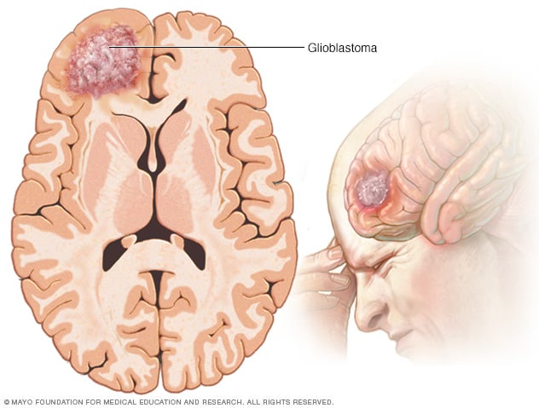
Glioblastoma
Glioblastoma (GBM) is the most aggressive primary brain tumor with poor survival despite standard therapy
  Type IV
  Incidence rate around 3 per 100,000 people
  5-year survival rate is only 6.8%
Molecular profiling defines key subtypes:
  Classical
  Mesenchymal
  Proneural
  Neural
Notes:
GBM is divided into Classical, Mesenchymal, Proneural, and Neural subtypes. Classical is EGFR-driven and proliferative; Mesenchymal is the most invasive with strong ECM and inflammatory signatures; Proneural is associated with PDGFRA (Platelet-Derived Growth Factor Receptor Alpha) and neural precursor markers; and Neural is high expression of neuronal markers, now known to be normal tissue contamination. My study found ARSI most strongly expressed in the Mesenchymal subtype.

Slide 3
Methods
Data Collection and Preprocessing using
TCGA GBM Data
Univariate Analysis
Copy Number Variation Analysis
ECM and Mesenchymal Associated Genes Panel Analysis
Clinical Correlation
Methylation Probe Analysis
RPPA dataset
Multivariate Analysis
by Subtype
Notes:
Univariate analysis
Clinical Data correlation
Multivariate analysis (correcting for age)
Multivariate by subtype (need to change– rn i did univariate)
Multiple test correction
Expression boxplots by subtype
Methylation
Overall and mesenchymal
CNV
Overall and mesenchymal
Panels for
MES associated genes
ECM associated genes

Slide 4
Univariate Analysis
Gene | HR | LCI | UCI | PVAL | FDR
NSUN5 | 2.188749 | 1.568035 | 3.055175 | 4.15E-06 | 0.083119
LRRC61 | 1.225964 | 1.119266 | 1.342834 | 1.16E-05 | 0.115874
NKX3-1 | 1.480686 | 1.224185 | 1.790933 | 5.25E-05 | 0.116802
C21orf96 | 2.505914 | 1.609502 | 3.901582 | 4.76E-05 | 0.116802
RPL39L | 1.252385 | 1.125155 | 1.394002 | 3.83E-05 | 0.116802
OR2AG1 | 28.7064 | 5.881135 | 140.1188 | 3.32E-05 | 0.116802
STATH | 151.4185 | 13.44155 | 1705.722 | 4.85E-05 | 0.116802
DNAJC30 | 2.378203 | 1.57078 | 3.600662 | 4.24E-05 | 0.116802
OSMR | 1.327997 | 1.15855 | 1.522226 | 4.64E-05 | 0.116802
BMPR1A | 0.506892 | 0.363727 | 0.706409 | 6.01E-05 | 0.120235
… | … | … | … | … | …
ARSI | 1.16895 | 1.06169 | 1.28705 | 0.00148 | 0.176389

Slide 5
Clinical Analysis and Multivariate Analysis
Variable | coef | exp(coef) | se(coef) | z | Pr(>|z|)
age | 0.025113 | 1.02543 | 0.007139 | 3.52E+00 | 4.36E-04
ARSI Correlation
Analysis | Type | HR | LCI | UCI | PVAL | FDR
Univariate | UNI | 1.16895 | 1.06169 | 1.28705 | 0.00148 | 0.17639
Univariate Mesenchymal | UNI | 1.39855 | 1.17428 | 1.66565 | 0.00017 | 0.41729
Multivariate | MULTI | 1.13295 | 1.02452 | 1.25286 | 0.01502 | 0.54655
Multivariate Mesenchymal | MULTI | 1.39674 | 1.16841 | 1.66969 | 0.00024 | 0.38676
Notes:
Treated primary GBM
GCIMP (Glioma-CpG Island Methylator Phenotype)

Slide 6
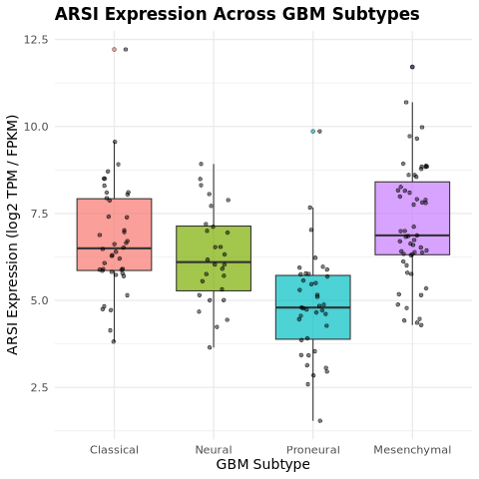
ARSI Expression
ARSI: Arylsulfatase I
Removes sulfate groups from ECM molecules
Low expression in most tissues
ARSI Expression Across GBM Subtypes
Highest Expression in Mesenchymal Subtype
Notes:
TPM/FPKM: transcripts per million / framents per kilobase of transcript per million reads mapped

Slide 7
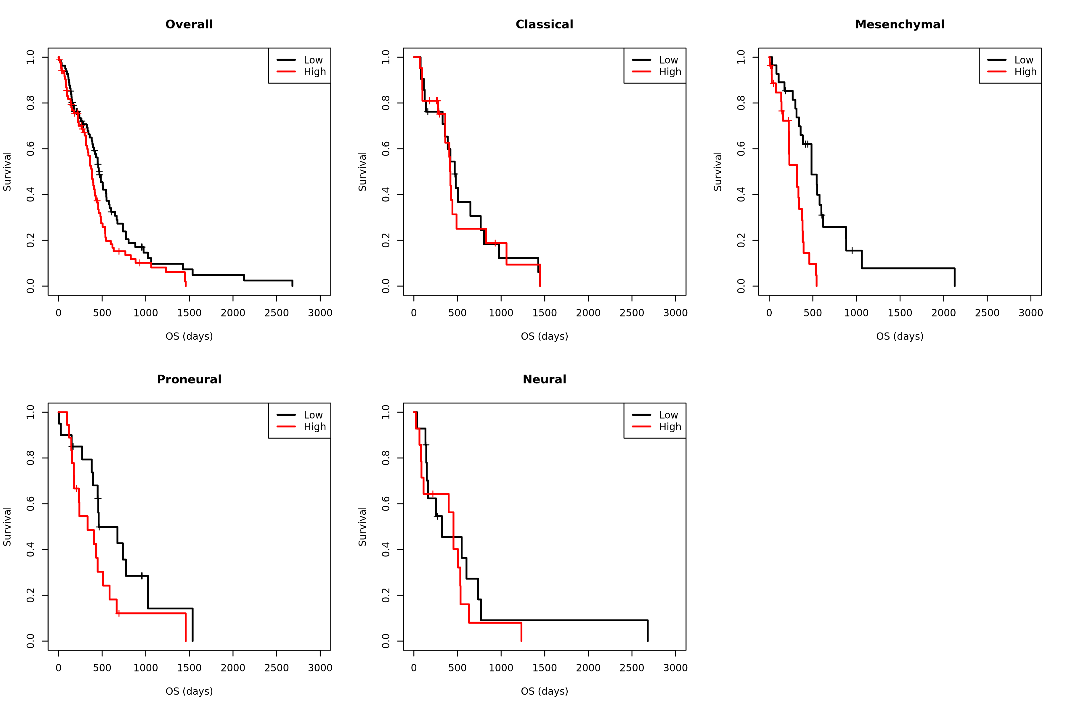
Kaplan-Meier Survival Curves: by Subtype

Slide 8
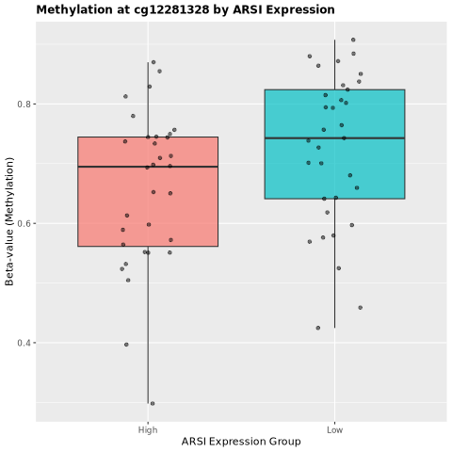
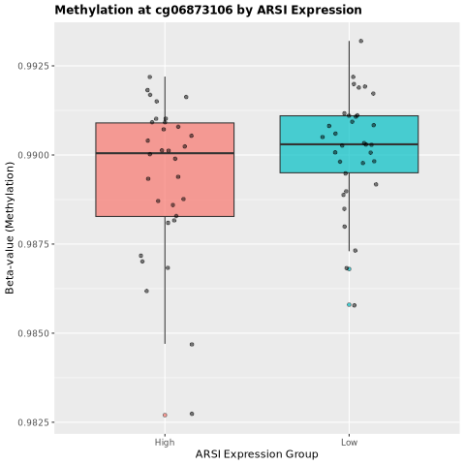
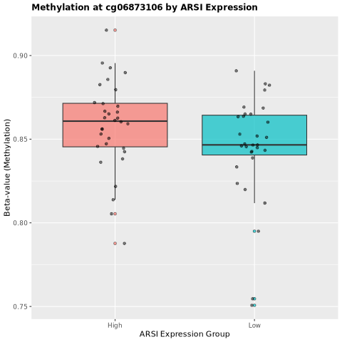
Methylation Analysis
CpG ID | Correlation | P-value | FDR | Slope | Mean ARSI High | Mean ARSI Low | Position | Island/Shore | UCSC_RefGene_Group
cg12281328 | -0.39625 | 0.001085 | 0.013017 | -5.99321 | 0.656769 | 0.723245 | 1.5E+08 | Island | 1stExon
cg06873106 | -0.29085 | 0.018749 | 0.112493 | -302.786 | 0.989353 | 0.990145 | 1.5E+08 | Island | Body
cg10941067 | 0.252179 | 0.042707 | 0.170829 | 6.634206 | 0.858031 | 0.820479 | 1.5E+08 | Island | Body
Methylation at cg10941067 by ARSI Expression
*2 outliers removed for better visualization
Notes:
Top 3 hits
A total of 12 were found and are included in the supplementary data

Slide 9
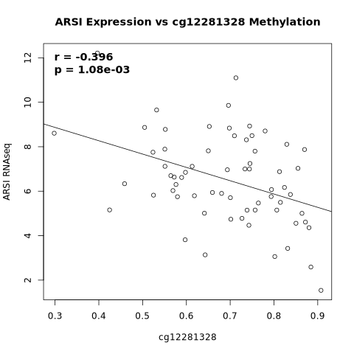
Methylation Scatterplot of cg12281328
Several ARSI-linked CpG sites show hypomethylation
cg12281328 shows a strong hypomethylation signal
The pattern suggests that specific CpG sites drive ARSI epigenetic regulation in this tumor type
Overall, the data points to epigenetic upregulation of ARSI, which may contribute to tumor subtype differences and more aggressive tumor behavior

Slide 10
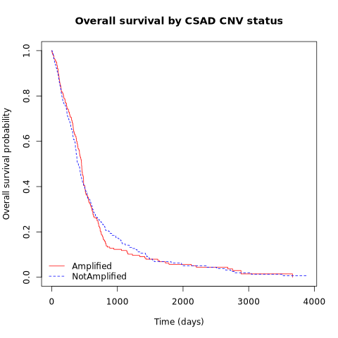
CNV Amplification on Survival Data

Slide 11
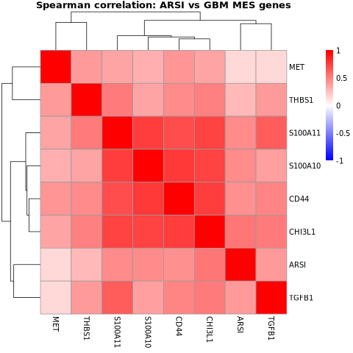
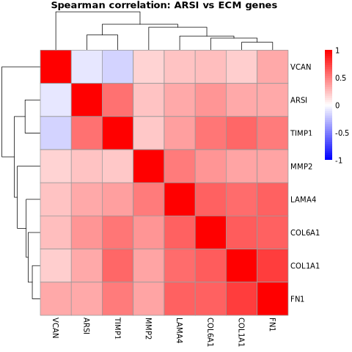
Panels for Mesenchymal and ECM Genes
Notes:
Mesenchymal: invasion, migration, and inflammation. Overall aggressive tumor behavior
ECM: structural components, matrix stiffness, ECM degredation
Mesenchymal / ECM Panel Genes
CD44
A cell-surface adhesion receptor that promotes invasion and is a classic mesenchymal GBM marker.
CHI3L1 (YKL-40)
Secreted glycoprotein highly expressed in mesenchymal GBM; promotes inflammation, angiogenesis, and invasion.
MET
A receptor tyrosine kinase activated by HGF; drives cell migration, EMT-like behavior, and mesenchymal transition.
TGFB1
Cytokine that induces EMT/mesenchymal programs, immune suppression, and ECM remodeling.
THBS1 (Thrombospondin-1)
ECM glycoprotein that regulates cell–matrix interaction, angiogenesis, and invasion.
S100A10
Protein involved in plasmin activation; promotes matrix degradation and tumor cell migration.
COL6A1
Collagen VI component; structural ECM protein associated with tumor stiffness and invasion.
COL1A1
Major collagen type I gene; increases ECM density and supports invasive tumor microenvironments.
FN1 (Fibronectin 1)
Key ECM adhesion protein; hallmark of mesenchymal states and promotes migration.
VCAN (Versican)
Large ECM proteoglycan that alters matrix structure and boosts motility and mesenchymal signaling.
MMP2
Matrix metalloproteinase that degrades basement membrane and ECM; enables invasion.
TIMP1
Inhibits MMPs but paradoxically often promotes tumor survival, proliferation, and ECM remodeling.
LAMA4 (Laminin α4)
Basement membrane protein; facilitates adhesion, migration, and angiogenesis.

Slide 12
RPPA
Gene | logFC | AveExpr | t | P.Value | adj.P.Val | B
ARSI | 1 | 6.322222 | 584.8917 | 7.99E-139 | 1.64E-134 | 215.4937
ANXA2P2 | 0.447674 | 11.04537 | 8.753244 | 4.43E-13 | 2.81E-09 | 19.06341
PQLC3 | 0.31393 | 8.192181 | 8.726516 | 4.98E-13 | 2.81E-09 | 18.94683
TIMP1 | 0.537266 | 12.4349 | 8.705092 | 5.47E-13 | 2.81E-09 | 18.85337
ANXA2 | 0.446881 | 11.98458 | 8.616827 | 8.06E-13 | 3.31E-09 | 18.46832
EPHB1 | -0.63172 | 8.727037 | -8.09874 | 7.81E-12 | 2.67E-08 | 16.20953
FAM176B | 0.308958 | 7.841022 | 8.021926 | 1.09E-11 | 3.20E-08 | 15.87518
ZNF711 | -0.3563 | 9.385268 | -7.93537 | 1.60E-11 | 4.10E-08 | 15.49868
ZC4H2 | -0.30467 | 8.259059 | -7.89805 | 1.88E-11 | 4.29E-08 | 15.33644
SPATS2L | 0.203068 | 11.20657 | 7.83181 | 2.51E-11 | 4.69E-08 | 15.04867

Slide 13
Conclusion and Clinical Implications
Methylation
  Proposes mechanisms of upregulation through hypomethylation
CNV
  Little change in high and low CNV
ECM
  High correlation with ECM associated genes
Mesenchymal
  High correlation with other Mesenchymal associated genes
RPPA
Conclusion:
Candidate biomarkers can guide patient stratification
Identification of a candidate biomarker for GBM: ARSI
  Needs to be further explored as it does not hold statistical significance
Support targeting therapeutic research:
  Methylation
  ECM Pathways

Slide 14
Limitations and Further Research
Size of GBM Dataset
  Limited Statistical power
  Wide Confidence Intervals
  High FDR → results not statistically significant after correction
Observational nature: Functional mechanisms need to be further explored
  Methylation
  ECM Matrix
Future Directions:
Validation on an external dataset
  CGGA: Chinese Glioma Genome Atlas
Function/Wet-lab studies: CRISPR, knockdown/overexpression experiments
Multi-omics integration: Combine methylation, CNV, and expression data to identify actionable pathways and refine patient stratification

Slide 15
References
Barbosa LC, Machado GC, Heringer M, Ferrer VP. Identification of established and novel extracellular matrix components in glioblastoma as targets for angiogenesis and prognosis. Neurogenetics. 2024 Jul;25(3):249-262. doi: 10.1007/s10048-024-00763-x. Epub 2024 May 22. PMID: 38775886.
Brown D. V., Daniel P. M., D’Abaco G. M., Gogos A., Ng W., Morokoff A. P., Mantamadiotis T. Coexpression analysis of CD133 and CD44 identifies Proneural and Mesenchymal subtypes of glioblastoma multiforme. Oncotarget. 2015; 6: 6267-6280. Retrieved from https://www.oncotarget.com/article/3365/text/
Behnan J, Finocchiaro G, Hanna G. The landscape of the mesenchymal signature in brain tumours. Brain. 2019 Apr 1;142(4):847-866. doi: 10.1093/brain/awz044. PMID: 30946477; PMCID: PMC6485274.
Cescon M, Rampazzo E, Bresolin S, Da Ros F, Manfreda L, Cani A, Della Puppa A, Braghetta P, Bonaldo P, Persano L. Collagen VI sustains cell stemness and chemotherapy resistance in glioblastoma. Cell Mol Life Sci. 2023 Jul 28;80(8):233. doi: 10.1007/s00018-023-04887-5. PMID: 37505240; PMCID: PMC10382393.
Chen X, Chen X, Xie W, Ge H, He H, Zhang A, Zheng J. BRAF-activated ARSI suppressed EREG-mediated ferroptosis to promote BRAF^{V600E} (mutant) papillary thyroid carcinoma progression and sorafenib resistance. Int J Biol Sci. 2025 Jan 1;21(1):128-142. doi: 10.7150/ijbs.99423. PMID: 39744439; PMCID: PMC11667812.
Shen Y, Wei Z, Zhou C, Song J, Wang J, Wang J, Wu L, Fang S, Shen Z. Arylsulfatase I is a prognostic biomarker for head and neck squamous cell carcinoma and Pan-cancer. J Clin Lab Anal. 2022 Sep;36(9):e24600. doi: 10.1002/jcla.24600. Epub 2022 Jul 23. PMID: 35870182; PMCID: PMC9459304
Verhaak RG, Hoadley KA, Purdom E, Wang V, Qi Y, Wilkerson MD, Miller CR, Ding L, Golub T, Mesirov JP, Alexe G, Lawrence M, O'Kelly M, Tamayo P, Weir BA, Gabriel S, Winckler W, Gupta S, Jakkula L, Feiler HS, Hodgson JG, James CD, Sarkaria JN, Brennan C, Kahn A, Spellman PT, Wilson RK, Speed TP, Gray JW, Meyerson M, Getz G, Perou CM, Hayes DN; Cancer Genome Atlas Research Network. Integrated genomic analysis identifies clinically relevant subtypes of glioblastoma characterized by abnormalities in PDGFRA, IDH1, EGFR, and NF1. Cancer Cell. 2010 Jan 19;17(1):98-110. doi: 10.1016/j.ccr.2009.12.020. PMID: 20129251; PMCID: PMC2818769.
Notes:
Behnan J, Finocchiaro G, Hanna G. The landscape of the mesenchymal signature in brain tumours. Brain. 2019 Apr 1;142(4):847-866. doi: 10.1093/brain/awz044. PMID: 30946477; PMCID: PMC6485274.

Slide 16
Supplementary: Datasets used
TCGA Glioblastoma (GBM) (25 datasets)
IlluminaHiSeq (n=172) TCGA Hub
Curated survival data (n=602) TCGA Hub
Phenotypes (n=629) TCGA Hub
Methylation450k (n=155) TCGA Hub
RPPA (n=244) TCGA Hub

Slide 17
Supplementary: Univariate Analysis
Gene | HR | LCI | UCI | PVAL | FDR
NSUN5 | 2.188749 | 1.568035 | 3.055175 | 4.15E-06 | 0.083119
LRRC61 | 1.225964 | 1.119266 | 1.342834 | 1.16E-05 | 0.115874
NKX3-1 | 1.480686 | 1.224185 | 1.790933 | 5.25E-05 | 0.116802
C21orf96 | 2.505914 | 1.609502 | 3.901582 | 4.76E-05 | 0.116802
RPL39L | 1.252385 | 1.125155 | 1.394002 | 3.83E-05 | 0.116802
OR2AG1 | 28.7064 | 5.881135 | 140.1188 | 3.32E-05 | 0.116802
STATH | 151.4185 | 13.44155 | 1705.722 | 4.85E-05 | 0.116802
DNAJC30 | 2.378203 | 1.57078 | 3.600662 | 4.24E-05 | 0.116802
OSMR | 1.327997 | 1.15855 | 1.522226 | 4.64E-05 | 0.116802
BMPR1A | 0.506892 | 0.363727 | 0.706409 | 6.01E-05 | 0.120235

Slide 18
Supplementary: Multivariate Analysis
Gene | HR | LCI | UCI | PVAL | FDR
SOAT2 | 1.618953 | 1.293461 | 2.026353 | 2.59E-05 | 0.261049
STATH | 176.8973 | 15.85178 | 1974.079 | 2.61E-05 | 0.261049
CDC73 | 0.36683 | 0.219892 | 0.611959 | 1.23E-04 | 0.275813
GUCA1C | 3.176344 | 1.760364 | 5.731295 | 1.24E-04 | 0.275813
PTPRN | 1.211702 | 1.100345 | 1.33433 | 9.46E-05 | 0.275813
C21orf96 | 2.442283 | 1.556734 | 3.831576 | 1.02E-04 | 0.275813
CHRM5 | 1.364823 | 1.169868 | 1.592265 | 7.65E-05 | 0.275813
PTPRN2 | 1.615105 | 1.274721 | 2.04638 | 7.19E-05 | 0.275813
OR2AG1 | 24.45167 | 5.081436 | 117.6605 | 6.67E-05 | 0.275813
NRXN3 | 1.23055 | 1.102854 | 1.373031 | 2.06E-04 | 0.289626

Slide 19
Supplementary: ARSI Expression
Analysis | Type | HR | LCI | UCI | PVAL | FDR
Overall | Univariate | 1.16895 | 1.06169 | 1.28705 | 0.00148 | 0.17639
Mesenchymal | Univariate | 1.39855 | 1.17428 | 1.66565 | 0.00017 | 0.41729
Classical | Univariate | 1.24562 | 0.92447 | 1.67835 | 0.14882 | 0.98821
Neural | Univariate | 1.17179 | 0.88696 | 1.54811 | 0.26454 | 0.99996
Proneural | Univariate | 1.03408 | 0.8546 | 1.25126 | 0.73044 | 0.93231
Overall | Multivariate | 1.13295 | 1.02452 | 1.25286 | 0.01502 | 0.54655
Mesenchymal | Multivariate | 1.39674 | 1.16841 | 1.66969 | 0.00024 | 0.38676
Classical | Multivariate | 1.24898 | 0.92429 | 1.68772 | 0.14778 | 0.95531
Neural | Multivariate | 1.05729 | 0.77468 | 1.44301 | 0.72553 | 0.99999
Proneural | Multivariate | 0.92918 | 0.7483 | 1.15379 | 0.50609 | 0.9258

Slide 20
Supplementary: Methylation Probes Data
CpG ID | Correlation | P-value | FDR | Slope | Mean ARSI High | Mean ARSI Low | Position | Island/Shore | UCSC_RefGene_Group
cg12281328 | -0.39625 | 0.001085 | 0.013017 | -5.99321 | 0.656769 | 0.723245 | 1.5E+08 | Island | 1stExon
cg06873106 | -0.29085 | 0.018749 | 0.112493 | -302.786 | 0.989353 | 0.990145 | 1.5E+08 | Island | Body
cg10941067 | 0.252179 | 0.042707 | 0.170829 | 6.634206 | 0.858031 | 0.820479 | 1.5E+08 | Island | Body
cg03405473 | 0.221516 | 0.076168 | 0.228503 | 2.855841 | 0.6232 | 0.527309 | 1.5E+08 | North Shore | Body
cg25652824 | -0.16292 | 0.194735 | 0.356951 | -91.1673 | 0.978459 | 0.979027 | 1.5E+08 | North Shore | Body
cg14105467 | -0.15818 | 0.208222 | 0.356951 | -5.65911 | 0.790097 | 0.789018 | 1.5E+08 | North Shore | 3'UTR
cg16633129 | 0.166043 | 0.186199 | 0.356951 | 6.257584 | 0.852338 | 0.836482 | 1.5E+08 | Island | Body
cg20873205 | 0.12922 | 0.304939 | 0.406585 | 4.98114 | 0.915775 | 0.8966 | 1.5E+08 | Island | Body
cg26530201 | -0.13441 | 0.28576 | 0.406585 | -7.42263 | 0.078653 | 0.084233 | 1.5E+08 | South Shore | TSS200
cg26292378 | 0.09517 | 0.450781 | 0.540937 | 3.957983 | 0.083622 | 0.081027 | 1.5E+08 | South Shore | TSS200
cg02613713 | 0.074428 | 0.555706 | 0.555706 | 6.042511 | 0.972075 | 0.963288 | 1.5E+08 | Island | Body
cg10607557 | -0.07921 | 0.530509 | 0.555706 | -1.24661 | 0.869347 | 0.841918 | 1.5E+08 | North Shore | Body

