Slide 1


Friends day
Data science

Slide 2

Data science course
Content:
Exploratory data analysis
Supervised learning
Linear models
Decision trees models
Neural networks
Unsupervised learning
Practical tasks with:
Tabular data
Natural Language Processing
Computer Vision
Recommender Systems
Competitions (Kaggle-like)
https://epa.ms/ds-course-2019

Slide 3
epa.ms/fd-playgroud

Slide 4
representation
hands-on practice with
learning

Slide 5


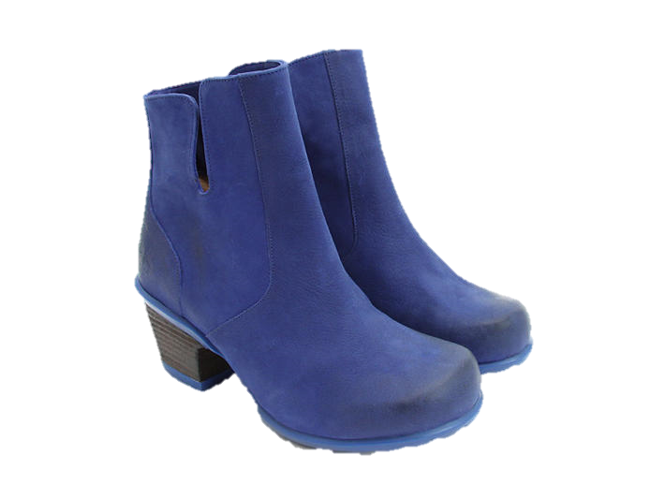
У вас есть голубые сапожки ?
Товар | Цвет | Релевантность
Сапоги | Красный | 0.3
Сапоги | Синий | 0.8
Туфли | Зелёный | 0.1

Slide 6
Петух
Курица
Цыплёнок
Гора
Горит
Семантическое
сходство
(по смыслу)
Лексическое
сходство
(по написанию)

Slide 7
T
Document-term matrix
 | Tiger | Lion | Leopard | Jaguar | Porsche | Ferrari | Maserati
Doc 1 | 1 | 0 | 1 | 1 | 0 | 0 | 0
Doc 2 | 1 | 1 | 1 | 0 | 0 | 0 | 0
Doc 3 | 0 | 0 | 0 | 1 | 1 | 1 | 1
Doc 4 | 0 | 0 | 0 | 0 | 1 | 1 | 1
What is the meaning of documents ?

Slide 8
T
Document-term matrix
 | Tiger | Lion | Leopard | Jaguar | Porsche | Ferrari | Maserati
Doc 1 | 1 | 0 | 1 | 1 | 0 | 0 | 0
Doc 2 | 1 | 1 | 1 | 0 | 0 | 0 | 0
Doc 3 | 0 | 0 | 0 | 1 | 1 | 1 | 1
Doc 4 | 0 | 0 | 0 | 0 | 1 | 1 | 1
Animals = Tiger + Lion + Leopard + Jaguar
Cars = Porsche + Ferrari + Maserati + Jaguar
Concepts

Slide 9
Representing documents and words via concepts
 | Tiger | Lion | Leopard | Jaguar | Porsche | Ferrari | Maserati
Doc 1 | 1 | 0 | 1 | 1 | 0 | 0 | 0
Doc 2 | 1 | 1 | 1 | 0 | 0 | 0 | 0
Doc 3 | 0 | 0 | 0 | 1 | 1 | 1 | 1
Doc 4 | 0 | 0 | 0 | 0 | 1 | 1 | 1
Animals = Tiger + Lion + Leopard + Jaguar
Cars = Porsche + Ferrari + Maserati + Jaguar
 | Animals | Cars
Doc 1 | 0.8 | 0.2
Doc 2 | 1 | 0
Doc 3 | 0.1 | 0.9
Doc 4 | 0 | 1
 | Animals | Cars
Tiger | 1 | 0
Jaguar | 0.5 | 0.5
Ferrari | 0 | 1
… | … | …
Representation of documents
Representation of words

Slide 10
Semantic similarity
Ferrari (0,1)
Cars
 | Animals | Cars | ?
Tiger | 1 | 0 | …
Jaguar | 0.5 | 0.5 | …
Ferrari | 0 | 1 | ..
… | … | … | …
Jaguar
(0.5, 0.5)
Representation of words
Tiger
(1, 0)
Animals
?
How to calculate
similarity(Ferrari, Jaguar) = ?

Slide 11
Semantic similarity
Ferrari
Cars
 | Animals | Cars | ?
Tiger | 1 | 0 | …
Jaguar | 0.5 | 0.5 | …
Ferrari | 0 | 1 | ..
… | … | … | …
 | Animals | Cars | ?
Tiger | 1 | 0 | …
Jaguar | 0.5 | 0.5 | …
Ferrari | 0 | 1 | ..
… | … | … | …
cos(angle) = 0.7
Jaguar
Representation of words
Tiger
Animals
?
similarity(Ferrari, Jaguar)
=
Cosine of the angle in a semantic space
angle(Ferrari, Jaguar) = 45°
cos(angle(Ferrari, Jaguar)) = 0.7

Slide 12








Comedy
Children
Adult
Drama

Slide 13
What about other things ?
Words – using documents
Movies – using favorites
Songs – using playlists
Communities – using subscriptions
GitHub repos – using stars (bookmarks)
Products – using orders

Slide 14
How to learn representations ?
StarSpace - general-purpose neural model for efficient learning of entity embeddings (representations)

Slide 15
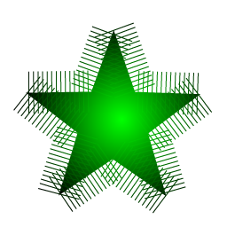
Practical session – VK publics embeddings
 | Page1 | Page2 | Page3
User1 | 0 | 1 | 1
User2 | 1 | 1 | 0
User3 | 0 | 0 | 1
Subscriptions.csv
Page2, Page3
Page1, Page2
Page3
Output.csv
Page1 0.2 -0.5 0.3 0.9 -0.2
Page2 -0.1 0.4 0.4 0.2 -0.5
Page3 0.1 -0.6 -0.2 0.4 0.7
=
StarSpace
./starspace train -trainFile ‘Subscriptions.csv’ -label 'page' -trainMode 1 -dim 128 -model ‘output.tsv'

Slide 16
Predicting user gender based on subscriptions
Features
(X_data)
Target
(y_data)
 | Page1 | Page2 | Page3 | IsMale
User1 |  | 1 | 1 | 1
User2 | 1 | 1 |  | 0
User3 |  |  | 1 | 1
Decision model (logistic regression):
IsMale = sigmoid( sum(w1*Page1 + w2*Page2 + w3*Page3 + b) )

Slide 17
How to get user’s representation ?
 | Page1 | Page2 | Page5
D1 | 0.5 | -0.5 | 0.1
D2 | 0.9 | 0.9 | 0.8
D3 | -0.3 | 0 | 0.9
… | … | … | …
D128 | 0.2 | 0.1 | 0.9
User
0.03
0.86
0.2
…
0.4
User’s subscriptions:
Page1; Page2; Page5
Averaging

Slide 18
Transfer learning
hands-on practice with
for images

Slide 19
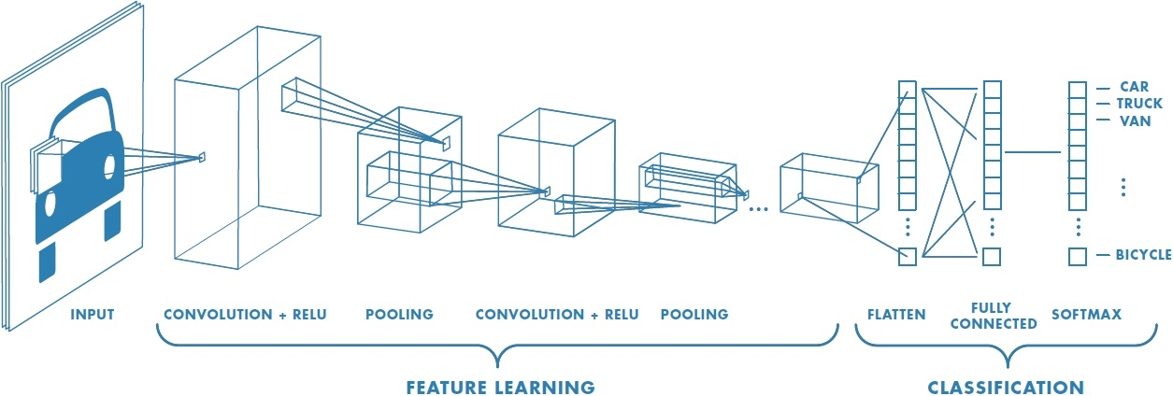
Convolution neural network

Slide 20
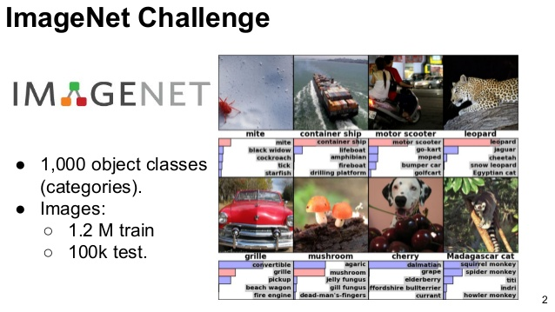
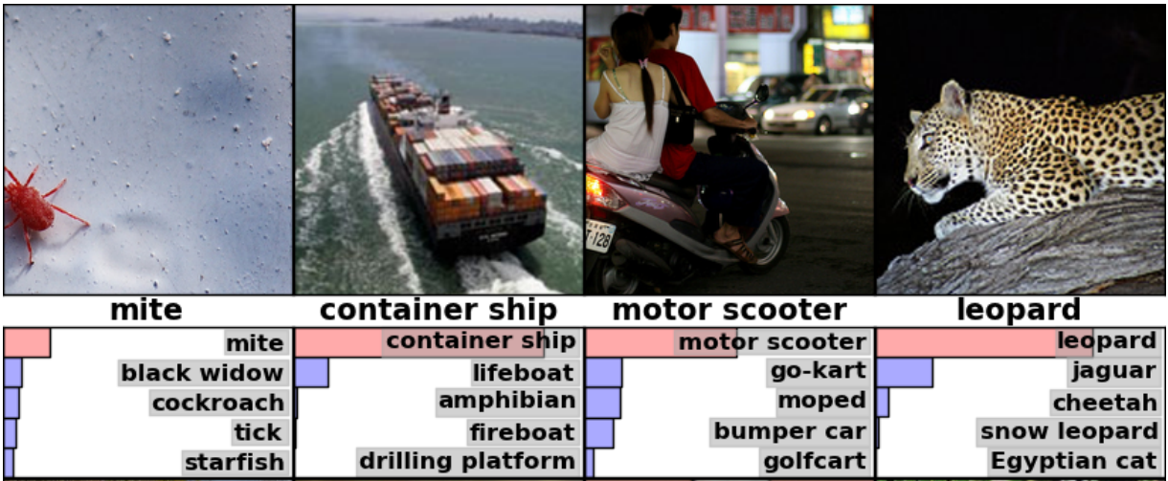
ImageNet dataset

Slide 21
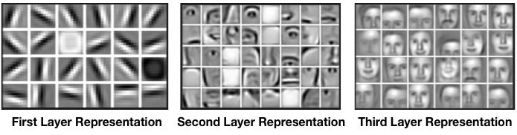
Convolutional Neural Networks

Slide 22
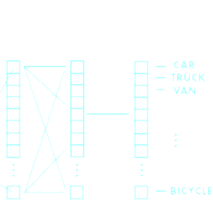
Extracting high-level semantic features
Semantic representation
2048D

Slide 23


THANK YOU
QUESTIONS?
Dmitrii_Nikitko@epam.com

